Slide 1
Keeping Students on Track
with Technology and Processes
PRESENTED BY:
Steven Birmingham • Jessica Haber • Todd Prattella

Slide 2
About Mercy

Slide 3
About Mercy
Multi-campus
Enrollment
Demographics
PACT Program

Slide 4
Impact of PACT on Student Success
20%
55%
41%
Improvement in college-wide retention*
Increase in 6-year graduation rate
Increase in 4-year graduation rate
* 20% is percentage increase; retention increased 12 percentage points from 60% (2009) to 72% (2016)

Slide 5
Processes & Technologies

Slide 6
Highlighted Technologies

Slide 7
Foundation & Resources for Success
Challenge
1. How do we give students the resources they need to keep themselves on track and set themselves up for success?

Slide 8
Foundation & Resources for Success

Slide 9
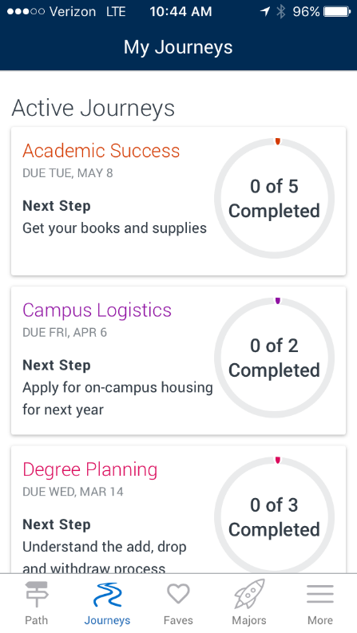
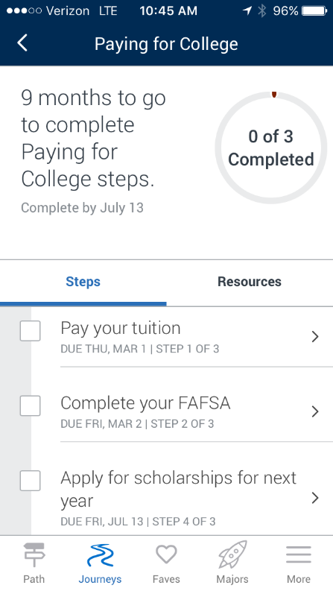
Foundation & Resources for Success
Journeys

Slide 10
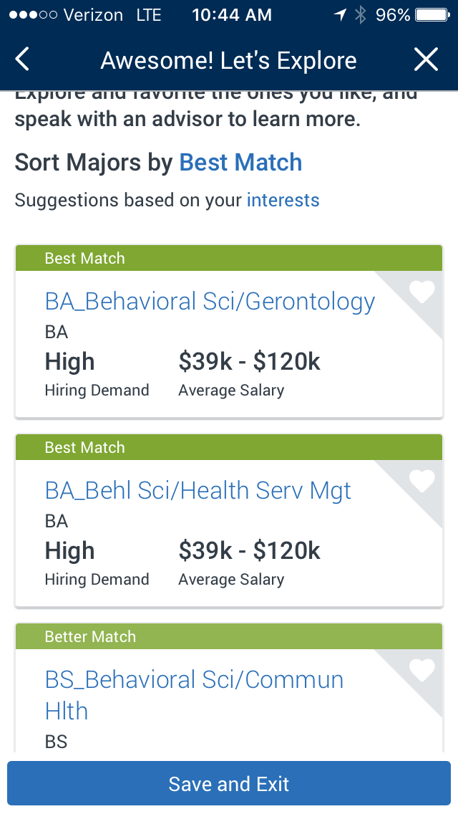
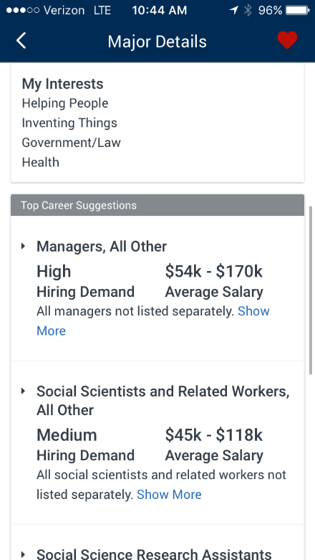
Foundation & Resources for Success
Major Matcher
Academic Planners
Degree Audit

Slide 11
At-Risk Student Identification
Challenge
2. How do we identify students who need interventions?

Slide 12
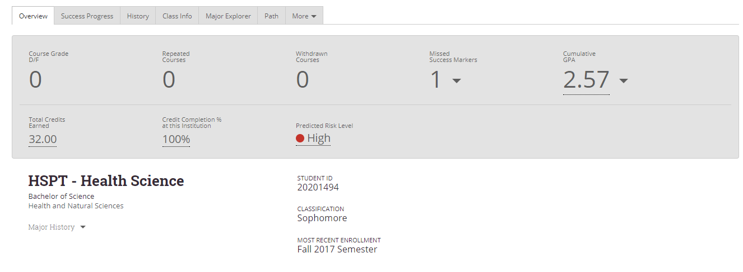
At-Risk Student Identification
Predictive Model
Progress Reports

Slide 13
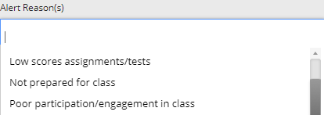
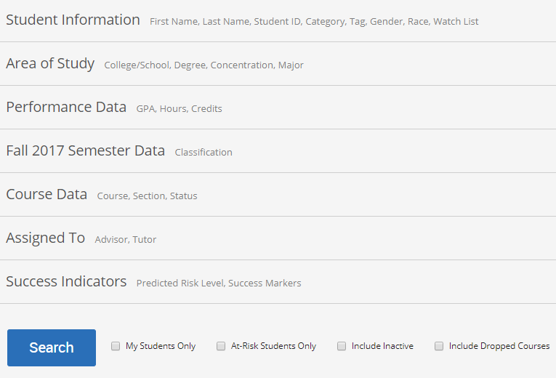
At-Risk Student Identification
Data Democratization
Swipe Everything
Planner Verification

Slide 14
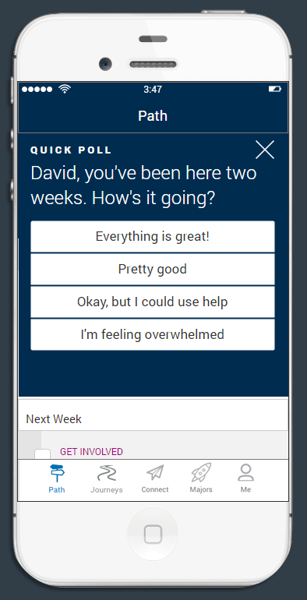
At-Risk Student Identification
Quick Polls

Slide 15
Student Interaction
Challenge
3. Once we know which students require an intervention, how do we interact with them to foster success?

Slide 16
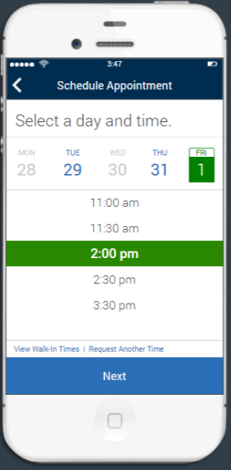
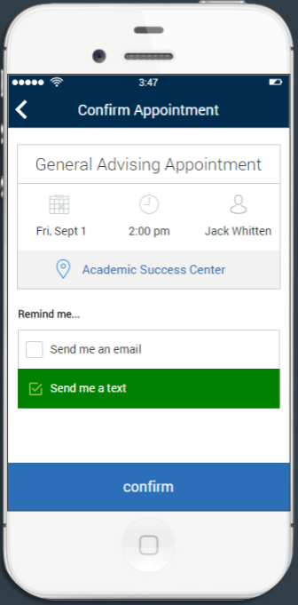
Student Interaction
Advisor Appointments

Slide 17
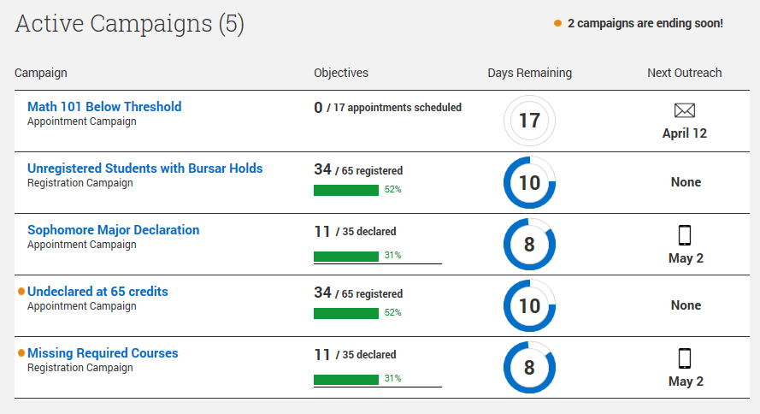
Student Interaction
Campaigns
Communications

Slide 18
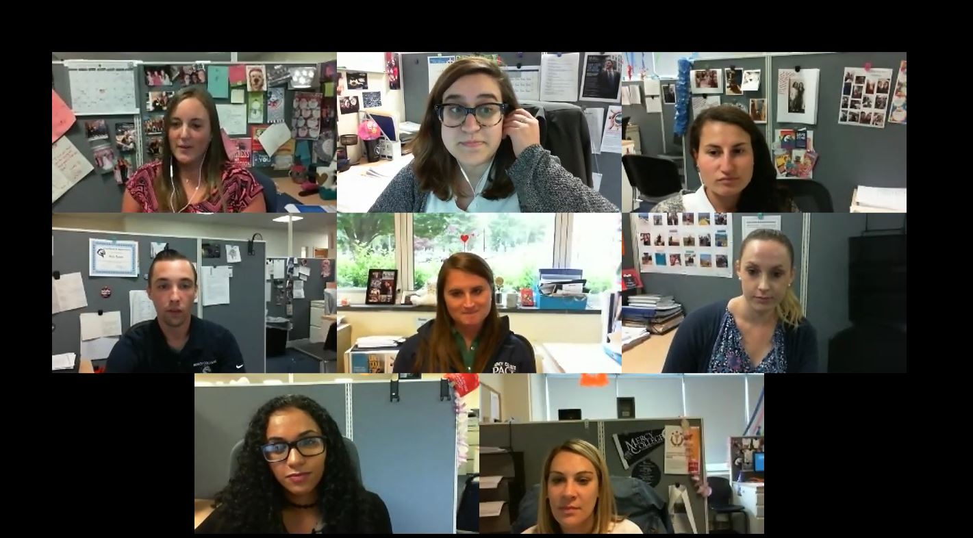
Student Interaction
Remote Meetings

Slide 19
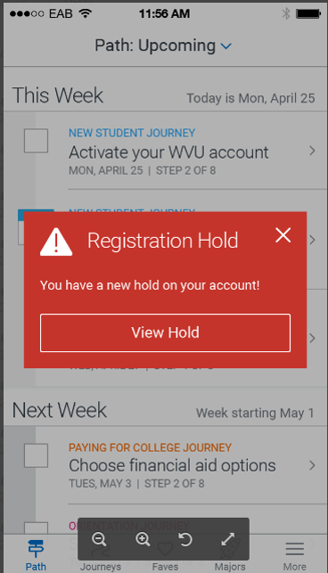
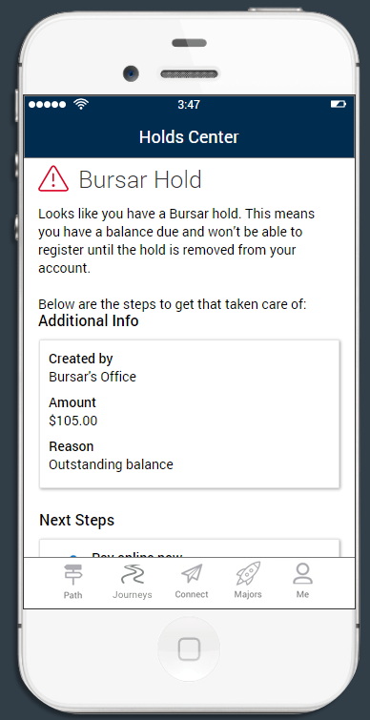
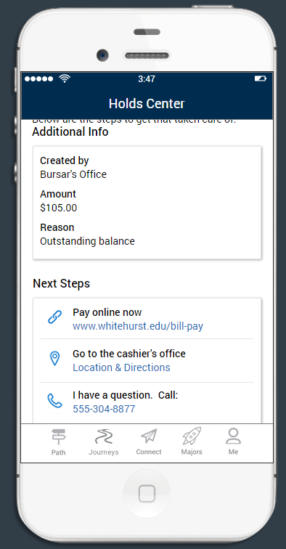
Student Interaction
Nudges

Slide 20
Group Discussions

Slide 21
Group Discussions
What are some of the issues your are facing at your institutions where these processes and technologies could help?
What best practices are you using at your institution to help students start on the right foot and cross the finish line?

Slide 22
Questions & Answers

Slide 23
Thank You!
Steven Birmingham, sbirmingham@mercy.edu
Jessica Haber, jhaber@mercy.edu
Todd Prattella, tprattella@mercy.edu

Slide 24
Technologies to Keep Students on Track at Mercy College
EAB Guide
Students download mobile app
Students follow predesigned journeys
Students use major matcher
Students participate in quick polls
Students receive nudges (push alerts)
EAB Campus
Advisors identify at-risk students
Advisors communicate with students
Faculty provide feedback about student performance
Advisors gather card swipe data
Advisors and tutors keep notes of student interactions
Students make appointments
Ellucian Degree Works
Students create academic plan
Students audit transcript vs. academic plan
Students audit transcript vs. graduation requirements
Students explore what-if scenarios
Zoom
Advisors conduct remote video advising sessions
** This will be a printed handout **

