Slide 1
ASU and Shindig Experiences
Synchronous Video Chat: Solving the Interactivity Vacuum
Amy L. Pate
Instructional Designer/Faculty Associate, ASU
Christopher Downs
Vice President of Higher Education, Shindig

Slide 2
What’s the word?
"peer learning, which has been mentioned as a feature of several of the above trends, is proving to be especially important in online courses. Online communication with peers has been shown to improve performance. But face-to-face communities of learners participating in an online course have also emerged around the world, filling an apparent interpersonal vacuum with peer instruction and support.”
- MIT Online Education Policy Initiative report 2016
Video" is a misnomer that reinforces traditional beliefs and misses the potential. Video in the classroom is still largely a one-way medium. The group with the knowledge (faculty, institution, etc.) makes a video (or worse yet, "captures" a lecture) and then replays it online. But even at the highest Hollywood production quality, it's still a "sage on the stage" model. This is not where students are. Students have fluency in Vine, Periscope, Snapchat, etc., and are communicating with video and other forms of media at level far beyond the basic concept of video. It's interactive. It's engaging. It's two-way. When they go into the classroom, whether in-person or online, it seems primitive. It's like asking faculty to go back to typewriters and Wite-Out.
- CampusTechnology: Johnathan Blake Huer, Ball State University, 2016
Other studies have found that decreased social interactivity can lead to lowered satisfaction among
students and increased feelings of isolation, disillusionment, and greater risk of dropping out of the
online learning environment
- 2014 MERLOT Journal of Online Learning and Teaching (Liu, Magjuka, Bonk, & Lee)

Slide 4
USE CASES
Office Hours
Guest Speaker Sessions
Recitations*
Class Delivery/ Overflow*
Review Sessions*
Student Presentations
Student Debates*

Slide 5
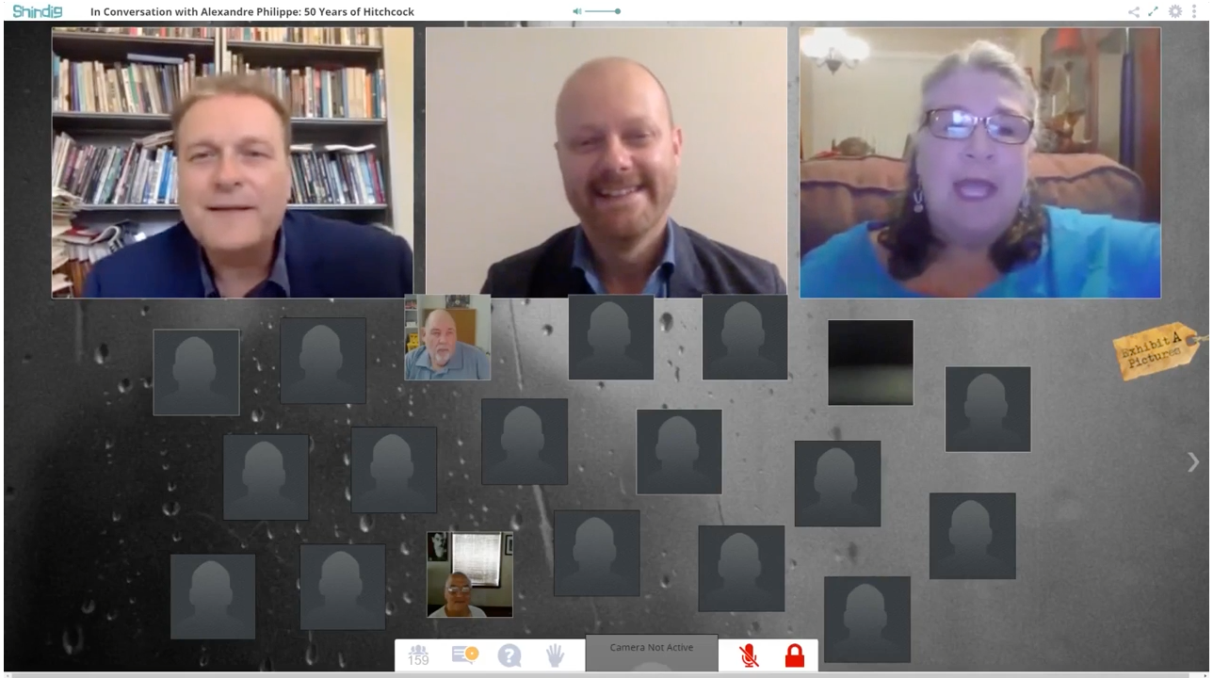
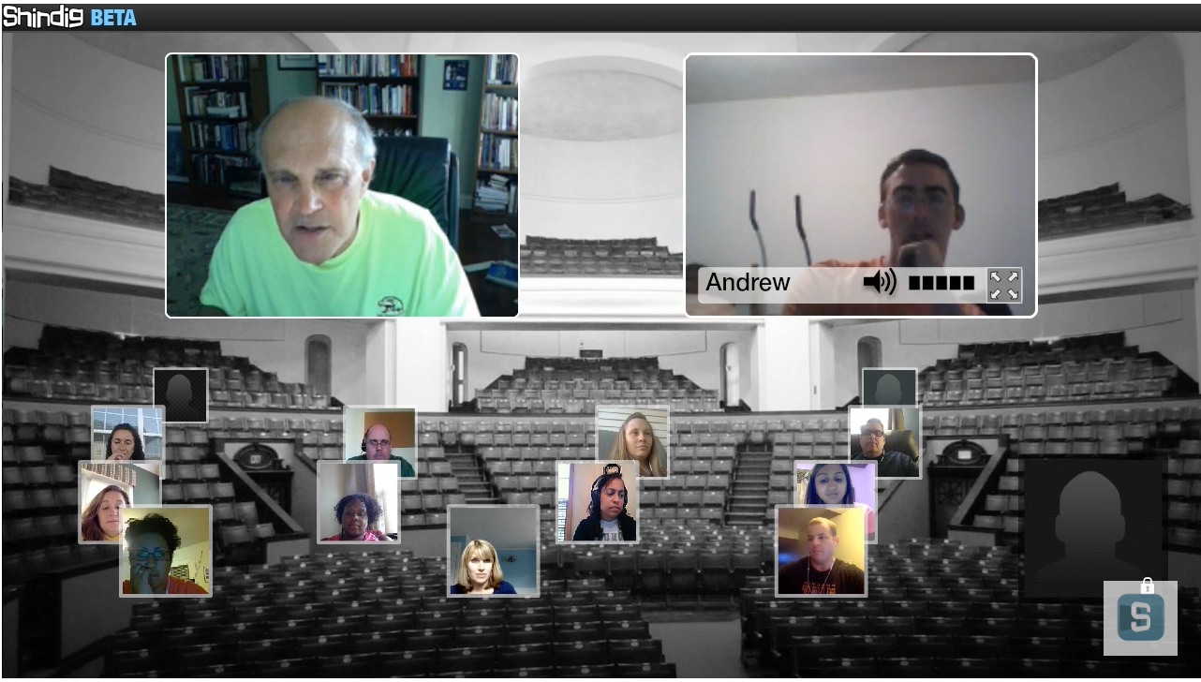
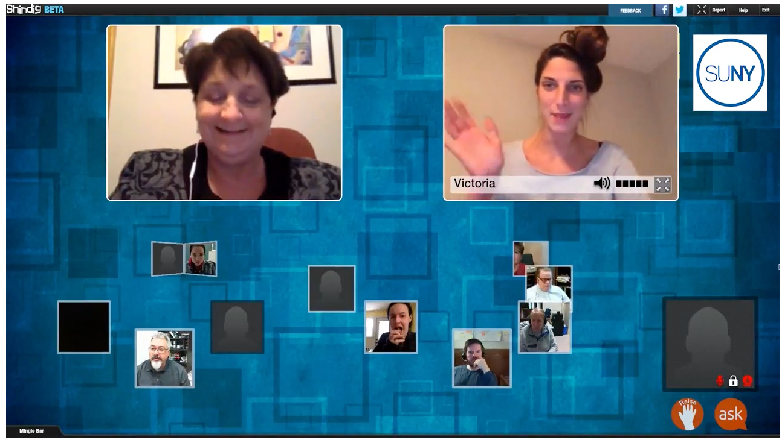
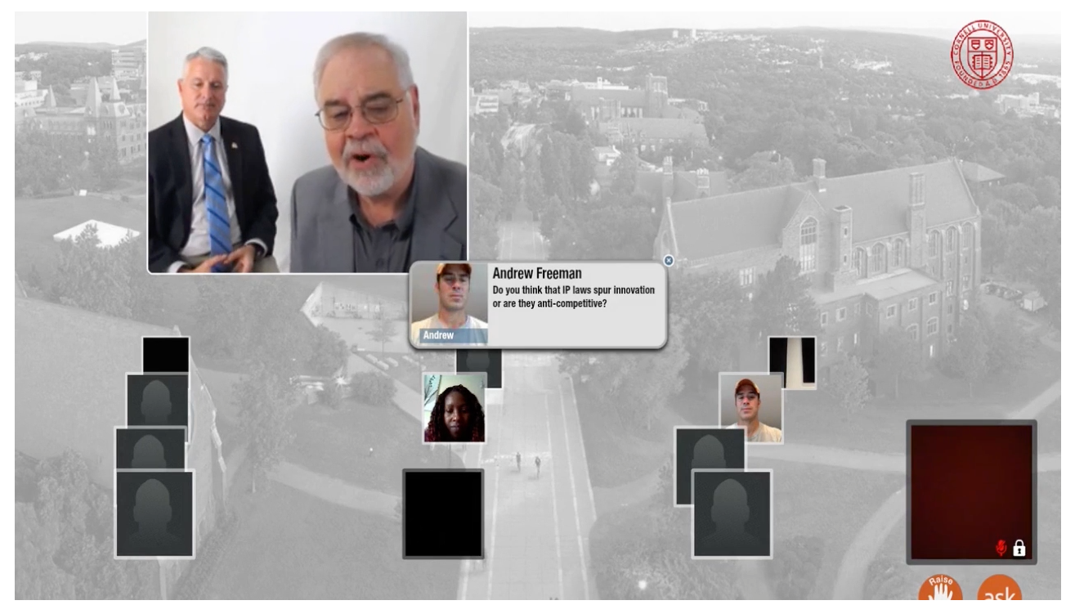

Slide 6
{
Active
Student-Centered
Learning
Evidence-Based Teaching
School
of Life Sciences
Priorities
Notes:
For Active learning- Move away from a traditional lecture model and start adding in interactive activities. Peer learning, discussions, collaborative projects, etc.
For Evidence Based Teaching- Look at valid research on what works, and carefully assess any teaching techniques that are used.

Slide 7
Online Course Issue: Faculty voiced concerns about feeling disconnected from students
1.
Notes:
Our faculty enjoyed discussions in the classroom, they were energized, and felt they got to know students in classroom F2F communications
With an ASU Mandate that we start doing more online courses, these traditional faculty were missing the interactions with students.
Asynchronous interactions, and blocky, boring formats for discussion boards.

Slide 8
BIO594:
Why People Lie, Cheat and Steal
Mike Angilletta, PhD
Challenge:
Online Debates
Notes:
Mike ASU’s Funniest professor last year. Very animated, passionate and active teacher.
Course name was Why people lie, cheat and steal.
Very controversial, and content needed to be really talked through with students. Mike usually set up debates with this content, and we were struggling with technologies to do this activity online. They felt “flat” and not engaging. Even products like Adobe Connect, didn’t have the “spontaneity” that we desired.
Shindig was integrated, and Mike was able to connect to the students the way he normally would. Mike could have students form groups to discuss a “pro/con” Argument, and then invite students up to the “Main stage” to present a side of the issue. He could bring a representative from both sides, and have them do an actual debate. The students were engaged with each other and Mike. Mike felt connected.

Slide 9
Campus Classrooms Reaching capacity in our rooms without losing student engagement
2.

Slide 10
Traditional Model Needed
MORE!
Notes:
Lecture halls were created for scale. Ours hold 400+ students. ASU has 85,000 students.
Allowing us to teach large numbers of students.
We still work to make the rooms active, with professors moving around the room, response systems and Eric Mazur’s approach to peer learning.
But we needed more. Enrollments were growing, and research was proving the typical lecture wasn’t providing learning for many students. Scott Freeman came to our department and showed his research that lectures were ineffective for most of our underserved populations. ASU Professor Micki Chi researched the importance of interactive “Collaborating in Dialogue” in student learning so we changed our classrooms.

Slide 11
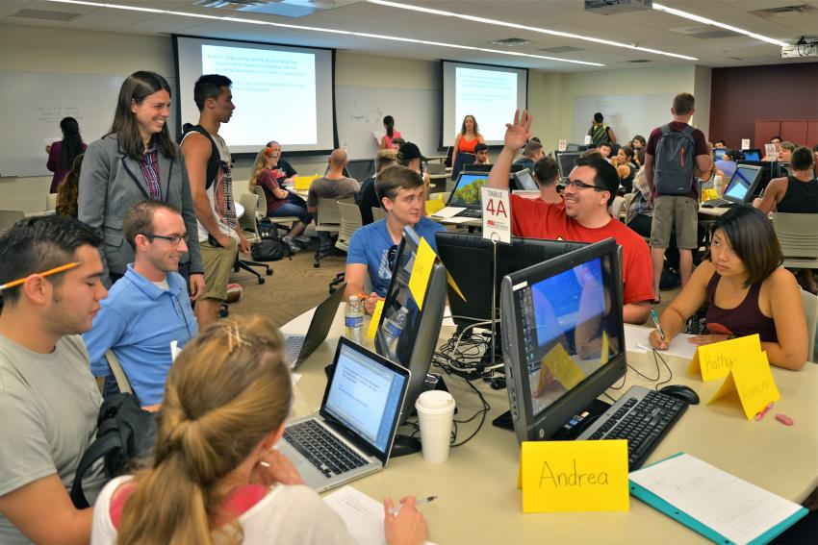
Notes:
We moved to active learning classrooms, Fantastic interactive dialogs and active learning. Faculty were feeling connected to their students and having fun teaching again.
but struggle with still teaching 400+ students with smaller sections.
When we started developing online courses, we also had to look at how to re-create these active learning sessions in an engaging online environment,
That’s when Shindig became a potential solution to our capacity issues.

Slide 12
Could it help replace lecture halls, give us more capacity rooms and make online students more active?
Notes:
We had used other technologies for a number of years, but they seemed too formal. And constrained conversations between students.

Slide 13
Students can flow easily in and out of groups.
Faculty can “wander” into groups and guide students

Slide 14
See It In Action!
https://www.youtube.com/watch?v=QXc7-U-KMSA&feature=youtu.be

Slide 15
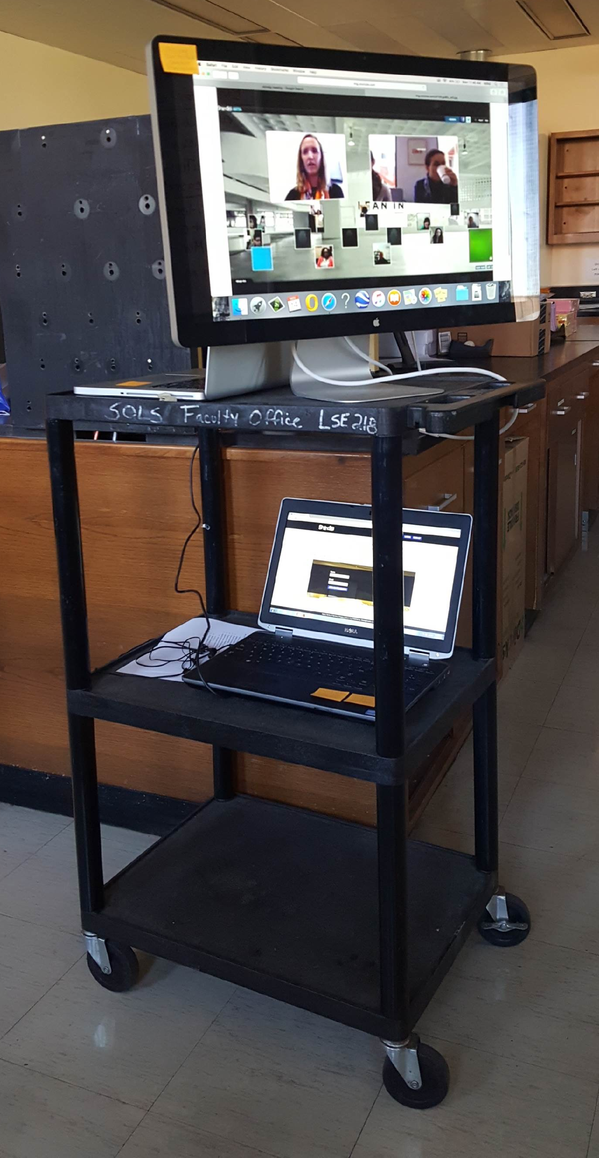
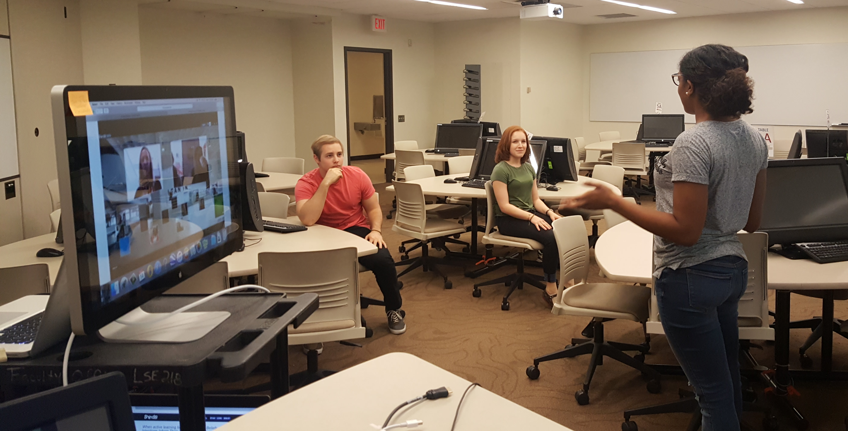
Shindig
Mobile Unit
Notes:
Cart rolls into classroom with a large monitor for faculty to view online students + admin computer for a TA to control online interactions
Transition period to allow students to access live content, but still interact and do small group activities. Mobile unit allows us to expand current classroom capacity
Eventually we see more faculty conducting sections fully in the Shindig environment, without using actual classrooms.

Slide 16
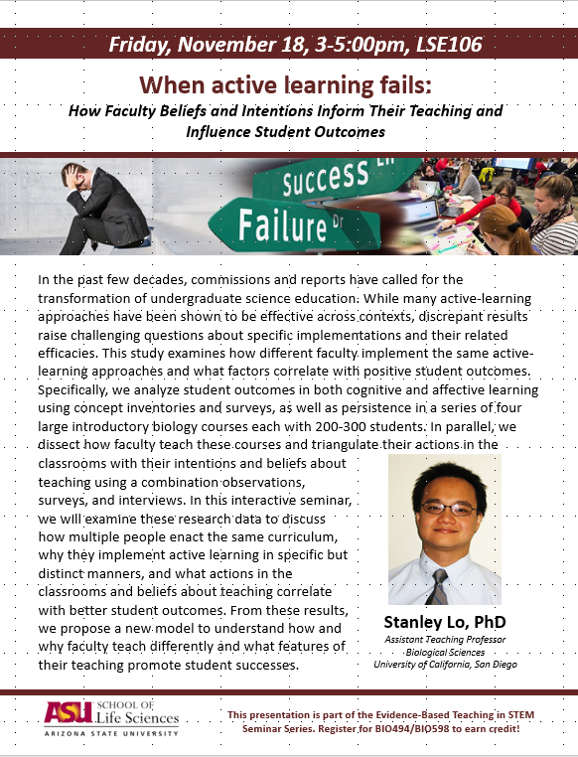
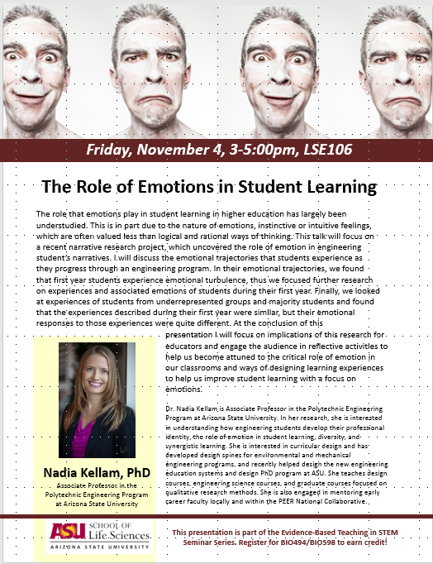
BIO494:
Evidence-Based Teaching Seminars
Notes:
Latest course to use Shindig Mobile Unit
Allows us to take guest speakers and share their content with colleagues at community colleges, and other campuses at ASU, AND
With a structure that allows for active leanring.

Slide 17
School
of Life Sciences
Priorities
{
Active
Student-Centered
Learning
Evidence-Based Teaching
Notes:
Shindig helped ASU meet our priorities of teaching and student learning.

Slide 18
SUCCESSFUL?
Success is “the accomplishment of an aim or purpose”
Define success for students; faculty and institution/departments
All students come with different experiences and different background
When teaching collaboratively both teachers should discuss how they will define success
Notes:
Success Means different things to different people, cultures, universities
success-not only do faculty need to agree on outcomes and what success means, but universities or departments may also have a “say” in this

Slide 19
Note: 168 Students Submitted Surveys &12 Faculty Surveyed

Slide 20
ASU and Shindig Experiences
The study was designed quantitative descriptive.
Participants included students and instructors in 12 different courses at higher education institutions across the United States.
Sample consisted of 168 students and 12 instructors who were selected from a population of 411 students and 12 instructors.
Participants completed synchronous web-based learning activities over a series of 3 to 5 sessions using the Shindig Video Chat Teaching Platform.

Slide 21
ASU and Shindig Experiences
The instrument included questions that required students and instructors to report on their perceived experiences with the Shindig Video Chat Teaching Platform in relation to three areas: satisfaction, attitudes, and retention.
Data obtained from the survey was combined for all 12 courses to provide a larger sample size that represented a larger population.
Data was analyzed using the frequency procedure of SAS to determine the overall frequency of responses to each question by course using Shindig Video Chat Teaching Platform as the fixed variable.

Slide 22
ASU and Shindig Experiences
The information provided by participants in reflecting on their experiences was not cross validated by observations of student grades
The sample size of the study: The 12 courses involved in the study had a total of 411 students enrolled and 168 out of 411 students (40.8%) responded to the survey.
Further collection of data may provide additional insight into student and instructor perceptions after using the Shindig Video Chat Teaching Platform in order to confirm these initial findings with a larger sample.

Slide 23
SAMPLE SESSION AGENDA
PRE-SESSION
Make sure students have easy access to all materials needed.
Have a discussion/chat moderator
Remind to run sound check
Have video on or provide picture
DURING SESSION:
“House keeping” items
Introductions
Just like you would in a presentation or paper start with something that will grab their attention
Break presentation up into chunks. Every 10 minutes stop for discussion/break out sessions/polls/interactive activity.
Summarize next steps
Set up asynchronous activity to continue discussion

Slide 24
Preparation!
Allow plenty of time for planning.
Dry run on the equipment you will use in the room you will be.
It’s all about the audio, make sure it works.
Explore all the features the tool has to offer
Practice, practice and practice some more
Be organized and have an agenda
Remember it is all about building community
Make it fun and interactive
Notes:
and planning so faulty can identify/discuss potential challenges and how to overcome obstacles (learning community)
-plan out what you will do ahead of time see if you can get some colleagues to do a mock session with you.
, you don’t have to create a “second course”. Think carefully about what you will do during the session
but don’t feel the need to use them all.
One hour goes by really fast,
ake sure to allow plenty of time for question and discussion
What is the pedagogical intent?

Slide 25
Promotion
Include links or login info in syllabus
Include links, session info, login in in course emails
Use a system that includes reminder emails about session start time
Share recordings of sessions in email and course announcements to spur interest in later sessions.

Slide 26
Faculty Feedback
“With Shindig, I was able to hold discussion and debates with my students as easily as if they were in the same room”
- Michal Angilletta, Professor & Associate Director of Undergraduate Studies, School of Life Sciences, ASU
Notes:
Faculty felt it increased engagement and sense of community-humanized the experience for them. Media team felt it was easy to set up.

Slide 27
?
Share your ideas and experience:
How might you use synchronous sessions?
What activities might you adopt?

Slide 28
solutions-oriented
excellence
impact
entrepreneurial
decisive
access
A New American University
visionary
Amy.Pate@asu.edu
bold
create
imaginative
re-envision

