Slide 1
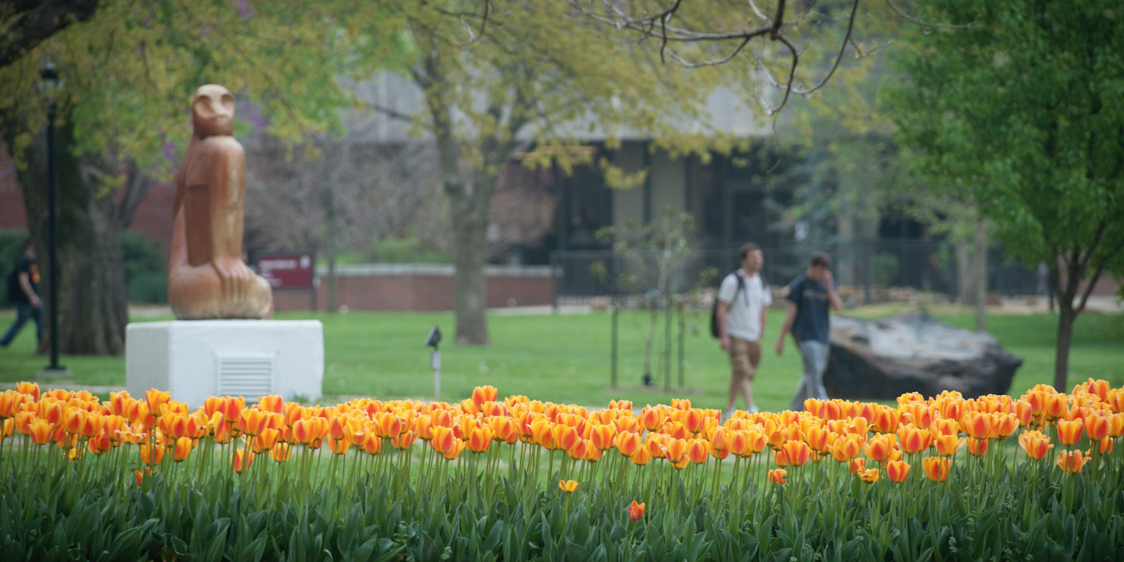
FOSTERING INNOVATION.
AT EVERY LEVEL.
EDUCAUSE 2017
Philadelphia, PA
Nov 3, 2017
AN
Notes:
Angela

Slide 2
Today’s Presenters
  Pittsburg State University:
  Information Technology Services (ITS)
  Jeff Burns, Assistant Director Development & Implementation
  jburns@pittstate.edu
  John Kuefler, Lead Architecture Developer
  jkuefler@pittstate.edu
  Angela Neria, Chief Information Officer
  aneria@pittstate.edu
Contact info
ALL
Notes:
Jeff
John
Angela

Slide 3
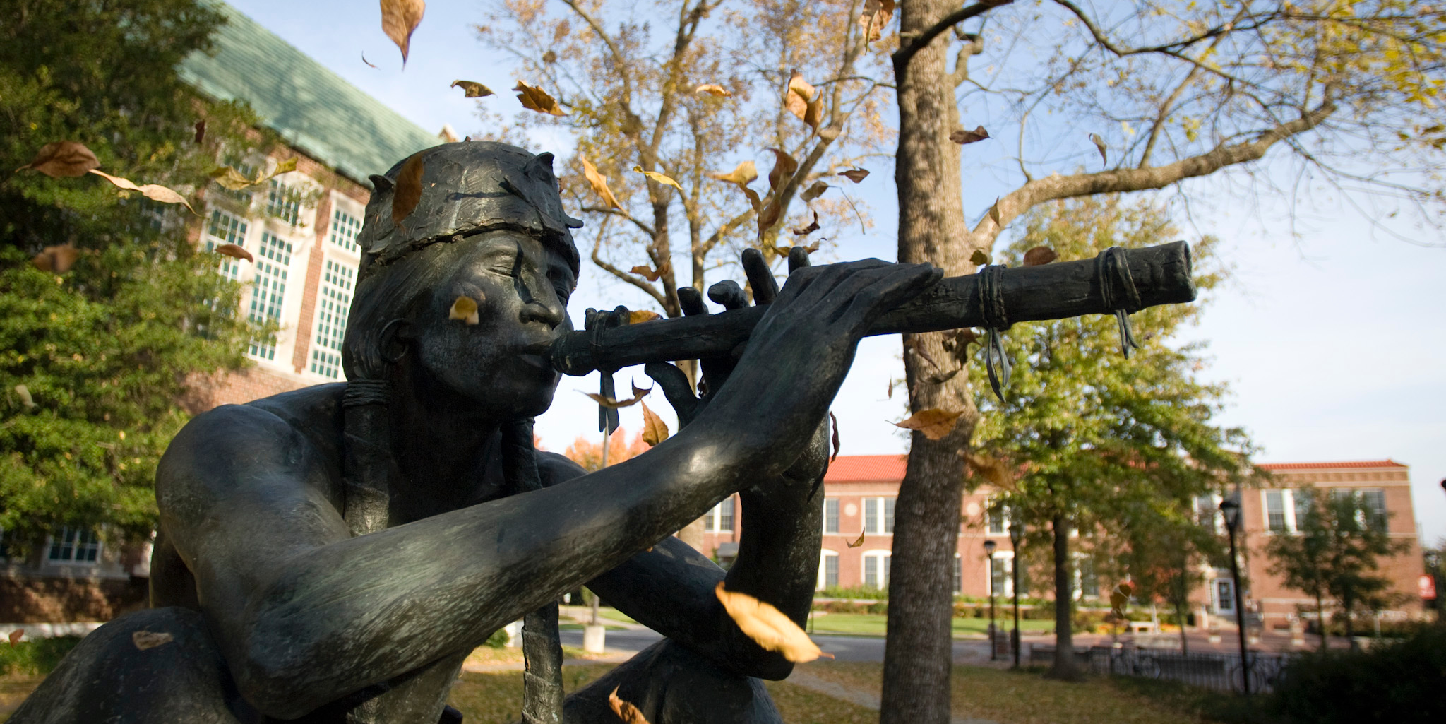
Pittsburg State University
Located in Pittsburg KS
Southeast Kansas
7400 students
1200 faculty and staff
We are the Gorillas
Mascot: Gus The Gorilla
AN
Notes:
Angela

Slide 4
What WE hope You take home
OUTCOMES
AN
Notes:
Angela

Slide 5
OUTCOMES
1. Understand how to develop an innovation plan.
2. Understand how to develop innovation leaders.
3. Understand how to promote an innovative IT culture.
PITTSBURG STATE UNIVERSITY
AN
Notes:
Angela
MENTION RECRUITMENT AND RETENTION

Slide 6
Share Out
WE ARE I.T.!
WHY DO WE GET STUCK
IN THE PAST?
JK
Notes:
John

Slide 7
WHY DO WE GET STUCK?
1.
2.
3.
4.
PITTSBURG STATE UNIVERSITY
JK
Notes:
John
Money
Talent
Time
Tools
Buy In
IT depts. Can become silo’d and we don’t jointly own ways to solve problems (how can you innovate when you are creating limits …silos)
We get too comfortable (Lose Motivation)
Lack of Empowerment (Quote: You Have The Authority)
????

Slide 8
WHY
THE PITT STATE STORY
AN JB
Notes:
Angela and Jeff

Slide 9

OUR IT HORROR STORY
PITTSBURG STATE UNIVERSITY
AN JB
Notes:
Angela and Jeff: Speak to the group about our story: Started out doing innovative stuff. Became lax. Division in our dept (silo’d).

Slide 10
OUR STORY
Can’t to Can
Reorganized
Re-energized
  New Culture:
  Communication/Collaboration Centered
PITTSBURG STATE UNIVERSITY
AN JB
Notes:
Angela
Culture: Speak to eliminating the obstacles and attitudes. Remind that culture is not a destination.

Slide 11
WHY
WHY WE NEEDED INNOVATION
AN JB
Notes:
Angela

Slide 12
WHY
ITS Culture & Morale
Client Experience
Limited Resources
      Does this sound familiar?
CREDIT: Movieclips.com http://www.movieclips.com/videos/apollo-13-official-clip-square-peg-in-a-round-hole-502948931746?autoPlay=true
PITTSBURG STATE UNIVERSITY
AN JB
Notes:
Angela

Slide 13
REsearch
WHAT THE RESEARCH TELLS US
JK
Notes:
John

Slide 14
RESEARCH SAYS
Clear Purpose
Promote Risk Taking
Consider Outside Forces
Resources
PITTSBURG STATE UNIVERSITY
JK
Notes:
John
RISK: “The biggest risk is not taking any risk... In a world that is changing really quickly, the only strategy that is guaranteed to fail is not taking risks.” -Mark Zuckerberg
RESOURCE: IT resources, yes. Organizational resources as well!

Slide 15

RESEARCH SAYS
Ask Questions & Listen Intently
Independence
Build Effective Teams
Benchmark Against the Best
PITTSBURG STATE UNIVERSITY
JK
Notes:
John
INDEPENDENCE: Autonomy empowers, Allows team members to be agile, Promotes creativity
TEAMS: Team types: Collaboration spaces (PITT Crew), Create a sense of ownership ,Stand up meetings (Scrum)—could have a question here for a prize
BENCHMARK: Who’s the best? How do we get there? How do we exceed? (Could have a question for a prize here too)

Slide 16
RESEARCH SAYS
So who is the best?
#3 Apple
#2 Chick Fil A
#1 Amazon
Ranked by USA Today. Best Customer Service Companies (2016)
151 companies in 17 customer facing industries
PITTSBURG STATE UNIVERSITY
JK

Slide 17
Our 2 cents
BEYOND THE RESEARCH
JK
Notes:
John

Slide 18
OUR TWO CENTS
Crisis Breeds Opportunity
Pay Attention To Grass Roots Ideas
Open Door Policy Among Peers
Transparency
Mistakes: Own Them & Keep Moving Forward
Intrinsic Reward When Working on Innovative Projects
Lead By Example
PITTSBURG STATE UNIVERSITY
JK
Notes:
John

Slide 19
PLAn
OUR PLAN
JB
Notes:
Jeff

Slide 20
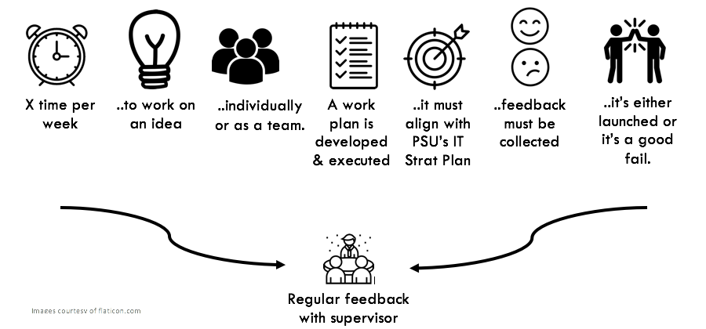
Elements of our Plan
PITTSBURG STATE UNIVERSITY
JB
Notes:
Jeff

Slide 21
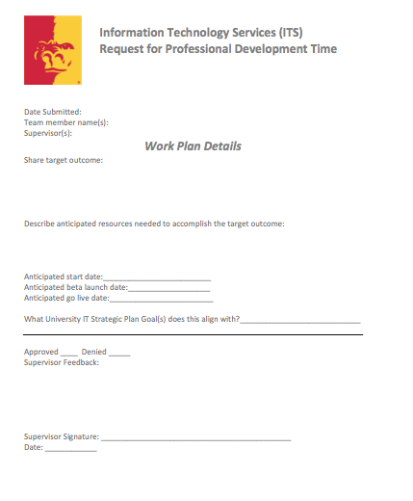
JB
Notes:
Jeff

Slide 22
RESULTS
OUR RESULTS
JB
Notes:
Jeff

Slide 23
RESULTS
PSU Mobile App
PSU ID Management
(award winning!)
Residence Hall Hospitality
Wifi Model
GUS Portal
GUS Ware
PITTSBURG STATE UNIVERSITY
JB
Notes:
Jeff

Slide 24
EXAMPLE
CASE STUDY
JK
Notes:
John

Slide 25
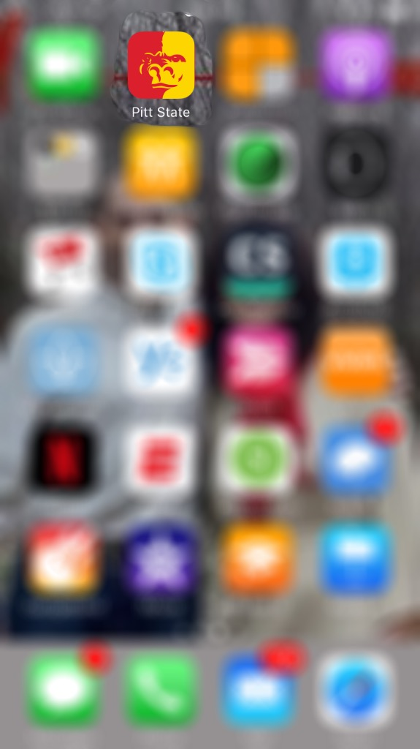

EXAMPLE
PSU Mobile App
PITTSBURG STATE UNIVERSITY
JK
Notes:
John

Slide 26
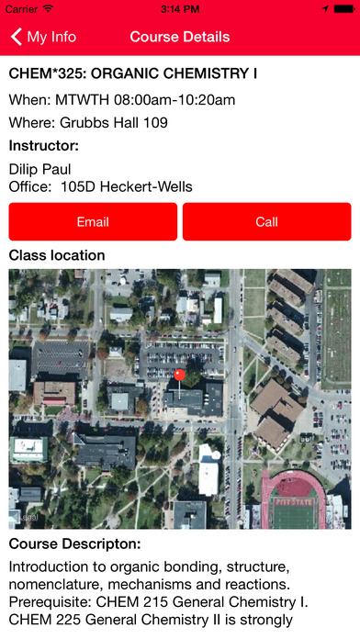
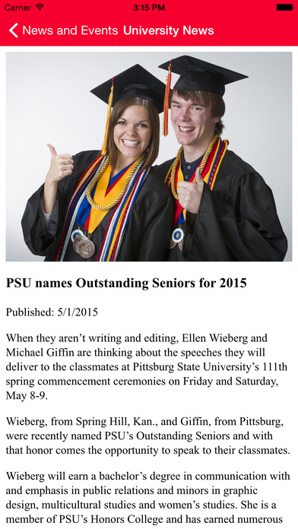
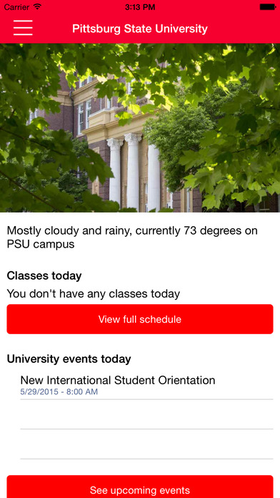
JK
Notes:
John

Slide 27
EXAMPLE
PITT STATE MOBILE APP COSTS
1. Time: 16 weeks x 1.5 hours per week x 2 people = 48 hours…plus a little personal time…because we love this stuff! = 60 hours total.
2. Xamarin Licenses.
3. Apple Developer License & Google Play.
Total:
Very low overall total time and monetary costs! Very big outcome for our clients!
PITTSBURG STATE UNIVERSITY
JK
Notes:
John

Slide 28
EXAMPLE
PITT STATE MOBILE APP COSTS
1. Time: 16 weeks x 1.5 hours per week x 2 people = 48 hours…plus a little personal time…because we love this stuff! = 60 hours total. $1,500
2. Xamarin Licenses. $2,000
3. Apple Developer License & Google Play. $125
Total: $3,625
Very low overall total time and monetary costs! Very big outcome for our clients!
PITTSBURG STATE UNIVERSITY
JK
Notes:
John

Slide 29
Next Steps
NOW WHAT?
AN
Notes:
Angela

Slide 30
NEXT STEPS
Expanding the plan in other areas
Managing updates/improvement
PITTSBURG STATE UNIVERSITY
AN
Notes:
Angela

Slide 31
Path
…never stop innovating
PITTSBURG STATE UNIVERSITY
AN
Notes:
Angela

Slide 32
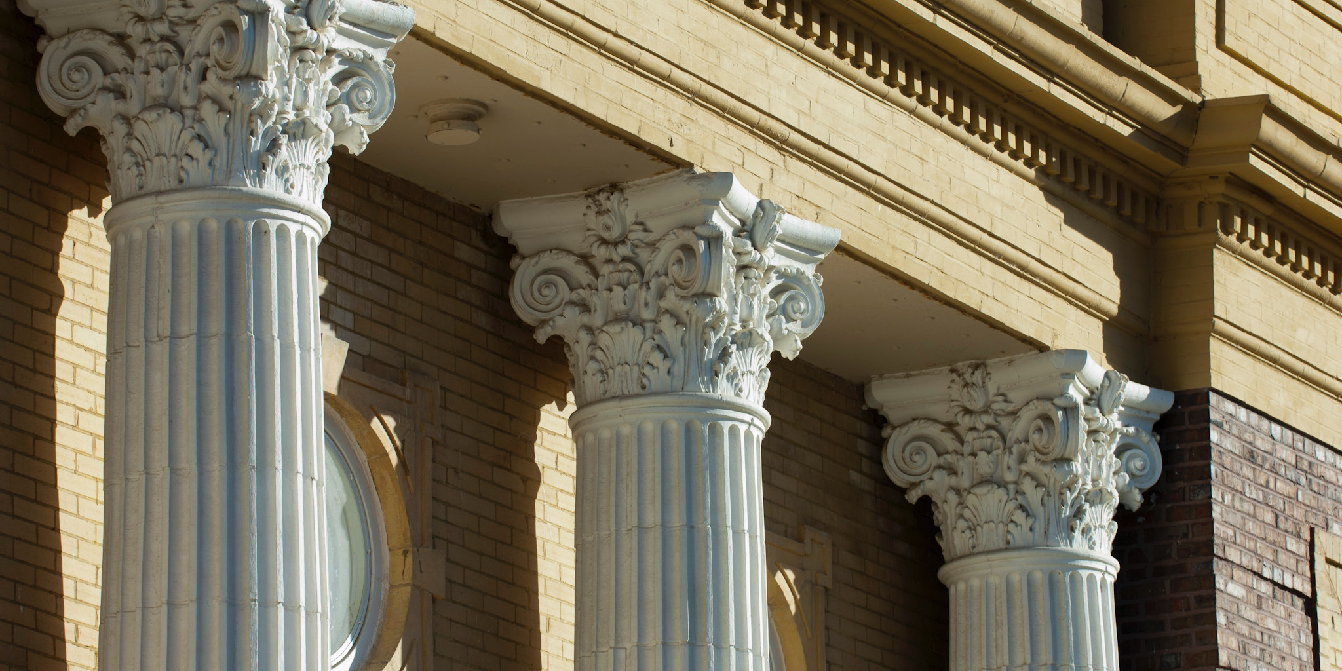




Thank you!
pittstate.edu
AN
Notes:
Angela will close out

