Slide 1
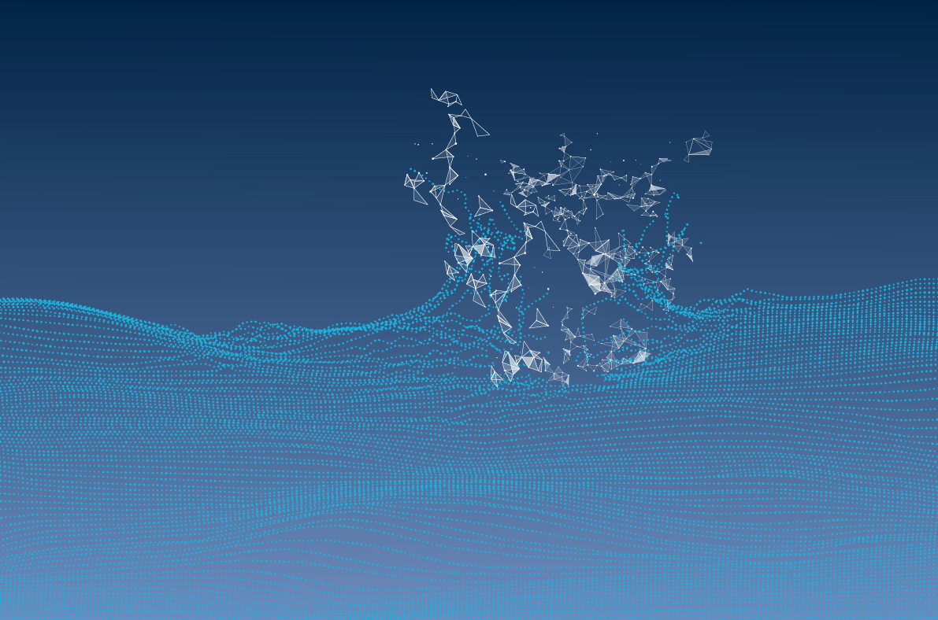
Learning to Put the Student First
How to Implement CBE with student-centric strategy and analysis.

Slide 2

^{Innovation Works Here.}
Introductions: A Shared Heritage
UMUC specializes in educating busy professionals like you. We are a respected state university offering career-relevant, affordable education that fits your life. You can earn most degrees entirely online or choose from hybrid classes that combine online learning with in-person instruction. You won't have to wait for graduation for your degree to start making a difference in your career. At UMUC, you build your professional value with each class you take.
Kara Van Dam
Dean, Undergraduate School
UMUC

Slide 3
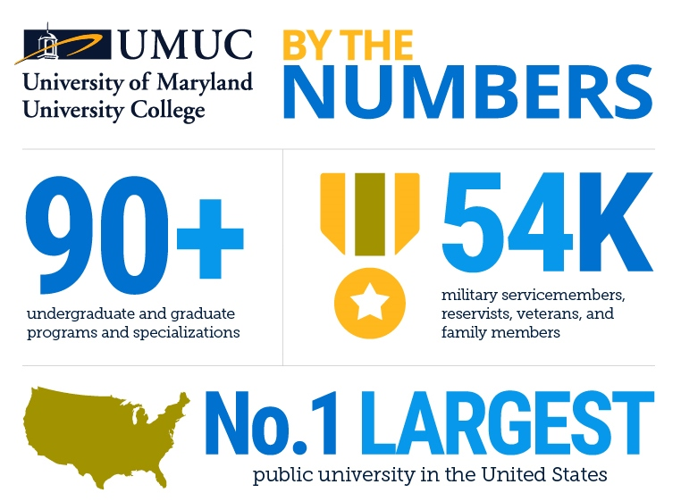
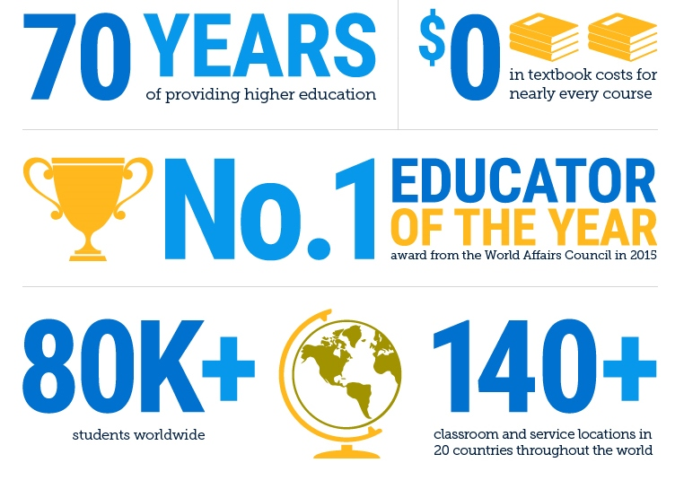
^{Innovation Works Here.}

Slide 4
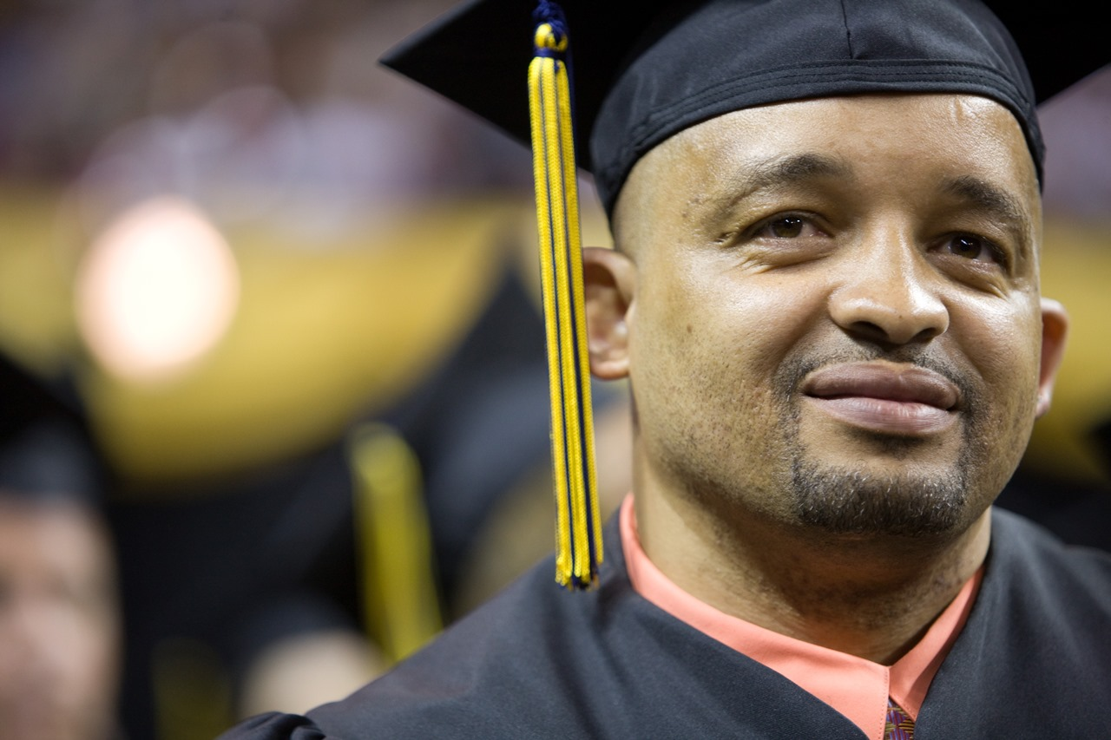
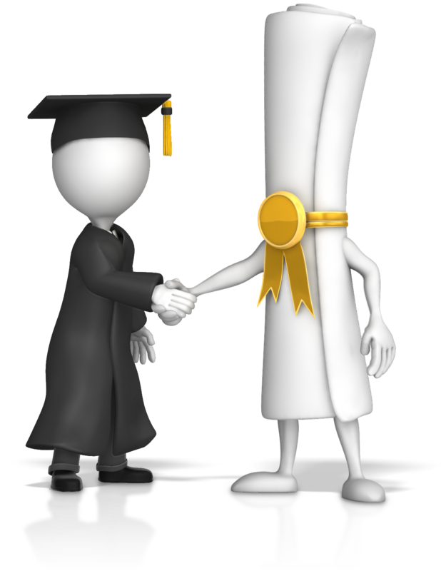

^{Innovation Works Here.}
Our Students
Adult learners juggling career and family while continuing their education to better themselves, their families, and their professional opportunities.
50%
80%
50%
>50%
MINORITIES
WORK FULL TIME
PARENTS
MILITARY AFFILIATION

Slide 5

^{Innovation Works Here.}
The Goal - Access, Openness, Flexibility
We are the open-access, adult-serving public institution of the University System of Maryland.
We are committed to smart growth and closing the learning and employment gap.
We educate our students in the modality they need – online, F2F, and hybrid.
We provide our students the ability to do the real work of their professions which is critical to our graduates’ future success.

Slide 6

^{Innovation Works Here.}
Introductions: A Shared Heritage
Josh Greenberg
Business Analysis Manager
AccelerEd
AccelerEd is an academic enablement company that makes next-generation technology both available and viable for educational institutions. We emerged from higher education. We know the challenges and constraints. We bring a seven-decade legacy in global innovation from which you can benefit.
Sheane Robinson
Senior Business Analyst
AccelerEd

Slide 7

^{Innovation Works Here.}
AGENDA
Goal: Practical Guide
Problem
  Traditional Model
  Where to Start
Approach
  What We Did
  Journey Mapping
  Outcome
Realized Success

Slide 8
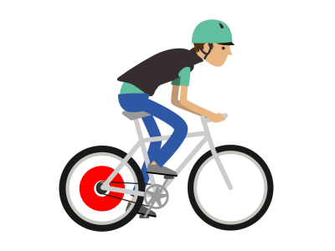
^{Innovation Works Here.}
The Problem - Traditional Model

Slide 9
^{Innovation Works Here.}
^{Innovation Works Here.}
The Problem - Traditional Model
Courses are one-shot attempts to demonstrate learning; first chance is all you get
Lacks Real-life Relevance
Student’s Experience Varies from Section to Section
Solution was Project Based Learning Based in a Competency Methodology

Slide 10

^{Innovation Works Here.}
The Problem
Where to Start?
False Starts
  CBE
    Calendar
    Learning Experience
  Academic Content Issue
    Learning Science and Design
Needed a method:
  How to focus?

Slide 11

^{Innovation Works Here.}
The Approach – What We Did
How: Make the Project Feasible
  Identify critical path
Who: Identify the Key Stakeholders
  Team building
  Collaboration
The A-HA Moment: The Learner
What: Define the Learning Model
  Identify Essential Processes
  Identify Training

Slide 12
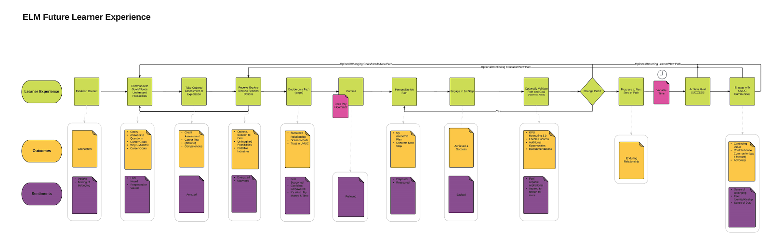
^{Innovation Works Here.}
The Approach - Journey Mapping
What is Journey Mapping?

Slide 13
^{Innovation Works Here.}
Example - Journey Mapping Educause
Register for Conference
Select Sessions
Attend Sessions
- Registration Confirmation
- Hotel
- Schedule
- Knowledge
- Contacts
- Frustration
- Excitement
- Relief
- Overwhelmed
- Excitement
- Waffling
- Engaged
- Bored
Notes:
Journey map def
Components 1, 2 ,3
Explain the components
Example: Not getting good grades. Is it they were sick? Not learning it? We don’t capture that.
We can solve with sentiments
Key to our success – we’re going to do one.

Slide 14
^{Innovation Works Here.}
^{Innovation Works Here.}
The Approach – Journey Mapping
How we used it:
Journey Mapped Current Student Experience
Visioned Ideal Future Student Experience
Determined Success Criteria
Determined Gaps and Effected Experience Steps
Determined Impacted Departments
Set the scope

Slide 15

^{Innovation Works Here.}
The Approach -
Outcome
Organization
Solved Initial Problem: Where to Start
  Project Based in a Competency Based Methodology
  Student focused
Project Work Streams:
  Process
  Technology
  Readiness
  Content

Slide 16

^{Innovation Works Here.}
Realized Success
Results
5 Graduate Programs
Rolled Out!
Several in Flight
Notes:
Kara
Cyber, MBA, Cloud, DM, LDT
Stats:
4% Increase in Re-enrollment
4% Increase in Successful course completion for on degree program, comparable success for the rest.

Slide 17


^{Innovation Works Here.}
Thank You!
Questions?

