Slide 1
QUANTIFIED STUDENT _ EDUCAUSE _ I KNOW WHAT YOU DID LAST SUMMER
QUANTIFIEDSTUDENT.NL HALLOWEEN EDITION

Slide 2
QUANTIFIEDSTUDENT.NL _ EDUCAUSE _HALLOWEEN EDITION_ I KNOW WHAT YOU DID LAST SUMMER

Slide 3
QUANTIFIEDSTUDENT.NL _ EDUCAUSE _HALLOWEEN EDITION_ I KNOW WHAT YOU DID LAST SUMMER

Slide 4
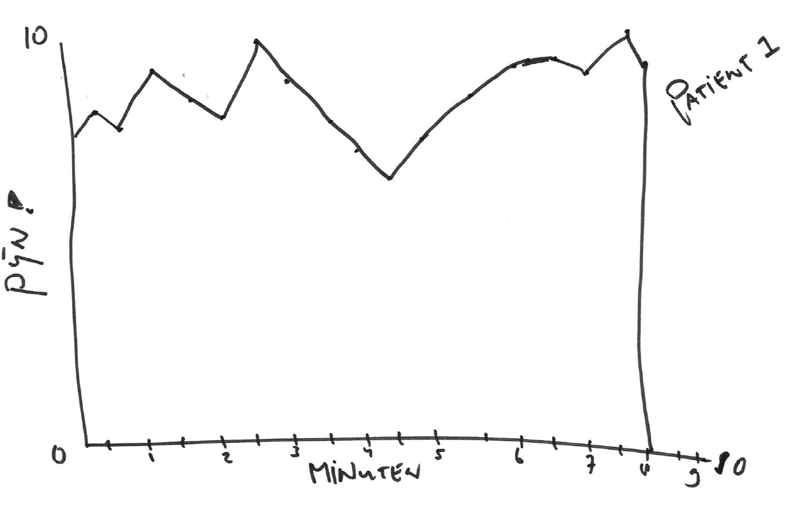
QUANTIFIEDSTUDENT.NL _ EDUCAUSE _HALLOWEEN EDITION_ I KNOW WHAT YOU DID LAST SUMMER

Slide 5
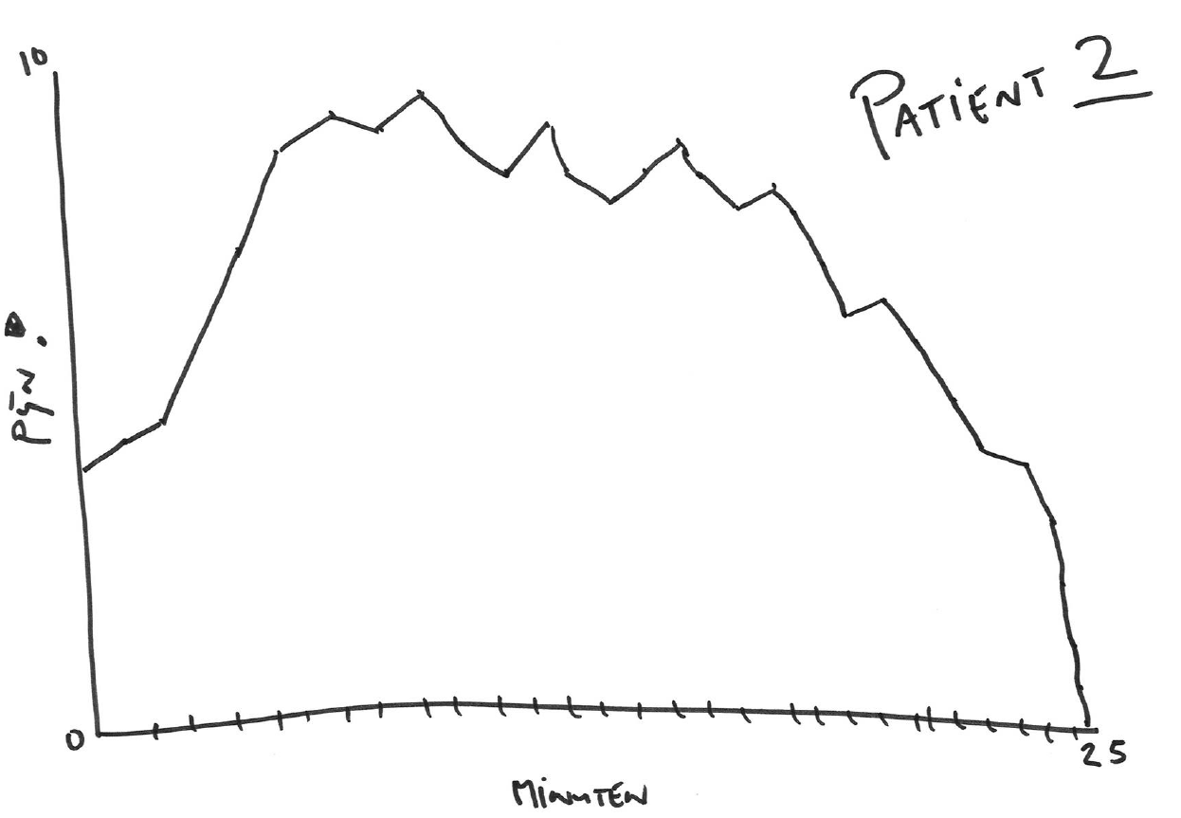
QUANTIFIEDSTUDENT.NL _ EDUCAUSE _HALLOWEEN EDITION_ I KNOW WHAT YOU DID LAST SUMMER

Slide 6
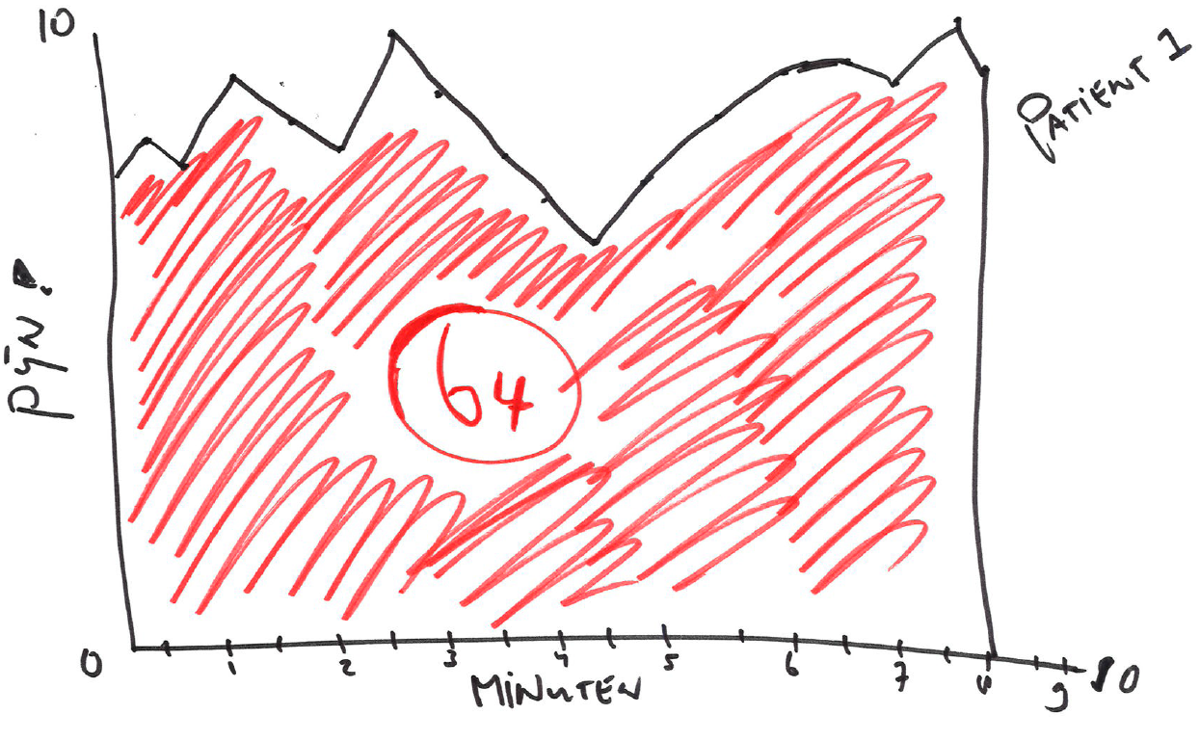
QUANTIFIEDSTUDENT.NL _ EDUCAUSE _HALLOWEEN EDITION_ I KNOW WHAT YOU DID LAST SUMMER

Slide 7
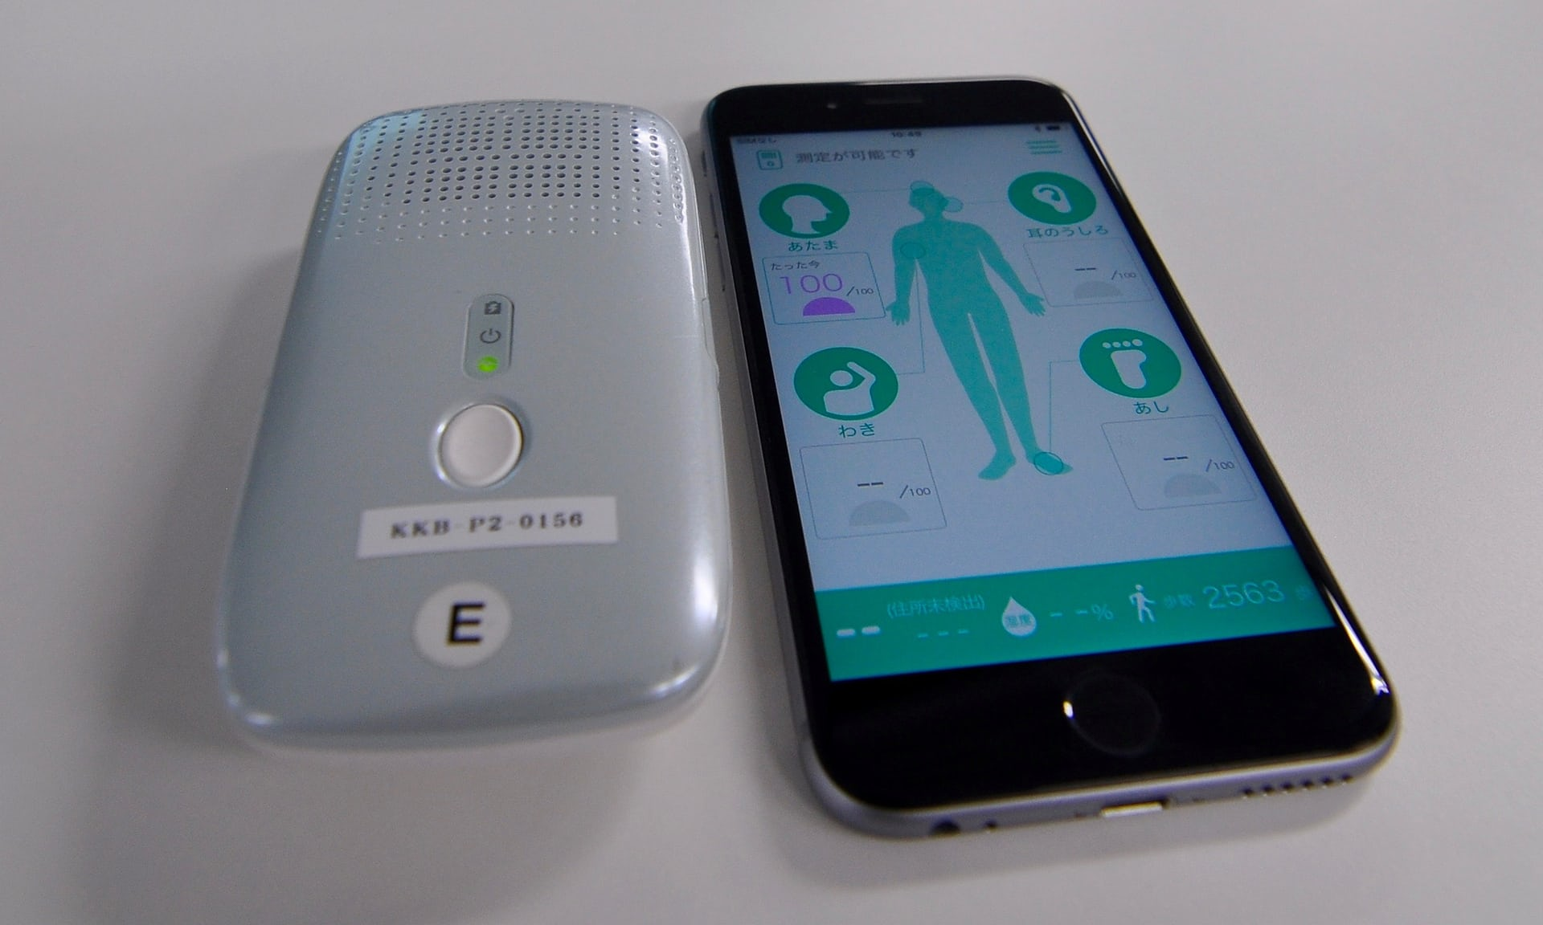
QUANTIFIEDSTUDENT.NL _ EDUCAUSE _HALLOWEEN EDITION_ I KNOW WHAT YOU DID LAST SUMMER

Slide 8
QUANTIFIEDSTUDENT.NL _ EDUCAUSE _HALLOWEEN EDITION_ I KNOW WHAT YOU DID LAST SUMMER

Slide 9
QUANTIFIEDSTUDENT.NL _ EDUCAUSE _HALLOWEEN EDITION_ I KNOW WHAT YOU DID LAST SUMMER

Slide 10
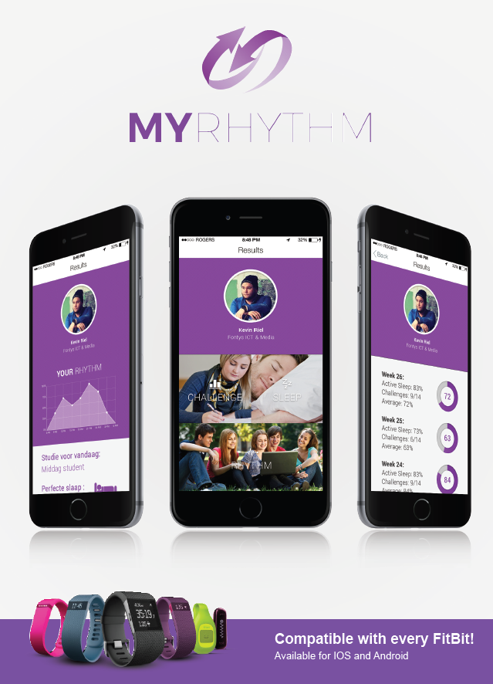
QUANTIFIEDSTUDENT.NL _ EDUCAUSE _HALLOWEEN EDITION_ I KNOW WHAT YOU DID LAST SUMMER

Slide 11
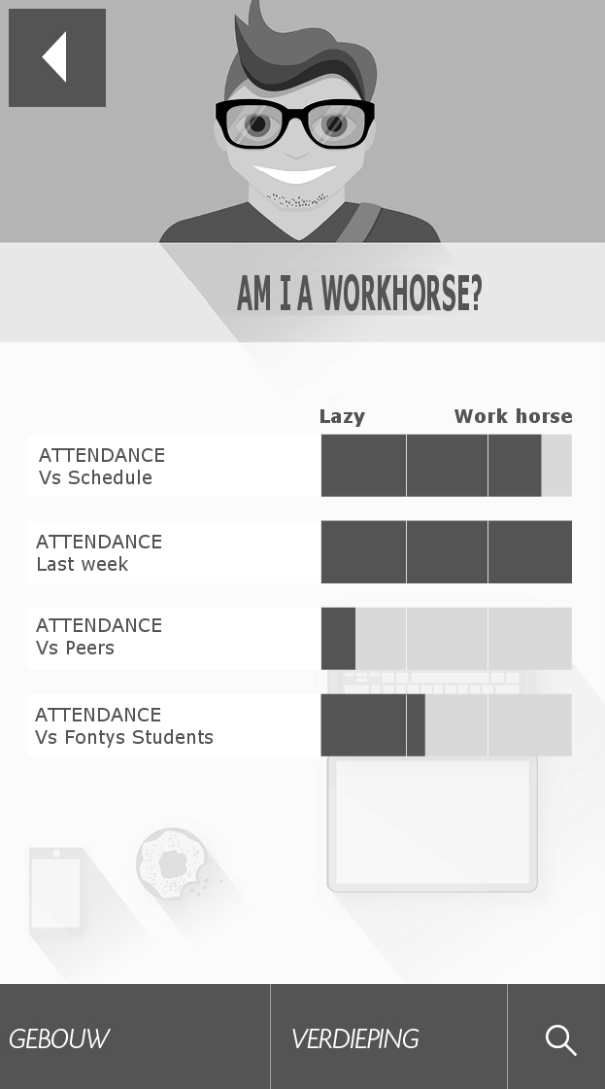
QUANTIFIEDSTUDENT.NL _ EDUCAUSE _HALLOWEEN EDITION_ I KNOW WHAT YOU DID LAST SUMMER

Slide 12
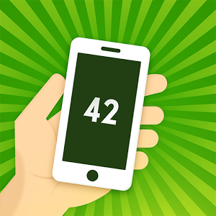
QUANTIFIEDSTUDENT.NL _ EDUCAUSE _HALLOWEEN EDITION_ I KNOW WHAT YOU DID LAST SUMMER

Slide 13
QUANTIFIEDSTUDENT.NL _ EDUCAUSE _HALLOWEEN EDITION_ I KNOW WHAT YOU DID LAST SUMMER
CAN YOU BUILD A
RUNKEEPER APP
FOR STUDYING ?
JOIN US: WWW.QUANTIFIEDSTUDENT.NL AND THERE IS MORE ->

Slide 14
Our educational Future? How we Quantify our students with educational Data
QUANTIFIEDSTUDENT.NL _ EDUCAUSE _HALLOWEEN EDITION_ I KNOW WHAT YOU DID LAST SUMMER

Slide 15
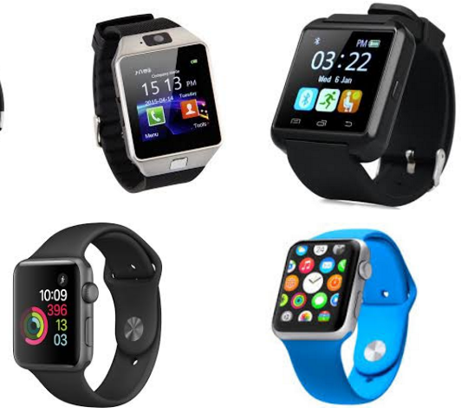
QUANTIFIEDSTUDENT.NL _ EDUCAUSE _HALLOWEEN EDITION_ I KNOW WHAT YOU DID LAST SUMMER
Learning analytics
Ed-Medium-data
Apps
Trackers and watches

Slide 16
Medium Data: 3 Questions
QUANTIFIEDSTUDENT.NL _ EDUCAUSE _HALLOWEEN EDITION_ I KNOW WHAT YOU DID LAST SUMMER
How to organize this in the Educational process: Programmatic Assessment + EPA’s
1
How do we get it easily without disrupting the Education process: Make it Easy
2
What can we give back to students and make it Quantifiable: Give Quantified feedback
3

Slide 17
1: How to organize this Educational Wize…
QUANTIFIEDSTUDENT.NL _ EDUCAUSE _HALLOWEEN EDITION_ I KNOW WHAT YOU DID LAST SUMMER
Programmatic Assessment + EPA’s

Slide 18
Programmatic Learning Apps System
QUANTIFIEDSTUDENT.NL _ EDUCAUSE _HALLOWEEN EDITION_ I KNOW WHAT YOU DID LAST SUMMER
P.L.A.S.

Slide 19
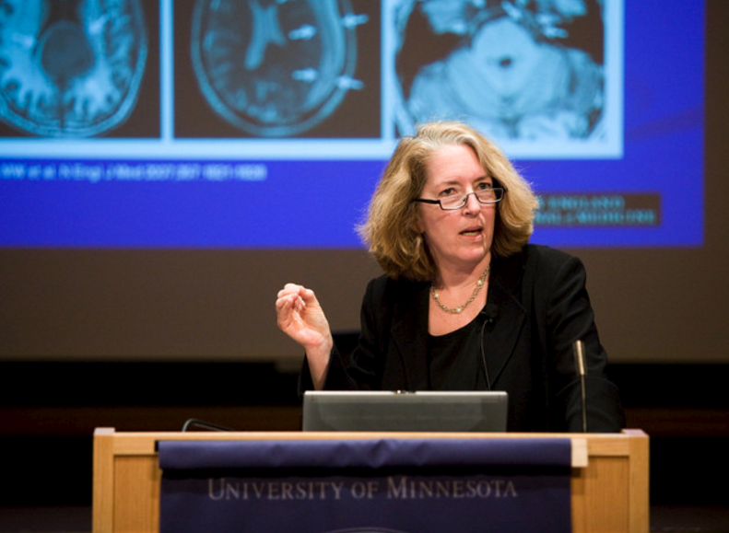
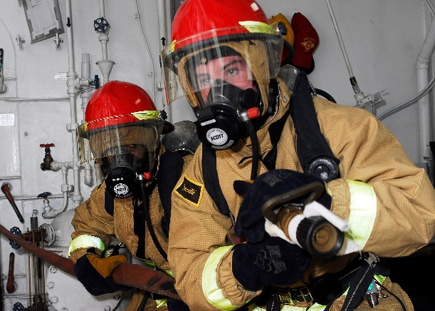
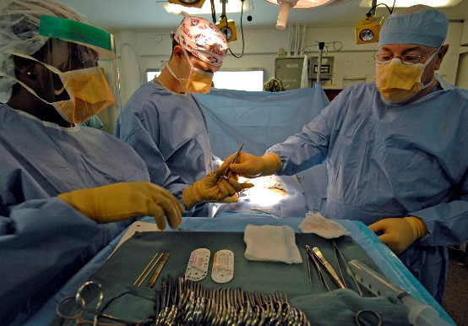
Grades do not give insight enough
QUANTIFIEDSTUDENT.NL _ EDUCAUSE _HALLOWEEN EDITION_ I KNOW WHAT YOU DID LAST SUMMER

Slide 20
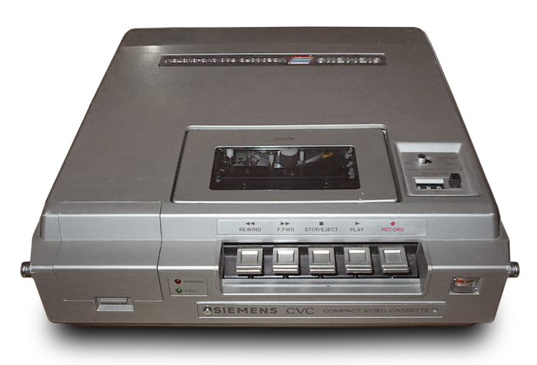
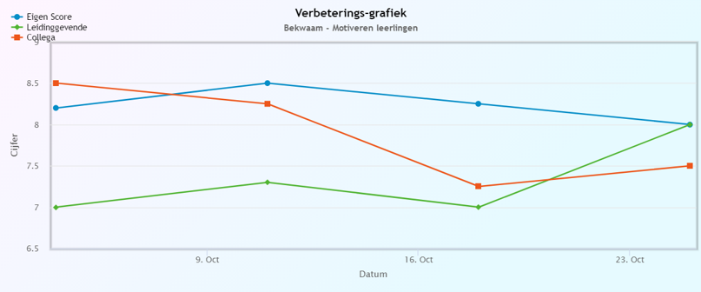
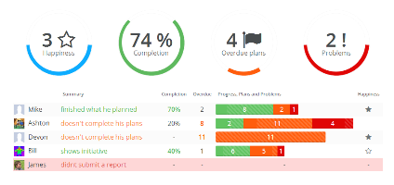
Programmatic Assessment
QUANTIFIEDSTUDENT.NL _ EDUCAUSE _HALLOWEEN EDITION_ I KNOW WHAT YOU DID LAST SUMMER
1st year
2nd year
3rd year
4th year
Edu activity
Edu activity
Edu activity
Edu activity
Edu activity
Edu activity
Edu activity
Edu activity
Edu activity
Edu activity
Edu activity
Edu activity
Apps that record
Your Education
Ed-data
Individual
Big

Slide 21
+ Entrustable Professional Activities
QUANTIFIEDSTUDENT.NL _ EDUCAUSE _HALLOWEEN EDITION_ I KNOW WHAT YOU DID LAST SUMMER
How we (try to) ensure that our education leads to what we want…
Redesign education to Entrustabel Professional Activities
US National Library of Medicine National Institutes of Health
Nuts and Bolts of Entrustable Professional Activities
https://www.ncbi.nlm.nih.gov/pmc/articles/PMC3613304/
Proffessor Dr. Olle ten Cate

Slide 22
2: Make it easy
QUANTIFIEDSTUDENT.NL _ EDUCAUSE _HALLOWEEN EDITION_ I KNOW WHAT YOU DID LAST SUMMER

Slide 23
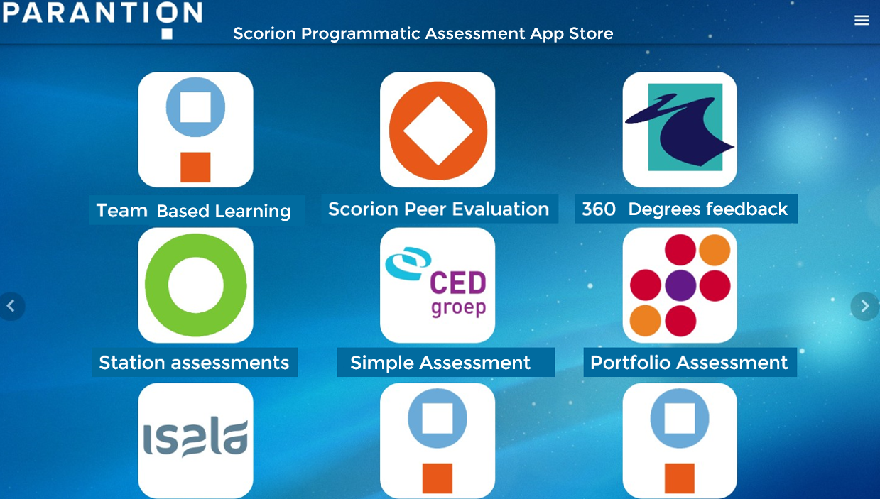
Record Education with Smart Apps
QUANTIFIEDSTUDENT.NL _ EDUCAUSE _HALLOWEEN EDITION_ I KNOW WHAT YOU DID LAST SUMMER

Slide 24
Giving feedback
QUANTIFIEDSTUDENT.NL _ EDUCAUSE _HALLOWEEN EDITION_ I KNOW WHAT YOU DID LAST SUMMER

Slide 25
3: Make it Visual
QUANTIFIEDSTUDENT.NL _ EDUCAUSE _HALLOWEEN EDITION_ I KNOW WHAT YOU DID LAST SUMMER
And give it straight, meaningfull and Quantified back to Student and Teacher

Slide 26
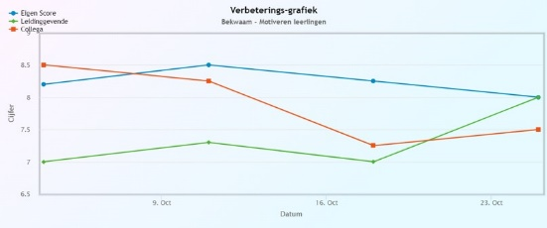
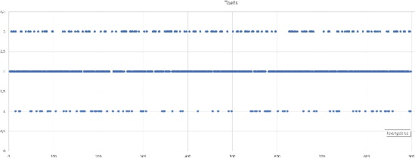
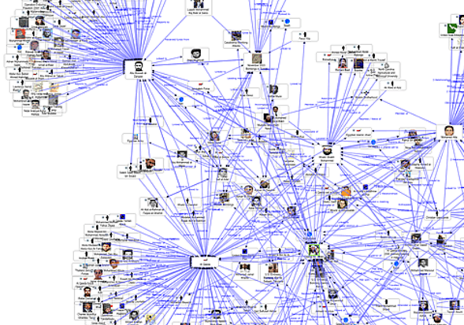
Quantified Student
QUANTIFIEDSTUDENT.NL _ EDUCAUSE _HALLOWEEN EDITION_ I KNOW WHAT YOU DID LAST SUMMER

Slide 27
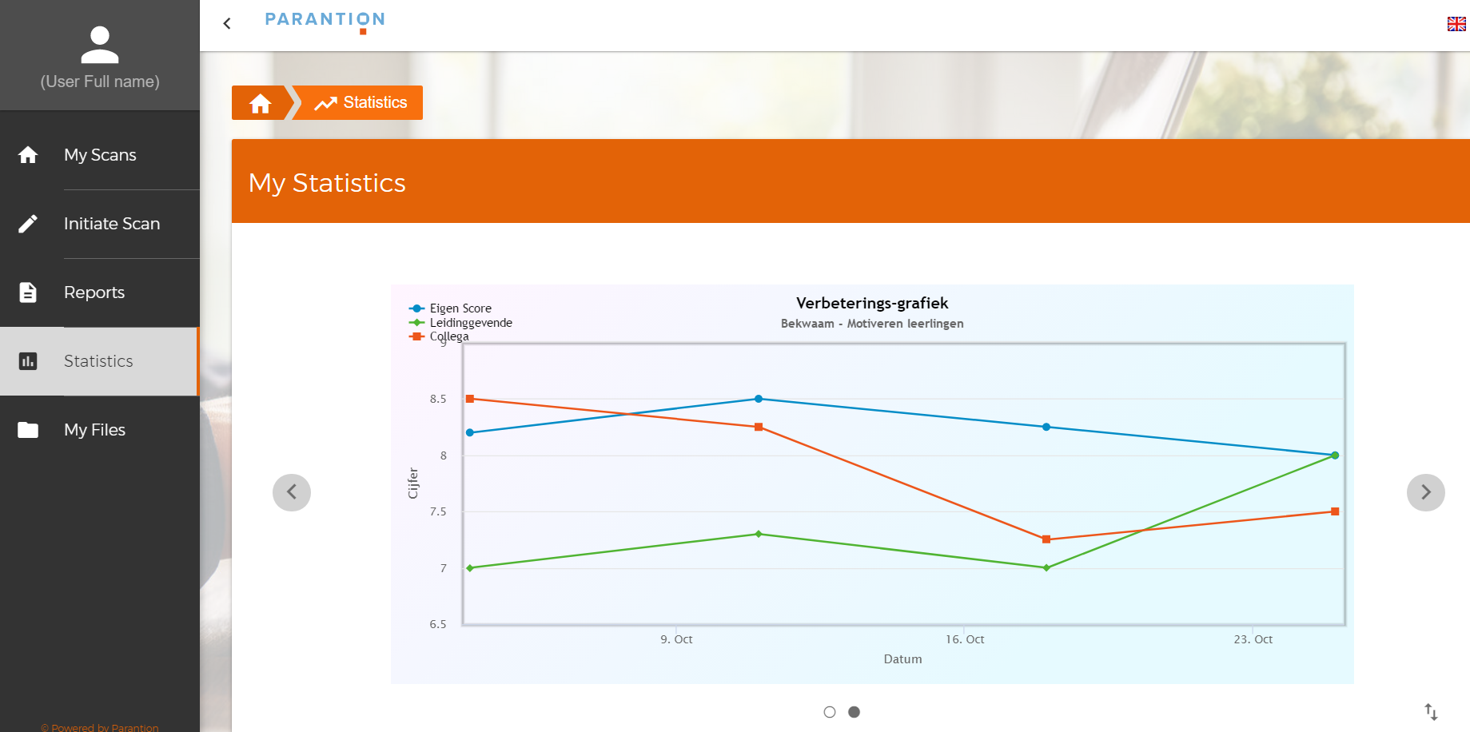

Slide 28
Presenting feedback
QUANTIFIEDSTUDENT.NL _ EDUCAUSE _HALLOWEEN EDITION_ I KNOW WHAT YOU DID LAST SUMMER

Slide 29
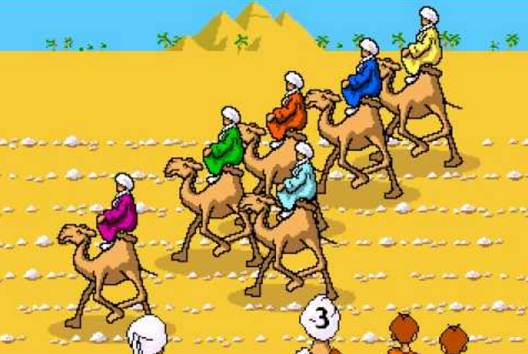
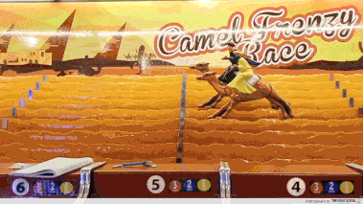
QUANTIFIEDSTUDENT.NL _ EDUCAUSE _HALLOWEEN EDITION_ I KNOW WHAT YOU DID LAST SUMMER

Slide 30
QUANTIFIEDSTUDENT.NL _ EDUCAUSE _HALLOWEEN EDITION_ I KNOW WHAT YOU DID LAST SUMMER

Slide 31
QUANTIFIED STUDENT _ EDUCAUSE _ I KNOW WHAT YOU DID LAST SUMMER
QUANTIFIEDSTUDENT.NL HALLOWEEN EDITION

