Slide 1
Supporting research on restricted data
EDUCAUSE Annual Conference 2017
Elias Eldayrie & Erik Deumens
Notes:
© Copyright Showeet.com

Slide 2
Part 1: Institutional involvement
Elias Eldayrie
Vice President and CIO
Information Technology
University of Florida

Slide 3




Research invokes DUA’s and regulations
HIPAA
FISMA 2014
ITAR
EAR
CUI
CSA
AES
HITECH
The Privacy Act
FISMA 2002
DFAR
UF BOG
DUA
FAR
FL State Statutes

Slide 4
Regulatory requirements increase in the current cyber climate
DoD: DFARS Amend.
NIST: 800-171
ISOO: 32 CFR 2002
2014 – FISMA “Modernization”
2010 – OMB Memo & EO 13556
2009 – HITECH
2002 – E-Gov Act/FISMA
2016 – FAR 52.204-21
2000 – Advanced Encryption
1996 – HIPAA
1987 – Computer Security Act
1976 – ITAR/EAR
1970 1980 1990 2000 2010 2016

Slide 5
Requires Institutional Collaboration
  Build Trust
  &
  Develop Long-Term Partnerships
  Office of Research
  Distributed Campus IT Units
  VP/CIO and the VPR
  Support from President, Provost, COO for Risk Management
  Office of Internal Audit, Privacy
  Research Computing, IT and Faculty

Slide 6
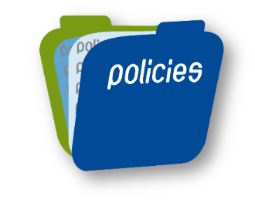
Information Security Governance
From Chaos to Control
Governance for IT @ UF
IT Policy
Development & Approval Process
Approved Policies
Acceptable Use
Risk Management
Identity Management
Remote Access
Mobile Computing & Storage Devices
Authentication Management
Data Classification
Recommend policies, standards, and priorities in support of the university’s mission and business goals.
  “Well Defined”
  “Transparent”
  “Business Driven”
Applies to all policies and standards recommended by governance and approved by the Vice President and Chief Information Officer.
  “Inclusive”

Slide 7
Risk Management, Security, and Compliance
  Information security
    Reduce chance of unauthorized data access and change.
    Ensure unauthorized data access is recorded.
Risk Decisions
Accept
Reduce
University Mission
Patient care
Transfer
Share
Service
Research
Education
  Compliance
    Provide a continuous record of security measures to show due diligence.
    Ensure that an auditable record exists of any incidents.

Slide 8
Enable UF Researchers to Create New Technologies, Discover Industry Breakthroughs, and Spawn New Economic Opportunities
  How do we abstract and secure the user interface layer to allow our research faculty to uncover ideas that change the world without having to understand regulatory compliance, information technology, information security and risk management?

Slide 9
Options to Secure Research with restricted data
Layer security onto existing systems
  Can be cumbersome and expensive to secure all general use computers and networks
  Creates usability problems
Outsource (Cloud)
  Cloud providers offer pre-certified Federally compliant systems
  They handle some controls, but we’re still responsible for many controls
Enclave
  A dedicated environment with added security controls
  Ability to deploy new projects rapidly

Slide 10
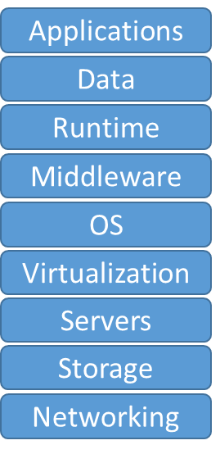
UF Strategy:
Provide Options Not Requiring Review
Research Vault
Typical
‘Gov Cloud’
Existing Systems
Cloud
Enclave

Slide 11
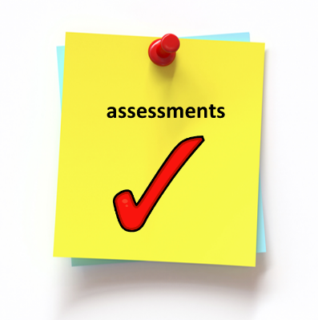
Risk and Compliance Assessment
Risk Assessment and Compliance Assessment are different activities
Security Risk Assessment
Evaluates all risks to the CIA
Assesses effectiveness of controls to mitigate the risks
Assesses ability of compensating controls against vulnerabilities
Allows leadership to accept risk
Compliance
Affirms security controls to sponsors and regulators
Risk Assessment often is required for compliance
Result is a report to share with sponsors
Information Security
Internal Audit
Notes:
Note that our Risk Assessment focuses on many criteria that were tailored out of 800-171, such as BCP/DR.
Until End of this year, Federal contracts with 7012 clause (mostly export controlled) require that we report gaps against 800-171

Slide 12
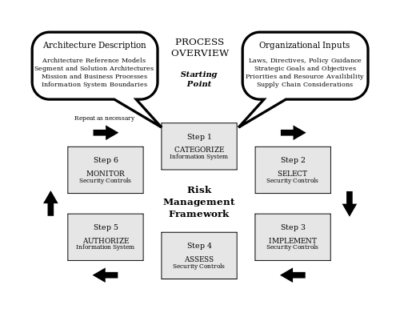
Risk Assessment Process
Categorize the data
Review the architecture
Assign surveys for each of the components
Evaluate effectiveness of each control
Develop remediation plan
Present residual risks to leadership
Risk Assessment is primarily attestation based
NIST SP800-37 Rev.1 Guide for Applying the Risk Management Framework to Federal Information Systems: a Security Life Cycle Approach
Notes:
Our risk assessment process is based on the NIST Risk Management Framework from SP800-37, but streamlined to fit the academic environment
Conduct a risk assessment at project initiation, and every 2 years or after significant changes

Slide 13
Compliance Process
Conducted by university’s Office of Internal Audit
Based on the FedRAMP assessment process
  Evaluate 1/3 of controls each year
  Incorporate results from the Risk Assessment & continuous assessment
  Examine evidence and test selected controls
Output will be two reports:
  Report for leadership with specific findings (SAR)
  Overview report to be shared with research sponsors
Notes:
Internal Audit not normally in the business of auditing specific IT systems, focuses on institutional issues
Recognizes that the research systems are fundamental to the university

Slide 14
Part 2: Implementation
Erik Deumens
Director
Research Computing
Information Technology
University of Florida

Slide 15
Implementation principles
  Meet Researcher Needs
      Affordable
      Reliable
      Easy to Provision
      Scale to many small projects
      Support large complex projects
      Simple to Use
      Or, as simple as possible
    Simple Process
    Research requires nimbleness
    Include in project planning
    Or, proposal
    Or, when award is made
    Or, when data use agreement is processed
    Offer simple budget model

Slide 16
Enclave implementation option
Create a pre-vetted environment
Build, operate, and maintain as a system
  Efficiency in hardware
  Provision projects as they come up
Test, monitor, audit, validate, and authorize as a system
  Efficiency in staff
Efficiency and economy of scale
  Like the cloud

Slide 17
Nimble for research needs
Cloud architecture
  Not self-provisioning
  But guided provisioning
Customization
  Not full custom built
  But flexible to meet specific needs

Slide 18
Charge for research budgets
Subsidized operation
University pays for
  Staff, data center, network, special infrastructure
Faculty and grants pay for
  Compute nodes
  Storage systems, primary and backup
Possible because of build once, deploy often, minimize customization

Slide 19
Optimize researcher time
Bulk of compliance work is done by staff
One big SSP (system security plan)
Some projects have a small SSP addendum
  Example: next slide
Do not turn researchers into security or compliance officers
  They do need training for their part of the compliance responsibility

Slide 20
More than technology
Compliance with CUI requires more than technology
Institutional policies
Business processes at multiple levels
Information system
  Architecture
  Technical controls

Slide 21
Technology in three layers
Physical
  Hardware or cloud
Security
  Built by Tera Insights
Work
  Research data and work on it in VMs with virtual desktop technology

Slide 22
ResVault components
Work layer
Security layer
Physical layer
On premise
BC/DR
Physical layer
In public cloud

Slide 23
Ambitious Security Goals
  Protect Users from the Administrators
    Assume admin malicious of hackers took over the system
  Security Independent of Infrastructure
    Assume SSL/TLS, VPN, Firewalls have failed
  Easy to Use Despite Security Measures
    Use web interfaces, integrated tools with no tedium
    Is this even possible?

Slide 24
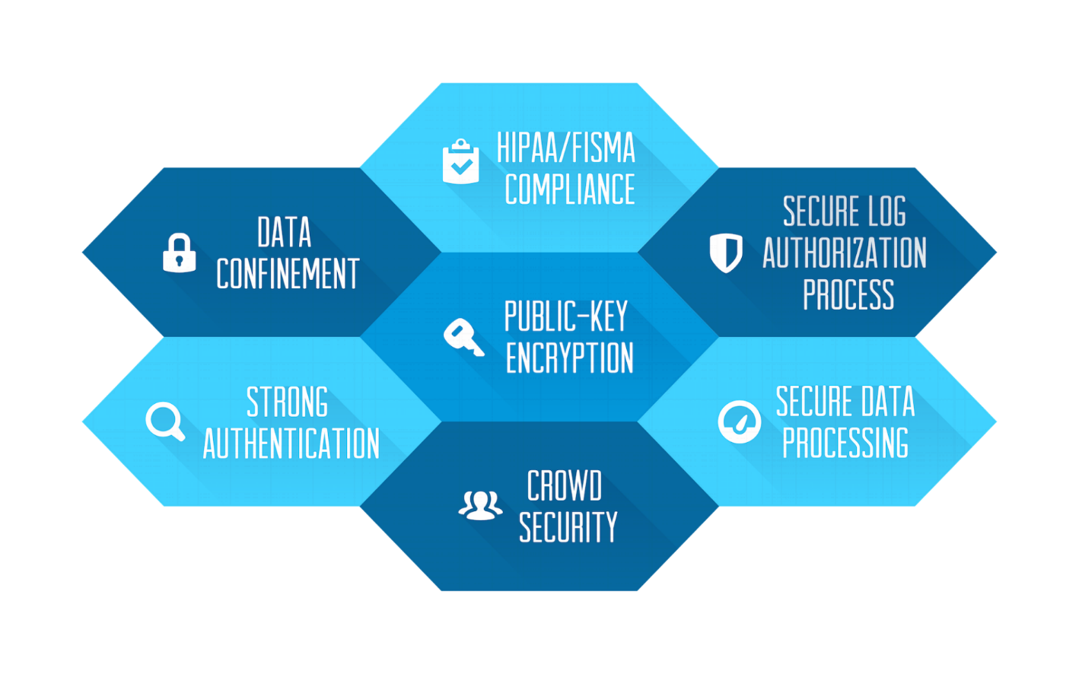
The Idea is Symmetric and Public Key Cryptography

Slide 25
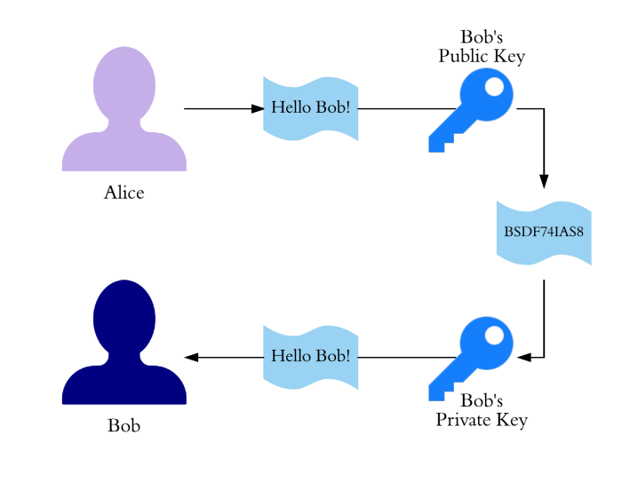
Public Key Cryptography
A Simple Idea

Slide 26
ResVault compliance process
Control
Outcomes
Business
Processes
Policies
Architecture
Technical processes

Slide 27
Questions?

Slide 28
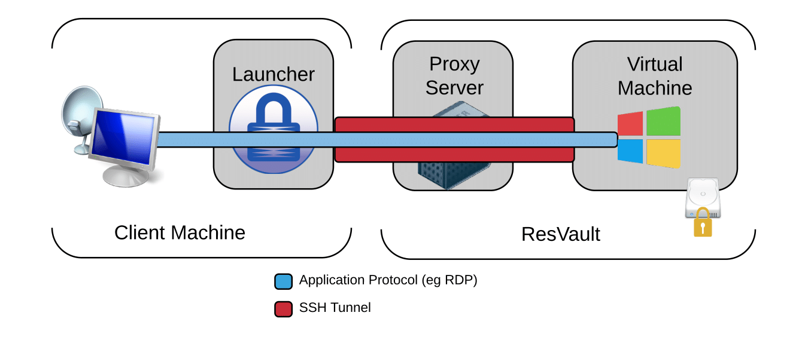
Secure Virtual Machines

Slide 29
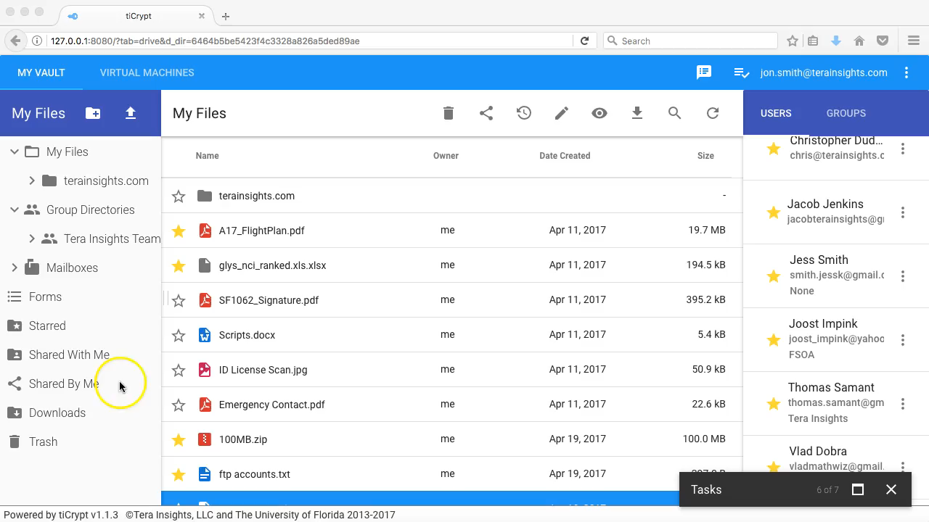
Video of Virtual machines
5 min 23 sec

