Slide 1
Women CIO Perspectives on the Ascension to Leadership
MODERATED BY:
Steven Burrell
PANEL
Mellissa Woo • Sharon Pitt • Celeste Schwartz • Sue Workman • Kathy Kral

Slide 2
Who are you and why are you here?
Keep it personable but not personal…
Notes:
Welcome. Having participated in EDUCAUSE and it’s predecessor organizations (CAUSE and EDUcom) the most valuable takeaway is the relationships we build. These relationships are immensely important to our success. Let’s take 1 minute of opportunity today, now to meet someone new who shares an interest in our topic. Please introduce yourself to someone and share why you are here today.
Today’s conversation is a safe place to talk and we want to provide you with an opportunity to question and comment right along with our panelists.. Let’s be open and honest and personally relevant, but please leave personal names and organizations out of our dialogue.

Slide 3
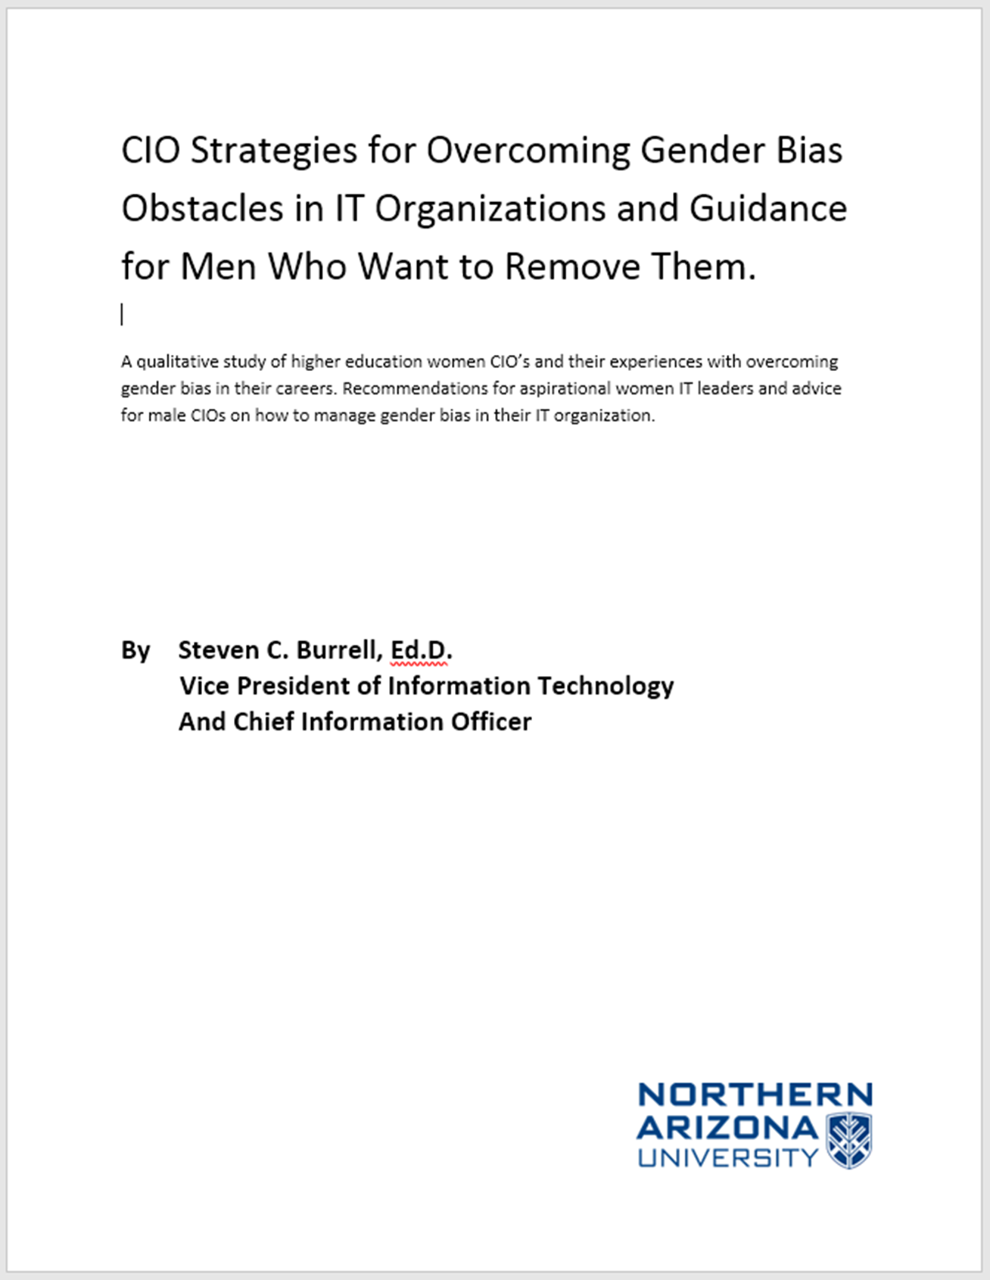
www.steveburrell.info
Notes:
Some of you may be thinking, “Steve, why are you here today?” Well today began several years ago. It started with a conversation I was having with Bob Orr, CIO at Georgia College and State University. We were discussing the brilliant contributions the women IT staff brought to our teams, and how awesome our fellow women CIOs in Georgia are. We also recognized how few of them there were, and we were painfully aware of the gender biases they faced. We wondered what we could do to make an impact, to create real change, and to make women's issues, issues for men.
As we explored our interest with others, it became clear that, like the recent article in Scientific America suggests, we needed to do a lot of listening. So I set out to do research, interviewing 13 women CIOs to learn about their successful journey and moreover, how men might best help women overcome the many obstacles in their ascent to top leadership positions. Similarly, Bob set out to create a forum to discuss women in IT and held the first state-wide conference for women in higher education IT this year.
Today we extend this conversation to EDUCAUSE, the questions stem from some of the key issues and success points these CIOs identified.
So let’s get to it. It is my pleasure to introduce 5 outstanding IT leaders.

Slide 4
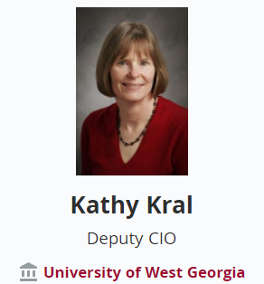
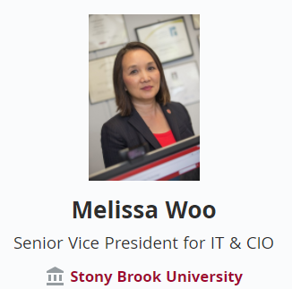
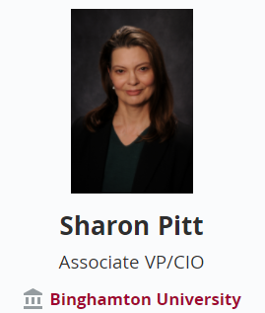
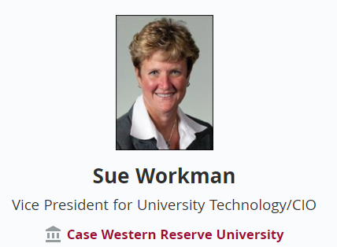
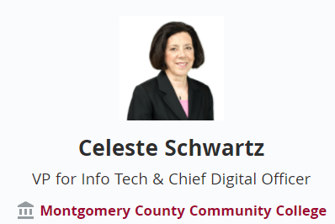

Slide 5
What advice do you have for women regarding building their confidence and risk taking?
Notes:
Research reveals us that women sometimes exhibit lower confidence in their abilities than their overly-confident male counterparts. This can limit the jobs that women apply for or temper the risks they take in accepting challenging roles or projects that might otherwise advance their careers. What advice do you have for women regarding building their confidence and risk taking?
INITIALLY DIRECTED TO SHARON PITT

Slide 6
What advice do you have about finding allies, collaborators, and mentors and how to leverage them?
Notes:
My research found that you often find mentors in unlikely places. I know that all of you had allies, collaborators, and mentors along the way to CIOship and these people were instrumental in helping you deal with or manage gender issues. What advice do you have about finding these people and how to leverage them?
INITIALLY DIRECTED TO SUE WORKMAN

Slide 7
What advice do you have for women with respect to the development of both hard and soft skills?
Notes:
It was clear from the women CIOs I interviewed for the research project that they excelled in some area of technology but also leveraged strong interpersonal skills. What advice do you have for women with respect to the development of both hard and soft skills?
INITIALLY DIRECTED TO MELLISSA WOO

Slide 8
What advice do you have for women who may be struggling with the Goldilocks syndrome in their environment?
Notes:
Many of the women I interviewed talked about “The Goldilocks Syndrome “ You, know- when your behaviors and actions have to be “just right” to be effective whereas men get by without being judged. For example the interviewees gave that classic example of finding that space where you are perceived to be overly assertive and labeled “bitchy” versus being too passive to be labeled a pushover. What advice do you have for women who may be struggling with the Golidlocks syndrome in their environment?
INITIALLY DIRECTED TO KATHY KRAL

Slide 9
What advice do you have for supervisors, managers, and leaders with respect to fostering the development of women in their careers?
What tools can we give them?
Notes:
What advice do we have for supervisors, managers, and leaders with respect to fostering the development of women in their careers? What tools can we give them?
INITIALLY DIRECTED TO CELESTE SCHWARTZ

Slide 10
Question for the panel?

Slide 11
See #EDU17 Poster Session Upload
Leadership Activities to Manage Subconscious Gender Bias
Steven.Burrell@NAU.EDU

