Slide 1
Scaling Adaptive Courseware USE At Public Universities: Implementation Processes and Early Outcomes
Karen Vignare, APLU
Don carter, NAU
Kari Goin, PSU

Slide 2
What is Adaptive Learning?
“As an approach to creating a personalized learning experience for students, adaptive learning takes a sophisticated, data-driven, and in some cases, non-linear approach to instruction and remediation, adjusting to a learner’s interactions and demonstrated performance level and subsequently anticipating what types of content and resources learners’ need at a specific point in time to make progress.”
Source: Tyton Partners, "Learning to Adapt: Understanding the Adaptive Learning Supplier Landscape," April 2013.
Notes:
So what is adaptive learning? We like this definition that Tyton Partners’ used in their 2013 analysis of the adaptive learning supplier landscape.
“As an approach to creating a personalized learning experience for students, adaptive learning takes a sophisticated, data-driven, and in some cases, non-linear approach to instruction and remediation, adjusting to a learner’s interactions and demonstrated performance level and subsequently anticipating what types of content and resources learners’ need at a specific point in time to make progress.”
Faculty and other institutional stakeholders “generally want to understand ‘how’ solutions work, including a set of descriptive solution attributes that address issues such as openness of the content model, scope of course coverage, interoperability with existing institutional resources, and support services, among others.” Tyton Partners, the Online Learning Consortium and SRI have developed a framework to help administrators, instructional designers, and faculty better understand adaptive and other digital learning solutions. (Mention CWiC Framework.)
In general, postsecondary education institutions with large adult learner populations have implemented adaptive technologies more aggressively and more comprehensively than traditional universities. That said, a growing number of large and highly innovative institutions, mostly public institutions, are making significant progress toward scale, as well as number of large adult-serving online education providers.”

Slide 3
APLU Accelerating the Adoption of Adaptive Courseware Grant
Cross-Institution Collaboration
Faculty Engagement Methods
Targeting similar programs and courses
Adopting from a list of approved adaptive courseware suppliers and products
Sharing information within the cohort by campus-based program managers
Common reporting requirements
Incentives (money, time, teaching support)
Training and instructional design support
Department-level adoption decisions
Peer learning communities
Senior leadership investment and recognition
Notes:
Now I am going to share a bit about what we are doing in the grant
Eight grantees agreed to scale adaptive courseware equal to or above 15% of their general education enrollments.
Most of their funding pays for a program manager and faculty development
We started last summer and six of the universities reported adaptive courseware enrollments this past spring and all will report them this fall.

Slide 4
Comparison of Courseware Adoption from Fall 2016 to Spring 2017
2016: 6
2017: 12
Notes:
Almost threefold increase

Slide 5
RESULTS: Course Content
After Six Months: 22,000 enrollments
Notes:
Ok, let me tell you a little bit about how our wonderful grantees are doing… IN a word AMAZING…

Slide 6
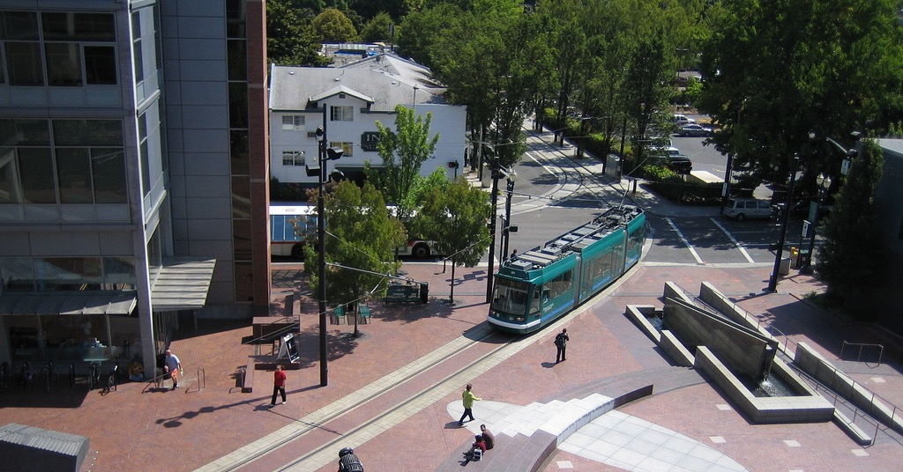
A+A at Portland State University
2017 The Personalized Learning Consortium at APLU

Slide 7
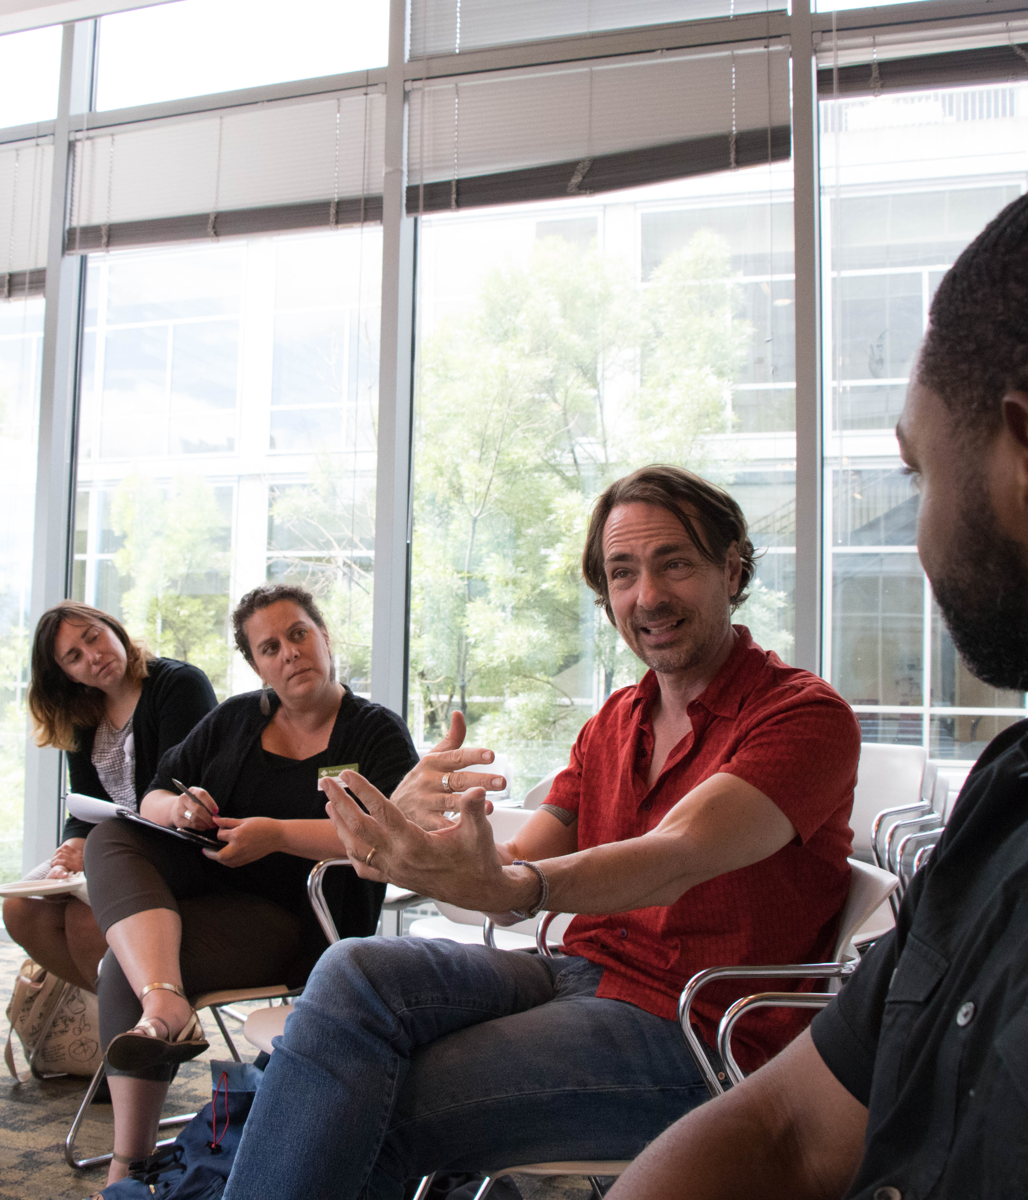
Our Approach
…is collaborative and focused on partnering with faculty in targeted departments to explore products, redesign courses, and collect data to build examples of good practices that inspire others to join a community of practice.
2017 The Personalized Learning Consortium at APLU

Slide 8
Biology

Slide 9
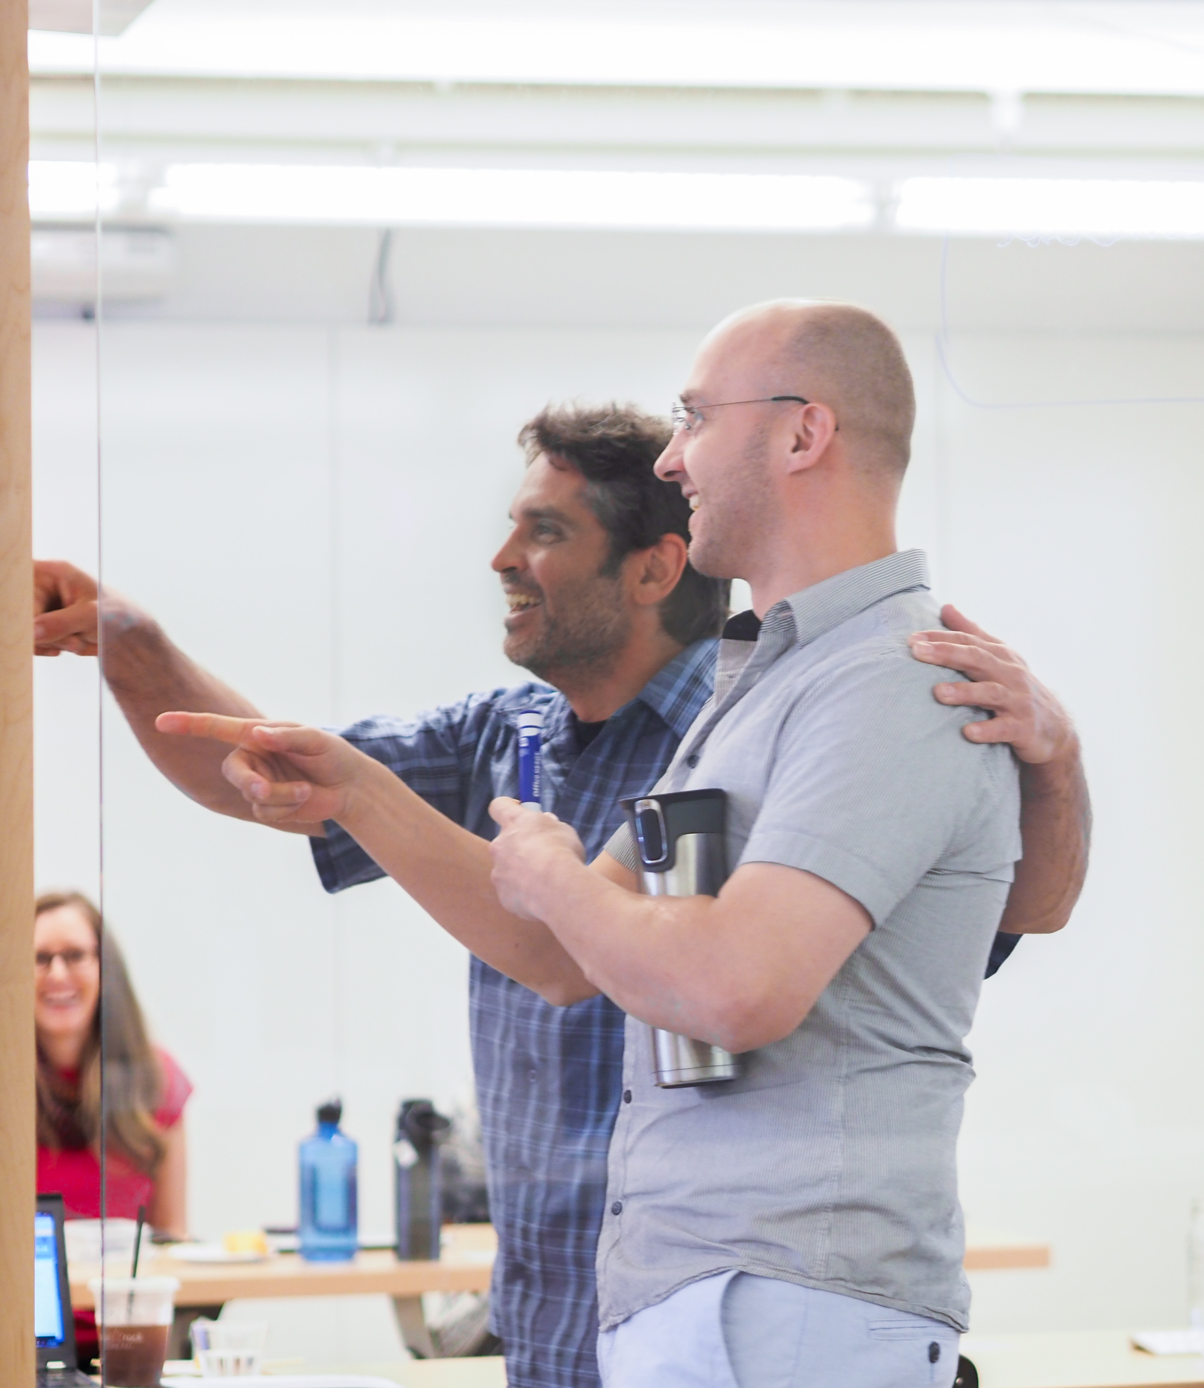
Scaling
2017 The Personalized Learning Consortium at APLU

Slide 10
Student Experience
2017 The Personalized Learning Consortium at APLU

Slide 11
Public State University - Flagstaff, AZ (pop. 71,500)
31,057 students (27,086 Undergrad, 3,971 Grad)
22,740 Flagstaff (main campus)
1,960 Community Campuses (statewide)
5,846 Online
511 Branch Campuses
61% female, 23% Hispanic, 4% Native American, 58% white
46% of freshmen are first generation college students
Top programs by enrollment
Undergraduate: Biomedical Science, Criminal Justice, Nursing, Mechanical Engineering, Elementary Education
Graduate: Educational Leadership, Physical Therapy, Master of Administration
Distance programs for over 45 years
Over 100 Fully online Degree & Certificate Programs

Slide 12
NAU Goals for Adaptive Learning
Develop a CULTURE of active and adaptive learning.
Increase SUCCESS and retention of UNDERSERVED student population.
28 courses EFFECTIVELY using adaptive courseware in 42 months.
TRANSFER lessons learned and faculty expertise to TRANSFORM all our programs, especially online.

Slide 13
Kick-Off August 2016

Slide 14
Culture Activities
Kick-off (2-1/2 day event, workshop style - August 2016)
30 faculty representing 14 of our target courses
Vendor showcase, including training of support staff
College & Department orientations (Fall 2016 & 17)
Mini-conference (2 day event, conference style - August 2017)
125 faculty & staff, including state-wide colleges & universities
Presentations from program participants at NAU and others
Vendor presentations
Learning Community of Practice (15 participants AY17-18)

Slide 15
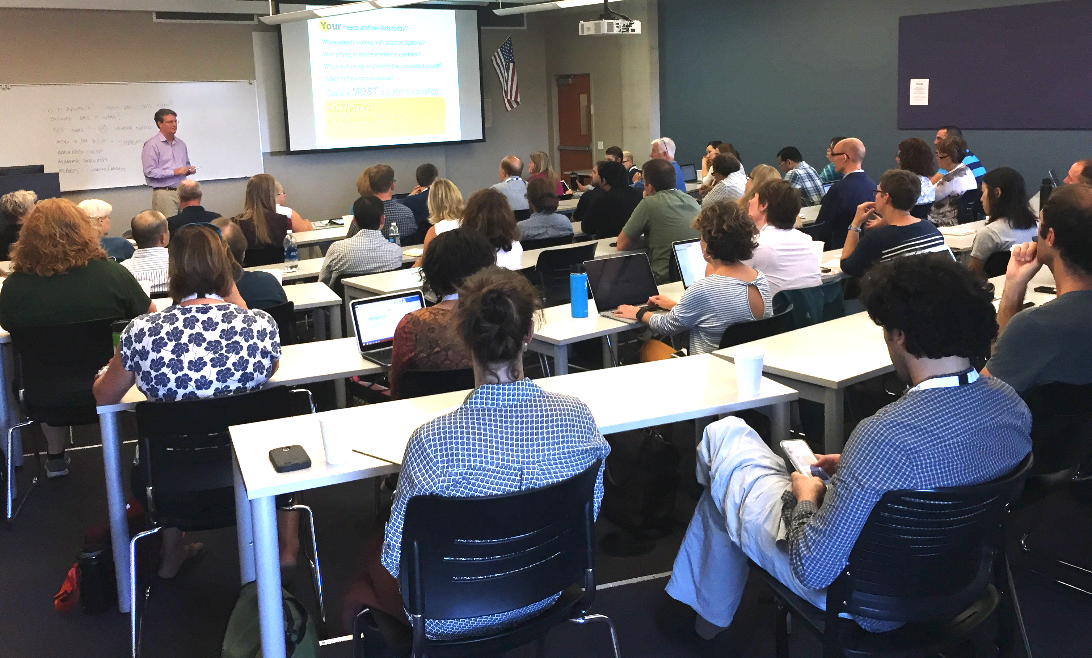
One session of 27 – August 2017

Slide 16
Increase Student Success & Retention
Previous Blended Learning Redesign program generally increased success (DFW rates) 4%
Collaborations
Office of Student Success
Retention Task Forces & Institution Retention Plan A few targeted courses with high DFW are on Adaptive List
First-Gen Office
Native American Success Team
First Year Learning Initiative
Director of SOTL activities
Frontier Set Activities

Slide 17
Courses
Expected: (30,000 enrollments annually) 28 courses
Current: (9,374 enrollments) BIO181, BIO182, CHM151, CHM152, ISM120, PSY240
In development: (over 9,000 enrollments) GLG112, PHI150, PSY101, CCJ101, PHY161, MAT125
Future development: (over 5,000 enrollments) ART100, BIO205, FIN190, NTS135, NTS256, PHY111, POS110, POS120, SOC101

Slide 18
Transfer & Transform future growth
NAU’s CBE Personalize Learning program expects to employ adaptive learning
New Nutrition degree programs exploring entire program as adaptive
Occupational Therapy, blended program, exploring adaptive to enhance out of class work
Other courses currently requiring adaptive courseware but not effectively using features
Upper level courses or non Gen-Ed courses expressing interest

Slide 19
Is Every Application of Technology a Good Thing?

Slide 20
Issues and Questions
Not enough active learning classrooms
Expanding the number of digital learning environments for students and support
New costs for students and the university
Integration of the 15 week lockstep model and the each student on their personalized learning journey (Time constant vs. Learning Constant)
Assessment & Evaluation:
Are we truly improving student learning
Are we effectively helping the underserved populations

Slide 21
We are Launched

Slide 22
QUESTIONS?
Karen Vignare, Executive Director, Personalized Learning Consortium, kvignare@aplu.org
Don Carter, Director, eLearning Center, Northern Arizona University, don.carter@nau.edu
Kari Goin, Course Designer, Portland State University, kgoin@pdx.edu

