Slide 1
Copyright
This presentation leaves copyright of the content to the presenter. Unless otherwise noted in the materials, uploaded content carries the Creative Commons Attribution-NonCommercial-ShareAlike license, which grants usage to the general public with the stipulated criteria.

Slide 2
Making the UK the most digitally advanced nation for Higher education and research
Educause

Slide 3
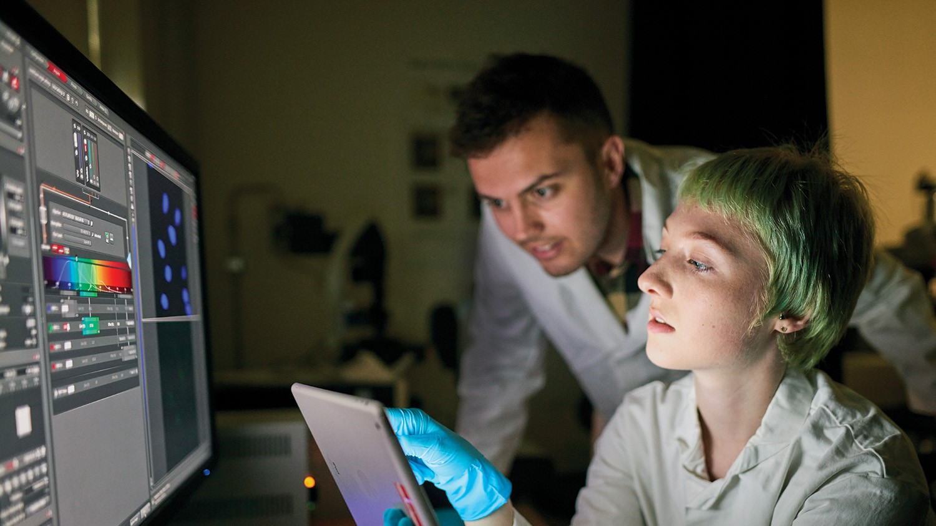
We provide digital solutions for UK education and research.
Our vision is for the UK to be the most digitally advanced higher education, further education and research nation in the world.
Notes:
Support every Govt funded university and community college in the UK

Slide 4
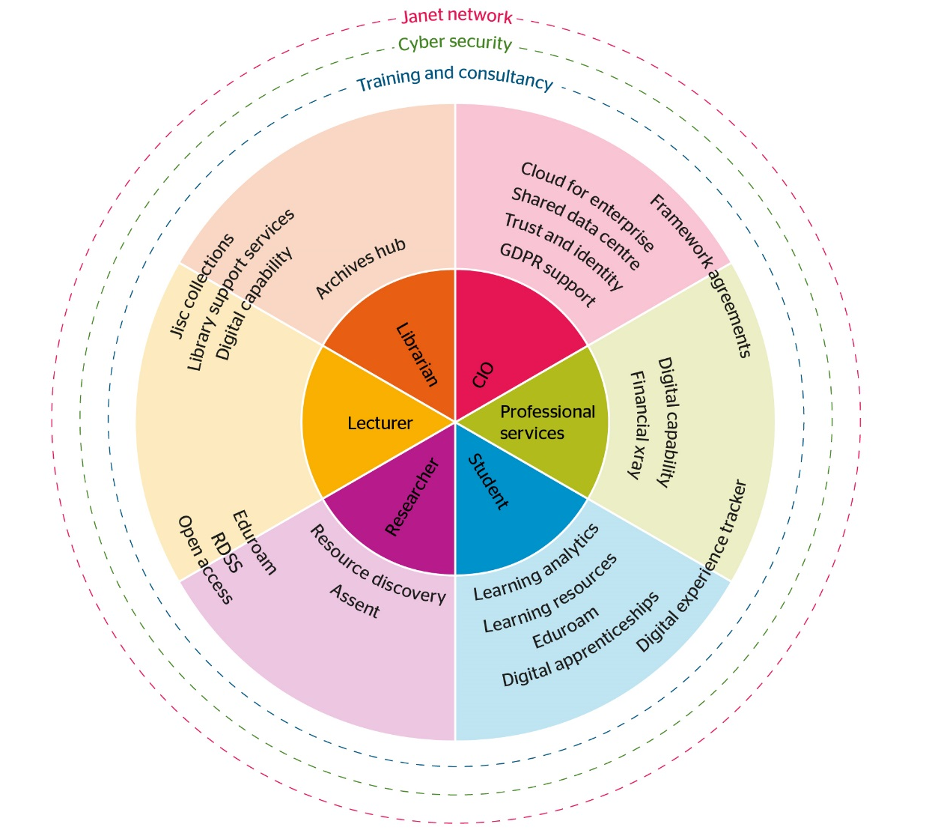

Slide 5
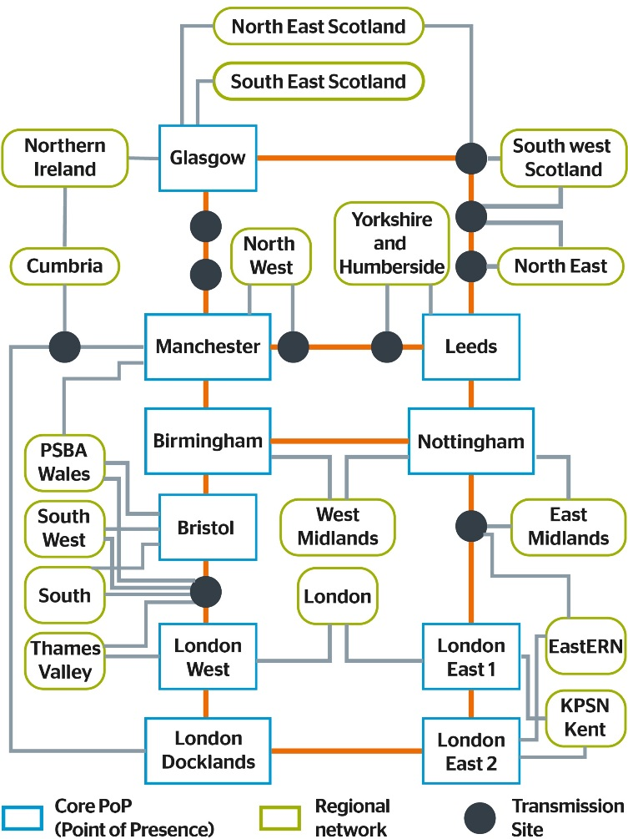
Janet network at heart of Jisc
TeleKom
Malaysia
Akamai
Amazon
Microsoft EU
Amazon
Apple
TV
GÉANT
Akamai
Gamma
BBC
Update
Redstone
Global Transit TeliaSonera
AQL
3G
UKCloud
Telehouse
Harbour
Exchange
Telehouse
North and
West
Datashop
Virgin
radio
Verizon Edge
Global Transit Level 3
MDNX for
Schools
Google
Google
MDNX for
Schools
LINX
Global Transit Level 3
Netflix
HEAnet
IX Manchester
IX Leeds
500 Peerings / 300 Organisations
Notes:
Our vision is for the UK to be the most digitally advanced higher education, further education and research nation in the world. Underpinning this is the need to provide a resilient, flexible and cost effective infrastructure on which our members can rely to provide the necessary administrative, teaching, learning and research services wherever that may be in the world. Our infrastructure ranges from underlying networking facilities to cloud based services.

Slide 6
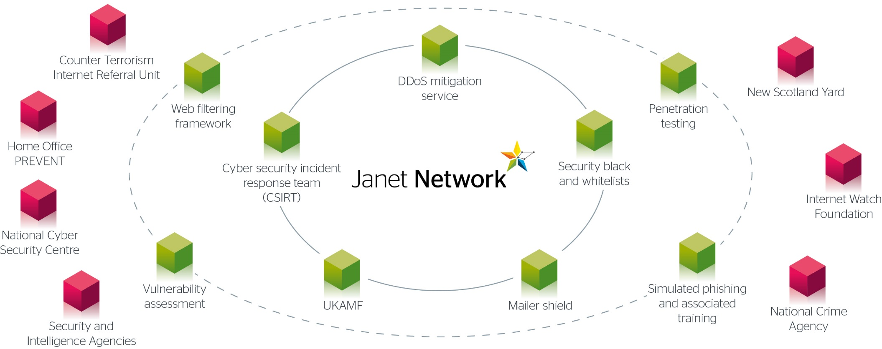
Not just any network, a protected network
Notes:
The green items are the core offering
Orange items are optional products and services

Slide 7
Summary of cyber security posture survey

Slide 8
Cyber security
Historically we defended our members against DDoS and the attacks were highly disruptive, not just to the college, but to all surrounding institutions
Then in late 2015 we experienced an attack on JANET itself
Since then we have implemented a sophisticated DDoS capability and established a well appreciated Cybersecurity team, annual conference and set of services
Now our core members do not notice attacks
The 2015 perpetrator is awaiting sentencing
We have seen no further attacks on the network (so far)

Slide 9
Cyber security
Notes:
This slide presents some of the key numbers and stats relating to cybersecurity in the FE sector.
There is a BIS/PWC survey that we have used to calculate VSE for the service. Figures for 2015-16 - Based on low range of BIS/PwC estimated cost in 2015 of single event to large organisation (HE) : £1.46m to £3.14m; to a small organisation (FE) : £75k - £311k. We used a midpoint of these figures - £2.3M for HE and £193k for FE at 1 in 8 (12.5%) of institutions. *NOTE – This makes the VSE estimate for cybersecurity products VERY conservative, but should give you some idea of the cost of a single event to an institution.
2 minute figure - if someone has DDoS’d a college then if the mitigation is successful then we have effectively solved their problem within 2 minutes as their network traffic will go back to normal levels. The actual attack may continue for hours and the attacker may keep tweaking the attack which we then have to respond to so although from the college’s perspective it appears that their problem is over, it isn’t until the attacker gives up. And that length of time is different for every attack.

Slide 10
Trust and identity
Internet2 and Jisc are the main funders of Shibboleth
UKAMF is one of the largest in the world and we work closely with publishers to maintain their commitment
Working with the UK government and HEIs to use Shibboleth to identify students for wider official purposes (student loans, passports, driving licences)
Liberate is Jisc’s new, cloud-based, fully-managed service for access management
Offers a single, simple, and cost-effective solution for federation, eduroam, and other access management requirements
Piloted with over over 10% of UK public library authorities since January, and a further eight Further and Higher education institutions since July
Liberate is supporting the newly merged Nottingham College
consolidate two Shibboleth systems
Aspiration to adopt eduroam across both colleges
Without Liberate, the college didn’t have the resource to support these two requirements
Liberate allows them to achieve both with minimal resourcing

Slide 11
The General Data Protection Regulations (GDPR)
Sweeping changes to the current Data Protection Act come into force in May 2018. Serious implications to the Sector.
Six key changes:
Accountability
We are required to document what personal data we hold, where it came from and who we share it with
Data Processors are now accountable for the personal data that it processes
Privacy by Design
Inclusion of data protection compliance from the outset in services systems and process design including r & d and beta projects and services
Legal Changes and Consent
Conditions of consent tightened – clear and concise terms and conditions – need to review all existing privacy notices and all existing supplier contracts
Reputational Damage and Penalties
Reputational damage of a Member data breach would do Jisc serious harm
Add to this GDPR maximum fine from £500,000 to 20 million euros or 4% of annual global turnover
Breach
Breach reporting to Information Commissioners Office mandatory and within 72 hours of breach detection
Individual rights
The GDPR also grants data subjects a number of rights over their information (eg access, erasure, portability
For further information see jisc.ac.uk/guides/preparing-for-the-general-data-protection-regulation-gdpr

Slide 13
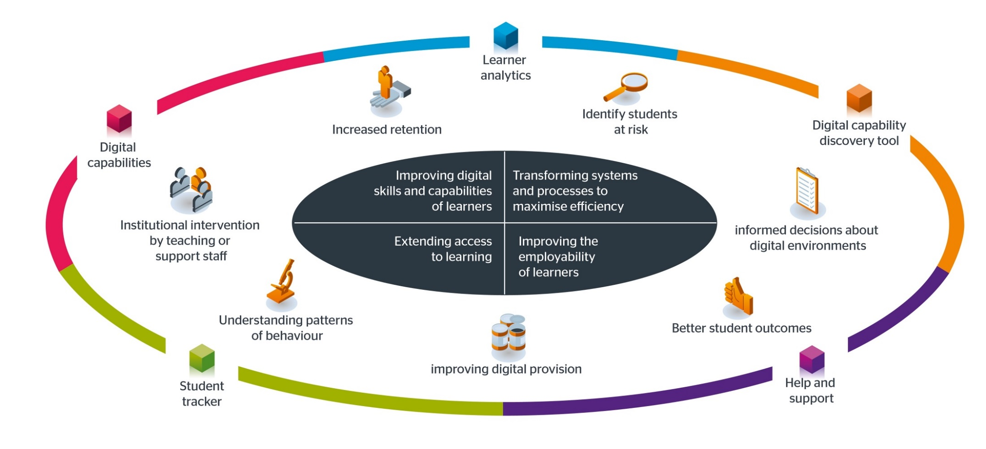
Some areas we aim to help learners
Notes:
We're working to ensure staff in colleges are equipped for a changing digital environment
Effective use of technology is vital in ensuring student satisfaction and in realising a good return on investment
Jisc has a number of products, projects and services which are supporting colleges make smart, informed decisions in a number of areas.
Student digital tracker (including opinions of over 22k students, 12,000 of which were from FE) –
You have the ability to gather evidence to support specific actions (e.g. in respect of the curriculum, student digital support, and/or digital infrastructure)
Evaluate yourself – against other institutions (benchmark), or over time (monitor), or in relation to our aims for a specific initiative/strategy/project etc (evaluate)
Demonstrate that you are engaging with students and responding to their feedback
Target resources for digital provision

Slide 14
Student digital experience tracker
We surveyed 22,000 students on their attitude to digital
Students are generally positive about the use of digital technologies in their learning
Some providers still need to get the basics right –
decent wifi provision across campuses
access to desktop computers, which many students still rely upon
The full benefits of technology to support learning are yet to be realised
The use of digital activities within courses is not as prevalent as we might expect.
technology more commonly used for convenience rather to support more effective pedagogy
80% of HE learners and 63% of FE recognise that digital skills will be important in their chosen career
Only 50% believe that their course prepares them well for the digital workplace
Questions about the provision and/or signposting of services to students which support the development of digital skills and capabilities

Slide 15
Student perspective on use of technology
When digital technology is used on my course:
I understand things better | 59%
I am more independent in my learning | 71%
I can fit learning into my life more easily | 73%
I am less likely to attend class | 16%
Main concern for learners: potential for distraction

Slide 16
2020 Jisc strategic priorities for learning and teaching
Learning analytics and personalisation
Better student outcomes
Better planning and management of technology-enhanced learning
Evidence-informed improvements
Digital capability
Delivery of high-quality, cost-effective blended learning
Affordable and engaging content and tools
Respond to a changing external landscape
New models of provision; expanded sector
Notes:
Rest of presentation will give an overview of the activities which flow from the implementation of the strategy

Slide 17
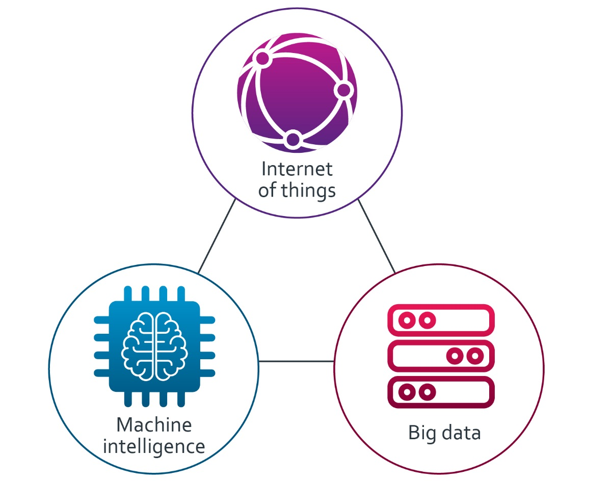
Three key forces driving tech in HE

Slide 18
Evolution of tech in teaching
Learning analytics
Institutional analytics
Educational analytics
Cognitive Analytics and AI
Now
Future
Better retention and attainment
A more efficient campus
Personalised and adaptive learning
Intelligent campus
Buildings data
+
Learning space data
+
Location data
Learning analytics
Next generation VLE
Content data
+
Learning pathways data
VLE data
+
Student record system
+
Attendance data
+
Library data
+
Improved teaching and curricula
Improved teaching and curricula
+
AR / VR
Teaching
Analytics
Teaching quality data
+
Assessment data
+
Curriculum design data
Efficient campus
+
Retention and attainment

Slide 19
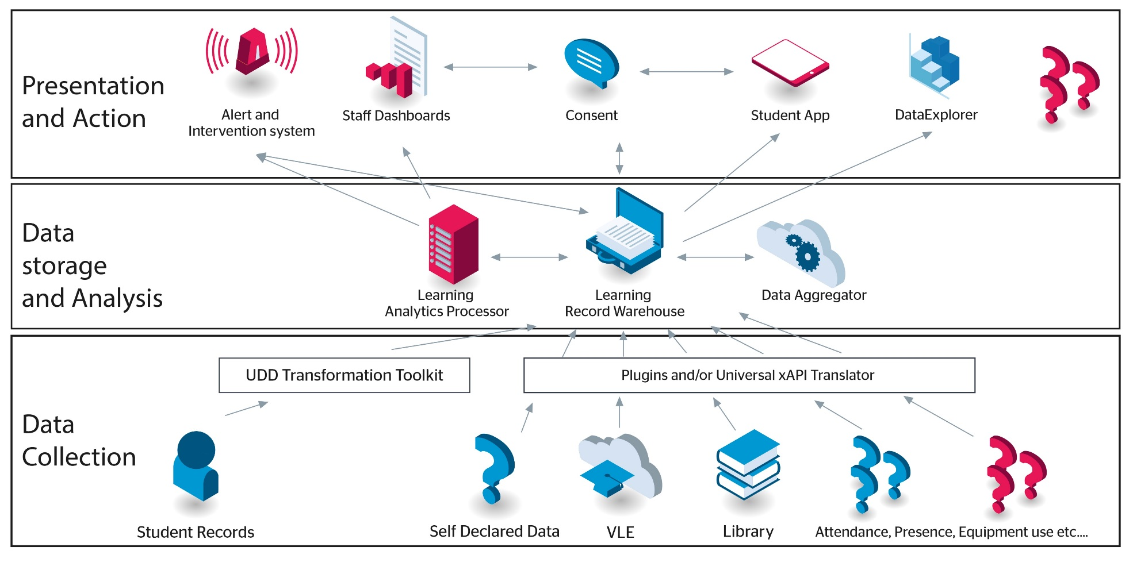
National learning analytics framework
https://www.jisc.ac.uk/rd/projects/effective-learning-analytics

Slide 20
Progress in learning analytics
25 institutions signed up, a further 20 coming on board
Active development community involving 2/3 HEI’s
Worked with this community to offer support on policy and practice.
Assessments
Role of the tutor
Referral routes
We have introduced common tools and methodology across the LRW (learning records warehouse) which in time will allow secure, anonymous, benchmarking by HEIs of parameters relating to teaching excellence

Slide 21
Future of learning analytics
Short/Medium term
Extend to include apprenticeship, allowing sponsoring organisations to track progress
Learning gain
Broadening data set / new metrics / more robust predictors
Hackathon competition – Engagement, learning gain, teaching excellence
Longer term
LRW an invaluable data set relating to higher education
Enabling deeper understanding of journey through school ➔ college ➔ university ➔ employment
Exploring more LRW in other countries
Discussions with US funder about opportunities in the USA

Slide 22
Edtech in the UK
At Jisc we want to work with these emerging companies to make it easier for our members to assess which companies could help them improve their services to students. We have developed an end to end accelerator so that we can work with these companies from idea to start up to first major investment.
Unitu - a service that helps universities gather and respond to student feedback more effectively
Placer – a tool to help students find work experience and companies access the next generation of talent
Hubbub – a crowdfunding tool focusing on alumni
Lumici – a collaborative lesson planning tool
Bibliotech – Spotify for textbooks
Wildfire learning – an AI content creation service
Vineup – connecting alumni to students they could mentor
Aula – a learning platform that focuses on communication and student engagement
Datazar – a research data collaboration platform

Slide 24
Library services
Library support services help libraries more efficiently manage the full life cycle of their collections
We help libraries leverage their usage data, and provide shared business intelligence tools to inform strategic decision making
We save the community £108m each year through shared license negotiation

Slide 25
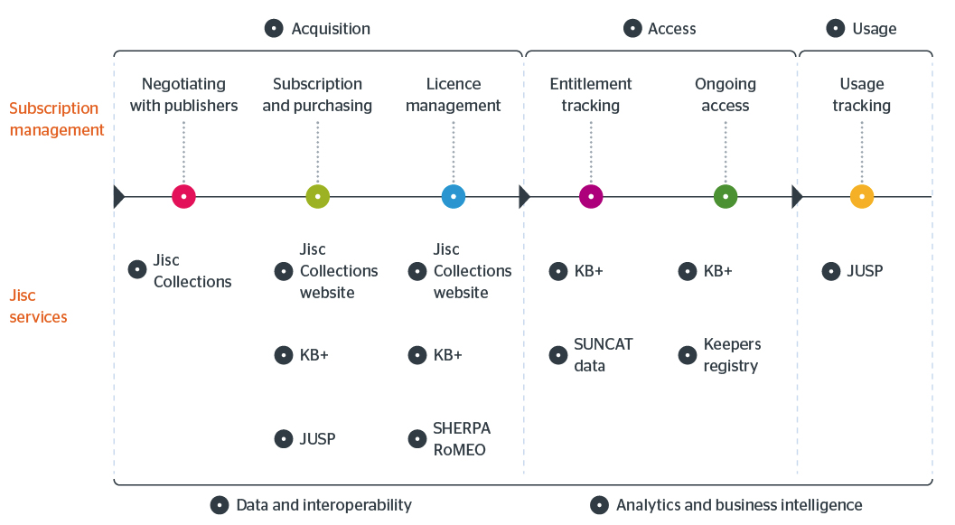
Library services

Slide 26
Coming soon
National
Bibliographic
Knowledgebase:
enabling nationwide
collaboration
National
Bibliographic
Knowledgebase

Slide 27
Open scholarship
We support open access and open data in the scholarly and research environment, allowing organisations to develop their research more easily – bringing economic and social benefits

Slide 28
Open access – publication lifecycle
Submission
Acceptance
Publication
Use
Select Journal
Check compliance
Manage costs
Deposit in repository
Report on compliance
Maximise impact
Record impact
Report
Research publication lifecycle
SHERPA RoMEO
SHERPA Fact
Monitor UK ^{R&D:Alpha}
Publications Router ^{R&D:Alpha}
CORE
RIOXX
Jisc services
SHERPA JULIET
SHERPA REF ^{R&D:Beta}
Jisc collections
OpenDOAR
Monitor local ^{R&D:Alpha}
IRUS-UK
Guidance, consultancy, technical support, and OA good practice

Slide 29
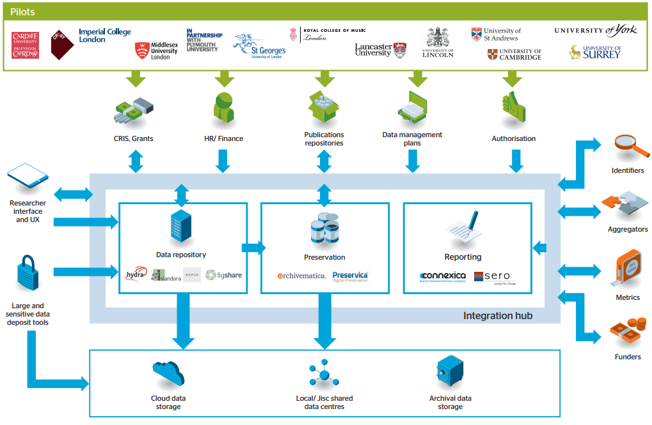
Big data in research

Slide 30
Summary of our findings and progress on RDSS
Jisc’s RDSS (research data shared service) transforms managing research data from a headache for members to business as usual. It allows members to:
Deliver a comprehensive research data service to their researchers
Ensure data is curated, accessible and reusable
Comply with research funder mandates
Currently in alpha at 15 UK institutions of varying sizes and types. RDSS will be in beta at the start of 2018 and we are aiming to launch as a full service by summer 2018
We have built a unique messaging layer that stitches existing commercial and open source solutions into a joined up service. The messaging layer also takes care of integrating with institutional software and key software and services outside the institution

Slide 31
Learning from RDSS
The human knowledge problems RDSS is looking to crack are:
Need to change to a culture where collection of research data is the norm across all relevant disciplines
Need to be able to make sure data is accessible for the long term, even as file formats and the software the data requires changes
Need to make it easy for researchers to find the data (as well as depositing it in the first place)
In most institutions managing research data is a spotty and distributed activity, we need to move to a situation where it is coordinated and comprehensive, this requires challenging conversations around the costs involved. We are starting those challenging conversations!

Slide 32
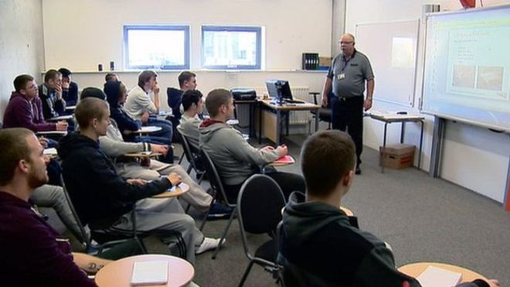
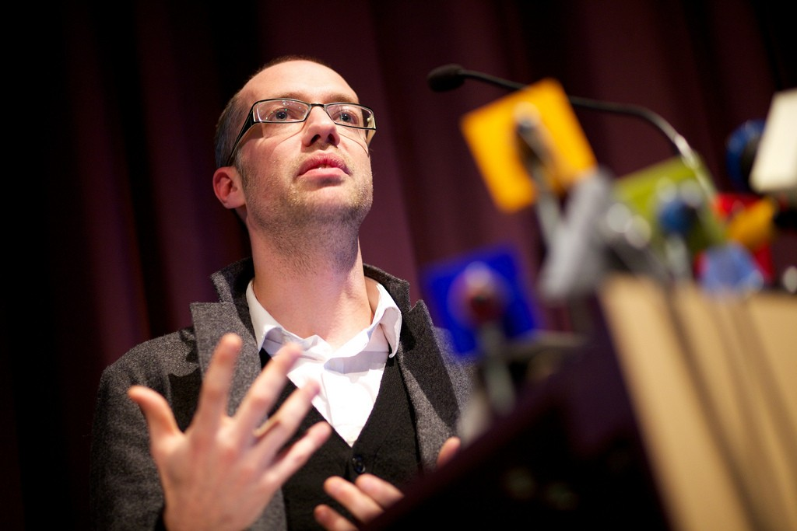

Slide 33
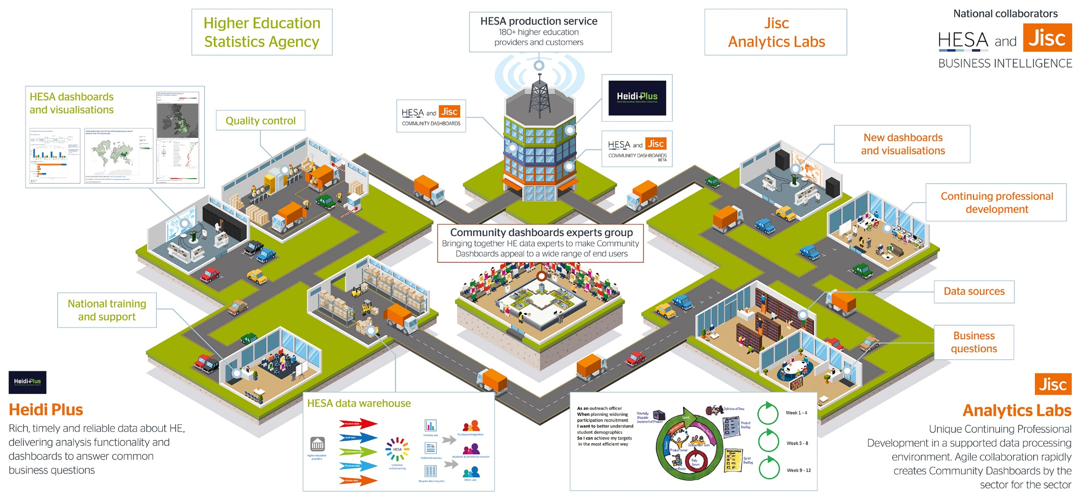
National business intelligence (BI) service for UK education

Slide 34
In summary

