Slide 1

The Future of the IT Workforce in Higher Ed
PRESENTED BY:
Elias Eldayrie • Orlando Leon
Mark Askren • Scott Lever
Notes:
[Orlando]

Slide 2

Agenda
Introductions
Learning Objectives
Topic Introduction
Gartner Thoughts
The Need for Leadership Development
Panel
Q&A
Notes:
[Elias]

Slide 3
Introductions
Elias Eldayrie – Vice President and CIO, University of Florida
Orlando Leon – CIO, University of California, Fresno
Mark Askren – University of Nebraska, Lincoln – Vice Chancellor and CIO
Scott Lever – Gartner - Analyst
Notes:
[Elias – 10 min]
Tee up problem
Only 3% of the higher ed IT organizations are thinking about this
We are focusing a lot on IT technologies; we are not focusing enough on YOU
Do our customers TRUST us? (Amazon examples)

Slide 4
Learning Objectives
Understand the various forces in industry and higher education that are driving the need to prioritize an effort of reshaping the current IT workforce
Learn techniques to help assess and anticipate technical and non-technical gaps in one’s higher education IT workforce
Understand strategies to initiate workforce upskilling and transformation
Learn techniques to lead conversations with campus leadership regarding strategies to start tacking the “wicked” problem of IT workforce transformation
Notes:
[Elias]

Slide 5
Topic Introduction
“The future never just happened. It was created.”
-Will Durant
Notes:
[Elias – 10 min]
Tee up problem
Only 3% of the higher ed IT organizations are thinking about this
We are focusing a lot on IT technologies; we are not focusing enough on YOU
Do our customers TRUST us? (Amazon examples)

Slide 6

Topic Introduction: 35 Years in 6 Seconds
By the Harvard Innovation Lab
Notes:
[Elias – 10 min]
Tee up problem
Only 3% of the higher ed IT organizations are thinking about this
We are focusing a lot on IT technologies; we are not focusing enough on YOU
Do our customers TRUST us? (Amazon examples)

Slide 7
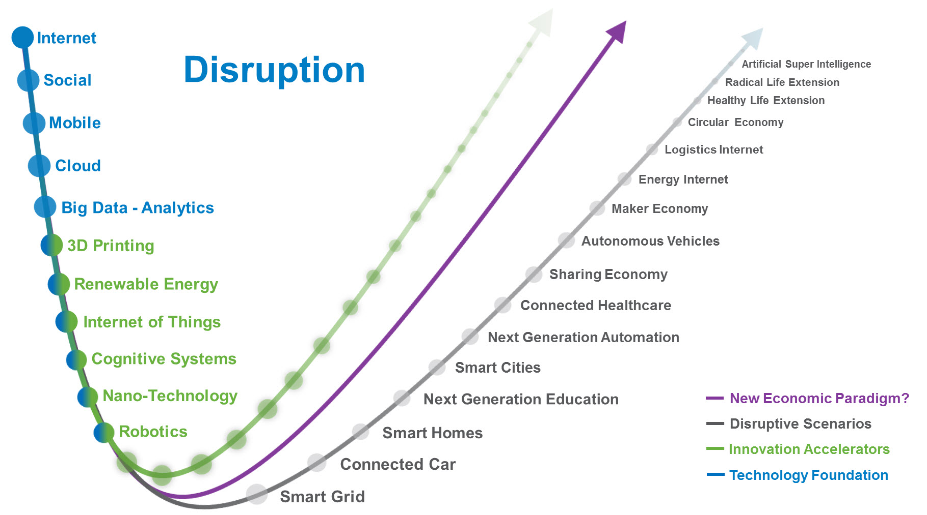
Topic Introduction: Digital Transformation
Notes:
[Elias – 10 min]
Tee up problem
Only 3% of the higher ed IT organizations are thinking about this
We are focusing a lot on IT technologies; we are not focusing enough on YOU
Do our customers TRUST us? (Amazon examples)

Slide 8
Topic Introduction: Transformation
Transformation
Notes:
[Elias – 10 min]
Tee up problem
Only 3% of the higher ed IT organizations are thinking about this
We are focusing a lot on IT technologies; we are not focusing enough on YOU
Do our customers TRUST us? (Amazon examples)

Slide 9
Topic Introduction: The Automation Jobless
“...not just number of jobs lost to more efficient machines, but automation may prevent the economy from creating enough new jobs …automation is beginning to move in and eliminate service and office jobs too”
February 24, 1961
Notes:
[Elias – 10 min]
Tee up problem
Only 3% of the higher ed IT organizations are thinking about this
We are focusing a lot on IT technologies; we are not focusing enough on YOU
Do our customers TRUST us? (Amazon examples)

Slide 10
Topic Introduction:
Information Technology In The Next Decade
Notes:
[Elias – 10 min]
Tee up problem
Only 3% of the higher ed IT organizations are thinking about this
We are focusing a lot on IT technologies; we are not focusing enough on YOU
Do our customers TRUST us? (Amazon examples)

Slide 11
Notes:
[Orlando]
Soft Skills
Effective Communication
Giving and Receiving Feedback
Conflict Management
Teamwork and Collaboration
Motivation and Inspiration
Mission-Driven Work
Culture of Professional Development
Culture of Service
Culture of Appreciation

Slide 12
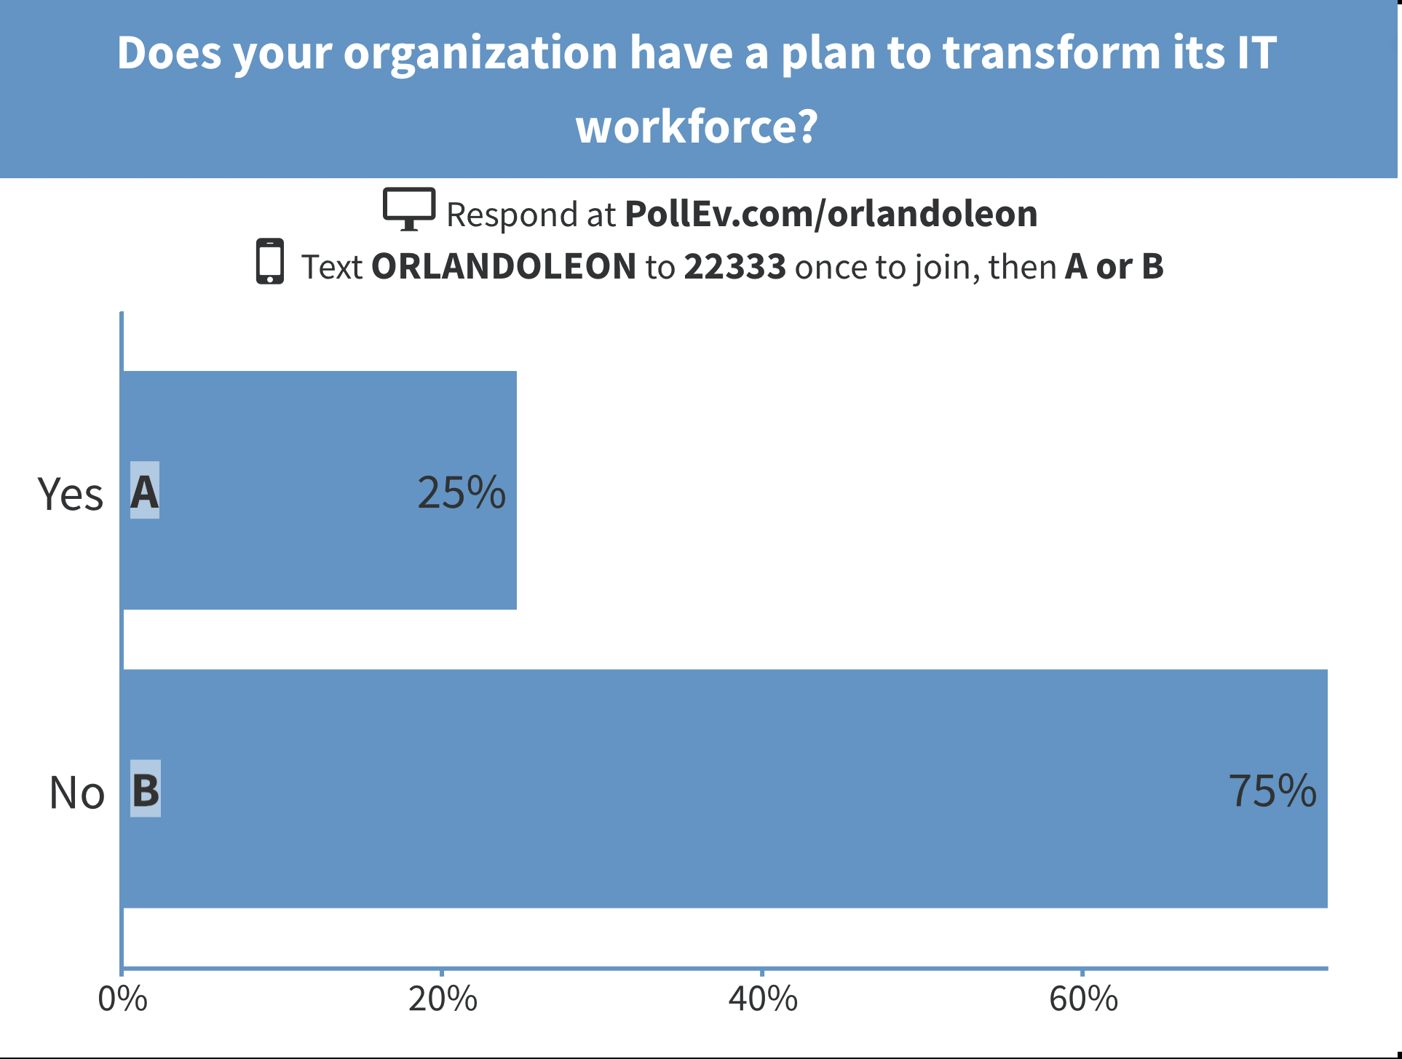
Notes:
[Orlando]
Soft Skills
Effective Communication
Giving and Receiving Feedback
Conflict Management
Teamwork and Collaboration
Motivation and Inspiration
Mission-Driven Work
Culture of Professional Development
Culture of Service
Culture of Appreciation

Slide 13
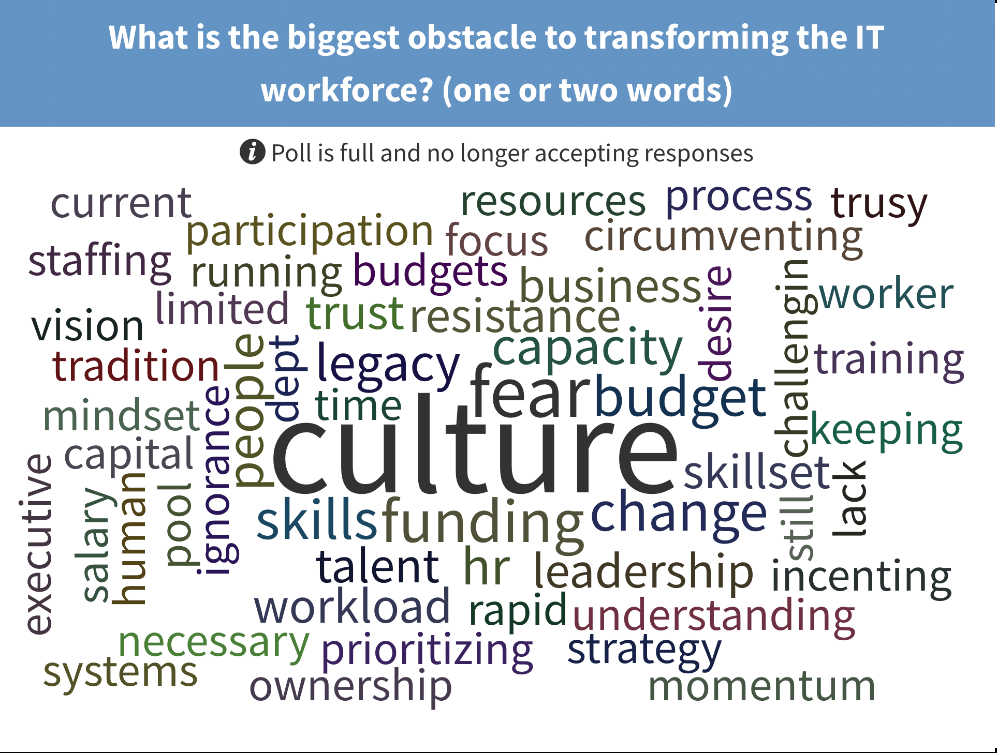
Notes:
[Orlando]
Soft Skills
Effective Communication
Giving and Receiving Feedback
Conflict Management
Teamwork and Collaboration
Motivation and Inspiration
Mission-Driven Work
Culture of Professional Development
Culture of Service
Culture of Appreciation

Slide 14
Introduction
Scott Lever Ph.D. is Gartner’s Consulting’s global leader for Organization, People, and Change Management.
He has 20 years of experience working with executives on change management, governance, organizational design, strategy, talent management, and shared services and outsourcing advisory.
Scott works extensively with Gartner’s Higher Education clients.
Prior to his consulting career, Scott was on the faculty at Indiana University Bloomington, School of Business.

Slide 15
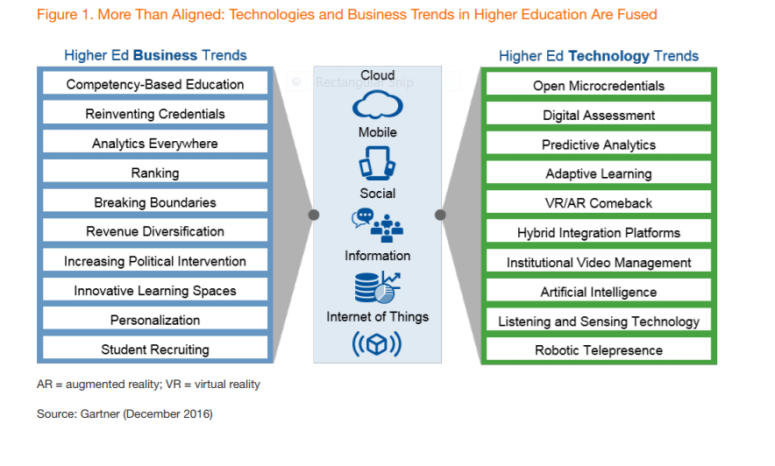
Digital Business has taken hold in higher education
How: Outputs increasingly delivered through and dependent on information technology
IMPLICATIONS
Increases stakes
Compresses time
Shifts skill profile

Slide 16
Many higher education institutions struggle with their own complexity
“Funding sources are numerous and controlled by different parties …There is a lot of institutional complexity to navigate. It’s tough getting questions answered and work done. We don’t know where all the funding will come from… we’re using spreadsheets…nobody does things the same way."
- Senior Administrator

Slide 17
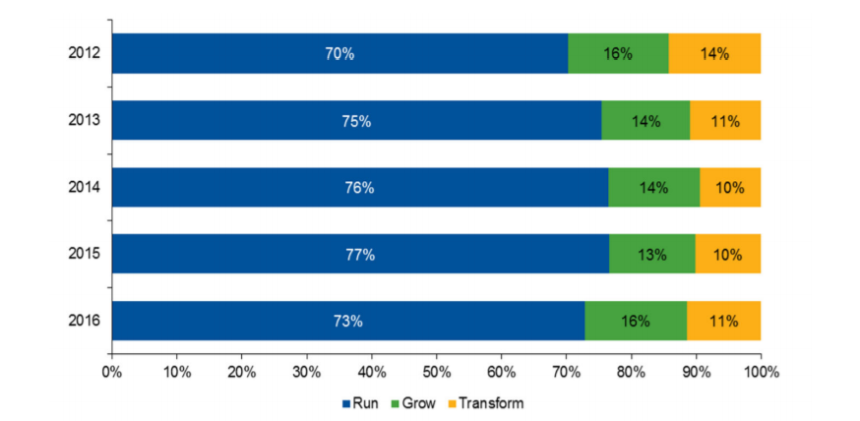
IT’s approach often lacks business understanding
IT thinks and acts like a servicer provider
Stakeholders increasingly go around IT
IT is enamored with technology
High levels of technical debt mean most budget and resources devoted to “run”
Gartner 2016 Key Metric Data for education
How does IT remain relevant and succeed?

Slide 18
“Nearly 80% of CIO’s and IT leaders project that the skill and knowledge their organization will need in 10 years have little resemblance to the skills and knowledge they have today.”
Does higher education IT have the focus
and talent to pivot?

Slide 19
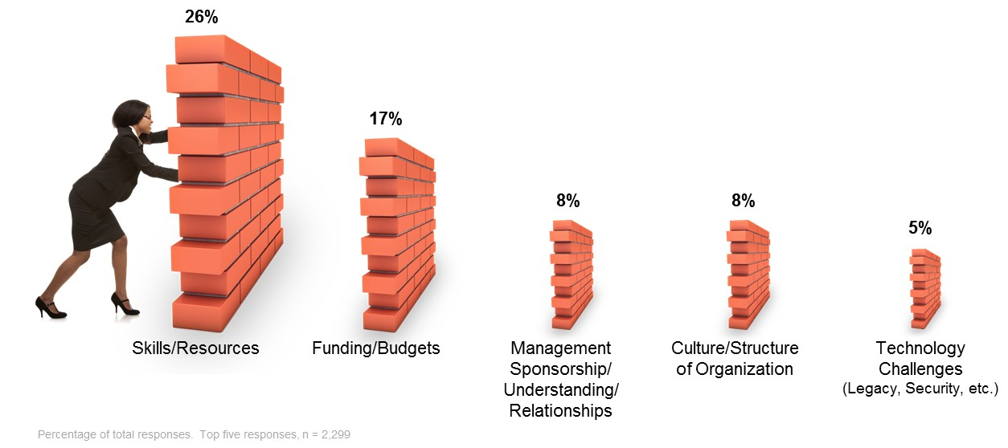
CIO’s perceive talent challenge
Even if we have the talent, are we organized to use it?
Source: Gartner

Slide 20
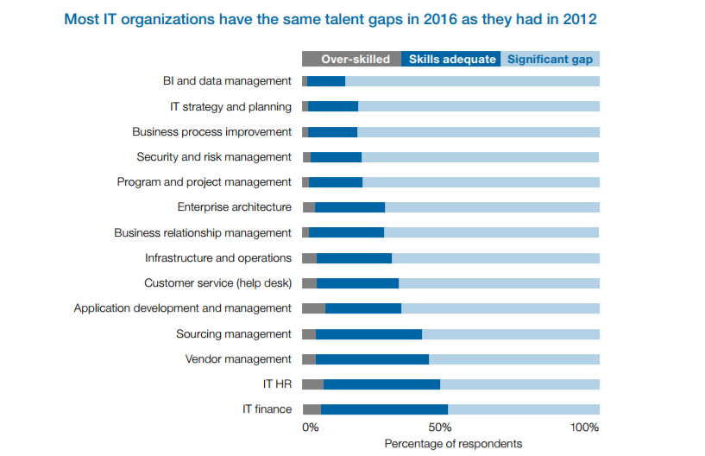
66% of CIOs believe there is a talent crisis in the world … yet there is surprisingly little talent innovation
Source: Competing for Top Talent: Build the Talent Platform, Gartner EXP Report 2016

Slide 21
The reality of the talent challenge depends on a host of considerations
CLIENT EXAMPLE
Location and geography
IT’s mission and role
Institution’s pace of change
IT’s employer brand
Workforce demographics and retirements
Higher Education client with significant brand in a major metro just lured away a CISO from a tech company
CLIENT EXAMPLE
Higher Education client in rural Texas is struggling to attract security related talent

Slide 22
Solving the “wicked problem” of workforce transformation
Elevate the problem
Identify & engage stakeholders
Open a broad discussion
Map out scenarios
Identify linkages & interdependencies
Orient to vision, mission, and values
Take actions to increase, dialogue and understanding
Source: IT Workforce Transformation Is the Next 'Wicked Problem' for CIOs, G00323722

Slide 23
Many talent problems to many talent solutions

Slide 24
Your people problem could have process and technology answers

Slide 25
Solutions in Action: IT process change that helps recruit & onboard better talent, faster

Slide 26
Solutions in Action:
Accelerating and injecting design thinking capabilities

Slide 27
Solutions in Action: Creative solutions to bridging the architecture talent gap

Slide 28
Workforce Transformation

Slide 29
Recommendations for discussion
Grow employer brand with:
  an achievable strategy
  meaningful work
  career growth via defined roles and paths
  collaborative and agile culture
Dig into workforce analytics, local labor market, and compensation metrics
Elevate workforce management & talent to “wicked problem” status
Get creative with solutions that stretch your supply and address demand
Make talent planning and talent management somebody’s job with expectations

Slide 30
Notes:
[Orlando]
Soft Skills
Effective Communication
Giving and Receiving Feedback
Conflict Management
Teamwork and Collaboration
Motivation and Inspiration
Mission-Driven Work
Culture of Professional Development
Culture of Service
Culture of Appreciation

Slide 31
Building the Case
Leadership Development
Succession Planning
Notes:
[Orlando]
Leadership Development + Succession Planning
Soft Skills
Effective Communication
Giving and Receiving Feedback
Conflict Management
Teamwork and Collaboration
Motivation and Inspiration
Mission-Driven Work
Culture of Professional Development
Culture of Service
Culture of Appreciation

Slide 32
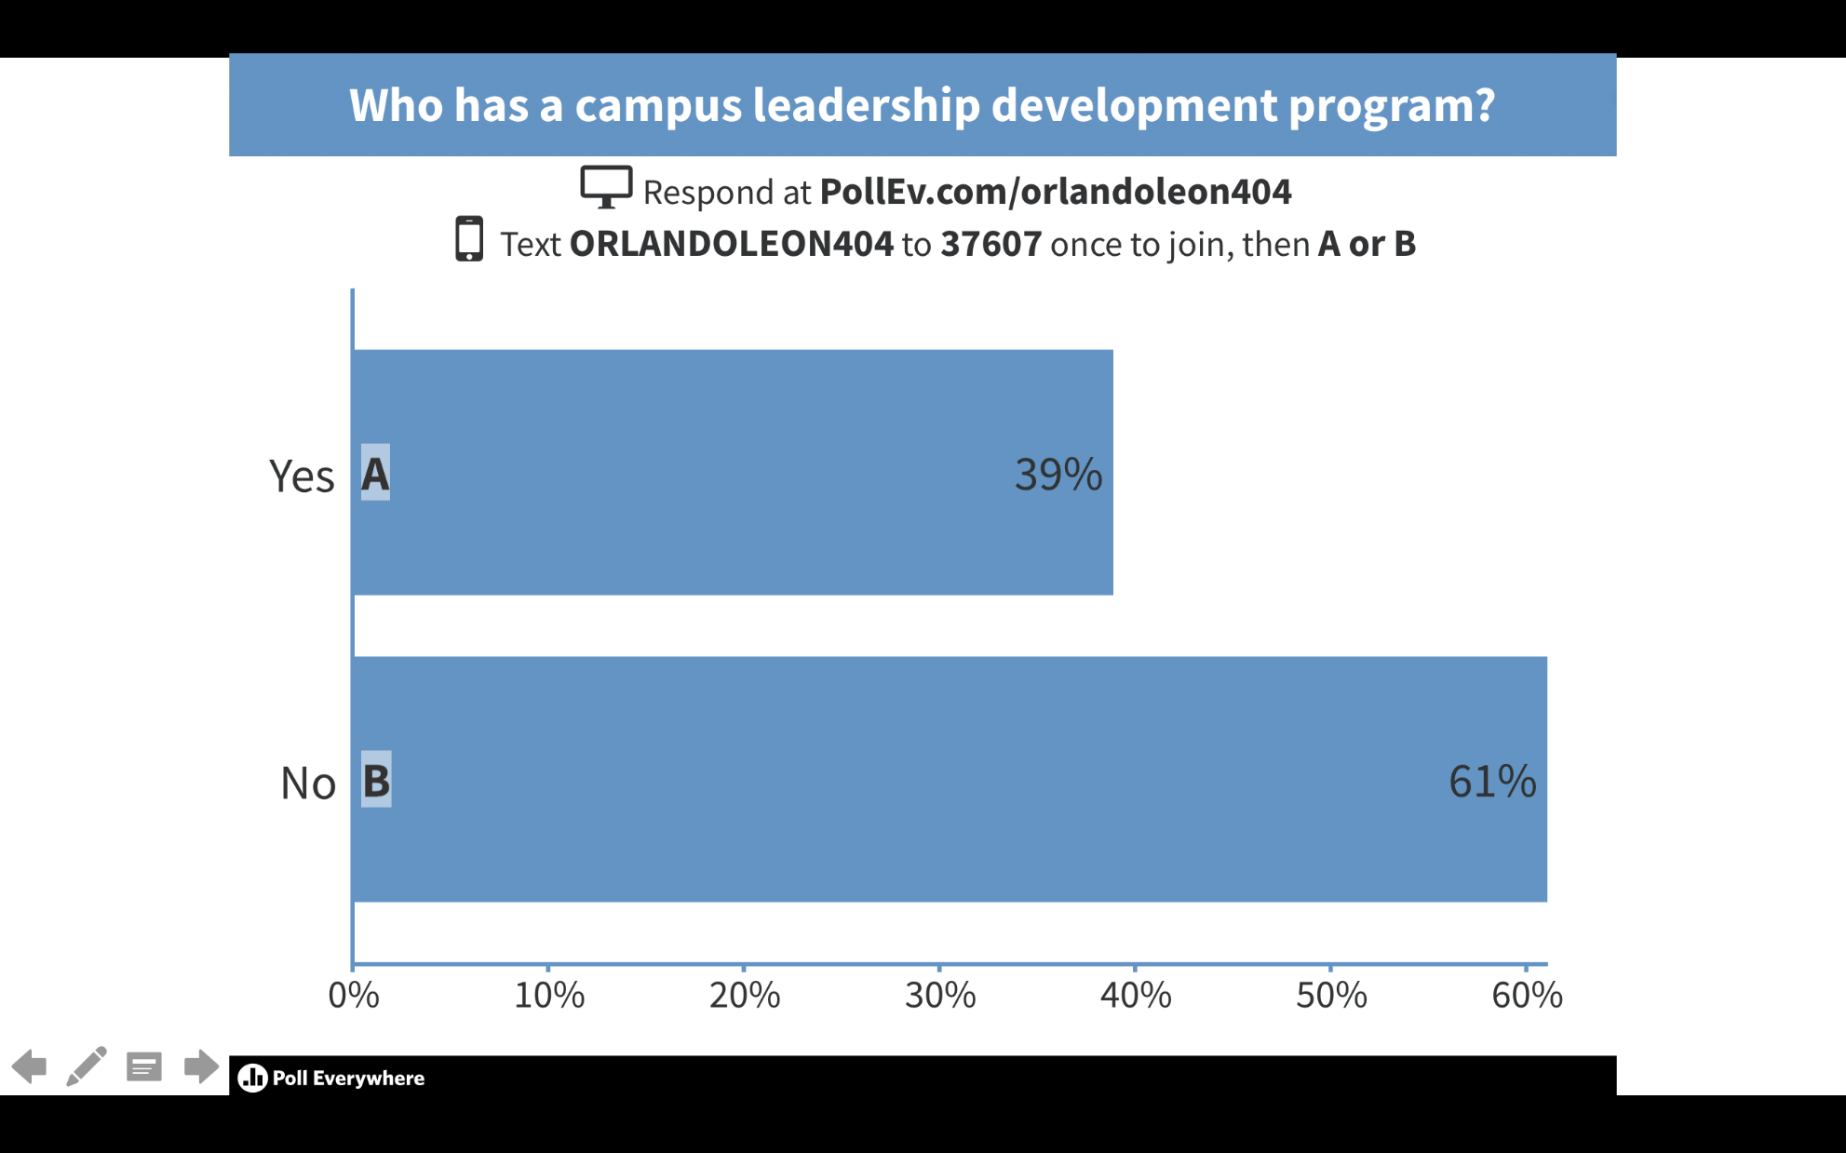
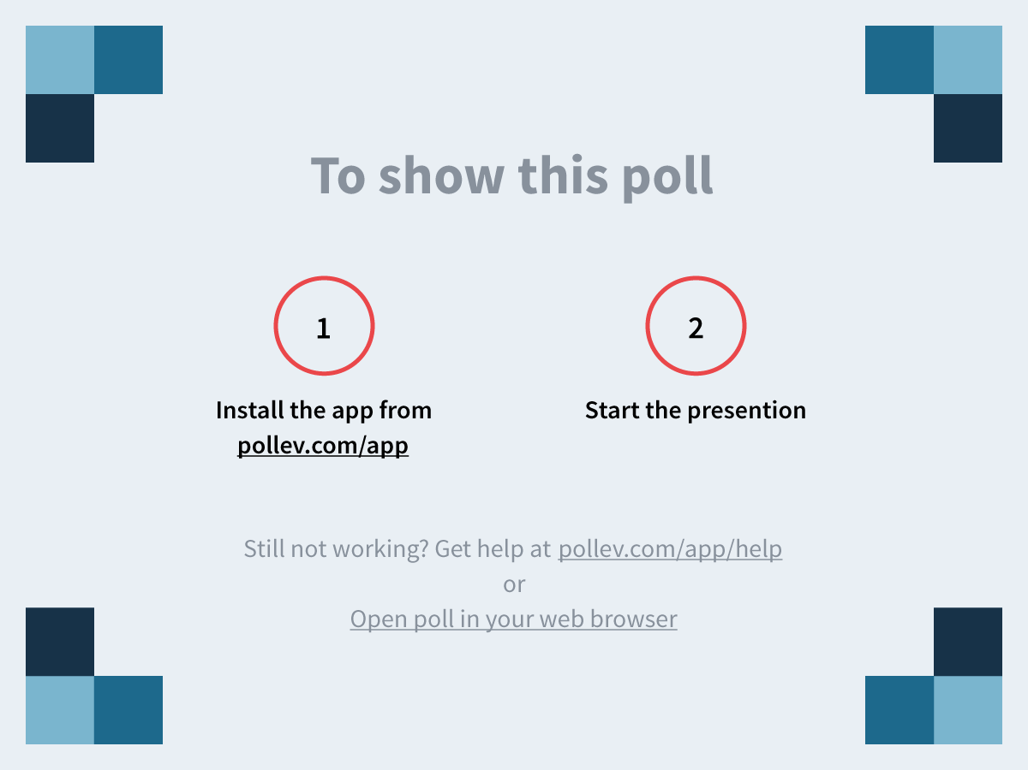
Notes:
From a previous presentation.

Slide 33
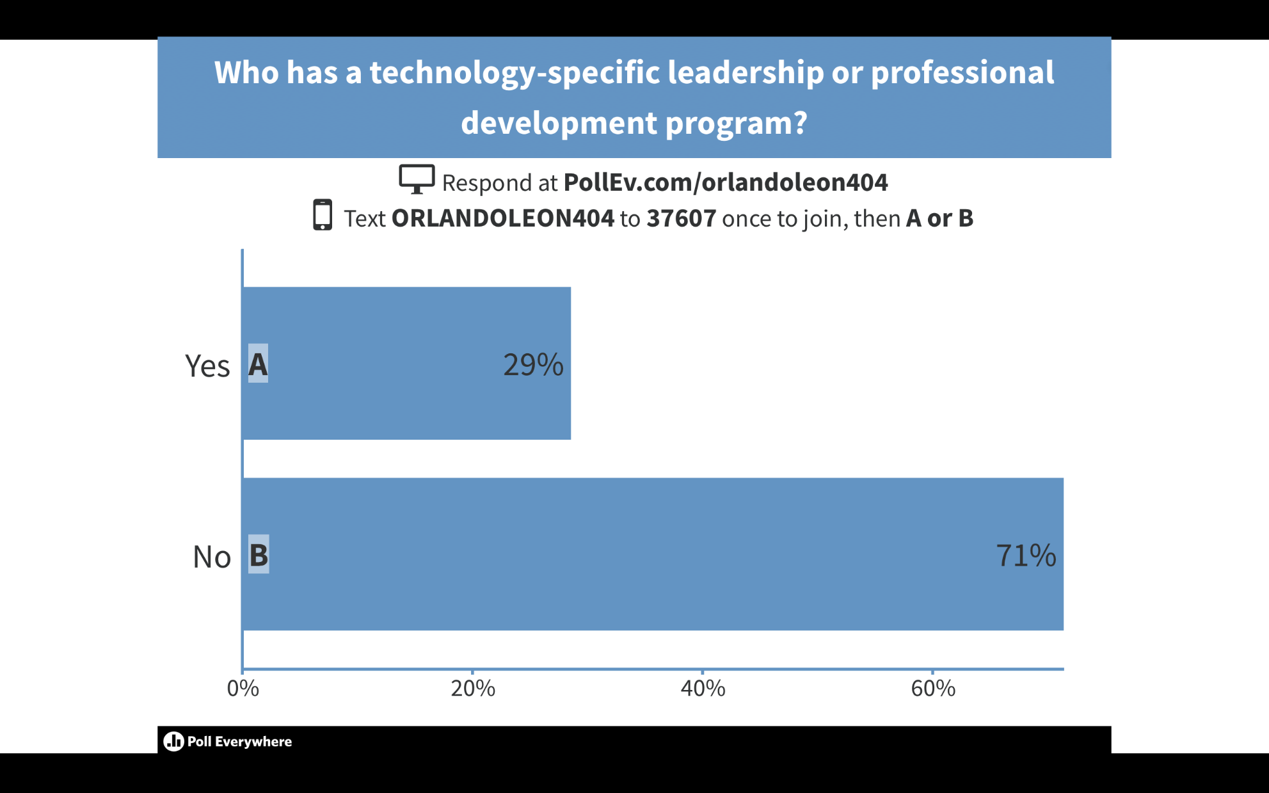
Notes:
From a previous presentation. A quick show of hands had this at less than 10% with a formal technology-specific professional development program.

Slide 34
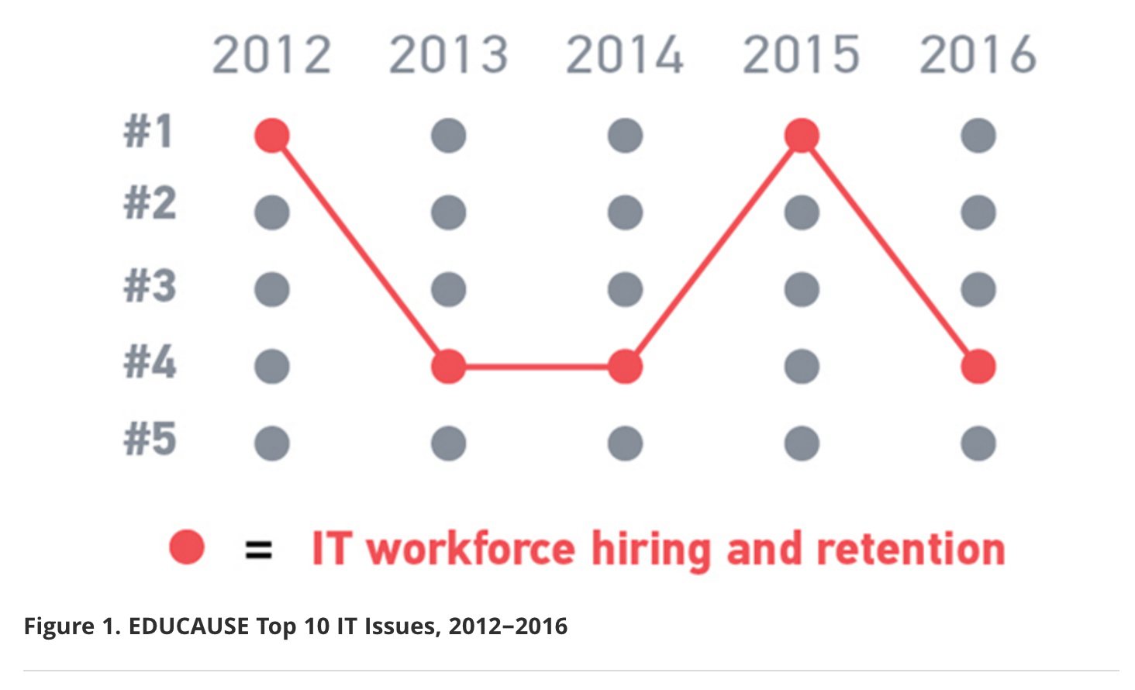

Slide 35
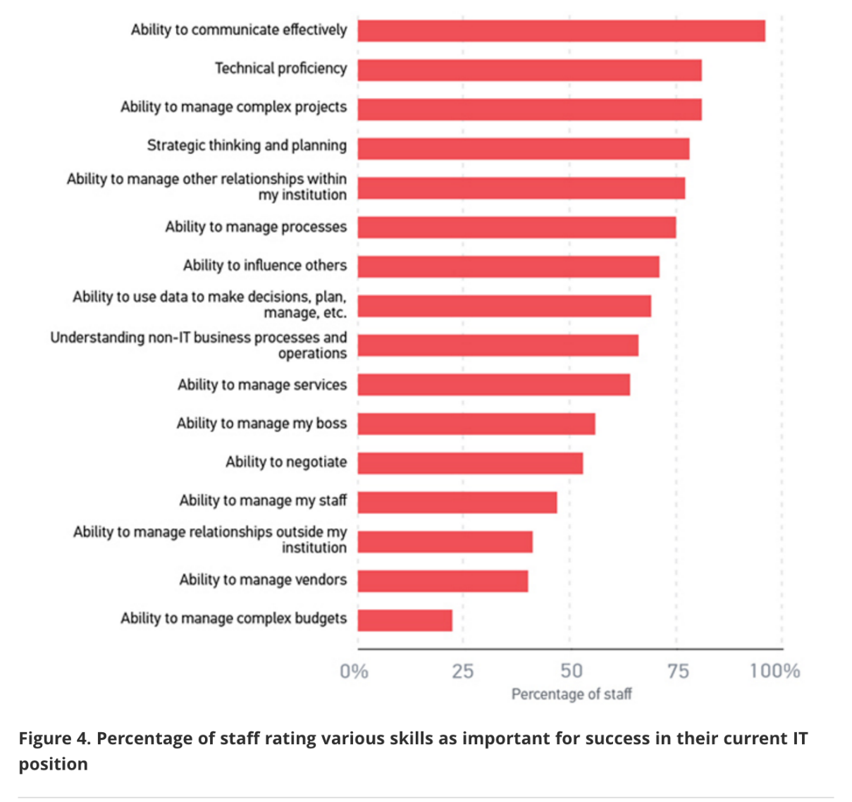

Slide 36
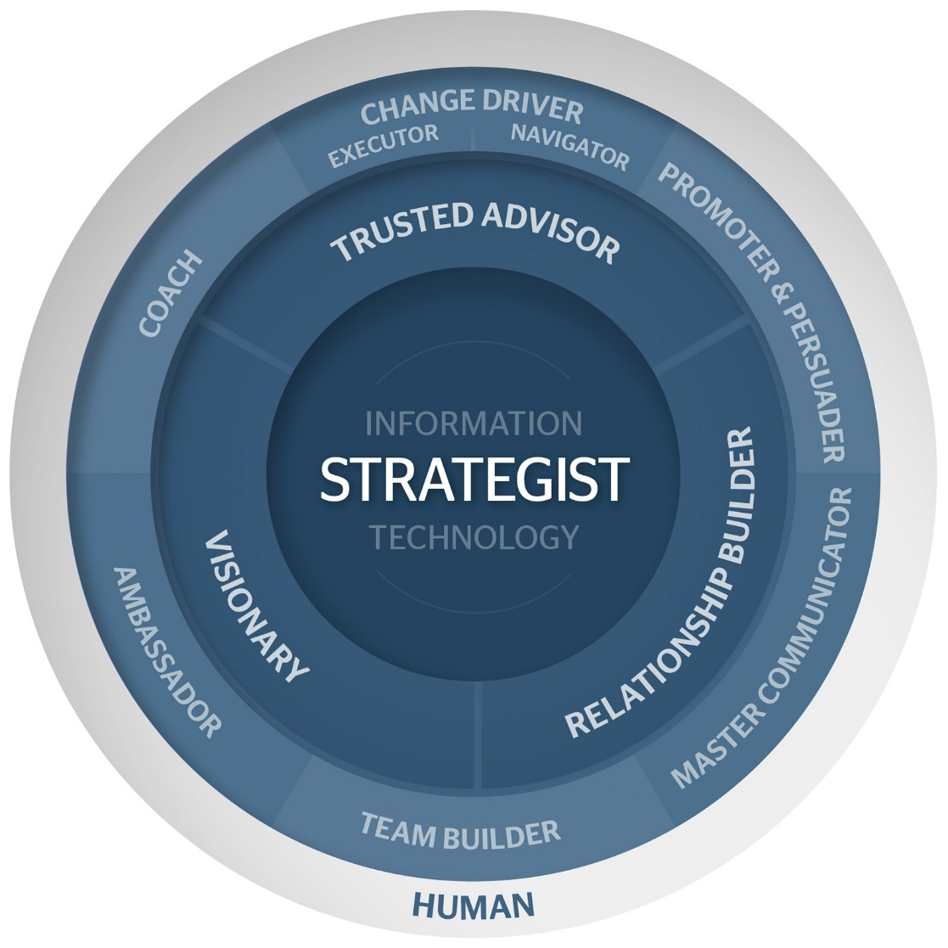

Slide 37
Leadership Program Objectives
Increase Awareness and Capacity for Formal and Informal Leadership within the Organization
Increase Emotional Intelligence Capacity (self-awareness, others-awareness, social awareness, self-regulation)
Provide Opportunities for Professional Development, Organizational Development, Networking, and Succession Planning
Help Bridge Gap between Staff and Managers
  Strategic Thinking
  Organizational Maturity
Provide Tools for Practical Use
  Profile Assessment Tools
  Facilitation Tools
  Communication Tools
Notes:
Created a technology leadership development program to address retention, professional development, leadership capacity, and succession planning.

Slide 38
Panel
Elias Eldayrie (moderator) – University of Florida – Vice President and CIO
Orlando Leon – California State University, Fresno - CIO
Mark Askren – University of Nebraska, Lincoln – Vice Chancellor and CIO
Scott Lever – Gartner - Analyst
Notes:
[Elias - 25 min]
Possible panel questions:
1
2
3

Slide 39
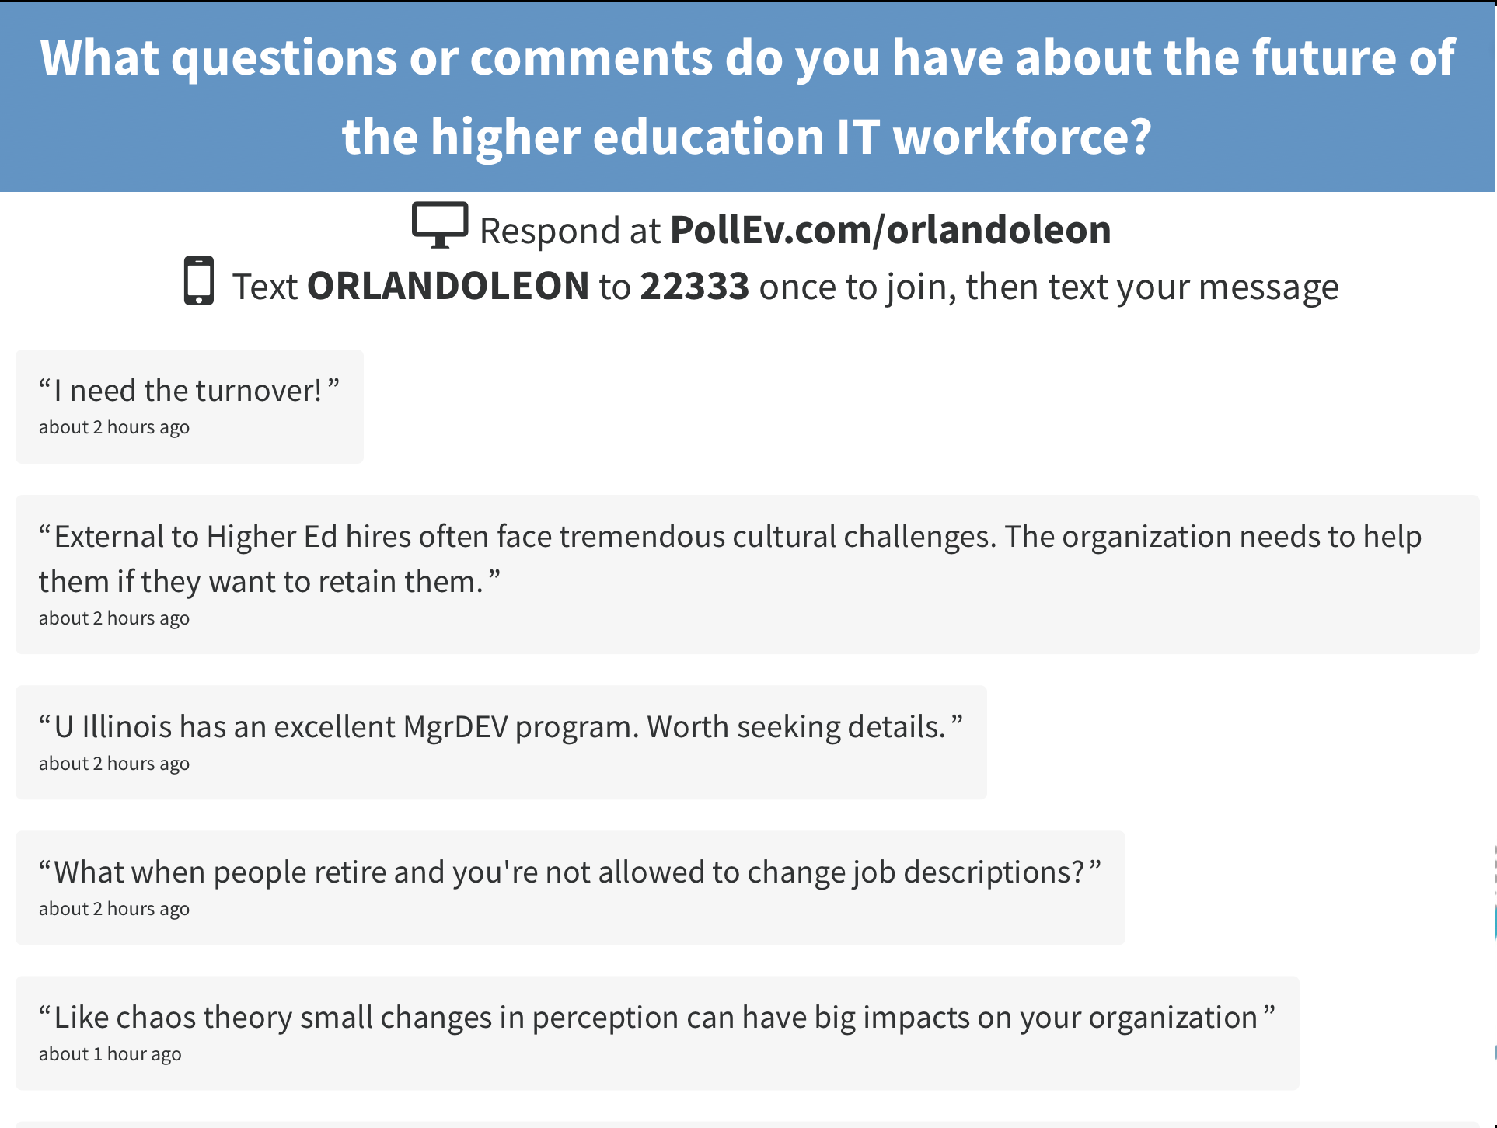

Slide 40
Thank you!
Please fill out your session evaluations!

