Slide 1
Capex to Opex: Are You Ready?
CIO Discussion
Educause 2017

Slide 2
Facilitators
Sherri Yerk-Zwickl
Chief Information Officer, Campbell University
Mike Gower
Executive Vice President for Finance & Administration, Rutgers University
Michele Norin
Senior Vice President and Chief Information Officer, Rutgers University

Slide 3
Is it Time?
Tech Trends
Top Ten IT Issues
Moving to the Cloud
Pressure for efficiency and predictability

Slide 4
The EDUCAUSE Top 10 IT Issues
Information security: Developing a holistic, agile approach to reducing institutional exposure to information security threats
Student success and completion: Effectively applying data and predictive analytics to improve student success and completion
Data-informed decision making: Ensuring that business intelligence, reporting, and analytics are relevant, convenient, and used by administrators, faculty, and students
Strategic leadership: Repositioning or reinforcing the role of IT leadership as a strategic partner with institutional leadership
Sustainable funding: Developing IT funding models that sustain core services, support innovation, and facilitate growth
Data management and governance: Improving the management of institutional data through data standards, integration, protection, and governance
Higher education affordability: Prioritizing IT investments and resources in the context of increasing demand and limited resources
Sustainable staffing: Ensuring adequate staffing capacity and staff retention as budgets shrink or remain flat and as external competition grows
Next-gen enterprise IT: Developing and implementing enterprise IT applications, architectures, and sourcing strategies to achieve agility, scalability, cost-effectiveness, and effective analytics
Digital transformation of learning: Collaborating with faculty and academic leadership to apply technology to teaching and learning in ways that reflect innovations in pedagogy and the institutional mission

Slide 5
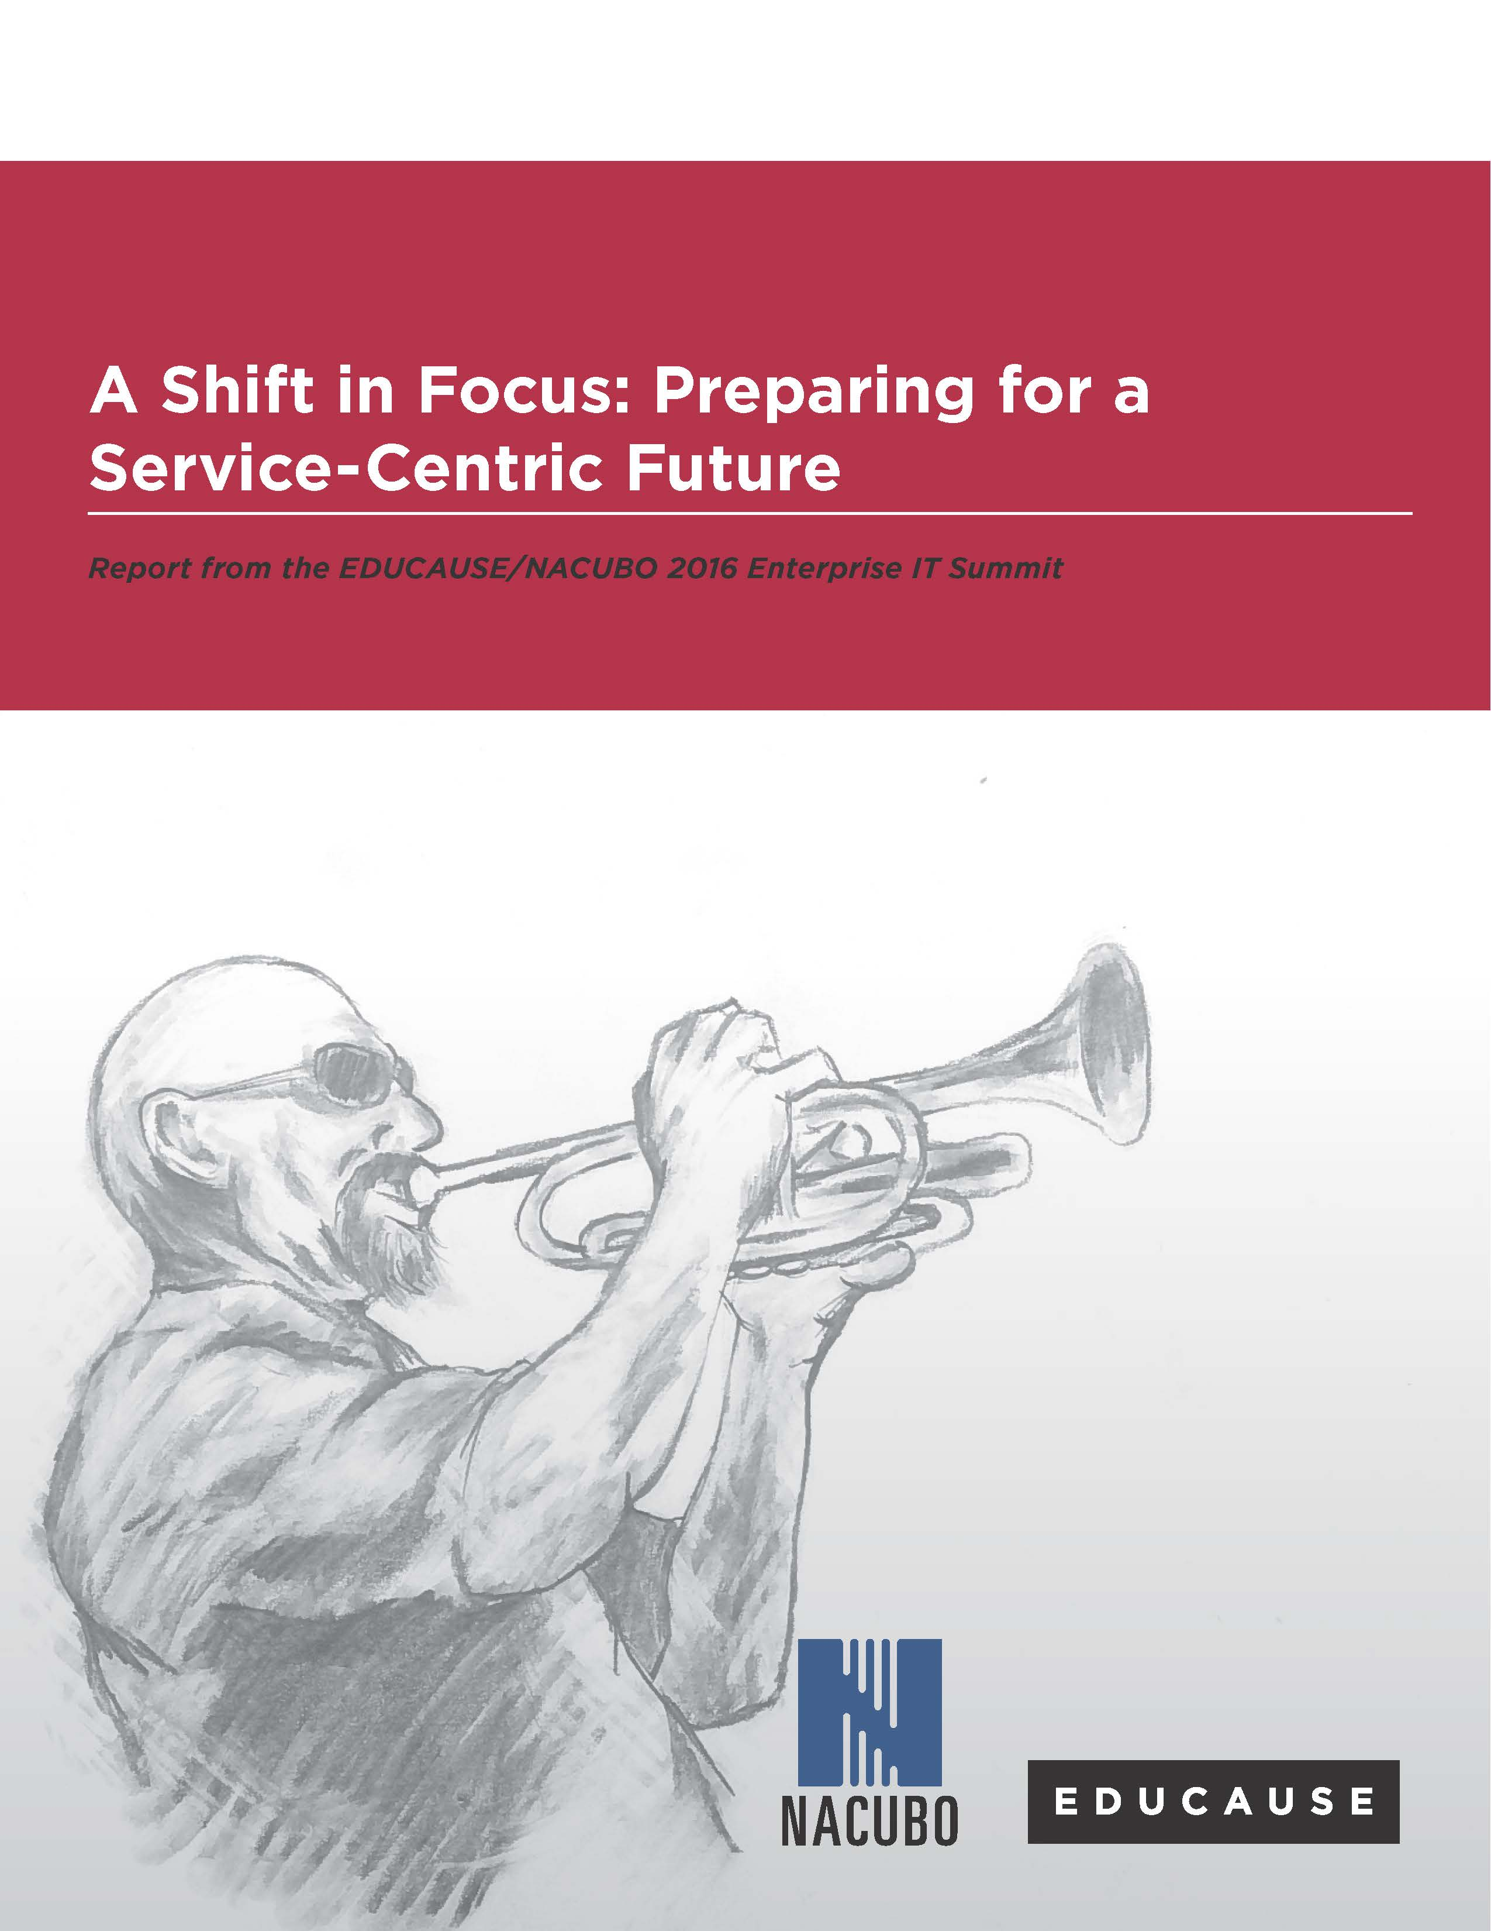

Slide 6
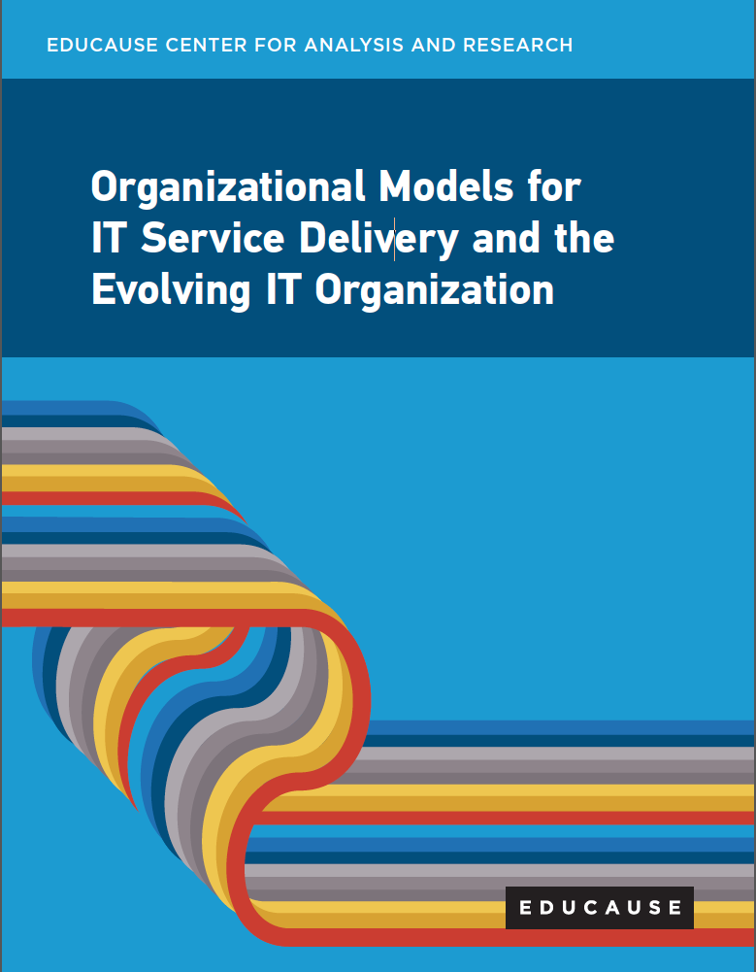
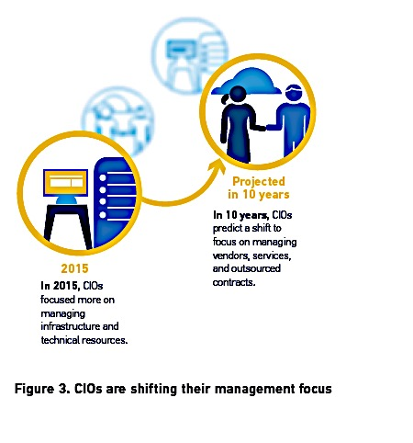
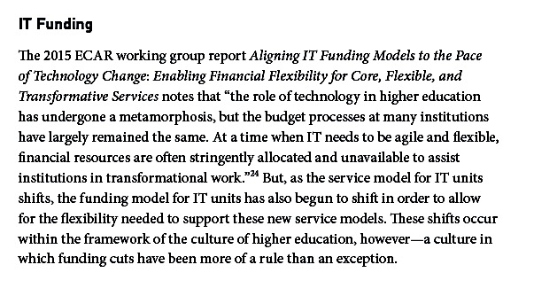

Slide 7
“Campus leaders must think differently about IT funding models. The models currently in place at most institutions are not sustainable if we want to truly make IT a strategic asset. IT funding models should be part of an overall institutional strategy on leveraging technology to achieve strategic objectives. With the emergence of cloud services and changing IT staff skill sets, IT leaders need the flexibility to holistically manage the IT CAPEX, OPEX, and salary budgets. Also, some of the savings enabled by institutional IT projects should flow back to the IT budgets to create a sustainable funding model.”

Slide 8
The Checklist
Collect data about spending patterns
Identify cost of IT services and operations
Define appropriate refresh cycles
Establish a strategy and working budget model with CFO
Identify potential funding sources
Build buy-in with leadership and campus stakeholders
Align flow of funds with project and operational work
Case study

Slide 9
Discussion
What are the challenges to moving to an Opex model?
Is Total Cost of Ownership (TCO) feasible? If not, why not?
What techniques have others used to make this shift?
What techniques have others used to work with the CFO/CIO on this concept?
How do we leave room for innovation in an Opex model?
What is the impact on staff?
What‘s missing?

