Slide 1
Developing Active Learning Spaces Perspectives from West Chester University & Jefferson (Philadelphia University + Thomas Jefferson University)
Jeffrey Ashley, Director of the Center for Teaching Innovation and Nexus Learning, Jefferson
Jeffrey Cepull, VP for Information Resources, IS&T, Jefferson
Dikran Kassabian, VP for Information Services & Technology, West Chester University
JT Singh, Deputy CIO, West Chester University

Slide 2
Jefferson (Philadelphia University + Thomas Jefferson University)
Combined institution (Philadelphia University + Thomas Jefferson University) as of July 1, 2017
10+ colleges, 100+ academic programs, 7,100 students
TJU –graduate health care focus in pharmacy, nursing, and medical school
PhilaU – undergraduate focus in architecture, design, engineering, textiles, and business
Part of a major regional medical center, Jefferson Health
Two primary campus location, Center City Philadelphia and the East Falls Campus (approximately 110 acres)

Slide 3
West Chester University
Combined institution (Philadelphia University + Thomas Jefferson University) as of July 1, 2017
10+ colleges, 100+ academic programs, 7,100 students
TJU –graduate
Part of
Two

Slide 4
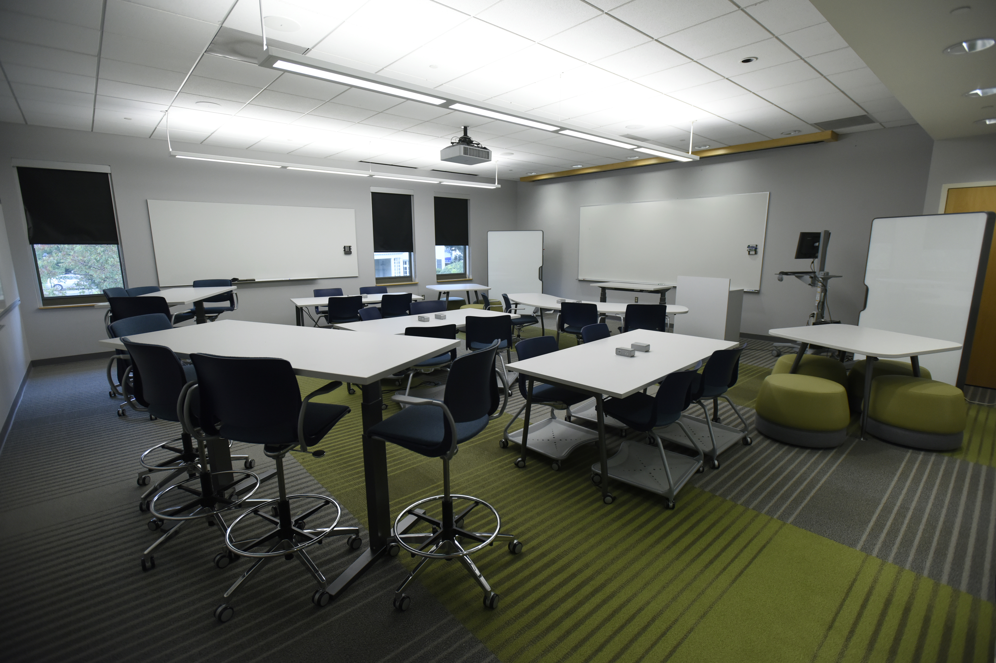
Why Do You Plan to Build Active Learning Spaces? ----Participant Exercise----

Slide 5
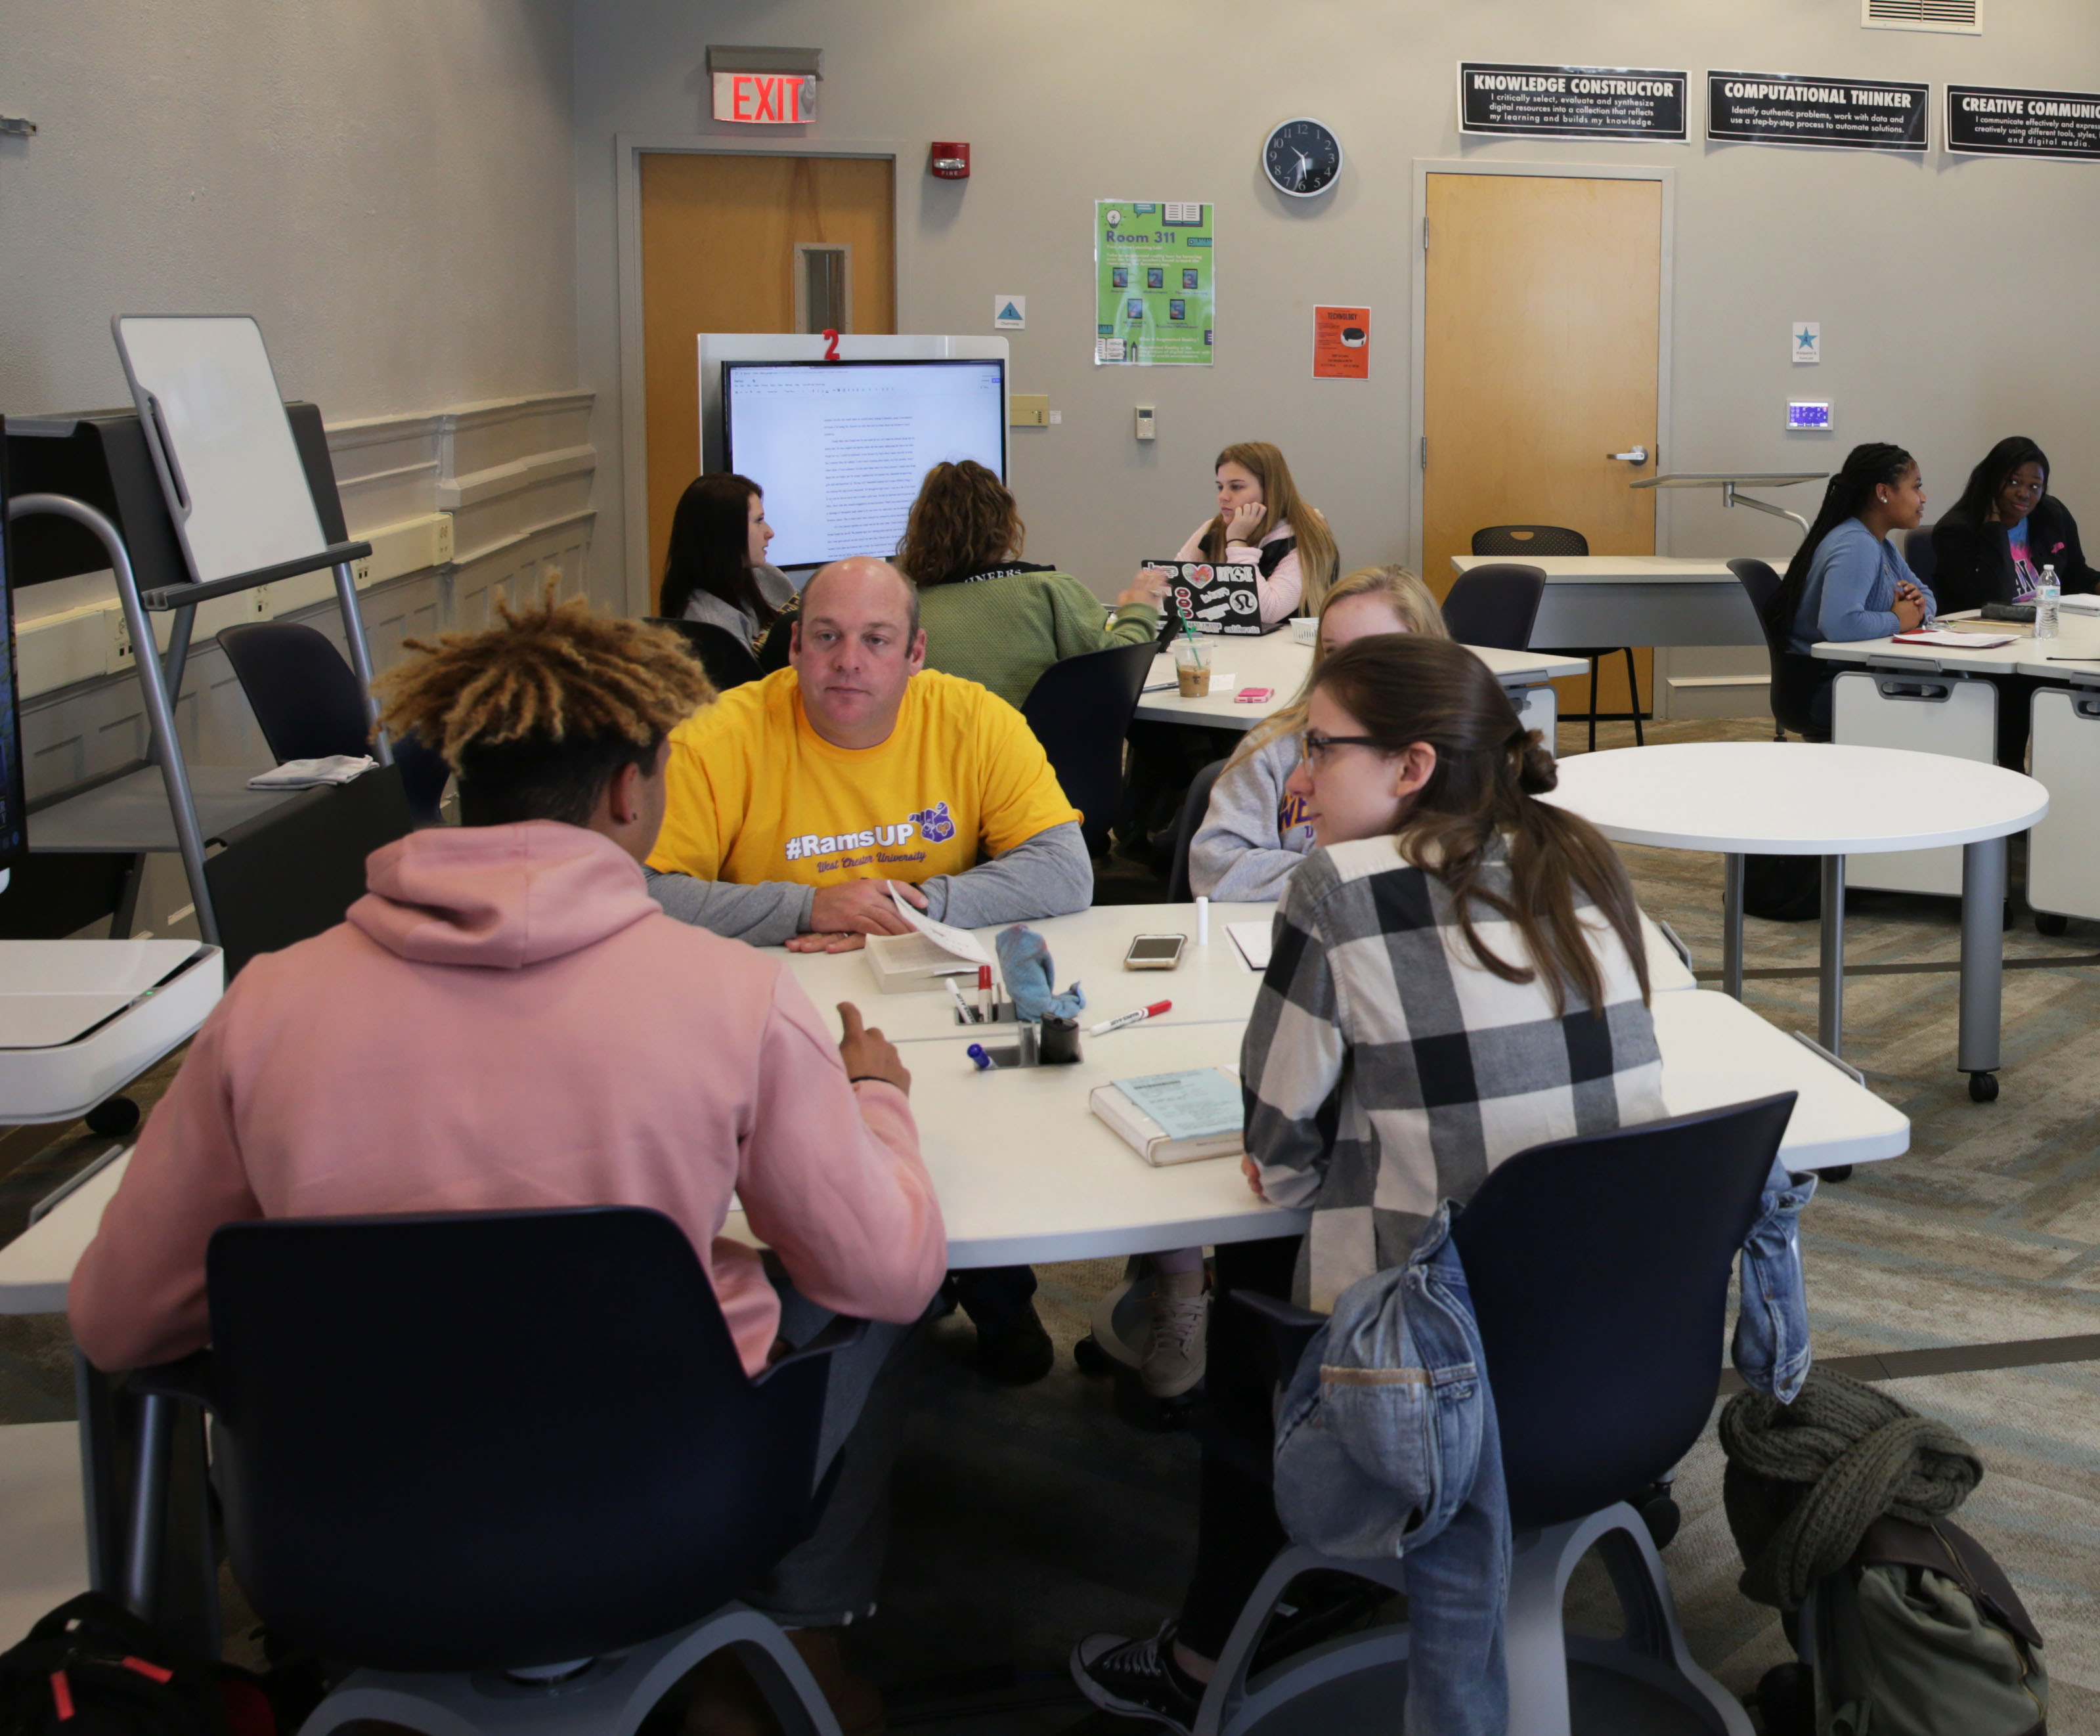
Why Did We Build Active Learning Spaces?
Mission-driven approach to instruction
Key component part of our strategic plans
Supports our signature pedagogies and tech-assisted methodologies
Fosters enhanced faculty-student and student-student interactions
Facilitates assessment of how physical environments and their affordances enhance student learning outcomes

Slide 6
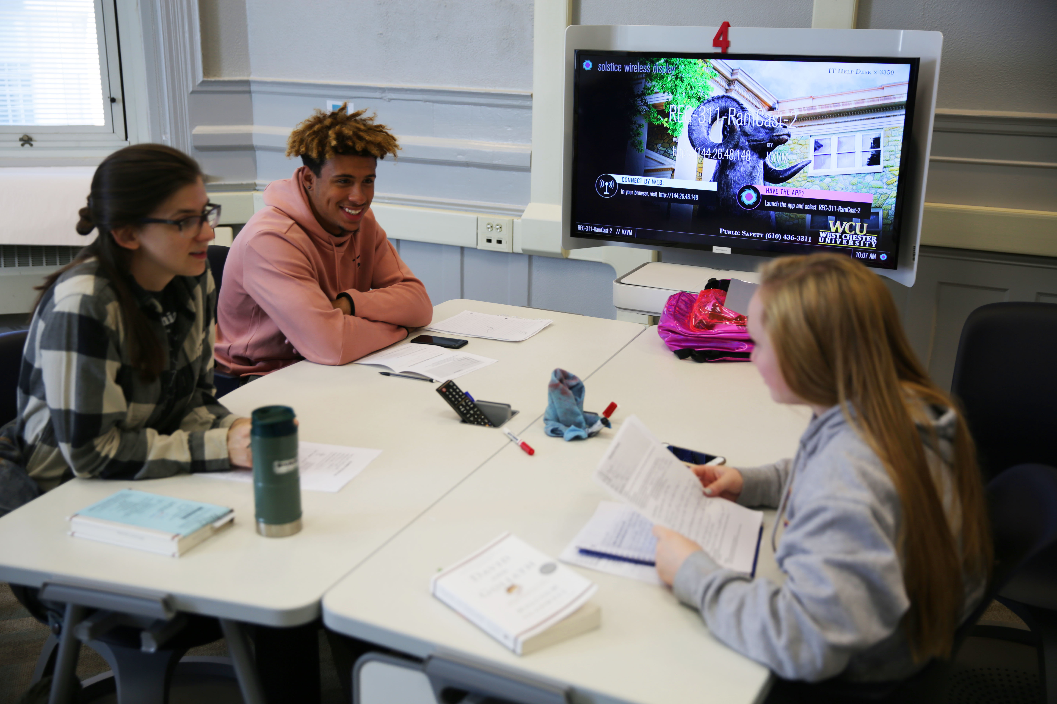
Can you identify challenges or barriers to building Active Learning Spaces? ----Participant Exercise----

Slide 7
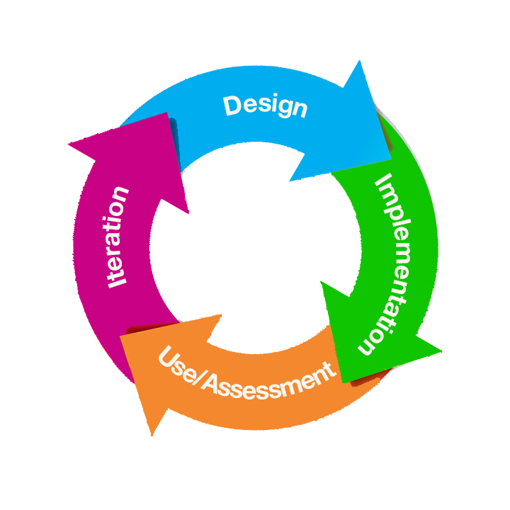
Active Learning Space Initiative: The Model

Slide 8
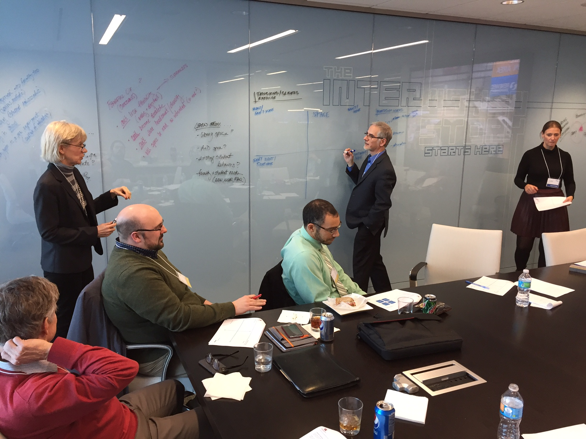
Design Phase

Slide 9
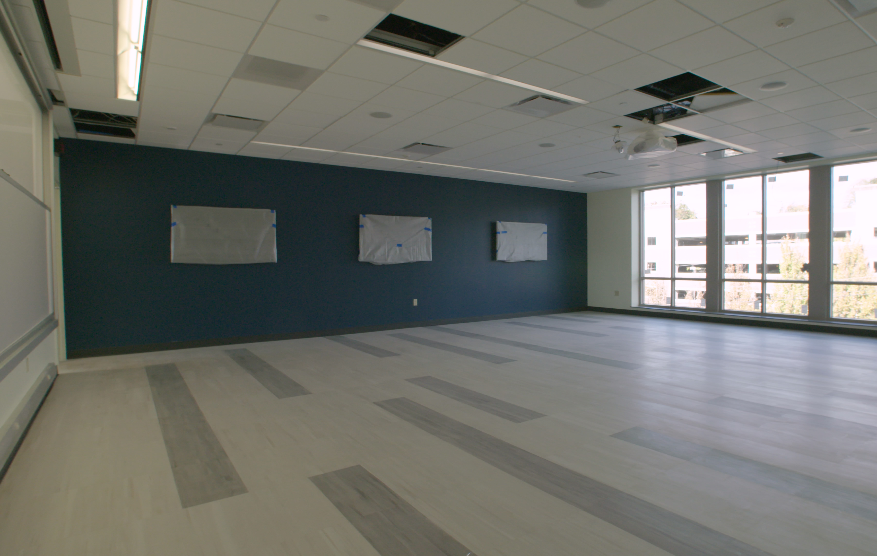
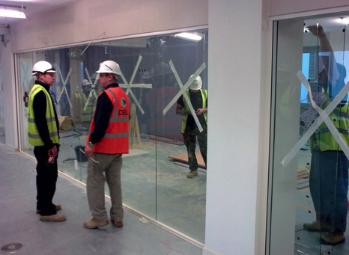
Implementation Phase

Slide 10
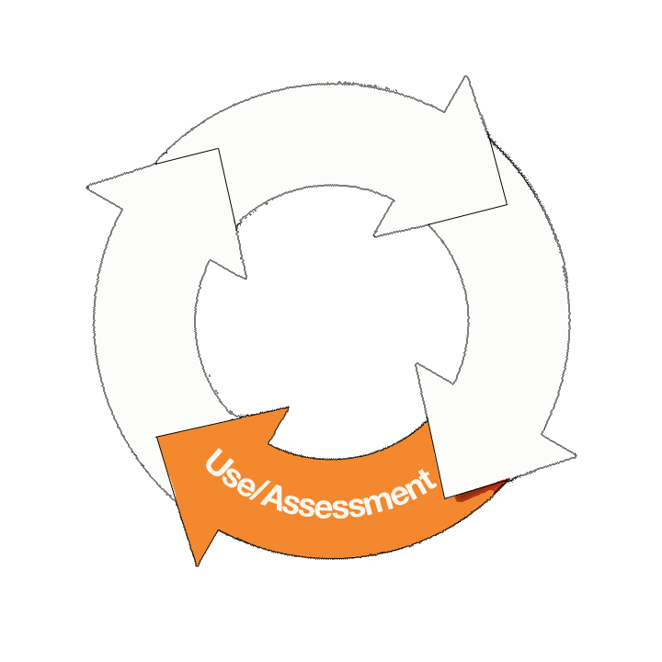
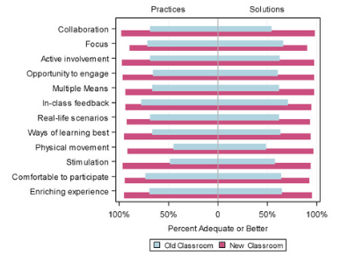
Use/Assessment Phase

Slide 11
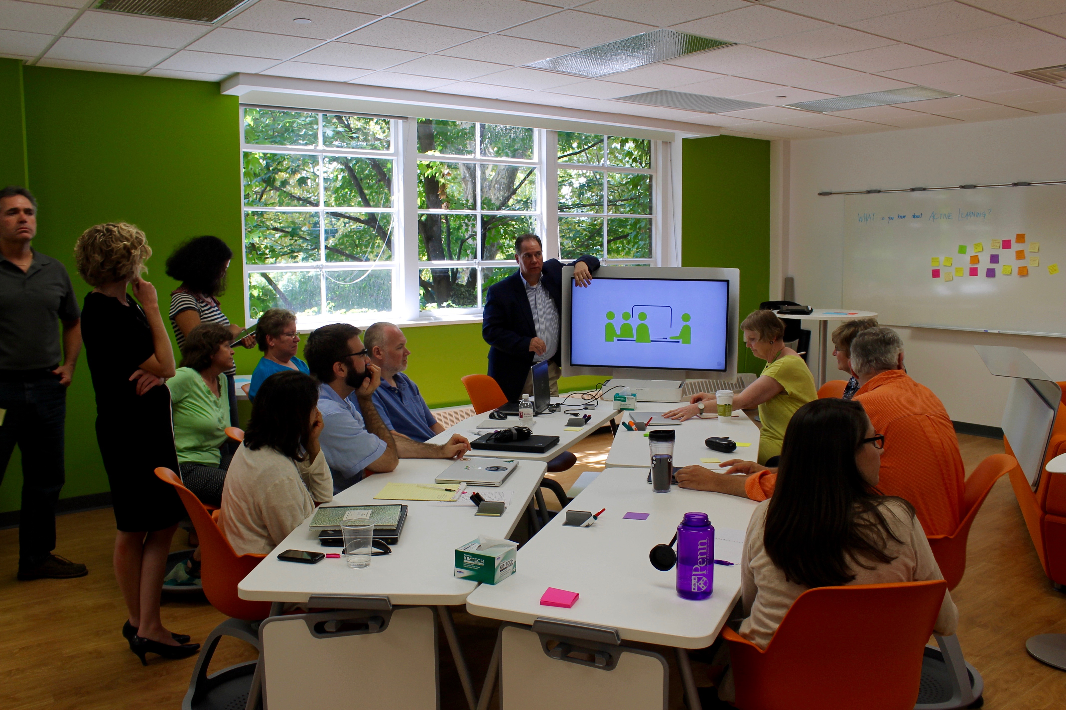
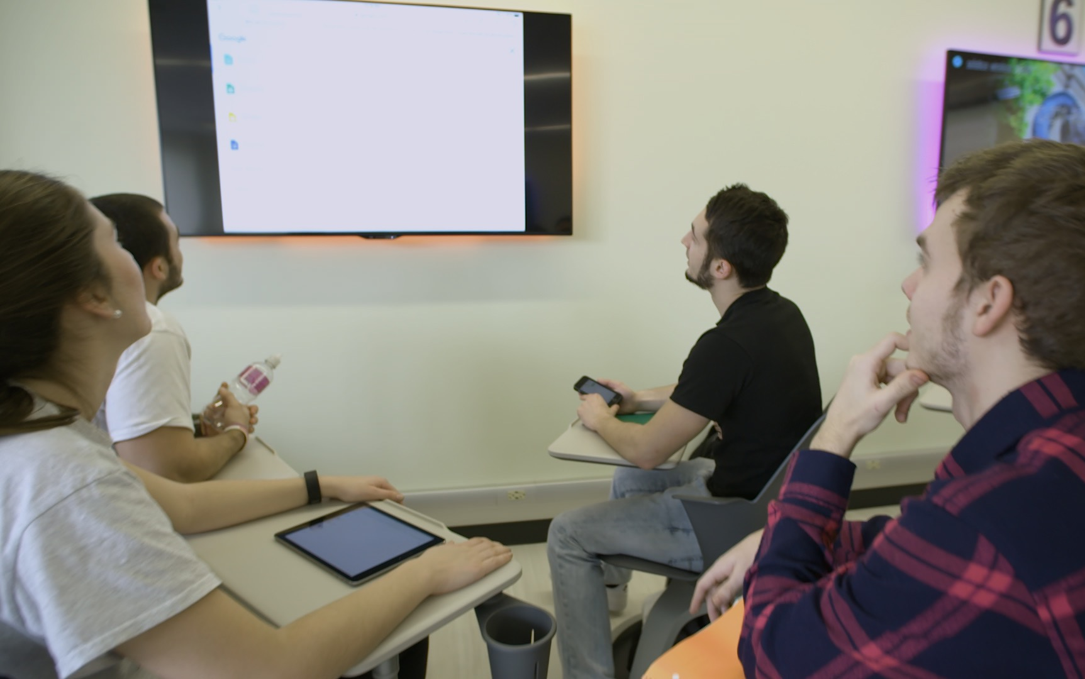
Iteration Phase

Slide 12
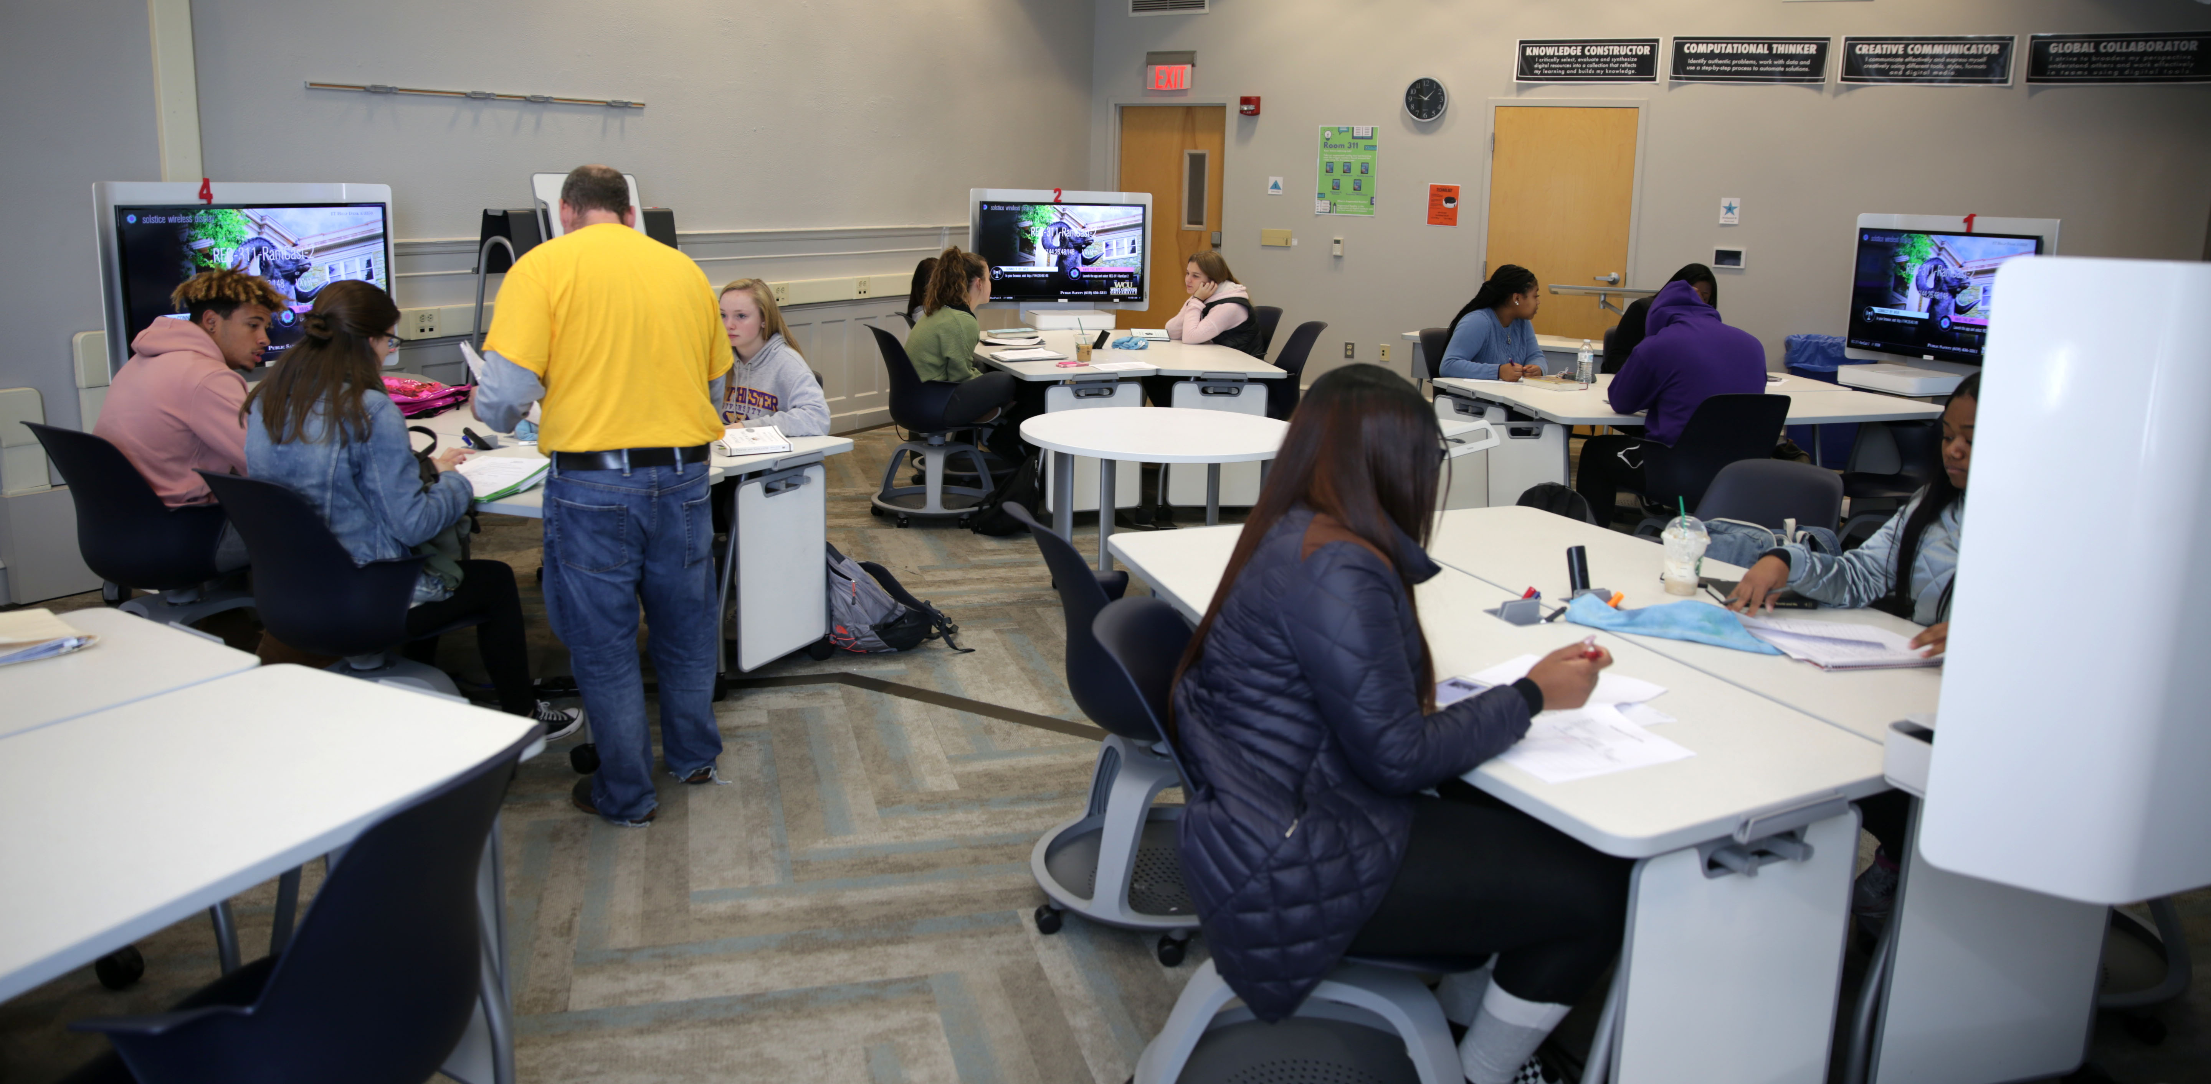
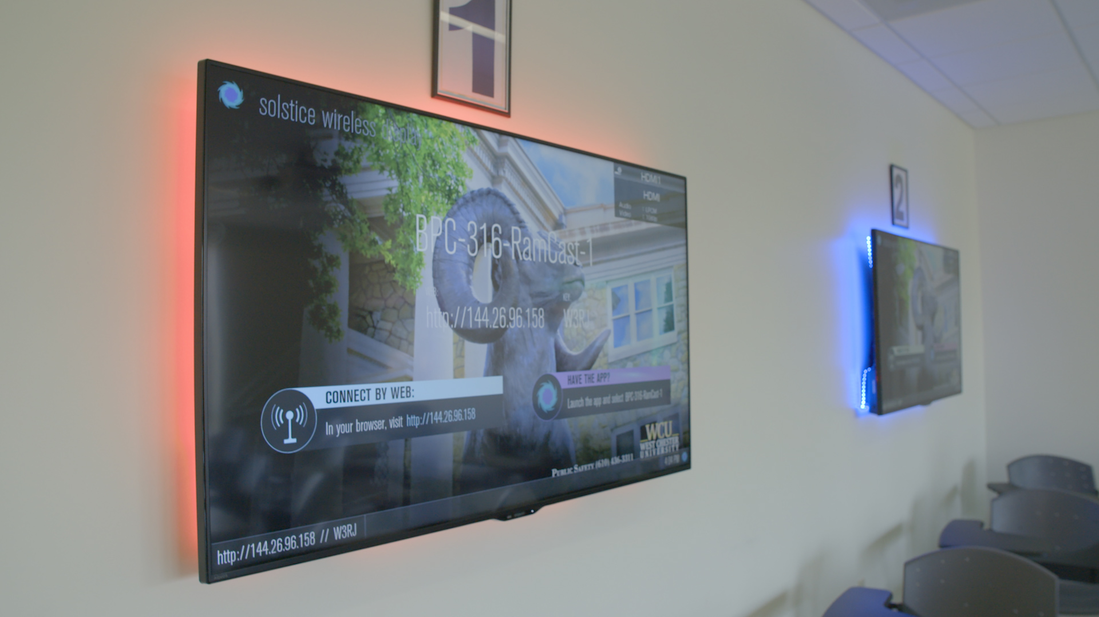
Lessons Learned
Notes:
Summary: What Really Worked About Our Processes
Mission-driven; supported strategic plan that found funding both internally and externally (and a plan for sustained funding)
Designating a “facilitator” for the process (e.g. Active Learning Space Coordinator) to keep stakeholders on track/involved/goal-directed, and feeling involved in all phases of the process
Identify, use, and recruit “leading edge” faculty to promote institutional buy-in
Mindset: This is an iterative, constantly evolving, ‘always room to improve’ process that is risk free for faculty
Assess everything and get your story out there.
Mindset: This is an iterative, constantly evolving, ‘always room to improve’ process that is risk free for faculty

Slide 13
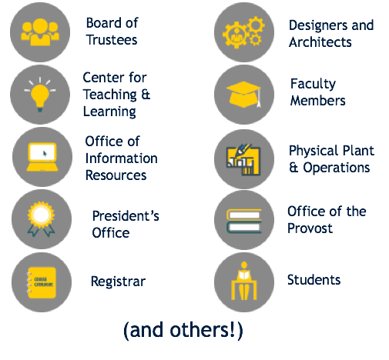
The Design Phase - Lessons Learned
Identify Funds to Support the Project
Build Coalition with Relevant Stakeholders
Consider Pedagogies and the Mindful Space/Tech to Optimize Them

Slide 14
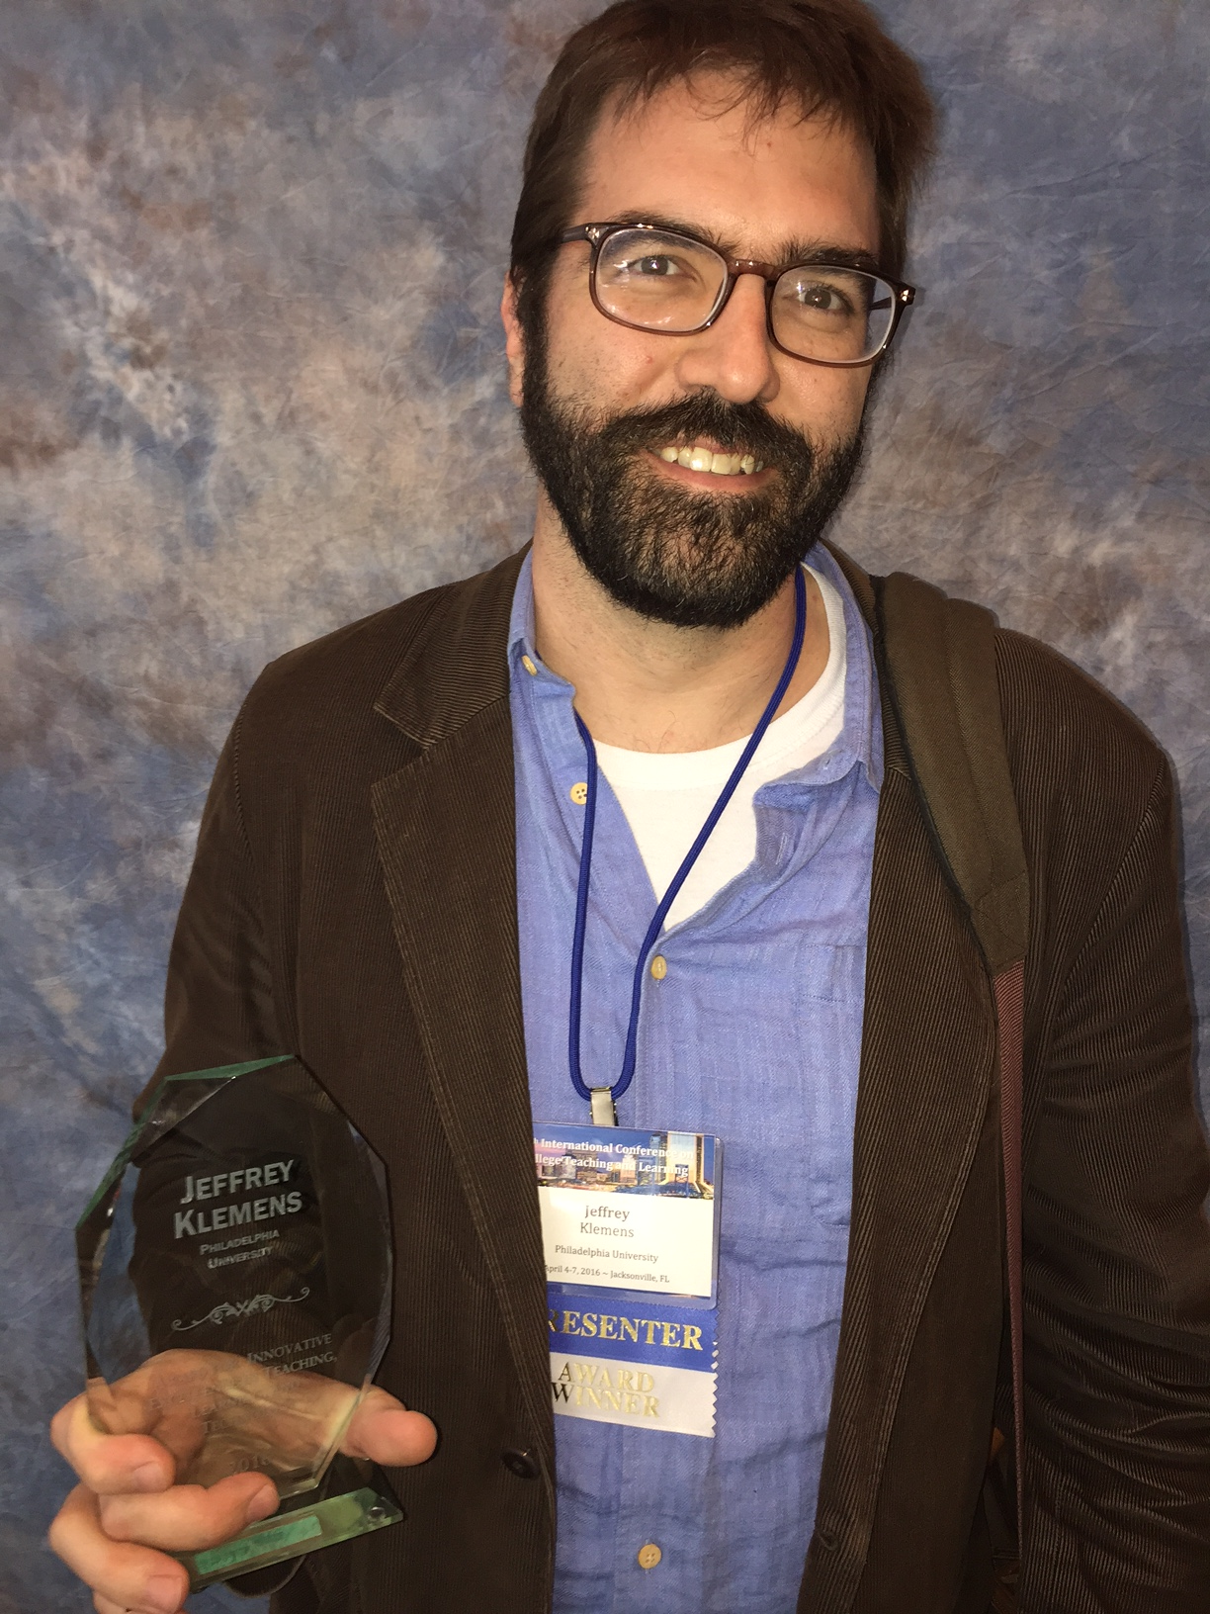
The Implementation Phase– Lessons Learned
Identify Faculty Champions
Design and Provide a Framework for Faculty Support
Capitalize on Stakeholder Collaboration

Slide 15
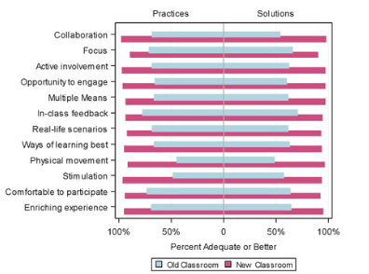
The Use/Assessment Phase – Lessons Learned
Create a Risk-Free Environment
Tout Your Successes
Identify Your Own Path
Create Conditions for Success and Personalize User Experience
Assess Everything!

Slide 16
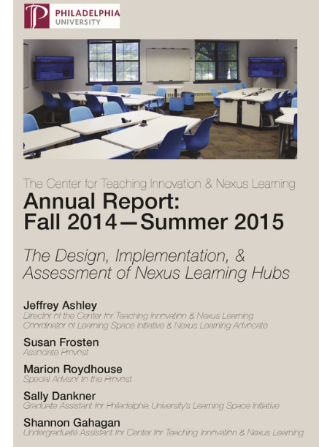
The Iteration Phase – Lessons Learned
1. Promote Change 2. Secure Further Funding Sources 3. Tout Your Success 4. Continue to Prototype 5. Scale Up – Scale Out

Slide 17
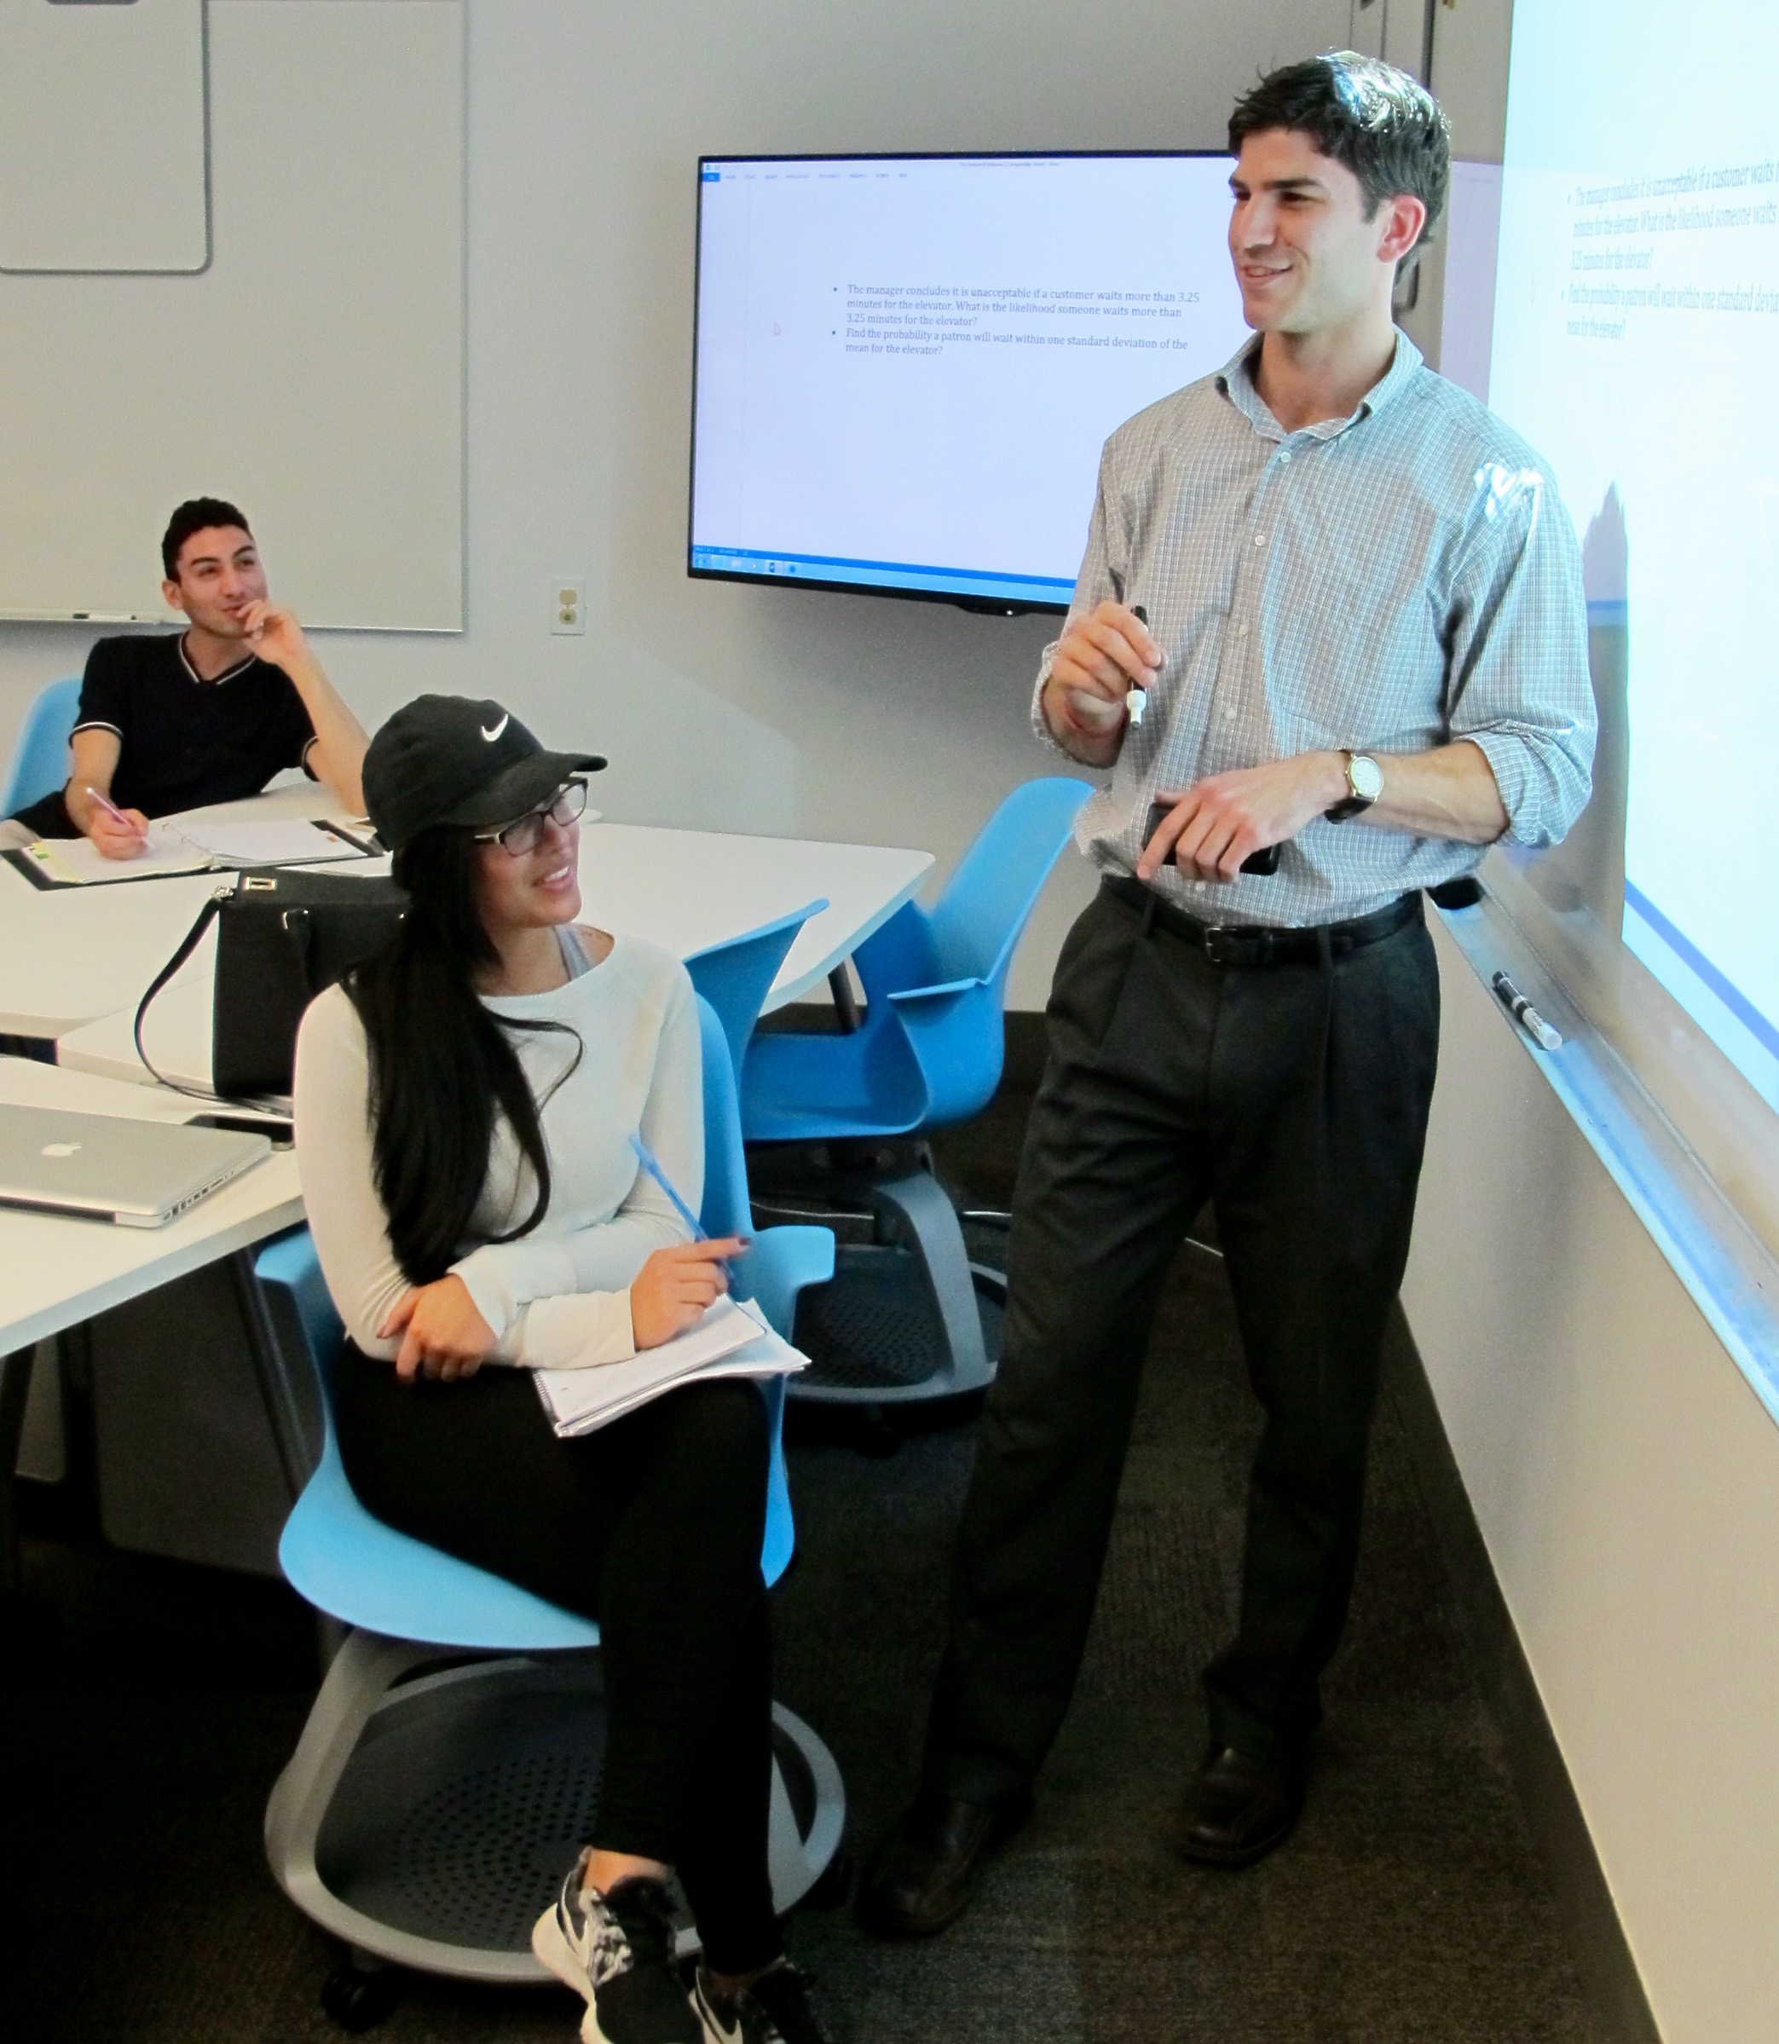
When you return to your institution, what will you take with you from this session? ----Participant Exercise----

Slide 18
Thank You Contact Us!
Jeff Ashley, Director of the Center for
Teaching Innovation and Nexus Learning, Jefferson E-Mail: AshleyJ@PhilaU.edu
JT Singh, Deputy CIO, West Chester University
E-Mail: Jsingh@wcupa.edu

