Slide 1
Why Does IT Cost So Much?
Notes:
Welcome
Thanks
Timeless
Jobs
Right tools => creativity
People issue

Slide 2
Notes:
Reddit
Visualize Moore’s Law
Summarizes expectations

Slide 3
Problem
Institutional IT budget demands continue to grow
Senior university leaders asking why
Era of greater cost scrutiny
Simple answer: IT costs growing because it is used more
Expanding IT demand appears counterintuitive
Full answer: controllable and uncontrollable forces
Notes:
Expectations: smaller/cheaper
Reality: doing more
Provost
VPFA
Steam power cheaper
Efficiency increases usage

Slide 4
Perspective
IT Complexity & Importance
Timeframe | Characterization
Today | Ubiquitous
2010 | Mission critical
2005 | Growth enabler
2000 | Competitive advantage
1995 | Innovation driver
1990 | Operational necessity
1980 | Useful
1970 | Interesting
IT Cost

Slide 5
Uncontrollable Drivers of Cost Growth
Notes:
Can’t stop
Accept as reality
Deal with it

Slide 6
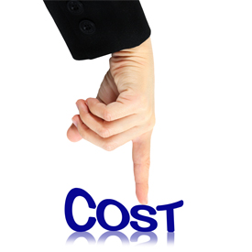
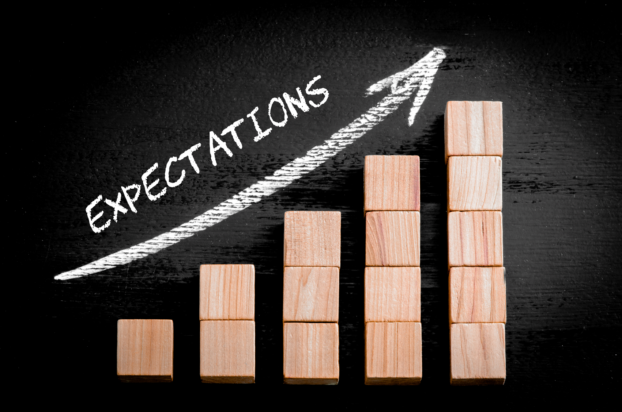
Background
Factors outside the university
How to manage their impact?
Our bottom line
Our clients’ expectations
Notes:
Opposing forces

Slide 7
Breadth of Demand
“Strategy 101 is about choices: You can’t be all things to all people.”
- Michael Porter
Every stakeholder on campus uses information systems
Every outcome is impacted by IT
Every process has a direct or indirect IT component
Every input is digitized
Notes:
All things to all people
Not strategic
It’s expensive to be non-strategic

Slide 8
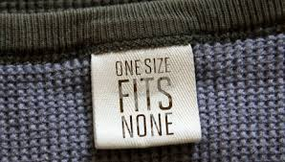
Depth of Demand
More systems + more devices
Average person brings 1½ IT devices on campus
Keep the response time fast
One size fits none.
Notes:
Greater penetration
Greater utilization
Volume drives cost

Slide 9
Demand for Quality
Seamlessly support exponential growth
Deliver high quality equivalent to Apple & Google & Microsoft
“I’m going to get a terrible student evaluation because wireless doesn’t support the size of my class.”
“Why isn’t Peoplesoft as easy to use as my iPad?”
Notes:
Class participation mark
Good question

Slide 10
Increasing Compliance Demands
Demand created by new legislation
Privacy
Copyright protection
Freedom of information
New layer of cost and complexity
Moral and ethical issues related to foreign clouds
Can’t implement a new system without a lawyer …
or a team of lawyers.
Notes:
Adding compliance effort = $
Adding lawyers = $$$

Slide 11
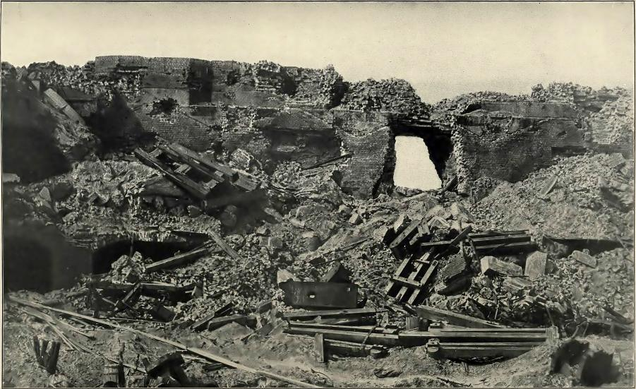
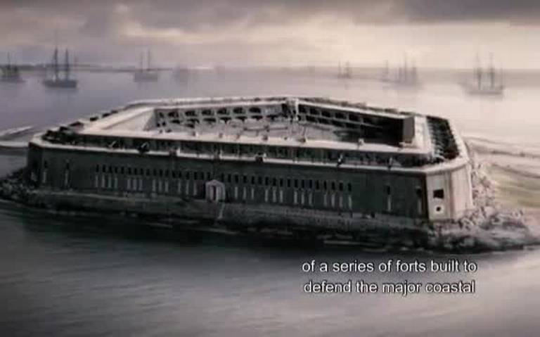
Increasing Security Demands
Hacking is a profitable business
Attacks come from inside & outside
IT is dangerous
Security is a fabric, not a wall
Quantum computing negates current encryption
History lesson: security built by people will be beat by people.
Notes:
US Eastern seaboard
1820-1860
Rifled cannon late 1850’s
Fort Sumter @ 8am Apr 13, 1861
Fort Sumter before lunch Apr 13, 1861
Security investment wiped out

Slide 12
Any Device
Access, not asset.
Baseline infrastructure budget designed for standard devices
Must design all services to serve any technology
IT used to set standards for devices
Now clients choose their devices
Notes:
Multiple technologies
From multiple years

Slide 13
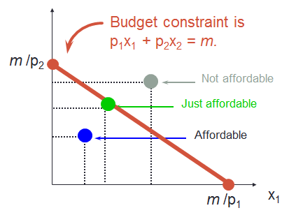
Any Time
IT department budgets established when systems were used during regular business hours
Today, systems are used 24 x 7
More availability requires
More investment in technology
Round-the-clock staff
Fail safe mechanisms
Note: not rocket science.

Slide 14
Any Place
Bring the campus
to the student
Distributed learning
Flipped classrooms
Distance education
Multiple campuses
Global access
IT departments established and funded for physical campus
Access to every system from any where is a brave new world of capital and operating costs
“Queen’s has instant brand recognition in Canada. In Bangalore it is meaningless.”
Notes:
Excellent IT needed for brand recognition

Slide 15
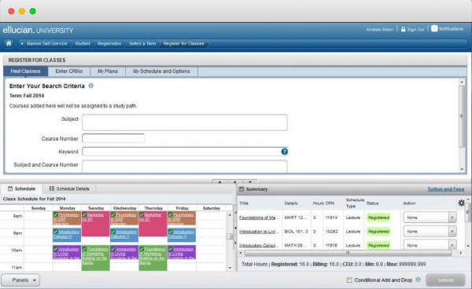
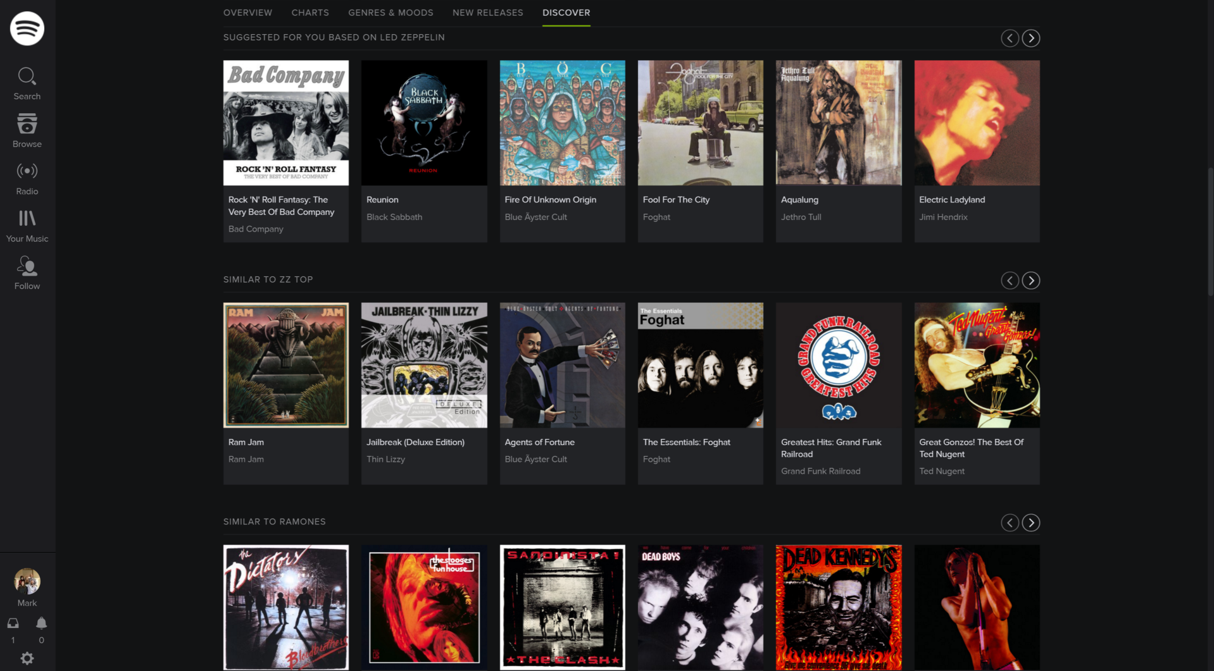
Quality of Software
Banner
Course
Search
Teaching experience as a CIO:
“Your systems suck.”
Compared to Facebook, LinkedIn, Twitter, Instagram, etc., Banner registration pales in comparison
Satisfying growing quality expectations is expensive
Spotify
Music
Search
Notes:
Banner/PS may be expensive
Spotify order of magnitude
More advanced
More expensive

Slide 16
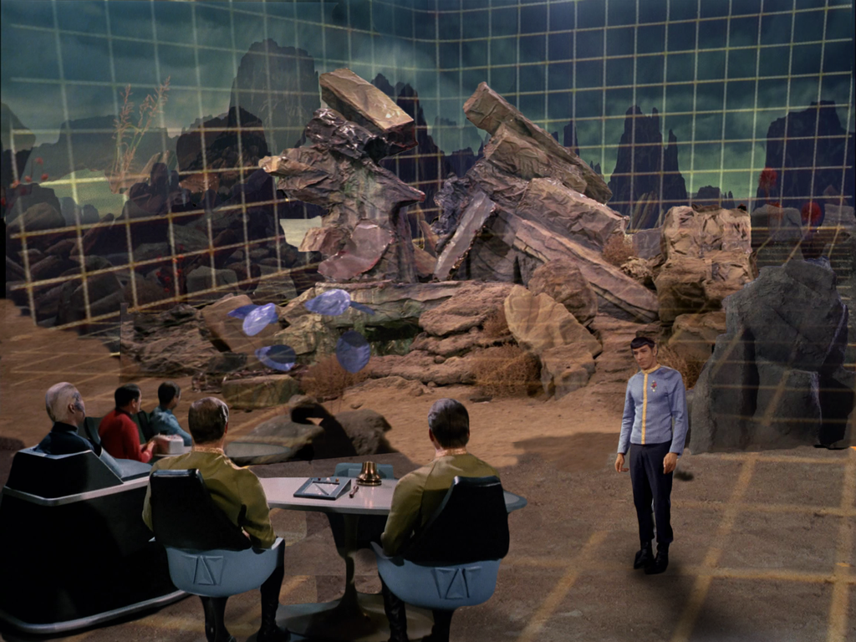
New Teaching & Learning Tech
New teaching methods
In-class student response systems
Students pay more
Works today
Changing demands
3D printers today
Massive video & image storage
Instantaneous wireless
They want more
Fails tomorrow (e.g. Second Life)
Classroom renos can’t keep up
Tomorrow …
Notes:
Latest tech in 100 rooms – too much
Pedagogical change = wipe out

Slide 17
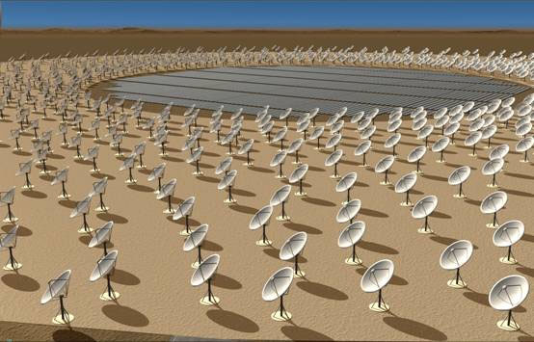
Exponential Research Data Growth
Exponential growth in data:
Sensor network
IoT (Internet of Things)
Dimensions of the problem:
Store it
Transmit it
Back it up
Growth in data demand is outpacing Moore’s Law
Square Kilometer Array research project will store 1,500 petabytes/year.
Notes:
1,500 refrigerators

Slide 18
Controllable Drivers of Cost Growth
Notes:
Things you can do something about

Slide 19
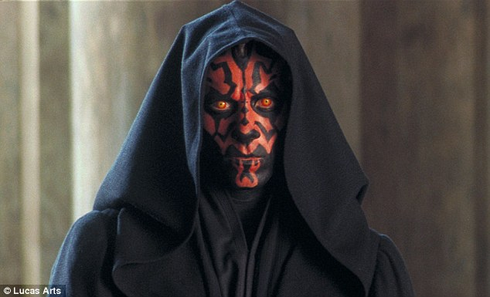
Background
Factors inside the university
Veiled and protected by:
Myths
Rumours
Assumptions
Culture
Notes:
Theory: controllable
Reality: hard to implement controls

Slide 20
Distributed IT
Independent, isolated, and silo IT groups create:
Expenditures for distributed IT are higher:
Duplication of efforts
Typical rigour and control of IT costs not applied
Ineffective standards
IT not managed by experienced IT leaders
Conflicting technologies
Costs not assessed in a portfolio
Highly risky security incidents
Costs not treated as investments
Notes:
Silo = high cost model
IRMACS example
Not professional IT mgmt
Can’t move assets
No TCO

Slide 21
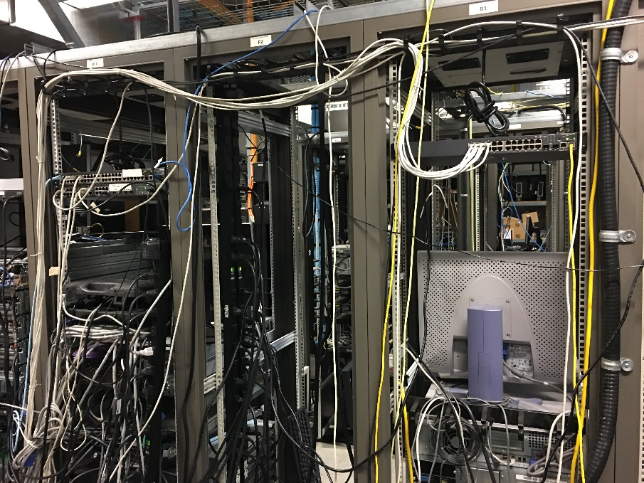
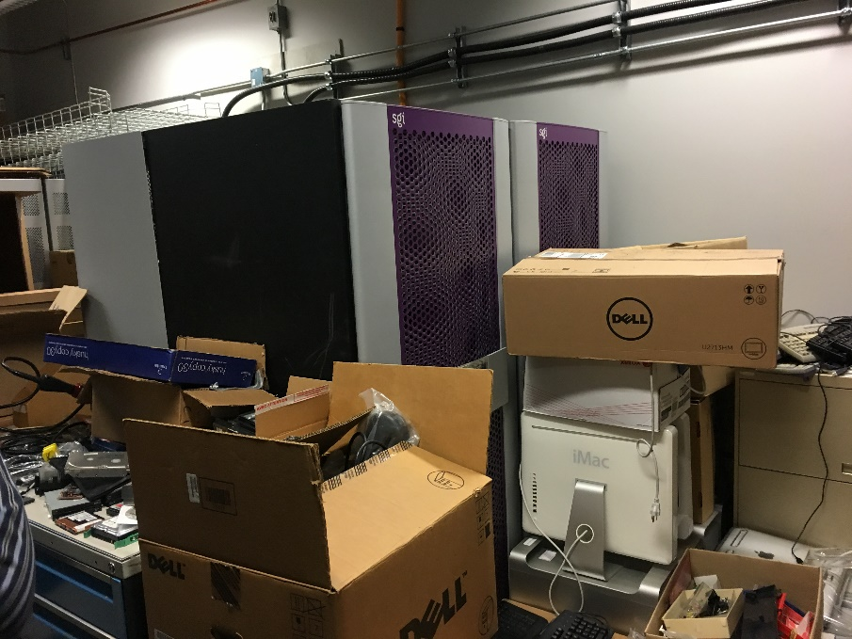
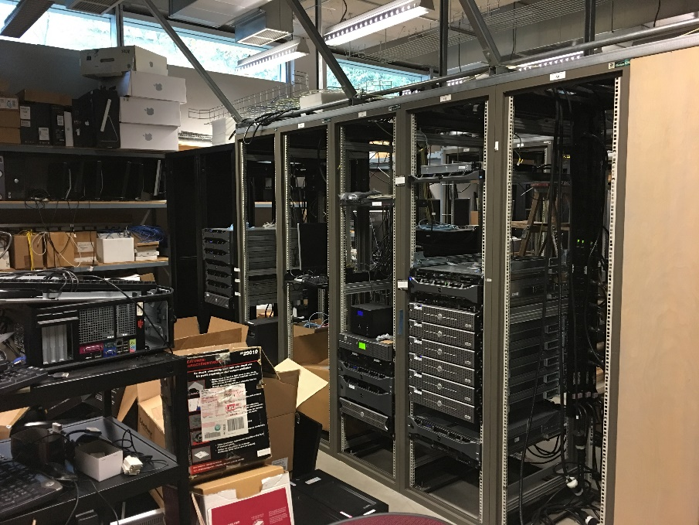
Unmanaged IT
Approximately 20% of data centre floor space on campus is managed by distributed IT
Up to 50% of IT staff are not part of central IT
Notes:
Don’t report to CIO
If problem, then CIO

Slide 22
Redundant Systems
Distributed IT spawns independent IT systems
No coordinated plan
Overlapping systems functionality
Disproportionate cost to fund inefficiencies
One of each.
Notes:
Robert May 1975 – Chaos theory
Appear orderly, but in fact chaotic
Although deterministic, not predictable
Redundancy drive chaos
Chaos = $$
No economy of scale

Slide 23
Data Integration
Distributed IT creates their own data
Multiple disparate systems data not integrated
Institution tries to report
Expensive data conflict resolution
Duplication
Redundancy
Inaccuracy
Inconsistency
“Your numbers don’t agree with my numbers. So your numbers are wrong.”
Notes:
Bad decisions more expensive than
Fixing data problems

Slide 24
What to Do About It
Notes:
Think differently about leading IT

Slide 25
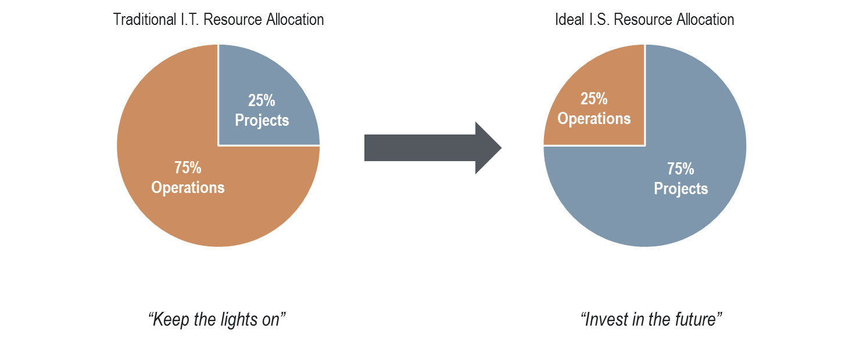
IT is an Investment
Notes:
Process vs. project
No change vs. change
Move to projects => Stop stuff

Slide 26
IT is an Investment
Think differently about IT
Revenue opportunities
Quality improvements
Capacity increases
Risk mitigations
Invest in the future
Investments are prioritized
Institution creates the prioritization model, not IT
Notes:
Not about cost
About value

Slide 27
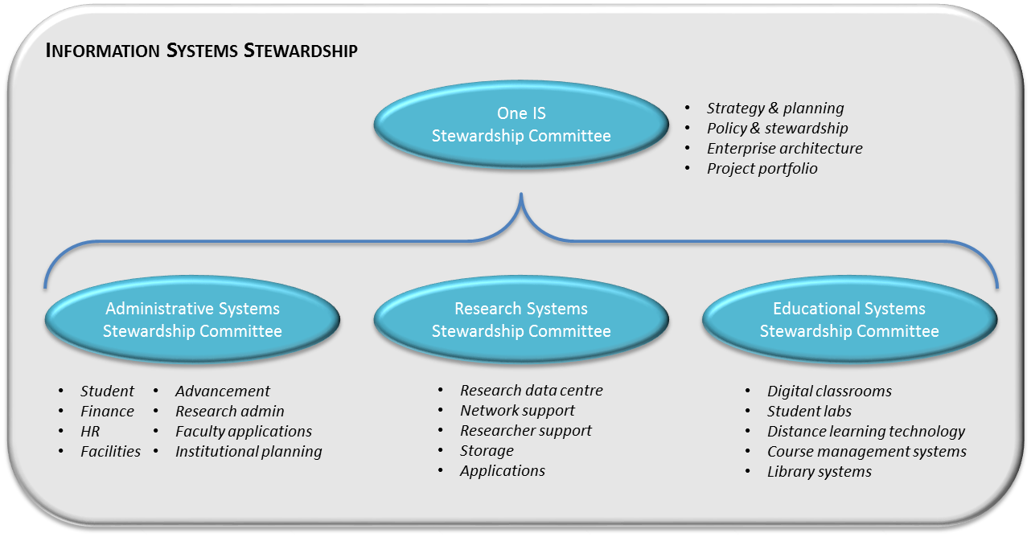
Shifting to Investments
Cultural shift: stewardship, not governance
Each project is an individual value proposition
Notes:
University makes decisions, not IT
IT facilitates
Switzerland

Slide 28
Shifting to Investments
IT initiatives are investments in the organization’s future
Manage IT initiatives as an investment portfolio
Stewardship committees define criteria for prioritization
Fit
Is the initiative aligned with the institutional strategy?
Utility
Quantitative & qualitative benefits outweigh costs & risks
Balance
Are investments made in a balanced manner across the organization?
Notes:
Principles focusing on value proposition
Not cost

Slide 29
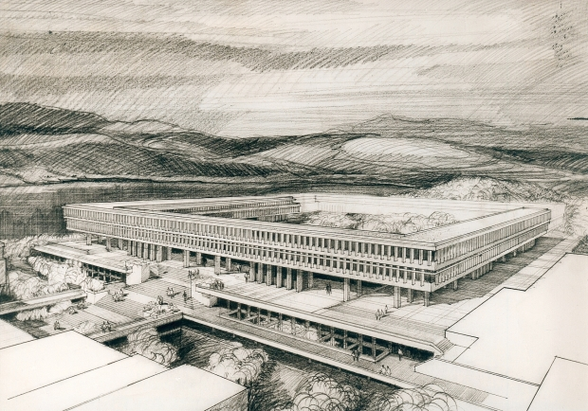
Leverage Shared Services
Treat enterprise IT as the on-campus shared service
Leverage and expand institutional collaborations
Create common processes to enable common infrastrucure
Notes:
Leverage institution, province, & national
AQ @ SFU
Shared physical space
Brings all together

Slide 30
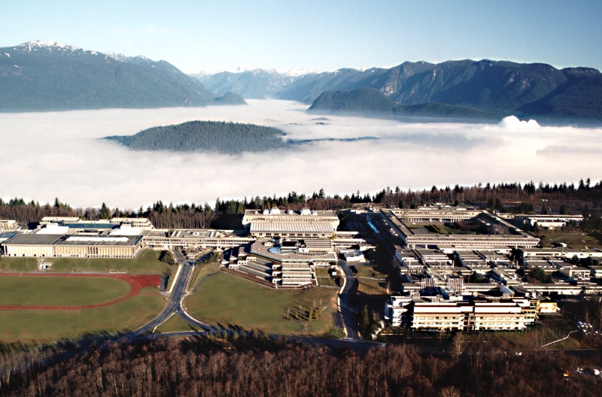
Cloud When Prudent
Cloud computing = outsourcing economic model
Requires a careful business case
Not “cloud first”
Notes:
Consumer & provider
SFU above the cloud

Slide 31
Conclusions

Slide 32
Why & What
Why does IT costs so much?
Outside world continues to create more demand for IT services from universities
Institutions are diplomatically delicate in their treatment of controllable IT costs
What we do?
Manage impact of demands created externally
Apply leadership, strategy, and discipline to information systems management within the institution
Create a vision that supports the world of ubiquitous IT

Slide 33
One I.S.
People, Process, Data, & Technology
Integrated
Administration
Processes
Leadership
People investment
Customer service
Stewardship
One I.S.
Project management
Planning
Unified
Research
Computing
Teaching &
Learning
Ecosystem
Process focus
Enterprise architecture
Culture and metrics
Notes:
Systems behave seamlessly
Staff behave seamlessly
Strat plan = left

