Slide 1
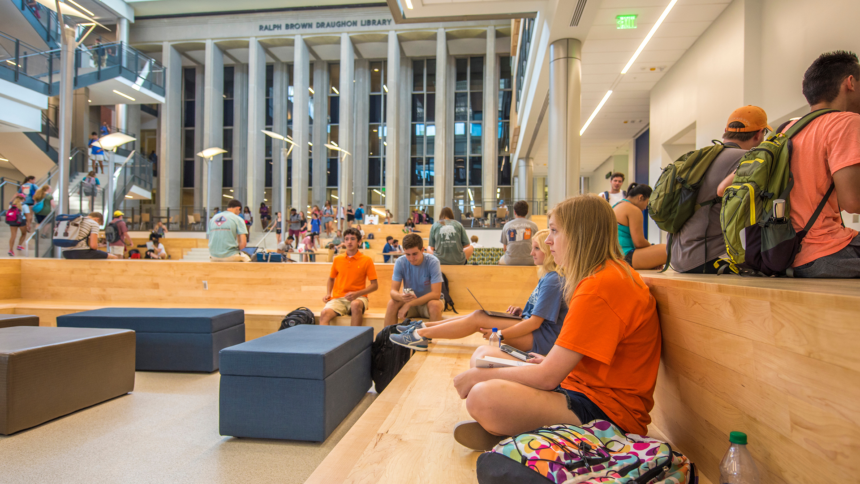
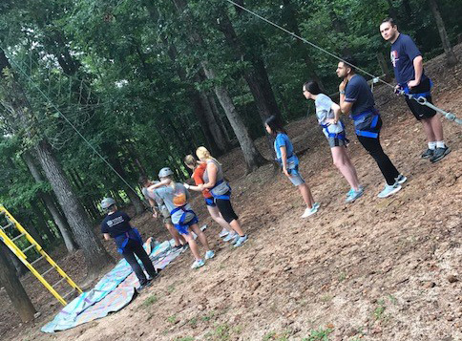
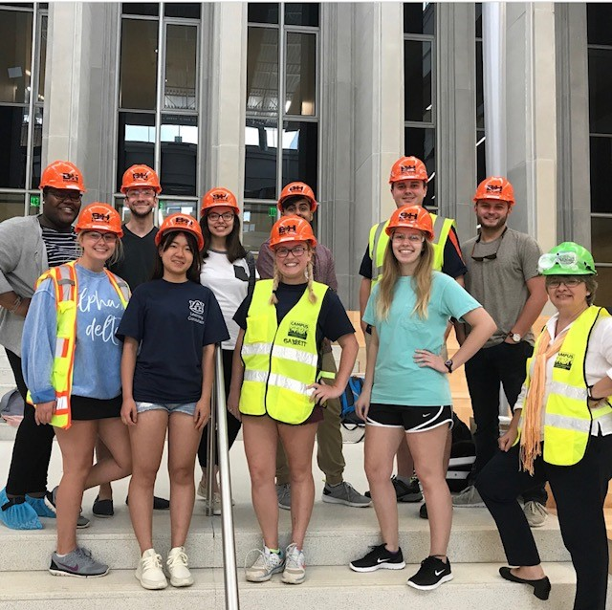
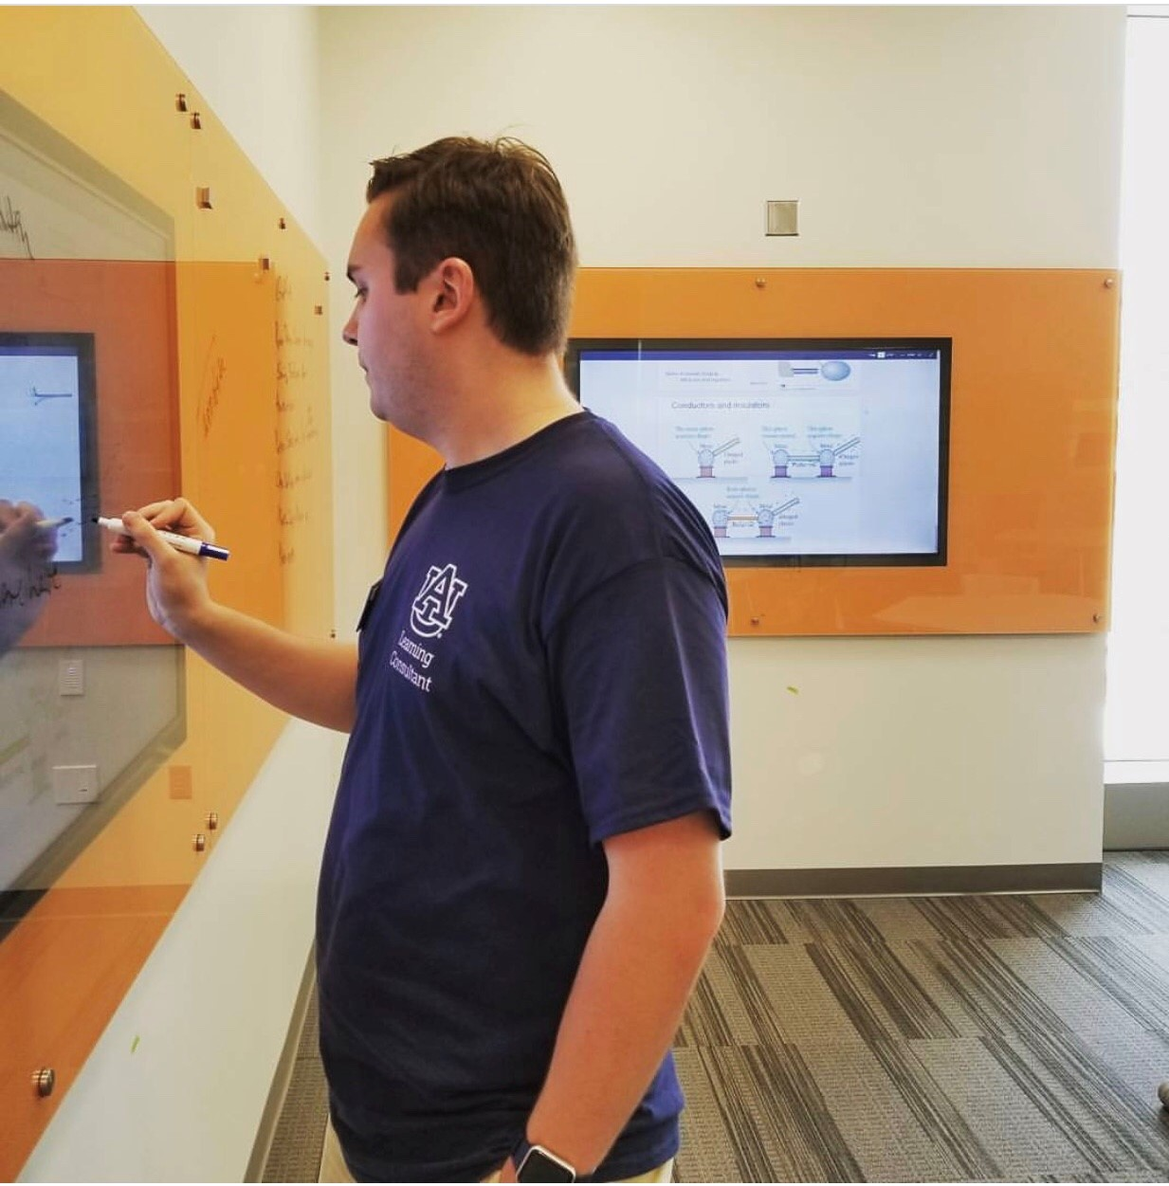
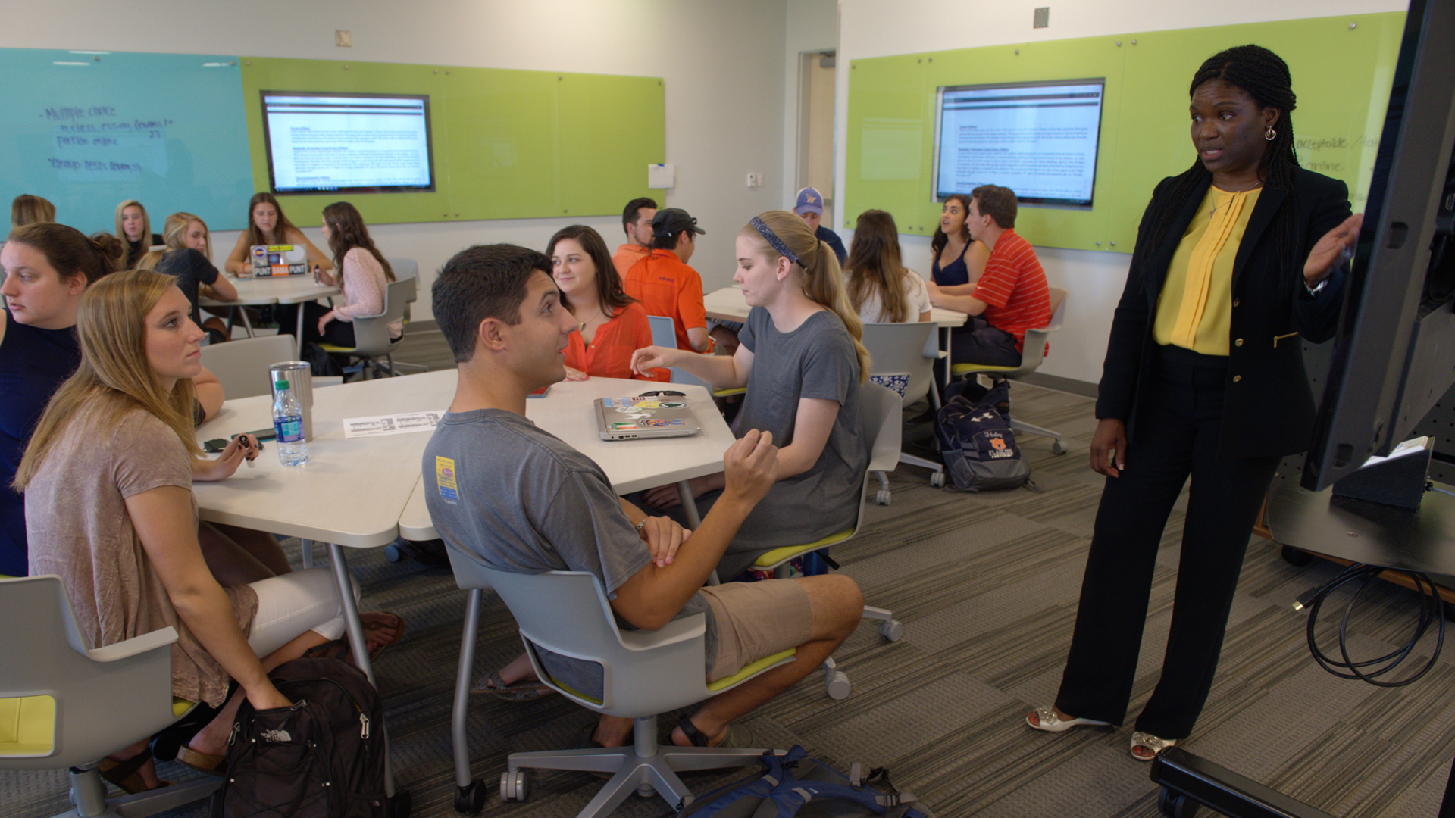
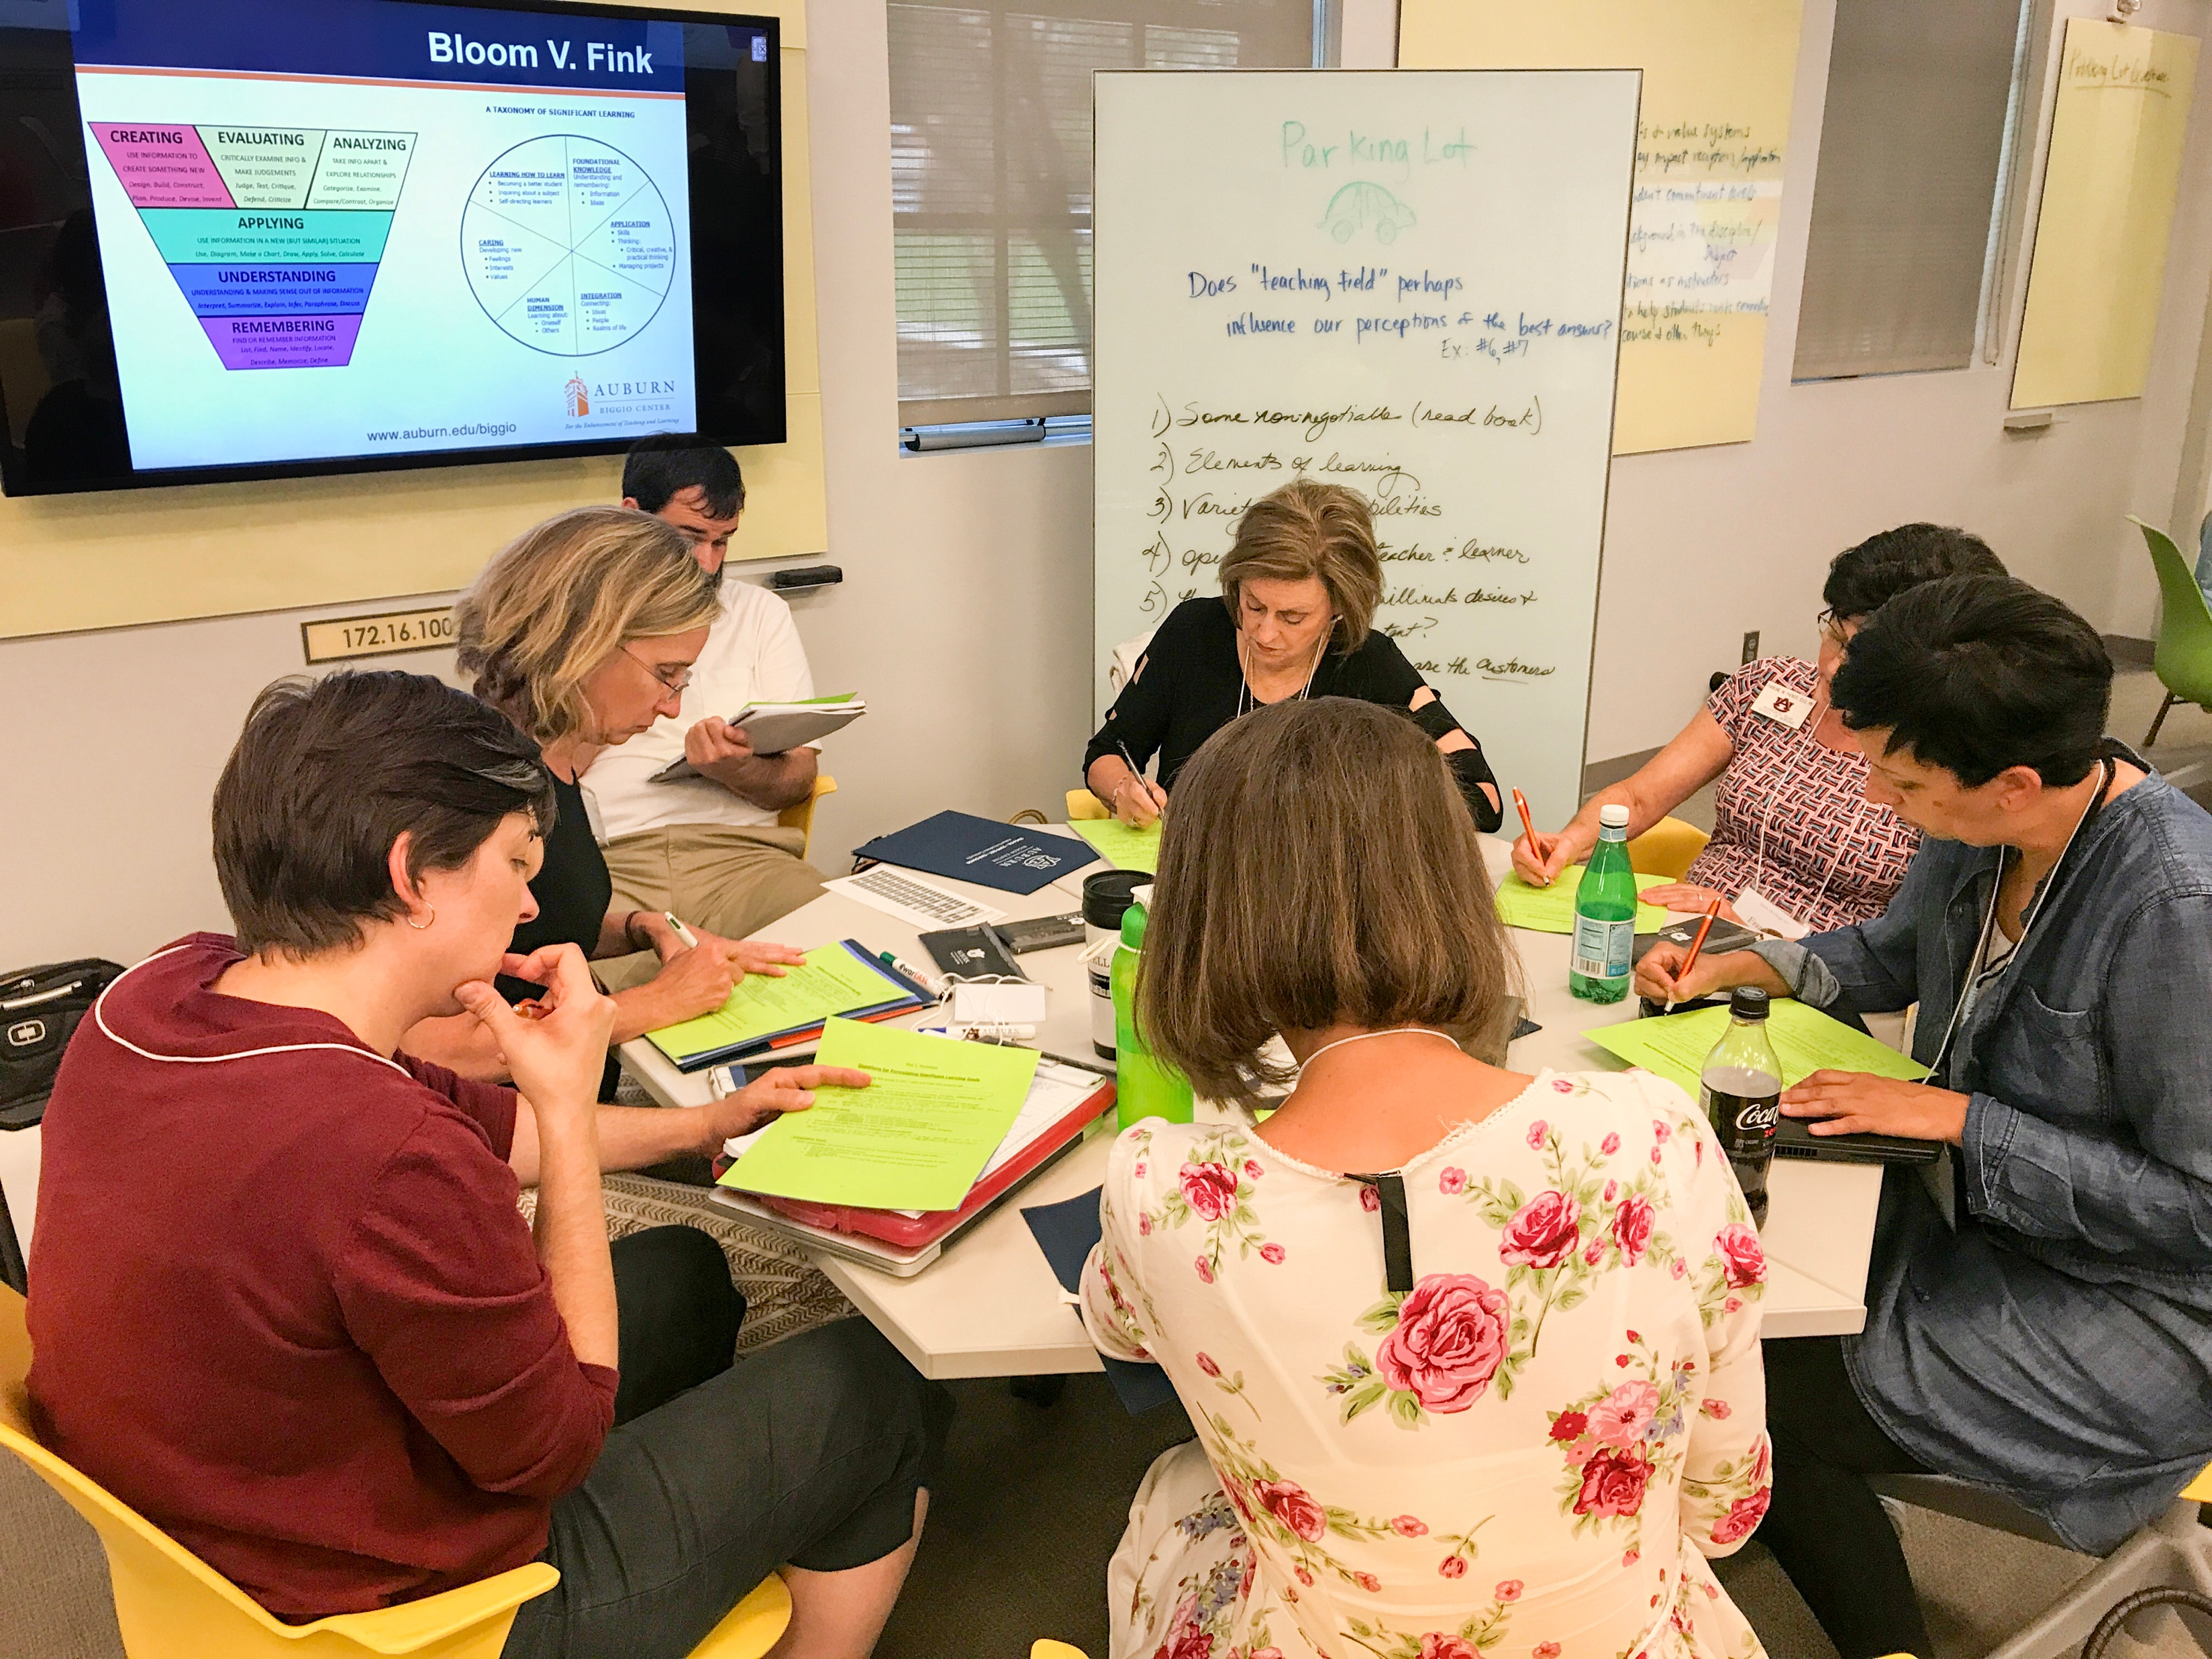
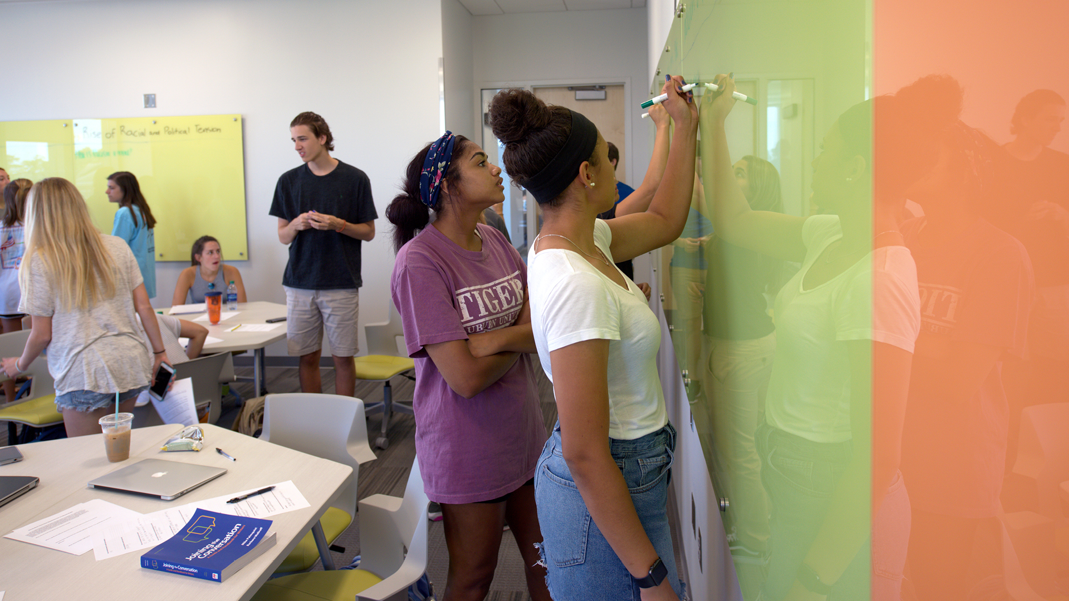
Preparing Students to Learn Differently: Workshops and Learning Consultants
Jerisha Farrer and Wiebke Kuhn
Biggio Center for the Enhancement of Teaching and Learning Auburn University
Outcomes: Learning Consultants
A Learning Consultant is an undergraduate student who helps faculty and peers using the spaces and the technology in the Mell Classroom Building @ RBD Library. Learning consultants
support from 7am-7pm and on request for designated university activities,
can be contacted through live chat using Bomgar as the platform for immediate tech support (Fall 2017 70 support sessions),
Are available for faculty and student training sessions through online requests (Fall 2017 16 sessions),
help demonstrate ways to use EASL Spaces through tours (faculty, donors and alumni, faculty candidates),
promote the Mell Classroom Building via multiple social media platforms,
observe classes as requested by faculty, using COPUS and ALCOT observation protocols,
plan, design, and produce short instructional and testimonial videos about Mell featuring faculty and students and other documentation and instructions,
troubleshoot basic technology issues and communicate more complex issues to OIT Classroom Support,
Background at Auburn University
Auburn University, Alabama, is a comprehensive land-, sea- and space-grant institution, with 28,000+ undergraduate, graduate and professional students. Beginning in 2010, the university started planning a central classroom facility to replace aging spaces for learning in the 21st century, in line with the university’s strategic plan. In 2013, our first EASL classroom opened, and its immediate success led to more renovations of existing spaces into EASL spaces and the design of an entire building that opened its doors for the Fall 2017 term.
Each new EASL space was accompanied with carefully planned workshops for faculty to re-envision their courses.
Auburn University now has over 300 faculty, ca. 20%, who have participated in EASL training.
Outcomes: LearnTalks
Fall 2017, over 7,000 students received invitation to participate in LearnTalks (delayed opening did not allow for all planned sessions).
120 students participated in the LearnTalks, indicating which class they were in. These classes received an invitation to participate in an anonymous pre- and post- survey where students self-reported if they had participated in LearnTalks and/or interacted with a Learning Consultant, specific class of enrollment, day and time of class, and room of class. We used the Motivated Strategies for Learning Questionnaire (MSLQ). The MSLQ specifically asks students to reflect on their motivational beliefs and study behavior by responding to a series of statements from “not at all true for me” to “very true for me” (seven-point Likert-type questionnaire). The survey consists of five scales and 44 questions in total (self-efficacy, intrinsic value, test anxiety, cognitive strategy use, self regulation).
162 students completed the pre-survey; 96 students completed the post-survey; however, only 23 students, identified through self-created anonymous identifiers, completed both surveys.
Findings:
Students were confused by cognitive-strategy and self-regulation questions but confident interpreting motivational scales questions.
Intrinsic value is significantly lower in post-test for students who came to LearnTalks – the only value showing significant change.
Interpretation:
Students who came to LearnTalks can be considered overachievers who think they know how to learn but may be at a higher stress level at the post-survey time right before final exams.
Overachievers may believe that they are learning less in the unfamiliar EASL spaces because they have to relearn what it means to be successful in a college classroom.
Next Steps:
Faculty development may benefit from renewed emphasis on continual use of language and activities that reminds students why EASL is important for them – essentially leading to culture change
Addendum to IRB protocol to include focus groups of students who participated in Fall 2017 surveys to gain deeper understanding of their motivational beliefs and study behavior.
Thanks to:
Katie Boyd, Auburn University Office of Academic Assessment for help with data analysis.
Why Focus on Students?
Auburn University’s new Mell Classroom Building @ Ralph Brown Draughon Library features 28 active learning spaces, including 2 166-seat lecture halls built with student interaction in mind and 26 Engaged and Active Student Learning (EASL) Spaces, featuring collaborative flexible furniture, glass boards on multiple walls and sharing technology for mobile devices. In addition, the building also contains a multitude of informal learning spaces and 40 study spaces that can be reserved online.
Faculty development has been at the heart of implementing the EASL spaces at Auburn University.
Student development and support becomes important when such a large number of rooms come online all at once. While over 80% of faculty who teach in these new spaces have participated in workshops focusing on EASL, not all will take the time to rethink their courses completely. Smith (2013) discusses preparing students in class with transparent discussions about the need for core skills such as leadership, communication, and collaboration, demanded by future employers. Providing students with resources, tips and tricks for active learning is important to ensure they have some level of preparation when heading into an EASL space.
Auburn University is providing student support in the following venues:
Incoming first-year students and their parents receive information about EASL at orientation, Camp War Eagle (3500-4000 students).
Fall 2017, we led a number of 30-minute workshops for students before classes started to provide students with opportunities to learn about active learning ahead of their courses. Based on assessment, we shifted away from workshops to a short youtube video for students for an even faster orientation: https://www.youtube.com/watch?v=hdKWOYBCG3I (over 200 views so far).
Learning Consultants, a group of undergraduate students, are supporting the spaces 7am-7pm, through an online chat system and their visible presence in the building. Students interact with the learning consultants on a regular basis to learn about features of the spaces.
First Year Experience, Tutoring Services, Supplemental Instruction and Auburn Global staff have gone through EASL training to provide a coherent message about EASL to all students using these services.
References
​Adedokun, O. A., Carleton Parker, L., Henke, J. N., & Burgess, W. D. (2017). Student Perceptions of a 21st Century Learning Space. Journal of Learning Spaces, 6(1). Retrieved December 12, 2017.​
Braxton, J.M., Milem, J.F., & Sullivan, A.S. (2000). The Influence of Active Learning on the College Student Departure Process. The Journal of Higher Education, 71:5, 569-590, DOI: 10.1080/00221546.2000.11778853​
Coates, H. (2006). Student engagement measuring and enhancing engagement with learning.​Proceedings of a Symposium, New Zealand Universities Academic Audit Unit AAU Series on Quality, No. 10.​
Pintrich, R.R, & Degroot, E.V. (1990). Motivational and self-regulated learning components of classroom academic performance, Journal of Educational Psychology, 82, 33-40.
Rands, M. L., & Gansemer-Topf, A. M. (2017). The Room Itself Is Active: How Classroom Design Impacts Student Engagement. Journal of Learning Spaces, 6(1). Retrieved December 12, 2017.
Smith, G.A. (2013). Helping Faculty Overcome Student Resistance to Team Work: Focus on Investment Rather than Buy ln. National Forum on Active Learning Classrooms University of Minnesota.
For more information on Auburn University’s EASL spaces, go to auburn.edu/mell.
This presentation leaves copyright of the content to the presenter. Unless otherwise noted in the materials, uploaded content carries the Creative Commons Attribution-NonCommercial-ShareAlike license, which grants usage to the general public with the stipulated criteria.

