Slide 1
WGU: 20 Years of Experience Bringing Competency-Based Education to Scale
Sarah Demark Vice President, Academic Programs Fred Hurst Vice President, Academic Advancement
AUTHOR’S NAME HERE

Slide 2
Universitas magistrorum et scholarium

Slide 3
Outline
The Case for Innovation
CBE at Scale
Utilizing Data to Advance Student Outcomes
What We’ve Learned

Slide 4
The Case for Innovation in Higher Ed
2 / 3
of jobs require post-secondary degree¹
15% 62.5%
Some Bachelor’s
Earnings premium vs. H.S. Diploma⁵
6%
of Bachelor’s graduates believe College prepared them for success⁴
61%
believe post-secondary is available (down from 67% in 2013)
33%
of adults in U.S. attain Bachelor’s degree²
$77,832
average cost of 4-year degree at in-state, public university⁵
1.9x
rate of increase in cost of 4-year degree vs. inflation⁷
5,000,000+
gap between jobs requiring degree and degree holders³
-38ppts
difference in employers’ vs. students’ perception of how college prepared graduates in key learning outcomes⁶
$37,146
average student loan debt per undergraduate in 2016
21%
believe post-secondary is affordable
36,000,000
adults in U.S. have some college, no degree³
¹Georgetown CED; Lumina Foundation
²U.S. Census
³Lumina Foundation
⁴Gallup / Lumina 2014 Survey
⁵Pew Research Center; Federal Reserve Board of S.F.
⁶Association of American Colleges and Universities, 2015 Survey
⁷College Board

Slide 5
Consumption vs. Mastery
“Institutions must move from a model of “time served” to a model of “stuff learned.” Because increasingly the world does not care what you know. Everything is on Google. The world only cares, and will only pay for, what you can do with what you know. . . . We’re moving to a more competency-based world where there will be less interest in how you acquired the competency — in an online course, at a four-year-college or in a company-administered class — and more demand to prove that you mastered the competency. We have to get beyond the current system of information and delivery . . .
--Thomas Friedman, The New York Times, March 5, 2013

Slide 6
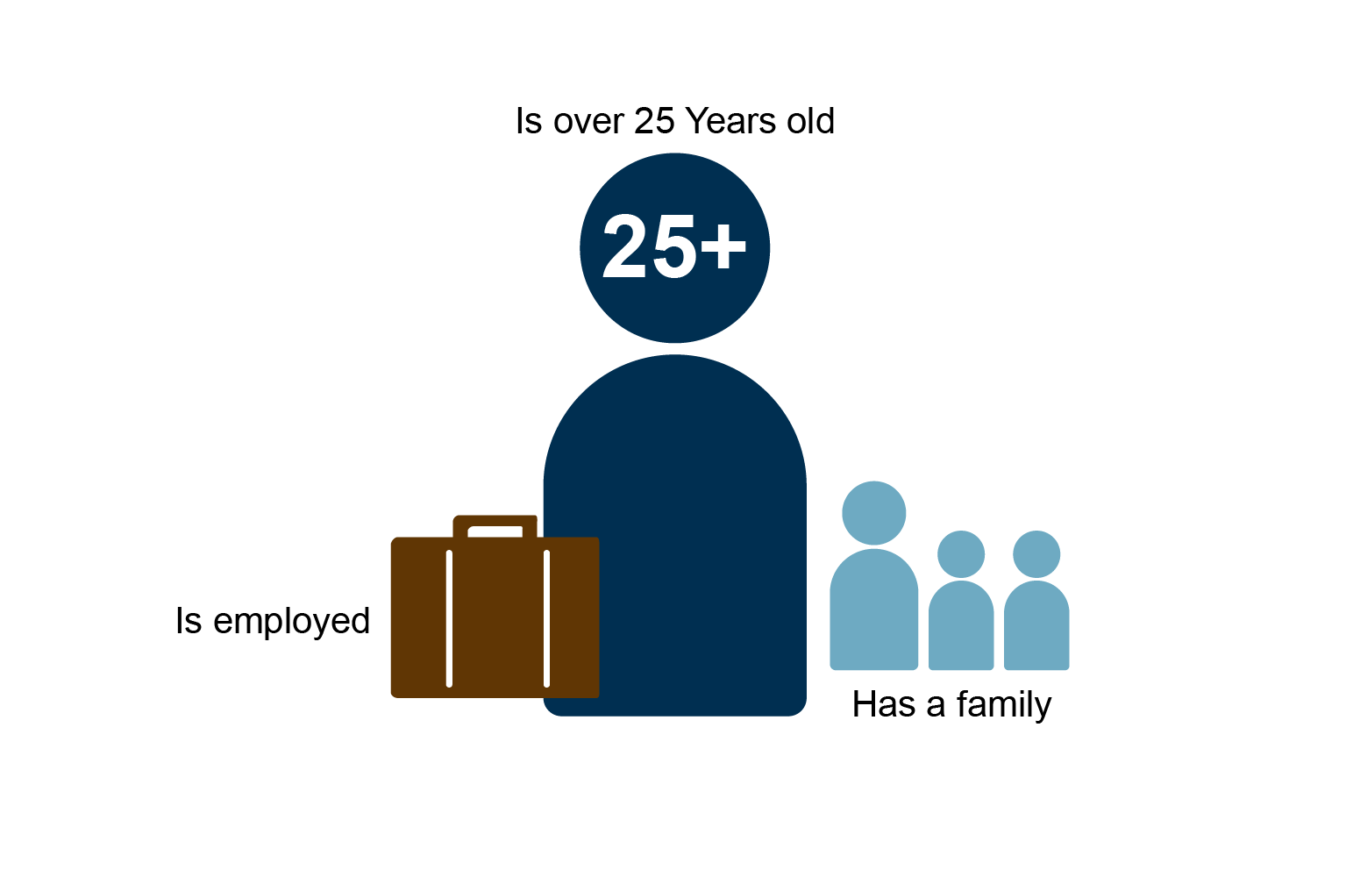
Non-traditional Students are the Majority
…and they have different needs
Flexibility
Access
Affordability
Ability to leverage knowledge and skills already acquired
Opportunity to advance career, not just begin or change
Notes:
While these needs are often important for traditional students as well, they are absolute requirements for nontraditional students. The absence of any one of these requirements can be a complete barrier to going back to college.
There’s a gap in U.S. higher ed opportunities, and these students are often unable to find a means to complete their degrees.

Slide 7
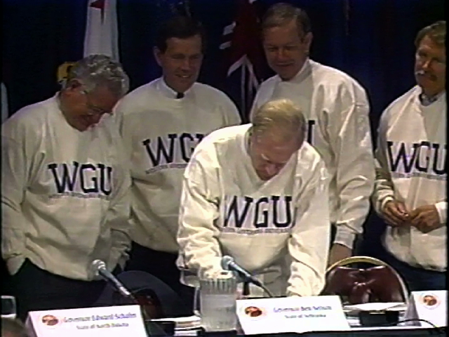
WGU
Nonprofit, founded in 1997 by 19 governors
84,000+ students and 92,000 graduates in all 50 states
60+ degrees in 4 Colleges for high-demand fields:
Business
K-12 teacher education
IT
Health professions
Competency-based, all online
$6,000 per year, “all you can learn”
Created to increase access and improve quality of higher education opportunities for busy adults

Slide 8
Outline
The Case for Innovation
CBE at Scale
Utilizing Data to Advance Student Outcomes
What We’ve Learned

Slide 9
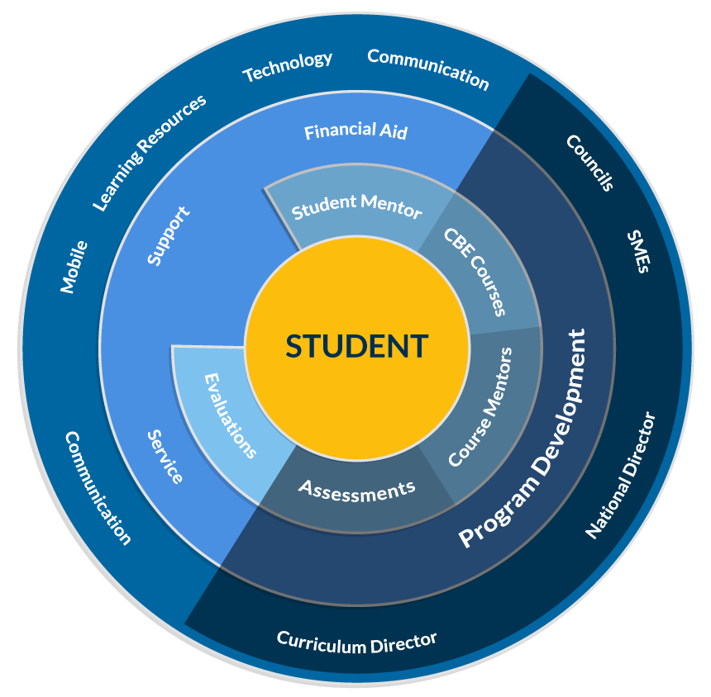
WGU and the Student-Centric Model Reinventing Higher Ed from Ground Up
Programs; not individual courses
Aligned with workforce needs
Fundamentally a teaching institution
Best content from third-parties; measure outcomes
Technology-enabled, 100% online
Specialized faculty roles
Data-driven, adapted to individual student needs
Notes:
Unlike more traditional models, WGU’s model is student centered. No research, facilities, sports, etc.

Slide 10
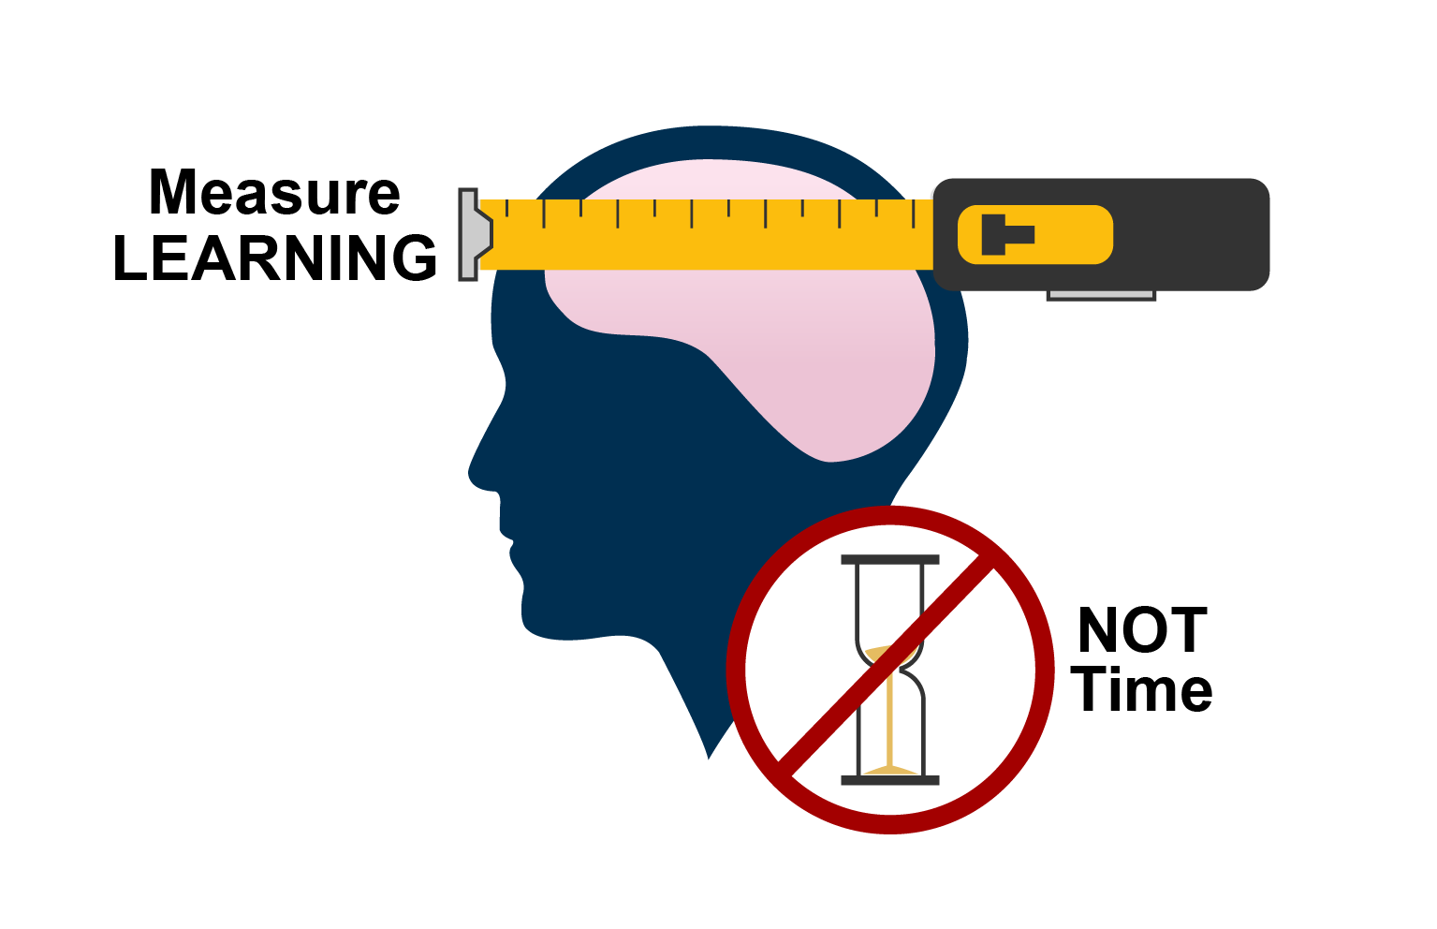
Competency-based Education
Recognizes adults have different levels of knowledge and learn at different rates.
Hold learning constant, let time vary
Advance when mastery demonstrated
Personalize and adapt learning path
Regular, substantive progress
ONLINE ≠ CBE

Slide 11
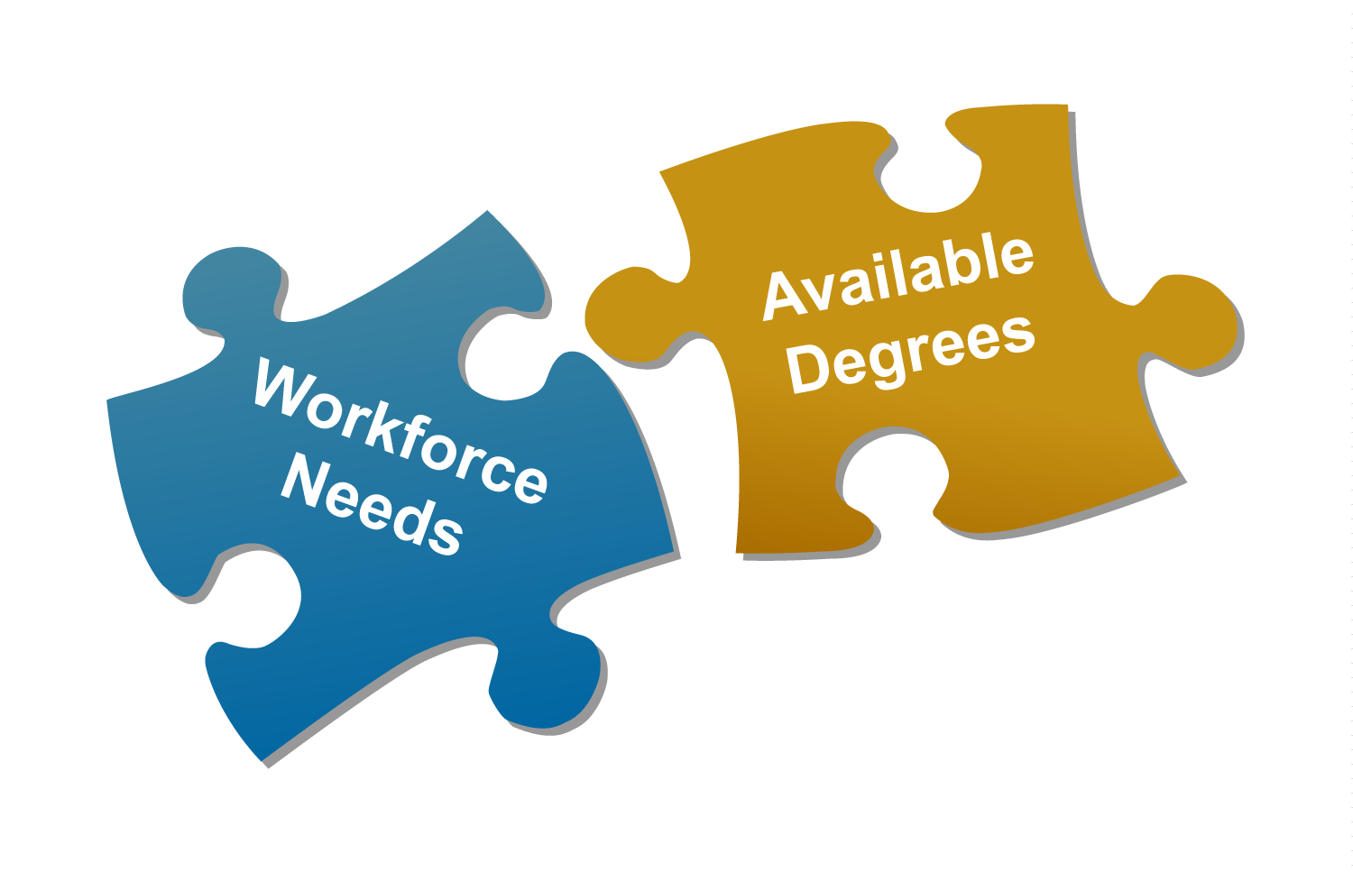
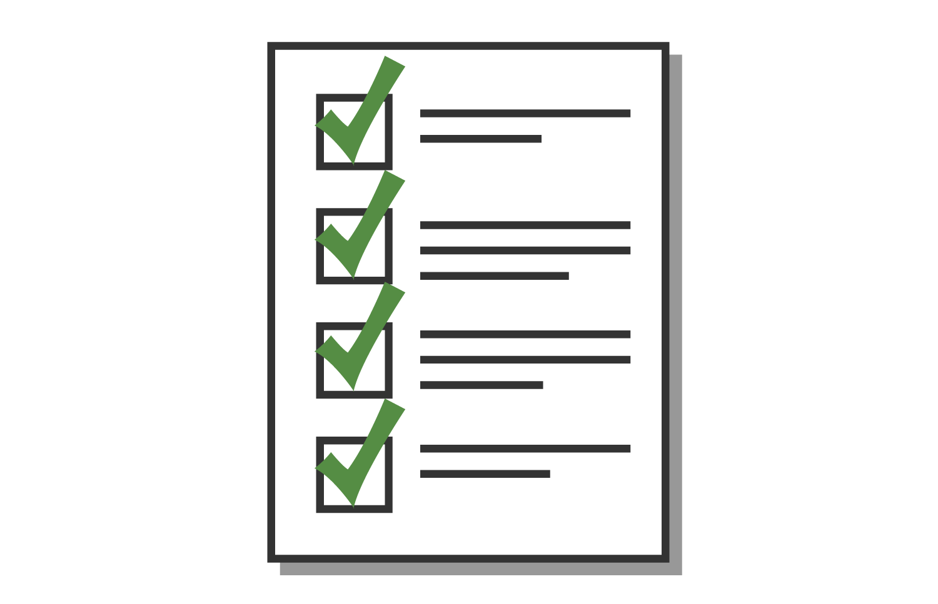
WGU: CBE at Scale
+
+
+
Quality
Relevancy
Assessment
Faculty
Technology-enabled Student Learning & Experience
College & Program councils
Academic & industry advisors
Assessments designed into curriculum
Data-driven
Aligned with workforce needs
Regular review by employers
Graduate surveys
Knowledge & Application
Expert, independent evaluators
Secure, online proctoring
Integrated field / clinical experiences
Specialized roles
One-to-one, personalized support
Guided by real-time data
100% student focused

Slide 12
Program & Course Design
Required competencies defined and updated in collaboration with academic and industry experts
Leverage best third-party course materials, where available
6-month terms, beginning each month
Allows for shorter cycle advancements in programs/courses
Competency validated through expert assessments
Students move quickly through what they already know
Focus on what they need to master

Slide 13
Faculty at WGU – Specialization
Student Mentors
Dedicated, regular one-to-one support for students
Course faculty
Provide individualized instruction
Lead group discussions
Support students engaged in specific courses
Evaluators
Experts grading / evaluating students performance
Curriculum and assessment faculty
Select and develop course materials and assessments

Slide 14
Outline
The Case for Innovation
CBE at Scale
Utilizing Data to Advance Student Outcomes
What We’ve Learned

Slide 15
Technology-enabled Student Experience
End-to-end Student Journey
Leading Web-Based Resources
1:1 Support
Discovery
Admissions &
Enrollment
+
+
Matriculation
Learning
Better Data = Better Outcomes, e.g.,
Ramp (credits earned ˂ 60 days)
On-time progress
Mastery rate
Term-to-term retention
Student delight / satisfaction
Field Experience
Alumni

Slide 16
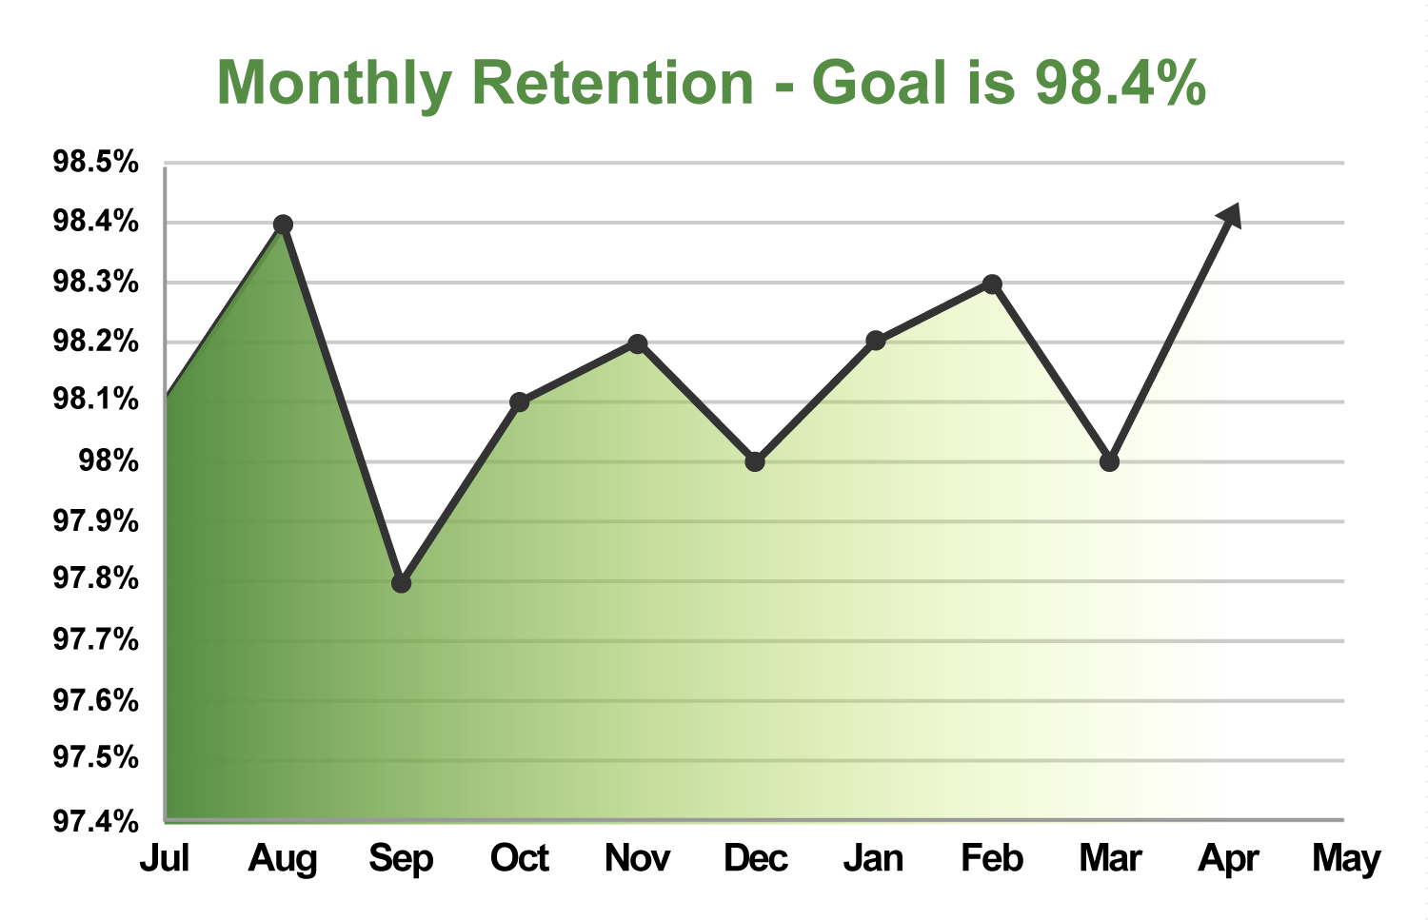
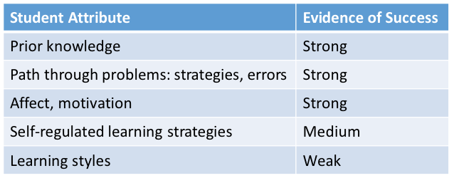
Adaptive, Individualized Learning
1
2
3
4
5
Everyone Can Learn
Map Student Persona
Personalize the Model
Observe & Adapt
Measure Outcomes
Start
Engagement
Mastery Rate
Progress
Pace
Retention
Delight
Graduate
Consistent Outcomes
Disparate Learners

Slide 17
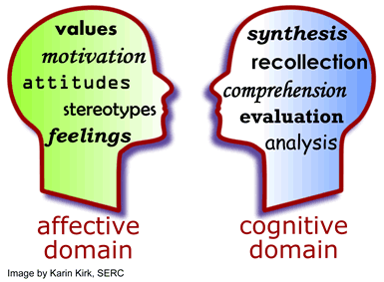
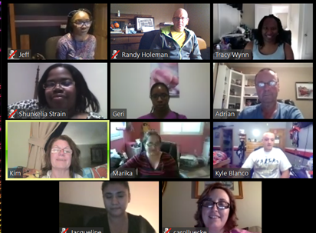
Affective Domain Impact on Outcomes Data-driven Innovation Example
Graduation outcomes = f(psycho-social factors) > f(cognition)
Hypothesis:
1
2
3
4
Proposed Solution:
Curriculum:
Test & Iterate:
Results:
Self-discovery / mindfulness
Working styles to leadership
Communication styles
Support network
Aug 2013 “offline” pilot
Adapted for online
Summer 2014 “Online” pilot
Sept. 2015 – scaled 500+ students
Training faculty
OTP +9 ppts
Term1 Retention: +2 ppts
Increased student confidence
Change student psycho-social framework through education in Affective Domain
Notes:
Addressing student and faculty psychology will increase retention and On-Time Progress rates by:
Increasing student resilience
Increasing the perceived value of a WGU degree
Increasing student self-efficacy
Helping students develop a supportive network of peers
Improving communication skills so students can interact with their environments in more meaningful and productive ways.
These skills also translate to leadership and teamwork which are highly sought after by employers in all fields.

Slide 18
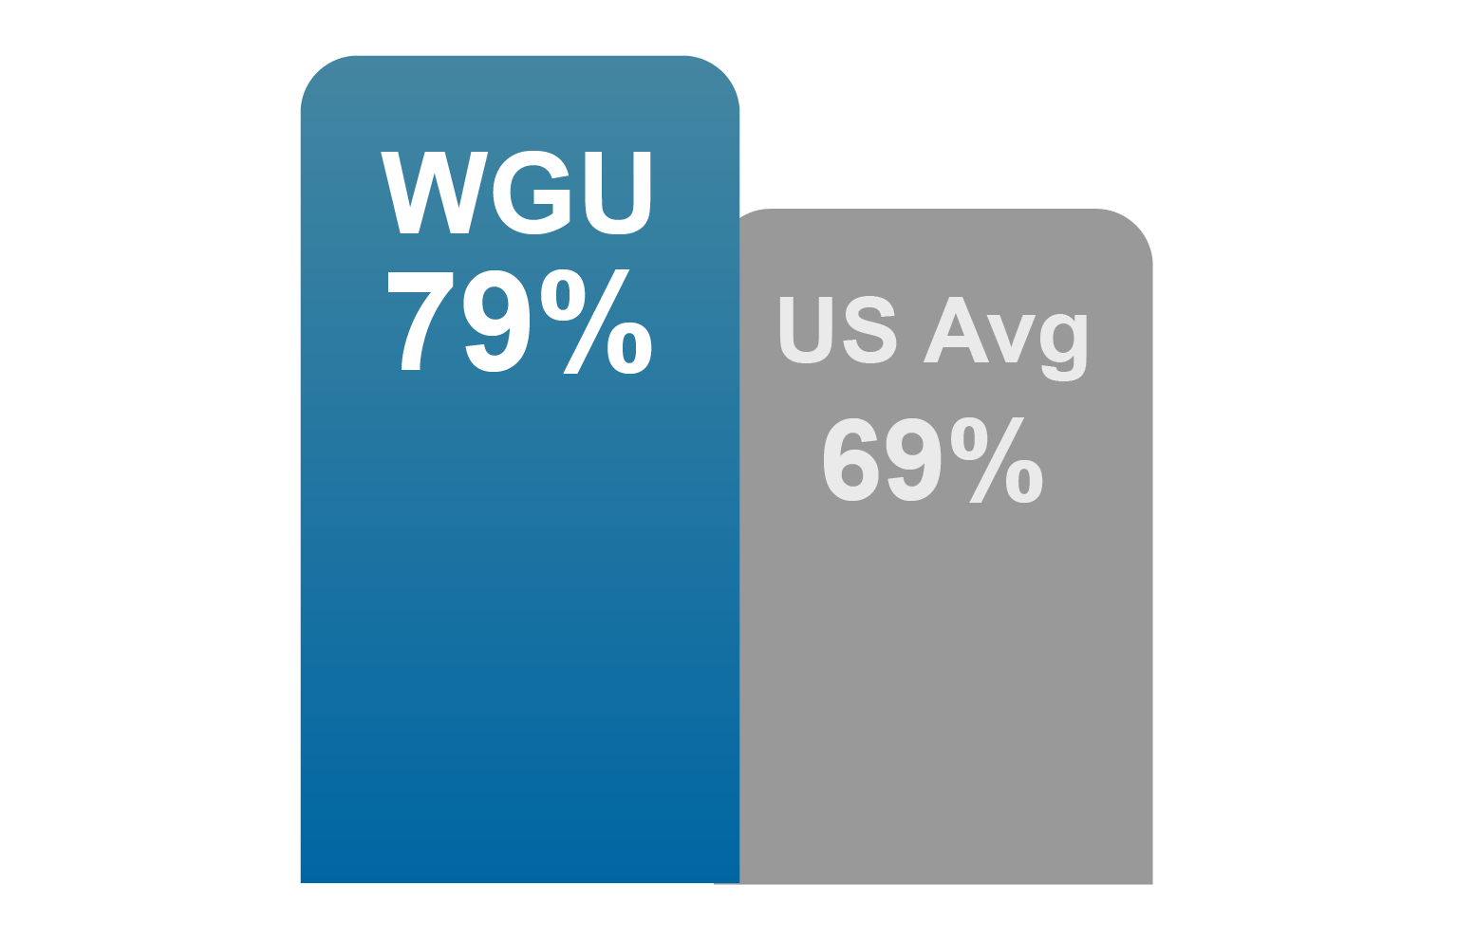
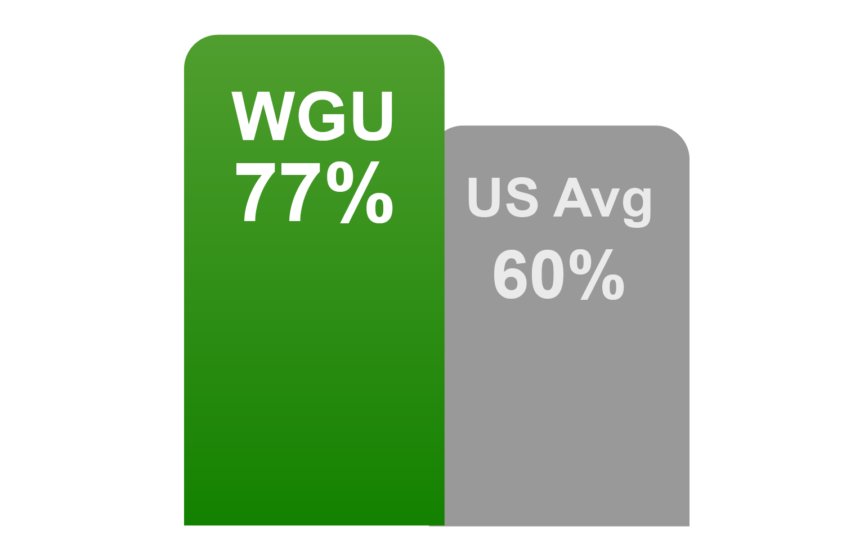
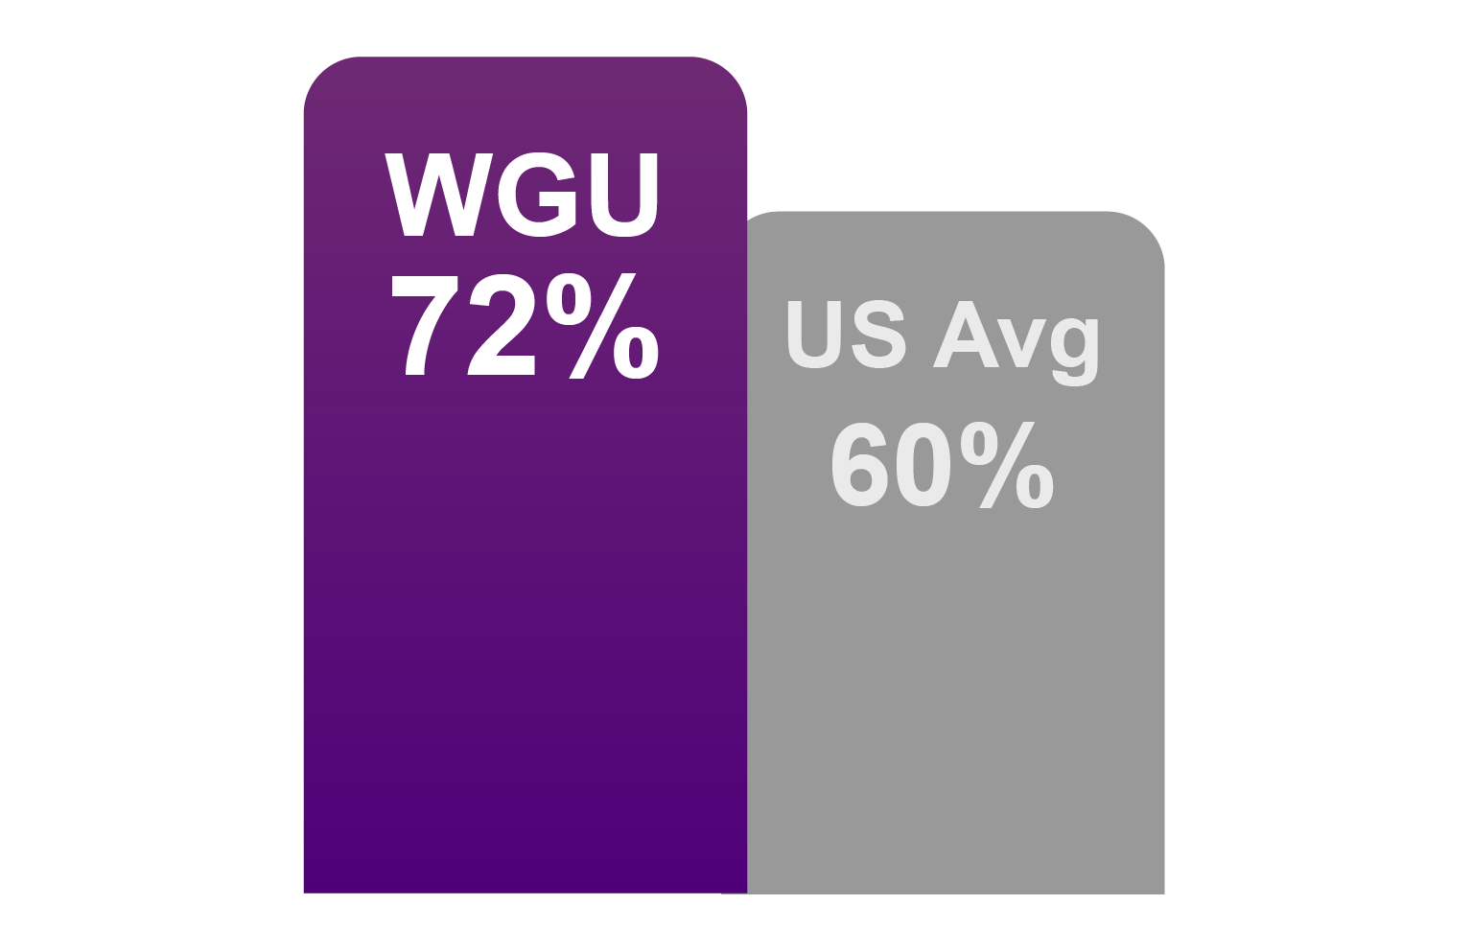
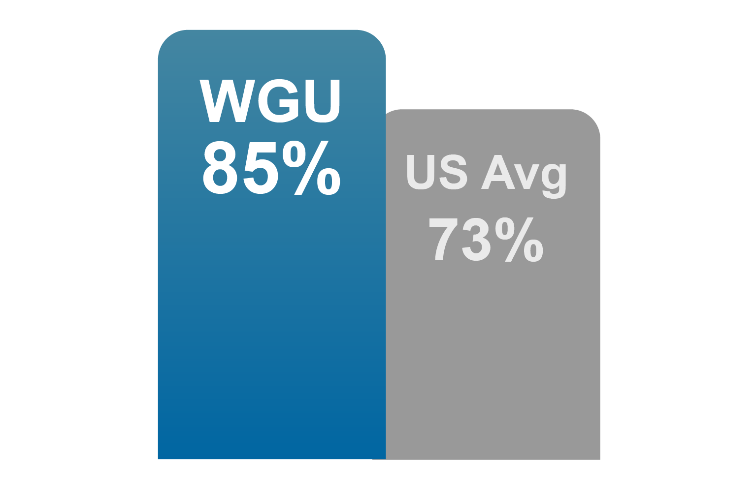
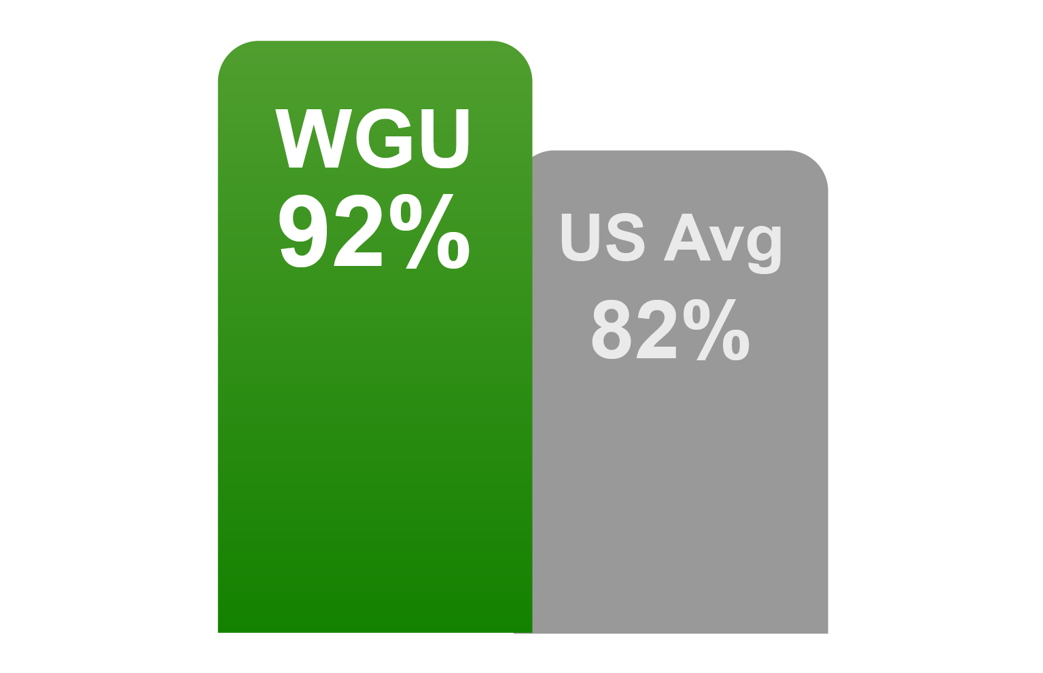
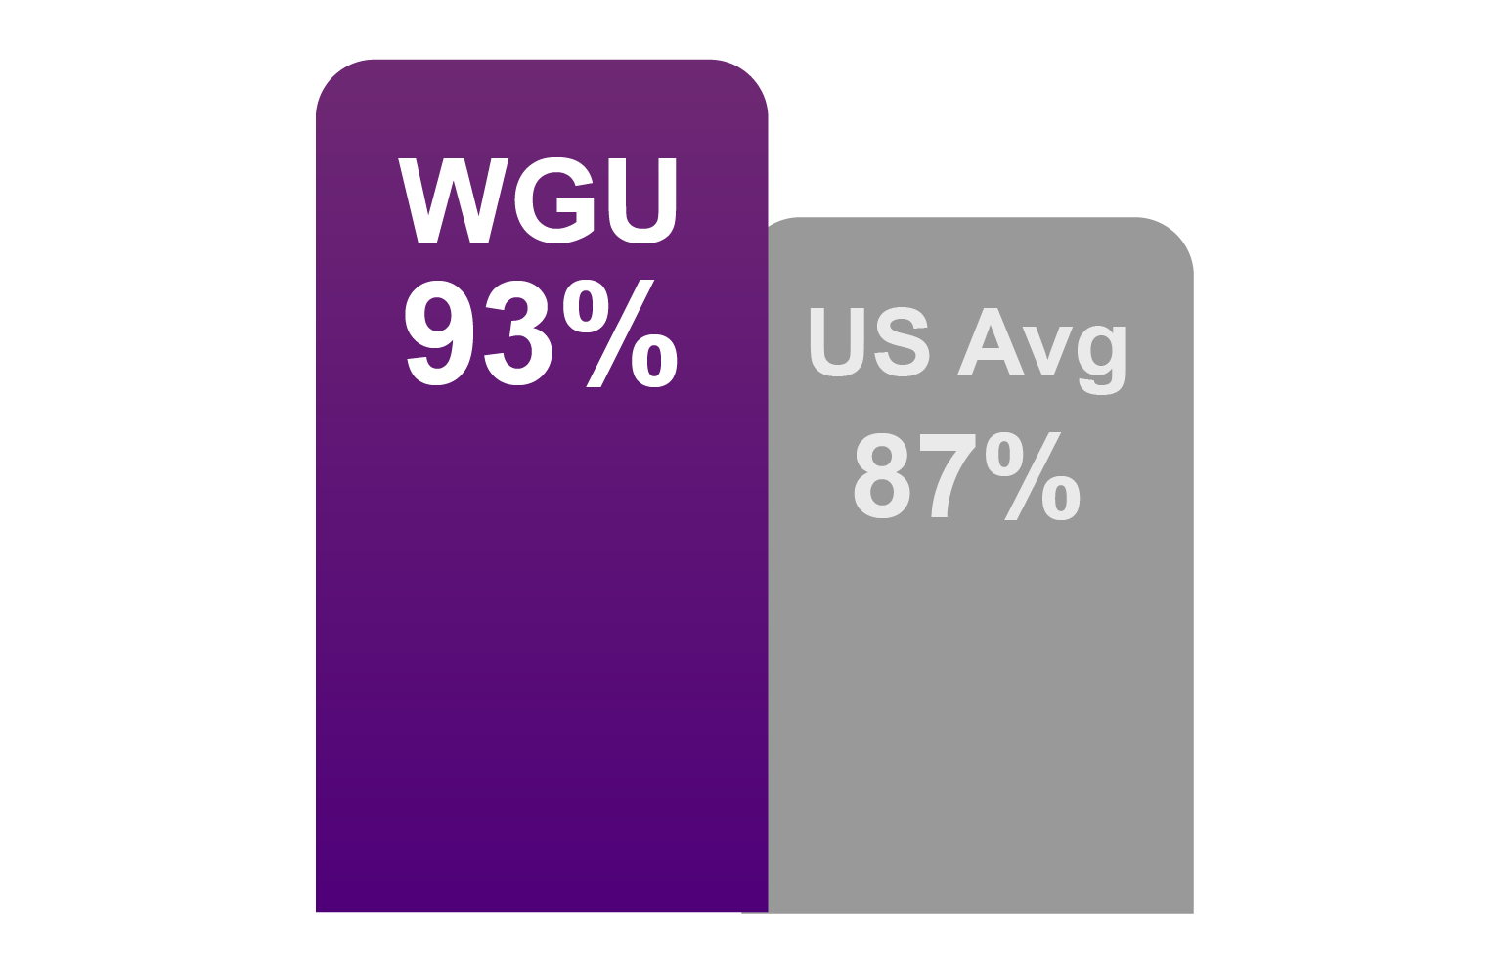
Delivering a Better Student Experience
Job-Related Knowledge
Challenging Work
Quality of Faculty Interactions
Quality of Academic Support
Would Attend Again
Rating of Entire Experience
Source: National Survey on Student Engagement
Notes:
94% of WGU students are in satisfactory academic standing (Federal financial aid designation to maintain eligibility)
WGU’s one-year retention rate of 79% is higher than the average for U.S. four-year public universities/colleges (theirs is 74%).
4-year graduation rate will be >50% by 2019

Slide 19
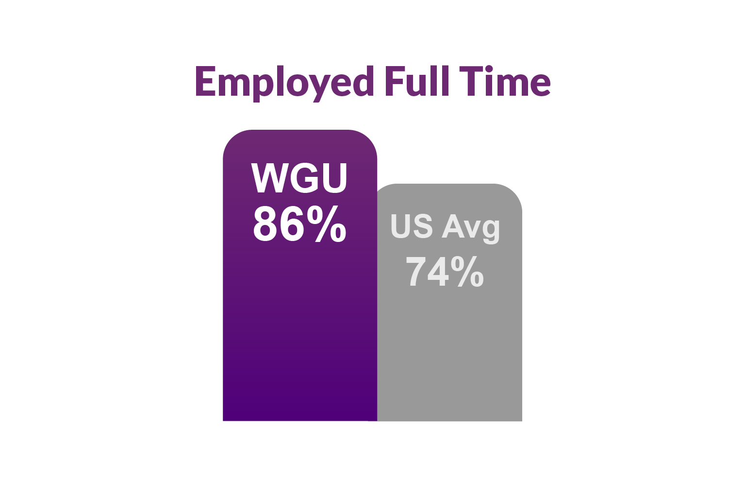
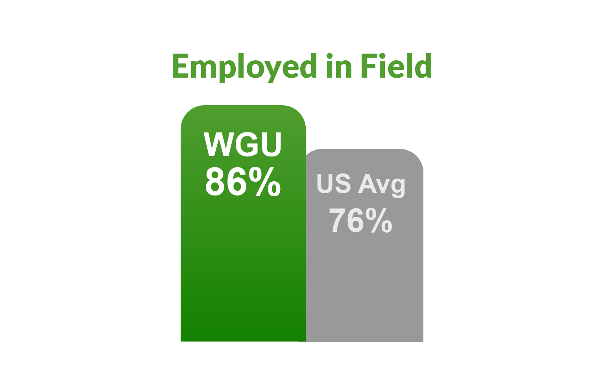
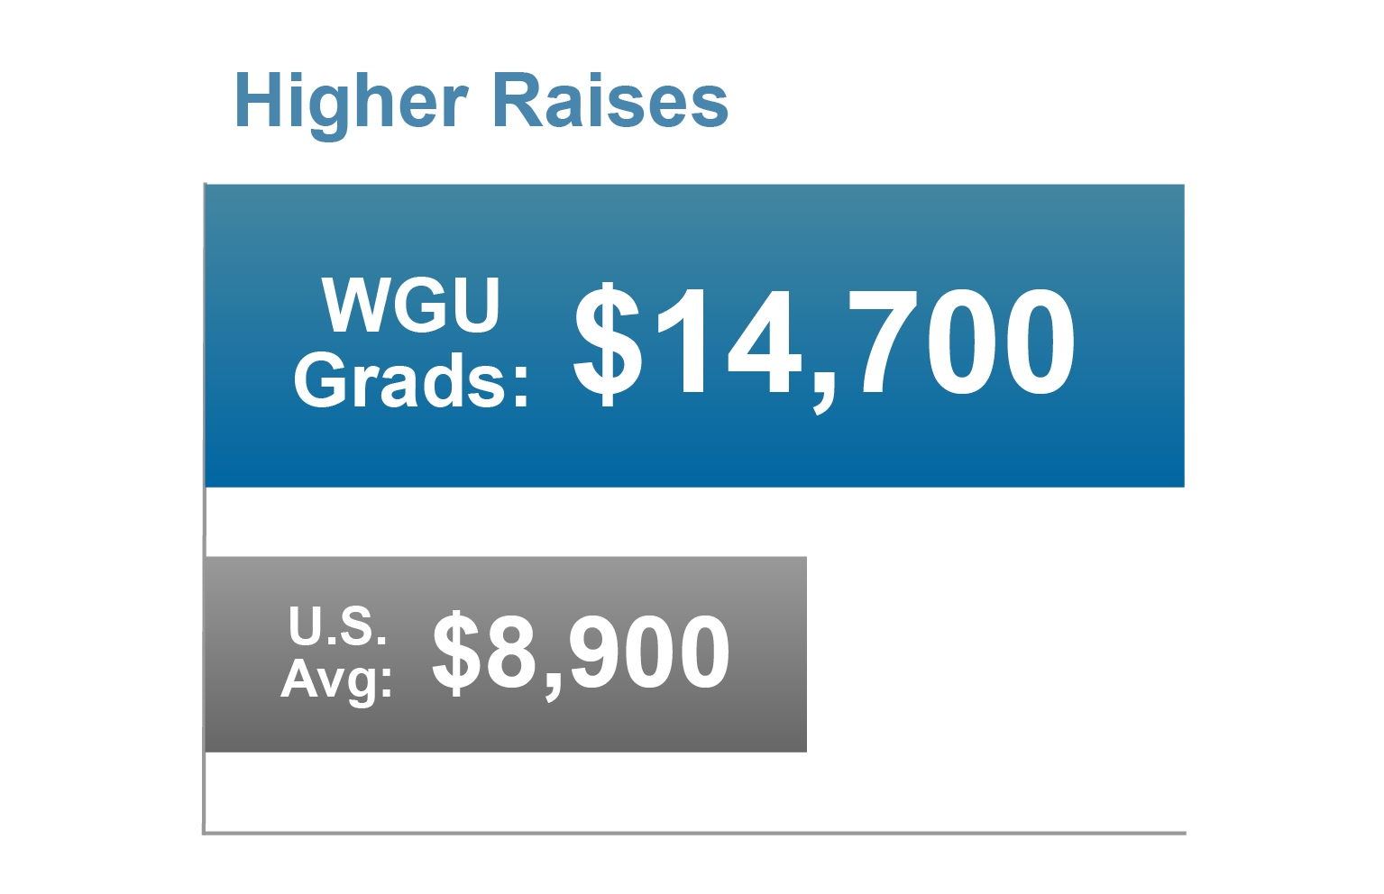
Delivering Value to Graduates
WGU graduates find the jobs they seek.
… And earn more.
Source: Harris Online poll

Slide 20
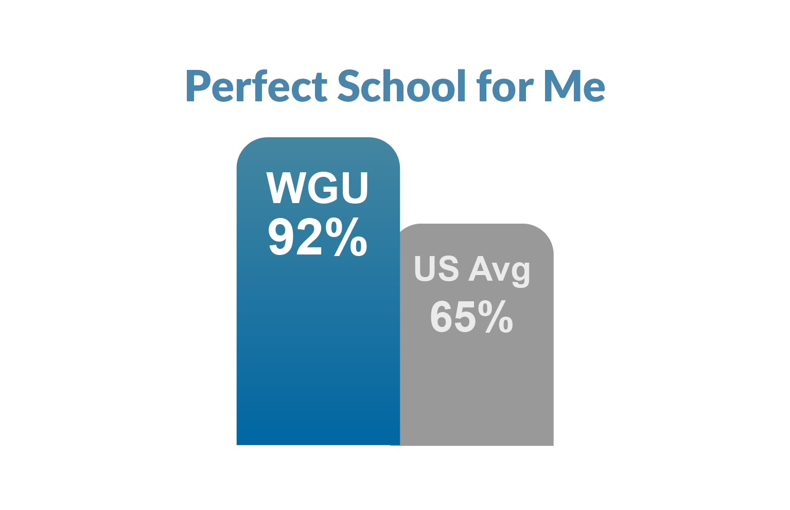
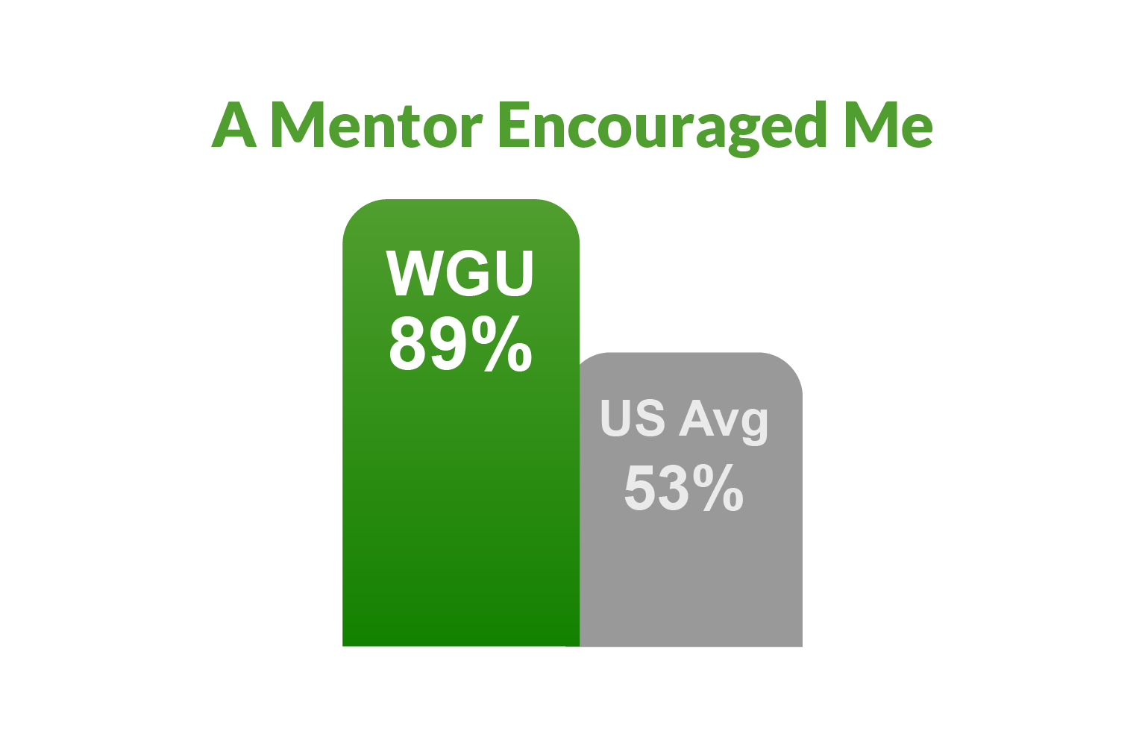
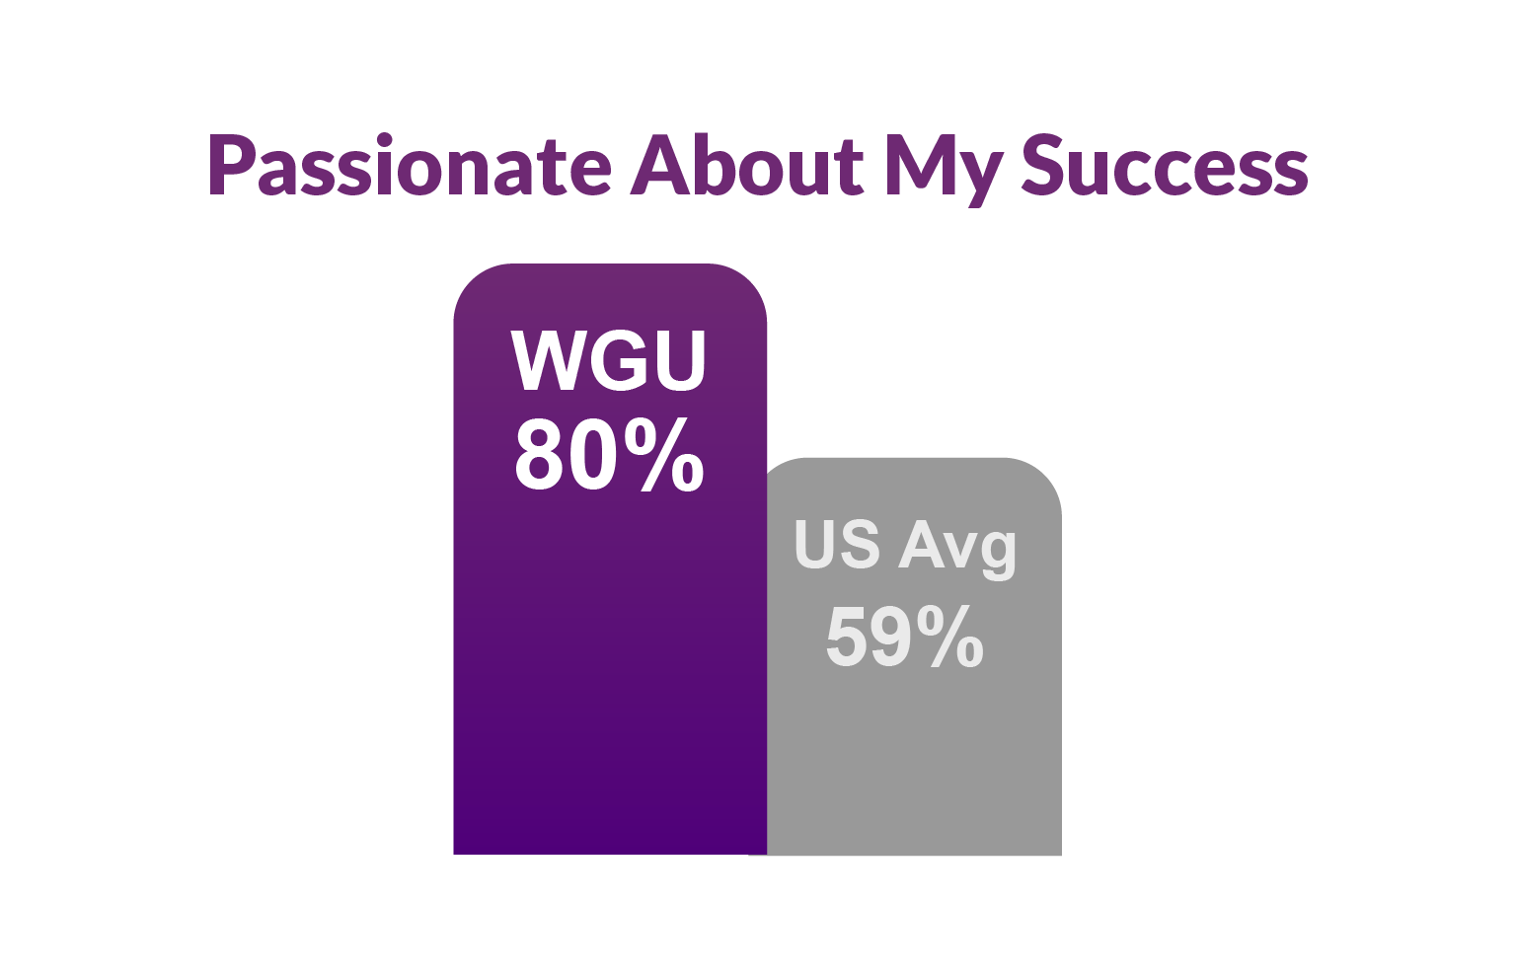
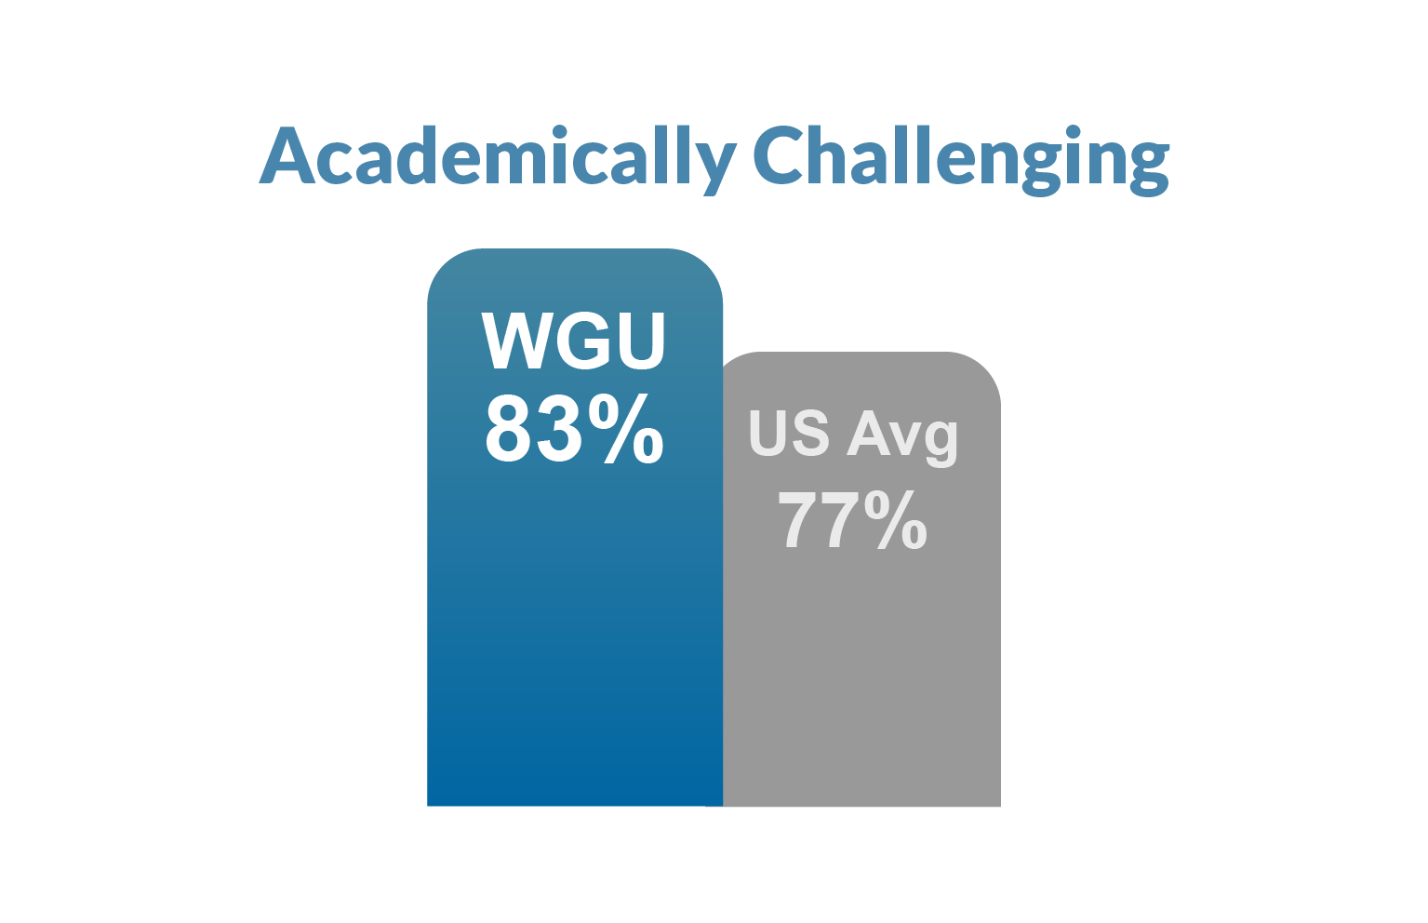
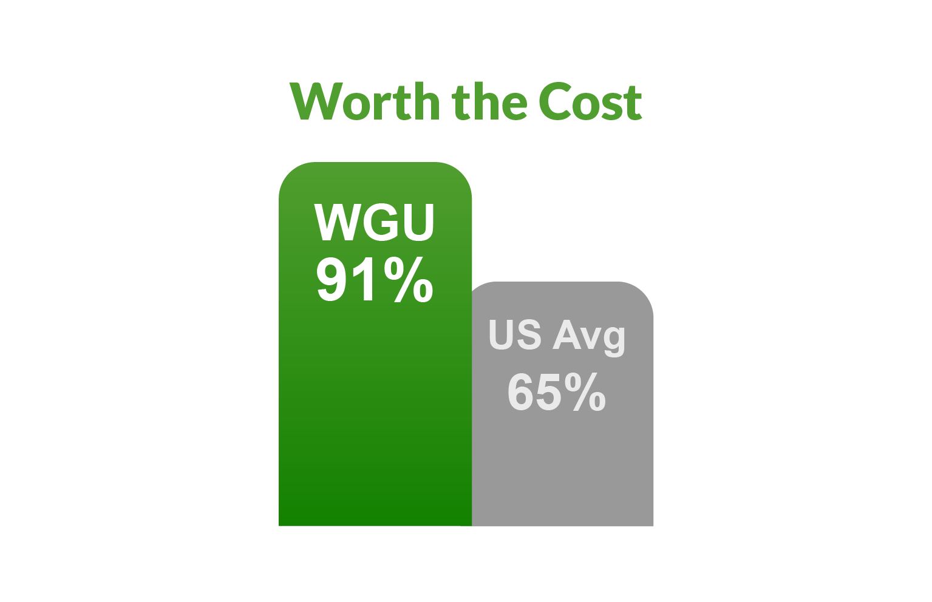
Great Jobs, Great Lives
Source: Gallup
Notes:
WGU participates in an annual survey conducted by Gallup, which checks in with graduates of WGU and other national universities to see how they are faring in the first few years after graduation. WGU alumni are almost twice as likely as graduates from other universities to be thriving in all elements of well-being—purpose, social, financial, community, and physical.
Gallup also reported that WGU alumni report higher levels of engagement at work—21% higher than the national average.

Slide 21
Delivering Value to Employers
100% said WGU grads were prepared for their jobs.
98% said WGU grads meet or exceed expectations; 92% said they exceed.
93% rate WGU grads’ job performance excellent or very good.
94% rated WGU grads’ soft skills equal to or better than other grads.

Slide 22
Outline
The Case for Innovation
CBE at Scale
Utilizing Data to Advance Student Outcomes
What We’ve Learned

Slide 23
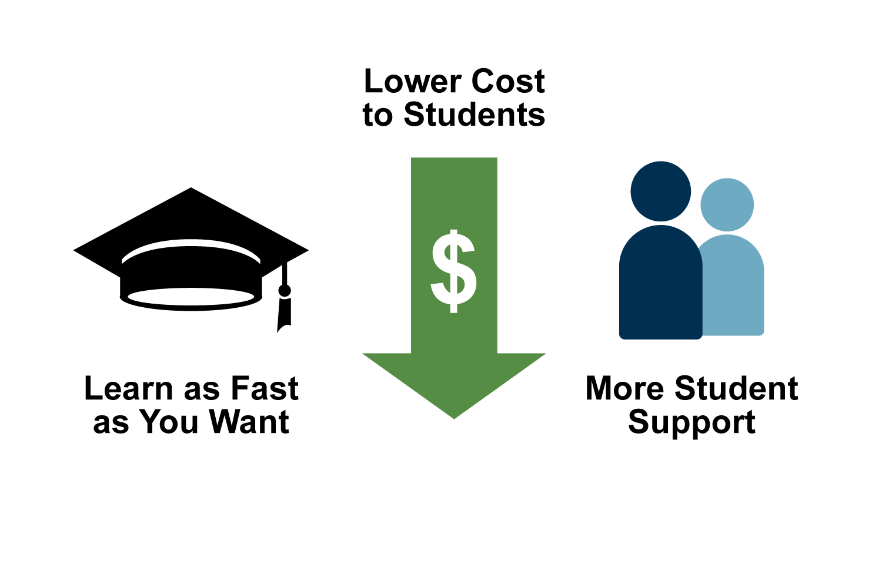
It Works
Lower Tuition, Faster Time to Graduate
Individualized Learning
Greater Student Support

Slide 24
What We’ve Learned
CBE ≠ Online Education
CBE ≠ Direct Assessment
CBE is not for everyone; complements existing options
Standardization works best
High demand, high volume; Programs and courses
Outcomes > process
Student motivation/engagement vital to success
Challenging, but not impossible, for online model
Advanced analytics key to advancing experience and outcomes
Requires courage – innovation requires sloughing off old methods

Slide 25
Questions and Discussion
Thank You!
Sarah Demark Fred Hurst
sarah.demark@wgu.edu fred.hurst@wgu.edu

