Slide 1
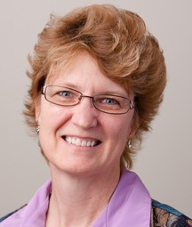
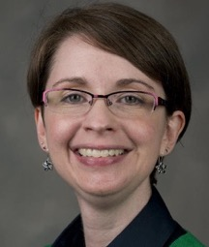
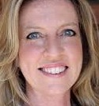
FLEXspace 2.0 Makes Learning Space Planning Easier!
Dr. Lisa Stephens, lisa.stephens@SUNY.edu
Adjunct Assoc. Prof., Dept. of Communication
Sr. Strategist, SUNY Academic Innovation
University at Buffalo – Office of VP/CIO
FLEXspace Core Team Lead
Dr. Dana Gierdowski, dcgierdo@gmail.com
Lecturer, Writing Program, University of Arizona
Learning Space Researcher
FLEXspace Core Team, Research Committee
Dr. Rebecca Frazee, rfrazee@sdsu.edu
Lecturer, Learning Design &Technology Program San Diego State University FLEXspace Manager
Notes:
5 - Lisa starting us off and giving a quick overview (what FLEXspace is, who we are, brief history), sponsors, numbers, growth
5 - Rebecca moving in to discuss the new interface/features,
5 - Dana discussing next steps with the research mission
1 - Lisa closing us out.

Slide 2
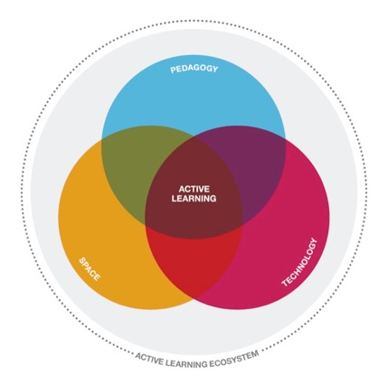
The Challenges
Campus stakeholders charged with refreshing, renovating and building learning spaces in academic settings need to:
Drive conversations with faculty, administrators, planning committees
Foster better communication through sharing information across various groups
Build consensus before involving architects and others to discussions
Improve process efficiencies and the effectiveness of design choices
Execute learning space projects “smarter, faster, cheaper”
Document and Research evidence of impact
]
Notes:
Fundemental challenges facing the SUNY System were

Slide 3
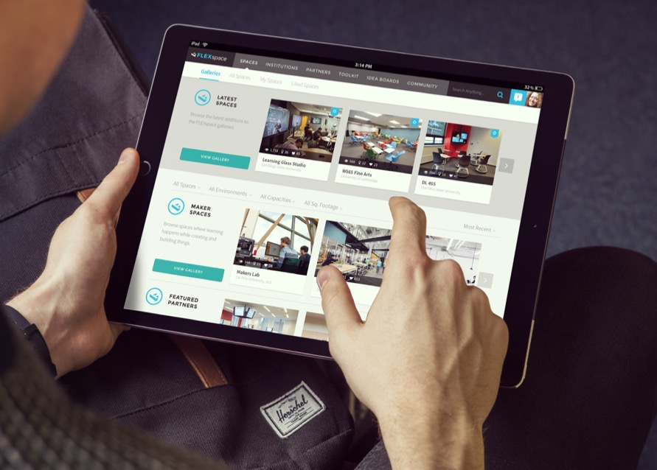
The Solution… a “One Stop Shop” named:
…for planning, designing, implementing, maintaining, assessing, and improving learning spaces in higher education, K-12, libraries and non profit groups…
Notes:
I’ll talk about what it is, why and how you might use FLEXspace, and where we are now and where we’re headed with the new and improved version.
FLEXspace is an open access online repository of learning space examples contributed by campuses from around the world. It s a free resource for anyone with an EDU email, created by academic institutions FOR academic institutions.
YOUR CAMPUSES? GO TO WEBSITE
LAUNCHED about 5 years ago by the SUNY Provost’s Office, (Learning Environments Task Group), and
TODAY, 2700+ user accounts, 1400+ academic institutions across 43 countries.
PROUD
THE “one stop shop” resource for those who plan, design, maintain and use innovative campus learning spaces.

Slide 4
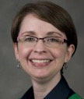
Created By Educators For Educators!
John Augeri, Deputy Director
Paris Île-de-France Digital University Kyoto University | Invited Researcher
Phil Long
Chief Innovation Officer and Associate Vice Provost For Learning Sciences University of Texas, Austin
Simon Birkett
Digital Campus Manager
Staffordshire Univ., U. Derby - UK
Mark McCallister
Interim Dir., Office of Academic Tech
University of Florida
Brad Snyder
Technical Services Coordinator
SUNY Cortland
James Young
Chief Learning Officer
Society for College & Univ. Planning and Claire Turcotte, SCUP Editor (ret.)
Lisa A. Stephens
Sr. Strategist, SUNY Academic Innovation
SUNY and University at Buffalo
James Frazee
Learning & Performance Technologies Senior Academic Technology Officer
San Diego State University
Malcolm Brown
Director
EDUCAUSE Learning Initiative
Jim Twetten
Manager
U. Minnesota
Joseph Moreau
Vice Chancellor – Technology
Foothill-De Anza CC District
Gerard L. Hanley
Sr. Dir., Academic Technology Svcs.
CSU Office of the Chancellor
Jeanne L. Narum. Director
The Independent Colleges Office Learning Spaces Collaboratory
Dana C. Gierdowski
FLEXspace Core Team, Research Committee Lecturer, University of Arizon
Rebecca Frazee
FLEXspace Manager
Faculty, San Diego State University
Joan Lippincott
Assoc. Exec. Director
Coalition for Networked Information
Special Thanks to Past Members:
Terry Calhoun, SCUP (ret.)
Clare van den Blink, Cornell U. (ret.)
Megan Marler, Artstor

Slide 5
Grand Collaboration AND Enthusiasm!

Slide 7
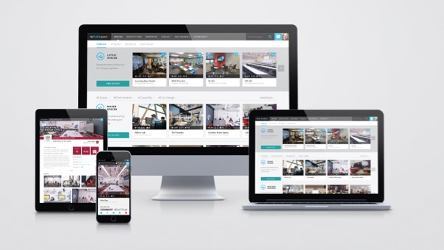
We anticipate significant growth with FLEXspace 2.0
Today:
2800+ users
1200+ EDUs
380 spaces
40+ countries

Slide 8
FLEXspace: a Tool and a Community
Stylish Case Study Format
Designs, images, videos & details:
facilities
furnishings
AV/IT systems
technology tools
learning activities
project cost
LSRS score
Stories of use and impact
Main contact
Global Community
Campus Leaders
Academic Technologists
AV / Technology Services
Facilities Planners
Faculty
Researchers
Architects and Designers
AV Integrators
Manufacturers / Partners
Notes:
REBECCA START
Centers on the Community
And Space Details – images, data, contact person.

Slide 9
Take a Virtual Fieldtrip!
Seek inspiration and proof of concept
Benchmark against peer institutions
Connect with others

Slide 10
Collect inspirations with Idea Boards
Idea Boards
Collect favorites
Collaborate with your team and others as you work on a space
Share your ideas to connect with ‘birds of a feather’
Notes:
Your spot to collect your own inspirations or share with your team while you create new spaces.

Slide 11
Leverage resources from the Toolkit
Toolkit
A rich collection of articles, research, tools, and guides for inspiration, planning, and assessment curated by our FLEXspace team and contributed by the FLEXspace community.
Notes:
how-to’s, resources, research, and information curated by the FLEXspace team.

Slide 12
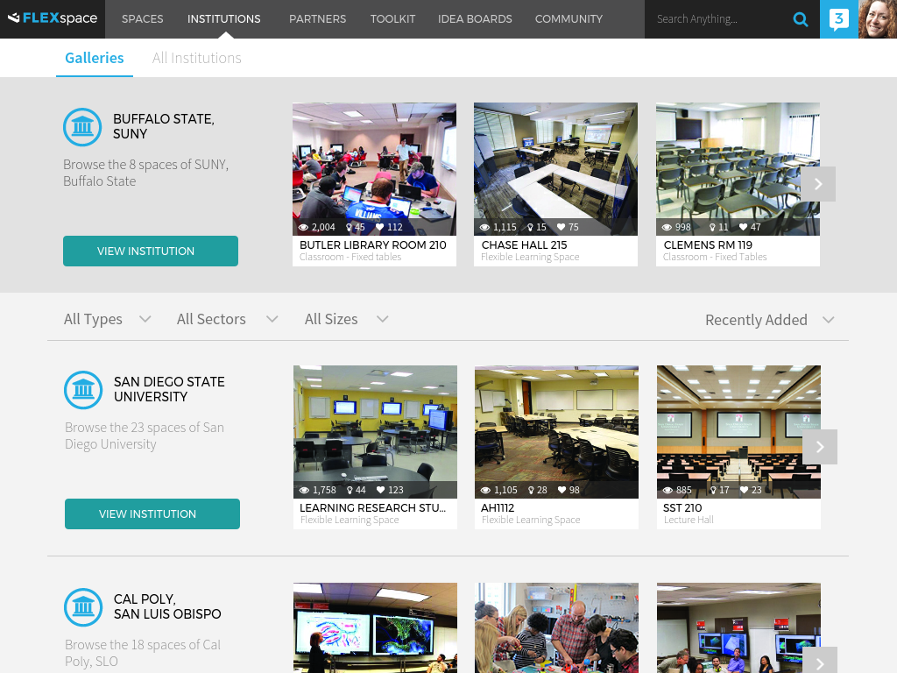
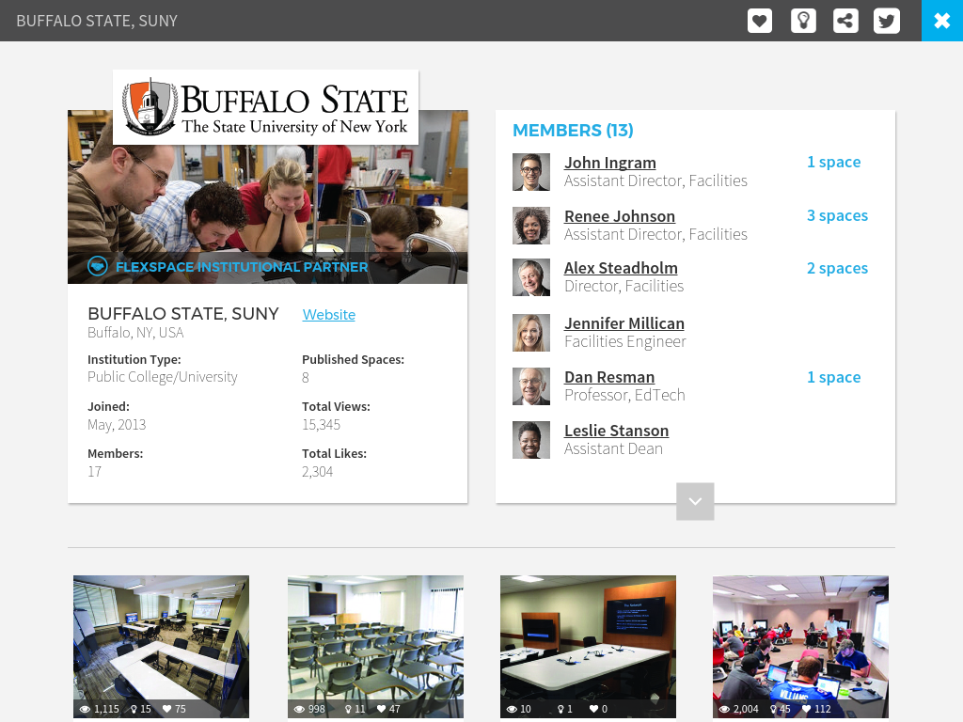
Document and Showcase Campus Spaces
Use FLEXspace as a digital repository
Create a gallery of campus spaces to share locally and globally – avoid duplication of effort!

Slide 13
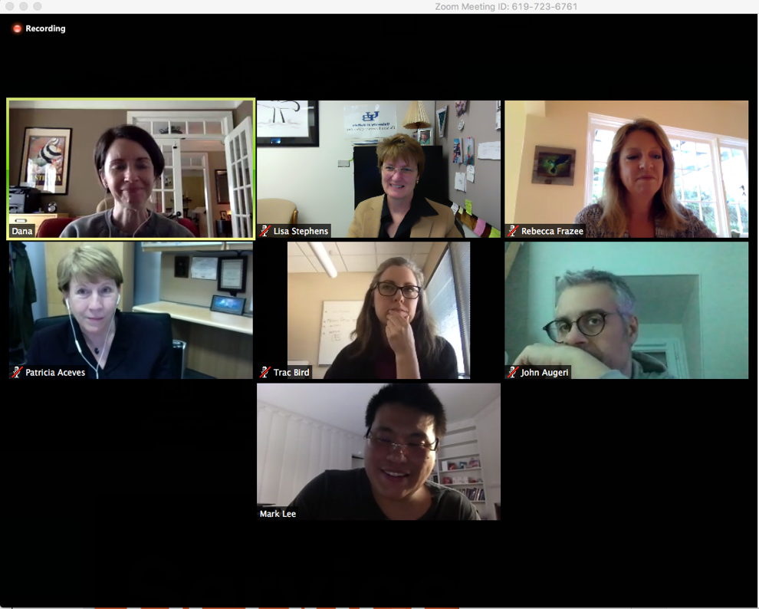
FLEXspace Research Team
…a quick email exchange morphed into a team within a week and a half-dozen time zones!
(pictured)
Dana Gierdowski – U or AZ
Lisa Stephens – U Buffalo
Rebecca Frazee – SDSU
Patricia Aceves – SBU
Traci Bird – U Indiana
John Augeri - Université Numérique Paris Ile-de-France
Mark Lee – Charles Sturt University and visiting CMU
James Frazee - SDSU (not pictured)
…+ other core team members and growing!
Notes:
Establishing a board

Slide 14
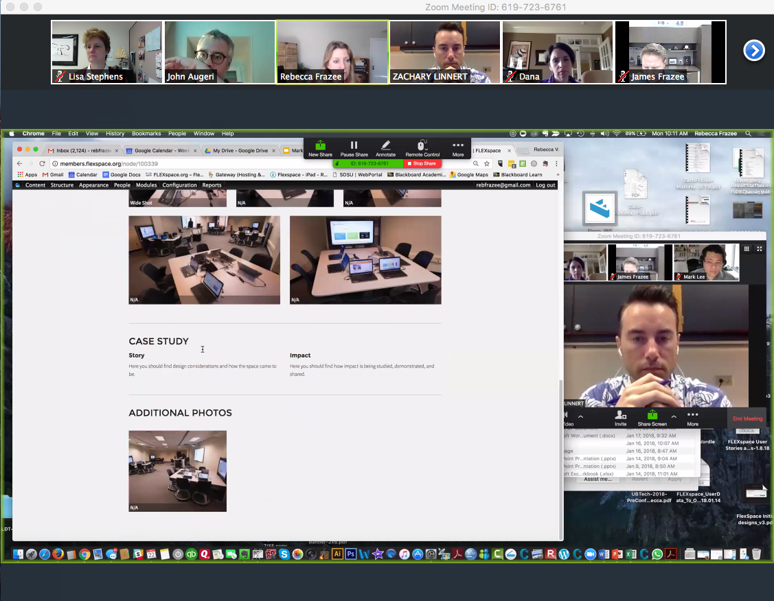
What’s Next
Research platform
Share data collection instruments, protocols, findings
Provide curated “research toolkit” for guidance
Crowdsourcing broad data collection and research
Analytics
Trend analysis (Who’s using it, what’s useful, popular, etc.)
Comparisons (K12, higher ed, community colleges)
Notes:
Highlight how this is useful/

Slide 15
What’s Next
Expanding the community
Connecting with researchers, SMEs, and practitioners across disciplines/fields
Highlighting best practices and exemplars in design, assessment, research, teaching/learning
Expanding and bridging partnerships
Architects
Libraries
Museums
Nonprofits
National/International Societies
Private sector
Notes:
SERC

Slide 16
Action Steps
Think about FLEXspace:
How to use FLEXspace on your campus?
Who else might benefit from FLEXspace?
What spaces, resources, or research can you contribute?
What communities can you engage through FLEXspace?
Get started today!
Visit FLEXspace.org to see spotlight spaces & resources.
Login to “FLEXspace 2.0” to request an account.
Browse the legacy collection (upload coming soon!)
Notes:
Lisa – how do you want to close out? Witha call to action? Recruitment? (This could be a challenge to identify) (I’ll THINK ABOUT THIS…)
Below is what we have as our outcomes in the proposal. Perhaps sum up in the closing?
Outcomes: Identify key challenges and 2–3 attributes of FLEXspace that can help advance campus initiatives * Identify key challenges and 2–3 attributes of FLEXspace 2.0 that may incentivize contributions of resources and campus space examples to help build the community of practice * Learn how to access the tools in FLEXspace 2.0 or the new features of the mobile platform

Slide 17
New design template makes it easy to upload and detail a space

Slide 18
Registered Users by Country
43 Countries and Counting!
(January 2018)

Slide 20
Spaces detailed with Robust Taxonomies that Align Key Stakeholders
Learning & Assessment
Pedagogies and learning activities
Facilities
Wall, ceiling, floor finishes
Electrical, lighting, acoustics
Area, dimensions, accessibility
Furniture and furnishings
Project cost and scope
Technology Integration
AV/IT academic technology & equipment
Graphic Courtesy Lennie Scott-Webber
Notes:
The ”killer app” of FLEXspace is “gluing” together the three key stakeholders in learning space design: faculty, instructional support and technology integration.
Each detailed record, high res photo or video can be coupled to a menu filtered through the lens of each key stakeholders experience/focus.

Slide 21
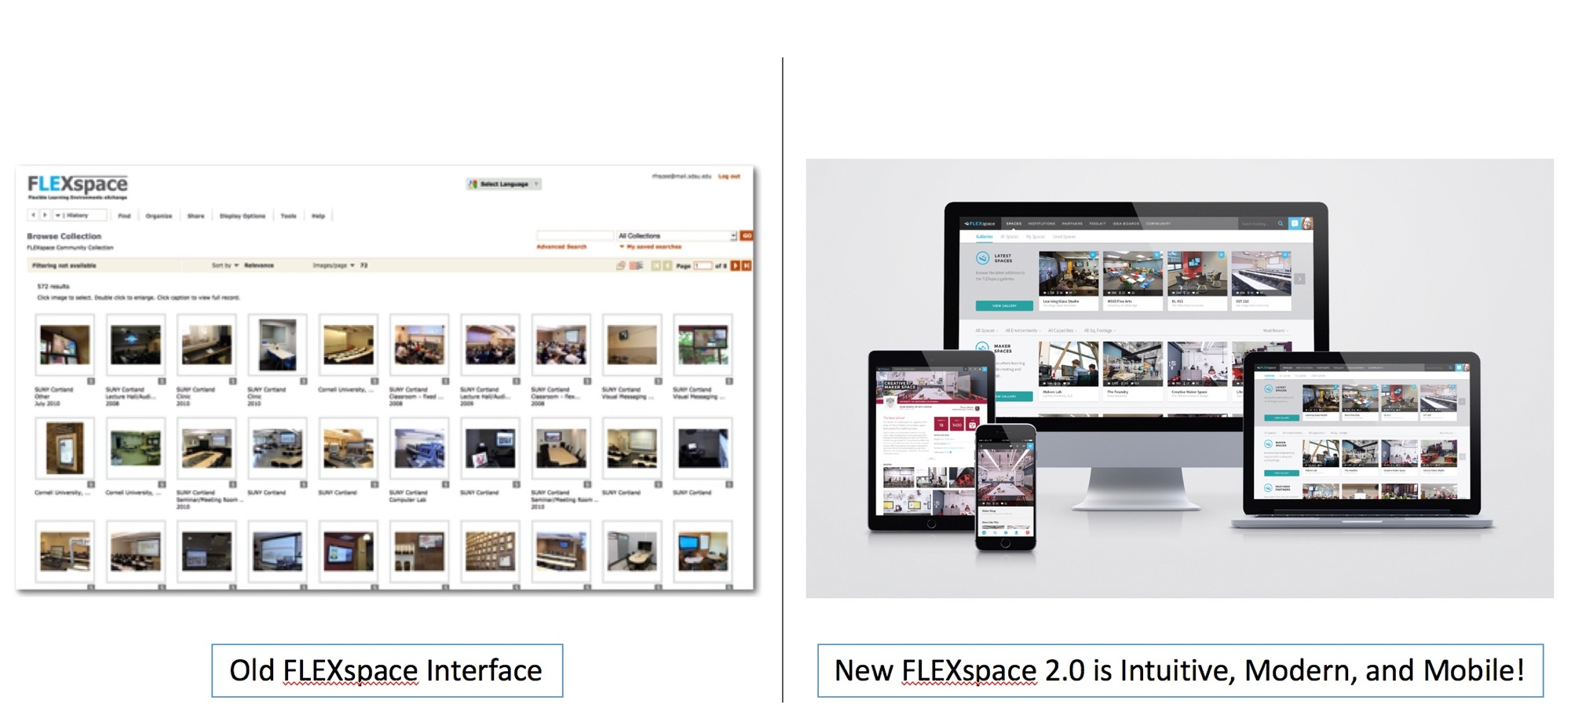
Migration from old to new FLEXspace 2.0

Slide 22
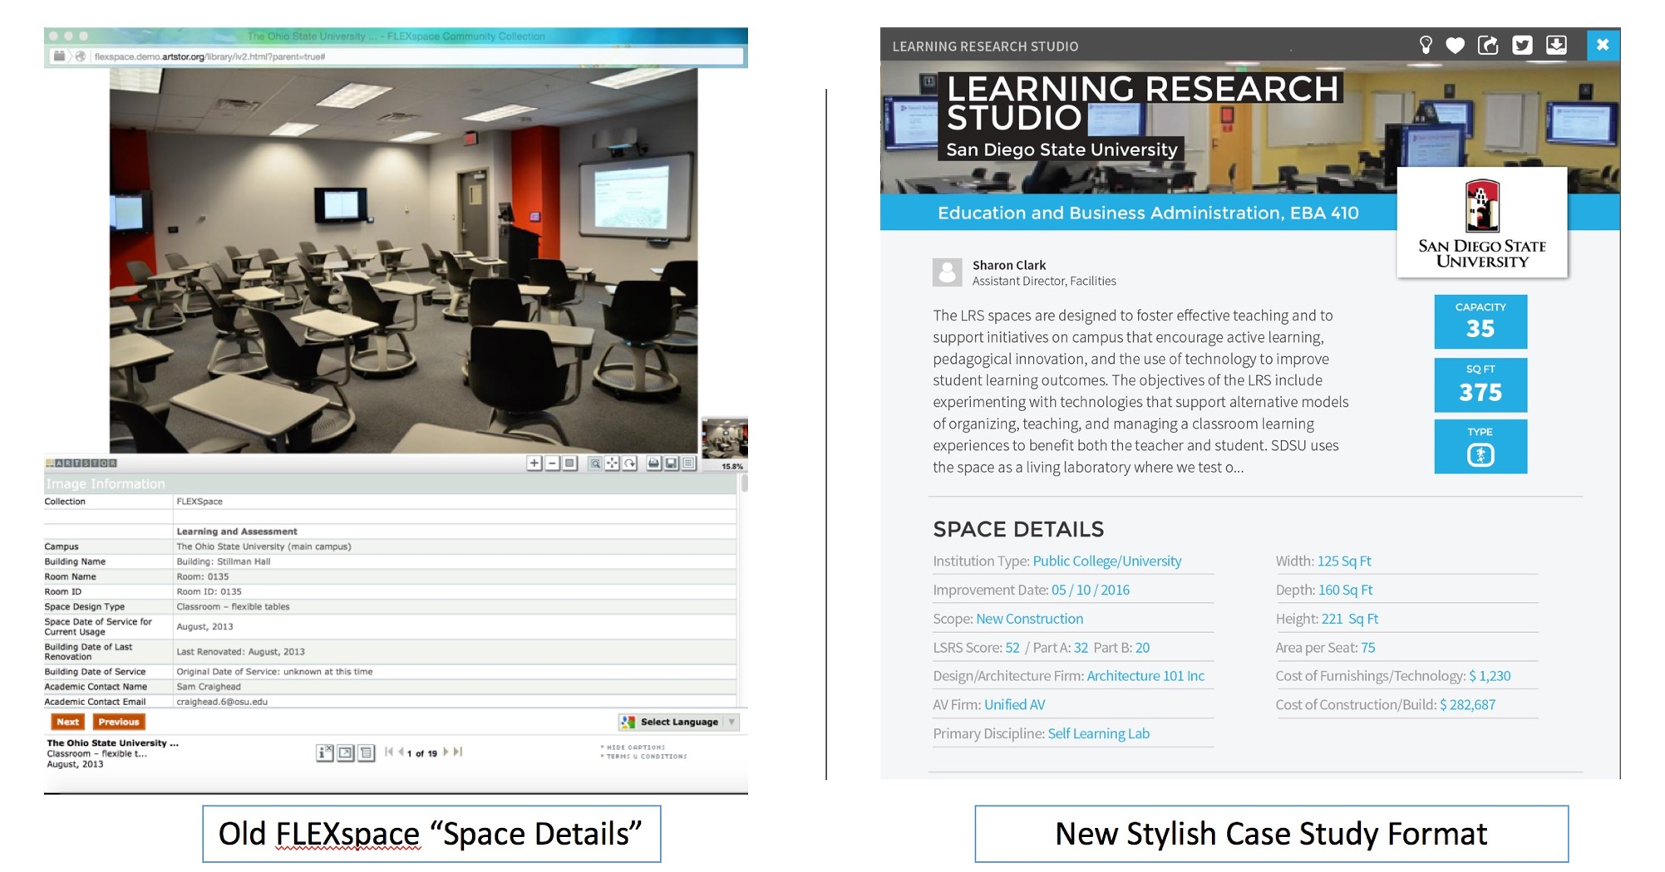
Before and After

Slide 23
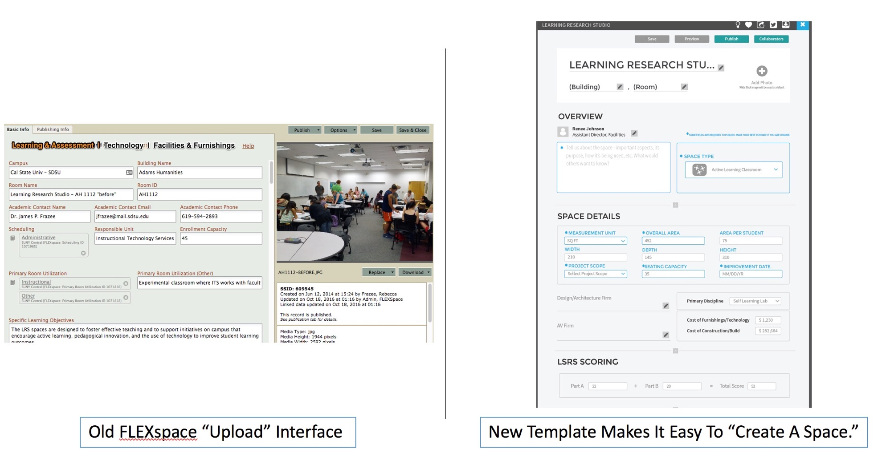
Before and After

Slide 24
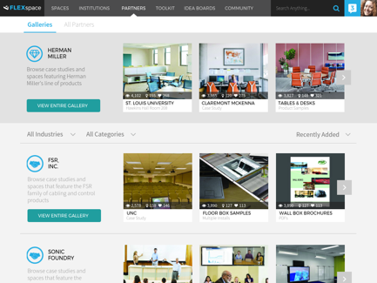
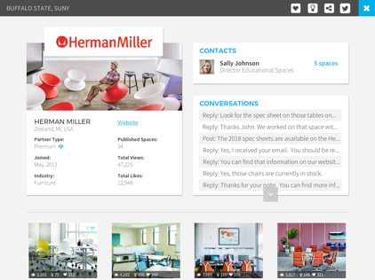
Partner Pages and Galleries
Branded Partner Pages
Users see company details, contacts, and spaces contributed by partners and any spaces that users have tagged with the brand.
Partner Galleries
View case studies, spaces, and products from partners.

Slide 25
Project Timeline for This Year
Dates | Activities
Mar-April ‘17 | Discovery (Formative Research) Campus user interviews (remote contextual inquiry) Sponsor interviews (remote interview sessions) Stakeholder interviews (Admins, core team)
April-May | Design (5-7 priority features)
May - June | Evaluate Prototype at UBTech ‘17
July-Dec | Secure WebDev Partner, Refine Requirements, Migrate Data, Build Basic View Only
Jan 2018 | Unveil the “First Peek” of Basic View, Secure Funding for Further Dev Show off at ELI in New Orleans presentation PR through partners, UBTech promotions
Jan - Mar ‘18 | Fully Flesh Out the Website in Phases Test and refine UI Increase PR efforts to promote adoption
Mar – Jun ‘18 | Continue to Onboard Partners and Promote Adoption Continue to test and refine UI Showcase FLEXspace 2.0 as UBTech Conference Program Sponsor with Expo Booth, Workshop, Branded Sessions, Podium time in general assembly
June ‘18 and Beyond | Extend discovery efforts and possibilities International UX, LSRS integration, Expanded audiences K12, libraries, architects, Expanded features, integration with other systems, etc.

Slide 26
Visit FLEXspace.org
LOGIN or Request an Account
Find resources, articles, links
Subscribe to our blog
Got an article to share or space to spotlight? Let us know!

