Slide 1
Methods for Researching Teaching + Learning Activities
within Small Active Learning Classrooms
Tiffany Roman | taroman@indiana.edu
Indiana University
Anastasia S. Morrone | amorrone@iu.edu
Indiana University
Paper link: https://iu.box.com/v/ALC-methods
Handout link: bit.ly/ALC-methods
Attribution-NonCommercial-NoDerivatives 4.0 International (CC BY-NC-ND 4.0)

Slide 2
Quick Overview
Indiana University’s Mosaic classrooms (big to small)
“Problem”/theoretical framework
Possible approaches to researching pedagogy in ALCs
Our approach to studying small ALCs – video platforms
Benefits/limitations of video platform data
Coding scheme + partner practice!

Slide 3
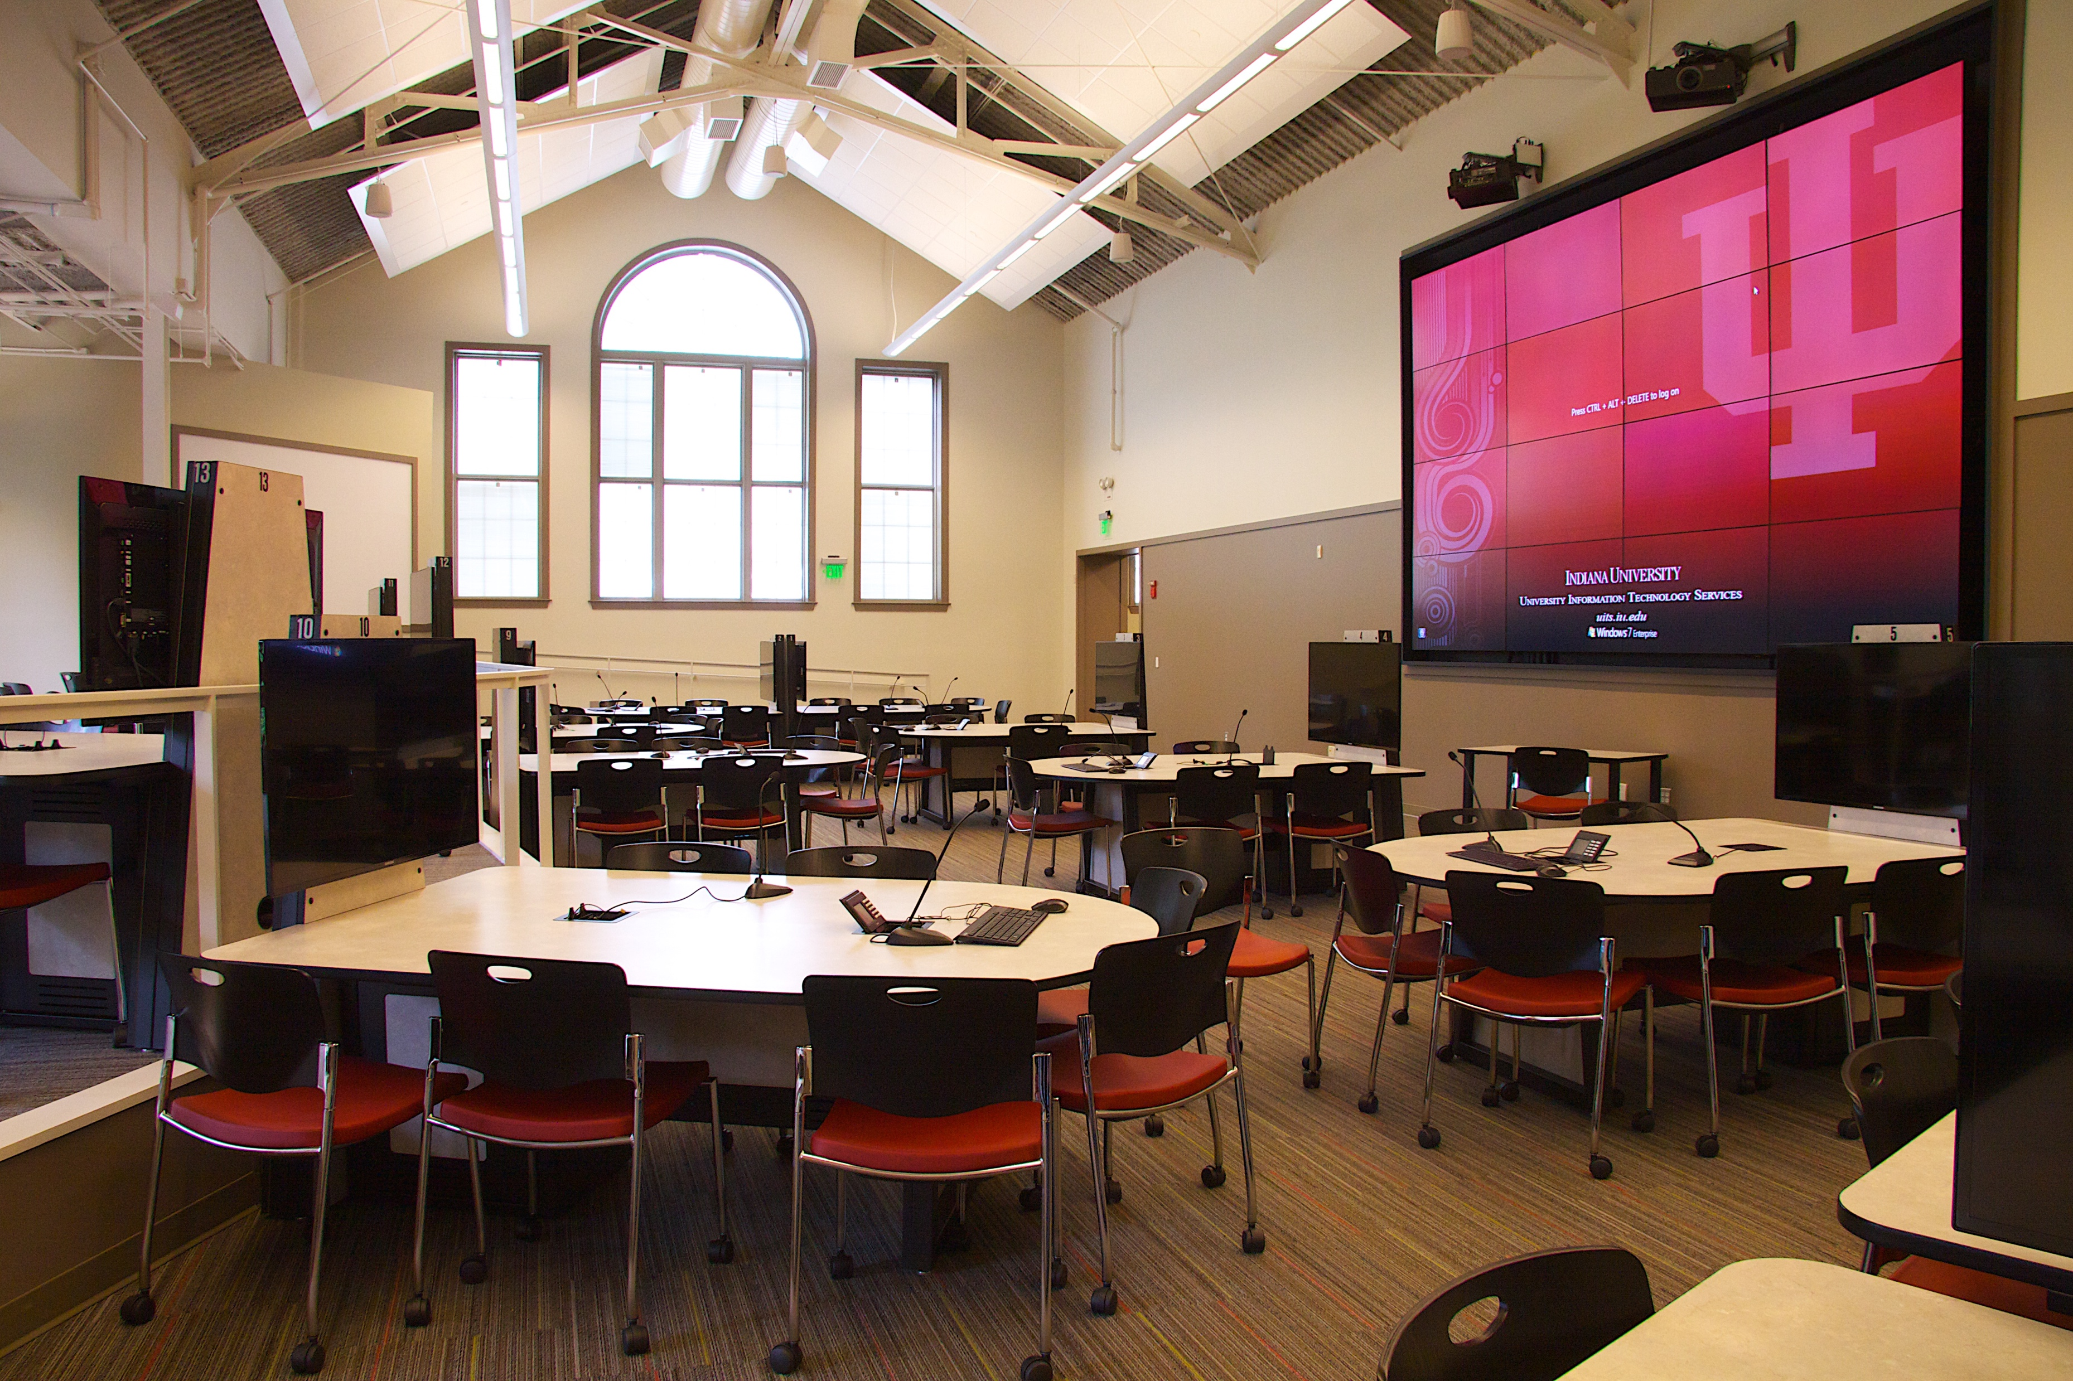
Student Building room 015 (IUB) – Site of a former pool. Largest of IU’s ALCs.

Slide 4
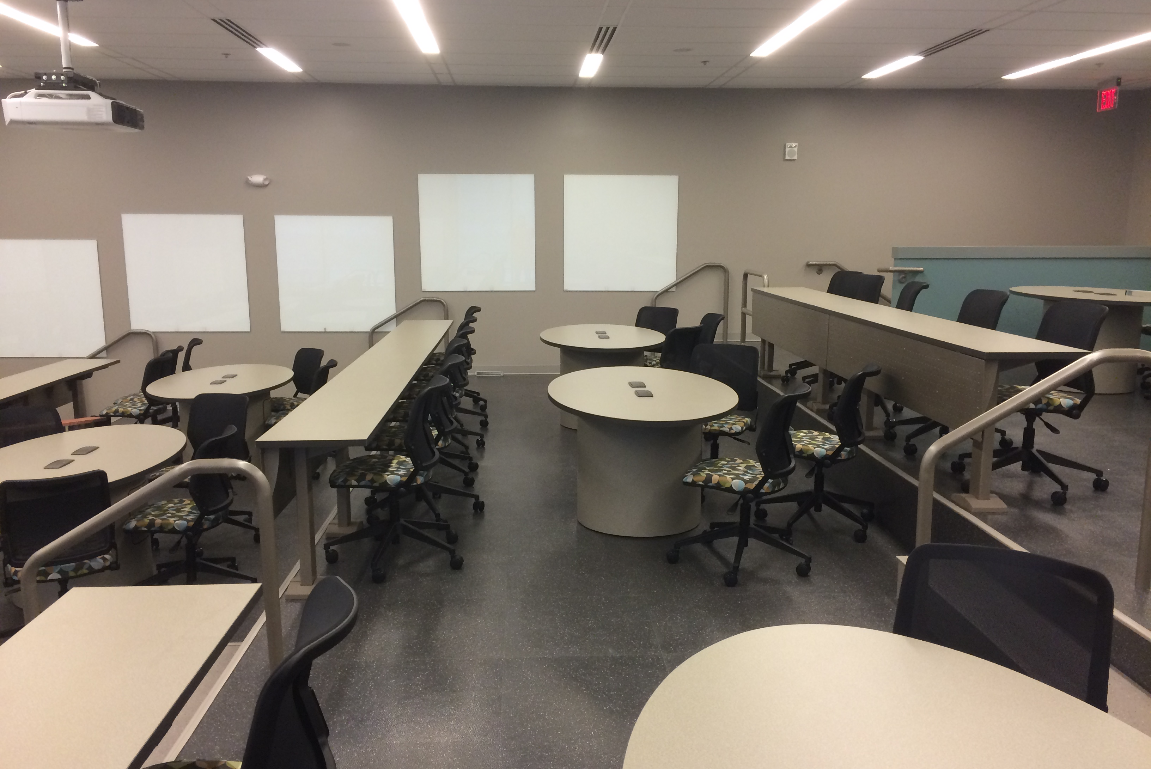
Hine Hall 118 (IUPUI) – Converted lecture hall and largest ALC at IUPUI

Slide 5
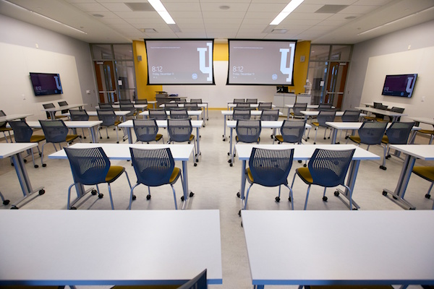
Mid-size active learning classroom (GISB building at IUB)

Slide 6
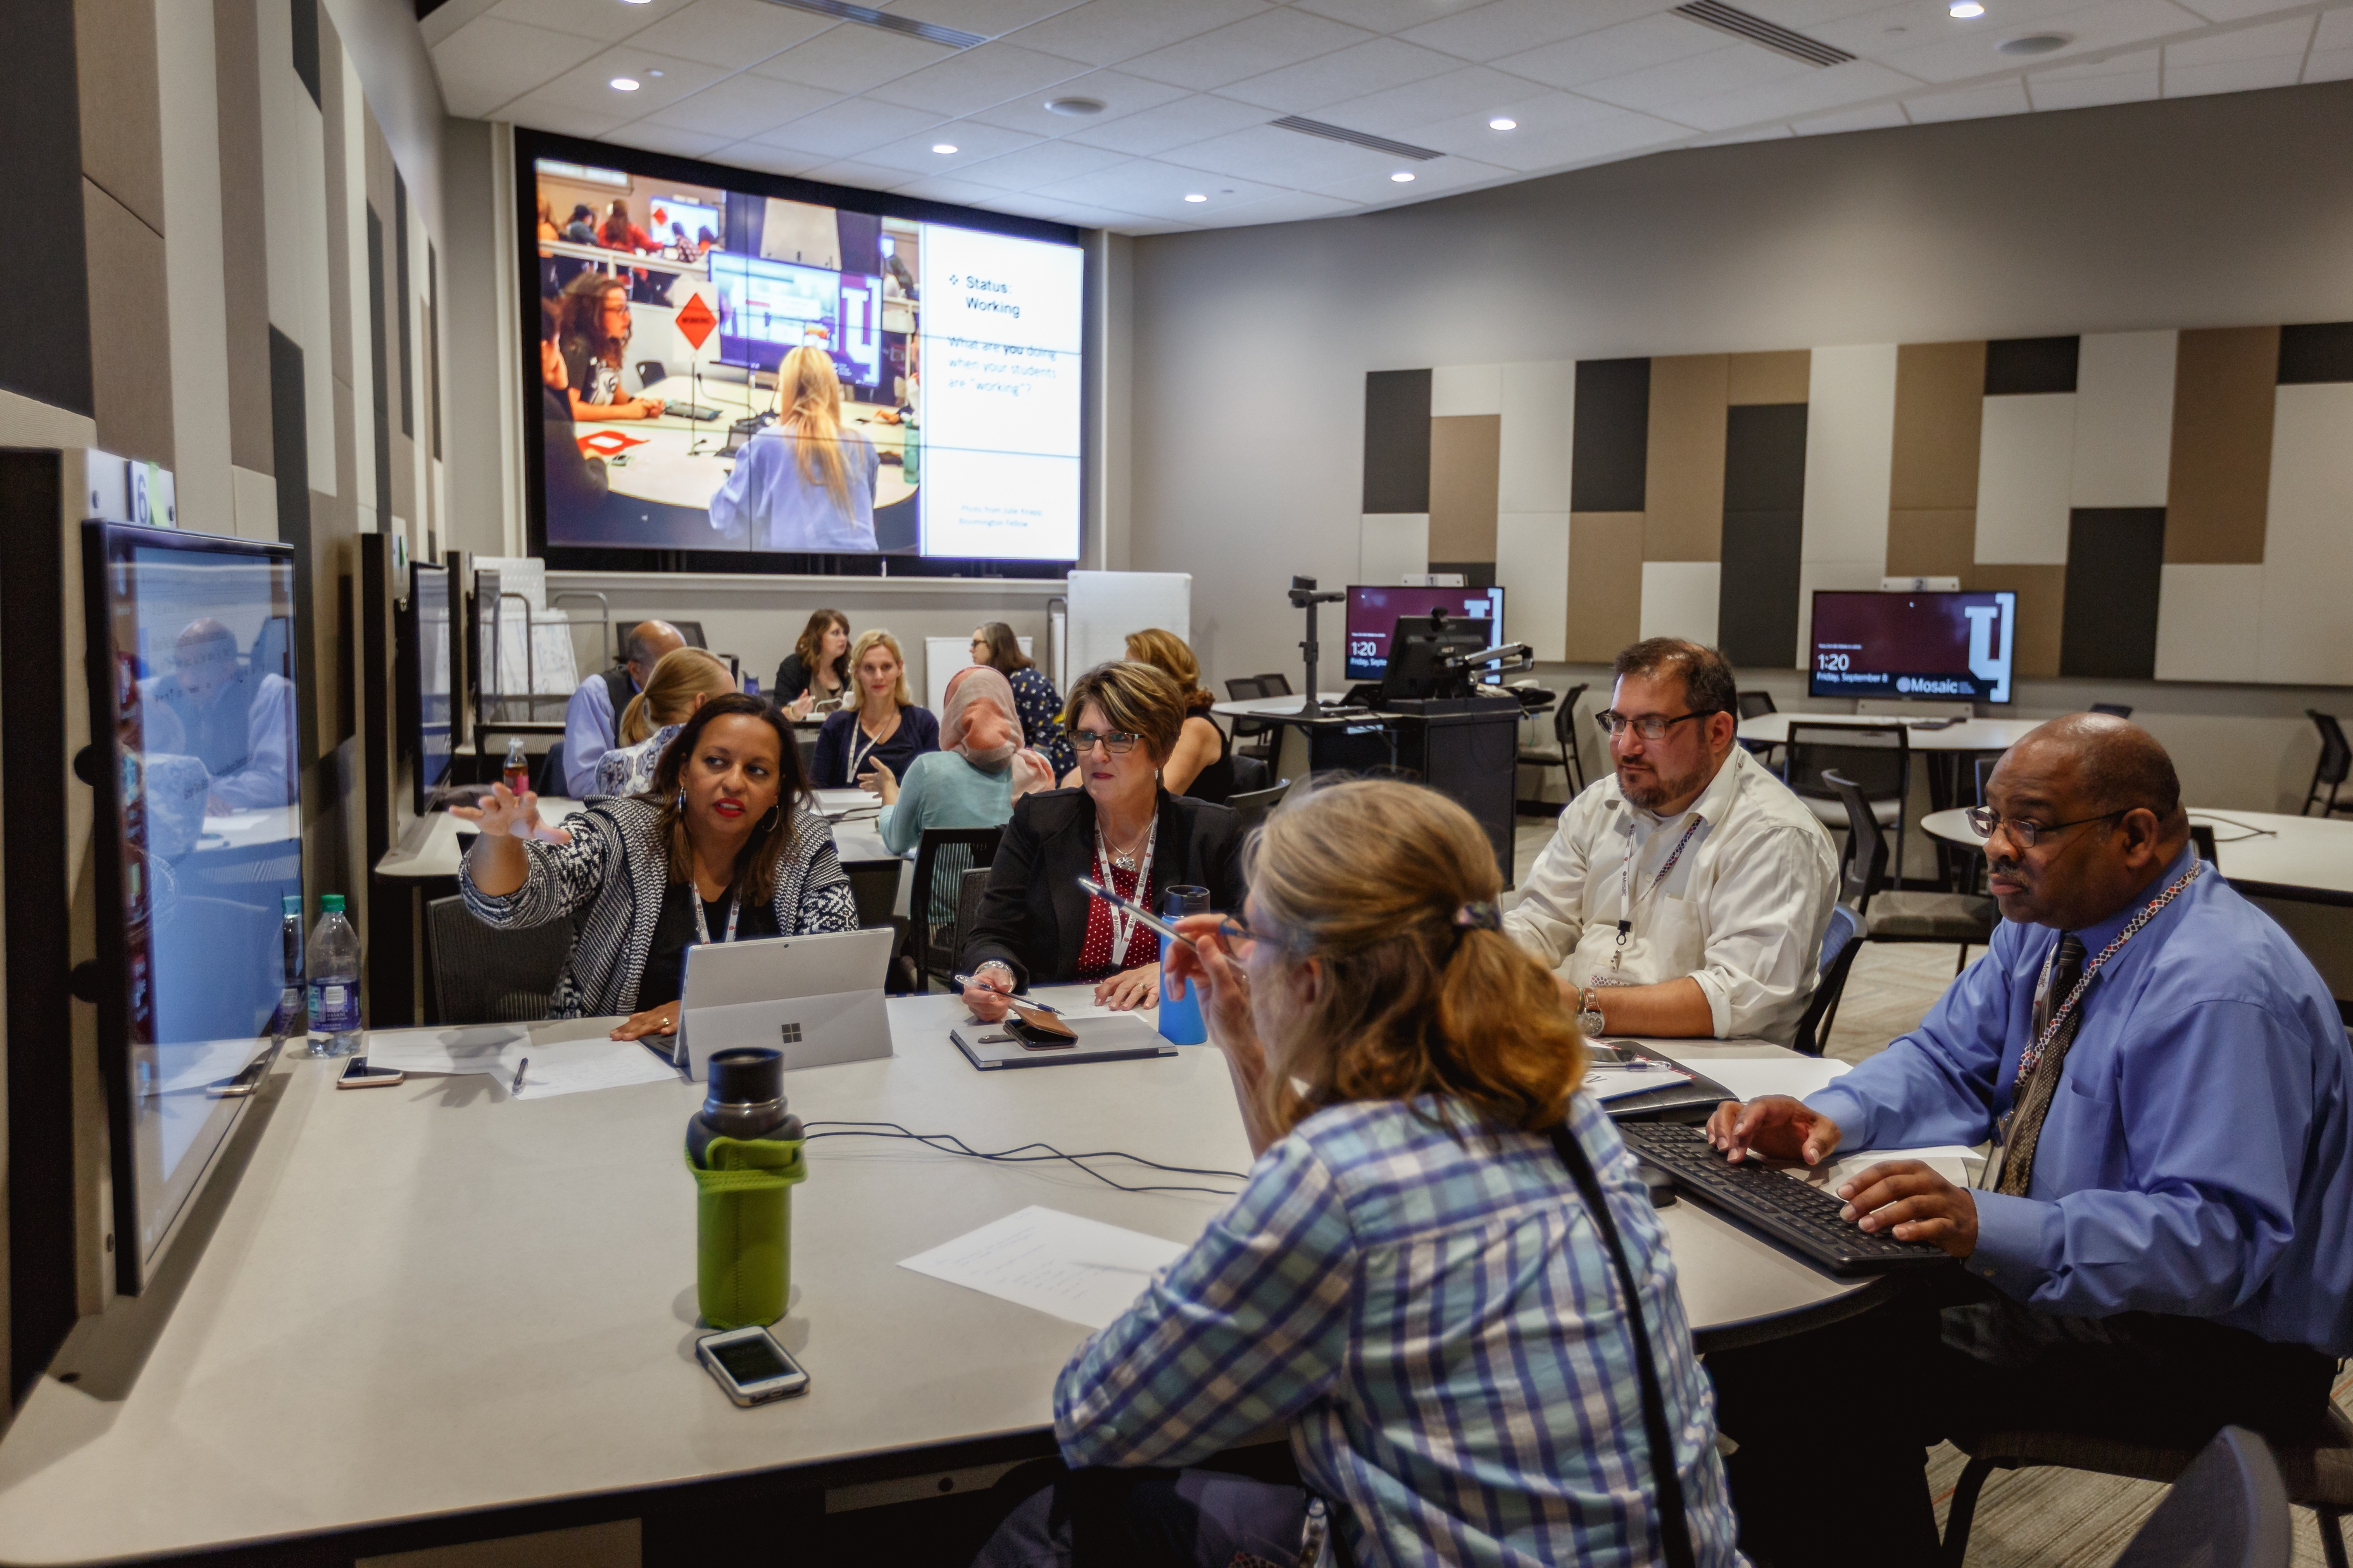
Mid-size active learning classroom at IUPUI (LE 104)

Slide 7
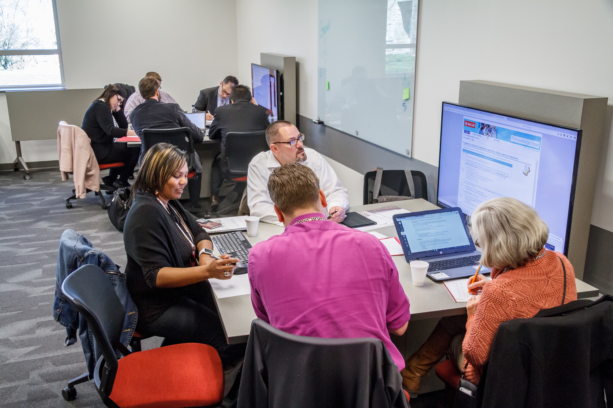
Mid-size active learning classroom at the IU Kokomo regional campus

Slide 8
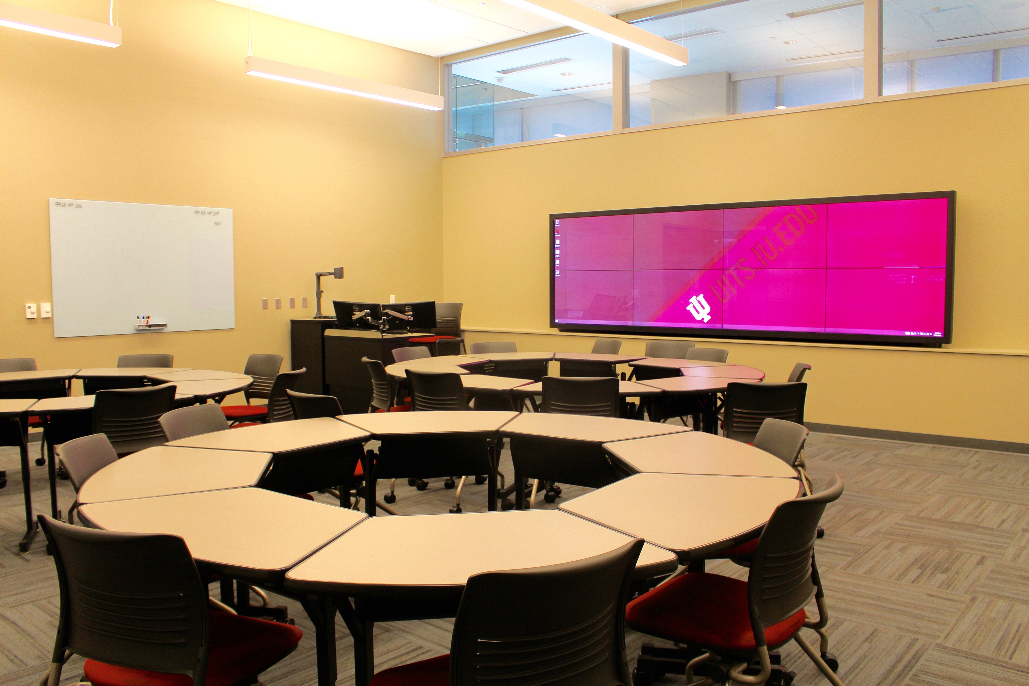
Administration Building 1000 – Small Active Learning Classroom (IUPUI)

Slide 9
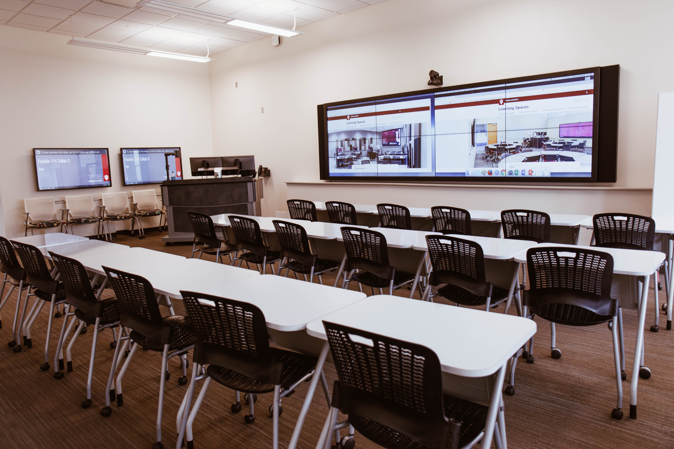
Franklin Hall 114 – Small Active Learning Classroom at IUB

Slide 10
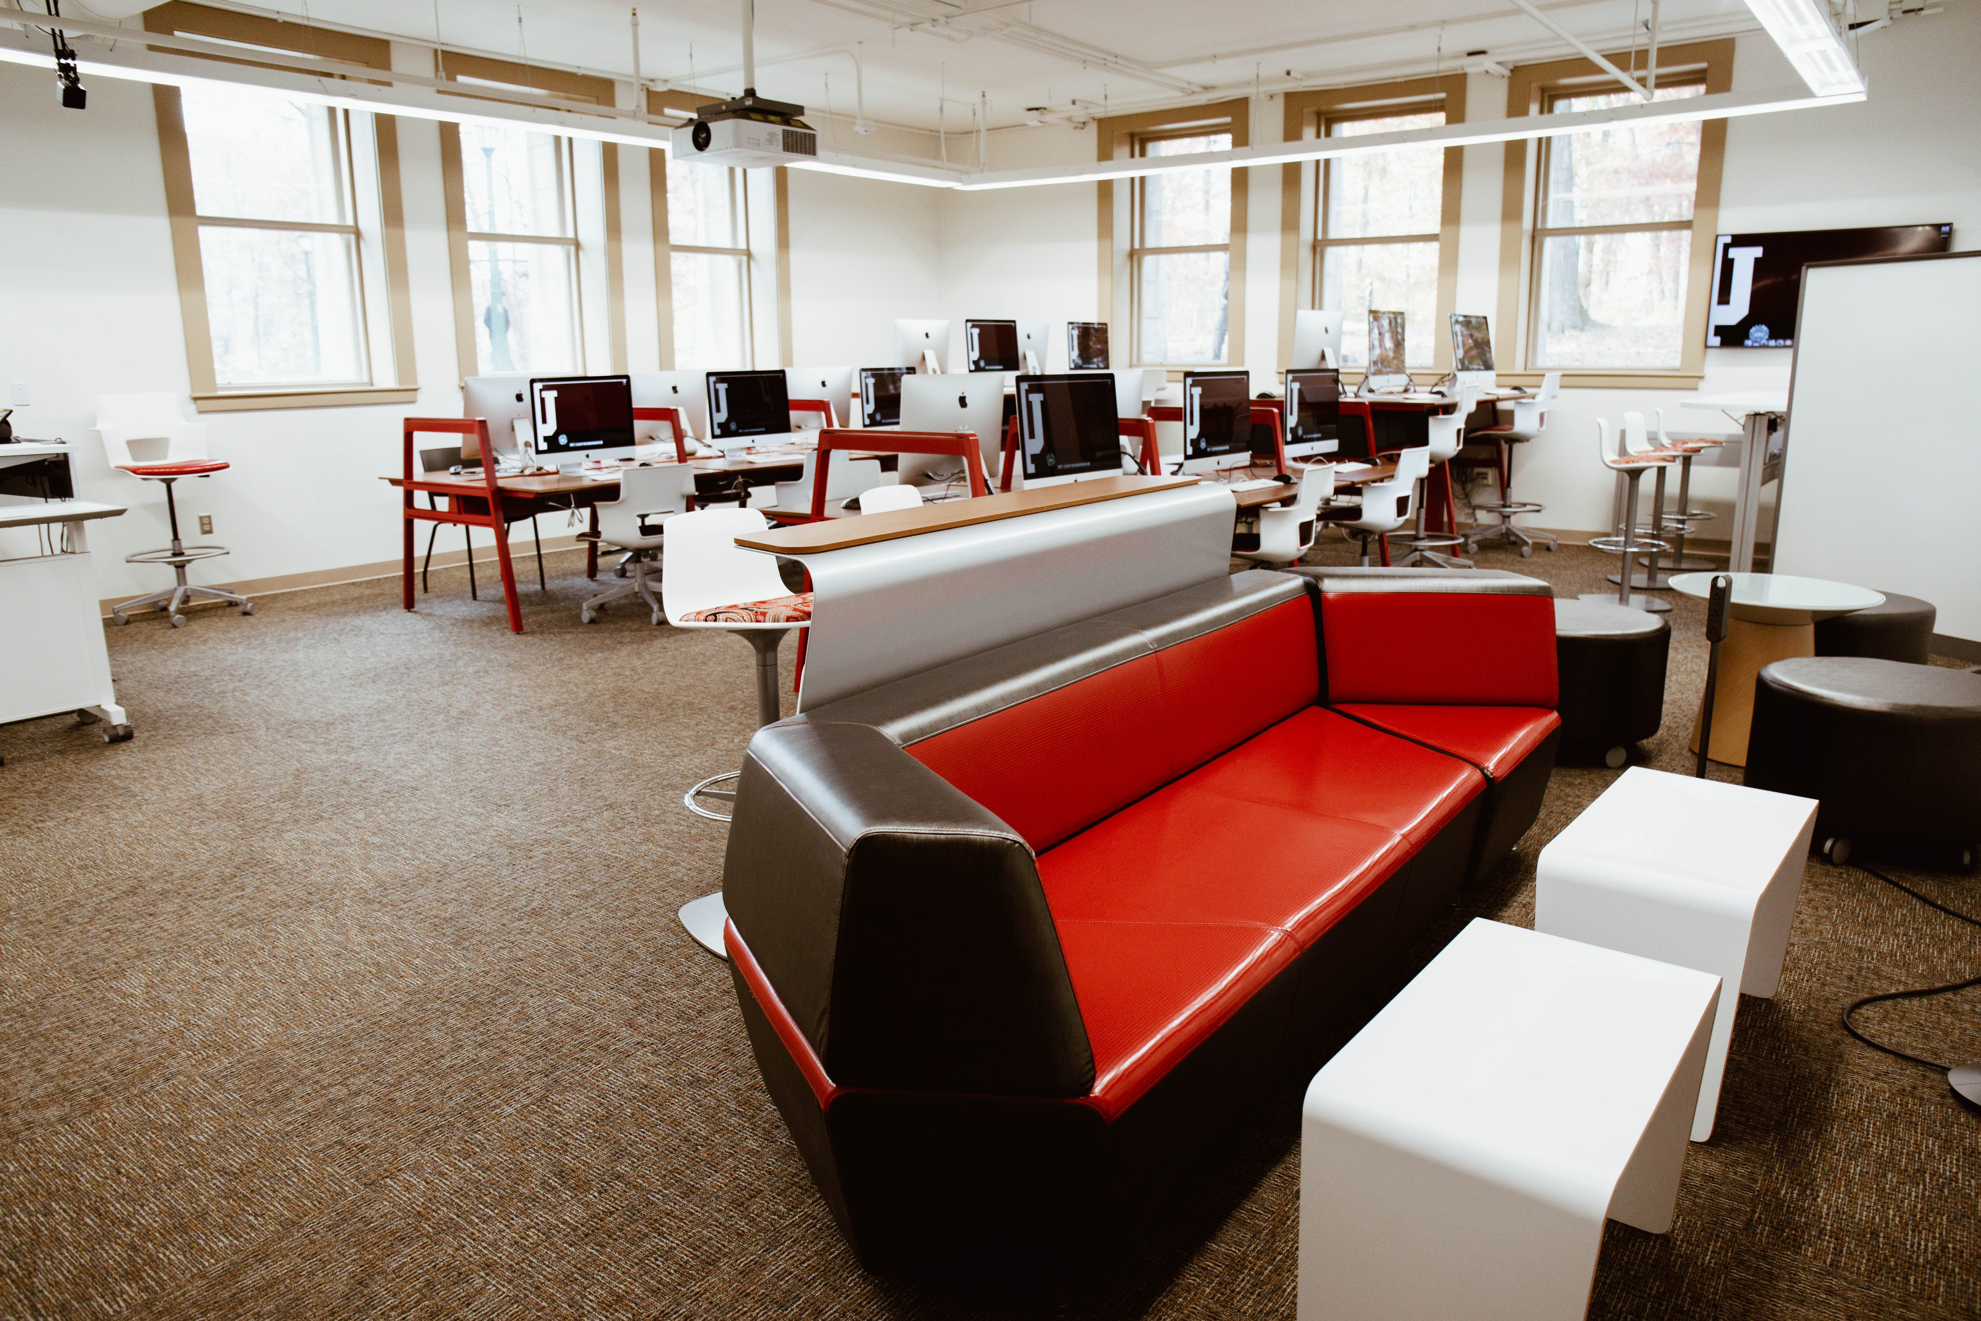
Kirkwood Hall 016 – A small ALC with a computer lab, VR area, and breakout areas.

Slide 11
“Problem” in ALC research + opportunity
Typical approach: ALC treatments are compared to traditional classrooms using quantitative measures + quasi-experimental research designs (e.g., Baepler, Walker, & Driessan, 2014; Brooks, 2012; Byers, Imms, & Hartnell-Young, 2014; Cotner et al., 2013; Stoltzfus & Libarkin, 2016)
Research methods which focus primarily on end-of-term learning outcomes fail to analyze why certain pedagogies are effective in certain contexts (Radcliffe, Wilson, Powell, & Tibbetts, 2008)

Slide 12
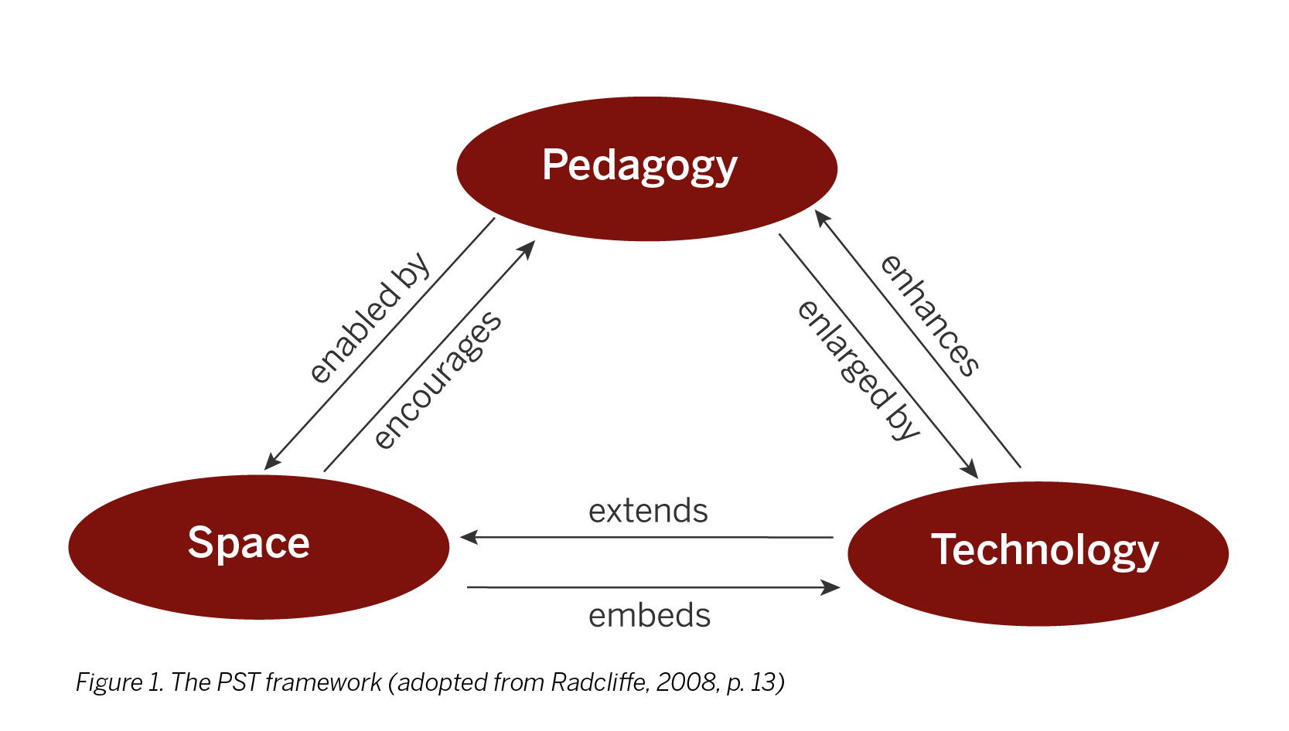
Theoretical Framework
Pedagogy-Space-Technology framework
(Radcliffe, Wilson, Powell, & Tibbetts, 2008)
Notes:
- Each element is considered influential to each other
IDEA: shape and use of a space influences desired pedagogies.
No matter the intended use of a space, the learning environment influences how people interact within that space,
This includes teaching and learning patterns
Within this context, spaces can also present opportunities or constraints on the introduction of certain technologies
JUST as technologies can impact how teachers and students use a space (Radcliffe et al., 2008).
Shape/use of space influences desired pedagogies
Environment influences interact within space
Spaces present opportunities/constraints of certain technologies
(Tondeur, De Bruyne, Van Den Driessche, McKenney, & Zandvliet, 2015)

Slide 13
Methods selection for ALC research
Consider:
Research questions posed
Dimensions of pedagogy: specified, enacted and experienced (Nind, Hall, & Curtin, 2017)
Looking beyond physical ALC; online activities matter (Ellis & Goodyear, 2016)

Slide 14
Researching specified pedagogies in ALCs
Perceptions of learning space design (e.g., FLEXspace; Casanova & Mitchell, 2017)
How configurations influence spatial hierarchy (Smith, 2017)

Slide 15
Researching enacted pedagogies in ALCs
Observations (Brooks, 2012; Cotner et al., 2013; Parsons, 2016)
Video (Chen, 2015; Lee, Arthur, & Morrone, 2014)
NEW! Video Platforms (Roman & Uttamchandani, in press)

Slide 16
Researching experienced pedagogies in ALCs
Reflections/ “flashbacks” or “re-captures” (Ramsay, Guo, & Baepler, 2017)
Focus groups/Interviews (Parsons, 2017; Adedokun, Parker, Henke, & Burgess, 2017)
Survey Methods (new SCALE instrument) (Walker & Baepler, 2017)
Notes:
How they work. Instructors are invited to reflect on—re-capture, in fact—how classroom configurations impacted their instruction.

Slide 17
Our approach: Video platform data
Three components required:
Lecture capture software (e.g., Echo360/Kaltura)
Wall mounted camera (or a high quality web cam)
Audio recording device*
Key Benefits
Pedagogical benefits for students/faculty
Allows for movement/camera are discrete
Ability to quickly observe affordances used/learning behaviors

Slide 18
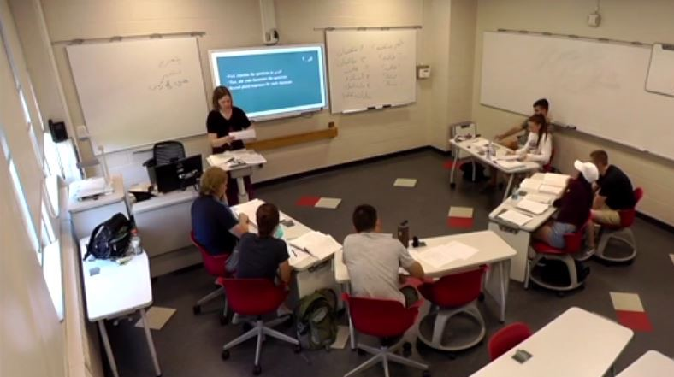
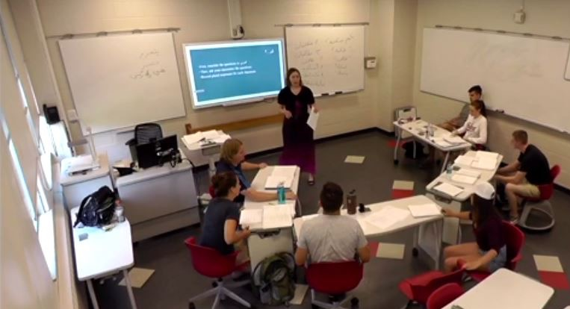
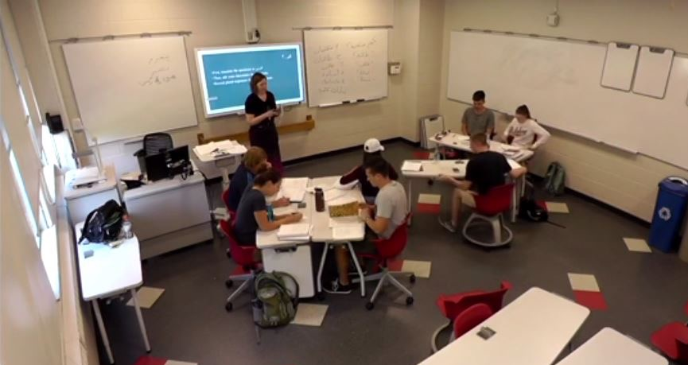
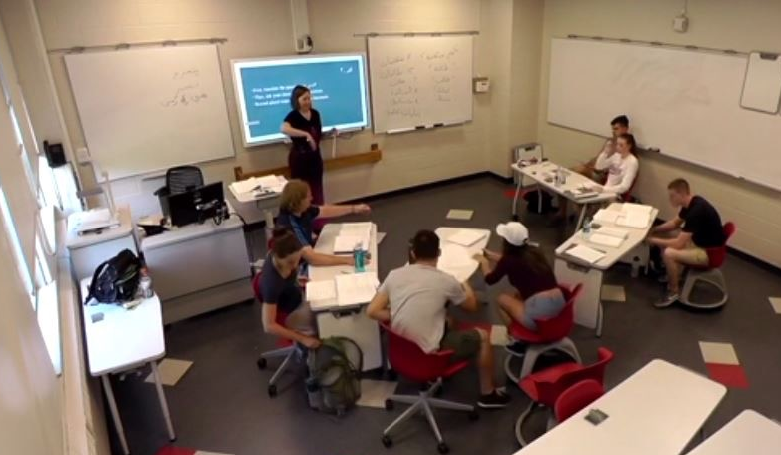
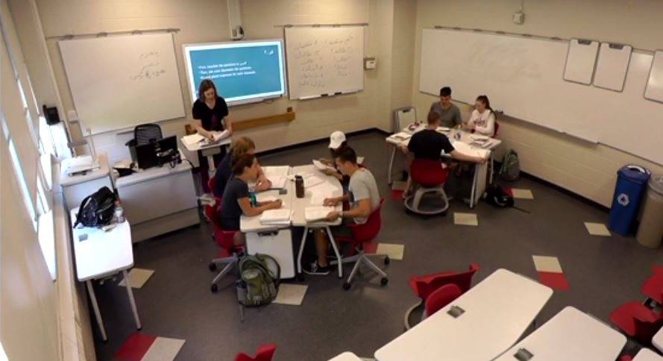

Slide 19
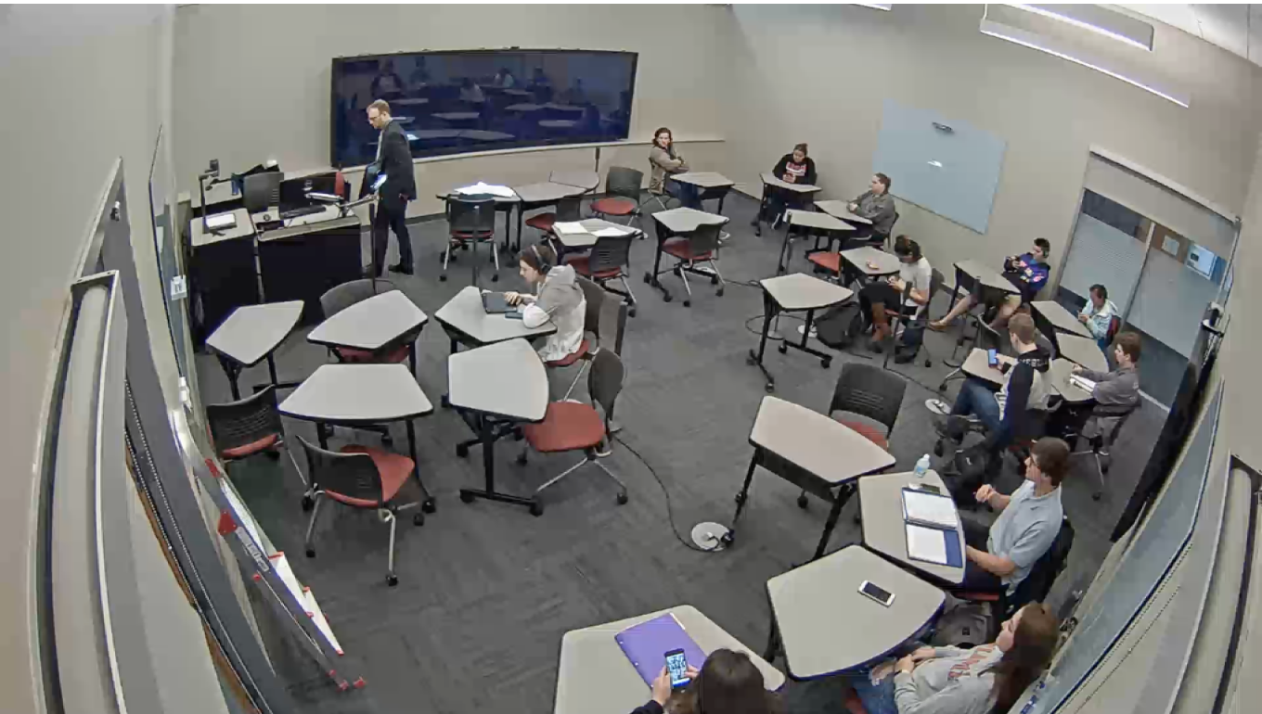
Still image from Active Learning Classroom in action
Notes:
Scroll through quickly so that people can see what is going on

Slide 20
Potential Issues with Video Platform Data
Challenges of using video data
Potential loss of data/logistical challenges
Technological costs
Extensive amount of data
ALC room size
Human Factors: Not all individuals like being recorded.
Additional Considerations
Learning curve of Atlas.ti or other CAQDAS programs
Time/resources/aims of analysis

Slide 21
Our Coding Scheme for small ALCs (see handout)
Instructor activity
Prep
Monitoring
Consulting
Instruction
Interactive instruction
Student activity
Whole class activity
Independent student work
Individual exam
Group activity/discussion
Dynamic
Independent
Mix of IND and DYN groups
Student presentation

Slide 22
Our Coding Scheme for small ALCs (see handout)
Technology Use
Computer (instructor)
Board + Type + Use*
Projection + Type*
Student Mobile Device
Student Personal Computer
Student Projection of Mobile Technologies
Configuration
Circle
Row
Cluster
Instructor Movement
Standing
Active
Student Movement
Standing
Active

Slide 23
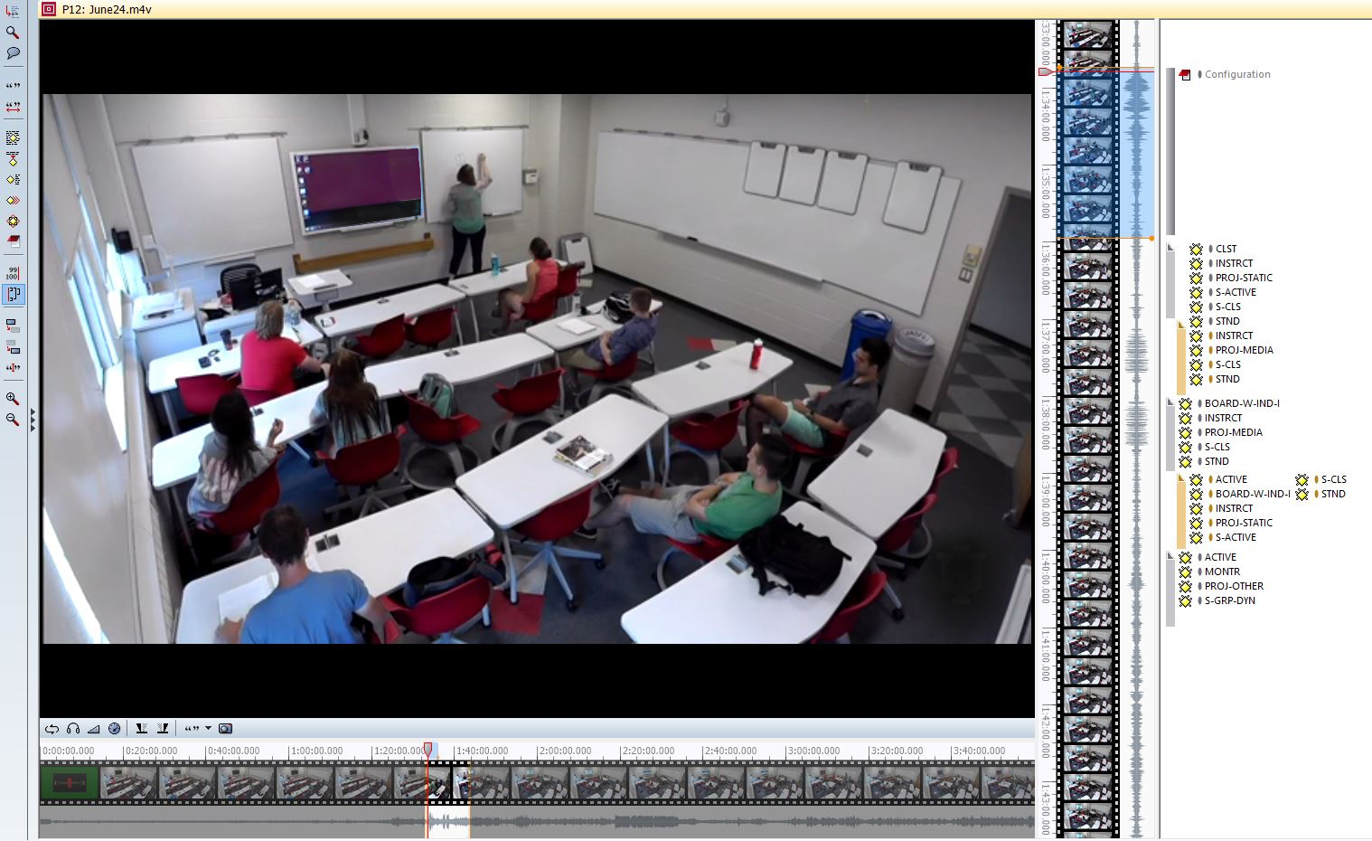
Visual of Applied Codes in Atlas.ti
Notes:
Five min. of every fifteen min. coded. (60 min. of every four hour class).

Slide 24
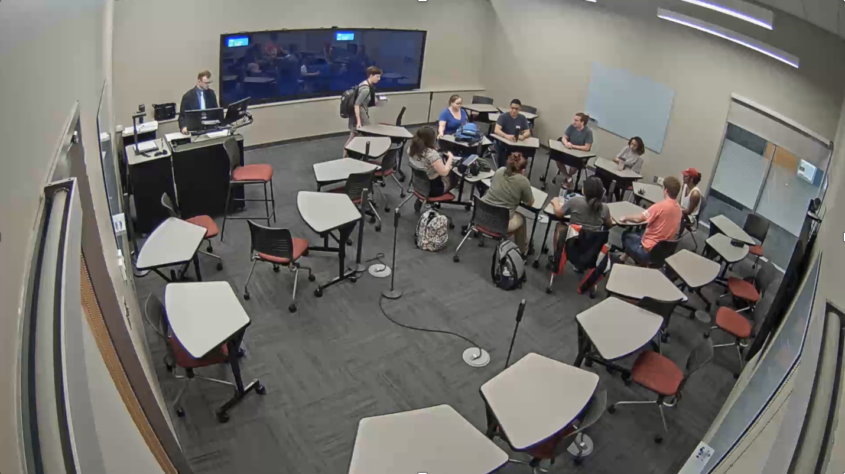
Your turn to practice coding video with a partner! Link: bit.ly/ALC-methods

Slide 25
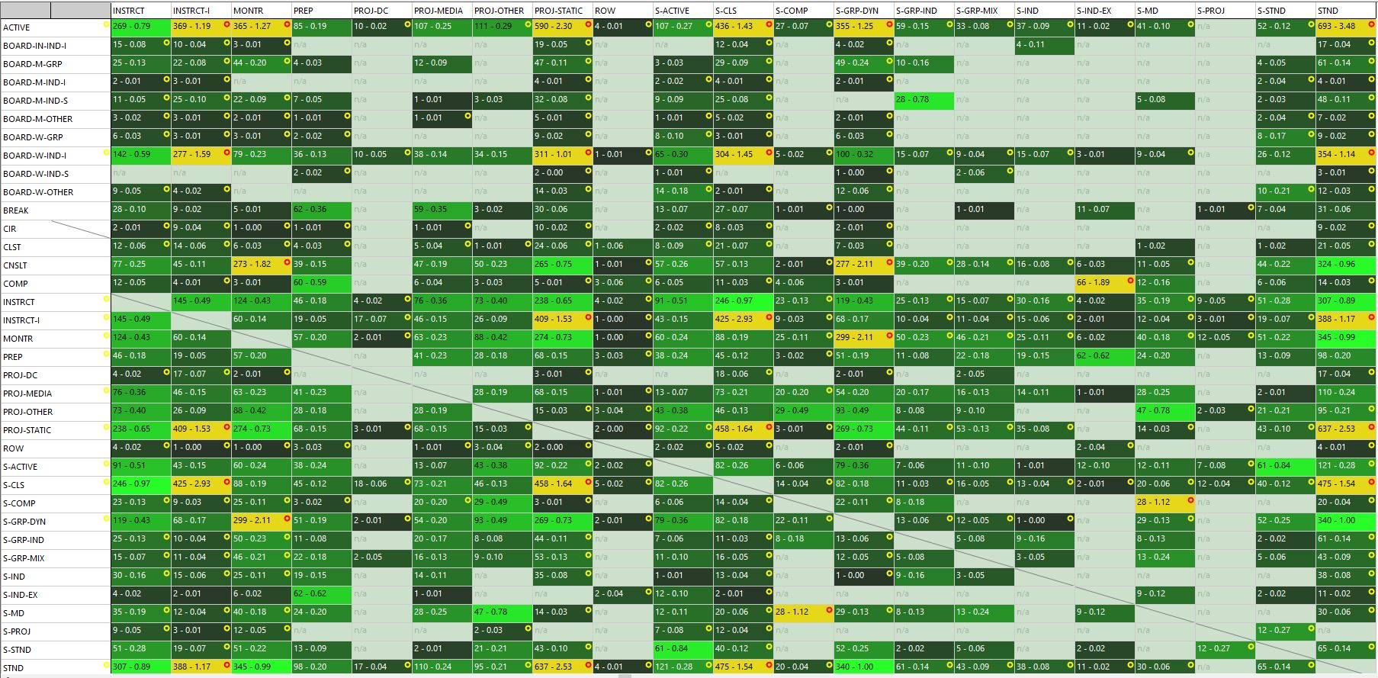
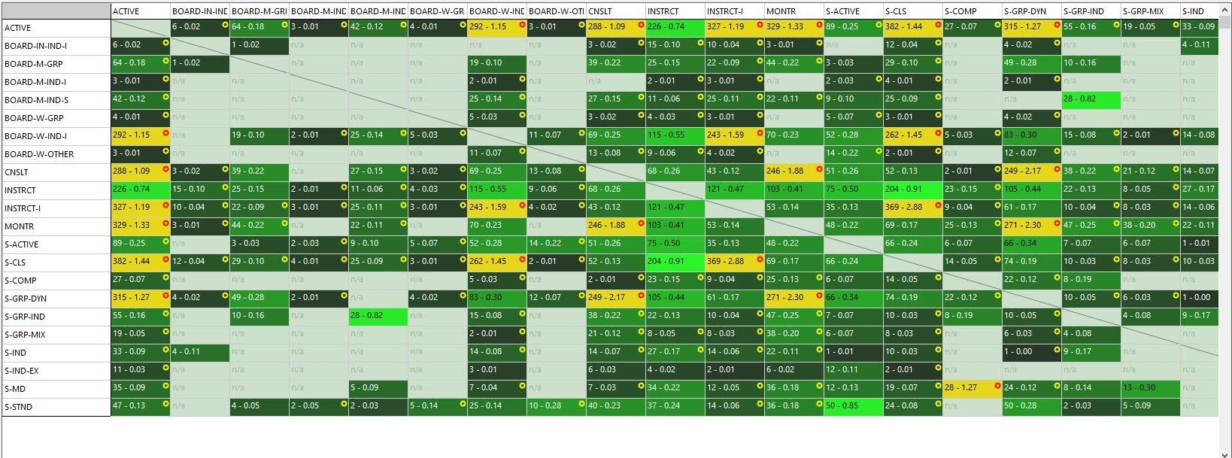
Analysis within Atlas.ti
Notes:
Five min. of every fifteen min. coded. (60 min. of every four hour class).

Slide 26
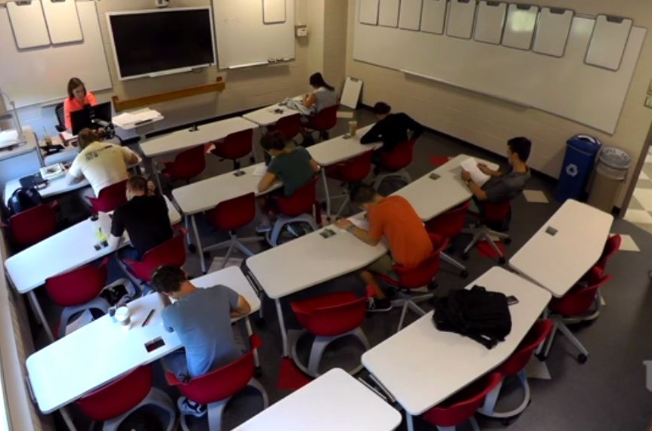
Following an exam, students were asked how they wanted to reconfigure.

Slide 27
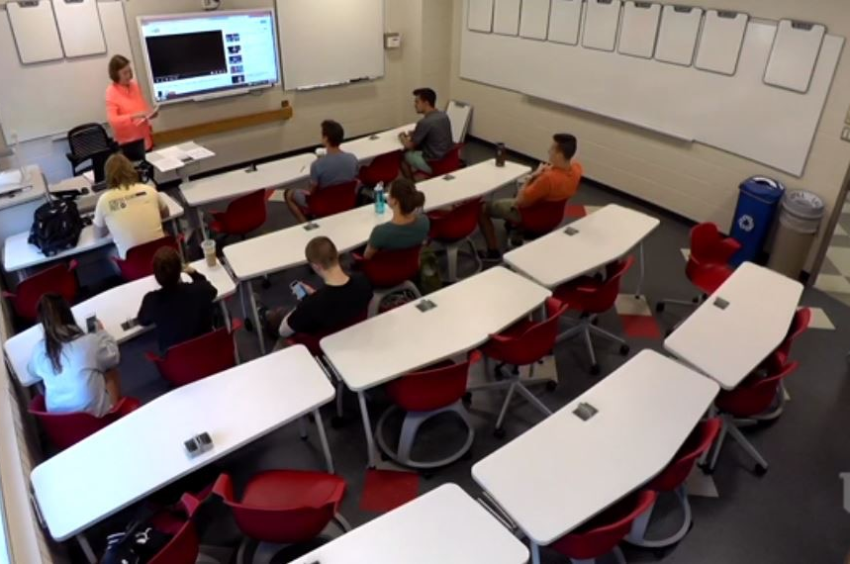
This is the configuration the students selected (so audio is an important factor).

Slide 28
Methods for Researching Teaching + Learning Activities
within Small Active Learning Classrooms
Tiffany Roman | taroman@indiana.edu
Indiana University
Anastasia S. Morrone | amorrone@iu.edu
Indiana University
Paper link: https://iu.box.edu/v/ALC-methods

Slide 29
References
Adedokun, O. A., Parker, L. C., Henke, J. N.,& Burgess, W. D. (2017). Student perceptions of a 21st century learning space. Journal of Learning Spaces, 6(1).
Baepler, P., Walker, J. D., & Driessen, M. (2014). It's not about seat time: Blending, flipping,
and efficiency in active learning classrooms. Computers & Education, 78, 227-236.
Brooks, D. C. (2012). Space and consequences: The impact of different formal learning spaces on instructor and student behavior. Journal of Learning Spaces, 1(2).
Byers, T., Imms, W., & Hartnell-Young, E. (2014). Making the case for space: The effect of
learning spaces on teaching and learning. Curriculum and Teaching, 29(1), 5-19.
Casanova, D., & Mitchell, P. (2017). The ‘Cube’ and the ‘Poppy Flower’: Participatory approaches for designing technology-enhanced learning spaces. Journal of Learning Spaces, 6(3).
Chen, V. (2015). From distraction to contribution: A preliminary study on how peers outside
the group can contribute to students’ learning. The Canadian Journal for the Scholarship of Teaching and Learning, 6(3), 1-14.

Slide 30
References
Cotner, S., Loper, J., Walker, J. D., & Brooks, D. C. (2013). “It's not you, it's the room”—Are the high-tech, active learning classrooms worth it? Journal of College Science Teaching, 42(6), 82-88.
Ellis, R. A., & Goodyear, P. (2016). Models of learning space: integrating research on space, place and learning in higher education. Review of Education, 4(2), 149-191.
Lee, D., Arthur, I. T., & Morrone, A. S. (2015). Using video surveillance footage to support validity of self-reported classroom data. International Journal of Research & Method in Education, 1-27.
Nind, M., Hall, K., & Curtin, A. (2016). Research methods for pedagogy. London, UK: Bloomsbury Publishing.
Parsons, C. S. (2016). Space and consequences: The influence of the roundtable classroom design on student dialogue. Journal of Learning Spaces, 5(2).
Parsons, C. S. (2017). Reforming the Environment: The influence of the roundtable classroom design on interactive learning. Journal of Learning Spaces, 6(3).

Slide 31
References
Radcliffe, D., Wilson, H., Powell, D., & Tibbetts, B. (2008). Designing the next generation
places of learning: Collaboration at the pedagogy-space-technology nexus. The
University of Queensland.
Ramsay, C. M., Guo, X., & Pursel, B. K. (2017). Leveraging faculty reflective practice to understand active learning spaces: Flashbacks and re-captures. Journal of Learning Spaces, 6(3).
Roman, T. A., & Uttamchandani, S. (in press). Researching pedagogy within small active learning classrooms: Examining enacted pedagogies of learner and instructor interactions. International Journal of Research & Method in Education.
Smith, C. (2017). The influence of hierarchy and layout geometry in the design of learning
spaces. Journal of Learning Spaces, 6(3).
Stoltzfus, J. R., & Libarkin, J. (2016). Does the room matter? Active learning in traditional and enhanced lecture spaces. CBE-Life Sciences Education, 15(4).
Walker, J. D.,& Baepler, P. (2017). Measuring Social Relations in New Classroom Spaces: Development and Validation of the Social Context and Learning Environments (SCALE) Survey. Journal of Learning Spaces, 6(3).

