Slide 1
Make it Personal: Using Data to Inform Faculty Professional Development

Slide 2
Session Objectives:
Guiding Questions
How can a competency-based needs assessment be used to personalize digital fluency faculty development?
How can you develop a competency-based assessment relevant to the faculty needs at your institution?
How can faculty developers plan programming based on data from a competency-based needs assessment?

Slide 3
Introduction of Context
Networked Learning Initiatives (NLI) a department of Technology-enhanced Learning and Online Strategies serves as professional development platform for Virginia Tech faculty.
~1200 faculty interact with a NLI touch point yearly with ~500 engaged in at least 12 hours of professional development

Slide 7
Faculty Personas (from Curedale, 2013)
When interacting with the education experience…
An archetypal character to represent a group of users who share common:
1. goals,
2. attitudes,
3. experiences,
4. needs, and behaviors

Slide 8
Pilot for Competencies and Need Assessment
Developed with a cross-institutional advisory group of units and departments with strategic goals related to professional development.
Needs assessment based on weighted deviation score of two self-identified variables:
Importance of competency to current faculty role
Proficiency with the competency.
Development of automated recommended for personalization.

Slide 9
Needs Assessment

Slide 16
Lessons Learned and Next Steps
Needs assessment structure encourages bias.
Competencies are not well described—
Better definition of competency in next version
Ongoing continuous improvement with curriculum advisory group.
Competencies do not afford movement/placement within a proven fluency model

Slide 17
Digital Fluency
New tool—
SAMR model
What activities took place along journey to expert?
How can organization facilitate the journey?
Moving being competent—to creating new practice.

Slide 18
How do you change the world?
Competency/Creativity Development Model
(Skills/Perspectives)
!
Creative Mastery
Capacity for Impact
Proficiency
Motivation Thresholds
Productivity
Appreciation
Familiarity
Time/Effort
This work is licensed under a Creative Commons Attribution-NonCommercial-ShareAlike 4.0 International License.

Slide 19
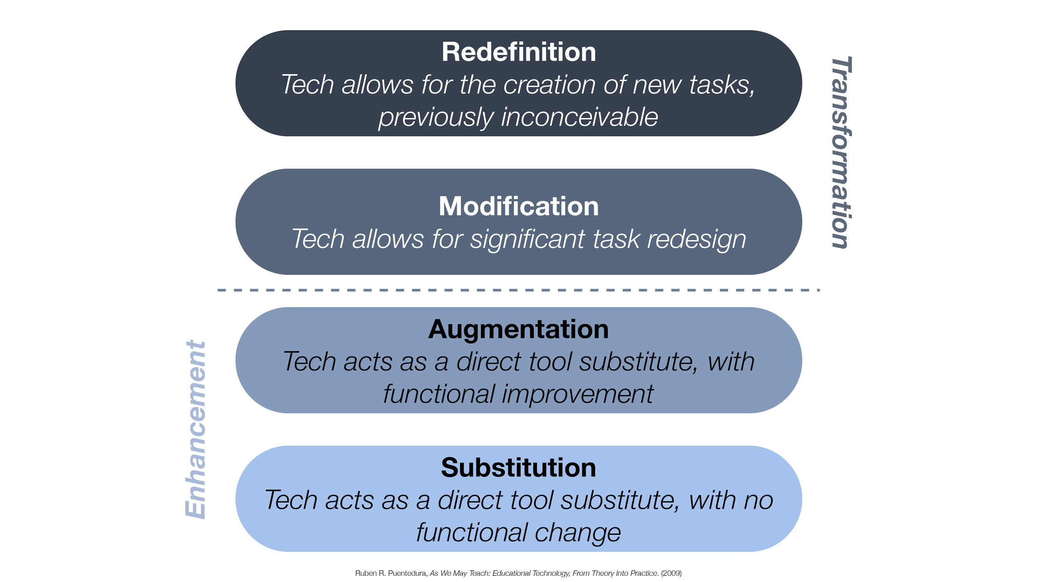
SAMR Model (Rueben R. Puentedura)
Reuben R. Puentedura, As We May Teach: Educational Technology, From Theory Into Practice (2003)

Slide 20
How do you change the world?
Competency/Creativity Development Model
(Skills/Perspectives)
!
Substitution
Augmentation
Modification
Redefinition
Creative Mastery
Capacity for Impact
Proficiency
Motivation Thresholds
Productivity
Appreciation
Familiarity
Time/Effort
This work is licensed under a Creative Commons Attribution-NonCommercial-ShareAlike 4.0 International License.

Slide 21
Planning Activity
Differentiating Programming for Faculty
SUBSTITUTION
AUGMENTATION
MODIFICATION
REDEFINITION

Slide 22
QUESTIONS?

