Slide 1
Our Journey to a 90% Student-Run Service Desk
Richard Musal & Gregory Quaglieni

Slide 2
Who Are We?
Richard Musal - Director of Client Services & Operations
Responsible for Computer Labs, Classroom Technology, Service Desk, & Training
TeamDynamix Functional Admin
Gregory Quaglieni - IT Support Specialist II of Operations
Coordinator for the Operations Team
Responsible for Classroom and Computer Lab Technology

Slide 3
Manhattan College Overview
Lasallian Catholic College founded in 1853
Original Location was Manhattanville, NYC
Current Location is Bronx, NY
Approximately 4,000 Students
Undergraduate Schools
Business
Continuing & Professional Studies
Education & Health
Engineering
Liberal Arts
Science
Graduate Programs
MBA
Counseling
Education
Engineering
Leadership
Mathematics
STEM

Slide 4
ITS Client Services & Operations Hierarchy
Richard Musal
Director of Client Services & Operations
Eileen McIntyre Ryan Fiore Gregory Quaglieni Anita McCarthy
Help Desk Manager IT Support Specialist IT Support Specialist II ITS Training Coordinator
(North Campus) of Client Services of Operations
(South Campus)
Student workers Student workers Student workers Student workers
(15) (15) (10) (2)

Slide 5
Presentation Overview
Why 90% Student-Run?
What Challenges Did We Face?
How Did We Overcome These Challenges?
End Result...Does It Work?!
Questions/Comments

Slide 6
Poll Slide: Student Worker Utilization

Slide 7
Why 90% Student-Run?

Slide 8
Why 90% Student-Run?
Not Enough Full-timers
2 Client Services, 1 Operations, 1 Trainer
Budget doesn’t allow for more
Student Workers are Budget-Friendly
Minimum wage
4 Year Plan
Guaranteed 4 years (unless they quit or get fired)
Cycle of new knowledge/ideas

Slide 9
What Challenges Did We Face?

Slide 10
What Challenges Did We Face?
Morale
Domino effect
Turn Over
Consistent Experience
Cycle
Skills
Management
Technical

Slide 11
How Did We Overcome These Challenges?

Slide 12
How Did We Overcome These Challenges?
Policies and Performance Agreement
Attendance expectation including days off allowed
Penalty Point System
Evaluations
Signature Page
Hierarchy
Empowering
Management (Resource Manager) Track
Technical (Technician) Track
Succession Planning
Smart Scheduling
Training
Hands-on, Moodle & KBAs
Management
Technician
Procedural

Slide 13
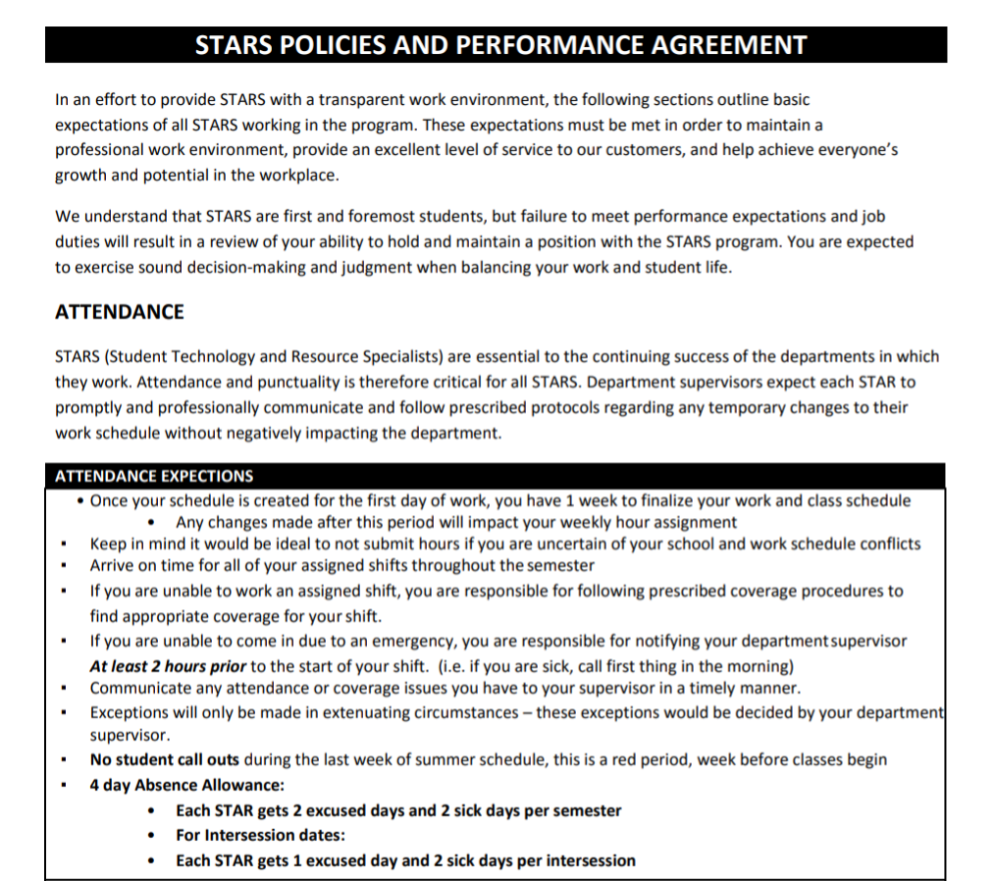

Slide 14
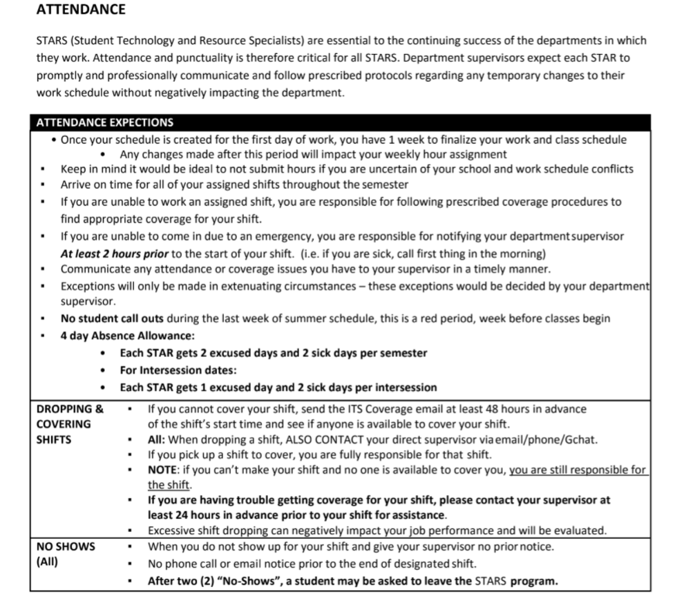

Slide 16
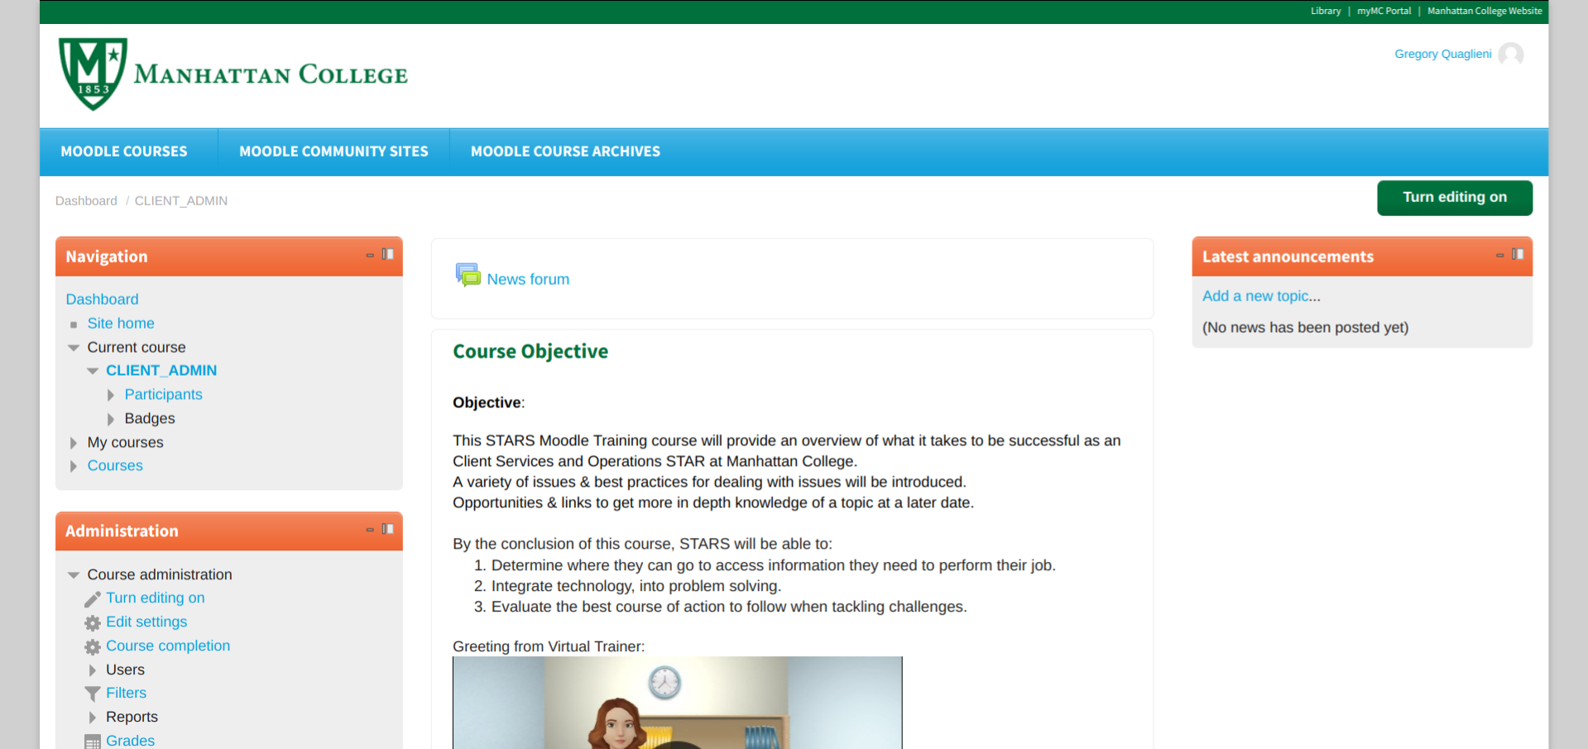
Moodle Course

Slide 17
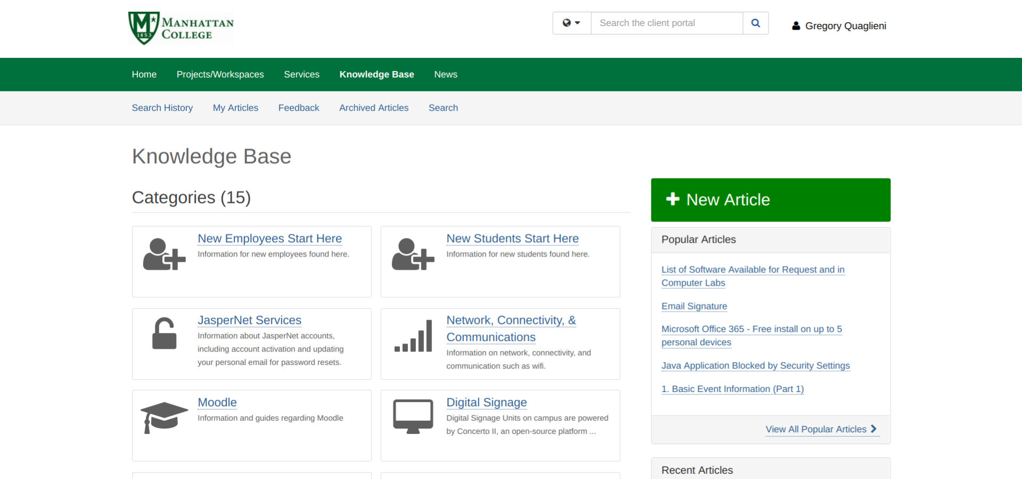
Knowledge Base

Slide 18
End Result...Does It Work?!

Slide 19
End Result...Does It Work?!
Less Turn Over
Give them reasons to stay
Skills
Increase in Applicants
Students want to work for ITS
Not just a “job”
Morale Improved
Skills/Confidence Improved
They like to be challenged
KPI Reports Prove It

Slide 20
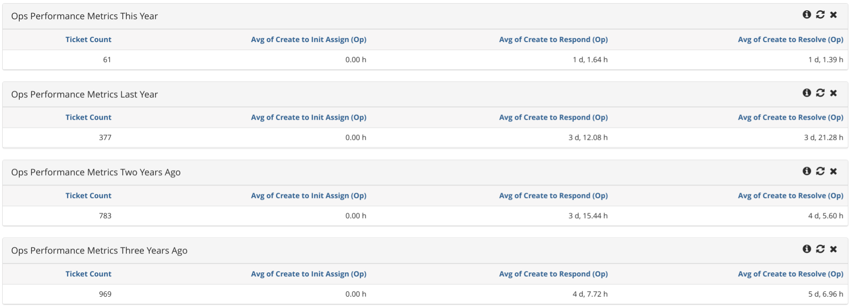
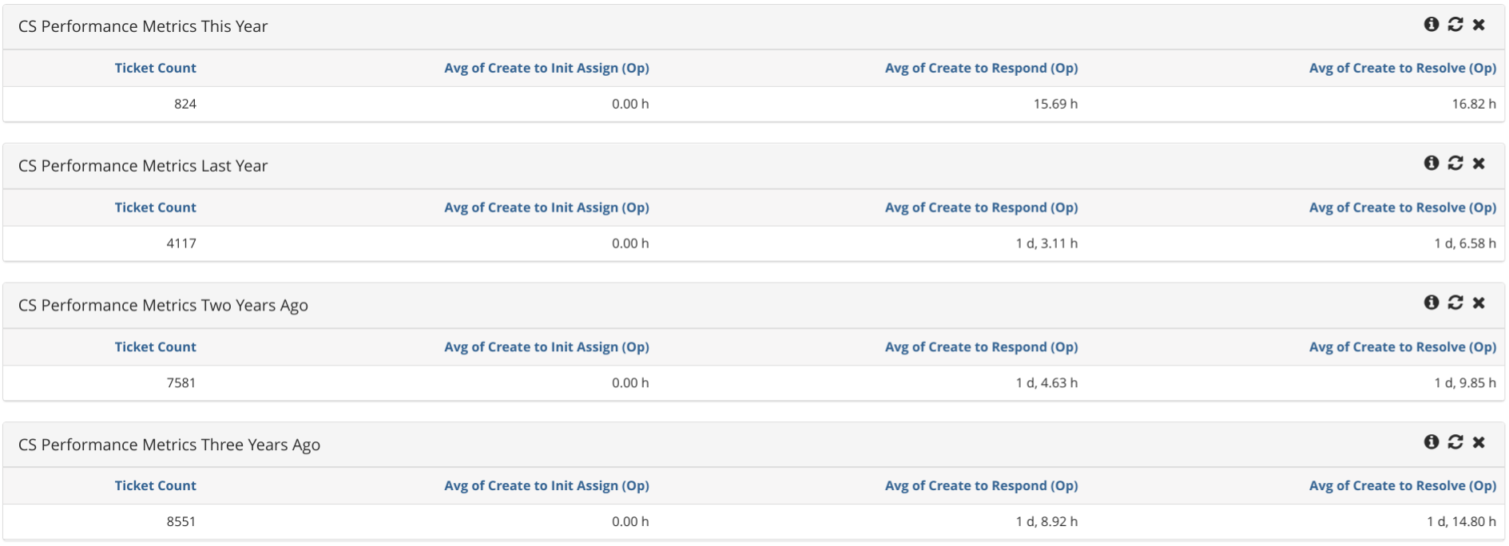

Slide 21
Questions/Comments

Slide 22
Thank You For Attending!
Please take a moment to evaluate this session
There are two ways to access the session and presenter evaluations:
In the online agenda, click on the “Evaluate Session” link
2. From the mobile app, click on the session you want from the schedule > then click the associated resources > and the evaluation will pop up in the list

