Slide 1
Cloud 101 – For the Security Team Nick Lewis, Internet2
Copyright Intertnet2

Slide 2
“Cloud 101” Workshop
Today’s Agenda
Welcome
Preparing for Cloud
Procuring & Contracting
General Information Security Issues in the Cloud
Using HECVAT and REN-ISAC CBI as Part of Your Cloud Strategy
Using Internet2 and InCommon to Implement your Cloud Strategy
Enterprise Service Selection Roleplay
Notes:
Welcome an conceptual framing
This is an adapted version of the Internet2 Cloud Services Workshop for the security team
When I say security team, it could include many different things – infosec, physical, BCDRP, policy, incident response, privacy, ITGRC, etc.

Slide 3
Objectives
Understand a “cloud strategy” & how to develop one
How to integrate the information security team into your cloud strategy
Articulate the challenges and techniques of procuring cloud services
Recognize the importance of legal agreements for cloud services; analyze some common legal terms and concepts
Avoiding negotiation mistakes and confronting tricky situations
Learn how community efforts through HECVAT, InCommon, and Internet2 Cloud Services help

Slide 4
Introductions
“Having heard these five objectives; your name, your school, and why you are here...”
Where are you in your cloud journey?
When you say infosec, what do you mean?
When you say cloud, what do you mean?

Slide 5
So you want a “Cloud Strategy”?
What does that mean?
Why do you want one?
What does that mean for your department?
What does that mean for other departments?
I’ve got one; now what do I do?

Slide 6
So you want a “Cloud Strategy” - What does that mean?
Deciding to procure all future services via the Cloud.
Having a decision process for deciding when to go to the Cloud [and NOT to go to the Cloud]
Having a decision process for procuring services via cloud services.
Don’t know.

Slide 7
So you want a “Cloud Strategy” - Why?
Because the EVP/Provost/Chancellor read about it on an airline magazine…
The faculty are already there
Because without it, there is chaos
Or…

Slide 8
So you want a “Cloud Strategy” - What does that mean for IT/other depts?
New policies and procedures
New systems
Totally new approaches
New/retrained people

Slide 9
So you want a “Cloud Strategy” - What does that mean for infosec?
Opportunity!
Updating processes to include infosec
Focusing on data, integrations, and ITGRC
Lots of new projects and assessments

Slide 10
So you want a “Cloud Strategy” - So now what do I do?
Assign it to my deputy
Create a new position
Hire more/fewer people
Retrain people
Or…

Slide 11
So you want a “Cloud Strategy” - So now what does infosec do?
Same thing as rest of IT!
Integrate into existing business processes
Integrate with contracts, legal, etc
Awareness campaigns
Policy

Slide 12
Status Quo
All Cloud/All the Time
“Cloud First, But Not Always”

Slide 13
Preparing for Cloud

Slide 14
Preparing for Cloud
What do we mean by “cloud”?
What drives us to cloud services?
Understanding cloud scale and the value proposition of cloud
Staffing and change management

Slide 15
What do we mean by “cloud”?
“[Cloud computing is a] paradigm for enabling network access to a scalable and elastic pool of sharable physical or virtual resources with on-demand self-service provisioning and administration.”
Source: ISO 17788:2014
“Cloud computing: overview and vocabulary”

Slide 16
What do we mean by “cloud”?
“[Cloud computing is a] paradigm for enabling network access to a scalable and elastic pool of sharable physical or virtual resources with on-demand self-service provisioning and administration.”
Source: ISO 17788:2014
“Cloud computing: overview and vocabulary”

Slide 17
What do we mean by “cloud”?
“[Cloud computing is a] paradigm for enabling network access to a scalable and elastic pool of sharable physical or virtual resources with on-demand self-service provisioning and administration.”
Source: ISO 17788:2014
“Cloud computing: overview and vocabulary”

Slide 18
What do we mean by “cloud”?
“[Cloud computing is a] paradigm for enabling network access to a scalable and elastic pool of sharable physical or virtual resources with on-demand self-service provisioning and administration.”
Source: ISO 17788:2014
“Cloud computing: overview and vocabulary”

Slide 19
What do we mean by “cloud”?
“[Cloud computing is a] paradigm for enabling network access to a scalable and elastic pool of sharable physical or virtual resources with on-demand self-service provisioning and administration.”
Source: ISO 17788:2014
“Cloud computing: overview and vocabulary”

Slide 20
What do we mean by “cloud”?
“[Cloud computing is a] paradigm for enabling network access to a scalable and elastic pool of sharable physical or virtual resources with on-demand self-service provisioning and administration.”
Source: ISO 17788:2014
“Cloud computing: overview and vocabulary”

Slide 21
What do we mean by “cloud”? (NIST)
Cloud computing is a model for enabling convenient, on-demand network access to a shared pool of configurable computing resources (e.g., networks, servers, storage, applications, and services) that can be rapidly provisioned and released with minimal management effort or service provider interaction. This cloud model promotes availability and is composed of five essential characteristics (On-demand self-service, Broad network access, Resource pooling, Rapid elasticity, Measured Service); three service models (Cloud Software as a Service (SaaS), Cloud Platform as a Service (PaaS), Cloud Infrastructure as a Service (IaaS)); and, four deployment models (Private cloud, Community cloud, Public cloud, Hybrid cloud). Key enabling technologies include: (1) fast wide-area networks, (2) powerful, inexpensive server computers, and (3) high-performance virtualization for commodity hardware.
Source: NIST Cloud Computing Program - NCCP
https://www.nist.gov/programs-projects/nist-cloud-computing-program-nccp

Slide 22
What do we mean by “cloud security”?
Contracts, contracts, contracts
Securing IaaS, PaaS, SaaS, and *aaS services
Securing your usage of AWS, Azure, GCP, etc
Cloud Access Security Brokers
Security services from the Cloud

Slide 23
What drives us to cloud services?

Slide 24
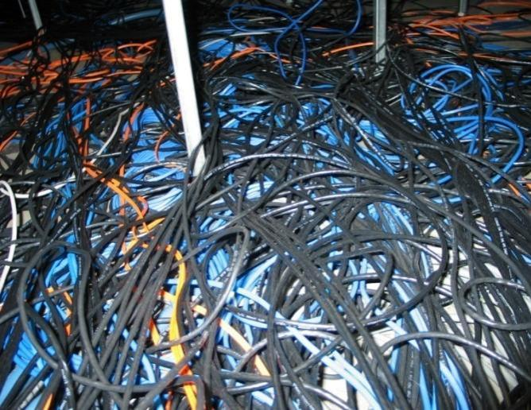
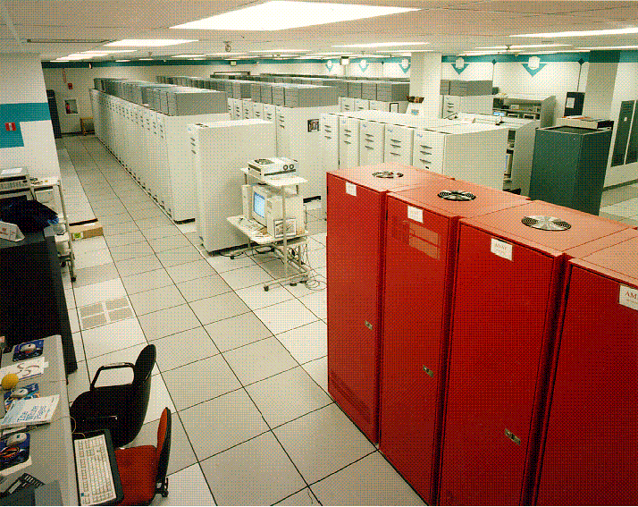
Aging Infrastructure & Replacement

Slide 25
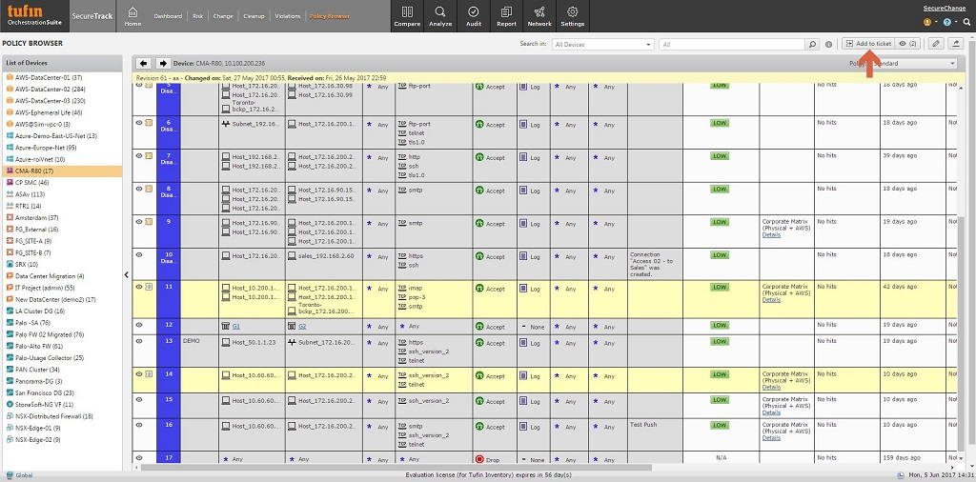
Aging Infrastructure & Replacement -Infosec style

Slide 26
What drives infosec to cloud services?
Opportunity!
To replace old and insecure systems
Adopt new services to address current problems
Remove some of the operational aspects

Slide 27
Insufficient Resources and Skills
Notes:
We don’t have the staff or the expertise (technology or application) to do the job

Slide 28
Requests (Demands?) from End Users

Slide 29
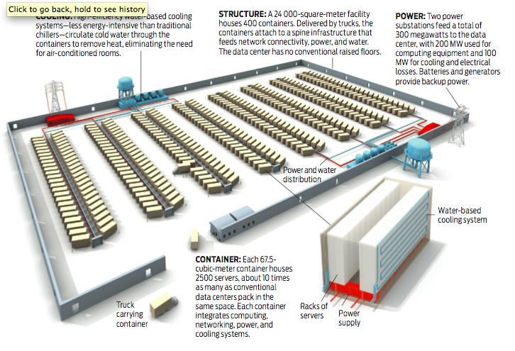
Cloud Scale:
Diagram of One Facility

Slide 30
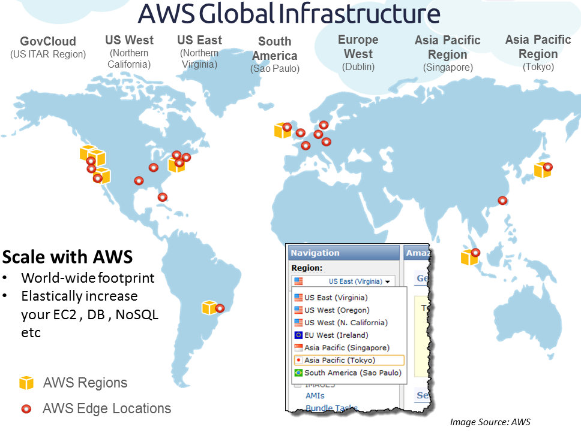
Cloud Scale:
One Provider’s Footprint
Multiple Regions / Availability Zones
Multiple Datacenters
10,000s of servers
100,000s of cores
(Note: updated frequently…)

Slide 31
Cloud Scale: Growth
Every day AWS adds the same server capacity as:
Its entire infrastructure had in 2004?
Would be needed to support $7 billion company?
Source: James Hamilton, VP and Distinguished Engineer; “AWS Innovation at Scale” AWS Re:Invent 2014

Slide 32
Cloud Scale: Growth
Every day AWS adds the same server capacity as:
Answer: Both
Its entire infrastructure had in 2004
Would be needed to support a $7 billion company
Source: James Hamilton, VP and Distinguished Engineer; “AWS Innovation at Scale” AWS Re:Invent 2014

Slide 33
Cloud Scale: Pace of Innovation
Amazon Web Services new services and major features:
2008: 24
2009: 48
2012: 159
2014: 449
2015: 600+
“We are iterating and adding features at a very fast clip”
- Andy Jassy, AWS CEO
Source: James Hamilton, VP and Distinguished Engineer; “AWS Innovation at Scale” AWS Re:Invent

Slide 34
Change Management
People as well as Products
Difficult at all levels
Leadership
IT Staff
All Staff
Faculty
Students too

Slide 35
Change Management – Security teams
People as well as Products
Difficult at all levels
Where to integrate security teams

Slide 36
Staffing Considerations
Moving to the cloud can be threatening
Staff are essential
Develop staffing plans
Consider a rotation

Slide 37
Preparing for Cloud
What do we mean by “cloud”?
What drives us to cloud services?
Understanding cloud scale and the value proposition of cloud
Staffing and change management

Slide 38
In the world of cloud, “contract is king”
You don’t own the hardware… You don’t own the software... All you own is the contract.

Slide 39
In the world of cloud, “contract is king”
Infosec team doesn’t own the contract
Infosec might not be able to be involved with every contract
Potentially no contract!
Data Protection Contractual Language

Slide 40
Procuring and Contracting for Cloud Services

Slide 41
Challenges of Procuring Cloud Services
Timeliness: RFP time scales do not align with “cloud speed”
Risk Management: “Click-through” agreements present challenges to university policy
Price Variability: different pricing for different schools; unexpected increases; various volume discount
Pilots and Trials: free trial may exclude that vendor from competitive consideration

Slide 42
Opportunities for Infosec in Procurement
Someone else to do some of the data collection for you
Put your requirements into RFPs
Perform risk assessment when choosing vendor

Slide 43
Procurement Timeline
CURRENT PROCUREMENT
Analyze service; prepare RFP
Analyze RFP responses
Negotiate contract terms & conditions
Sign contract
6 mo
12 mo
18 mo
Cloud needs…
Internet2: analyze service; negotiate contract
Early adopters
Univ: signs contract
60 days
120 days
18 mo
2 mo

Slide 44
Procurement Approaches Used in Higher Ed
Informal review of service providers
Formal selection process but without RFP
RFP process
RFP process with requirements based on NET+ Service Validation process
Sole source based on special features, contract terms, pricing approach
Other

Slide 45
Buying Consortium RFP Process
Consortium determines service need and issues RFP
Service Providers respond to RFP
Consortium member team evaluates RFP responses
Consortium schools order based on RFP and contract

Slide 46
The Procurement Challenge
State and university procurement rules are designed for local (individual school) analysis of products and services
The Internet2 approach is all about community analysis and contract negotiation
RFPs and competitive analysis do not necessarily result in the “best deal” when a community effort (like Internet2) is the alternative

Slide 47
Internet2 Aims to Help Supplier Management
Improves risk management by vetting service providers
Improves risk management via standard and beneficial contract terms
Ensures fair treatment in the market (no hidden clauses for other universities)
Reduces costs of administration
Leverages purchasing power of the higher ed community

Slide 48
Vendors
Universities
Internet2 solves procurement complexity once
I2 NET+
Internet2

Slide 49
Break

Slide 50
Cloud Contracts & Negotiation
Interactive Workshop: Find the Problems within the Provisions
Additional Legal Provisions and Concepts (for reference)
Common Mistakes to Avoid in Negotiations
Responding to Negotiating Lines

Slide 51
Interactive Workshop Find the Problems within the Provisions

Slide 52
Legal slides are included for reference only! Please consult with your campus counsel on legal matters.

Slide 53
Exercise 1: Data Privacy
The parties recognize the importance of preventing unauthorized entities from gaining access to Customer Data during the term of this Agreement. Provider shall take reasonable steps to protect Customer Data that it receives under this Agreement from such unlawful access, and Provider shall not knowingly share Customer Data with any third-party except in connection with Provider performing its obligations or exercising its rights under this Agreement.
If applicable, Provider will perform background checks on all personnel who have the potential to access any Customer Data.

Slide 54
Exercise 2: Payment
Customer shall pay all amounts set forth in any invoice from Provider within 30 days of the date of such invoice. Provider has the right to raise fees in connection with any renewal terms but may only raise fees during the initial term if Provider is permitted to do so under this Agreement, or any such increase does not exceed five percent (5%).
Customer’s failure to comply with Section 1 shall be deemed a material breach of this Agreement and shall permit Provider to terminate this Agreement and seek all damages permitted under law.

Slide 55
Exercise 3: Security Breach
Following Provider’s actual discovery of (a) any unlawful access to any Customer Data stored on Provider’s equipment; or (b) any unauthorized access to any such equipment that has resulted in loss of such data (each a “Security Incident”), Provider will notify Customer and the Security Incident shall thereafter be investigated. Provider shall not have any liability to Customer for any damages arising as a result of a Security Incident unless such incident is caused by Provider’s negligence or willful misconduct.

Slide 56
Exercise 4: Service Levels and Credits
Provider shall ordinarily respond to any outages of the Services within a business day after Customer notifies Provider of the outage, and Provider will thereafter use commercially reasonable efforts to resolve any issues. In any month that the mean time to repair all total outages to the Services in such month exceeds 10 hours, Customer shall receive a credit of 30% of the fees for such month as long as Customer notifies Provider by the end of the month that it wishes to receive such credit. Under no circumstances shall Customer be entitled to any refund of any fees, and other than the credit set forth above, Provider shall have no liability nor shall Customer be entitled to any other relief for any failure by Provider to provide the Services in a timely manner.

Slide 57
Exercise 5: Termination
Provider may terminate this Agreement, or just one or more Service Orders but not the entire Agreement if it so wishes, to the extent contemplated or permitted under this Agreement, including in any then current Terms of Use, Acceptable Use Policy, Privacy Policy, or other applicable document. Upon termination of this Agreement or any Service Orders, Provider is authorized to promptly delete Customer Data. If Customer wishes for Provider to provide transition services at the end of the Term, Provider shall do so if it offers such transition services at that time and if Customer agrees to Provider’s then current “Transition Services Agreement.”

Slide 58
A Few Provisions in Technology Agreements (for reference)
Limitation of Liability
Exclusions from Liability
Indemnification
Terms of Use, EULAs, Privacy Policy, etc.

Slide 59
Limitation of Liability
Each party will seek to limit its liability to the other party, but to the extent that any limitations on liability are mutual, each party will need to weigh the risk versus the benefit of agreeing to a higher versus lower dollar amount of liability (e.g., of the two parties, who is more likely to breach the agreement and cause damages).
The parties will often agree to a mutual disclaimer and waiver of liability for indirect, consequential, exemplary, punitive, special and incidental damages, although each party will frequently want certain exceptions to this exclusion

Slide 60
Limitation of Liability (cont’d)
One or both parties will want to make sure that the agreement contains an exclusion/clarification so that the disclaimer and waiver of such damages does not apply to the other party’s indemnity obligations under the agreement
Each party must also decide if it wants the agreement to contain per claim, annual, or aggregate caps on liability, or whether there should be no caps
Often, the agreement is ambiguous as to whether the cap is a per claim or aggregate cap

Slide 61
Limitation of Liability (cont’d)
Frequent Exclusions from any Caps on Liability
The indemnity obligations of a party
Damages caused by gross negligence or willful misconduct
Liability for personal injury or death caused by the negligence of a party
Violation by a party of the other party’s IP rights
Breaches of the provider’s data-related obligations
As to a customer, violations of the “restrictions” provision
Breaches of confidentiality

Slide 62
Exclusions from Liability
University Specific Exclusions
Universities often seek to avoid any liability for the actions or omissions of the following people
Students
Contractors (and particularly contractors acting outside the scope of their retention)
Employees acting outside the scope of their employment

Slide 63
Indemnification
Customers generally want providers to indemnify for, at the very least, the following:
Any allegations that the technology infringes on or violates the IP or other proprietary rights of any third party
A breach of any of provider’s data security or data privacy obligations or other data-related obligations

Slide 64
Indemnification
Some customers also try to get a provider to indemnify for the following:
Any claims brought by a provider’s contractor or agents
Any breach of the agreement by a provider
Any violation of law by a provider
Any acts or omissions of a provider

Slide 65
Indemnification (cont’d)
Providers may seek to have their indemnity obligations limited as follows:
IP (limitations). Providers may seek to limit their IP infringement obligations to (i) only certain IP claims (e.g., copyright and trademark but not patent), (ii) only IP rights existing as of the effective date of the agreement, and/or (iii) only IP rights in certain territories (e.g., the U.S. and Canada)

Slide 66
Indemnification (cont’d)
IP (exclusions). Providers may also seek the following exclusions from the IP indemnity:
No indemnity obligation if the customer fails to stop using the technology after receiving notice of the infringement
No indemnity obligation if the customer is not using the provider’s most current technology (e.g., the most current version of the applicable software)

Slide 67
Indemnification (cont’d)
IP (exclusions). Providers may also seek the following exclusions from the IP indemnity:
No indemnity obligation with respect to so-called “combination” or “misuse” claims (e.g., a claim that would not have occurred but for the combination of the provider’s technology with third-party technology)
No indemnity obligation if the applicable claim was caused by or arose out of any materials (including information) provided by customer to provider (e.g., to complete a deliverable)

Slide 68
Indemnification (cont’d)
Providers may also want their indemnity obligations limited as follows:
Data-related breaches -- Some providers will refuse to indemnify for data-related breaches and others will seek to insist on capping their liability under an indemnification for such breaches
Many providers will refuse to indemnify for the items listed under B on the prior page or at least try to further limit their obligations with respect to those matters.

Slide 69
Indemnification (cont’d)
Many providers seek to have their customers indemnify them for some or all of the following:
IP infringement of third-party rights arising from the customer data or customer technology
Violation of any restrictions set forth in the agreement (including in any terms of use)
Violations of applicable law
Any acts or omissions of a customer’s users
Customers will often push back on most, if not all, of the foregoing. When customers agree to indemnify, it is ordinarily in connection with IP infringement.

Slide 70
Terms of Use, EULA’s, Privacy Policy, etc.
It is critical that customers understand how a provider’s terms of use, EULA’s, or privacy policies impact their agreement with the provider
If a customer is not careful, these documents can undermine the rights and protections that a customer believed it was receiving under its agreement. For example, the body of a cloud services agreement may appear to greatly limit what the provider can do with customer data, but the provider’s privacy policy that is incorporated by reference may then significantly expand upon provider’s rights with respect to customer data.
Customers also need to know what rights they have if a provider modifies any of its policies in a manner than harms the customer
Notes:
On last point, if SP modifies ToS, EULA, PP, etc in a way the campus doesn’t like, then need an out of the agreement.

Slide 71
Common Mistakes to Avoid in Negotiations

Slide 72
Assuming that the Business and Technical Terms of the Deal are Accurately Reflected in the Agreement
Do not assume that just because you and the other side agree as to what the business and technical terms are, that such terms are accurately reflected in the agreement
Always review the agreement yourself to ensure the terms are accurately reflected
Also, make sure that your attorney knows the business and technical terms and that he or she is also reviewing the agreement to ensure that those terms are accurately reflected in the agreement

Slide 73
Failing to Ensure Your Opening Position Gives You Sufficient Room to Negotiate
Reasonableness without flexibility is rarely sufficient
Everyone in a negotiation wants to believe he or she has made a difference and added value for his or her clients – the other party may not believe it has added value if you do not give yourself the flexibility to compromise
Giving yourself this leeway also provides you with the flexibility to make compromises on one provision to obtain a better result with respect to another provision
By not starting with your bottom line position on a number of issues, you also will likely get a better result on some of those issues

Slide 74
Admitting Your Eagerness to Complete the Deal Very Quickly
Examples:
Telling the other side that, no matter what, the deal must be completed by the end of the week, the end of the month, or some other fixed period of time in the very near future
Telling the other side that while there are many outstanding issues right now, you are certain that the parties will reach an agreement
Telling the other party that your institution has no other viable option but to use the other party’s services

Slide 75
Admitting Your Eagerness to Complete the Deal Very Quickly (cont’d)
You can make brilliant arguments as to why certain issues should be resolved in a certain way, but if the other side knows that if, no matter how it responds to your requests, your institution will execute the agreement anyway, the other party generally has no incentive to compromise on anything of significance
Your admission that the deal must get done very quickly may lead to a fast deal, but not a fair deal

Slide 76
Failing to Use the Other Party’s Reasoning to Persuade Him or Her on Issues
Whatever methods a person uses to try to persuade you on issues are generally extremely effective methods to use on that person when you are trying to persuade him or her
Just as a coach in sports needs to base his or her strategy in part on whom they are playing in a game, an effective negotiator must do the same thing

Slide 77
Responding to Negotiating Lines

Slide 78
In Many Instances, Responding to Negotiating Lines May Require Using the QELEC™ Method to Resolve Issues
The QELEC™ method involves the following:
Questions
Experience
Logic
Examples
Compromise if necessary

Slide 79
Negotiating Lines
There are countless negotiating lines that a party may use to try to convince you to immediately concede an issue.
A few of our favorites are listed in the upcoming pages.

Slide 80
Negotiating Lines
This provision is standard in the industry.
Therefore, there is no reason to change it.

Slide 81
Negotiating Lines
Your requested change is a non-starter.

Slide 82
Negotiating Lines
The issue you raise involves a scenario that will never happen.
You don’t need to worry about that at all, and therefore we don’t need to address it in the agreement. It simply won’t happen.

Slide 83
Negotiating Lines
These are our standard terms and conditions. Our T’s and C’s.
We simply can’t change them.

Slide 84
Negotiating Lines
You are the first person to ever raise that issue.

Slide 85
Negotiating Lines
Your request is a deal-breaker.
If that is your position, then I think we are done here.

Slide 86
General Information Security Issues in the Cloud

Slide 87
How to apply general information security principles to the cloud
Privacy
Policy
Backups and BCDRP
IT GRC
Incident Response

Slide 88
Privacy in the Cloud
Be aware of who owns the data
Metadata is important as well!
What parties the SP shares the data with
Look for a term in your agreements about Customer Data can only be used in conjunction with the service.

Slide 89
Policy in the Cloud
What do your policies say about cloud services?
What kind of data can be stored in cloud services?
Do you need a cloud policy?

Slide 90
Backups and BCDRP in the Cloud
We don’t need no stinkin backups in the cloud!
The cloud never goes down
Having a plan is a good idea
Notes:
Way down in the weeds!

Slide 91
IT GRC in the Cloud
How do you plan to handle compliance in the cloud?
Governance may be more difficult with everyone wanting their service
Extension of existing programs

Slide 92
Incident Response in the cloud
Yes, you are going to have to respond to incidents in the cloud
Compromised accounts
Do you have access to sufficient log data?
Notifications from SPs

Slide 93
How the Following Sections Fit Together

Slide 94
NET+
InCommon / Web based SSO
HECVAT/CBI

Slide 95
Shared Cloud Security Assessments / HECVAT

Slide 96
HECVAT Presentation Thursday, April 12 2:20pm Maryland Ballroom F, Fifth Floor https://events.educause.edu/special-topic-events/security-professionals-conference/2018/agenda/leveraging-the-hecvat-for-cloud-vendor-assessments

Slide 97
Project Inspiration
Campuses are rapidly adopting cloud services and deploying software systems
Assessing the risk for cloud services and software systems as quickly as possible
Developing vendor risk management programs
Developing enterprise risk management programs
Evolving information security programs as quickly as possible
Too much to do to effectively do it all!

Slide 98
The Job to Be Done
How to as easily and quickly as reasonably possible share work done at one campus with other campuses
Freeing up time & resources to dedicate back to critical information security functions
Create a forum/space to share and find existing shared assessments
Build on the existing higher education information security community sharing
Ease vendor burden in responding to security and privacy product assessment requests
This is a big project--so it was divided into multiple phases.
Notes:
Objective from Working Group Charter
Create a cloud services assessment questionnaire/template that can be used to surface a short executive summary for review & sharing
Provide a comprehensive vendor evaluation tool geared towards higher education use/consumption
Creative Efforts
Many existing questionnaires but none that covered the broad range of subjects to the degree needed in Higher Ed

Slide 99
Deliverables
Created a cloud services assessment questionnaire/template that can be used to surface a short executive summary for review & sharing.
Also a Lite version
Cross-walk to standards
Collaboration between Internet2, EDUCAUSE, REN-ISAC and its members.
The Higher Education Cloud Vendor Assessment Tool (“HECVAT” if you are cool)
Notes:
Deliverable: Crosswalk to Standards
Understanding how HECVAT questions compare to industry standards is useful
Did we mention, 284 questions? That is a lot to crosswalk.
Currently we are reviewing, ISO 27002:2013; NIST SP 800-53 Controls; NIST SP 800-171 Controls; NIST Cybersecurity Framework; CIS 20 Critical Security Controls (ver 6.1); HIPAA Security Regs; PCI DSS Regs

Slide 100
HECVAT and How We [want to] Share It
By completing the Higher Education Cloud Vendor Assessment Tool, cloud service providers understand that the completed assessment may be shared among higher education institutions.
Four Tiers of Sharing
Assessment template and discussion regarding the assessment process
List of service providers assessed and contact information of service providers
Completed assessment (vendor answers intact)
Security report created by this Higher Education institution

Slide 101
How can the HECVAT be used?
Use it for your security questionnaire
Include it in your procurement processes
Ask for it from your vendors
Sharing!

Slide 102
REN-ISAC Cloud Broker Index

Slide 103
REN-ISAC Cloud Broker Index
The Cloud Broker Index provides an up-to-date index of participating vendors with links to their completed assessments.
If a vendor is already listed in the CBI, security assessors at colleges and universities can utilize the posted assessment, saving time for both security assessors and service providers.
If you’d like to see a vendor added to the Index, or if you have feedback, please contact us at HECVAT@REN-ISAC.NET and provide us with the vendor, the product, and contact information.
https://www.ren-isac.net/hecvat/cbi.html

Slide 104
Implementing Your Cloud Strategy with InCommon and NET+

Slide 105
InCommon Federation and the Cloud
Federated Access Control – IDPs and SPs
InCommon metadata for connecting it together
Eases integration with IDM
Don’t need to expose internal authentication systems to the Internet or require VPNs
Notes:
What attributes are used
Don’t need to open holes in firewalls for AD or setup VPNs

Slide 106
InCommon Baseline Expectations
InCommon is implementing baseline expectations for all InCommon participants
This includes very basic security requirements that you can expect of all vendors
Build on top of these expectations for your campus

Slide 107
InCommon Contract Language
Using InCommon as a requirement
InCommon has template contract language to use with potential service providers
https://www.incommon.org/federation/working_sp.html

Slide 108
Implementing Your Cloud Strategy with NET+
What it means to be a NET+ Service
Legal Agreements
Procurement and Purchasing
Security Assessments
Accessibility, Compliance
Community

Slide 109
What it means to be an NET+ Service
Service Validation: comprehensive 60-90 day (or longer) process involving 5-7 universities
Technical Assessment: network connection; federated identity
Functional Assessment (features/functionality)
Security Review
Legal Agreement
Business model and “MFN” pricing

Slide 110
What it means to be a NET+ Service
Service Validation:
Support model and ability to escalate
Documentation and community of practice
Develop use cases

Slide 111
What is available for each service?
Pricing: published on the Internet2 website or available upon request by “qualified entities”
Contract terms: standard legal agreement
Procurement Analysis Sheet: legal and business terms “cheat sheet” in format designed by procurement officers
Security Materials: HECVAT, CAIQ, SSAE16, etc from SV, and most current version from service provider
Documentation: developed by campuses

Slide 112
Benefitting from Legal Agreements
Community contract templates *not* “vendor contracts”
We start with our paper, not theirs…
Question: How did these templates get developed?
Service validation campuses work with provider and Internet2 to customize and negotiate for the specific program
Question: How does that work in practice?

Slide 113
Benefitting from Legal Agreements
Once service validation is complete the service is available to other schools to consume using the standard agreement
Question: Why would a school need to review an Internet2 Cloud Services agreement? Hasn’t that already been done as part of SV?
Question: What context would be most helpful for campus counsel presented with a NET+ Services agreement for review?
Question: How should a campus best review an existing NET+ Services agreement?

Slide 114
Procurement and Purchasing
During service validation campus business/procurement officers negotiate community scale pricing and is contractually guaranteed to be the best available (“MFN”)
All details about the business and legal terms are summarized in a “Procurement Analysis Worksheet”
Question: Is this worksheet like an RFP response?
Question: How does NET+ Services work with RFPs generally?

Slide 115
Technical Assessment
Network: Integrate service with the Internet2 R&E network and optimize for enhanced delivery
Test the network connection to create benchmarks
Identity: Review Service Provider’s identity strategy and determine InCommon integration
Process and Deliverables: Service Provider and participating universities assign technical team members on networking and identity; develop and review testing plans; and produce reference documents for service subscribers

Slide 116
Technical Assessment cont.
Review features and functionality
Tune service for research and education community
Accessibility

Slide 117
Security Assessments
Campus security officers review materials to sign off on a service’s security during service validation
Question: How do any of us know a cloud service is secure?
Question: What are the common materials used for security reviews? What is a HECVAT, CAIQ compared with a SSAE16?
Question: What gaps have the community identified in assessing service security? What’s next beyond requiring a CAIQ or SOC2?

Slide 118
Advisory Board and Ongoing Relationship
In the NET+ program, once a program has reached a certain size, we setup an advisory board
This is to provide ongoing oversight and management of the program
You’ll need to have ongoing oversight as well

Slide 119
Summary: Using NET+ Services for your Campus
Legal Agreements and Contract Terms
Pricing and Community Scale
Procurement Analysis Sheet
Security Materials
Documentation
Advisory Board and Ongoing Relationship

Slide 120
Sample Services

Slide 121
Enterprise File Sync & Share Selection Roleplay

Slide 122
Setting the Scene
What university are you?
Consider the parameters of your university
Brainstorm and select a name for the campus

Slide 123
Scenario Detail
Our CIO has asked us to select a File Sync & Share Solution for the enterprise

Slide 124
Your role at your Campus
Study the product cards for your role

Slide 125
What product do you choose?
Study Product card for your role.
Discuss pros and cons of each with colleagues.
Vote based on each role and consider the results
Come to consensus decision ( ~11 min )

Slide 126
Oh those pesky users…
Chose 2-3 Scenario cards ( ~4 min )
Discuss if/how this changes your decision.
Capture changes.

Slide 127
Lessons Learned
Group discussion and report back
What product did you choose?
Did that change with the scenarios?

Slide 128
Revisiting Our Objectives
Understand a “cloud strategy” & how to develop one
Articulate the challenges and techniques of procuring cloud services
Recognize the importance of legal agreements for cloud services; analyze some common legal terms and concepts
Avoiding negotiation mistakes and confronting tricky situations
Learn how community efforts like CBI and HECVAT can help
Learn how community efforts through Internet2 help

Slide 129
Feedback & Questions

Slide 130
Please complete the session feedback!

Slide 131
Contact…
Nick Lewis
Program Manager
Internet2
nlewis@internet2.edu

