Slide 1
Creating A Campus Information Security Program
T e c h n o l o g y C o n s u l t i n g G r o u p
N e w Y o r k ● S a n F r a n c I s c o ● B o s t o n ● L o s A n g e l e s

Slide 2
Workshop Presenters
Cathy Bates, Senior IT Consultant, Vantage Technology Consulting Group
Jon Young, Senior IT Consultant, Vantage Technology Consulting Group
Josh Beeman, Chief Information Security Officer, University of Pennsylvania
Theresa Semmens, AVP and Chief Information Security Officer, University of Miami
Lisa Warren, Director of Information Security Services, North Carolina Agricultural and Technical State University
This presentation leaves copyright of the content to the presenter. Unless otherwise noted in the materials, uploaded content carries the Creative Commons Attribution-NonCommercial-ShareAlike license, which grants usage to the general public with the stipulated criteria.

Slide 3
Workshop Topics
Defining an InfoSec Program
Mission
Governance
Program elements
Assessment and Continuous Improvement
Annual Plans / Roadmaps

Slide 4
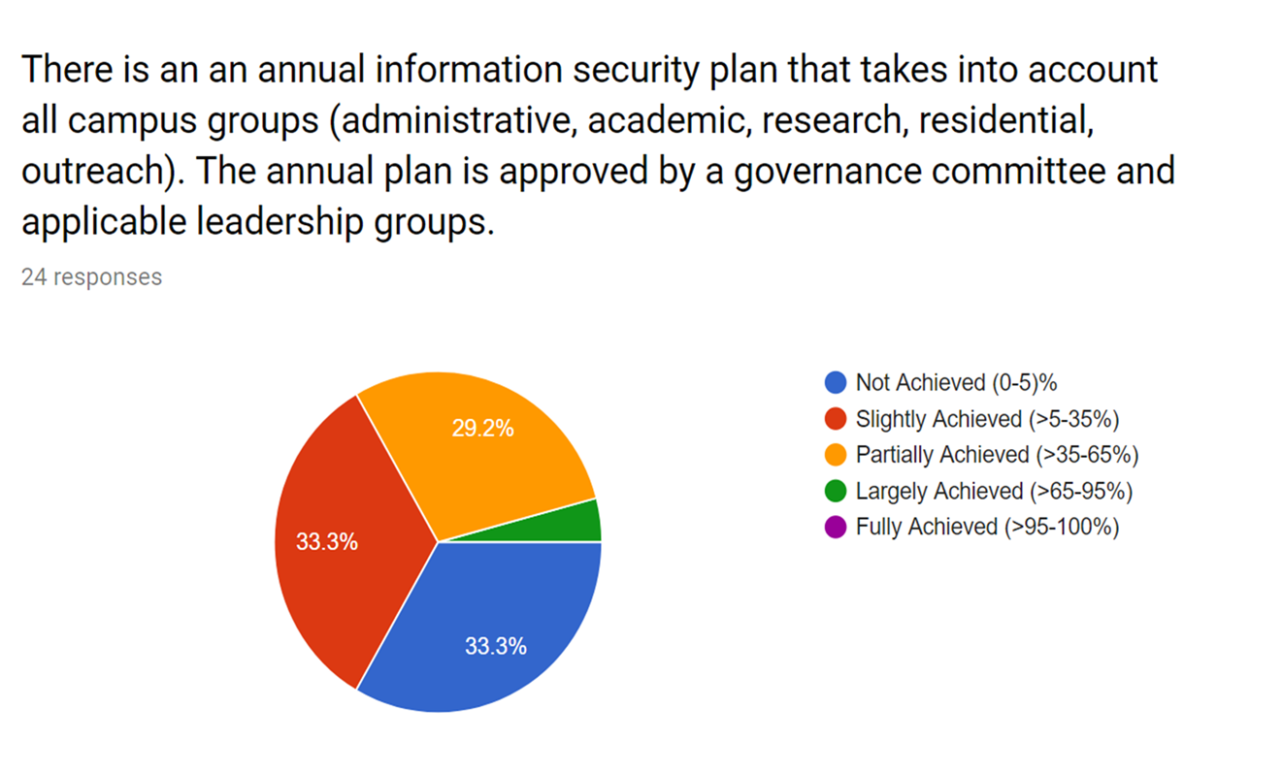
Pre-Workshop Program Maturity Survey

Slide 5
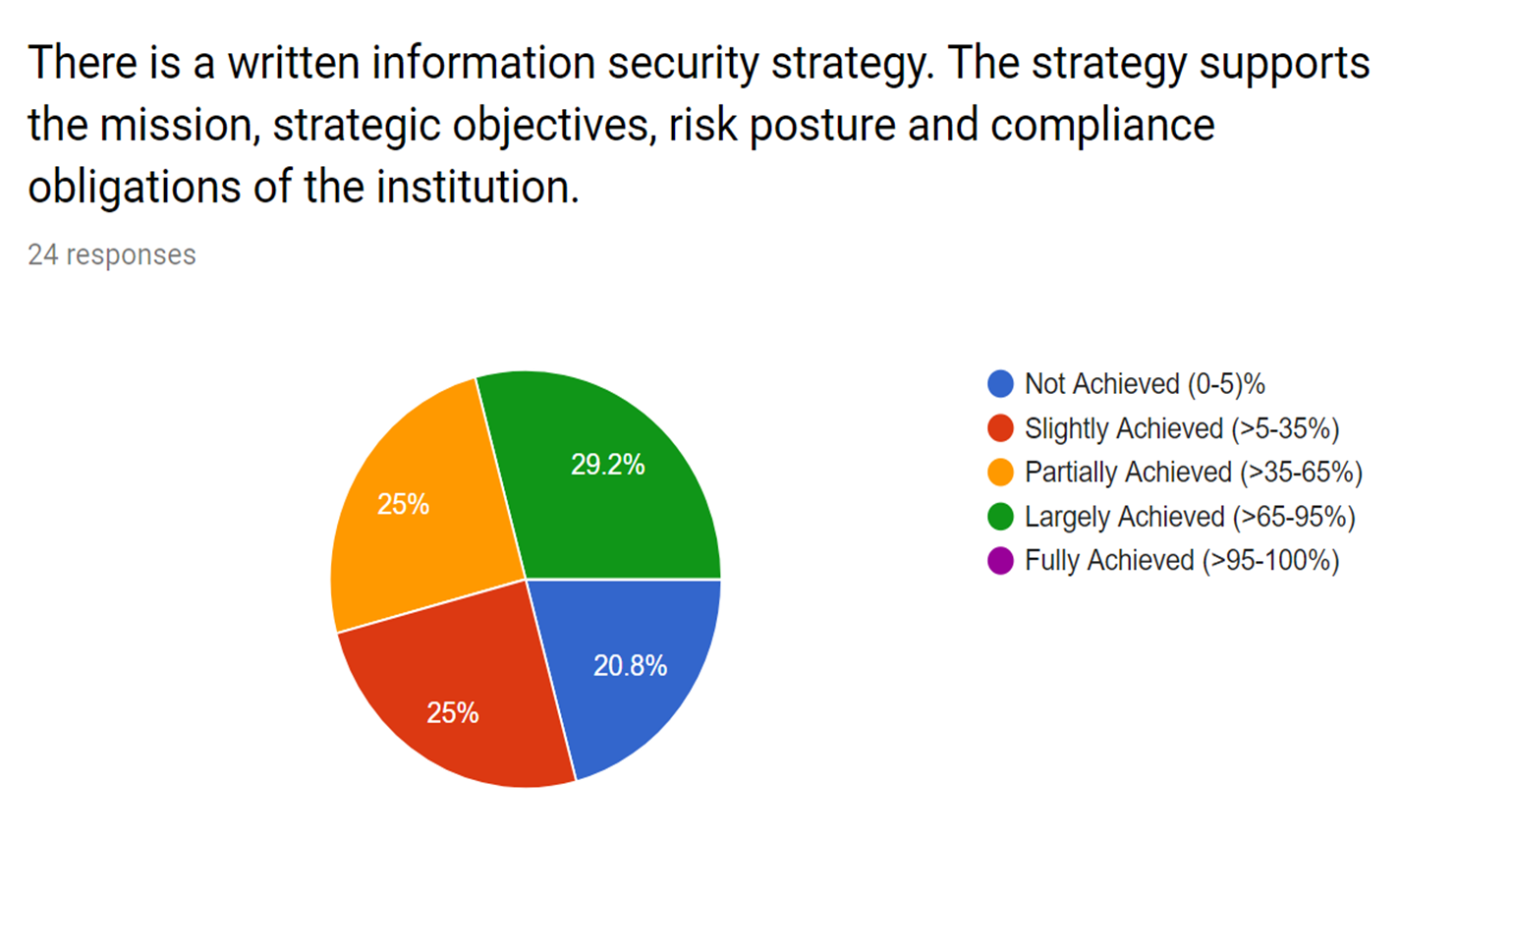
Pre-Workshop Program Maturity Survey

Slide 6
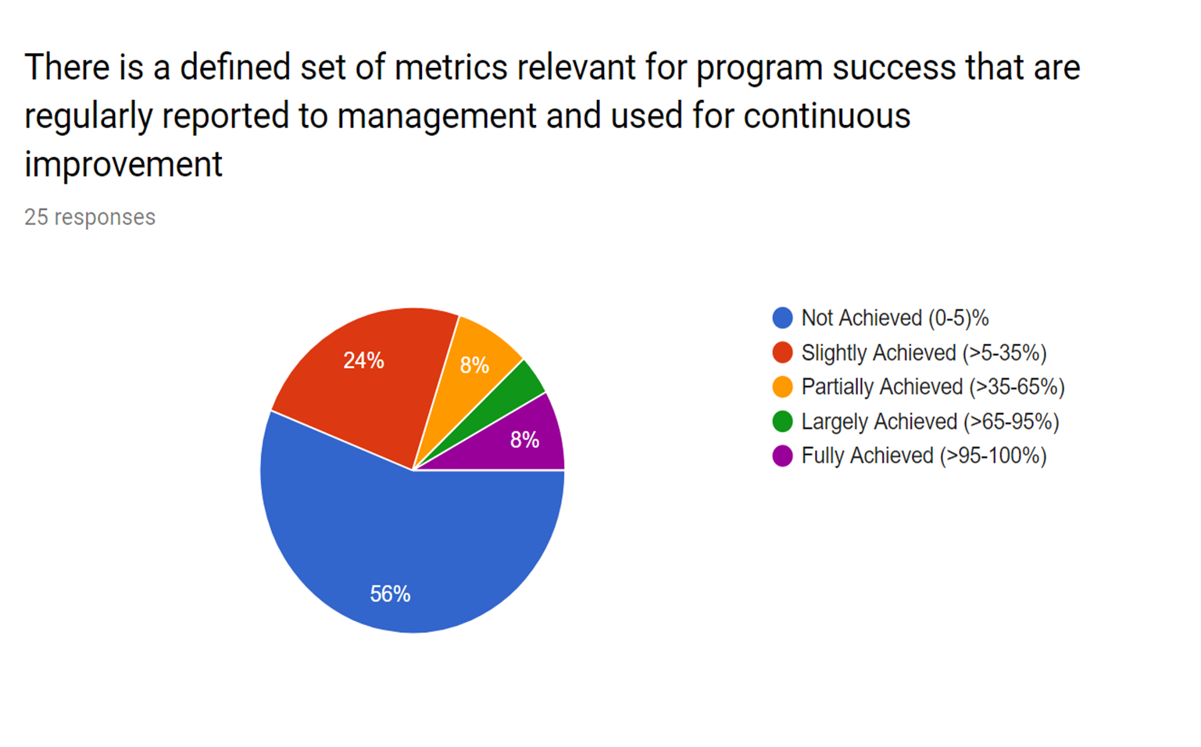
Pre-Workshop Program Maturity Survey

Slide 7
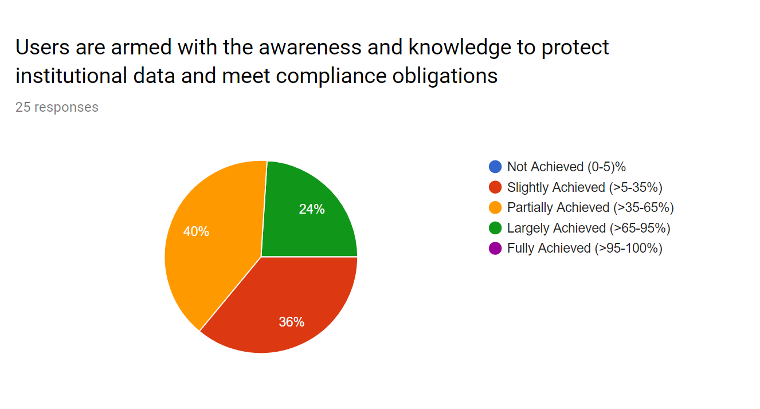
Pre-Workshop Program Maturity Survey

Slide 8
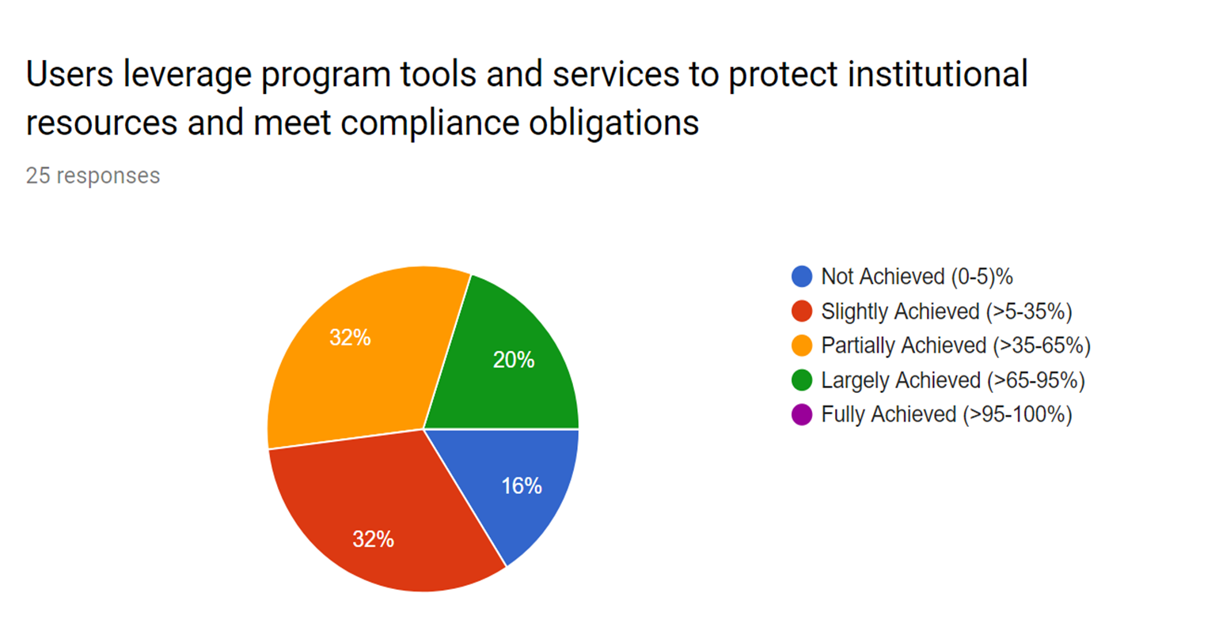
Pre-Workshop Program Maturity Survey

Slide 9
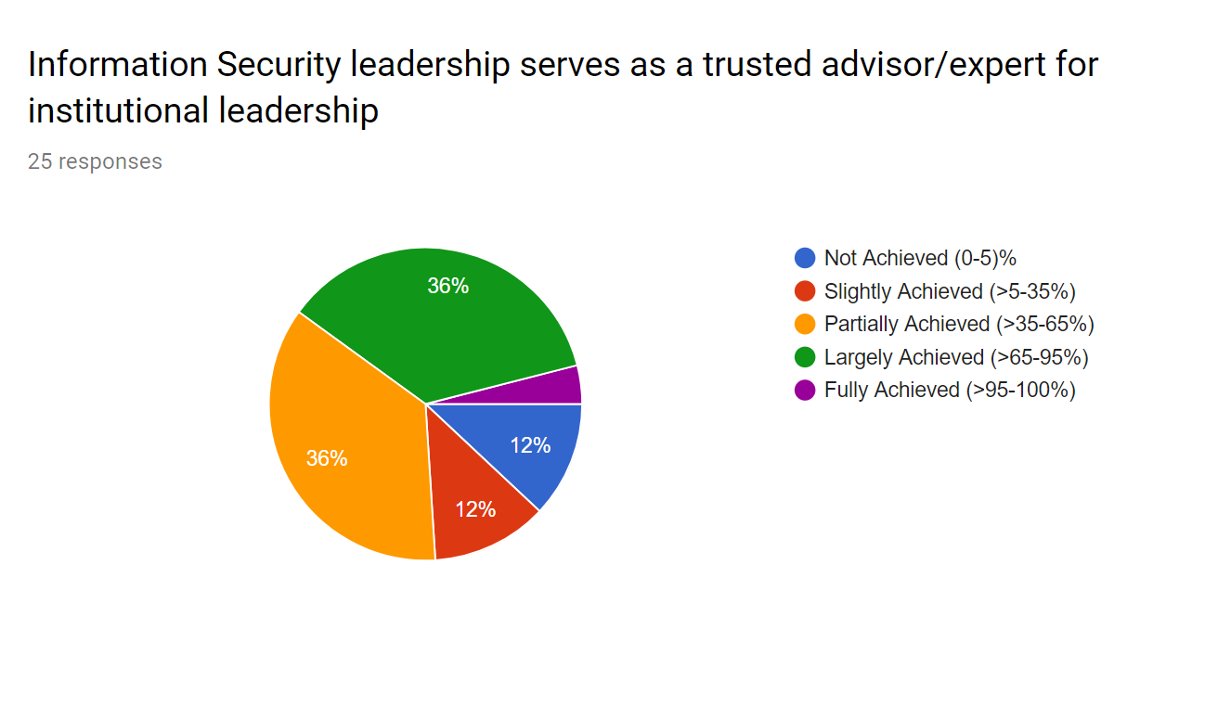
Pre-Workshop Program Maturity Survey

Slide 10
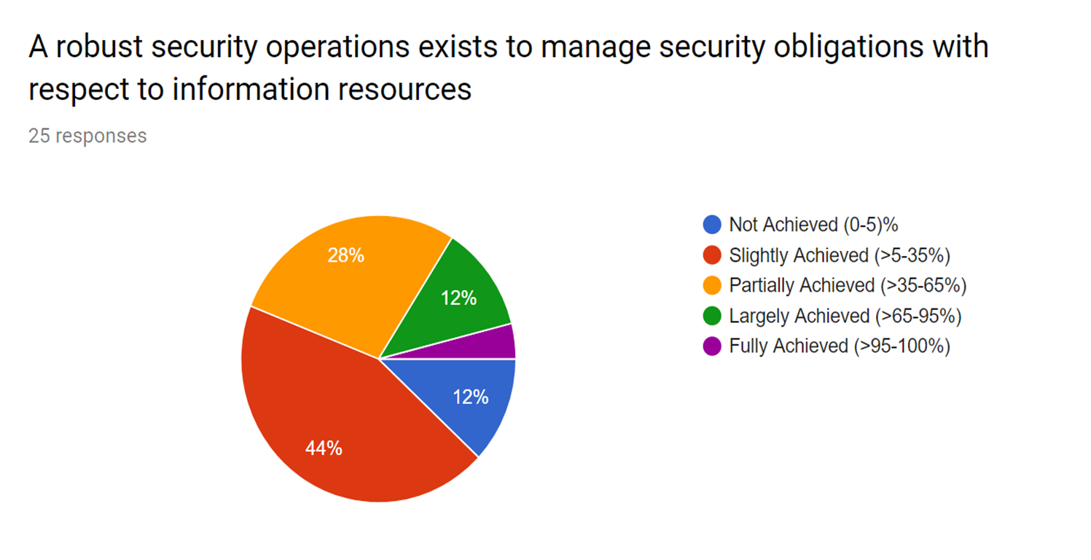
Pre-Workshop Program Maturity Survey

Slide 11
Defining a Program

Slide 12
InfoSec Program Leadership
Advises senior leadership on security direction and resource investments
Designs appropriate policies to manage information security risk
Leverages collaborations and campus-wide resources
Facilitates information security governance
https://spaces.internet2.edu/display/2014infosecurityguide/CISO+Job+Description+Template
https://library.educause.edu/resources/2016/3/technology-in-higher-education-information-security-leadership
Strategist
Technologist
Trusted Advisor
Visionary
Promoter/Persuader Relationship Builder

Slide 13
InfoSec Program Organization
Team development – roles and capabilities
Online presence - website/social media
Relationships across campus
Contacts/membership in state, REN-ISAC, InfraGard, FBI, EDUCAUSE, etc.
https://spaces.internet2.edu/display/2014infosecurityguide/Toolkit+for+New+CISOs
https://spaces.internet2.edu/display/2014infosecurityguide/Security+Program+Development
https://spaces.internet2.edu/display/2014infosecurityguide/Developing+Your+Campus+Information+Security+Website
Team Professional Development Annual Tabletop Exercises
Continuous Process Improvement

Slide 14
Evolving InfoSec into a Program
Short term projects with small immediate goals
A strategy to improve the security posture of the organization
Coordinated program services support the mission of the institution in a way that is understood and leveraged by users

Slide 15
What else needs to be defined in a Program?
A program is an organizational effort defined to meet an overarching goal.
A program includes all the collective:
Vision, Goals, Strategy, Governance
Services, Planning, Projects and
Daily Operations
necessary to meet the program mission.

Slide 16
Information Security Strategy
Data Centric
Help Yourself
Campus Partnerships
Trusted Advisor
Unified Com-pliance

Slide 17
CMMI Maturity Levels
Initial
Managed
Defined
Quantitatively managed
Optimized
Continuously Improving: Process control
Predictable: Quantitative process management
Consistent: Process definition
Disciplined: Basic project management and control

Slide 18
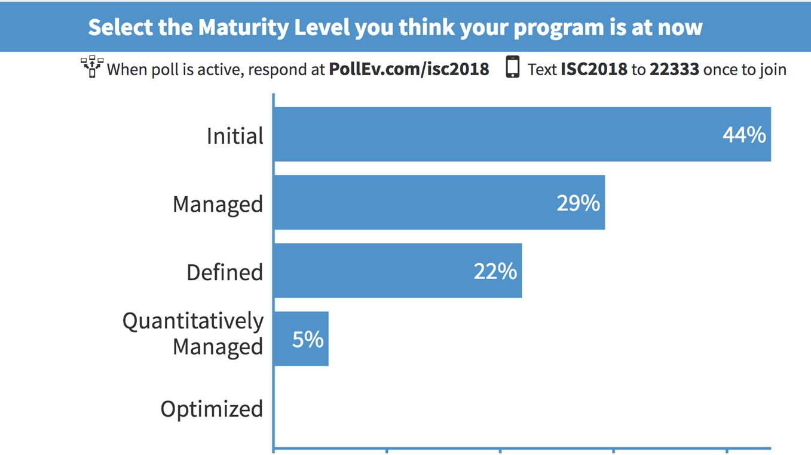
Workshop Poll:

Slide 19
Mission

Slide 20
Mission
Penn's ISC Office of Information Security coordinates security services and projects across campus to help safeguard the University's information assets against unauthorized use, disclosure, modification, damage, or loss.
Notes:
Mention Josh’s charter

Slide 21
Mission
The Office of Information Security supports Appalachian State University by improving the identification and management of risks related to University information resources, and fostering resilient, safe computing environments for our community. We achieve our mission through vision, innovation, strong partnerships, broad collaboration, and outstanding program services.

Slide 22
Draft your Mission
List some words or phrases that should be in your mission statement.

Slide 23
Workshop Poll:

Slide 24
Governance

Slide 25
Governance versus Management
Governance: doing the right thing.
Management: doing things right.
https://spaces.internet2.edu/display/2014infosecurityguide/Information+Security+Governance
https://library.educause.edu/~/media/files/library/2017/12/itgovernancetoolkit2017.pdf

Slide 26
Advisory Council
Charge and Scope
Membership
Develop information security plan, including policies and standards, initiatives and services
Evaluate and advise on risks
Identify awareness and training needs
https://its.appstate.edu/it-governance/information-security-advisory-council
https://security.arizona.edu/information-security-steering-committee
General Counsel Controller
Registrar Campus Police
Human Resources Research Control / IRB
Record Retention Data Analytics
Student Life Advancement
Risk Management Internal Audit (perhaps)
Faculty Senate Academic leadership
Student Senate Rep. Staff Senate Rep.

Slide 27
Security Incident Response Team
Charge and Scope
Membership
Central response and management of incidents
Security advisory distribution and information sharing
Technical consulting
https://security.appstate.edu/teams/csirt/
https://ts.tulane.edu/computer-incident-response-plan
Specialized skills (standing or adhoc)
Network Admins System Admins
Desktop Support Security Specialists
Database Specialists Application Specialists
Web Developers IDM Specialists
Middleware Admins Data Center Admins

Slide 28
Information Security Liaisons
Charge and Scope
Membership
Central point of contact for department relationships
Assist in awareness efforts and/or developing standards
Periodically report unit security compliance
Participate in selecting and developing security solutions and services
https://security.appstate.edu/teams/is_liaisons
Administrative Departments
Academic Departments
Research Offices / Departments
Student Senate Representatives

Slide 29
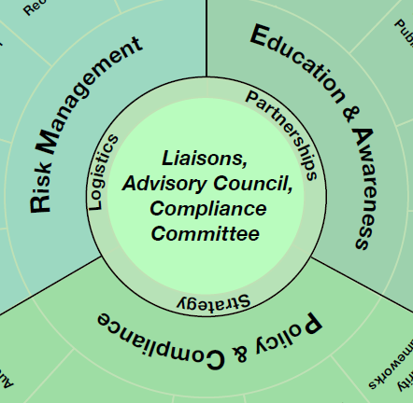
People and Process
ISAC – Strategy - PC
SIRT – Logistics - RM
ISL – Partnerships - EA

Slide 30
Draft your Governance
Governance Groups
Charge and Responsibilities
Membership

Slide 31
Program Elements

Slide 32
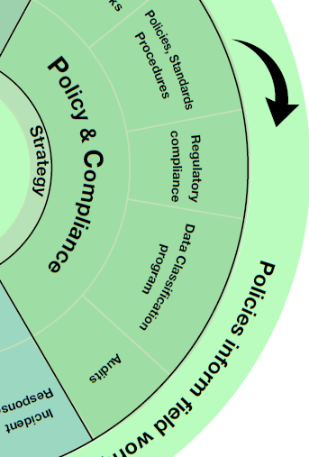
Policy and Compliance Service Catalog
Security Frameworks | Research Security Plans
Policies | Research Security Assessments
Standards | HIPAA Compliance
Procedures | IRB Consulting
Data Classification Program | Data Management Program
Financial Audits | Breach Notification
IT Controls Audits | Digital Copyright Compliance
PCI SAQs | E-Discovery
Internal Audit(s)

Slide 33
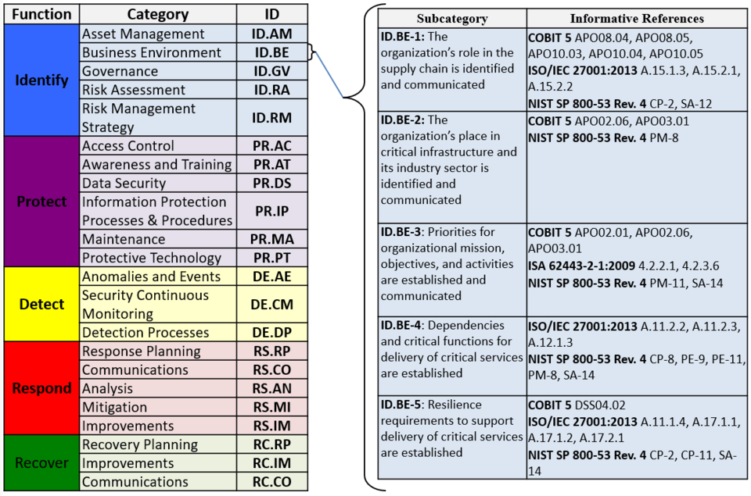
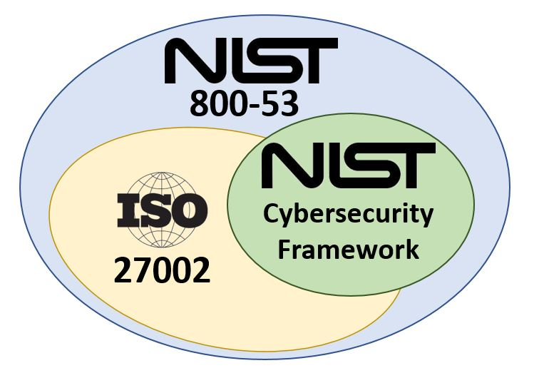
Security Frameworks
Your Program “Kickstarter” Kit
Elements are common between frameworks, and can be mapped from one to the other
Culture, budget, staffing, regulatory environment and oversight, personal preference may all influence decision.
Notes:
References includes mapping tools and links describing different frameworks

Slide 34
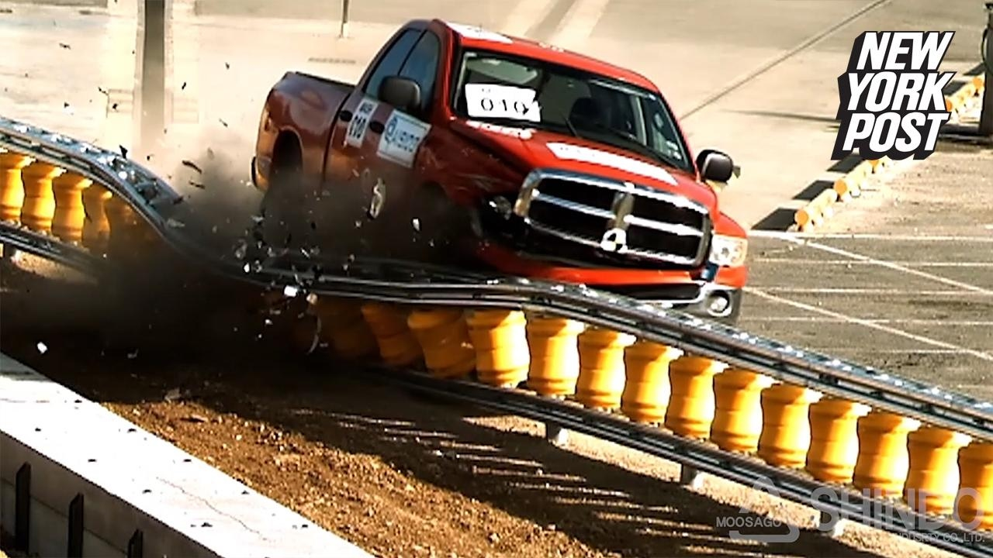
Policies and Standards
Administrivia
Guard-rails
VS
Notes:
Boring – until they are not. They are amazing when they work. They are ignored when they are not relevant. Faculty email searches. Law enforcement requests. Incident handling responsibilities.
The best policy takes time, which is why people associate it with being boring.
Time spent: Writing/publishing policy (very high), ensuring governance of policy is in place/works (medium), communicating policy (low).

Slide 35
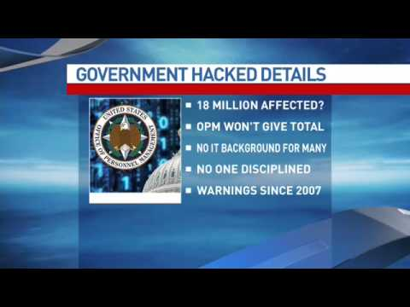
Compliance
Witness the power of partnerships!
The “E” Word: enforcement does not always live in InfoSec office.
But technical controls – that enforce things automatically – typically do.
“Compliance is Not Security”

Slide 36
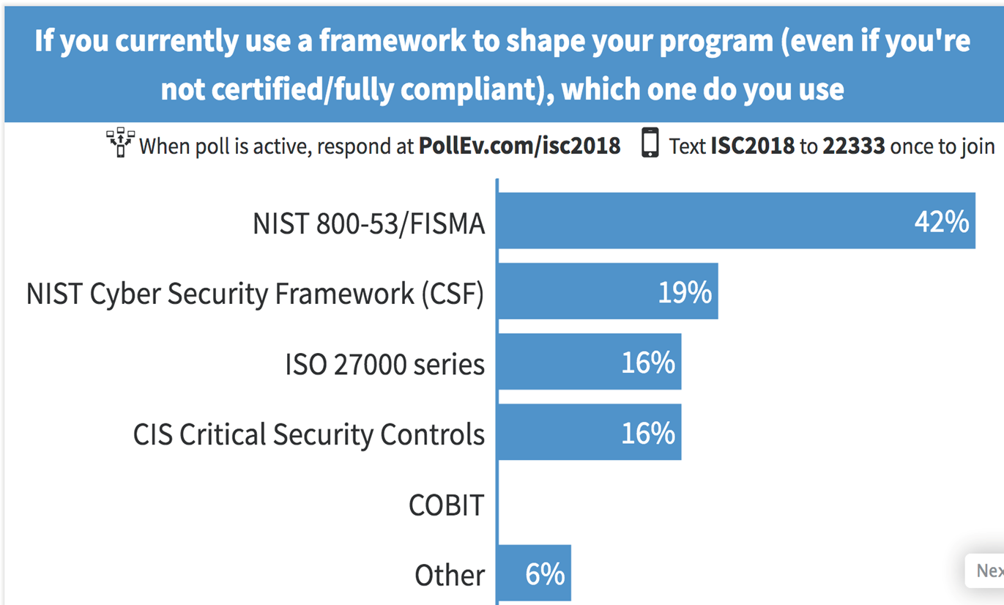
Workshop Poll:

Slide 37
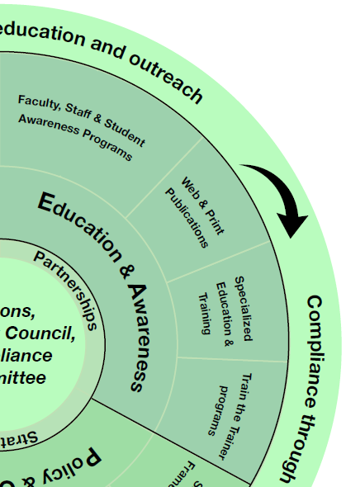
Education and Awareness Strategic Frame Work
Align with Strategic Plan Objectives
Scope and content – building blocks
Responsibility
Elements
Design
Program Components – Service Catalog
Material Development
Implementation
Continuum

Slide 38
Education and Awareness Content/Material Objectives
Who is your audience?
Behaviors and skill sets to enforce
Mandatory/Optional?
Deployment method?
Documentation, feedback, & evidence of understanding and application
Frequency of exposure
Evaluate & update

Slide 39
Education and Awareness Challenge Questions
How many topics/issues/concerns does your office currently offer awareness and training on?
What audiences does your program focus on?
What do you consider to be evolving considerations/topics to add to your awareness and education program?

Slide 40
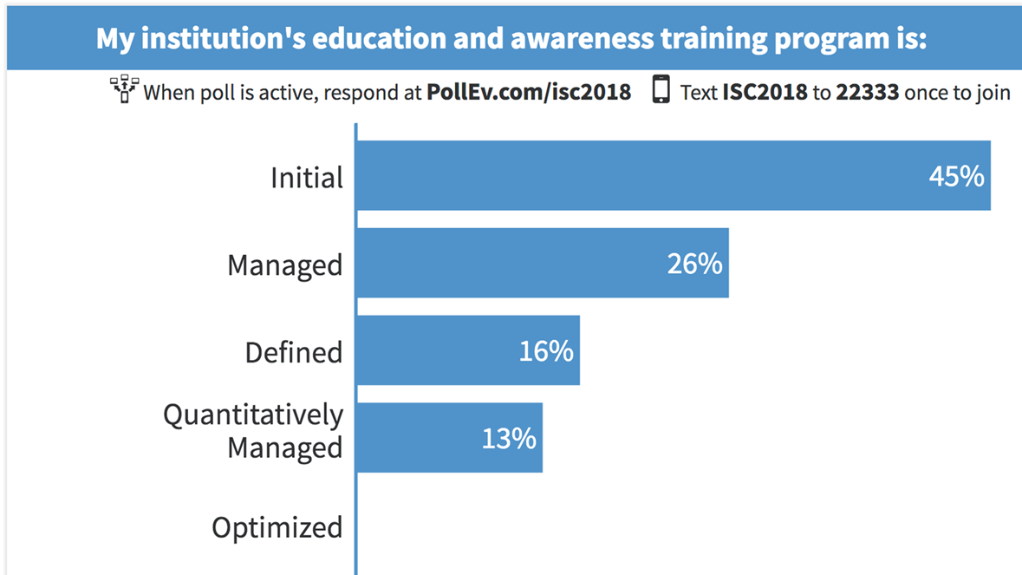
Workshop Poll:

Slide 41
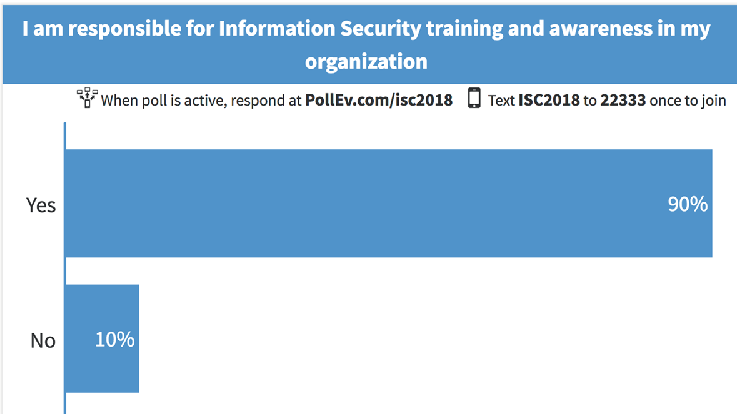
Workshop Poll:

Slide 42
Education and Awareness Service Catalog
Faculty & Staff Training | Phishing Alerts
Student Training | Identity Theft
Web & Print Publications | International Travel
Awareness Programs | Social Networking Security
Technical Roles Training | Online Reputation
Specialized User Role Training | Security Games, Videos
Train the Trainer Programs | Wireless Security
Compliance Based Training | Outreach

Slide 43
Education and Awareness Resources
https://nvlpubs.nist.gov/nistpubs/legacy/sp/nistspecialpublication800-50.pdf
https://staysafeonline.org/
www.educause.edu
www.sans.org
https://spaces.internet2.edu/display/2014infosecurityguide/Cybersecurity+Awareness+Resource+Library
https://getgophish.com/
https://teachprivacy.com/privacy-and-security-training-games/

Slide 44
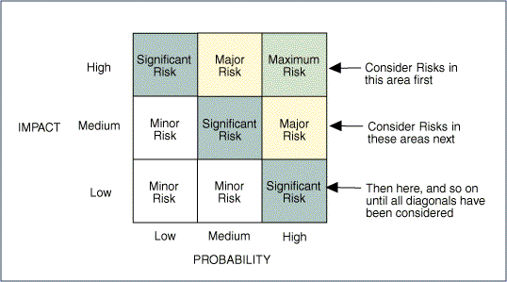
Identifying and Managing Risk
Higher levels risks require action:
Reduce to acceptable level (mitigation)
Transfer the risk
Assume (accept) the risk

Slide 45
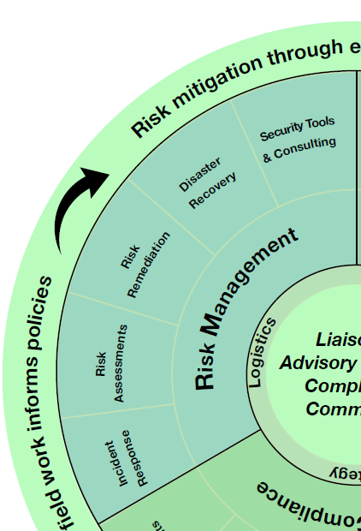
Risk Management Service Catalog
Incident Response | Secure File Transfer
Security Event Monitoring (SIEM) | Data Loss Prevention Tools
Penetration Testing | Vulnerability Scanning
Disaster Recovery | Software Testing
Security Consulting | Data Recovery
VPN Services | Forensic Analysis
2-Factor Authentication | Intrusion Detection/Prevention
Mobile Device Security | Identity & Access Management
Data Encryption Solutions | Virus Remediation / Removal
Firewalls | Secure email

Slide 46
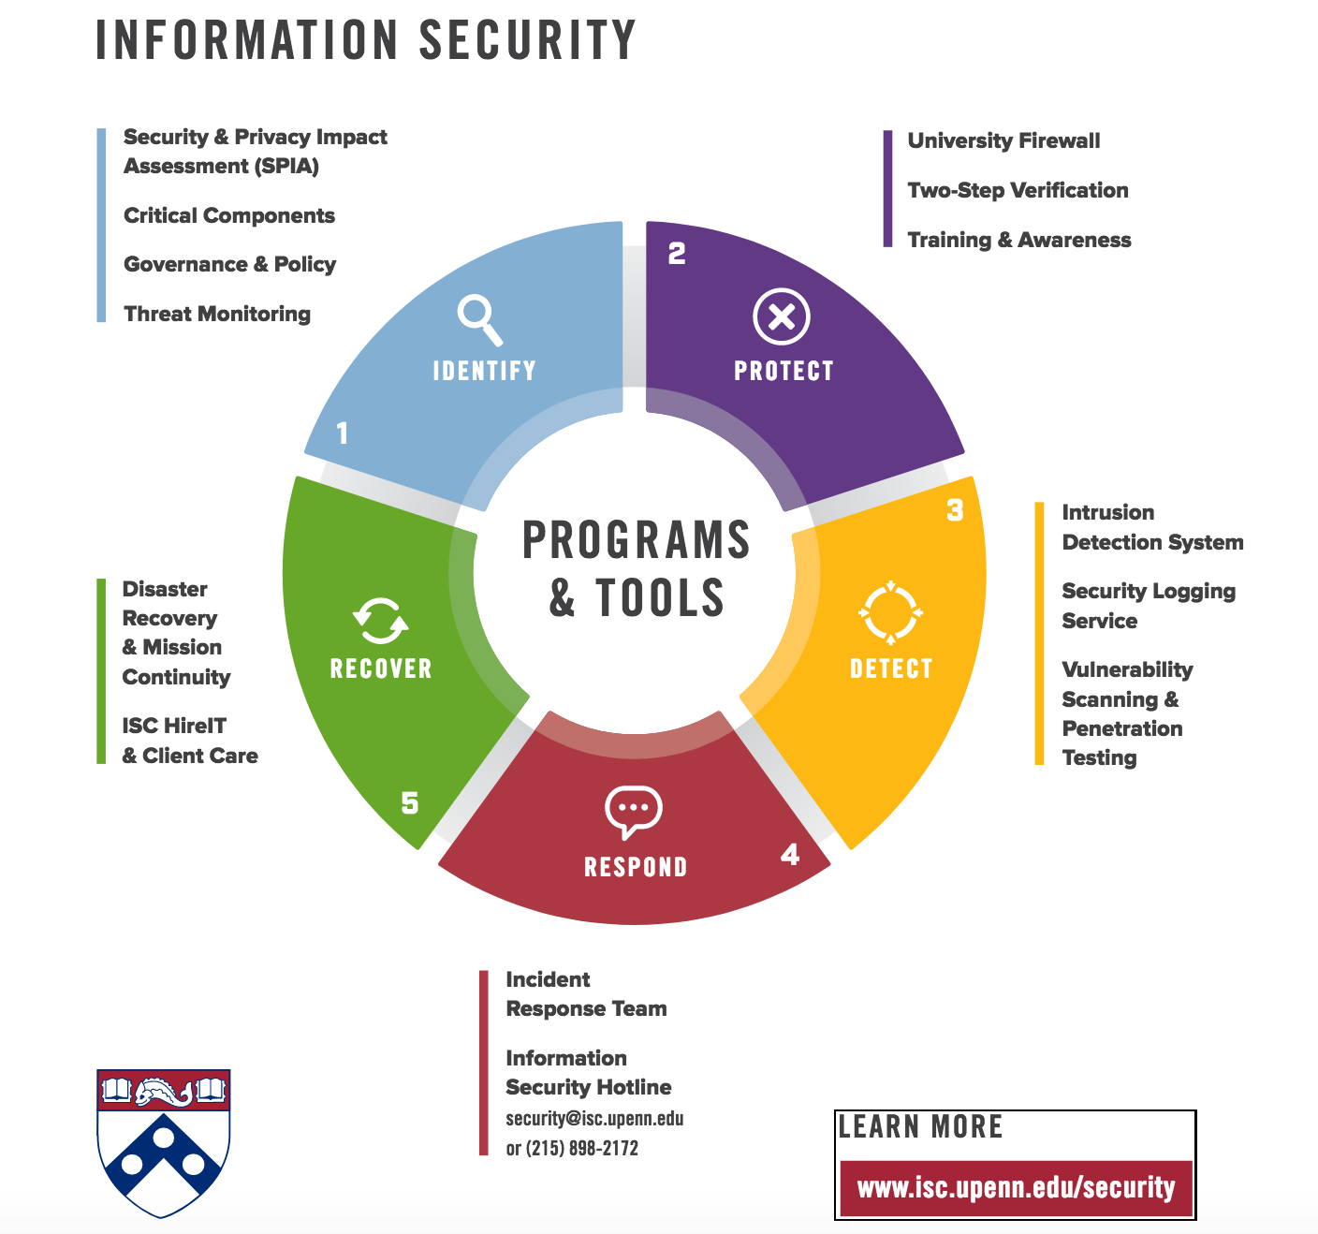
Tools, glorious tools
There are a lot of common options for security tools and processes to help with prevention, detection and response.
At right, an example of how frameworks can help you organize and conceptualize tools.
Helps you more clearly identify gaps and management understand why you need a Firewall and Vulnerability Scanning.

Slide 47
Incident Response
W
Why
Matters…

Slide 48
Risk Assessment
Quantitative vs Qualitative Risk Assessments
Quantitative
Qualitative
Takes more time
Faster
Formulas/calculations
Attempts to be more objective/reproducible
Best if participants are trained in methodology
No/simple calculations
Subjective
Requires less training/explanation

Slide 49
Security Consultancy
consultant
kənˈsəltnt/
noun: consultant; plural noun: consultants
a person who provides expert advice professionally.

Slide 50
Workshop Poll:
What examples of "quick-wins" (or other low-effort, high-impact outcomes) have you implemented based on a risk review?

Slide 51
Assessments and Continuous Improvements

Slide 52
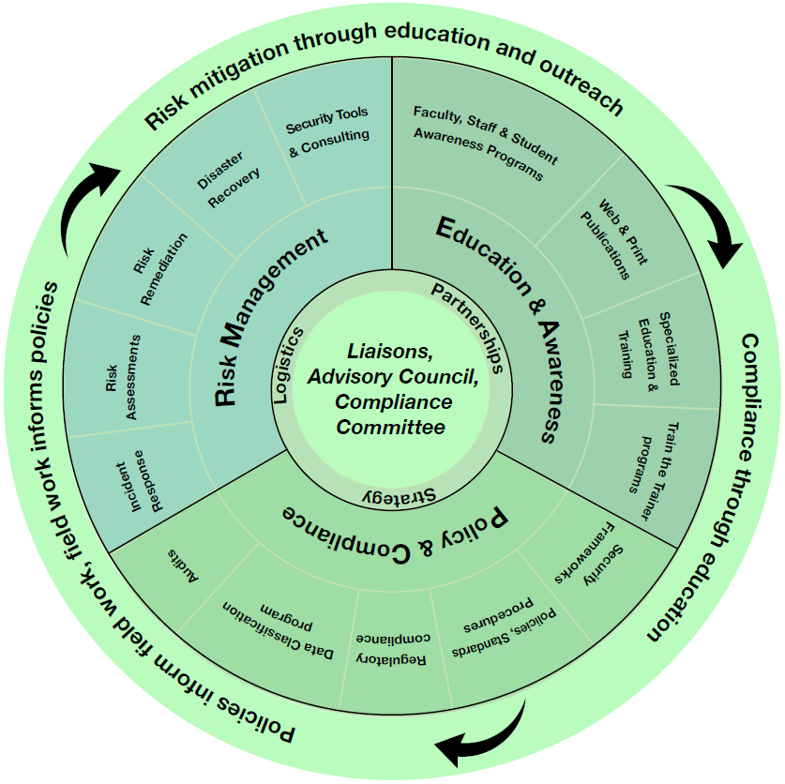
Continual Improvement

Slide 53
Program Assessments
Maturity Assessment Process:
Use the HEISC tool for:
ISO Program Maturity
Central IT Security Assessment
Departmental Security Assessments
Prioritize results and use as input to annual work plans
Create new program goals appropriate for maturity level
Note improvement over time
Repeat annually
HEISC maturity assessment tool (based on ISO standard)

Slide 54
Program Assessments
Higher levels risks require action:
Reduce to acceptable level (mitigation)
Transfer the risk
Assume (accept) the risk

Slide 55
Metrics
How do we know that our work is ACTUALLY improving the institution’s security program and security posture?

Slide 56
Measuring Program Value
Users agree they have been given the awareness and knowledge to protect institutional data and meet compliance obligations
Evidence that users leverage program tools and services to protect institutional resources and meet compliance obligations
Evidence that Information Security leadership serves as a trusted advisor/expert for institutional leadership
Funding and people resources support a robust security operations that addresses high-medium risk areas

Slide 57
Executive Metrics
Percentage of technology budget spent on Information Security
CDS InfoSec questions – peer comparison and trends over time
Percentage of employees participating in education and awareness training
Number of departments completing information security risk assessments
Percentage remediation plans accomplished for information security risk assessments
https://library.educause.edu/~/media/files/library/2015/6/erb1514-pdf.pdf

Slide 58
Annual Plans and Roadmaps

Slide 59
Essential Intent & Prioritization
 | General | Concrete
Inspirational | Vision/Mission | Essential Intent
“Everyday” | Values | Quarterly Objective
“The main thing is keeping the main thing the main thing”
- S. Covey
Example: Proactively identify all reported security events by 2017. Eliminate all avoidable events by 2018.
Essential Intent: inspirational and concrete, both meaningful and measurable. Done right, an essential intent is one decision that settles one thousand later decisions.
From Mckeown, Greg (2014-04-15). Essentialism: The Disciplined Pursuit of Less (p. 128).

Slide 60
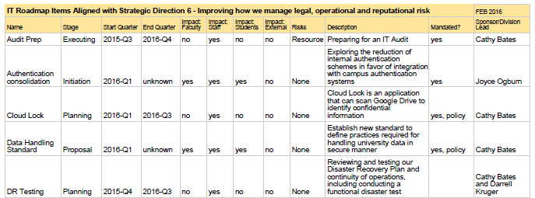
Annual Plans

Slide 61
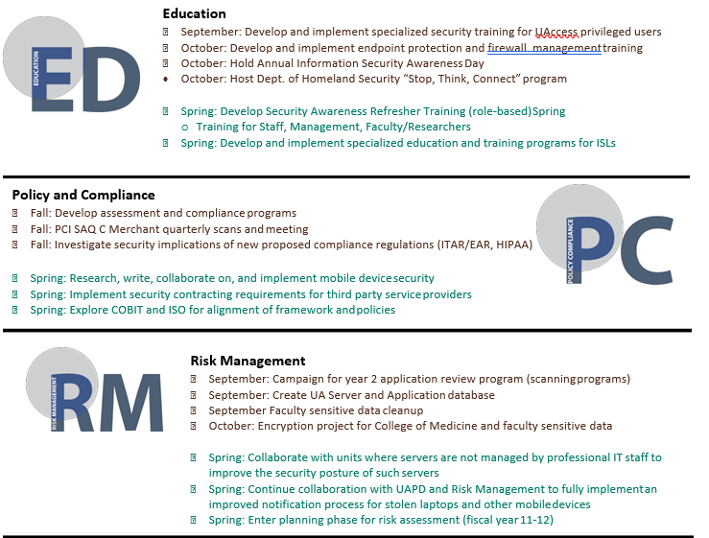
Roadmap

Slide 62
Questions and Contact Info
Cathy Bates – Cathy.Bates@VantageTCG.com
Jon Young – Jonathan.Young@VantageTCG.com
Lisa Warren - lewisl@ncat.edu
Josh Beeman - jbeeman@isc.upenn.edu
Theresa Semmens - theresa.semmens@miami.edu
Don’t forget to fill in the session evaluation form using the mobile app or online.

