Slide 1
Syracuse University

Slide 2
Muster Your Students Aboard!
Building and Operating a Student-Staffed SOC
2018 Educause Security Professionals Conference

Slide 3
$whoami
Christopher Croad
SU’s ISO for 10 years
Been doing InfoSec for 20+ years; started as DoD contractor
Teaches as an adjunct at SU’s iSchool
Random Fact: I just moved into a new house
ccroad@syr.edu
Notes:
Chris and Dan

Slide 4
Overview of Syracuse University
Founded in 1870, Syracuse University is a private Research I university offering over 200 majors and 100 minors. The University has over 15,000 undergraduate and 5,000 graduate students in attendance, and over 250,000 alumni in all 50 states and 162 countries. The University also has a rich research profile that utilizes its network resources. The University employs 5,281 faculty and staff.
Syracuse University’s main campus is located in Syracuse, New York , but the University operates a number of facilities around the globe including:
Los Angeles, California (Syracuse University Los Angeles)
New York, New York (Lubin House)
Washington, D.C. (Greenberg House)
London, England (Faraday House)
Florence, Italy (Syracuse University Florence)
The University also has students, faculty, and staff with technology needs located on various campuses, and military installations all over the world.
Notes:
SU was founded in 1870, and is a private Research 1 institution. We host about 20,000 students, and employ about 5200 faculty and staff. The University’s technology is primarily located in Syracuse, but SU also operates facilities and equipment in New York City, Washington DC, Los Angeles, Florence, London, China, and countless military installations around the United States.

Slide 5
Information Security at Syracuse University
Part of Information Technology Services (ITS)
Headed by ISO, reports to CIO
5 Full time staff
Usually 4-8 part time/ full time intern students who perform SOC operations
InfoSec’s budget is 5% of overall ITS budget
IT at SU – Hybrid of centralized/decentralized
But in general, all look to InfoSec for policy, direction and guidance
Notes:
Chris
The InfoSec department at SU falls under Information Technology Services, or ITS. I head up the department as the ISO, and reports directly to the CIO. Including myself, there are 5 full time staff members, a number that’s remained constant for the past 9 years (neglecting the occasional turnover periods).
We supplement the full time staff with SU students in our SOC. These students focus on day-to-day operational tasks, while the full time staff focuses on more bsuiness oriented issues.
Our total budget is right around 5% of the overall ITS budget…again a number that has remained relatively constant.
IT at SU is a huberdized model. ITS provides central serivces (email, web, AD, Blackboard, PeopleSoft, etc), while the individual schools and units may hire their own IT staffers to support school level needs. ITS still has “pull” in this area as we cost share the salary of many of those staff members. It works, and it works well. In general though, there is no distributed security model. While the unit staffers may implement actual security measures, they look to InfoSec for policy and guidance.

Slide 6
One Page History of InfoSec
Computers got popular, connected to the Internet
Bad guys got in
We started finding ways to stop them
Wash-Rinse-Repeat for many years
Regulation
We did what we always did, plus some more stuff, (even if it didn’t make sense)
Bad guys still got in
We kept fighting ‘em off
Wash-Rinse-Repeat

Slide 7
The Problem
Technology use grew
Data spread
Compliance requirements grew
InfoSec’s job grew
Budgets did NOT kept pace
More full time staff positions are not forthcoming

Slide 8
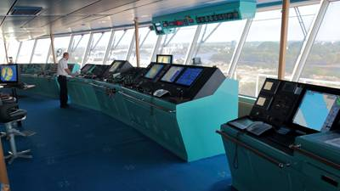
…and let’s not forget the skills gap
Lots of studies, lots of numbers
Lets just say there are tens of thousands of unfilled InfoSec jobs out there
Salaries are high
And Higher Ed isn’t keeping pace
So even if we COULD hire more employees, can we find and retain them?
Geography can make it even more challenging
(My last staff replacement took 10 months to find)

Slide 9
So… in summary
Not enough resources
More work
Increasing expectations
Have to figure something else out

Slide 10
So I go on walkabout
My peers must be dealing with this too
So what are they doing?
A visit to RIT starts me on the path to student employees

Slide 11
Hired two RIT Co-ops
Secured funds
Found a “room” for them
Dug up equipment
Found things for them to do
...but we were still trying to figure it all out

Slide 12
Over the next 2 years
We started finding Syracuse University students who could work part time
We even found a few who could intern
Best students were out of School of Engineering, CompSci Masters Program
We could find unique students from the iSchool
RIT moved to a semester system, we stopped hiring them
We were all SU! Go Orange!

Slide 13
Step #1 Funding : Show the Need
Help management see the need
If your organization is “mature”, you may have metrics
If not, just show ‘em a list.
…and tell the story of how students will give you time to GET mature.

Slide 14
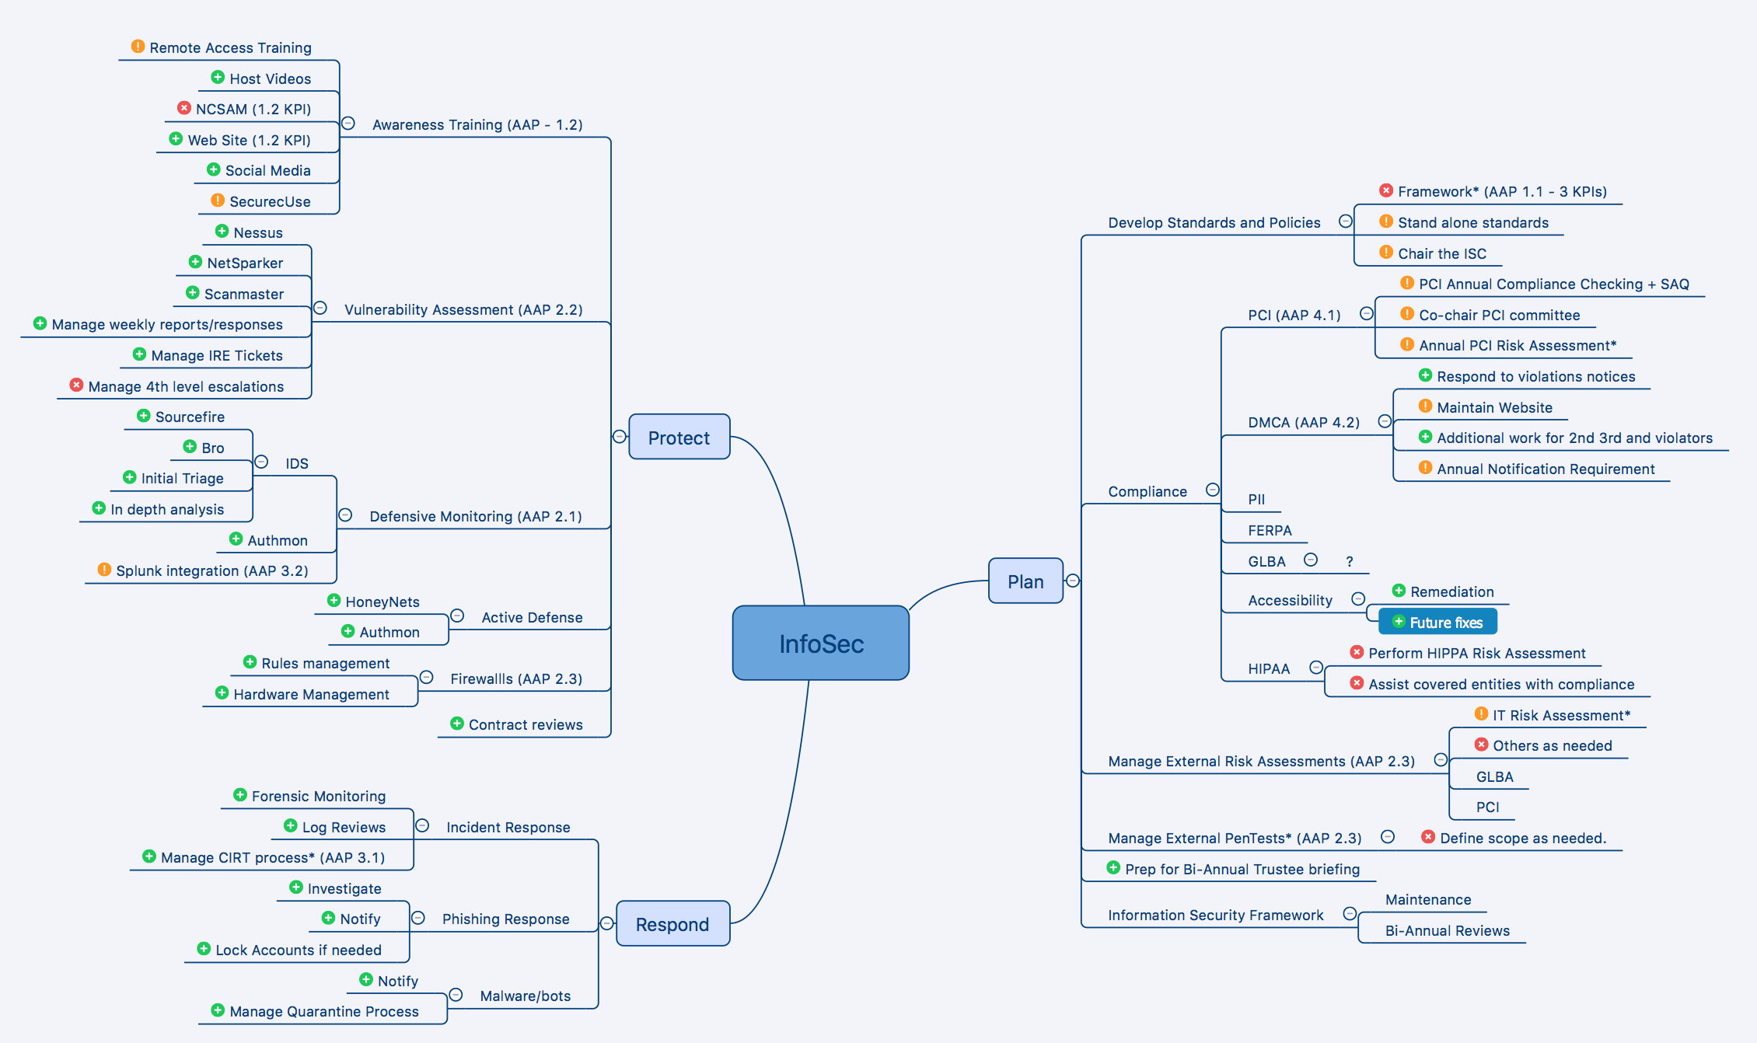

Slide 15
Step #1: Funding : Identify Sources
Find “non-staff” dollars
Work Study
Graduate Assistantships
”Stuff” money
Slush fund

Slide 16
Step #1: Funding : Do the Math
How many student hours can you buy for 1 FTE?
What can you pay and be competitive with the rest of your institution?
For SU, 1x FTE dollars = 2 full time and 6 part time students for 1 year.
Those students do the work of 2-4 FTE’s.

Slide 17
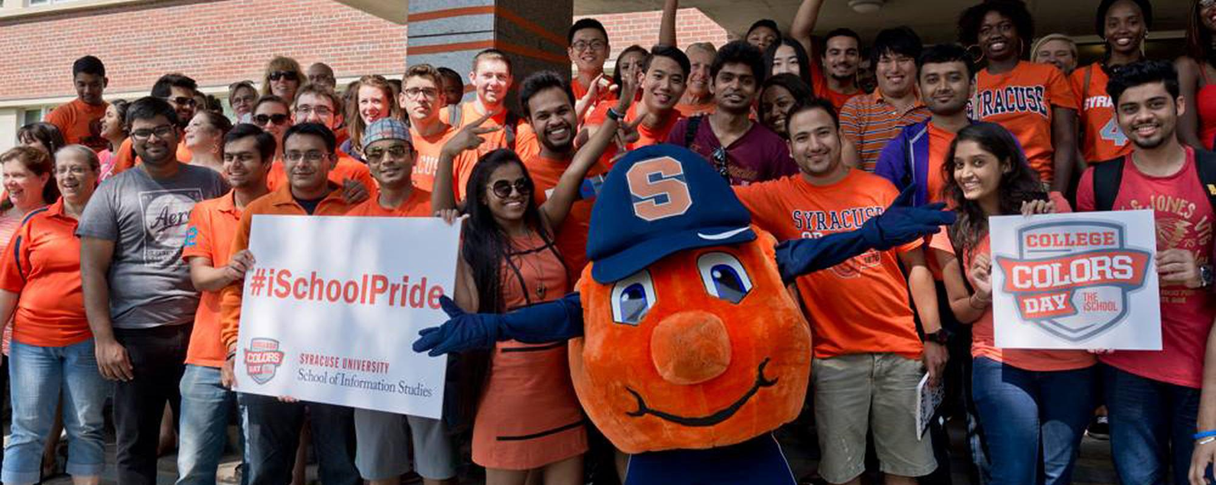
Step #1: Funding : Stress Student Experience
You get to engage in student learning activities
Students get REAL work experience they can use
BIG political win at SU
Our students have gone on to Google, Mandiant, JPMC, Indeed, Microsoft and various Three Letter Orgs.

Slide 18
Step #2: Identify Work
Define what you want them to do
Focus on day to day operations
Procedural, step by step work
Vulnerability Assessment
IDS
Threat Hunting
Phishing response
DMCA violations
Ticket Management
Customer Support
Code Development
Be patient… build SOC capabilities over time

Slide 19
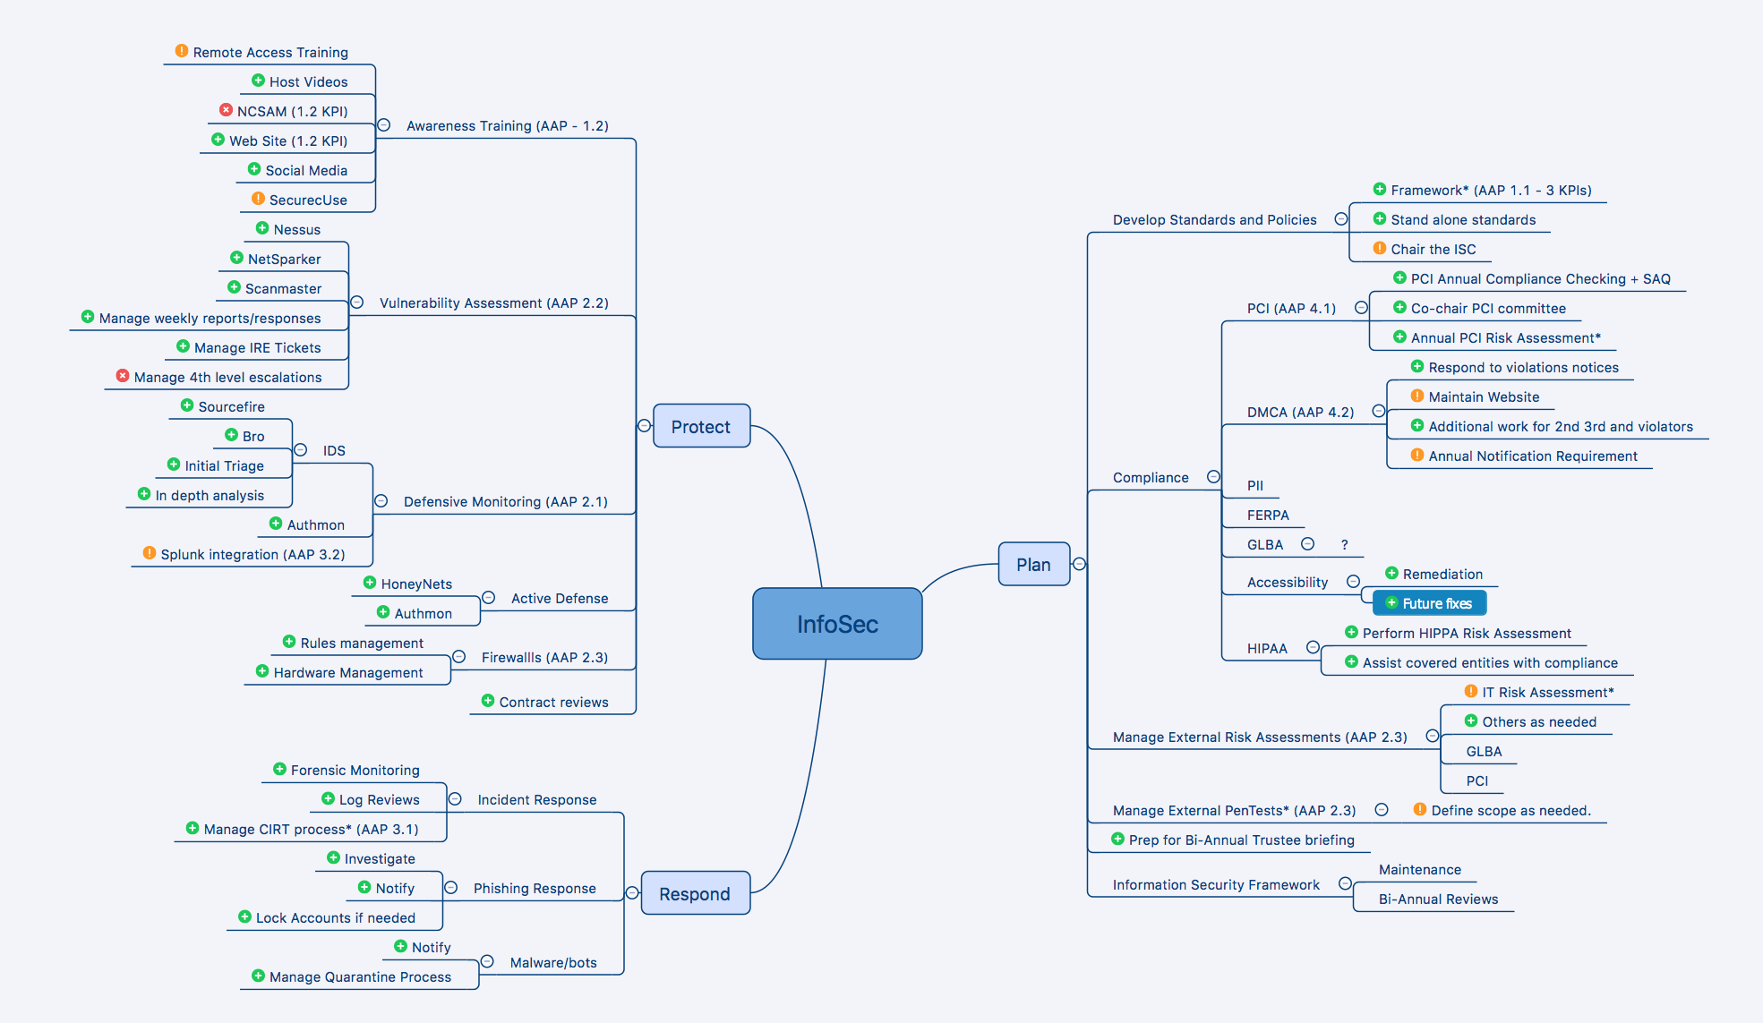

Slide 20
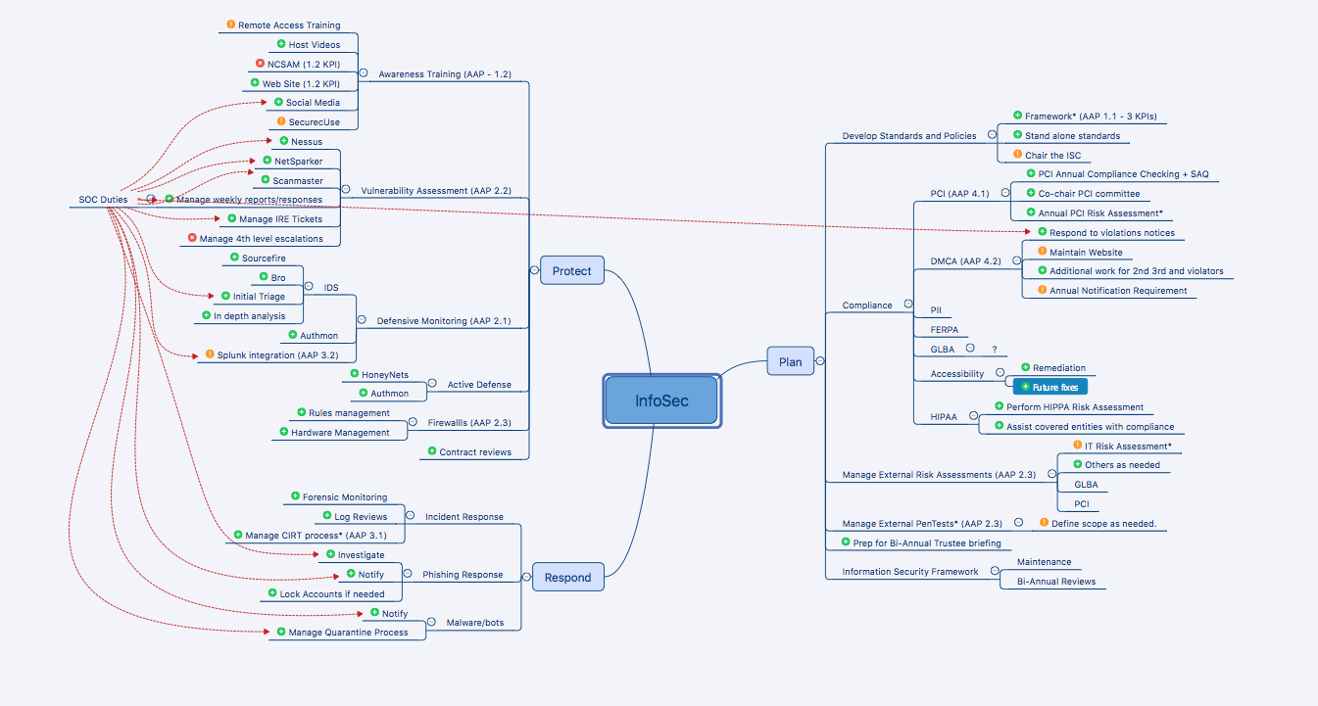

Slide 22
Step #2: Identify Work Things to NOT have students access/work on
Anything that would allow them to access personal data or behavior of individuals.
This can be a fine line to walk.
We do formal background checks of ALL student employees as well as have them sign a non-disclosure document.
I have a serious discussion with them on hire date RE: honesty, integrity, and consequences should they break our trust.

Slide 23
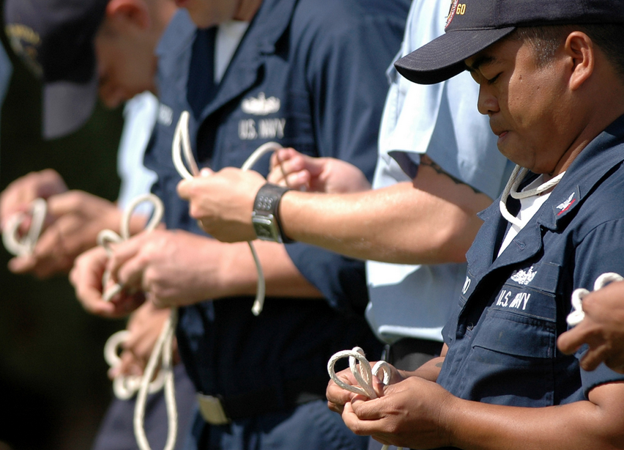
Step #3: Identify Needed Skills
We look for students with following tangible skills
Network Fundamentals
Information Security course work/interest
Scripting (python, bash)
Linux background
Don’t forget the intangibles
Passion for technology
Maturity
Learning ability

Slide 24
Step #4: Identify Mangers/Mentors
Who will manage the students
Make it an official part of their job description
Don’t let them have too many masters
Let the more advanced students do mentoring and managing

Slide 25
The Mentoring Cycle

Slide 26
Step #5: Find a room and equipment
You don’t need this….

Slide 27
Step #5: Find a room and equipment
All you really need is this…

Slide 28
Step #5: Find a room and equipment
Want the students to be comfortable, especially if they are full time interns.
Each workstation needs a PC and two monitors, and some drawer space
Big monitors on wall for dashboards (maybe)
Whiteboards!!
Collaborative space
Let students make it their own, but keep it professional

Slide 29
Step #6: Acquire talent
You do not NEED InfoSec students
CompSci, Engineering, Information Management, IT
Build relationships with key faculty
Build relationships with school placement offices
Post on student job boards
Interview…make them challenging
The target is 2 years of employment
Never stop looking and hiring
Don’t forget background checks, NDA’s etc…

Slide 30
Step #6: Acquire Talent
Don’t settle for students who don’t meet your hiring goals!
Sometimes, this means you ‘ll be short staffed.
Short staffed is less work than trying to manage staff that are not capable.

Slide 31
Step #7: Start Working
Start mentoring your students with a few tasks.
Have them document the procedures you teach
Listen to their suggestions
Add more work as they can handle it, but not to capacity
If hiring in a staggered manner, veteran students can train new students.

Slide 32
Step #8: Make Their Experience Positive
Real work that they can put on their resumes
Reviews and raises
Appreciation events
Introduce them to your vendors

Slide 33
Wins and Loses
Wins!
Workforce is
Eager
Quick to learn
Moldable
Cost effective
Students train students
FTS has time for other work
Ability to mentor
Direct impact in student experience
Losses
Still human, human problems
Document performance issues
Short notice turnover (but manageable)

Slide 34
Some Detail: Vulnerability Assessment

Slide 35
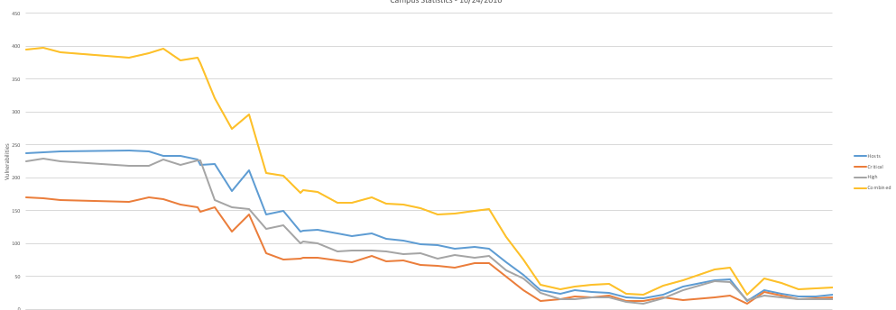
Scanmaster Metrics

Slide 36
Some Detail: Intrusion Detection
Traditional IDS
(SourceFire and Bro)
SOC
IPBlocker
(Blocks at Border)
Threat
Feeds
Honey-Pi’s

Slide 37
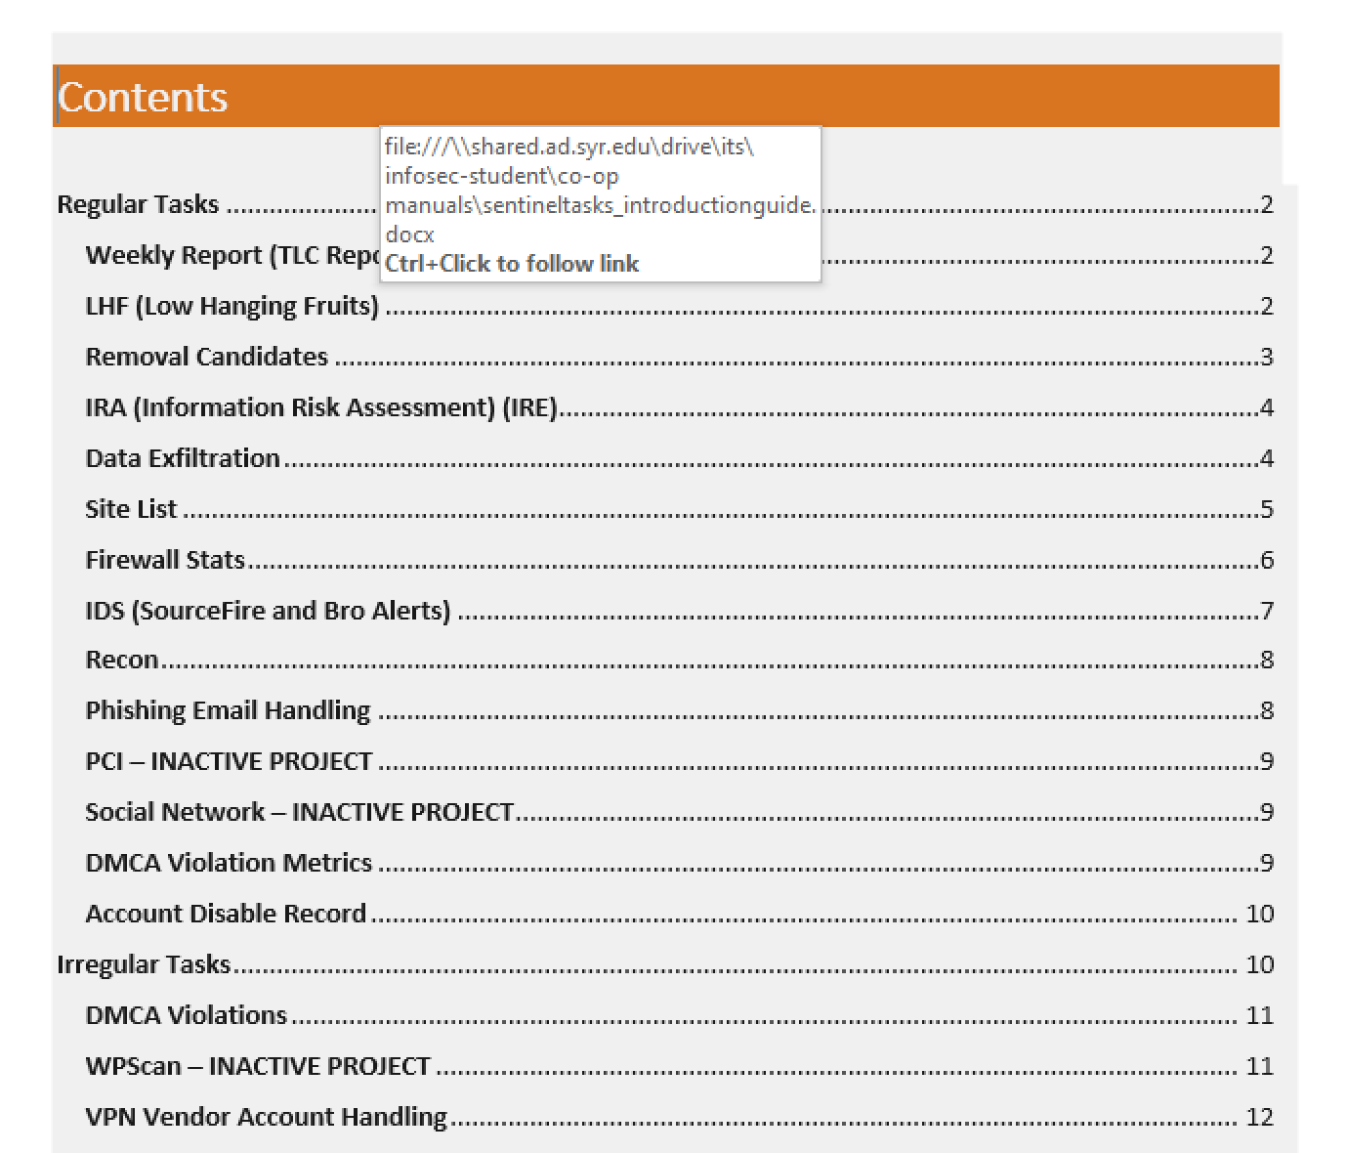
Some Detail: The Flight Manuals

Slide 38
Some Detail: Flight Manuals

Slide 39
Questions?

Slide 40
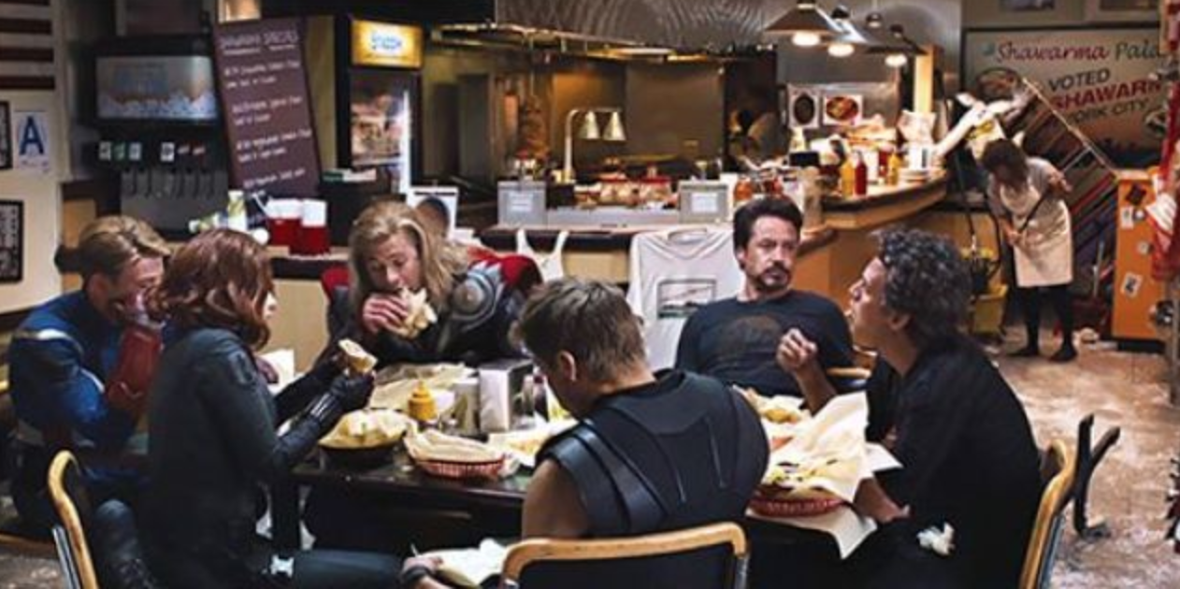
Thank You! Let’s go get some shawarma

