Slide 1
Casting a Wide Net in a Sea of Identities April 12, 2018

Slide 2
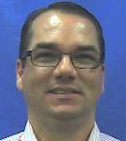
Speaker Bios
Bill Arnold, Sr Information Security Analyst @ The University of Tampa
15 years working for the University of Tampa in multiple technology and security roles.
Expertise in network security, providing security awareness training to diverse audiences, ID management & Workday security
Jay Barone Information Security Analyst @ The University of Tampa
3 years working for the University of Tampa in a security role.
Expertise in Vulnerability management, ID management & Network Access.

Slide 3
About The University of Tampa
Private University
9000 Students
1500 Staff/Faculty
1400 Students Employed
30 ITS Staff
3Information Security Analysts
"

Slide 4
1. Cyber-Security Implications
Identities Don’t Live Here Anymore
Identity Management Challenges
Benefits of Identity Management
Our Experience with Okta IDaaS
"This presentation leaves copyright of the content to the presenter. Unless otherwise noted in the materials, uploaded content carries the
Creative Commons Attribution-NonCommercial-ShareAlike license, which grants usage to the general public with the stipulated criteria."

Slide 5
On many campuses faculty, staff and students need 5 or more identities to utilize academic or business technology services
Off campus, many of them use their university email address to represent their identity in the cloud
They may use their univ email password as well!

Slide 6
Cyber-Security Implications
Phishing.
Ubiquitous identities
Authentication is inconsistent
Impersonation is too easy
Users want ease and convenience and we’re not giving it to them fast enough
Password repetition

Slide 7
Identities Don’t Live Here Anymore...
On Premise
Cloud-based
Through 2013 on prem and hosted
solutions comprised >85% of our enterprise apps portfolio, including legacy ERP/SIS
12%
13%
As of 2017 cloud solutions comprise
>85% of our enterprise apps portfolio, including new ERP/SIS
88%
87%
2013
2017

Slide 8
Enterprise Cloud Apps - Identities
Don’t always integrate with campus ID systems
Use a variety of authentication standards good or bad
Provide IT/Sec orgs limited visibility
May not adequately validate users
Always impact the user experience

Slide 9
IDM IT/Security Challenges
Users are expected to maintain too many usernames and passwords
Shell scripts and hard coded integrations maintained to keep HR, Active Directory and business systems in sync
Ineffective tools for self service password reset or account unlock

Slide 10
Identity Management Business Challenges
New hires do not receive access to core business systems day one
Terminated users may still have access to core University business systems.
Challenges with compliance, license management and reporting

Slide 11
Identity Lifecycle Management Benefits
Identity Management
Automate identity management lifecycle
Centrally manage all university related identities
Access Management
Protect Data through User validation beyond
passwords
Gain better visibility, control and oversight
Directory Services
Improve user experience
Reduce number of ID’s and Passwords to remember

Slide 12
How we chose Okta
Representatives from ITS, HR, Financial Management, Provost, and Admissions
Had presentations from 6 vendors
Invited 2 vendors back for a deeper dive
One requirement was integration with Workday (Implementing HCM/Payroll)
Okta has over 4,000 built in connectors for Single Sign On
Provided option for Multi-Factor Authentication (Was investigating DUO)
Workday uses Okta as their IdM

Slide 13
Our Experience with Okta IDaaS
Choosing Okta
Expert Professional Services
Password Reset
Automate Onboarding
MFA
Integration with Workday
What is next

Slide 14
Rollout with Okta Professional Services
Okta Professional Services helping UT implement a phased approach
Staff and faculty rolled out first, getting buy-in, working out kinks
Student rollout follows a successful pilot

Slide 15
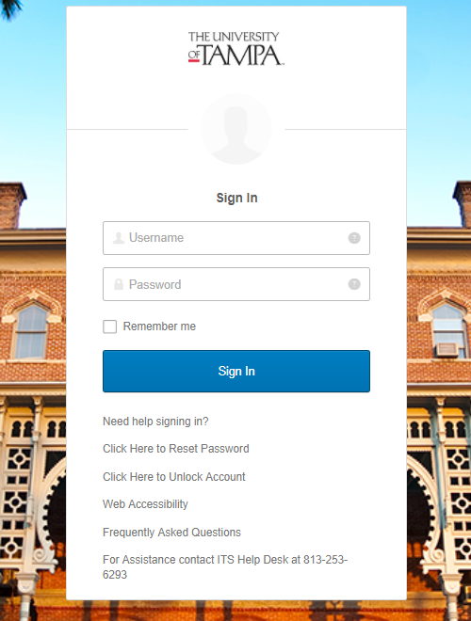
Improved and Secure End User Experience

Slide 16
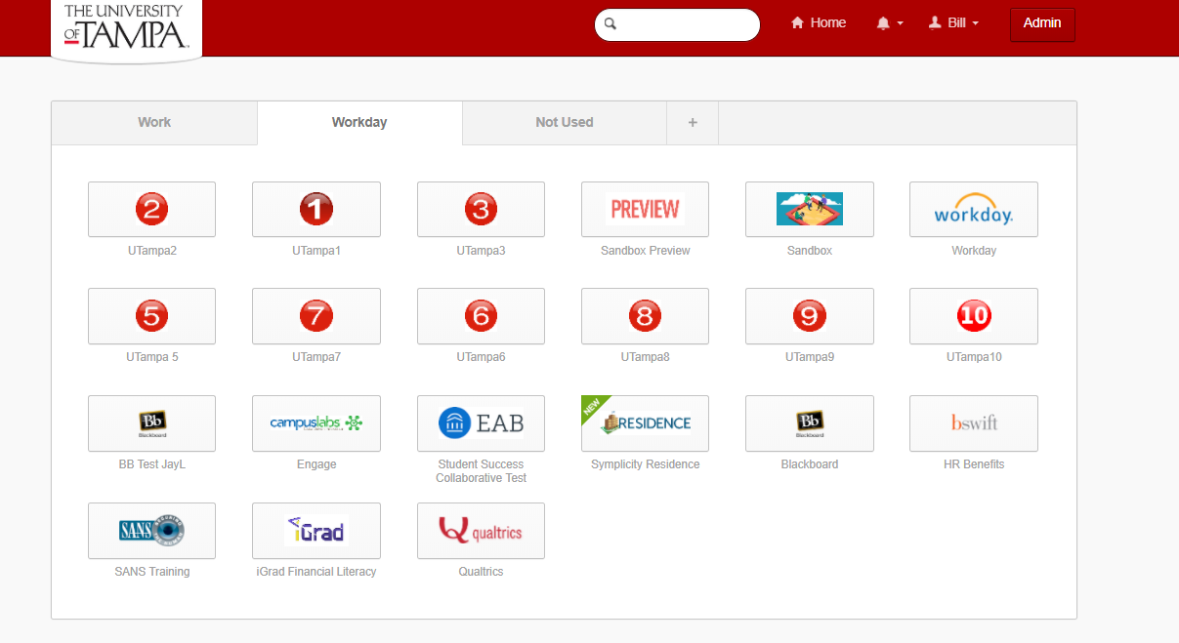
SSO Dashboard

Slide 17
Single Source of Truth

Slide 18
Automate onboarding and offboarding

Slide 19
Okta WD Integration Leverages WD RTS
Workday Real Time Sync (RTS) allows Okta to receive user creation, update, and termination events from Workday on a real-time basis.
Improvements include the following features:
-IP developed in conjunction with Workday and Okta
-Okta is the only Identity Provider for Workday that is investing in this capability
-Investing in Okta->Workday write-back together in the future

Slide 20
Automate onboarding and offboarding
Workday as a Master automatically provisions and de-provisions staff and faculty with necessary access based on assigned status and roles
Once we are on Workday for our SIS, automation of provisioning and deprovisioning of Student Accounts will be through Okta

Slide 21
Multi-Factor Authentication

Slide 22
What’s ahead...
Using Okta to facilitate Business or Academic needs
Inclusion of additional SSO applications

Slide 23
What’s Next for Students
Medicat (Student Health Portal)
Everfi (Health Center Videos)
Papercut (Student Printing)
Office 365
Atomic Learning
Residence (Housing)
Blackboard
Front Rush (Athletics Compliance)
Advantage Design (Online Orientation)
Neo Post (Post Office)

Slide 24
What’s Next for Staff/Faculty
Blackboard
Citrix Sharefile
Raiser Edge (Development)
SAMANAGE (Asset Tracking)
Ad Astra (Room Scheduling)
Office365 (Project)

Slide 25
O• ur advice…
Set up a dedicated website -- see ours at
The University of Tampa - Information Technology -
Okta
You need a comprehensive comm and training plan
Test Test Test!
Partner with Campus Departments
Consider ‘incremental implementations’

Slide 26
Questions? Feel free to contact us:
In addition to ID Mgt, you’ll want to carefully review your third party service providers’ security posture.
Bill Arnold
warnold@ut.edu
Jay Barone
jbarone@ut.edu
Visit: REN-ISAC
HECVAT
to obtain a free cloud vendor assessment tool

