Slide 1
PeopleSoft and Data Compliance: Adapting to New Regulations
PRESENTED BY:
Greg Wendt – Executive Director of Security Solutions Appsian

Slide 2

Formally GreyHeller

Slide 3


Slide 4
Agenda
Introduction
Compliance – Where We Are / How We Got Here
Challenges of Existing Security
Layered Security

Slide 5
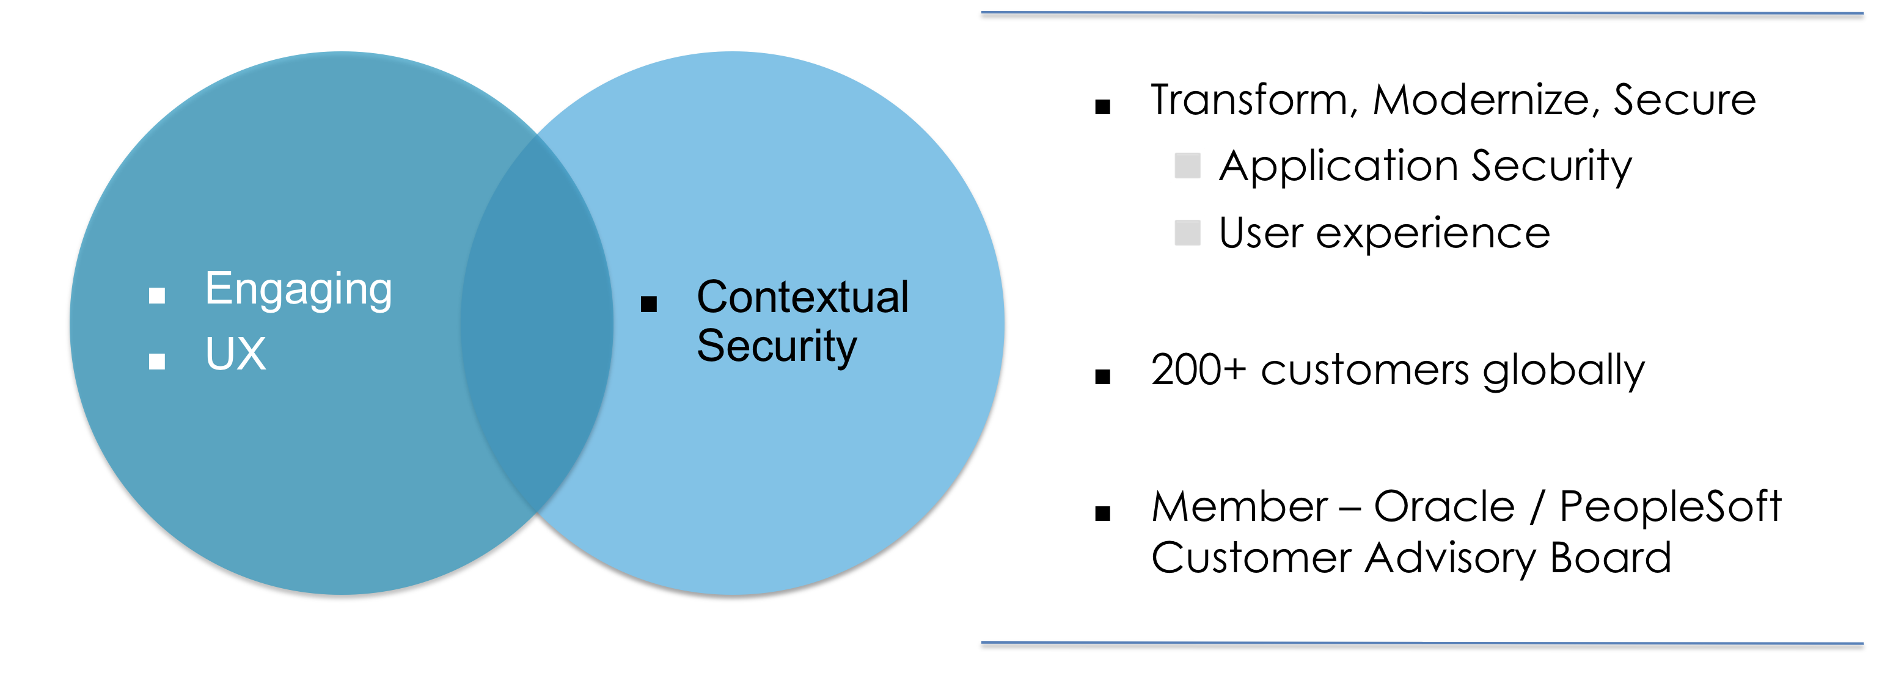
Appsian

Slide 6
Evolution of a Regulatory Environment

Slide 7
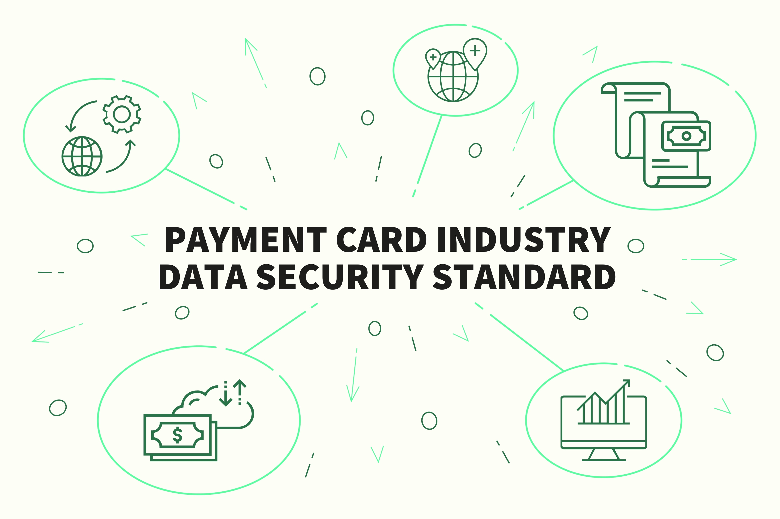
Payment Card Industry (PCI)
PCI Data Security Standard
Version 1: 2004 / Current Version: 3.2
  Build & Maintain a Secure Network
  Protect Cardholder Data
  Maintain a Vulnerability Mgt Program
  Implement Strong Access Controls
  Regularly Monitor & Test Networks
  Maintain an Information Security Policy
Applies to all entities that store, process or transmit cardholder data

Slide 8
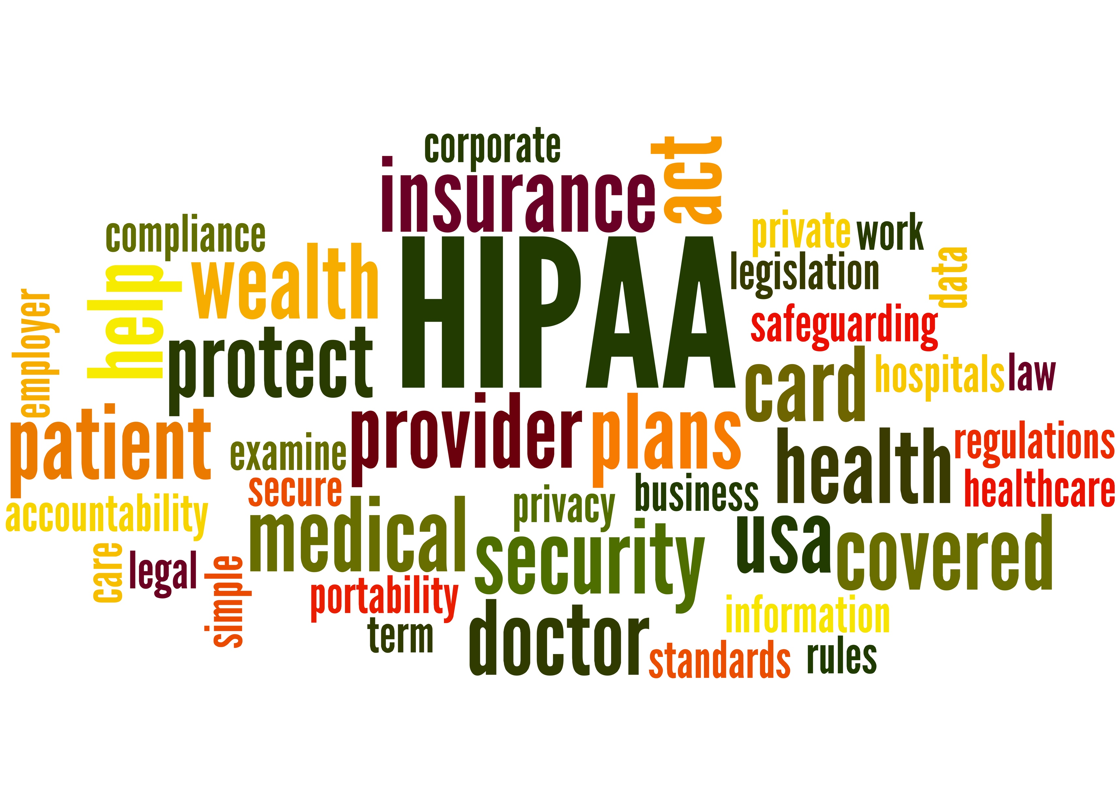
HIPAA
Health Insurance Portability & Accountability Act
Signed: 1996 / Phased In: 2003-2005
  Privacy Rule
  Security Rule
  Enforcement Rule
  Breach Notification Rule
Big focus on Electronic Data Interchange (EDI)
Applies to all entities that store, process or transmit private health information

Slide 9
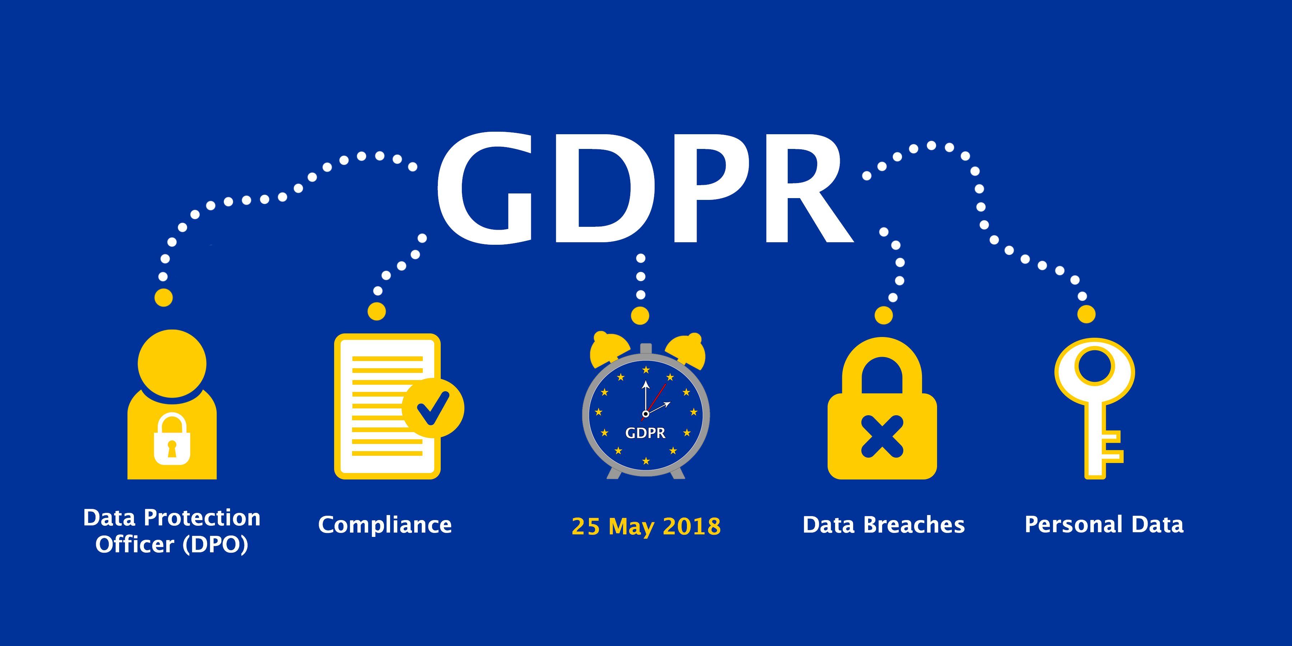
GDPR
General Data Protection Regulation
Implemented May, 2018
EU law mandating data protection & privacy for all individuals in the EU and EEA
Addresses the export of data to non-EU entities
Requires a new role: Data Protection Officer
Substantial revenue-based penalties
Still evolving: what data is covered?
U.S. based companies are not exempt based on location alone
"personal data is any information relating to an individual, whether it relates to his or her private, professional or public life”

Slide 10
California Consumer Privacy Act
The Act mandates that consumers:
Have the right to know what information is being collected about them
Have the right to know why that information is being collected:
Have the right to know who that information is being shared with or sold to
Under the age of 16 have even more stringent controls on the selling or sharing of their data

Slide 11
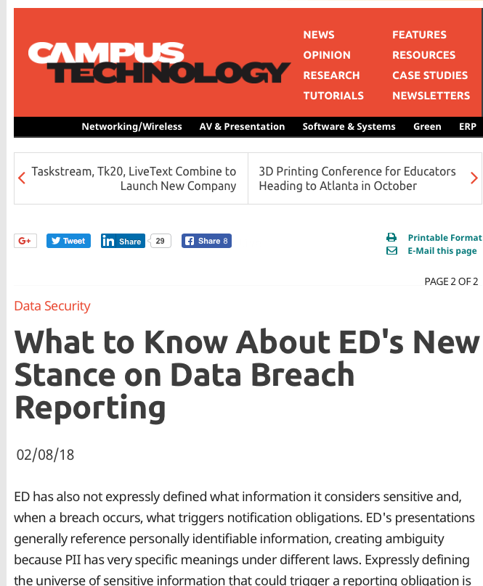
US Department of Education
Change in reporting
  FERPA does not contain a breach reporting obligation
Informal Notification
  Via webinars
Must report any “suspected” data breach on day it was detected
  Live topic –changes likely

Slide 12
Fines
GDPR
Fines up to 4% of global annual revenue or 20 Million Euro whichever greater
Breaches at 29 of the FTSE 100 in the last 8 years would’ve incurred penalties
Of the FTSE 100
  A 4% fine would wipe out the profits of 34 companies
  A 2% fine would wipe out the profits of 19 companies
  A 1% fine would wipe out the profits of 15 companies
U.S. Department of Education
Levying Cleryesque fines up to $56,789 per violation
California Consumer Privacy Act
???????
More states will be implementing stringent privacy laws

Slide 13
Causes of Malicious Data Leakage

Slide 14
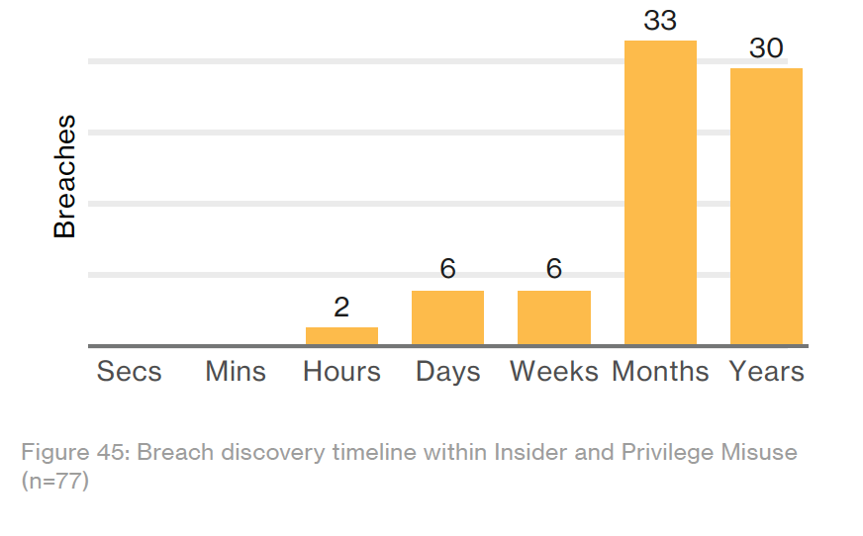
Insider Misuse
Security controls to catch hackers also catch insiders
Average of months to YEARS to discover

Slide 15
No Finish Line in Compliance
Baseline
Requirements
Assessment
Prevention
Detection

Slide 16

Challenges of Existing Security

Slide 17
Cisco Annual Cybersecurity Report
56% of security alerts are investigated
  Less than half are legitimate
Criminals use organizations lack of response time against them
Leveraging classic attacks spam and adware
CSO’s cite budget constraints, compatibility issues, and lack of trained talent as their biggest barriers
  66% of organizations use more than 6 security products

Slide 18
Challenges of Existing Secrurity
Implementing MFA effectively
  End-user security engagement
Enterprise Firewalls are challenged by ERP Applications
Stolen credentials
  Effects on security
Patching and Maintenance
Policies and Procedures
  Verifying process are done

Slide 19

Layered Security

Slide 20
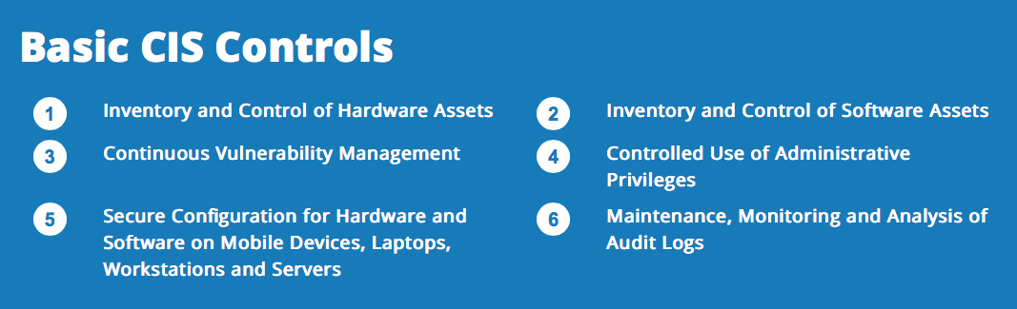
CIS 20 - Controls

Slide 21
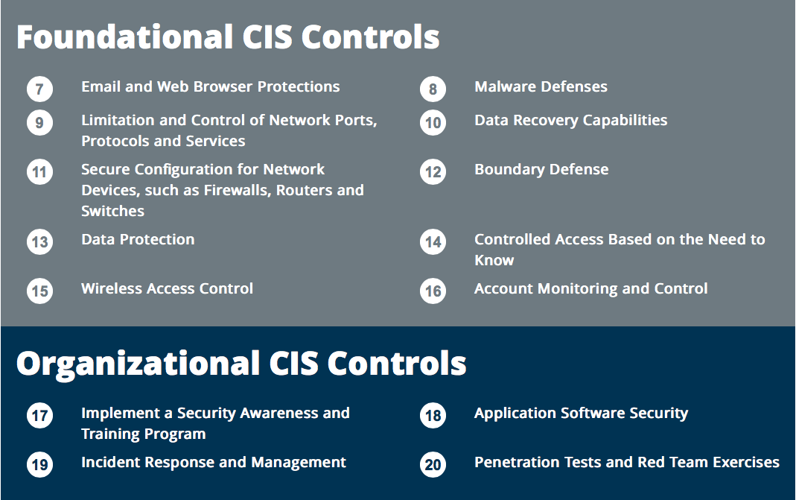
CIS 20 - Controls

Slide 22
CIS 20 – Appsian Controls
3 | Continuous Vulnerability Management | ☑
4 | Controlled Use of Administrative Privileges | ☑
6 | Maintenance, Monitoring, and Analysis of Audit Logs | ☑
12 | Boundary Defense | ☑
13 | Data Protection | ☑
14 | Controlled Access based on the need to know | ☑
16 | Account Monitoring and Control | ☑
18 | Application Software Security | ☑
19 | Incident Response and Management | ☑

Slide 23
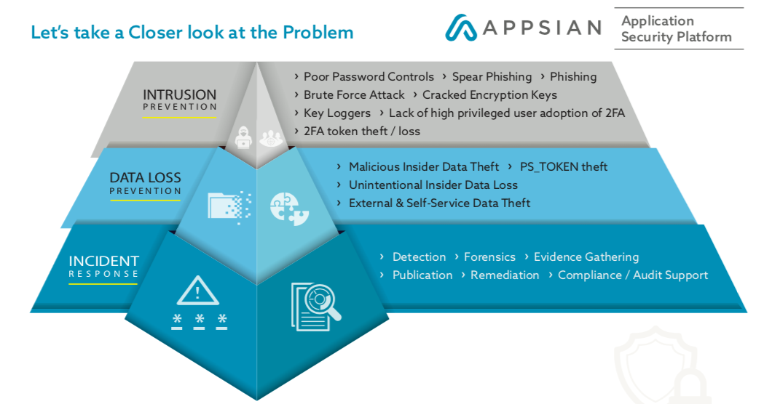
Appsian’s Application Security Platform

Slide 24
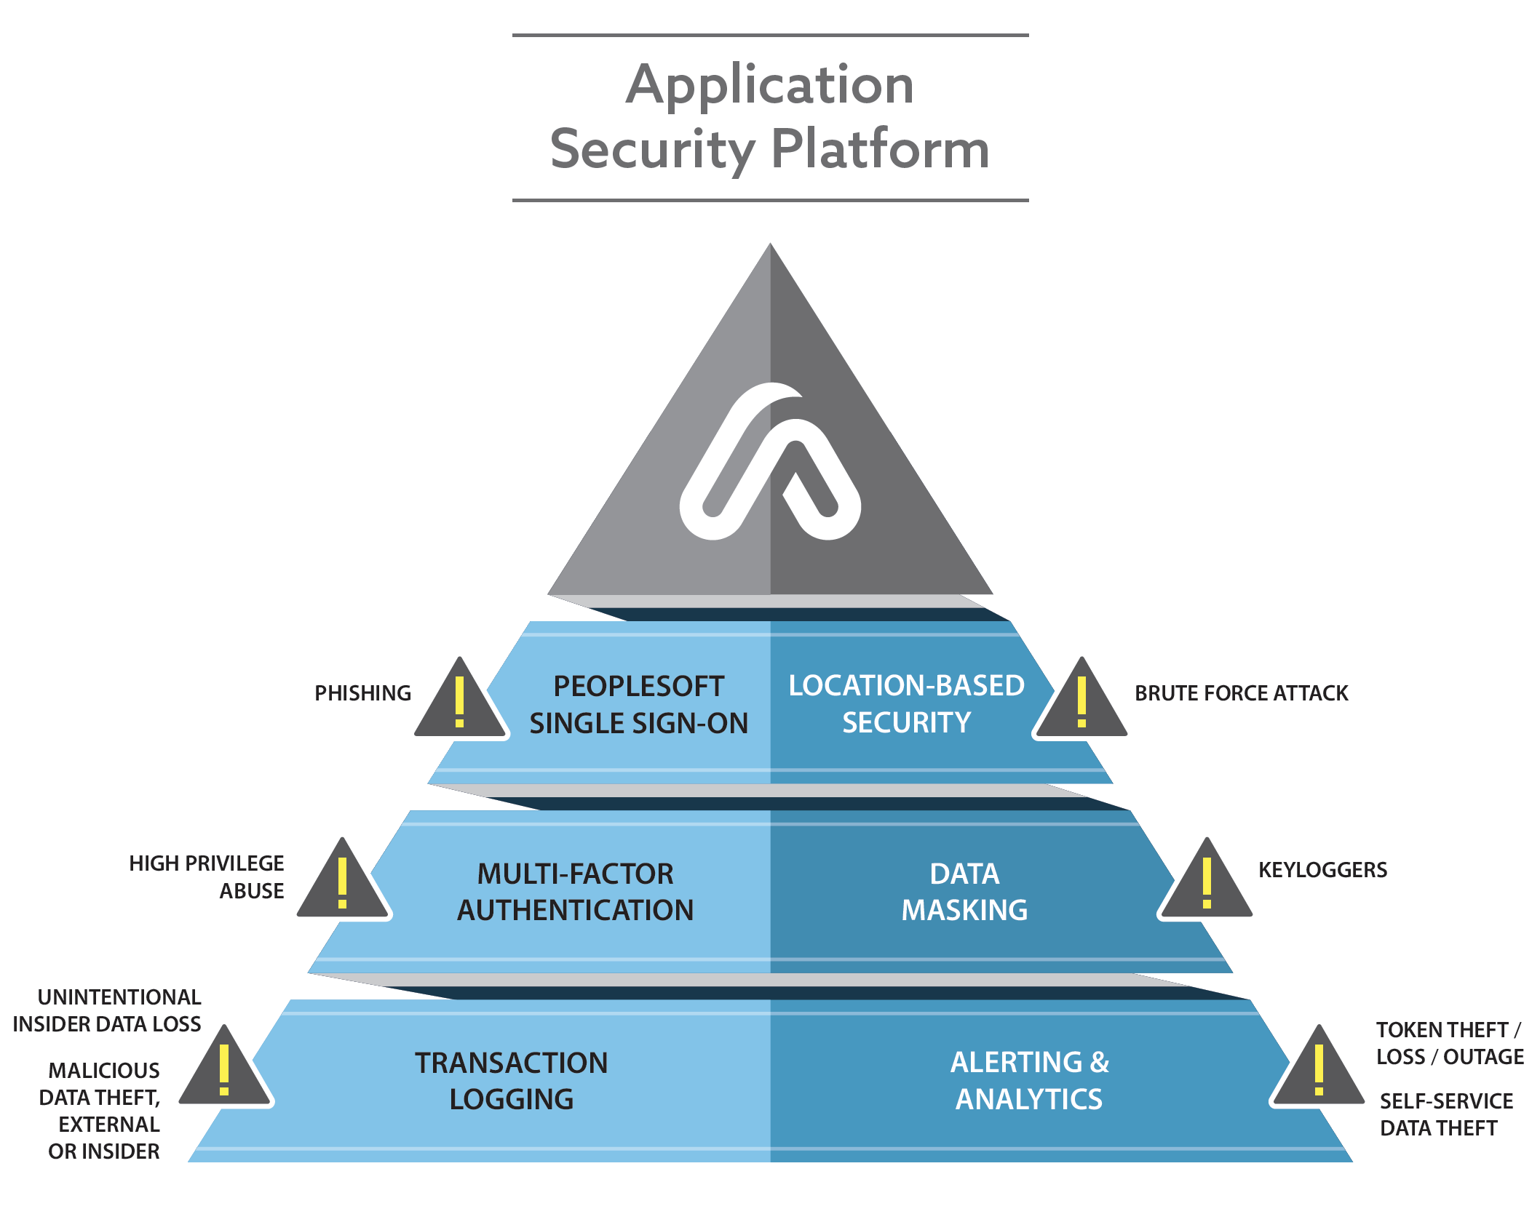
ASP

Slide 25
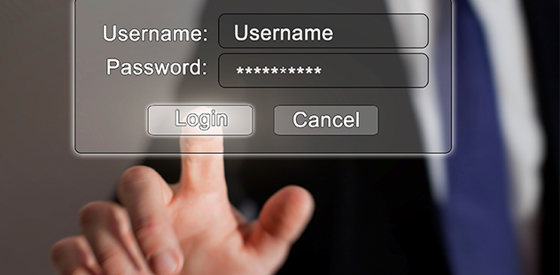
Demo

Slide 26

Questions

Slide 27
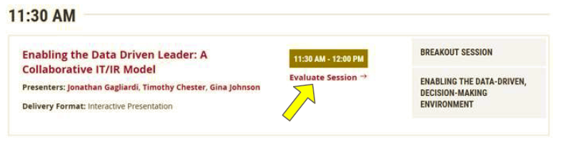
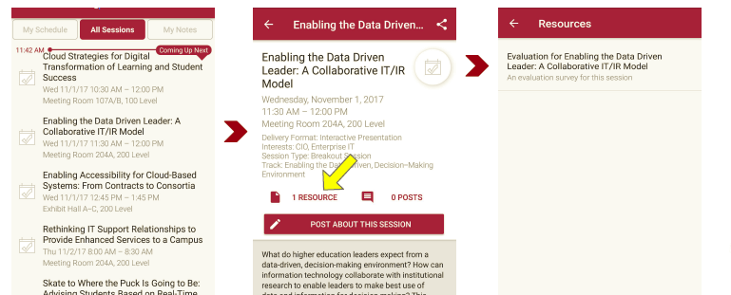
Please take a moment to evaluate this session
There are two ways to access the session and presenter evaluations
1
2
In the online agenda, click on the “Evaluate Session” link
From the mobile app, click on the session you want from the schedule > then click the associated resources > and the evaluation will pop up in the list

