Slide 1
ERP on Azure:
Penn State’s Journey
EDUCAUSE 2018
Michael Büsges
Director, Penn State Enterprise Project Management Office
Bill Wrobleski
Senior Director for Infrastructure, Penn State Information Technology
Rich Langford
Director, US Education Partner Team, Microsoft Corporation

Slide 2
Enterprise Project Management Office
  Established March 2013
  Mission is Two-fold
  lead the transition of Penn State’s administrative enterprise systems from homegrown mainframe applications to third-party ERP solutions
  oversee post-launch maintenance and development
  Structure within Penn State
  unit of Penn State Finance & Business
  director reports to Provost and Senior Vice President for Finance & Business/Treasurer
  staff includes director, operations, communications, security, leads for each enterprise business system, business analysts, developers

Slide 3
How EPMO Teams are Formed
PROJECT
POST-PRODUCTION
University Subject Matter Experts (Appointed)
Project Staff (New Hires)
Implementation Partner
ERP Vendor
Retain Some of the University Subject Matter Experts and Project Staff
Hire Additional Staff

Slide 4

General Governance and Advisory Structure
Project sponsors
Executive steering committee
Governance committee
Advisory committees

Slide 5

LionPATH
PURPOSE — Student Information System
Software — Oracle’s PeopleSoft Campus Solutions 9.0 (on premise)
Project official launch — Spring 2014
Phased deployment — Fall 2015–Fall 2016
Post-production — LionPATH Development and Organization established Fall 2016
Current efforts — user experience, system upgrade

Slide 6

WorkLion
PURPOSE — HCM and Payroll
Software — Workday (SaaS)
Project official launch — April 2015
Deployment — December 2017
Post-production — WorkLion Management Office established Fall 2016
Current efforts — benefits open enrollment, recruitment

Slide 7
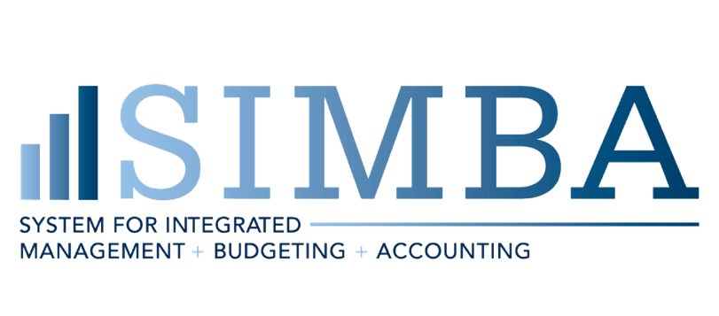
SIMBA
PURPOSE — University Financial System
Software — SAP S/4HANA
Project official launch — June 2018
Target deployment — July 2020
Current efforts — explore phase, enterprise structure design document, stakeholder analyses

Slide 8
Why SAP?
Chart of Accounts — Depth and breadth met Penn State requirements, including integrated posting between ledgers
Sponsored Awards/Grant/Contract Management — Offered the strongest functionality, especially for the University's Applied Research Lab (DoD Federal Contractor)
Treasury-Cash Management — Modules provided functionality not available from other vendors
Budget Management and Planning — Featured strongest functionality
Technical — Evaluated as the strongest vendor for security, integration, workflow and general technical requirements
Compliance — Met FedRAMP and Accessibility requirements more completely than other vendors
Notes:
WHY SAP
Functionality
1. Chart of Accounts depth and breadth to meet Penn State requirements, including integrated posting between ledgers
2. Strongest functionality for Sponsored Awards/Grant/Contract management, especially for our Applied Research Lab (DoD Federal Contractor)
3. Natural integration to Concur, which we have been using for over a decade as our Travel system
4. Treasury-Cash Management modules provided functionality not available from other vendors
5. Strongest functionality for budget management and planning
Technical -- SAP was evaluated as the strongest vendor for security, integration, workflow and general technical requirements
Compliance -- Met FedRAMP and Accessibility requirements more completely than other vendors
(transition to Bill)
We had conversations about going to a SAS solution with the third project as well. On functionality, SAP won out. It was a business decision. We negotiated with SAP to also host, but those discussions broke down. So, we pivoted to looking to a could provider.

Slide 9
Penn State’s
Infrastructure
Approach
Notes:
Photo credit: http://www.maxkade.la.psu.edu/resources.html

Slide 10
Why put our ERP on a
public cloud platform?

Slide 11
Penn State’s Technical Principles
We will spend less time managing infrastructure
We will relentlessly pursue automation
We are “cloud first” for the selection of applications and infrastructure
We will buy solutions rather than develop them ourselves
We will become integration experts
We will avoid the proliferation of functionally-redundant technology
(And more)

Slide 12
Why put our ERP on a
public cloud platform?

Slide 13
Why Azure?

Slide 14
Penn State’s Implementation
Automate, automate, automate.
Integrate with Penn State technologies/infrastructure
  Splunk, Palo Alto, CloudChekr, Active Directory, more…
Meet compliance standards
  NIST 800-171
Timely delivery of infrastructure to application team

Slide 15
Lessons
Learned

Slide 16
THANK YOU

Slide 17



Education Transformation Framework
Vision
For education transformation to be effective, an institution must carefully analyze, design, develop, implement and evaluate their plan for change. Carefully crafting a vision is the first step toward a successful, holistic education transformation.
The Microsoft Education Transformation Framework provides practical advice to develop a strategy for digital transformation; supporting new approaches to:
Manage student success and lifecycle
Modernize teaching and learning
Empower research
Provide efficient and effective physical and digital infrastructure
Student Success
& Lifecycle Management
Teaching, Learning & Research
Connected
Campus
Student Recruitment
Alumni
Learning
Management
Systems
Research
Security Management
Data
Sharing
Student Retention
Student Completion
Collaborative Teaching & Learning
Learning Spaces
Facilities Management
Institutional
Operations
Transformative Outcomes
Notes:
The Microsoft Education Transformation Framework shows you how emerging technologies, such as artificial intelligence, support new approaches to managing student success and student lifecycle; modernizing teaching, learning and research; and building efficient and effective physical and digital infrastructure.
It provides practical advice to help you develop a strategy for digital transformation with a holistic, long-term view implemented in discrete phases that you can begin today.

Slide 18
Why Azure for SAP workloads
Deep partnership and unique offering from
SAP and Microsoft
20+ year partnership
SAP is migrating 17 internal systems on Azure including S/4HANA for a business unit
Microsoft runs SAP
and S/4HANA for central finance
Get the best of both worlds in managed services and infrastructure with SAP HANA Enterprise Cloud with Azure
Most powerful and scalable cloud for
SAP HANA
Up to 4 TB SAP HANA certified VMs available worldwide, more regions of any public cloud
Largest SAP HANA workloads (up to 24TB of RAM) of any hyperscale public cloud provider, bigger than AWS
Scaling out to 60 TB RAM for HANA OLAP, with single-node support up to 24 TB for HANA OLTP
Enterprise-proven +
most secure
Largest compliance portfolio—
72 compliance certifications including tools for GDPR
Best platform for digital transformation—take advantage of high-level services like IoT, data, ML, and Power BI for insights
Broad database support: As you prepare for HANA, you can bring in your existing applications using Oracle or SQL Server

Slide 19
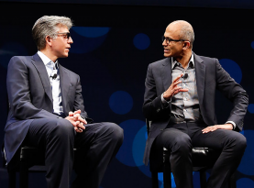
SAP and Microsoft partnership—the next chapter
The trusted, optimized, seamless enterprise-ready cloud partnership
  Trusted
  20+ year alliance partnering together for the benefit of our mutual customers
  Microsoft runs SAP and S/4HANA
  SAP runs internal S/4HANA on Azure
  Seamless
  Co-located engineering resources & aligned sales and marketing teams provide a seamless customer experience
  Optimized
  Unique capabilities, roadmap, and experience to support SAP HANA & enterprise workloads from on-premises and Azure
“We are taking our partnership to the next level… Together, we will help companies win the customer-driven growth revolution...”
—Bill McDermott, CEO of SAP
“Building on our longtime partnership, Microsoft and SAP are harnessing each other’s products to not only power our own organizations, but to empower our enterprise customers to run their most mission-critical applications and workloads with SAP S/4HANA on Azure.”
—Satya Nadella, CEO of Microsoft
Notes:
SAP and Microsoft’s partnership has a deep history -- and is now being taken to the next level – with a shared commitment to empowering the digital transformation of our customers.
The relationship between our two companies is:
TRUSTED
We have a 20+ year alliance partnering together for the benefit of our mutual customers with
85% of Fortune 500 using SAP & Microsoft Cloud
Microsoft runs on SAP S/4HANA. SAP runs on Azure.
We are both running our businesses on our new joint solutions, so customers can invest in the cloud with confidence
OPTIMIZED
Together we have unique capabilities, roadmaps, and experience to support SAP HANA & enterprise workloads from on premise to the Azure cloud
Azure has unique capability to support SAP-specific enterprise workloads due to our joint development agreement
SAP has a level of influence in the Azure roadmap to better support SAP customers
Extensive work has gone into running hybrid SAP landscapes (across on-premise, private and public cloud).
SEAMLESS
Co-located engineering resources -- and aligned sales and marketing teams -- provide a seamless customer experience
Sales, marketing, engineering and support organizations are aligned and incentivized to work together
Microsoft provides scale in geographies where SAP customers have the greatest coverage requirements

Slide 20
Azure has a full set of built-in services for SAP solutions
Migrate
Govern
Secure
Policy management
Cost management
Security management
Threat protection
Microsoft Azure
Configure
Protect
Configuration
Update management
Automation
Scripting
Backup
Disaster recovery
Monitor
App, Infra, and network monitoring
Log analytics & diagnostics
Notes:
Azure has a full set of services to meet all your security and management needs
I just walked you through the three services that get you started to easily to secure and manage your Azure resources.
However, I understand there is a lot more you need to manage and secure in your IT environment, both in the cloud and on-premises. Your job is complex and challenging.
We have a whole set of tools natively in Azure to help you manage the full lifecycle of security and management.
We covered Security capabilities protecting your data – besides Azure Backup we also discussed how Azure Site Recovery helps in disaster recovery.
In Monitoring, we are bringing all the monitoring capabilities together in Azure Monitor, including Application Insights, Log Analytics, Network Watcher, and other monitoring tools.
We also have tools for configuration, patching, automation, and PowerShell scripting.
We have new exciting tools in the Governance area. Azure Policy, in limited preview, helps you centrally manage your policies. Azure Cost Management, previously known as Cloudyn, helps organizations manage and optimize cloud spend across a multi-cloud environment.
Plus, they’re all built in to our platform so you don’t have to worry about 3rd party integration. The services are intelligent – gathering rich intelligence about your cloud infrastructure and resources with advanced analytics and machine learning algorithms, and are hybrid—extending security and management capabilities from cloud to your on-premises environment.

Slide 21

Thank You

