Slide 1
Staying ahead of Innovation Curve with Cloud and Data
Make Digital Real | Execute Smart

Slide 2
Staying ahead of Innovation Curve with Cloud and Data
In today’s world, the mediums of education are rapidly changing. Hence, it’s important for educators (faculties and staff) to build insights understand student behavior and adopt to their changing needs. In this session, we will discuss approaches for -
Building a data-centric organization to enhance experience of constituents (Student, Faculty and Staff)
How to drive agility in delivering solutions through cloud native approach

Slide 3
Today’s Speakers
Harvard Business School | HBX
Mindtree Ltd
Ryan Frazier
Director, Systems Engineering & Operations, HBX
Sudhir Sawant
Associate VP and Head – Digital Architecture

Slide 4
Agenda
1 | Quick Introduction to HBX
2 | Leveraging Cloud for HBX Systems and Infrastructure
3 | Cloud Data Ecosystem
4 | Implementation Approach for HBX for Building Data Ecosystem
5 | Q&A

Slide 5
Session Agenda
1 | Quick Introduction to HBX
2 | Leveraging Cloud for HBX Systems and Infrastructure
3 | Cloud Data Ecosystem
4 | Implementation Approach for HBX for Building Data Ecosystem
5 | Q&A

Slide 6
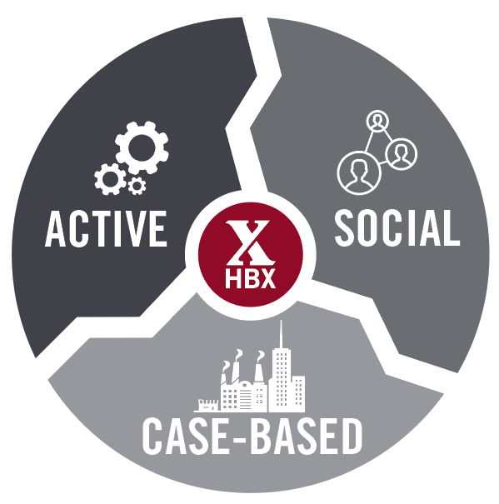
HBX Overview
First course opened in June 2014 to deliver HBS experience online
Multiple Course Offerings
CORe (Business Analytics, Financial Accounting, Economics for Managers)
Disruptive Strategy with Clayton Christensen
Leading with Finance
Becoming a Better Manager
Negotiation Mastery
Entrepreneurship Essentials
Managing Your Career Development
Sustainable Business Strategy
Additional course in development
http://hbx.hbs.edu
The teaching model sets HBX apart from many online learning options and is reflective of the HBS in-person classroom approach

Slide 7
Mindtree’s relationship with Harvard
HBX Live Consulting
Architecture and QA consulting for HBX Live platform
HBX: Business Systems
Architecture definition, design & implementation
HBX: Course Platform
Security, Performance and Accessibility testing
Quality Assurance
Building a horizontal QA organization at HBS IT
SIS Core Enhancement
Enhancing the current SIS portfolio with continued support
Data & BI
Design and implementation of cloud hosted e-Data warehouse
Salesforce Foundation
Foundation CRM implementation for HBS IT for future integrations
IT Service Delivery (ServiceNow)
Standardization of multiple ServiceNow modules
Service Desk and Support
24x7 support of all HBX applications

Slide 8
Session Agenda
1 | Quick Introduction to HBX
2 | Leveraging Cloud for HBX Systems and Infrastructure
3 | Cloud Data Ecosystem
4 | Implementation Approach for HBX for Building Data Ecosystem
5 | Q&A

Slide 9
HBX Technology Principles
Run independent of HBS IT
Be able to scale up—or down—rapidly
Move Fast
90 days to deliver application & registration system
<1 year for complete course delivery platform
Minimize impact on existing services
Enable new approaches to new needs
Prepare for success or failure of the experiment

Slide 10
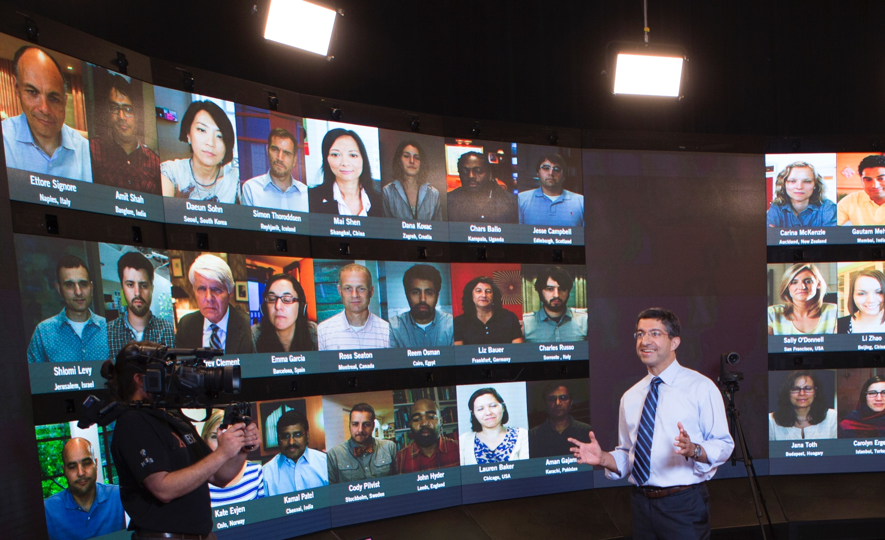
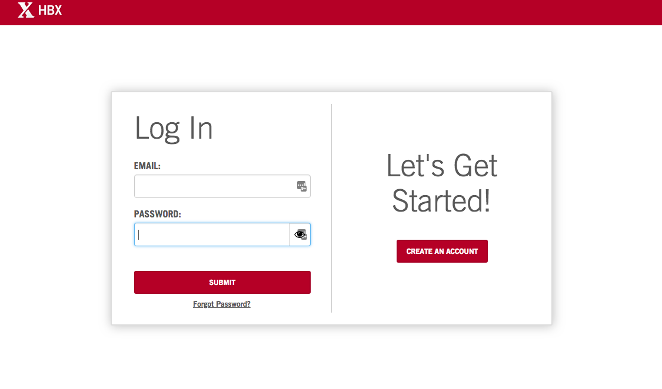
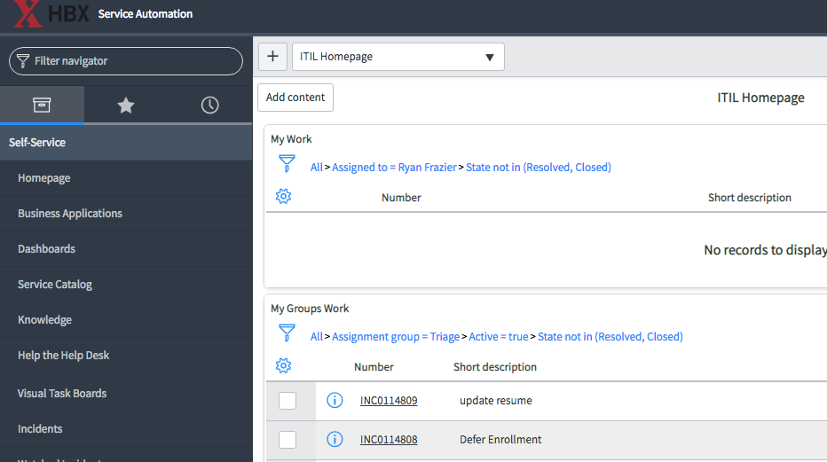
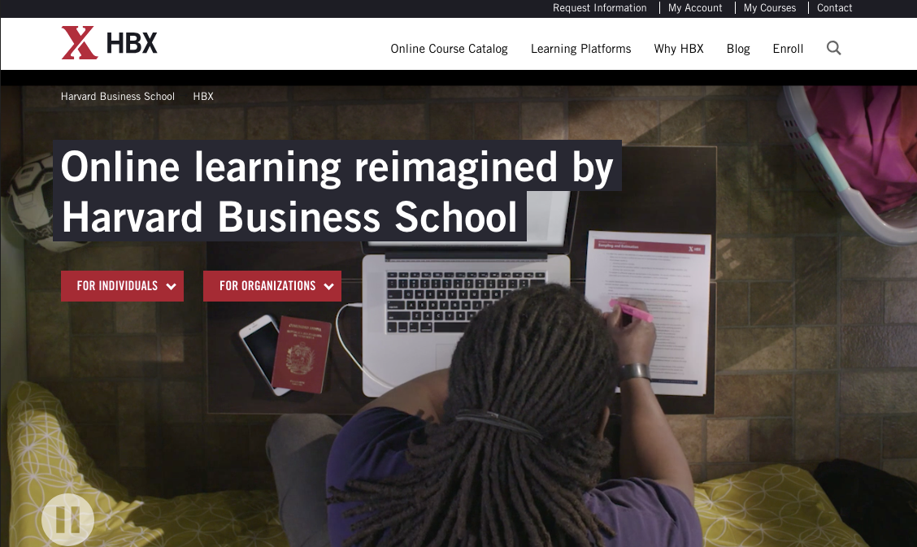
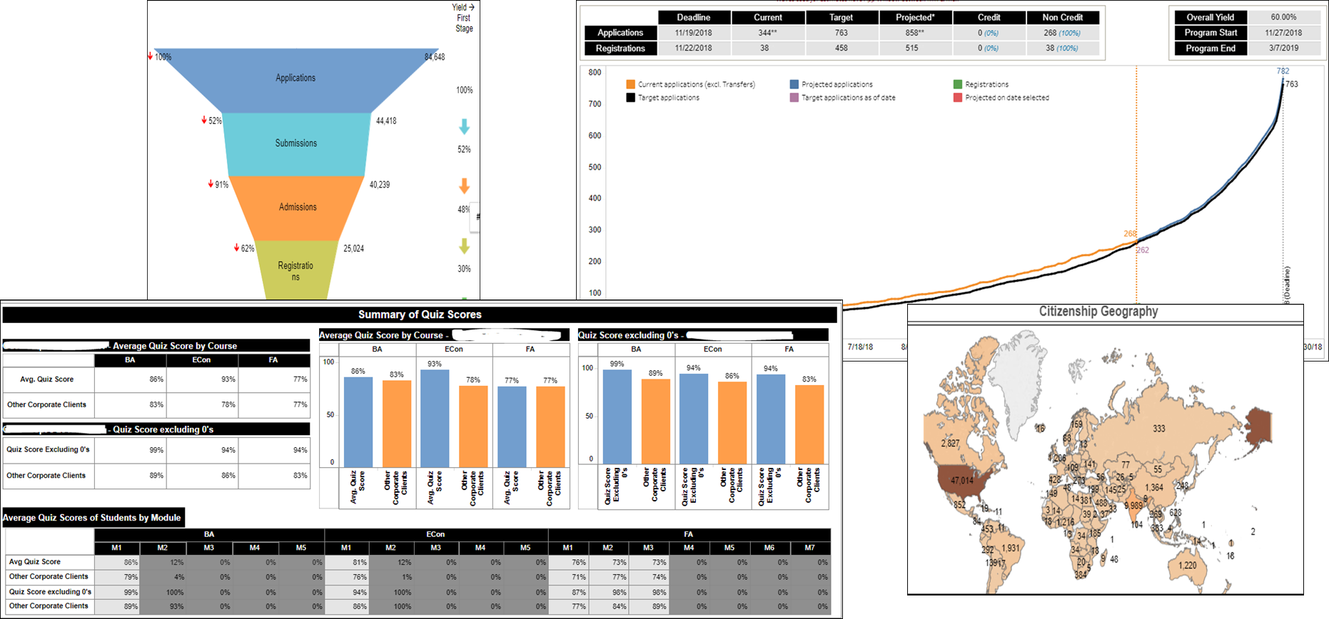
HBX Systems
HBX Course Platform (AWS)
HBX Live (On-premise)
SIS (Salesforce)
Support (ServiceNow)
Marketing (Web, HubSpot, GA)
HBX Insights
(Tableau/AWS/Informatica)

Slide 11
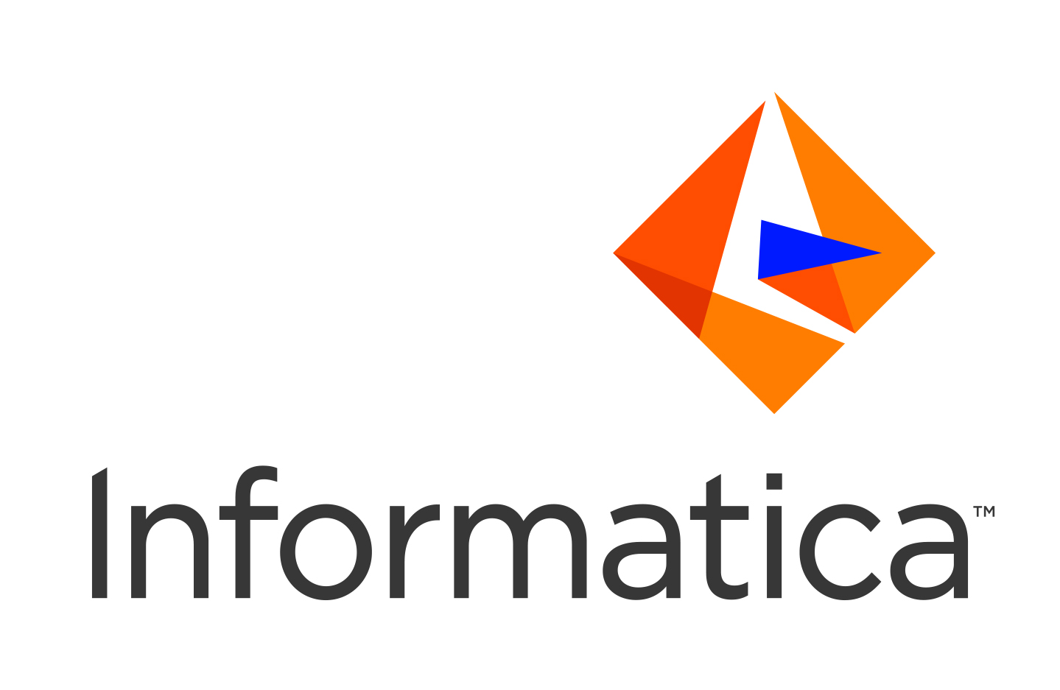
Leveraging Cloud Services
SaaS Focused Services
IaaS Foundational Components
PaaS Flexible Frameworks
AGILITY
FLEXIBILITY
RISK MGMT
AWS REDSHIFT

Slide 12
Key Trends in Cloud Adoption
Most of customers are using Cloud in some way
Many Enterprises are leveraging Public Cloud and it’s adoption is growing
More focus on leveraging PaaS and SaaS than IaaS
Serverless computing and Container-as-a-service gaining popularity
Multi-Cloud architecture has become preferred strategy
Integration Cloud has become very important in multi-cloud architecture to integrate these applications
Automations first approach in needed (“Infrastructure as a code” and “Continuous build and Integration”)
Organizations needs to adopt to Cloud Security Principals
Cloud Governance has become very important for the success of the cloud
Need to build single view of operation across applications in multi-cloud architecture which can be imple

Slide 13
Seven Stages of Cloud Adoption
A holistic approach from advisory to operations to transform your business and drive innovation and efficiency
Cloud Native
Enterprise collaboration
Continuously available business platforms
Multi-cloud serverless architecture
SaaS implementation and integration
Cloud Advisory
Readiness assessment
Roadmap and strategy
Architecture audit
Change management
Security roadmap
Innovation incubator: Digital Pumpkin
Portfolio Analysis
Current state analysis
Cloud fitment analysis
Migration plans and timelines
Cloud Build
Cloud data center design, sizing and build
Private cloud build-out
Cloud Governance
Cloud governance lifecycle model
Secure governance practices setup
Finance management
RACI matrix
Managed Cloud
Cloud sustenance
CloudOps and DevOps
Cloud Migration Factory
Migration factory
Cloud-to-cloud movement

Slide 14
Advisory for Non profit organization serving academic medical community
Strategic Cloud provider selection to enable next generation architecture based on a 360 platform
Issue
Mindtree approach
Cloud Provider Selection
Twenty week detailed application and cloud assessment was performed along with cloud provider selection.
This recommended approach is taken for larger rollout and continuous improvement model to best leverage the cloud capabilities.
Cloud Reference Architecture
Created cloud reference architecture for their internal application.
Anchor partner
Mindtree chosen as Anchor partner for comparison against Google Cloud Provider.
Modernizing the Core to elevate experiences from student to a professional
50+ custom java applications in on premise.
Multiple CRM, eCommerce applications without 360 view of data.
No modularity and single responsibility principle followed in system.
50+
Services in Google Cloud across Web, Mobile, Data and AI compared
against leading cloud providers

Slide 15
Session Agenda
1 | Quick Introduction to HBX
2 | Leveraging Cloud for HBX Systems and Infrastructure
3 | Cloud Data Ecosystem
4 | Implementation Approach for HBX for Building Data Ecosystem
5 | Q&A

Slide 16
Key Objectives for Creating Data Ecosystem
Students
Staff
Faculty
Enhance Outcomes
Identify Challenging Content
Evaluate and improve interactive content and retention
Proactively support struggling students
Improve effectiveness
Scale data intensive activities like marketing, admissions & grading
Use data to test ideas and improve quality of decisions
Redefine Pedagogy
Evaluate new pedagogical approaches
Optimize evaluation approaches
Support pedagogical research activities and innovation
Innovation & Continuous Improvement
Identify and evaluate innovation opportunities
Drive Continuous Improvement

Slide 17
Considerations for Technology Selection
Integration using
Informatica Cloud
Storage using S3, Amazon Redshift, Snowflake
Insights using Tableau,
custom queries
Cloud based infrastructure with minimal infrastructure management
Development Tools for management integration
Pluggable connectors to S3, Redshift, ODBC, Salesforce, ServiceNow, REST
S3 – As Landing layer to stage the data
Redshift - MPP based with scalability and performance ; suited for analytics
Snowflake for processing semi-structured (JSON) data
Interactive dashboards for insight and decisions
Ad-hoc analysis using semantic layer
Standardized views for consistent reporting (“student-wave”)

Slide 18
High-level Architecture of the Data Ecosystem
HBX AWS Acct
External Data Sources
Course Platform
Historical Data
Salesforce
ServiceNow
Google Analytics
Hubspot
Reporting Copy
MongoDB MySQL
MongoDB MySQL
Amazon Redshift
Interactive
Reports
Firehose
Tableau
Secure Agent
Metadata
Ad Hoc Query/Reporting
Course Platform MongoDB data (json)
Informatica Cloud Services
Local Data Center
HBX Live
Data Flow
Snowflake Virtual DW
Future Data Flow
Snowflake Data Persistence
Snowflake Metadata Services
Ad Hoc Query/Reporting

Slide 19
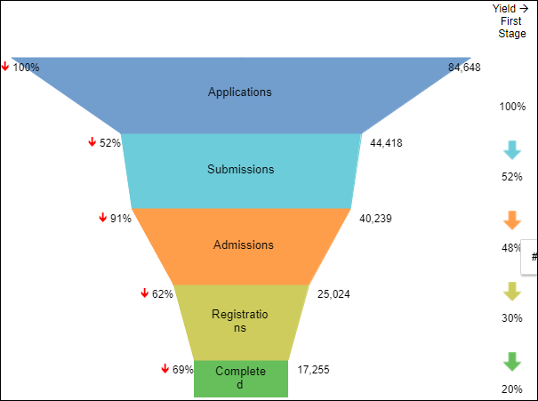
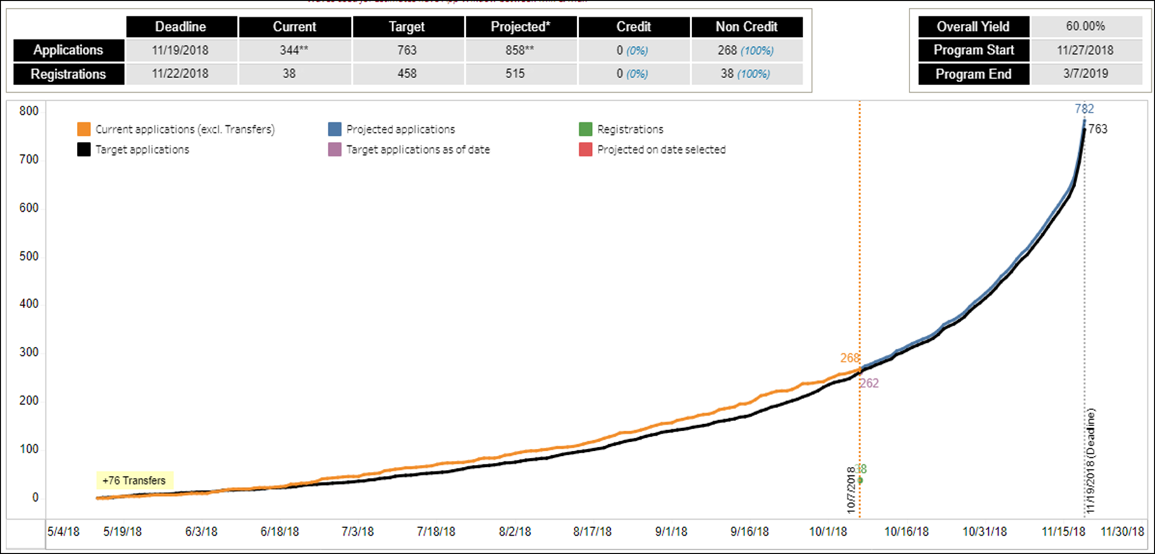
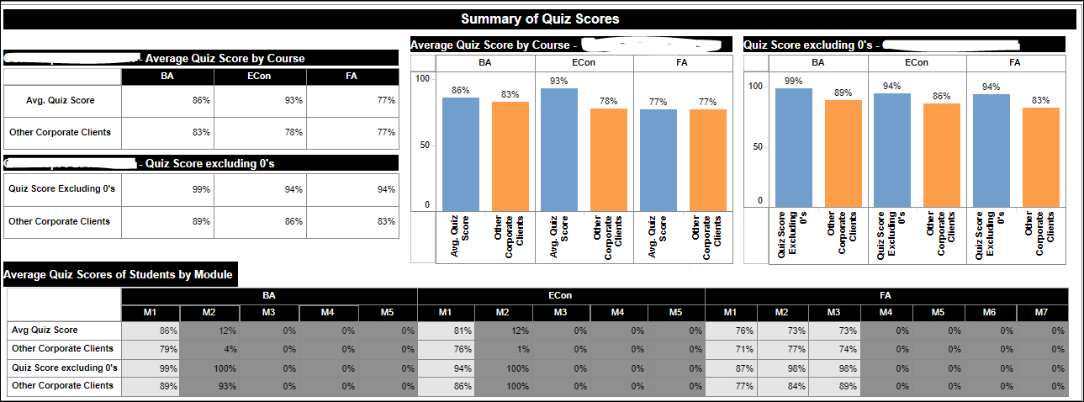
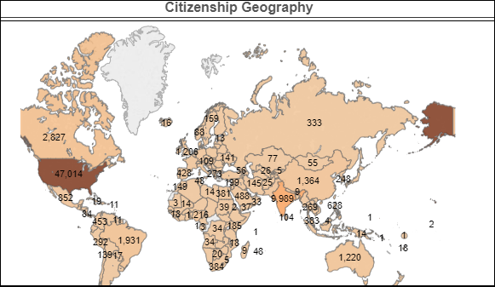
Sample Insights

Slide 20
Approach for Building an Insights-Driven Digital Enterprise
Take Journey Science View
Identify and prioritize journeys and build persona
Identify the underlying processes and the data infrastructure
Understand the insights and recommendations needs of personas
Experience Layer
Adopt Value-led Experimentation
Select use case and define KPIs
Adopt a hypothesis validation approach
Start with the existing data and integrate new sources and type of data
Apply analytics and ML to develop actionable insights
Measure results based on defined KPIs and refine insights
Develop a MVP of intelligent apps to deliver insights
Insights Layer
Data Infrastructure Layer
Build and Scale Point of Insights
Leverage data lakes with platform-led approach
Operationalize with core and flex teams for platform development, enhancements, and use case realization
Set up the governance strategy, frameworks, guidelines and processes with a PMO

Slide 21
Understand Journey to build insights for Making Better Decisions
Decision Making and Applying
Being a Student
Graduating
and Being an Alumni
Know
& Engage Me
Help Me Decide & Apply
Welcome
& Delight Me
Empower Me
Leverage Me
Unknown Student
Lifelong Advocate
Formal and Informal Learning Spaces
Intelligent Tutoring
Interactive Collaboration and Guidance
Course Completion
Post-graduation Planning and Placement
Cross-channel Outreach & Engagement on new course initiatives
Course Recommendation
Alumni Connections
Cross-channel Outreach & Engagement
Recruitment, Enrollment
Financial Assistance
Student Residence and Extracurricular Engagement
Digital Profile Creation
Create new sites
Notes:
What are the different paths institutions and larger enterprises taking in their data & cloud journey?

Slide 22
Reference Architecture for Data Driven Ecosystem
From “Build” to “Managed Services”
Data Ingestion and Transformation
Business Intelligence
Visual Insights
Insights-as-a-Service
IoT Devices
Social Media Feeds
Web clicks
Real Time Data
Data Design
RDBMS
Structured / Delimited files
Databases
Data Stores
Structured
Data
Data Lake
Un-Structured
Data
Images
Chat Transcripts
Text Files
Data Warehouse
MDM
Predictive Analytics
Insights Sandbox
Machine Learning / Deep Learning
Data Discovery, Governance and Quality

Slide 23
Session Agenda
1 | Quick Introduction to HBX
2 | Leveraging Cloud for HBX Systems and Infrastructure
3 | Cloud Data Ecosystem
4 | Implementation Approach for HBX for Building Data Ecosystem
5 | Q&A

Slide 24
Implementation Objectives
Integrate Data Sources into Comprehensive Data Warehouse
Build Reports and Dashboards
Leverage Partner Resources
& Expertise
Enable Self Service
Ensure Data Quality and Integrity
Achieve Rapid Time to Value
$
t

Slide 25
High-level Timeline and Key Challenges
First Interactive
Reports
HBX Challenges
Building a data-informed culture
Data proliferation and analytical inconsistency
“Data Last” business processes
Complex data strcutres
Data
Management
Initiative
Launched
Data Inf.
Architecture
Review
Report Data
Migration
2012
2013
2014
2015
2016
2017
2018
CORe
Program
Launched
HBX
Live
Launched
HBX
Formed
SIS Migrated
to Salesforce

Slide 26
Operating Model for Data Management Ecosystem
HBX End Users
Data Mgmt Workgroup
Business Stakeholder
Core Team Roles
Platform
Development
Platform
Enhancements
Use Case
Realization
Tech Program Manager, ETL Dev, Report Dev, QA, Operations
Core Analytics Team
Flex Analytics Team
Flex Team Roles
Data Mgmt Team
Data Eng, Report Dev, Analyst, Director
On-Shore Coordinator
Architects, Data Scientists, Developers
(Team sized as per needs for use case execution/ enhancements)
Ensures long term functional and technical control
Ensures availability of resources with fluctuations in demand
Program Management Office
Ramp Up
Ramp Down
Tech Team
Architecture, DevOps, SW Dev, Prog Mgmt, UX
Program Mgmt
Change Mgmt
Training and Knowledge Mgmt
Quality Mgmt
Mindtree Analytics COE

Slide 27
Best Practices and Learning
Standardization-driven Platform Approach for future scalability
Use Case or Insight Driven Approach for implementation
Ensuring Quality of Data through data profile and validation
Establishing Data Governance for consistency
Securing Data and Protect Privacy Constituents through defense-in-depth principals
Direct access to the data for Ad-hoc Analysis

Slide 28
Increase market share
Cross-sell and Up-sell
Customer journey mapping
Predictive analytics
5 basis points improvement in CSAT
30% increase in sales
Multinational Technology Company Increases Market Share and Improves Customer Experience

Slide 29
Session Agenda
1 | Quick Introduction to HBX
2 | Leveraging Cloud for HBX Systems and Infrastructure
3 | Cloud Data Ecosystem
4 | Implementation Approach for HBX for Building Data Ecosystem
5 | Q&A

Slide 31
Cloud Adaption for Changing Business Needs
Goal: Rapid enhancement with platform stability
Goal: Operational efficiency with frequent feature releases
Solution: Multiple production environments with short lifespan
Solution: Single production environment with blue-green deployment support
Cohort A
v1.0
Cohort B
v2.0
Cohort C
v4.0
v4.1
v3.0
31

Slide 32
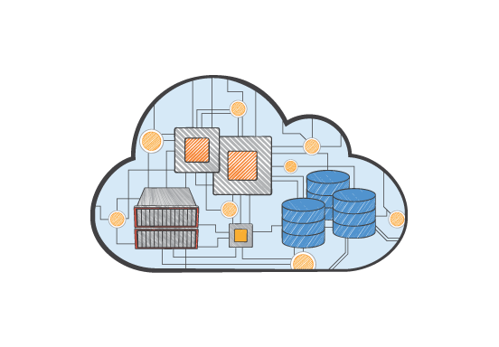
AWS Service Mix
5 Accounts
188 TB Object Storage
39 VPCs
30+ TB Loaded via Snowball
26 Elastic Load Balancers
28 RDS Databases
180 EC2 Instances
4 Redshift Clusters
470 EBS Volumes
28 TB Instance Storage

