Slide 1
Business Relationship Management
Community Group
PRESENTED BY:
West Phinney • Shari Kearl

Slide 2
Agenda
Welcome
CG Exercise – ‘Lightning Chats’
Next Steps
Networking

Slide 3
Lightning Chats
15 minute roundtable discussions of 4 BRM-related questions
Chat facilitators: West Phinney, Shari Kearl, Mike Morris, Sarah Spaulding

Slide 4
Directions
Select a table of non-coworkers
Please sign the attendance sheet at each table!
Tables rotate every 15 minutes
Report Out

Slide 5
Questions
Tips & Tricks to start a successful BRM?
What was the primary driver for BRM at your institution?
How would your BRM program improve if you were to receive additional resources?
How is the value of BRM measured or demonstrated?

Slide 6
Wrap up
Report out of themes from all 4 questions
Feedback: Questions? Ideas?
Contact information:
  West Phinney (phinneyw@isc.upenn.edu)
  Shari Kearl (slk9@cornell.edu)
Join BRM Community Group! BRM@listserve.educause.edu
Join the BRM CG Slack Channel! https://brmcg.slack.com

Slide 7
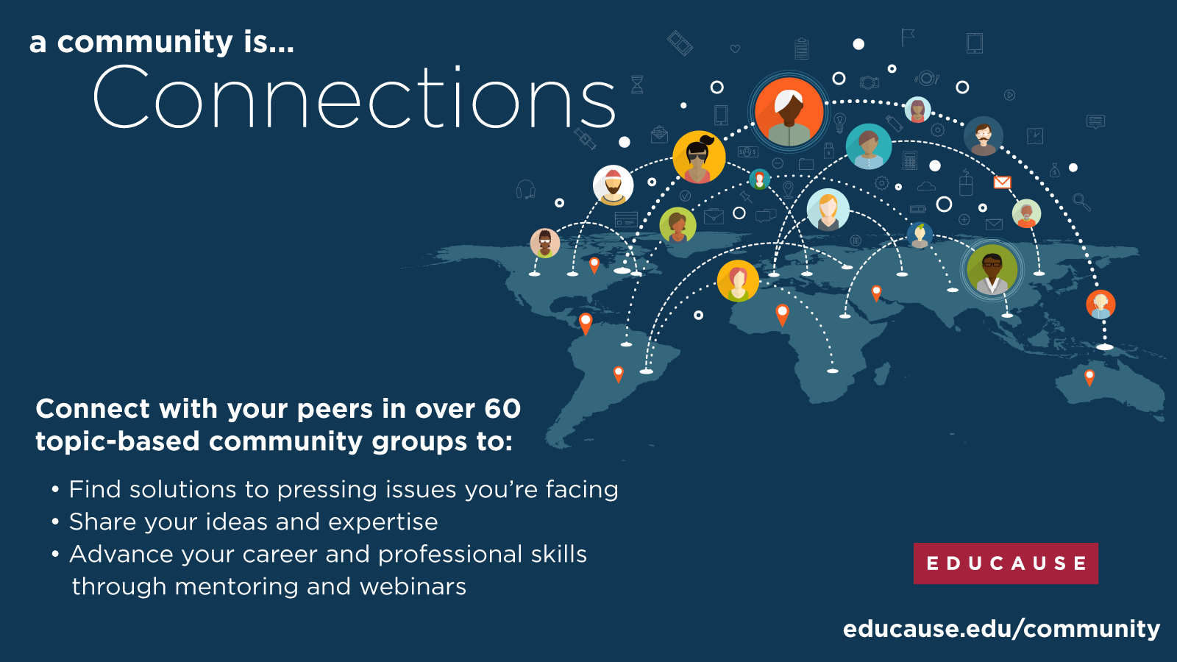

Slide 8
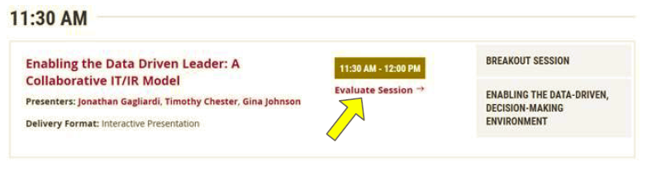
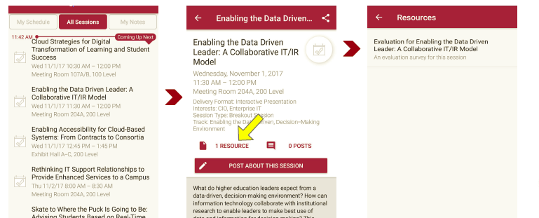
Please take a moment to evaluate this session
There are two ways to access the session and presenter evaluations
1
2
In the online agenda, click on the “Evaluate Session” link
From the mobile app, click on the session you want from the schedule > then click the associated resources > and the evaluation will pop up in the list

