Slide 1
Evidence of Impact Community Group Session
Tanya Joosten
University of Wisconsin - Milwaukee
Patsy Moskal
University of Central Florida

Slide 2
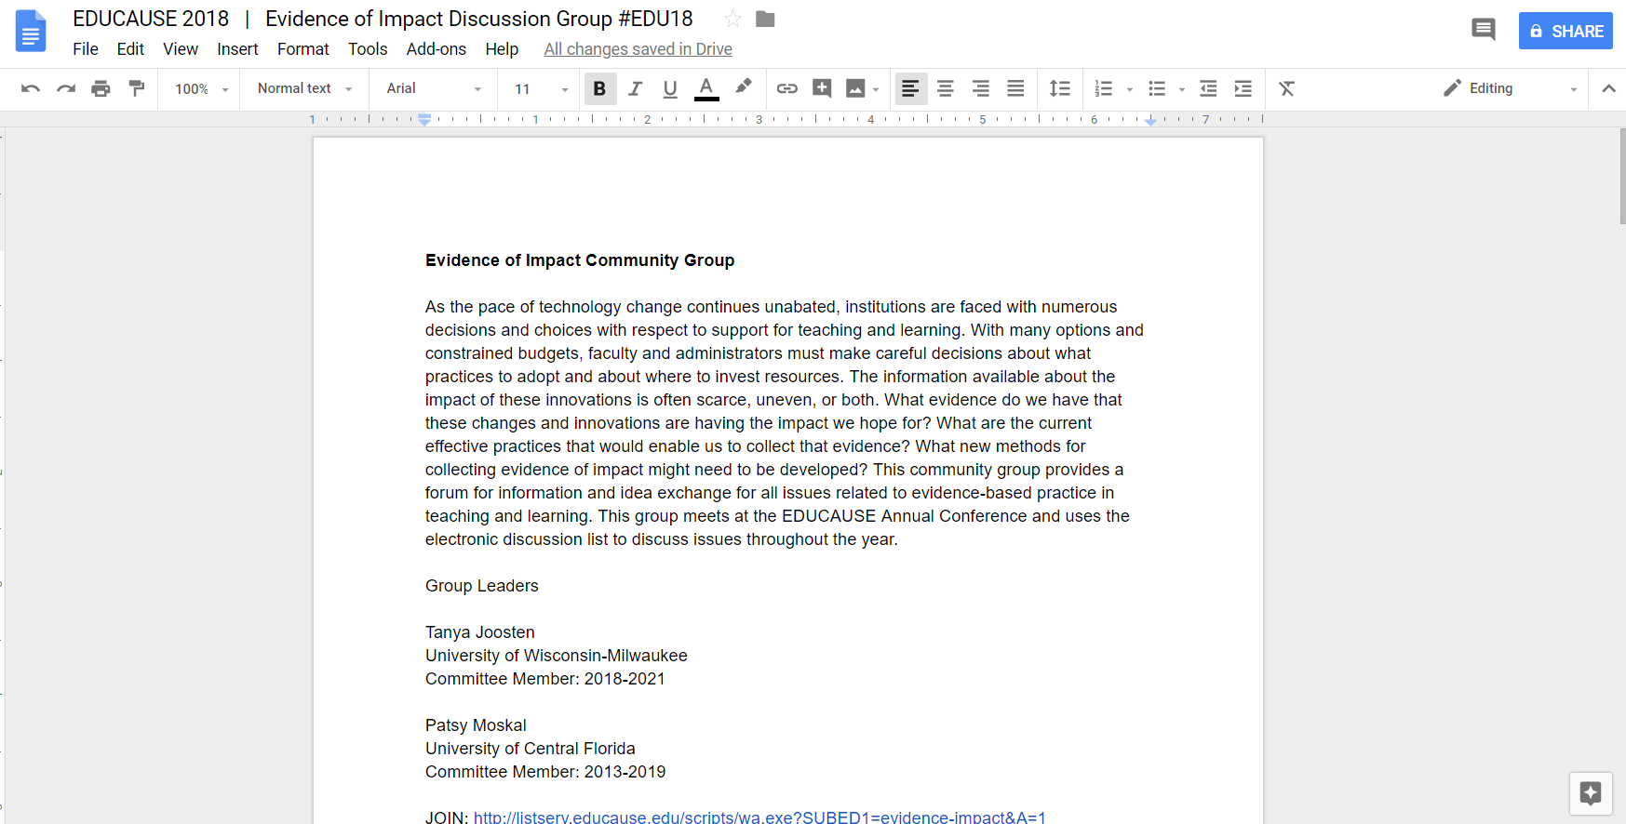
Collaborate in today’s discussion doc at https://tinyurl.com/EOIEDU18

Slide 3
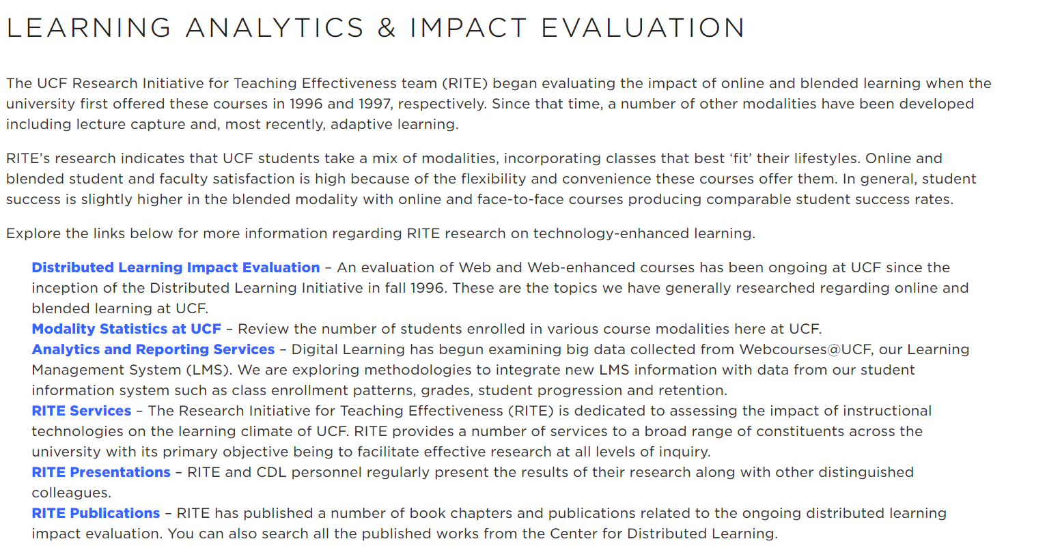
UCF RITE
https://digitallearning.ucf.edu/learning-analytics/

Slide 4
DETA activities
Develop Toolkit
Collect Data
Share Effective Practices

Slide 5
What resources can you share with the group today that can support other’s research efforts?
Please plug into the collaborative doc at https://tinyurl.com/EOIEDU18

Slide 6
http://uwm.edu/deta/toolkits/

Slide 7
What research are you doing or want to do at your university?
Please describe in 2 minutes or less

Slide 8
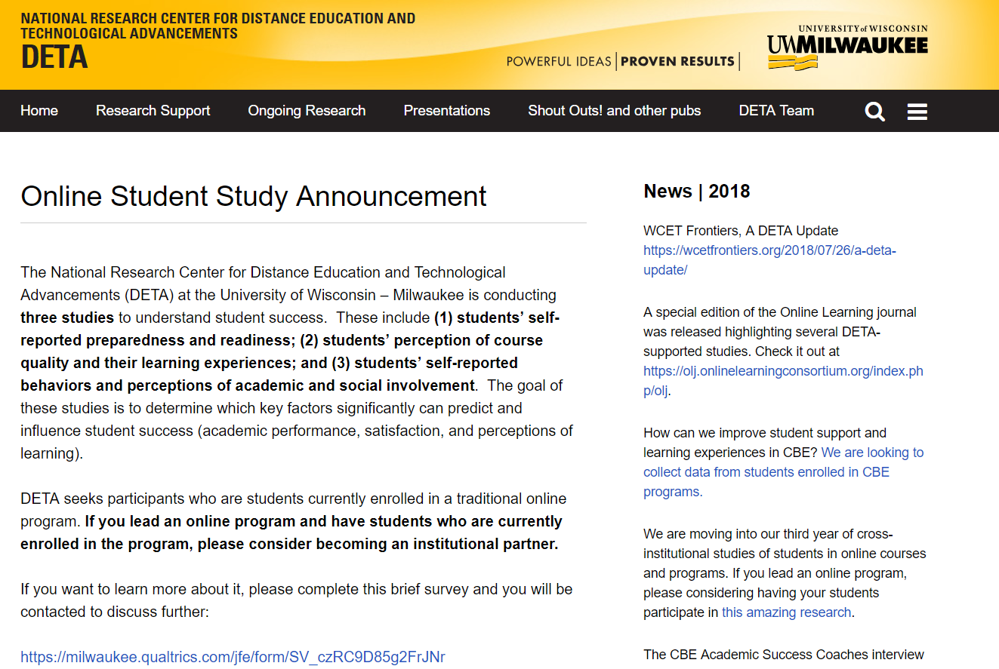
https://uwm.edu/deta/online-student-study-announcement/

Slide 9
What challenges have you had in conducting research at your university?
Please describe in 2 minutes or less

Slide 10
https://uwm.edu/deta/top-5-challenges-in-conducting-deta-research/

Slide 11
What findings have you discovered that helped you improve practices on your campus?
Please describe in 2 minutes or less

Slide 12
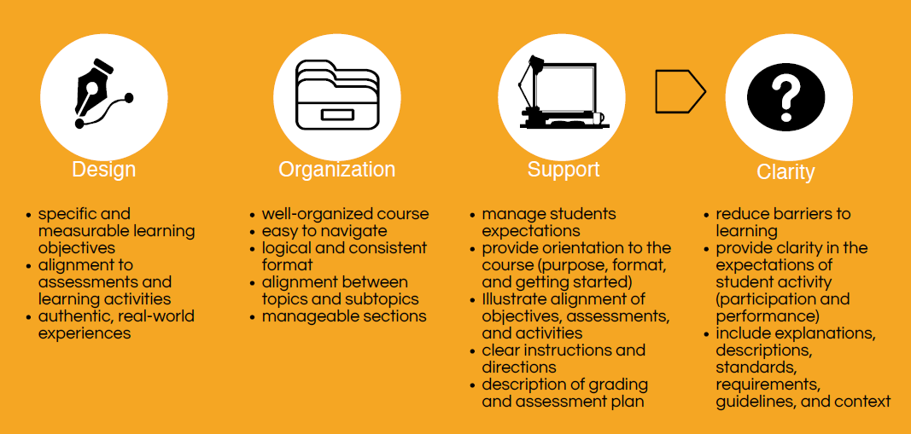
Course structure

Slide 13
Course activity

Slide 14
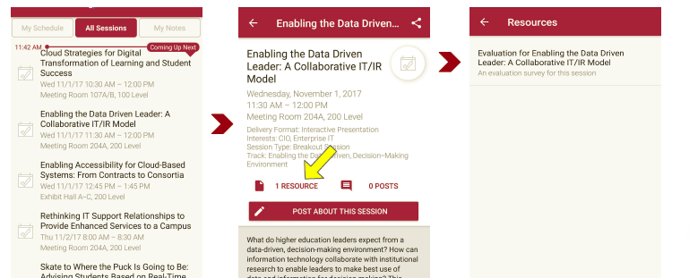
Please take a moment to evaluate this session There are two ways to access the session and presenter evaluations
1
2
In the online agenda, click on the “Evaluate Session” link
From the mobile app, click on the session you want from the schedule > then click the associated resources > and the evaluation will pop up in the list

Slide 15
Contact Us!
Tanya Joosten
tjoosten@uwm.edu
Director, Digital Learning Research and Development, Academic Affairs Co-Director, National Research Center for Distance Education and Technological Advancements
University of Wisconsin-Milwaukee
Patsy Moskal
Patsy.Moskal@ucf.edu
Associate Director, Research Initiative for Teaching Effectiveness
University of Central Florida

