Slide 1
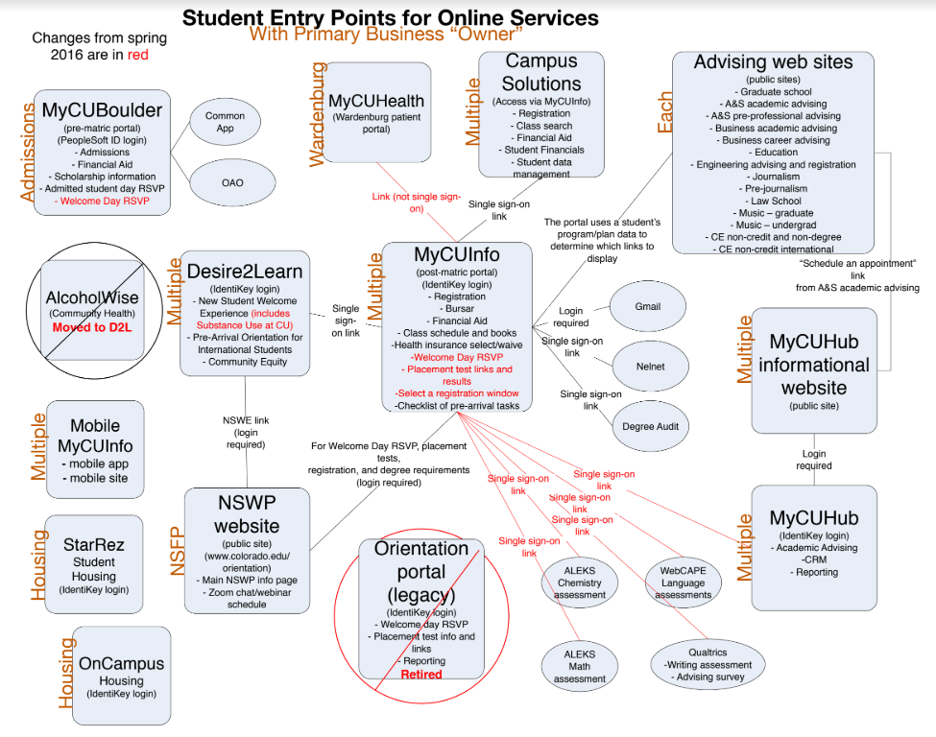
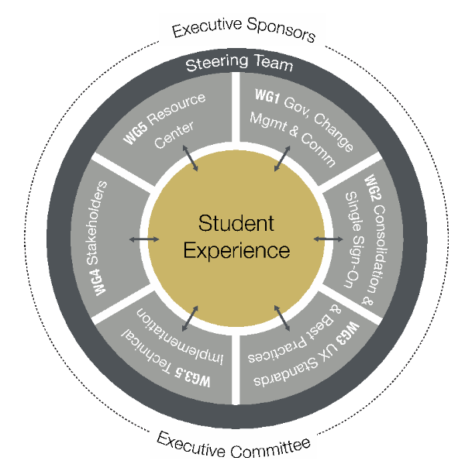
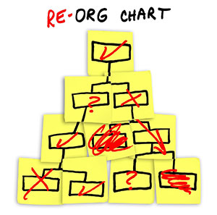
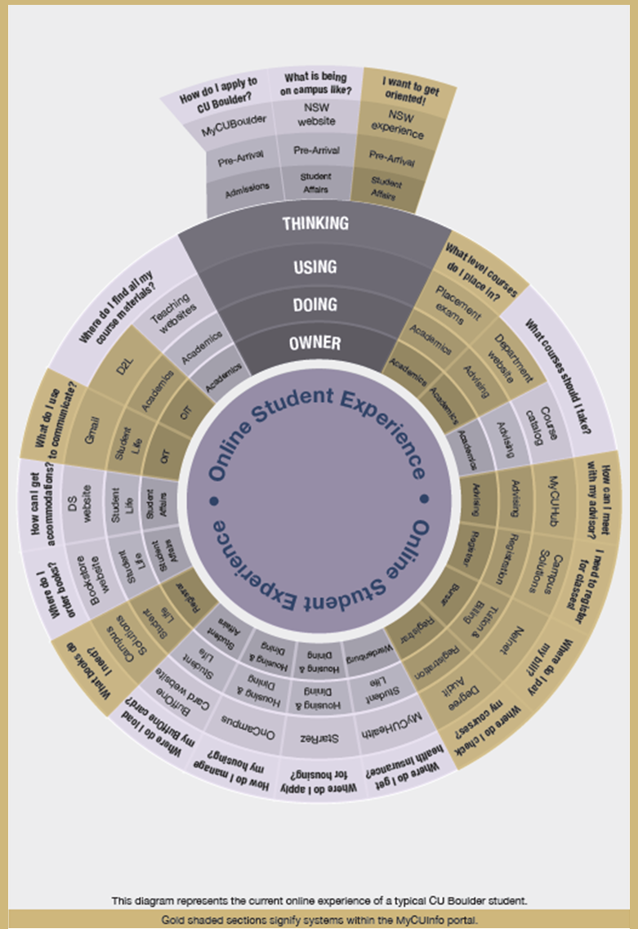
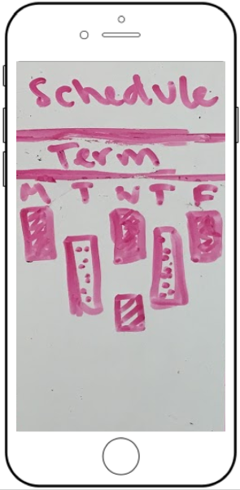
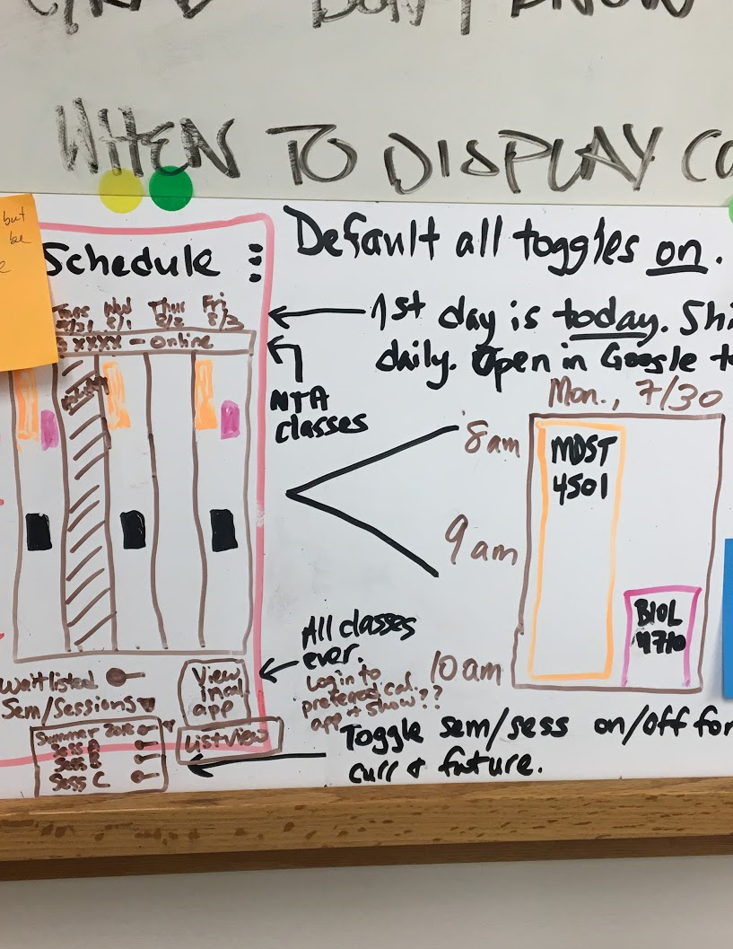
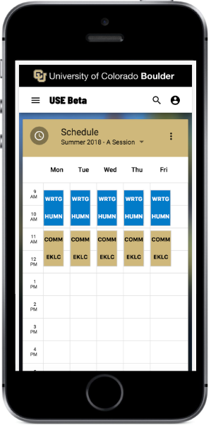
BLURRED LINES
Creating a Unified Student Experience
Paul O’Brian, Elaine Schriefer, Robin Swift
Introduction
FEB17
MAR17
JUN17
JUL17
SEP17
SEP17
OCT17
DEC17
JAN18
JAN18
FEB18
JUL18
AUG18
SUM19
FALL19
There are more than 100 student-facing systems providing various services to CU Boulder students, and hundreds of forms to initiate various processes. The Unified Student Experience (USE) project aims to address this cognitive cacophony by creating a single, simple starting point from which any of these systems and processes can be found. This new portal blurs the lines between these systems so that students don’t have to care about which system performs which job.
Charter Approved
Project Kickoff
Scope & Goals Approved by Leadership
Business Requirements Defined
Portal UI Prototyped
Best Practices Defined
Technologies Analyzed
Technology Determined
Business Requirements Finalized & Roadmap Started
Implementation Phase Began
Beta Design & Development
Beta Launch Testing & Feedback
Design & Development
Testing & Feedback Continues
Replace Legacy Portal
Project Initiation & Structure
Design Process & Development
Student Testing & Feedback
Executive sponsorship for the USE project comes from our CFO and Provost. The project itself consists of six different working teams, each co-led by an IT manager and a campus business office expert:
Each feature in Buff Portal follows a repeatable design and development process:
01
Central to the USE project’s philosophy is involvement of students through every iteration of design, but most important of all is collecting student feedback on the “finished” product. Our methods of collecting student feedback include:
‘Spaghetti’ diagram: Messy and fragmented online workflow that new students have to go through. This powerful visual made its way to CU Boulder leadership, spurring them to demand a simplified experience for all students.
Policy: Tasked with creating a usability policy. It continues to communicate about the project and build awareness and acceptance of its goals in the campus community.
Single sign-on: Tasked with bringing online services behind the same authentication mechanism. This is another key part of blurring the lines between systems.
Best practices: Tasked with pulling together technical, functional, and communications experts to create a set of best practices for all new student-facing implementations.
Stakeholders: Tasked with identifying and understanding the many student-facing online systems.
Resource center: Tasked with identifying and developing a location or process where students can ask questions of actual human beings, without being passed from one office to the next.
Portal implementation: Tasked with combining development, design, project management, business analysis, and student contact experts to create the new student portal, named Buff Portal.
Design Sprint Process
Surveys: Large groups of students for general principles, and smaller groups for more targeted questions.
Flash interviews: Students walking by are asked to answer quick questions.
ADA investigation: In spring of 2014, the U.S. Department of Justice opened an investigation of ADA violations at CU Boulder, centering around digital accessibility. In response, the university not only remediated the problems presented in the initial complaint, it also created a policy and program to institute a campus-wide culture of accessibility and usability.
“I really like how simple and connected all the features are.”
Focus groups: Small groups of students to answer in-depth questions.
Usability testing: Individual students to use an implemented feature and “think out loud” about their experience with it.
Group testing: Small groups of students to test implemented features, noting the strengths and weaknesses of the experience.
Daily mobile tasks: Daily text messages to students asking them to complete a task and fill out a short survey about their experience.
Data: Student contact and business analysis team leaders gather data from students and subject matter experts (SMEs). We elicit what the main student pain points are with a particular process, and what their ideal experience of that process would be.
Design sprint: Students, SMEs, developers, analysts, accessibility experts, and a designer gather to review the data, see analogous inspirations from other systems, and sketch designs for the new feature.
Prototype: Based on the outcome of the design sprint, our designer then creates a prototype of the Buff Portal experience for that feature.
Review and finalize design: Students and SMEs review the prototype and provide feedback. Based on this, the designer creates a final version of that design and marks it ready for development. Business analysts supplement the design with all captured requirements for that feature.
Development: Developers build a working version of the feature based on the design and requirements.
Testing: Students and SMEs test the feature and provide feedback for future iterations.
Structural challenges: CU Boulder has struggled leveraging to strike the right balance between delivered Oracle functionality, aligning with other campuses, and providing an excellent user experience.
Portal feedback: A 2015 survey about our student portal revealed that its Top 3 issues were:
Cluttered/confusing navigation
Lack of mobile device compatibility
Difficult class search and registration
“I love the look of my schedule versus what it is in MyCUInfo [legacy portal]….. It looks sleeker and more appealing.”
“I love it so far!”
www.colorado.edu/unified-experience/ buffportal@colorado.edu
Notes:
Images down the side for an introduction… tangled mess leading into a timeline
Start with the leadership>move to the research>6 principles>project structure>Design methods (spiral/funnel/cone image)>Beta Launch>Replace legacy

