Slide 1
Tools, Traits and Teams:
Planning and Assessing Effective Learning Spaces
Susan Brower • Shirley Dugdale • Rebecca Frazee • Lisa Stephens

Slide 2
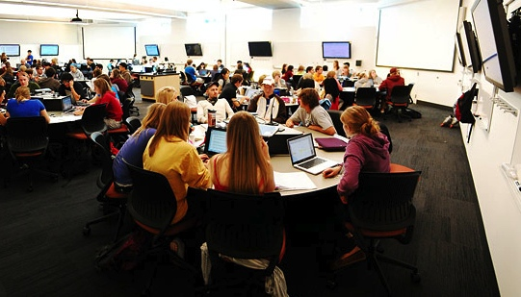
Workshop Part 1 | TOOLS
Project Planning
Introduction to FLEXspace
How to get started with planning

Slide 3
Workshop Part 1 | TOOLS
Project Planning
Introduction to FLEXspace
How to get started with planning

Slide 4
Activity 1: Connect the Dots!
Specific learning environment type or room design
A learning space master plan (department, school or campus)
Need to upgrade a single space
Need to develop a plan to upgrade classrooms across campus (including a support and refresh plan?)
Working with campus facilities or architects to plan a new building which features (or includes) several learning spaces
Creation of a model or ‘sandbox’ space, to foster pedagogy and enable experimentation
Creation of a space that includes “maker tools” or elements to create or support virtual reality

Slide 5
Workshop Part 1 | TOOLS
Project Planning
Introduction to FLEXspace
How to get started with planning

Slide 6
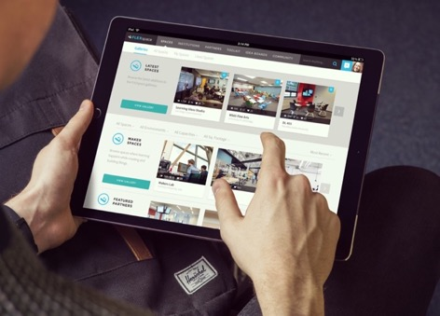
Introducing FLEXspace
FLEXspace:
What is FLEXspace?
How can it help you, your team and campus?
How can you use it today?
What’s coming next?
Activity:
Hands-on with FLEXspace!
Notes:
RF (LS?)
Description of the system and its redesign; types of listings, new features and capabilities available, etc.

Slide 7
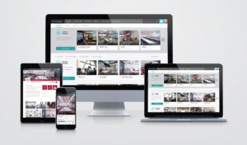
FLEXspace™ is a one-stop open resource for best practices, detailed examples, and a community dedicated to improving learning spaces around the world.
FLEXspace is:
A database and community initiative
Free to academic users
Built by educators for educators
Fully searchable and mobile friendly
FLEXspace helps:
Improve the process and end results
Get big picture ideas and close-up details
Bridge various stakeholders to improve communication and build consensus before involving architects, donors and others.
Notes:
When it comes to designing, renovating, building, we all want to do things smarter, faster, cheaper, right?
Improve the process and the end results
improve communication, engagement, and buy-in across various stakeholder groups

Slide 8
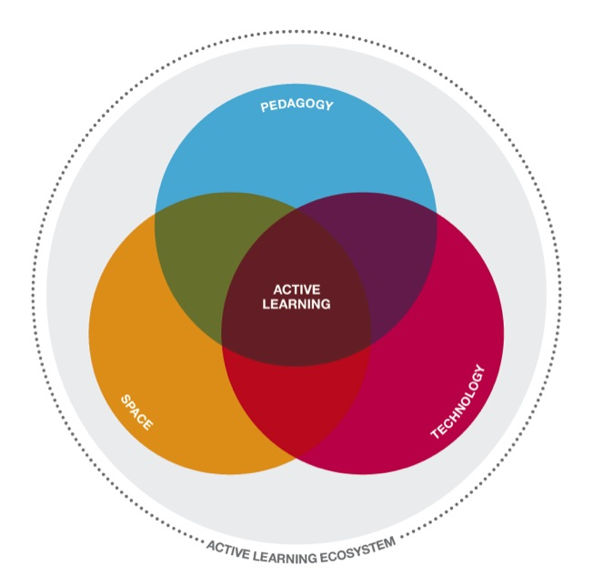
Spaces detailed with Robust Taxonomies that Align Key Stakeholders
Learning & Assessment
Pedagogies and learning activities enabled
Facilities
Wall, ceiling, floor finishes
Electrical, lighting, acoustics
Square footage, dimensions, accessibility
Furnishings
Cost for renovation, furnishings, technology
Technology Integration
AV/IT Academic Tech & Equipment
Notes:
Research is critical – this is what is going to sustain FLEXspace far into the future.
When you upload images and examples of your learning spaces, you also add lots of descriptions and tags on 3 dimensions:
The core team worked with over 50 people from across the country for a year;
Balancing act – enough, but not BURDEN
LSRS - And these details are similar to some of the 6 elements and details that are scored on the LSRS.

Slide 9
Growing Collaboration AND Enthusiasm
+
Notes:
NEW –
AWARDS - CHEC Cal Higher Ed Collaboration - Focus on Efficiency Award for projects that represent innovative practices that have been implemented to improve operational performance, services, and outcomes for California Public Higher Education.
New returning partner Mediasite

Slide 10
By 2020:
9K Users
4K Institutions
7K Spaces
3K Posts
5K Idea Boards
2K Toolkits
2K Shares
Today (09/18)
3200+ Users
1200 Institutions
54 Countries
Notes:
Why a new interface?
Data driven: focus groups, polls and surveys at national conferences, work groups and re-design focus groups.
Adding spaces flattened in 2017, and froze the collection Nov 2017
Tools = 15% spaces
Idea boards = 65% users
Forum = 30% of users
Sharing spaces = 30% spaces
Share spaces outside of FLEX to create that expansive social reach.
e.g, 500 spaces shared, x traffic and visitors, beyond FLEX members….

Slide 11
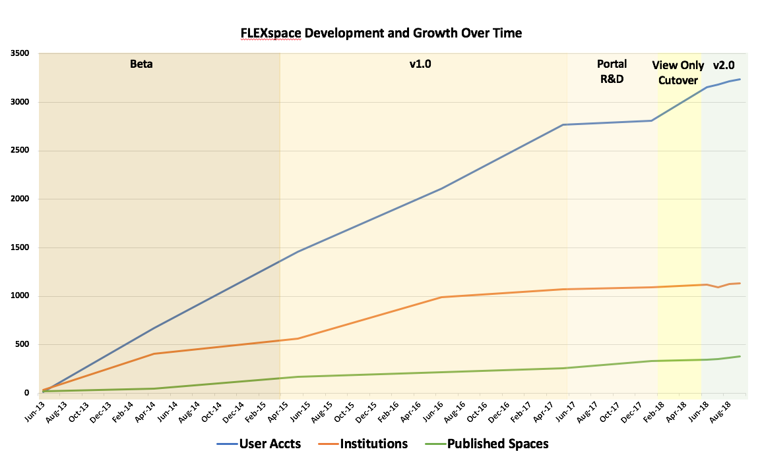
Development Timeline to FLEXspace 2.0
Notes:
Users would like:
Once I find a location that has a room or design similar to what we are considering I would like to communicate with that organization through email, phone and possibly visit.
Add community engagement (commenting, voting perhaps)
3D ‘flythrough’, mobile app; 360 video or other extended reality
Formatting limitations (paragraph breaks, or HTML code, hyperlinks as well to other sites like our YouTube or ITS website.)
More vendor showcases so we don't have to browse multiple websites to view vendor selections
Promote research showing the impact the spaces have on learning gain etc.
Include easy-to-use space design tools and templates
Make it to where our classroom directory could be made available to all instructors at our campus without them needing to create an account for FlexSpace since they only want to look at the classrooms they will be teaching in for the semester.
Provide a forum to get ideas about how to design a space, also a platform for designers to collaborate and create digital designs
Continue to grow the K-12 market, target these institutions more

Slide 12
Impressive Community of Members and Advisors
Role
Global Network of experienced and respected academic and industry partners, advisors, and advocates.
Directors/Executives (40%)
Managers/Coordinators (14%)
Faculty (11%)
Instructional Designer and Technology Specialists (25%)
Global Research Working Group
Core Advisory Team
Partners & Advocates
Outreach and PR
Institutional Support
Department
Information Technology (27%)
Academic Departments (24%)
Library/Library Services (12%)
Instructional Technology (12%)
University Ops & Admin (10%)
Notes:
Bringing together a community of experts and practitioners from instructional design, learning technology, facilities, furnishings, and research
University Presidents, Vice Chancellors, Deans, VPs, CIOs, CLOs
University Directors, Managers, and Specialists in:
Academic Technology
AV/Media Services
Centers for Teaching and Learning
Distance Education
Educational Technology
Facilities and Campus Infrastructure
Information Technology and Systems
Instructional Design
Learning Space Technologies and Design
Libraries
Policy, Planning, and Administration
Systems Integrators and Engineers
Architects and Interior Designers
Faculty and Researchers
Tea for Teaching podcast episode featuring FLEXspace (May) (teaforteaching.com hosted by the Center for Excellence in Learning and Teaching at the SUNY, Oswego)
SUNY CIT Conference (May 22-25): FLEXspace Featured Keynote session
UBTech/Campus Technology Conference (June 4-6): FLEXspace is a program sponsor
ISTE Annual Conference (June 23-27): FLEXspace featured in the Learning Spaces PLN Lounge and panel presentation
AVI-SPL – (June 26) customer workshop and expo in Miami - keynote and booth with Xennial
Academic Impressions webinar (Sept 27), with Herman Miller campus
Future Trends in Technology and Education Forum featuring FLEXspace (bryanalexander.org); live Future Cast (Oct).
Open Ed conference presentation (Oct)
CCUMC conference presentation (Oct)
EDUCAUSE Annual Conference (Oct 30-Nov 3): FLEXspace Integrated Planning Workshop
A4LE Annual Conference (Nov 1-4): FLEXspace featured at Expo booth - Shaw Contract
DET/CHE (Nov 27)
LSC roundtable at CSU-LA (Dec)
ELI 19 (Jan)
UBTech 2019 Partner - June 2019

Slide 13
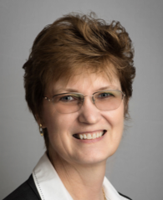
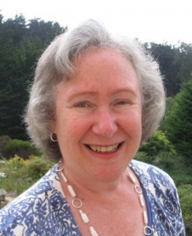
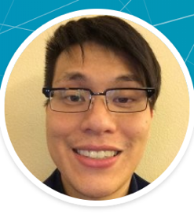
Created By Educators For Educators…
Lisa A. Stephens
Asst. Dean, Digital Education - Engineering
University at Buffalo
Sr. Strategist, SUNY Academic Innovation
James Frazee
Learning & Performance Technologies Senior Academic Technology Officer
San Diego State University
Malcolm Brown
Director
EDUCAUSE Learning Initiative
Jim Twetten
Academic Technology Spaces
U. Minnesota
Joseph Moreau
Vice Chancellor – Technology
Foothill-De Anza CC District
Gerry Hanley
Asst. Vice Chancellor
Academic Technology Services
CSU Office of the Chancellor
John Augeri, Deputy Director
Paris Île-de-France Digital University Kyoto University | Invited Researcher
Phil Long, Sr. Scholar
Center for New Designs in Learning & Scholarship
Georgetown University
Simon Birkett
Digital Campus Manager
Staffordshire Univ., U. Derby - UK
Mark McCallister
Director, Academic Technology
University of Florida
Brad Snyder
Assoc. Dir., Classroom Media Services
SUNY Cortland
James Young
Chief Learning Officer
Society for College & Univ. Planning
Jeanne L. Narum. Director
The Independent Colleges Office Learning Spaces Collaboratory
Dana C. Gierdowski
EDUCAUSE Research Associate
Rebecca Frazee
FLEXspace Manager
Faculty, San Diego State University
Joan Lippincott
Assoc. Exec. Director
Coalition for Networked Information
Mark J. W. Lee Adjunct Senior Lecturer
Charles Sturt U., Australia
IEEE Ed Tech Associate Editor
Christopher Johnson
Co-Director, EdTEch U. of Arizona ISTE Learning Space Past-Chair

Slide 14
Take a Virtual Fieldtrip
Filter
Seek inspiration and proof of concept
Benchmark with peer institutions
Connect with others
SEARCH across all data fields
FILTER on space Type, Seating Capacity, Project Scope, Institution Type, Build Date

Slide 15
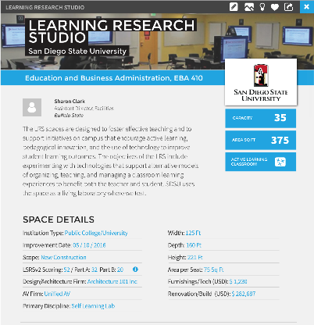
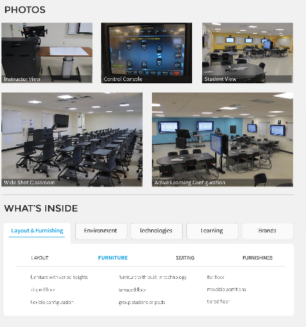
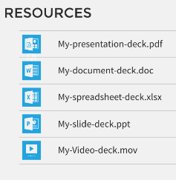
Browse Examples or Add Your Own
Resources might include:
Faculty training & support
Use guidelines
Research findings, protocols
Presentations, videos
Case study layout
Captioned photos
Details and descriptions
Stories of design rationale and post-occupancy use
Tags for Facilities, AV, EdTech, Pedagogy, and Brands

Slide 16
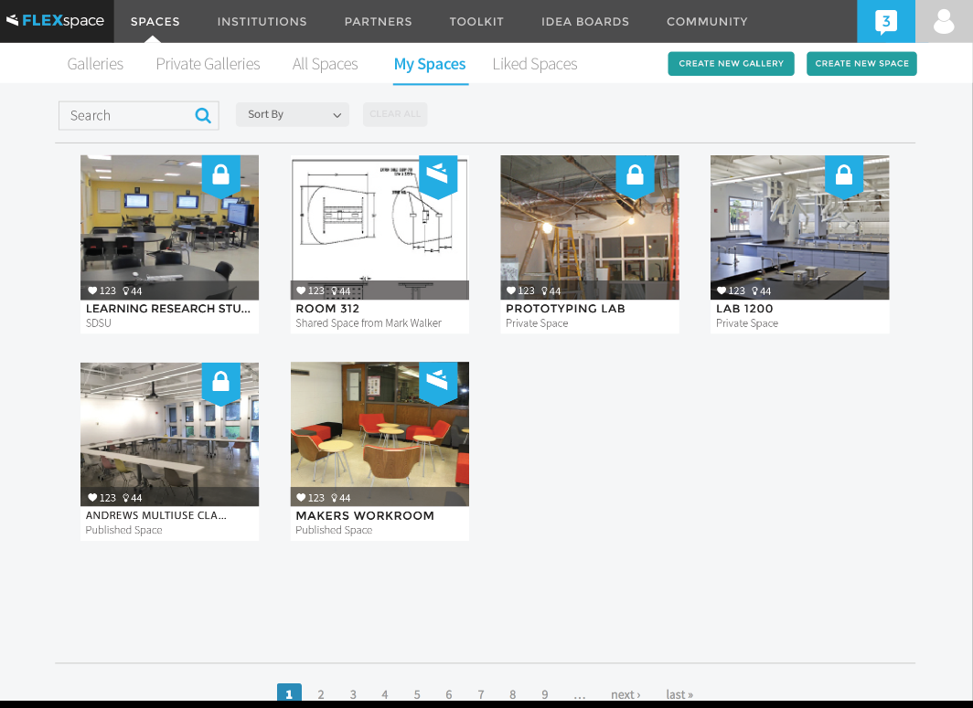
‘Add collaborators’ to your spaces so you can all co-edit the details and resources.
Add collaborators to get their input about how the space is being used, tips and resources for supporting users, using the equipment, arranging the space, and more.
Keep spaces private or publish to the community

Slide 17
Show ‘em vs. Tell ‘em to Drive Conversations
Discuss possibilities with Librarians
Director of ITS and CSU Council of Library Deans discuss possibilities for converting library spaces into flexible learning spaces.
Promote collaboration among Faculty + Facilities + IT
The Center for the Enrichment of Teaching and Learning, Facilities and Information Technology collaborate on a classroom renovation project as part of the Herman Miller Learning Spaces Research Program.
Bring everyone to the table, document your “before” spaces needing improvement, and show completed spaces that help people see the possibilities.
https://www.une.edu/news/2016/une%E2%80%99s-center-enrichment-teaching-and-learning-plans-classroom-renovation-project
Notes:
Who in your sphere of influence may benefit from FLEXspace?
UNE – Bring everyone to the table, document your “before” spaces - those needing improvement and show completed spaces that help people see the possibilities.
https://www.une.edu/news/2016/une%E2%80%99s-center-enrichment-teaching-and-learning-plans-classroom-renovation-project

Slide 18
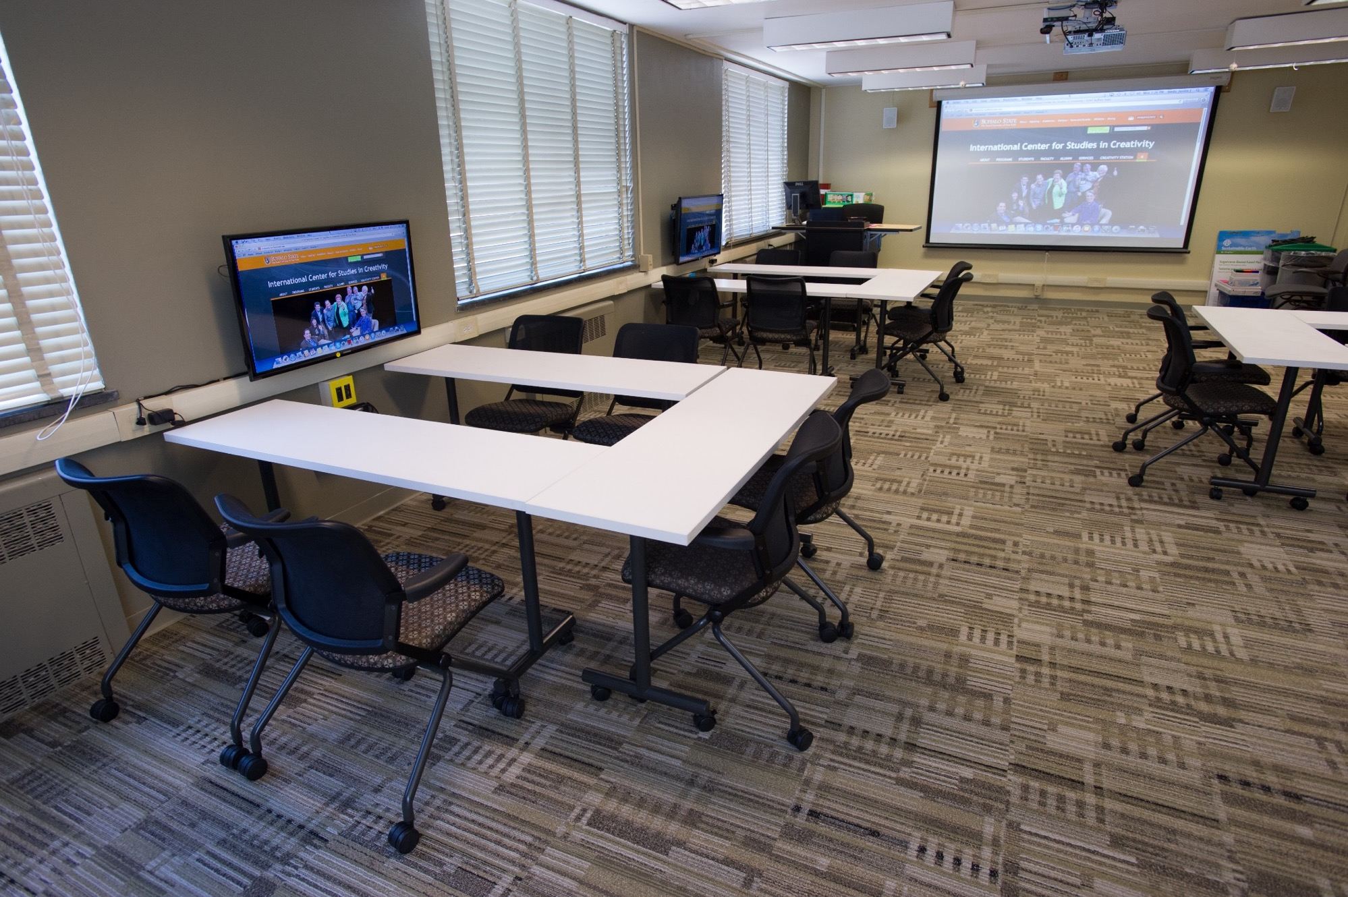
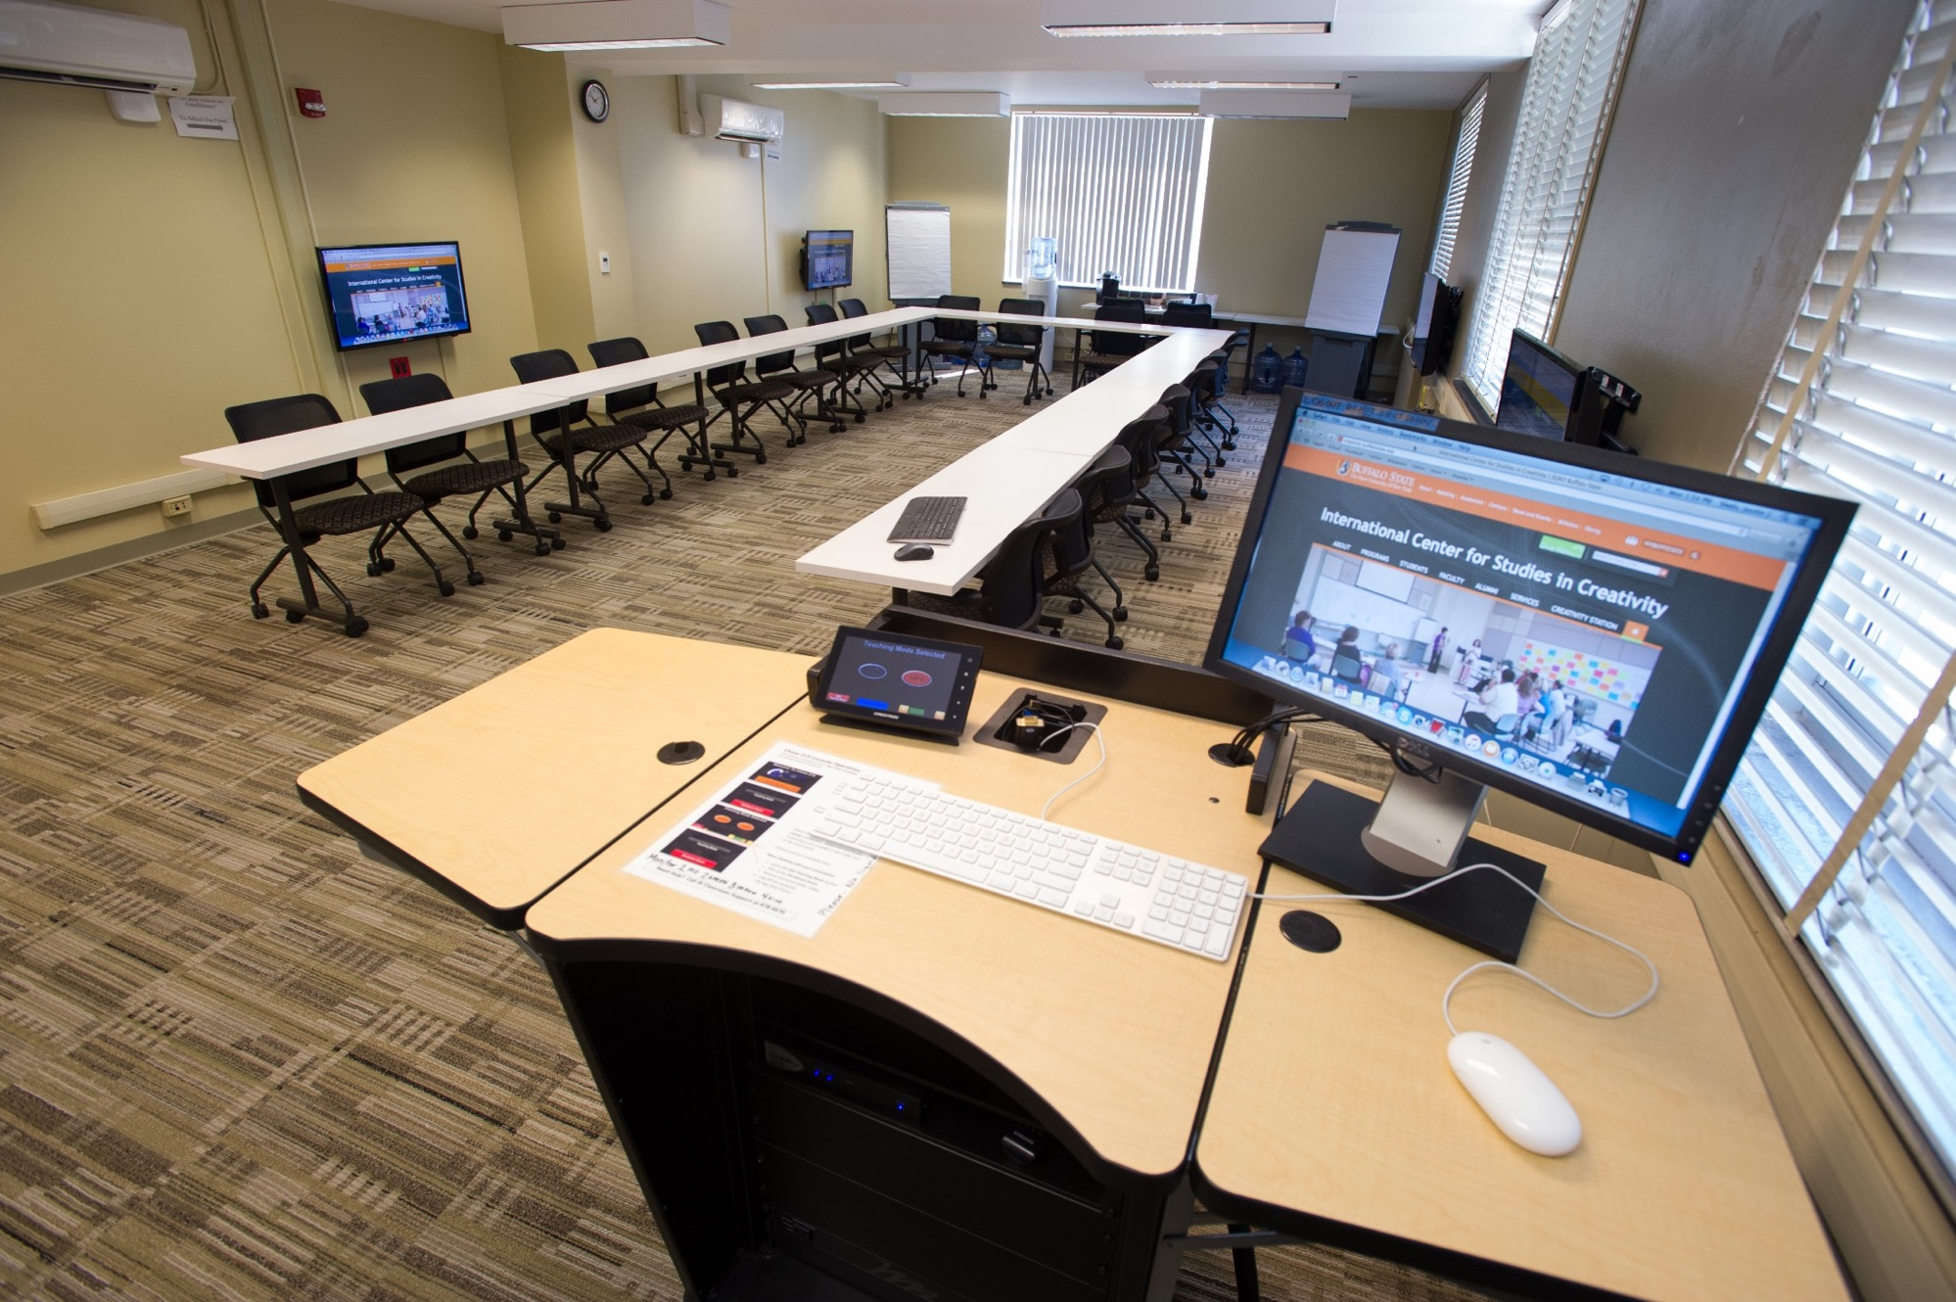
Show ‘em vs. Tell ‘em to Drive Conversations
Clarify your ’wish list’ for the planning group
CIO shows campus architects and facilities planning group the kinds of spaces he wants to build.
Guide conversations with vendors
The Director of Technology Support Services uses FLEXspace to showcase completed spaces and help with technology integration by documenting spaces to help open conversations with vendors when discussing technology in spaces
Notes:
Who in your sphere of influence may benefit from FLEXspace?
UNE – Bring everyone to the table, document your “before” spaces - those needing improvement and show completed spaces that help people see the possibilities.
https://www.une.edu/news/2016/une%E2%80%99s-center-enrichment-teaching-and-learning-plans-classroom-renovation-project

Slide 19
Tell Your Story
Use FLEXspace to create:
Classroom inventory
Gallery of showcase spaces
Show to:
Administration
Faculty teaching in these spaces
Donors
Staff
The world!
Coming Soon

Slide 20
CSU Using FLEXspace to Showcase a System-wide Initiative
#CalStateMaker

Slide 21
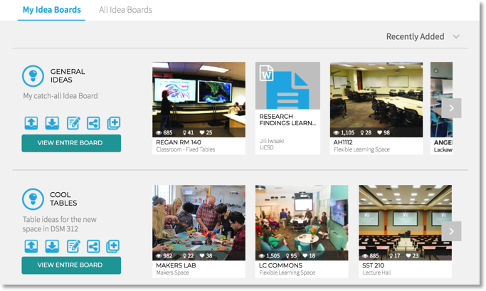
Gather Stakeholder Input with “Likes” and “Idea Boards”
Coming Soon
Create a shared 'pin board':
Facilities
AV/EdTech
Faculty
Students
Alumni
Gather input about potential designs and favorites
Share prototypes, scoresheets, and planning docs
Use Idea Boards as a Collaboration Tool
Keep PRIVATE or SHARE your team

Slide 22
Leverage resources from the Toolkit
Coming Soon
Toolkit
A rich collection of curated articles, research, tools, and guides for inspiration, planning, and assessment contributed by the FLEXspace community.
Notes:
Currently under development - Tool kits benefit the community
We have a full day workshop on space planning at EDUCAUSE “Tools, Trait and Teams” – intend to publish the materials in the Toolkit

Slide 23
Users predict explosive growth with FLEXspace 2.0
‘We will use FLEXspace MORE than we’re using it today.”
“We plan to upload many more spaces with the new mobile template.”
”We would pay to use FLEXspace!”
More than three-quarters of users say they will use FLEXspace MORE or Much More after seeing Version 2.0.
65% said they would likely use FLEXspace to learn more about a particular brand.
“We would like to see more vendor showcases so we don't have to browse multiple websites to view vendor selections.”
Two-thirds said their campus would be willing to contribute annual financial support.
On average, current users predict they will upload 9 exemplar spaces and 26 ‘classroom directory’ type spaces from their institution.
9900 more exemplar spaces
28,600 more classroom directory space
Notes:
Users would like:
Once I find a location that has a room or design similar to what we are considering I would like to communicate with that organization through email, phone and possibly visit.
Add community engagement (commenting, voting perhaps)
3D ‘flythrough’, mobile app; 360 video or other extended reality
Formatting limitations (paragraph breaks, or HTML code, hyperlinks as well to other sites like our YouTube or ITS website.)
More vendor showcases so we don't have to browse multiple websites to view vendor selections
Promote research showing the impact the spaces have on learning gain etc.
Include easy-to-use space design tools and templates
Make it to where our classroom directory could be made available to all instructors at our campus without them needing to create an account for FlexSpace since they only want to look at the classrooms they will be teaching in for the semester.
Provide a forum to get ideas about how to design a space, also a platform for designers to collaborate and create digital designs
Continue to grow the K-12 market, target these institutions more

Slide 24
Roadmap for WebDev
Today You Can…
Next Up (Dec 18)
Next (Feb 19)
Search fully
Filter and Sort
Like and organize favorites in Liked Spaces
Create a Space
See My Spaces for my private and published spaces
Add Collaborators collaborators to expand details
Invite others to join FLEXspace
Edit My Profile
Galleries** in production
Toolkits** in production
Updated search features (autocomplete)
Create “lite” spaces with limited fields, typically from a mobile device, later add required fields to Publish
Share space link outside FLEX
Partner features
Institution features
Idea Boards features
Community Member Directory
Lead generation features for partners
Print spaces to PDF
Data Export (basic for external reports)
Analytics
Classroom Directory Phase 1 Features and Functionality, UX,
Classroom Directory - Next Phase Vision
Idea Boards – next phase updates
User Notifications and more robust community features
Mail System Integration (click member name to email them)
GDPR Compliance

Slide 25
FLEXspace Activity
Now it’s you’re turn to:
Search & filter spaces and “Like” favorites
Upload your space and add collaborators
About 20 min
See workbook details
User Name
Password
Notes:
Description of the system and its redesign; types of listings, new features and capabilities available, etc. [20 min] (Participants follow along online during the explanations. Assumes participants have created an account before the workshop.)
Activity 2: Hands-on/try-it opportunity [Rebecca F., Lisa S.] – 20 min
Demonstration 1: how to upload images
Demonstration 2: how to search and enter metadata, create collections, etc.
Demonstration 3: how to create an Ideaboard and share it

Slide 26
ACTVITY: Explore, Search & Save Spaces
Log in at: members.flexspace.org
User: EDU18workshop
PW: flextour
1. Explore the collection
See ‘All Spaces’ tab
Search, Browse, Filter, Sort
2. View space details
3. Click to “Like” a space
4. See your personal “Liked Spaces”
You might search on:
Maker
BYOD
Tiered
Learning Glass
VR
LED
Rolling chairs
TEAL
SCALE-up
Herman Miller
Computer Comforts
Notes:
You might search terms such as:
Maker* (makerspace, makerlab, etc.)
BYOD
Tier* (tiers, tiered, etc.)
Crestron

Slide 27
ACTVITY: FLEXspace Create a Space!
3. Now you can Add COLLABORATORS
If you don’t find their email, invite them to join FLEXspace!
1. Click “Create New Space”
Upload images, resources (Use any image or file as a test if you like)
Add details and as many ‘tags’ as you can
2. SAVE or PUBLISH your space
Save the space (keep it private)
Publish to share with the FLEXspace collection
FIRST, Search on LASTNAME or INSTITUTION
THEN, if you don’t find them, enter their email and INVITE them to join FLEXspace.

Slide 28
FLEXspace Action Plan
How you can benefit from FLEXspace?
How you can encourage FLEXspace adoption on your campus?
Take a few minutes to complete the action plan in the workbook.

Slide 29
How can you help FLEXspace grow?
Upload spaces to FLEXspace
Add exemplars and ‘directory’ type spaces
Update existing records you’ve already added
Provide lots of photos and details
Add collaborators to get their input about how the spaces are being used today, and plans for refresh
Use FLEXspace for planning or during projects
Document before, during and after photos
Spread the word on your own campus to stakeholder groups
Facilities, Faculty, Libraries
Nudge vendors and consultants to support us
Give us input using the ‘Suggestion Box’ in the Community Forum or use the Feedback Form on the website
Suggest campuses, buildings, spaces ‘galleries’ to add
Tell us how we can better meet your needss!
Follow our Blog and Social
@FLEXspaceorg

Slide 30
Workshop Part 2 | TEAMS
Planning the Engagement Process
Creating Teams
User Needs Research
Developing the Plan
How to develop your engagement plan

Slide 31
Workshop Part 2 | TEAMS
Planning the Engagement Process
Creating Teams
User Needs Research
Developing the Plan
How to develop your engagement plan

Slide 32
USER RESEARCH
Dana C. Gierdowski, PhD
Researcher
EDUCAUSE

Slide 33
Big Picture Questions
How will (or how does) the space reflect:
the mission of the institution/ department/program?
sound and effective pedagogical practices?
comfort and accessibility for users?

Slide 34
Planning
KEY PLAYERS
Depart. & Program Admin
IT
Facilities
Campus architects & designers
Registrar
Notes:
WHO IS MISSING??

Slide 35
Involve Users!
TALK to and COLLECT DATA from those who use the space before you move forward.
Students
Faculty
Preferences may vary
Design for flexibility & accessibility

Slide 36
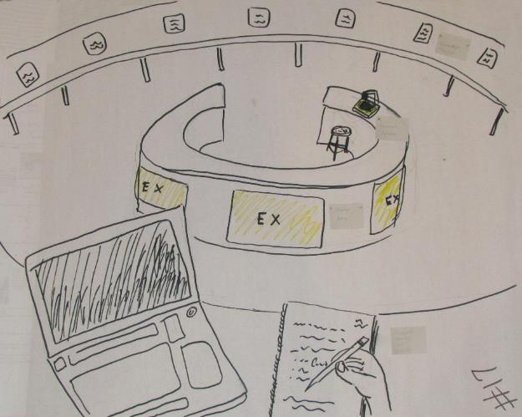
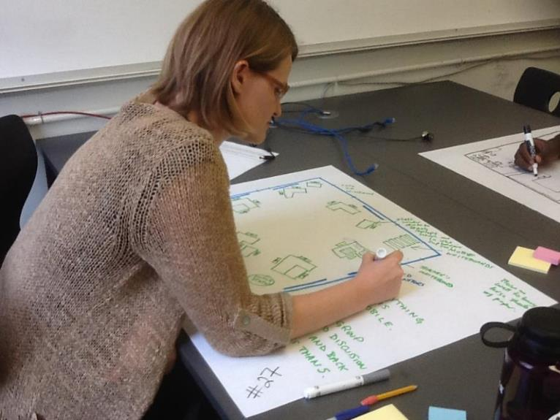
Planning & Collaboration
Talk & Collect Data
User workshops, focus groups, interviews, and conceptual mapping…

Slide 37
Talk & Collect Data
Notes:
Ask about general preferences
To users of the space: students
Pre occupancy surveys; space-needs surveys
Questions about how the space is used…but also…

Slide 38
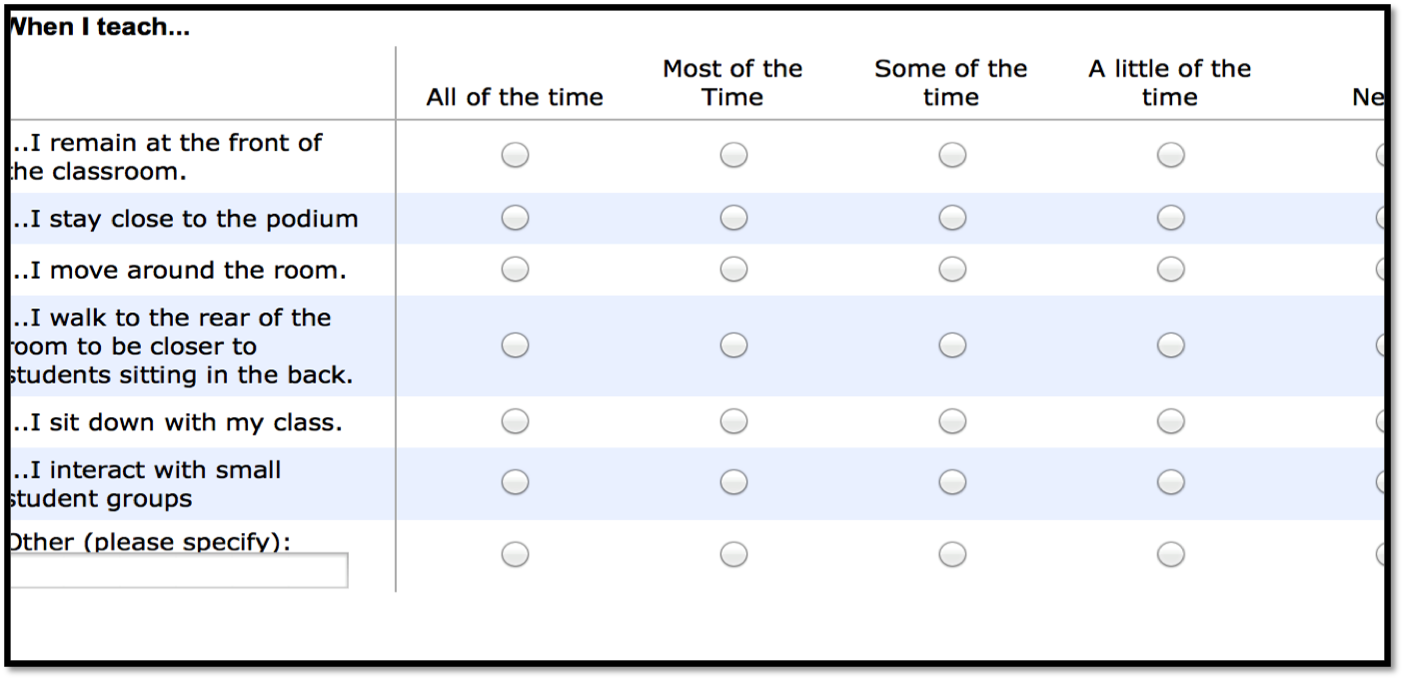
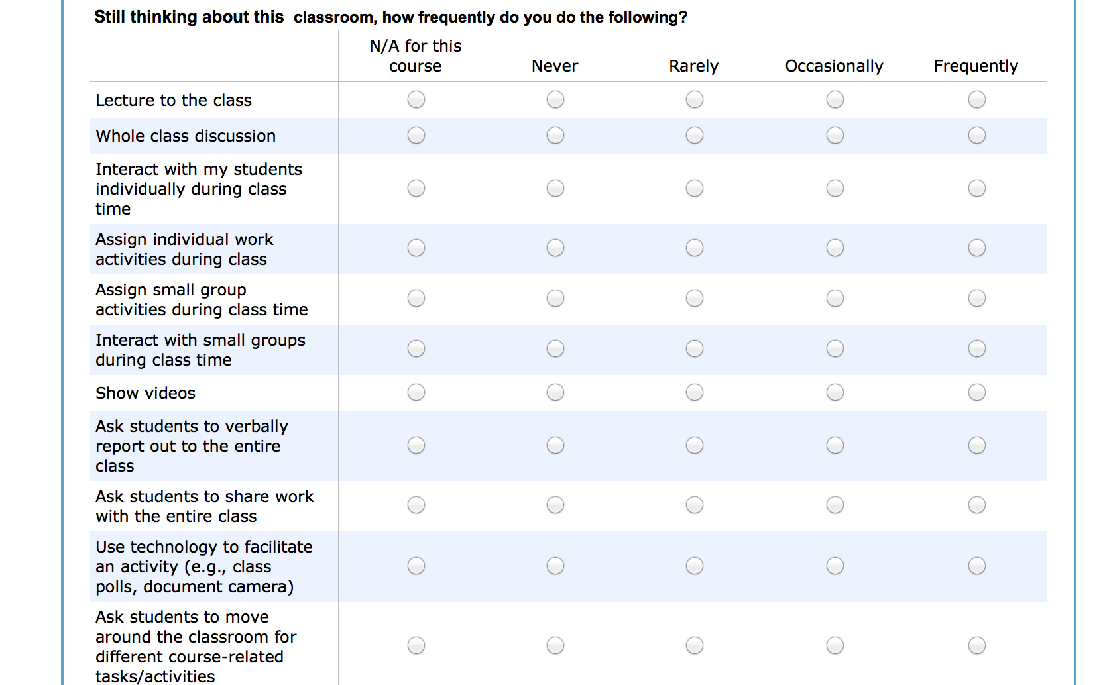
Talk & Collect Data
Notes:
To users of the space: faculty
Qs about where the instructor positions him/herself around the space; how space is used.
How often they lecture, do group work, the tech they use/don’t use.
These don’t have to all be in surveys – can ask these sorts of Qs in focus groups, informal, unstructured interviews – the point is to ask them of the RIGHT people

Slide 39
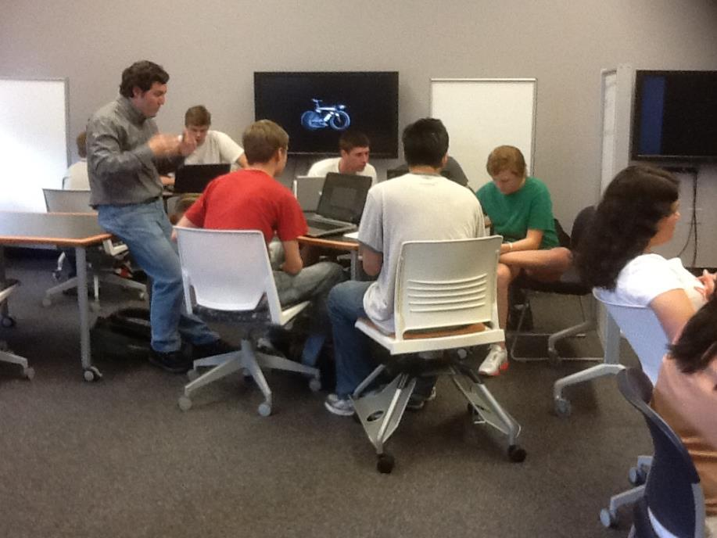
Talk & Collect Data
Observations
Look for patterns in responses
Notes:
Combine methods for richer results
Richer data gained through observations – the more, the better
Survey/interview data don’t always align with observations. Through observations, you get a chance to see how the space is being used versus the way users report it is being used.
With observations/interviews, you have the opportunity to triangulate the data you collect from surveys. You’ll get quantitative and qualitative data that will be useful in moving forward with a plan for redesign.
Triangulate – people don’t always use a space the way they say they do

Slide 40
Review Findings
Surveys
Observations
Design based on user needs
Interviews/Focus Groups
Notes:
Triangulate and look for patterns

Slide 41
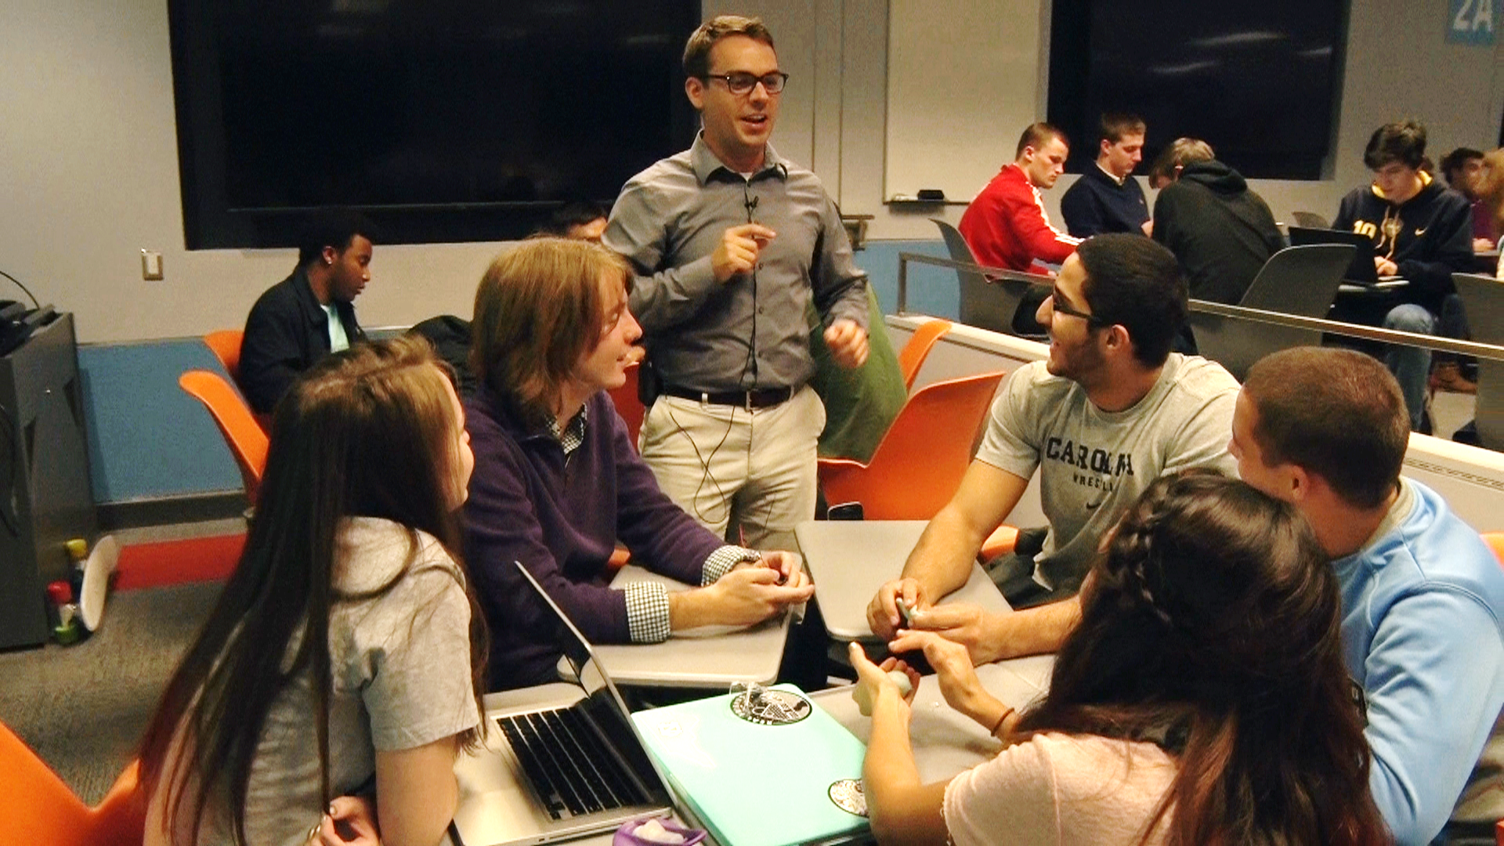
Designing for Users
Notes:
SUNY Buffalo – in the Butler Library active learning hall at UNC Chapel Hill (both in FLEXspace)
This bottom image is from UNC Chapel Hill, which I’ll be talking more about this afternoon – the design idea started from a group of faculty that their Center for Fac Excellence got together and they posed the Q: “How can we make a large lecture hall more like a seminar room?”
Highlights the importance of gathering info before you design
what they say they need isn’t always what they will necessarily use
The perception of having a choice is powerful for users
– offers faculty the opportunity to use varying pedagogies and do different kinds of activities to engage students
Instructors have reported in much of the research I’ve done that they want FLEXIBILITY to do different things in the classroom
They want to be out in the space with their students versus tied to the “front”

Slide 42
ASSESSING & RESEARCHING LEARNING SPACES

Slide 43
Overview
Why assess, evaluate, research?
What methods should I use?
What should I evaluate?
Where to look for assessment/research tools?

Slide 44
Why assess and research?
Findings can be used to:
make the case for more innovative spaces
help improve existing designs
influence future designs
help meet the needs of users with specific needs
help identify opportunities for professional development
add to the body of knowledge – SHARING IS CARING!

Slide 45
What Methods?
Surveys
Structured/semi-structured interviews
Focus groups
Observations
Mapping
User profiles
Mixed methods for triangulation and deeper understanding
Notes:
If you have baseline info that you’ve collected BEFORE, then you have a place to start with assessment/research
Small survey sample size – can’t generalize

Slide 46
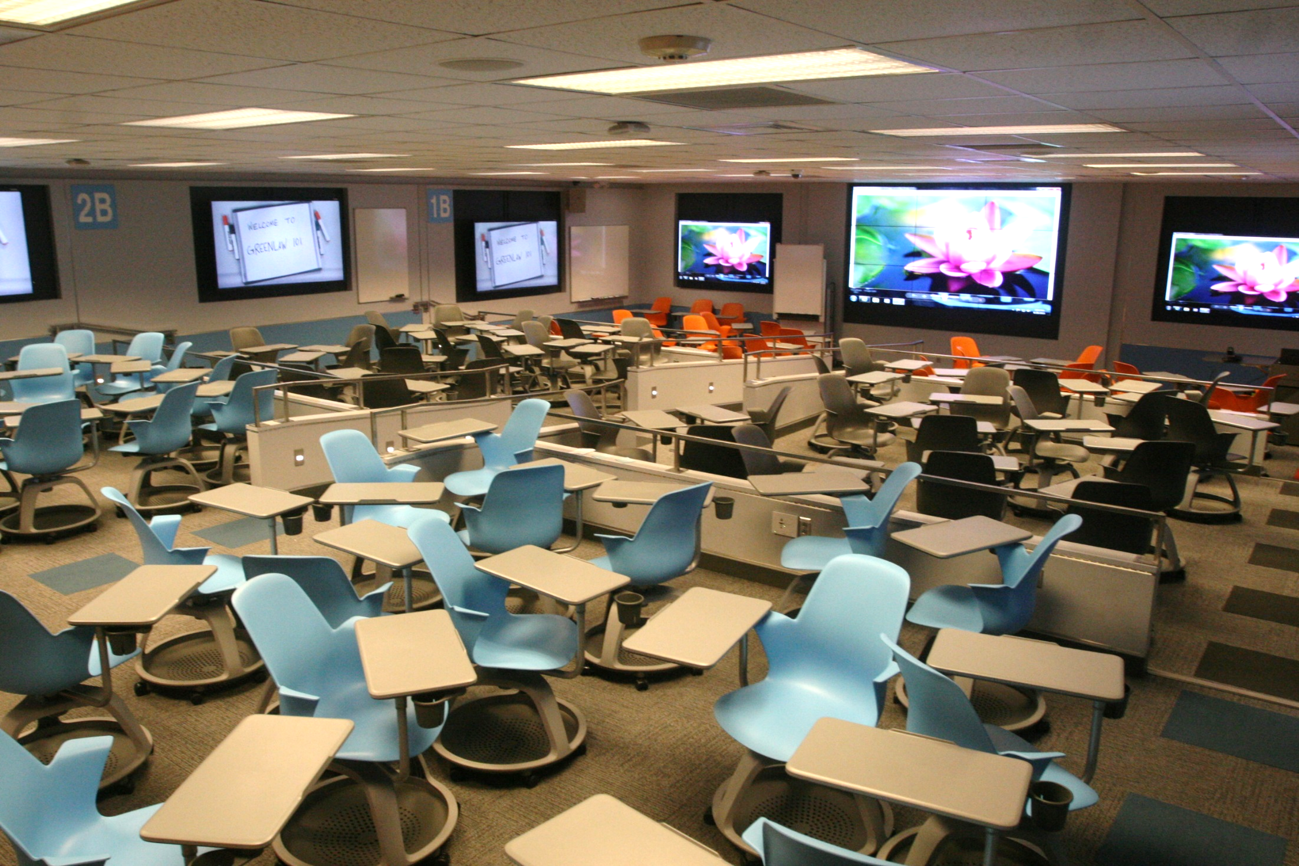
One Example
The Active Learning Hall at University of North Carolina –
Chapel Hill

Slide 47
One Example
Learn about the Active Learning Hall (aka “Greenlaw 101”)
at UNC-CH in FLEXspace
Notes:
Follow link to sign into FS.
Access ALH entry, review photos and highlights:
Photos
Zones
Flexibility

Slide 48
What to Examine?
Comfort levels
Feelings of inclusion/engagement
Preferences for elements in the space
Design characteristics & perceptions of impact on teaching & learning
Notes:
Comfort levels – physical, social (how comfortable to you feel working with others in small groups)
Easy/difficulty of performing tasks
Interacting w/ peers, instructors
movement
How often activities occur – for teachers, how often they are doing small group work; for students, how often they are doing the same - compare

Slide 49
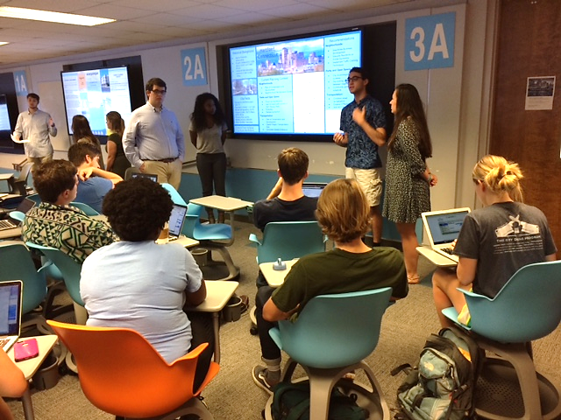
What to Examine?
Easy/difficulty of performing tasks
Frequencies/ease/difficulty of interactions
How often particular activities occur
How/how often resources are used
Others?
Notes:
You may notice I don’t have a specific mention about grades on this list

Slide 50
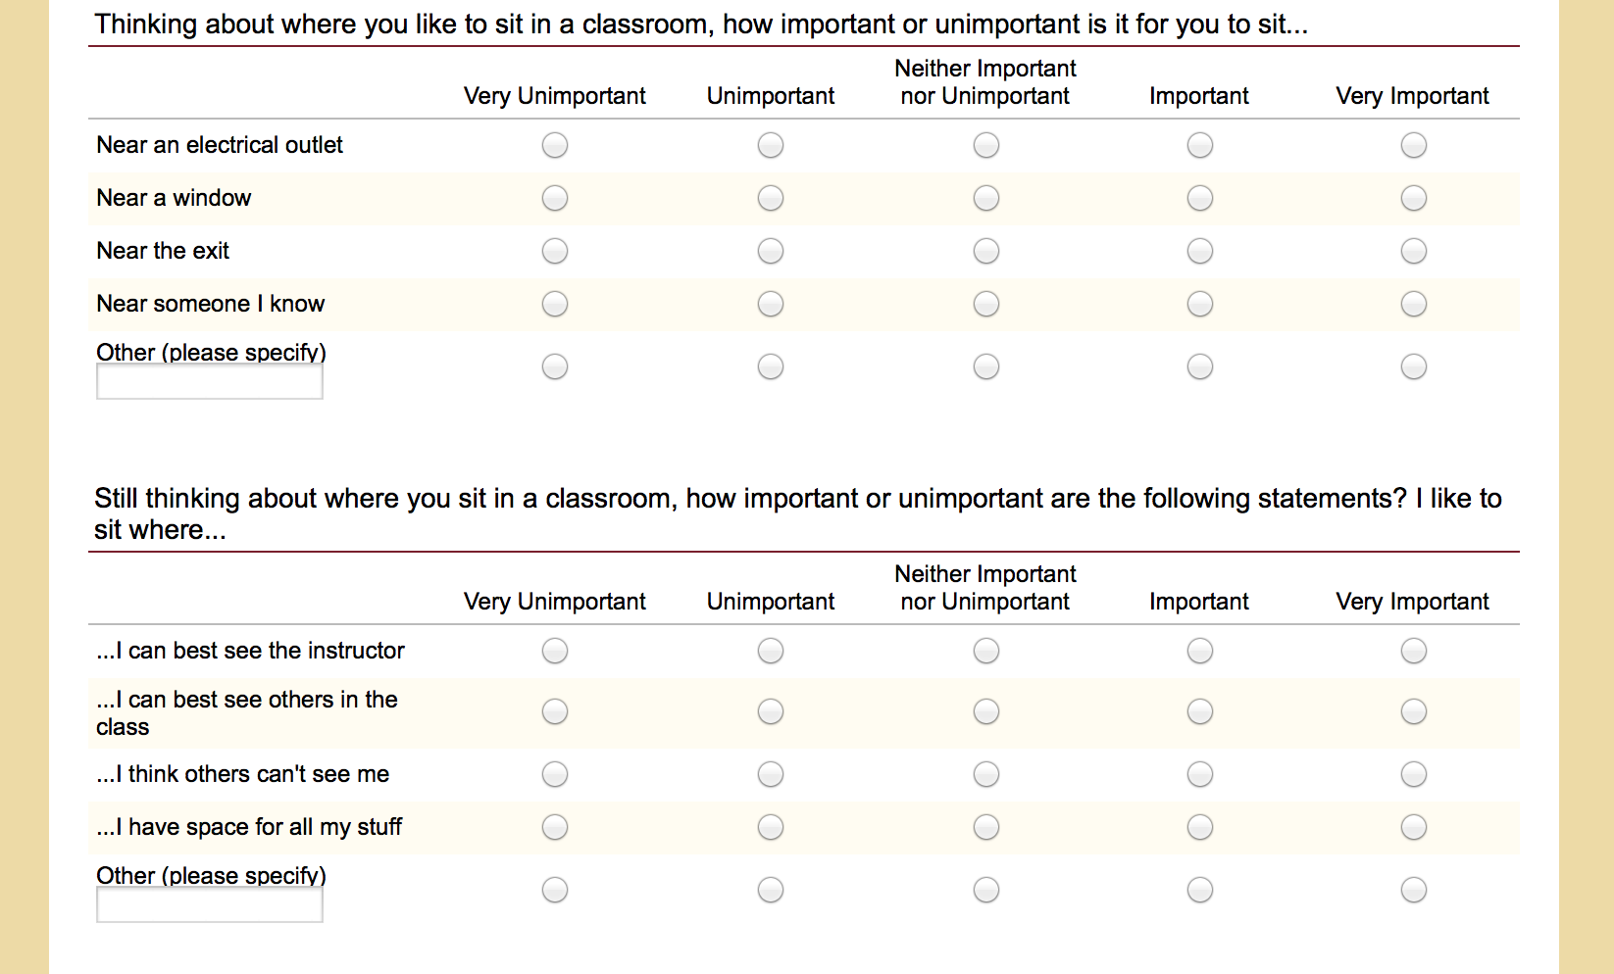
Finding Assessment Resources
Sharing is Caring!
Building the collection in FLEXspace
“Toolkit” feature on the horizon
Notes:
Go back into FS, and show instruments that have been uploaded for sharing.

Slide 51
Workshop Part 2 | TEAMS
Planning the Engagement Process
Creating Teams
User Needs Research
Developing the Plan
How to develop your engagement plan

Slide 52
How Can FLEXspace Help With Teams and Stakeholders?
Let’s Explore!

Slide 53
Examples of FLEXspace and LSRS for planning

Slide 54
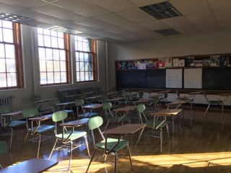
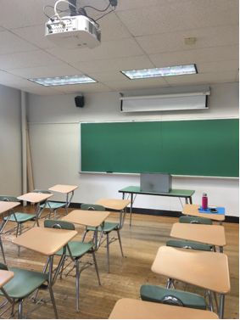
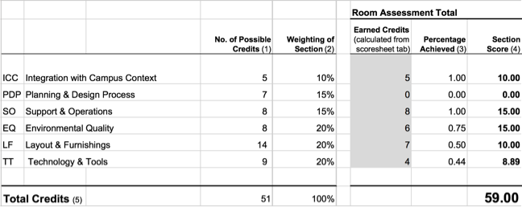
SUNY Geneseo
LSRS
Rating all our rooms
Integrate into planning
FLEXspace
Idea generator and conversation starter
Showing off our best work

Slide 55
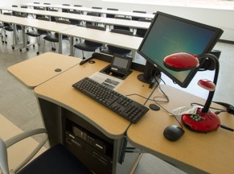
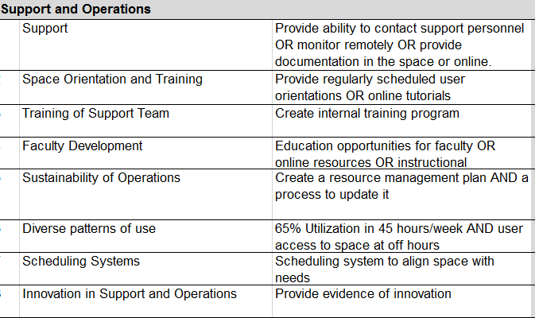
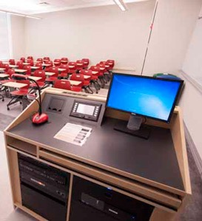
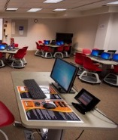
SUNY Buffalo
LSRS – Prioritize and Measure Impact
Which rooms to upgrade?
Assess staffing levels
FLEXspace – Support Master Planning
Look for attributes of technology integration
Show off the results, document spaces
Share learning environment data and contact information to save time, money and effort
Provide guidance with conversations with vendors when discussing technology in spaces.
Notes:
Support and operations section
On our campus this section was not static – depending on the space - the support, faculty development and training of staff were different
These differences affected almost everything, add to that…
The LSRS process highlighted his patchwork of technology had an impact on staff and student training / how to teach them about all of these spaces, very high learning curve. The LSRS score helped us segment spaces (by control system, by analog or digital) which we used to create training materials.
FLEXspace
gives a solid base to open conversations with vendors when discussing tech in spaces
provide guidance in conversations with vendors
contact information to share information
shares learning environment data to save time, money and effort

Slide 56
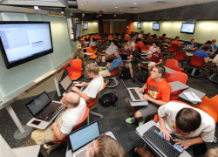
Case Study: Iowa State University
Concurrent local studies
Architectural review of all classroom spaces
Learning Ecosystem Review
LSRS aided prioritization
Rated multiple spaces and prioritized
FLEXspace aided brainstorming
Bring ideas to groups
Notes:
Commonality of discussion provided by LSRS and FLEXspace
Rated multiple spaces; determined that it could be a factor in prioritization
Used FLEXspace to bring ideas to groups
Allows for exporting of pictures and records for consumption by campus community

Slide 57
FLEXspace Research & Evaluation Working Group http://flexspace.org/frewg/
Aims to support research and evaluation efforts that:
Facilitate evidence-based and data-informed practice in learning spaces
Leverage FLEXspace capabilities & contribute to its ongoing development
Current research focus areas:
Stakeholder criteria for evaluating learning spaces (Kevin McDonough)
Usage/applications of FLEXspace and the Learning Space Rating System (Coordinator: TBA)
Learning space design patterns and analytics (Mark J. W. Lee)
Virtual and hybrid-flexible (HyFlex) learning spaces (Brian Beatty)
Assists the FLEXspace community:
Add research findings and tools to the Toolkit
Help curate Galleries and contribute to Forum
Help guide FLEXspace user research
Provide input on UX and taxonomies
Research Lead Contact:
Dr. Mark J. W. Lee malee@csu.edu.au
Notes:
Research is critical – this is what is going to sustain FLEXspace far into the future.
Brit Toven-Lindsey, Active Learning Specialist, University of California, Berkeley, United States

Slide 58
Workshop Part 2 | TEAMS
Planning the Engagement Process
Creating Teams
User Needs Research
Developing the Plan
How to develop your engagement plan

Slide 59
Stakeholders

Slide 60
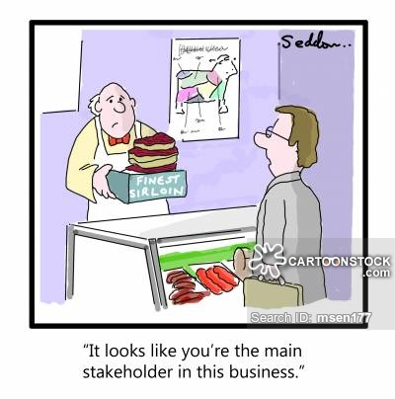
What is a Stakeholder?

Slide 61
Stakeholder Definitions
The holder of the stakes of a wager. - Google
What ARE the STAKES?
…an individual, group, or organization who is impacted by the outcome of a project.
have an interest in the success of the project
can be within or outside the organization...
- projectmanager.com Jun 13, 2017 | Peter Landau Project Management 101
…an individual, group, or organization who may affect, be affected by, or perceive itself to be affected by… the outcome of a project. - Project Management Institute, 2013

Slide 62
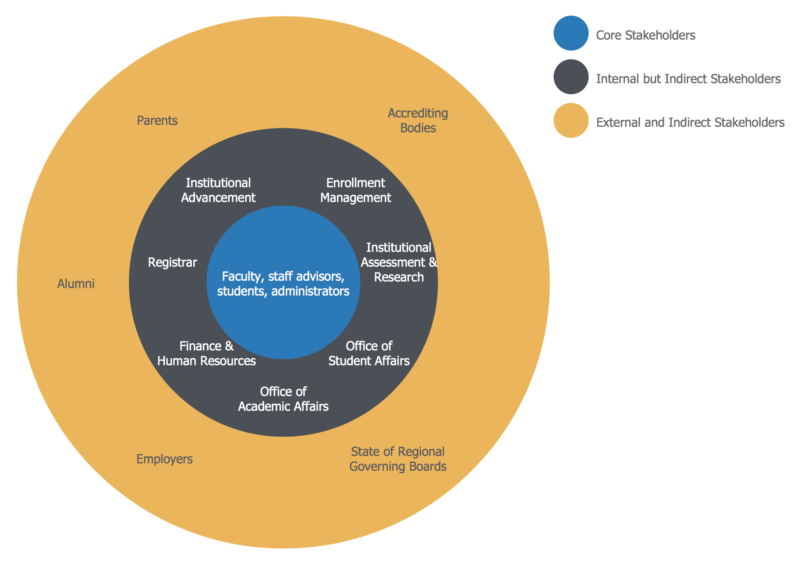

Slide 63
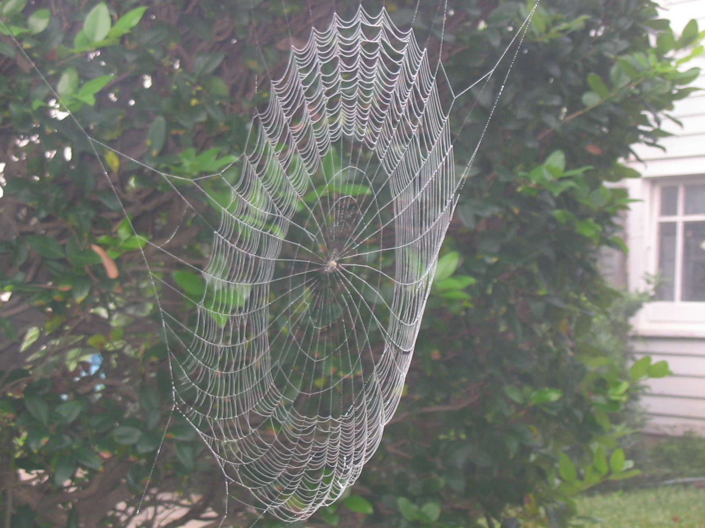

Slide 64
Learning Space Stakeholders…
Individuals internal to the university:
Upper administration: President, Provost (VP Academics), Dean(s)
Classroom Scheduler/Registrar’s Office
Learning Space Designer/Manager
Teaching & Learning Center rep
IT (Information Technology/Academic Technology) rep
AV (Audio Visual Department) rep
Physical Plant/Facilities rep
Users: faculty, students; staff/administrators

Slide 65
Workshop Part 2 | TEAMS
Planning the Engagement Process
Creating Teams
User Needs Research
Developing the Plan
How to develop your engagement plan

Slide 66
Learning Space Stakeholders…
Individuals external to the university:
Subcontractors
Construction
Space
Electrical
HVAC
Architect
System Integrator (AV)

Slide 67
Learning Space Stakeholders…
GROUPS:
Classroom/Learning Space Committee
Academic and Non-Academic Departments; Organizations
Others…

Slide 68
Who are YOUR Stakeholders?
Individuals: Internal; External
Groups
LIST YOUR STAKEHOLDERS:
NAME
POSITION
FUNCTION for PROJECT
STAKE

Slide 69
Stakeholders vs…
Partners
Decision Makers …
YOUR Position
The tie that binds…
SUCCESS !!!

Slide 70
Managing Stakeholders
communicate, Communicate, COMMUNICATE!
document, Document, DOCUMENT!
Keep the process GOING!
communicate, Communicate, COMMUNICATE!
document, Document, DOCUMENT!
Share and acknowledge people and SUCCESSES!

Slide 71
Workshop Part 2 | TEAMS
Planning the Engagement Process
Creating Teams
User Needs Research
Developing the Plan
How to develop your engagement plan

Slide 72
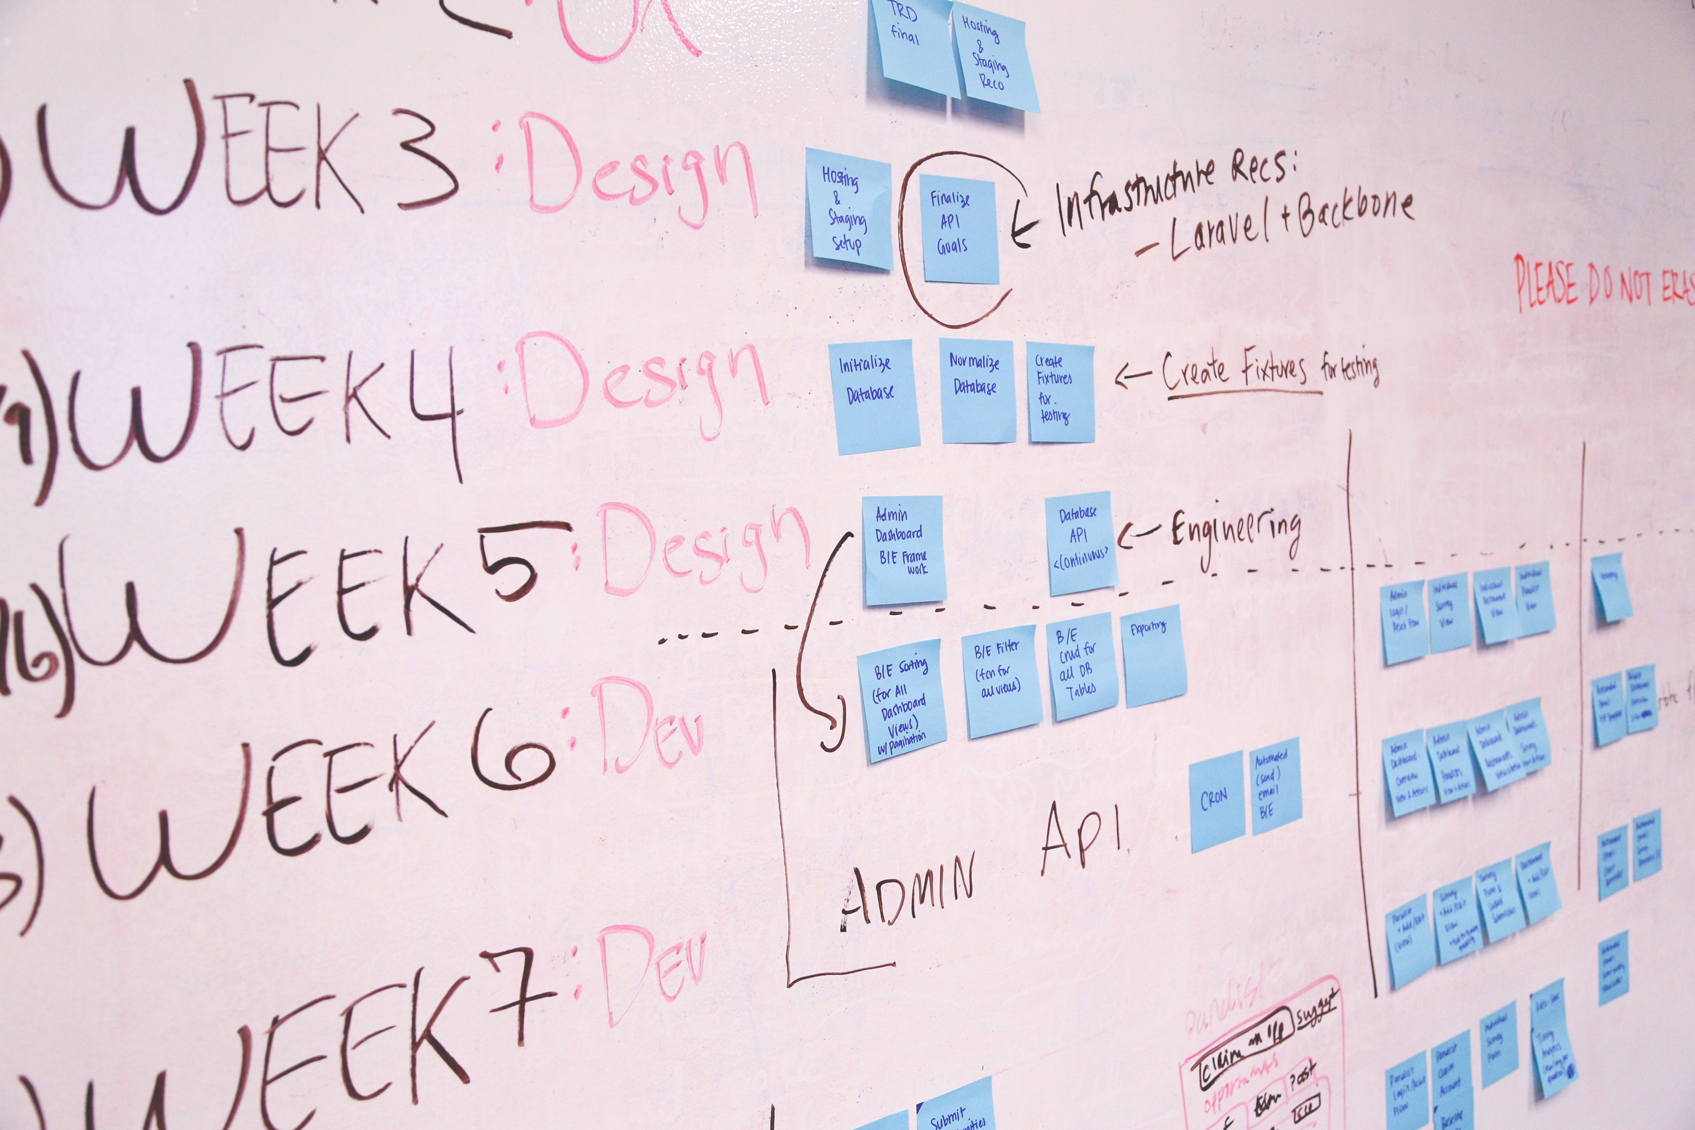
Developing the PLAN

Slide 73
Planning
BUDGET!
New installations
Upgrades
REFRESH RATES
Minimum Specs for equipment, infrastructure, etc.

Slide 74
Group Activities for Decision-Making & Prioritizing
Organized Brainstorming
Affinity Process
Ease/Impact Diagram
Cost/Benefit Analysis

Slide 75
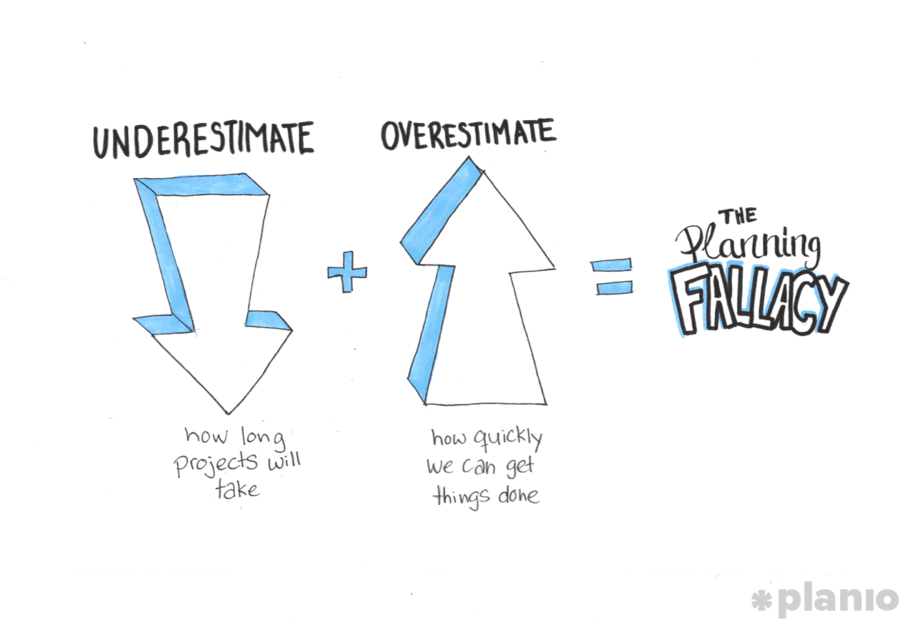

Slide 76
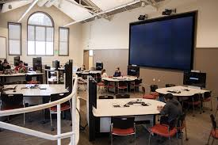
Workshop Part 3 | TRAITS
How to define traits of the spaces you want to create.
Please refer to: Comprehensive Traits FINAL file
Introduction to the Learning Space Rating System
Applying the Tools to Define Traits
Assessment
Case Studies

Slide 77
Workshop Part 3 | TRAITS
Introduction to the
Learning Space Rating System
Applying the Tools to Define Traits
Assessment
Case Studies
How to define traits of the spaces you want to create

Slide 78
Workshop Part 3 | TRAITS
Introduction to the Learning Space Rating System
Applying the Tools to Define Traits
Assessment
Case Studies
How to define traits of the spaces you want to create

Slide 79
Workshop Part 3 | TRAITS
Introduction to the Learning Space Rating System
Applying the Tools to Define Traits
Assessment
Case Studies
How to define traits of the spaces you want to create

Slide 80
Workshop Part 3 | TRAITS
Introduction to the Learning Space Rating System
Applying the Tools to Define Traits
Assessment
Case Studies
How to define traits of the spaces you want to create

Slide 81
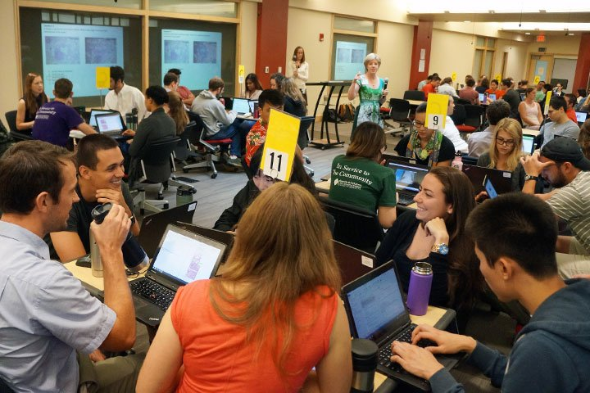
Workshop Part 4 | ACTION PLAN
Confronting Challenges Activity
Team Share Back Discussion
Planning for Support
Wrap Up/Next Steps
Putting it all into action…

Slide 82
Workshop Part 4 | ACTION PLAN
Confronting Challenges Activity
Team Share Back Discussion
Planning for Support
Wrap Up/Next Steps
Putting it all into action…

Slide 83
Workshop Part 4 | ACTION PLAN
Confronting Challenges Activity
Team Share Back Discussion
Planning for Support
Wrap Up/Next Steps
Putting it all into action…

Slide 84
Workshop Part 4 | ACTION PLAN
Confronting Challenges Activity
Team Share Back Discussion
Planning for Support
Wrap Up/Next Steps
Putting it all into action…

Slide 85
Tools, Traits and Teams:
Planning and Assessing Effective Learning Spaces
Susan Brower • Shirley Dugdale • Rebecca Frazee • Lisa Stephens

