Slide 1
Tools, Traits and Teams:
Planning and Assessing Effective Learning Spaces
Susan Brower • Shirley Dugdale • Rebecca Frazee • Lisa Stephens

Slide 2
Schedule at a Glance: Workshop Overview
Intro: Why a Workshop?
Objectives: Take home actionable knowledge to build a campus learning environments plan - Tools, Processes and Community
Tools: Project Planning & Priorities – Intro to using FLEXspace Coffee Break @ 9:30 – 10:00a
Teams: Stakeholder engagement & needs assessment Lunch @ 11:30-12:30p
Traits: Defining the spaces we want to create! Coffee Break @ 2p – 2:30a
Presentation of the key points, wrap up, next steps!

Slide 3
But first, a story…

Slide 4
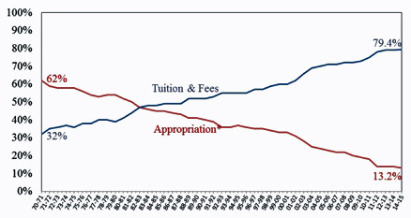
But first, a story…

Slide 5
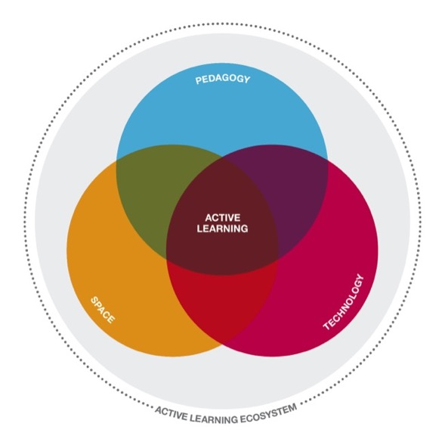
But first, a story…

Slide 6
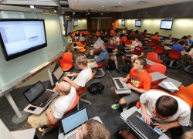
But first, a story…
Diverse Stakeholders
Faculty Governance
LSRS – data shifts rivalry
“Team of Rivals” uses FLEXspace to focus on learners
Alignment before contracts
Community sharing

