Slide 1
Creating Breakthrough Communication Across Individuals, Teams, and Organizations
PRESENTED BY:
Jonathan B. Hardy – University of Georgia
Patrick Wagman – UC Riverside

Slide 2
People Skills
While we’re waiting to begin, please read “Why People Skills” on page 1.

Slide 3
ICE BREAKER
Notes:
Page 2 of Workbook
Icebreaker – 15 minutes
How many of you have ever been frustrated with someone you work with, live with or do business with?
Explain icebreaker: at your table, go around and write down some things that people do that frustrate you. Everyone writes down everything that everyone says as you go around your table. You have 1 minute to write down as much as possible.
As each table to tell us how many they identified. Award the “most frustrated table” to the one that came up with the most.
Ask: How many of you will admit that YOU were the person that frustrated others? (If you’re not raising your hand, there’s another class we teach called ‘Denial 101’.)
Pick three items from your list that you will admit that you have done at one point or another. (See if anyone’s willing to share.)
Pick 3 of your items that you think you have done in the past.
Ask questions:
Toothpaste (neat tubers or squeeze and hope something comes out)
How many of you brush your teeth with your right hand, left hand, or both? How hard would it be to switch to the other hand?
How many of you like the toilet paper coming off the top of the role? The bottom? Don’t care as long as it’s there? Have you ever been in a public place and changed it?
TRANSITION
So admit it: You have a certain way that you like to do things. One way to better understand what furstrates us at work is to break the workplace down into two parts. We all do things differently because we’re focused on the task, or we’re focused on the people. So what we’re going to do now is explore that a little more.

Slide 4
TRUST AND RESPECT
People
People
Tasks
Tasks
People
People
Tasks
Tasks
Notes:
Page 3 of Workbook
What is this symbol? (yin and yang) What does it represent? (balance, harmony, the integration of opposites, complementary opposites, a really bad choice for a tattoo…)
Let’s look at this as tasks and people in the workplace.
Tasks are what we do
People are how and why we do what we do
In the workplace, there is typically an emphasis on tasks that need to be accomplished, which can reflect an environment that looks like this visual.
What are some good things about this?
What are some bad things about this?
Can you think of any examples of companies who have been successful doing this?
What about a workplace that focuses more on people than on tasks
What are some good things about this?
What are some bad things about this?
Can you think of any examples of companies who have been successful doing this?
Is either style right or wrong, or is it better to balance the two?
Balance is static, but highly variable.
You’re never actually in balance; you have to be able to switch back and forth between the two.
Every task involves, impacts and influences someone else (could be negative or positive).
TRANSITION
In order to have a well balanced workplace with sustained productivity, both sides of the yin/yang must be well done.
To create this balance, we need to generate trust and respect in relationships.
If we are able to do this, people issues diminish and productivity related to task completion increases.
It is all about trust and respect.
How you do your tasks will build trust and respect with other people.
People Skills focuses specifically on developing awareness for and skill which, if used, will help this balance between task issues and people issues.

Slide 5
OBJECTIVES
DAY ONE FOCUS
1
Know your behavior style and how you impact others
Understand the differences between behavior and personality, and how/why behavior is situational
2
3
Gain awareness of and identify four behavior patterns
Explore two dimensions of behavior in terms of how you use energy when working with others
4
Discover how others experience you and how intent versus impact could influence perceptions
5
Notes:
Page iv in Workbook
So in order to create that trust in respect in your relationships, here’s what we’re going to be doing throughout today.
Day 1 = all about you
* If doing the full course ===> Day 2 = all about others

Slide 6
WHY WE’RE HERE
Awareness
Options
Choices
Control
Power
Position
Money
Notes:
Page 5 of Workbook
So let’s talk about why we’re here.
In this class, I want to make you aware of something new.
Walk out of here saying “oh, I didn’t know that”, awareness means the light bulb goes off.
When you have awareness of something, that provides you with options.
Options to fix or change something.
Those options provide you with choices of whether or not to implement these concepts.
Choices enable us to have more control for building trust and respect in relationships, so when you have choices, you are in control.
This is not control over other people. This is control of yourself and how you respond to things.
That control has nothing to do with power (do it because I said so), money (do it because I sign your paycheck) or position (do it because I’m higher on the org chart than you).
There is nothing wrong with these things, but they don’t generate trust and respect. They tend to distract from the organization’s ability to maintain balance between tasks and people.
Let’s put it in simple context:
I’m aware that we have company coming into town this weekend.
Now that I’m aware that they’re coming, I have some options as far as entertainment, meals, where they’ll stay, etc.
So that gives me choices (Am I going to cook every meal, or will we go out some? Should we check out the farmer’s market in the morning or see a movie at Cine in the evening? Will they stay in the guest room or on the pull-out couch?)
Since I have a choice, that means I’m in control of my decisions and the situation. It has nothing to do with me being in charge of other people, it has nothing to do with how much money I’m planning to spend or how much my guests will spend, and it has nothing to do with my “rank” in the family, though I’m definitely last man on the totem pole.
TRANSITION
So in this class, we’re going to provide you with some tools and techniques so that you can gain awareness of things that you do and how you interact with others, which will lead to options and choices for building trust and respect.

Slide 7
COMFORT ZONE
Integration
Expanded Comfort Zone
Skill
Reduced Discomfort Zone
OPTIONS
Awkwardness
(Potential) Fear Zone
OPTIONS
Practice
OPTIONS
OPTIONS
Choice
Awareness
Discomfort Zone
Current Comfort Zone
Notes:
Page 6 of vi of workbook.
So we all have a preferred method of doing things, a way that you feel most comfortable going about your day. So one of the first things we want to do is help you become aware of your current comfort zone.
When you’re pushed out of your comfort zone, you become aware of it, and that becomes a discomfort zone for you.
So you have a choice to make a change about that.
You practice making that change to hopefully overcome the discomfort.
Now this will cause some awkwardness and put you in a potential fear zone because it’s unfamiliar territory; you’re not comfortable here.
But because of the skills you learned while practicing, you’ll find that you’re in a reduced discomfort zone; it’s not as bad as it was before.
You’ll integrate those skills into your day-to-day, and find yourself in an expanded comfort zone.
And what this does, is it creates a new current comfort zone.
(Go through Horse example)
So in this class, you may become uncomfortable at times. It’s all about moving you into a discomfort zone.
You’re going to be given some choices on how to overcome that, and we’ll practice some ways to make that more comfortable for you.
It’ll be awkward, and uncomfortable at times, but through the skills you’ll learn in this course, it won’t be as much of a discomfort zone as it was before. And if you integrate these skills into your tasks and relationships in the workplace, you’ll find that you’ve expanded your current comfort zone to a new current comfort zone.
Quote: Change is certain, growth is optional. To be extraordinary is a choice.
Is higher education changing? Do we have to make some choices in order to meet these ever-changing demands? Absolutely.

Slide 8
ROADMAP
Day One - Self
Module 1: Behavior Versus Personality
Module 2: How I See Me
Module 3: How I Show Up
Module 4: How You See Me
Notes:
Page 7 of Workbook
So here’s the roadmap we’ll be following throughout the day.
This is day one, and it’s basically a path to expand your current comfort zone.
There is a two day course option for this material as well if you are interested. While the first day focuses on you, the second day goes into others and how to apply these skills.

Slide 9
Behavior Versus Personality

Slide 10
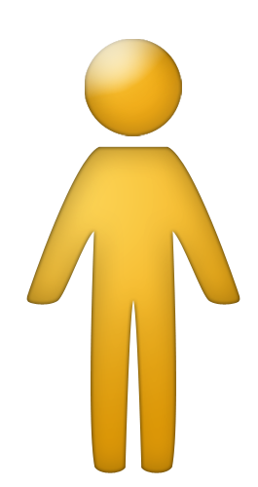
Perceptions
Perceptions
(Values)
(Values)
Beliefs
Beliefs
Behavior
Behavior
Notes:
So here’s me, and how I interact with other people. How I interact is based on my perceptions of other people.
Our perceptions are our filters that we use to interpret everything around us.
Humans are perceiving machines. We perceive things almost instantly.
You perceived me the second you walked into this class room.
You‘ll perceive things differently based on your experience, your background, etc. (carpet salesman, electrician)
How long do you think it takes to make a 1st impression? .7 seconds
We are constantly perceiving things
When you perceive something, you run it through your values.
Values are tightly held principles that influence your actions.
These tend to be tucked away.
If something is contrary to our values, we do not let it through our filters.
Your values shape your beliefs.
Beliefs come from and reflect our entire life experience.
Come from your family, teachers, mentors, friends, etc.
You act according to your beliefs, and this determines your behavior.
Your behavior is shaped by your perceptions, values and beliefs.
Quick example:
I perceive that you are not being entirely honest with me.
I value complete and total honesty, so I believe that you are a liar and are untrustworthy.
This is going to influence my behavior around you. I might seem guarded, or not very friendly towards you.
You will behave in a way that’s consistent with your values, beliefs and perceptions.
So look what’s going on over here. Here comes a coworker. They’re going to perceive your behavior, run that through their filters based on their beliefs, and behave towards you in a certain way.
Example of girl in move theater with disability
Which is easiest to change?
If I asked you to change your behavior, what would you say? (Why should I?)
Do you think you could change someone’s values? Those tightly held principles that we keep tucked away?
What about your beliefs that you have formed over a lifetime?
Only through a significant emotional experience.
You cannot separate a person’s perceptions, values and beliefs from their behavior.
It is easiest to change your perceptions. If you can change those, you will increase effectiveness.
You can’t control someone else’s beliefs, perceptions or behavior, but you can change yours.
You should change your behavior all the time in order to correct or change others’ perceptions of you
TRANSITION
In this course, we will try to impact your beliefs and perceptions about behavior and increase your awareness of ways to modify your behavior to build trust and respect.

Slide 11
Break
10 Minutes

Slide 12
ICEBERG
Choice
Observable Behavior
Total Personality
Notes:
Page 11 of Workbook
To continue our behavior, personality and perceptions discussion, we’re going to use the analogy of your SELF as an iceberg. This whole iceberg is your personality.
Your total personality is everything that you are, and this is generally kept below the waterline. What are some things below the waterline that impact personality (e.g. family of origin, childhood issues, biochemical issues, etc.)?
Ask someone to tell how many siblings they have, and where they are in the birth order. (I’m oldest, brother is 6 years younger than me.)
Even though these are real and they are manifested above the waterline we’re not talking about or working on these. I’m willing to bet that there aren’t too many people who know your total personality.
Your observable behavior is what everyone else sees, above the waterline. The observable behavior that we show can be controlled by choice based upon the situation.
If you’re laughing and joking around with coworkers on your way in from lunch, will your behavior change if President Adams suddenly walks by? Absolutely. And that’s a choice you make.
Any idea on a percentage of how much you keep above and below the waterline? (10% above, 90% below)
So what’s the difference between behavior and personality?

Slide 13
BEHAVIOR VS. PERSONALITY
PERSONALITY is who you are.
BEHAVIOR is what you do.
PERSONALITY cannot be situationally, intentionally, & temporarily modified by choice.
BEHAVIOR can be situationally, intentionally, & temporarily modified by choice.
11
Notes:
Page 11 of Workbook.
Step through these points.
You can’t change your birth order or where you’re from. But you can change what you do.
We are going to focus on the behavior piece in this course and revisit this many many times.

Slide 14
Patterns of Behavior
Choice
Observable Behavior
Personality
Situation
Environment
Notes:
So we’ve built on this analogy of our personality as an iceberg.
Observable behavior is above the waterline and can be seen, and you can control this by choice. Making that change to rotate my iceberg can be easy or hard, depending on the situation and the environment.
Example:
I’m generally a people person. Like to laugh, have fun, work in groups and have a good time. This is me most of the time.
(rotate) If I need to have a one-on-one meeting with a coworker where I need to focus on what they’re saying and really concentrate so that I can help them through a project issue or task, I can do it, but with a little bit of effort.
(rotate) Let’s say my boss gives me a very lengthy assignment that’s going to require me to bring everyone together, have them focus, and get this done quickly and efficiently. I can rotate the other way, and take that role to get things done without laughing and joking and making it a fun thing to do, but again, it’s going to take some effort. So rotating to the left or to the right, I have to demonstrate some very different behaviors from where I’m most comfortable and it’s not as typical for me. But I can make the change with minimal effort.
(rotate) I can also turn my iceberg all the way over. My manager asks me to proof-read a 100-page report. I have to check spelling, grammar, punctuation, formatting, make sure the references are correct, etc. I’m also told I have to work on this until it’s done. Because this is so different from the norm for me, it’s going to take an immense amount of effort, energy, and it would be very hard for me to sustain. This isn’t easy for me, but it’s part of my job. I change my typical behavior to perform the task, but I’m exhausted when I’m done.
(rotate) So after work, I’m going to invite a couple of friends over for dinner, where I can “be my normal self” again.
(Quadrants) You’re always rotating your iceberg based on what’s going on. (click) In different situations and different environments, you behave differently.
Regardless of how I rotate my iceberg to behave in different ways, there is a portion of the iceberg that never goes above the waterline.
You personality never changes, but you can rotate our observable behavior in order to get the appropriate result.
Our beliefs, perceptions, the situation and environment, all work together to inform and dictate how we “rotate our iceberg” and cause us to adjust our behavior situationally, intentionally and temporarily.

Slide 15
We call these Patterns of Behavior Behavior Style
Behavior Style is NOT a label – everyone demonstrates all the Style behaviors at one time or another
Notes:
Go through points on slide.

Slide 16
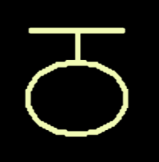
WHAT’S THE PATTERN?
?
If you can identify the pattern you can make sense of it and know what comes next
Notes:
Build 1 – (click) See if participants can recognize the pattern. (30 seconds) If anyone knows it, have them draw it.
Build 2 – (click) Reveal next shape, ask participants to raise their hands if they can recognize the patter now.
Build 3 – (click) Reveal the pattern
What can we take away from this?
(click) If you can identify the pattern, you can make sense of it and know what comes next.
You can know what to do to build trust and respect in your relationships.
Remember how awareness ultimately leads to control? The more self-aware you are, the more fully present you can be with someone.

Slide 17
How I See Me

Slide 18
“As I See Myself” Profile
Notes:
This profile is going to help you gain insight into your preferred behavior style (the top of your iceberg, where you feel most comfortable).

Slide 19
CSAP GRAPH
Tally Box
C O N T R O L L E R
C
10
0
1
2
3
4
5
6
7
8
9
10
11
12
14
16
18
2
S T A B I L I Z E R
S
2
0
1
2
3
4
5
6
7
8
9
10
12
14
16
A N A L Y Z E R
A
1
0
1
2
3
4
5
6
7
8
9
10
12
14
P E R S U A D E R
P
11
1
0
1
2
3
4
5
6
7
8
9
10
11
12
14
16
24
TOTAL - Must equal 24
Mid-line
Notes:
Add up the number of checkboxes for C, S, A and P.
Build 1 –Enter your total scores for C, S, A, and P in the Tally Box column, and total those in the Total Box.
Build 2 – Next, highlight from left to right, out to your score for that letter. So if I had a 10 for C, I’d highlight from the edge of the Tally Box to the number 10. (The highlighter here is in blue.)
Build 3 – Next, observe what numbers fall to the right of the midline. Place a 1 in the space provided that was your highest right of midline score.
Place a 2 in the space provided that has the next highest right of midline score.
So what these letters represent are behavior styles: Controller, Stabilizer, Analyzer and Persuader. The profile identifies the style you prefer in the work place.
Ask for show of hands for who has what style as #1.
Emphasize: I’m all four and you’re all four. We all rotate our icebergs at one time or another depending on the situation and environment.
Don’t pigeon hole yourself into one behavior style, because we all do all four.

Slide 20
STYLE COMBINATIONS (in electronic copy of AISM)
Notes:
Instruct participants to fill in their #1 and #2 in 1a and 1b of page 15 of their AISM workbook. Tell them to turn to the page that describes this behavior and see if that’s an accurate description of their behavior.
If it doesn’t seem accurate, tell them to flip it and do the inverse.
Go around the room and get participants to tell how accurate the description is, in a percentage. (Shooting for 70% accuracy.)

Slide 21
FLEXING AND COMFORT ZONE
T A S K E N E R G Y
A-A
A-C
C-A
C-C
IMPLEMENTING
E NE RGY
I NI TI ATI NG ENERGY
A-S
A-P
C-S
C-P
S-A
S-C
P-A
P-C
S-S
S-P
P-S
P-P
R E L A T I O N A L E N E R G Y
8.8
Notes:
Transition: If you’re going to flex, let’s put it into real terms so that you’ll know what you need to do.
The yellow box represents your preferred Behavior Style.
You can easily take one step and “rotate your iceberg” go accommodate the needs of people in those quadrants immediately around you in your “neighborhood.”
While these quadrants are an additional step away from your style quadrant, you can still take one more step and “rotate your iceberg” a bit further to meet the needs of people here. It requires a bit of stretching but can be done.
The red area represents people in quadrants that will be very difficult for you to accommodate over and extended period of time. You may be able to “rotate your iceberg” to meet the needs of people in these quadrants for a short time, but it would be unsustainable.

Slide 22
FLEXING AND COMFORT ZONE
T A S K E N E R G Y
A-A
A-C
C-A
C-C
IMPLEMENTING
E NE RGY
I NI TI ATI NG ENERGY
A-S
A-P
C-S
C-P
S-A
S-C
P-A
P-C
S-S
S-P
P-S
P-P
R E L A T I O N A L E N E R G Y
8.8
Notes:
Same goes for this person over here…

Slide 23
FLEXING AND COMFORT ZONE
T A S K E N E R G Y
A-A
A-C
C-A
C-C
IMPLEMENTING
E NE RGY
I NI TI ATI NG ENERGY
A-S
A-P
C-S
C-P
S-A
S-C
P-A
P-C
S-S
S-P
P-S
P-P
R E L A T I O N A L E N E R G Y
8.8
Notes:
If you are able to take one step toward someone else in terms of Styles and better meet his/her needs, he/she will be willing to take one step toward you to better meet your needs.
Flexing must be practiced consistently over time. There may be resistance and skepticism on the part of the other Style at first. However, over time, trust and respect can increase for both individuals.

Slide 24
BRIDGE STYLES
T A S K E N E R G Y
A-A
A-C
C-A
C-C
IMPLEMENTING
E NE RGY
I NI TI ATI NG ENERGY
A-S
A-P
C-S
C-P
S-A
S-C
P-A
P-C
S-S
S-P
P-S
P-P
R E L A T I O N A L E N E R G Y
8.9
Notes:
Bridge styles are able to bridge communication between styles which would naturally have a more challenging time “speaking each others’ language”.
These styles have a unique characteristic that allows for bridging: they demonstrate seemingly opposite behavior.
These styles can be excellent communicators within and between teams. For this reason, it’s important to identify any teammates who regularly demonstrate a Bridge style preference.
They can connect with a diagonal style… (Stabilizers, can you believe that someone could connect with a controller?? Impossible!)
These styles are very flexible and don’t always have a red zone. They’ve likely learned one of their behavior styles, and the other is more natural.

Slide 25
FLEXIBILITY Situationally, intentionally, and temporarily modifying behavior
Flexibility is a CHOICE
Willing
Able
A change of what you DO, not who you ARE
8.10
Notes:
Step through bullets.
People Skills was designed to help people achieve results through thoughtfully and deliberately building relationships. One of the most powerful ways we’ve discovered to accomplish this is by flexing to create win-win outcomes.
You now have the awareness of Behavior Styles and understand the options available for flexing to meet Style needs.
With this knowledge you have a choice whether or not you will flex your behavior – situationally, intentionally and temporarily – to create a win-win. This is a change of what you do, not who you are.
You might not be willing because there is no trust and respect in place (no desire to improve). And you also might not be able to flex because there is no skill. But hopefully you’ve been made aware of your options through this course, and you will choose to incorporate those skills into your everyday lives.

Slide 26
Break
10 minutes

Slide 27
VIDEO
16-17
Notes:
Only show first part
Now we’ll have an opportunity to learn more about each individual behavior style and what each of them bring to a team.
In this video, Tom Champoux, co-founder of the Effecitiveness Institute, is going to walk you through each style’s strengths, weaknesses, their holstershot, how they appear to others, their needs, what they do with ideas, and many other details. Keep in mind that these are the behavior styles in their pure form.
Take notes on each behavior style on pages 16 and 17 of your workbook.
Go over key points of the video (their major focus, and any other details that the class brings up).

Slide 28
Lunch
60 minutes

Slide 29
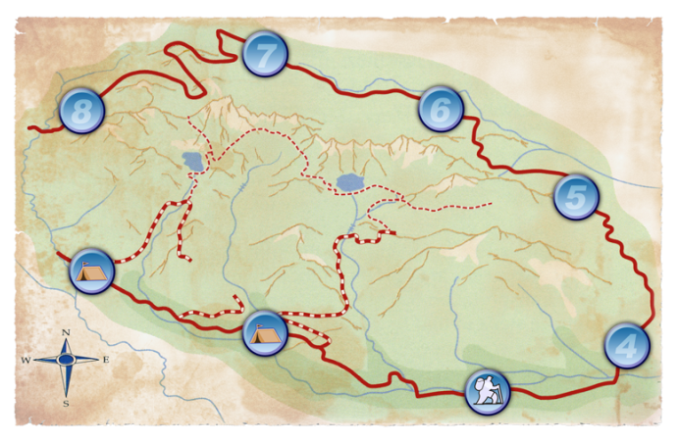
MODULE 3
How I Show Up
19
Notes:
Module 1 was all about bringing awareness, and realizing the difference between behavior and personality.
Module 2 showed you that there are four different behavior styles that we all exhibit at one time or another.
Now, in Module 3, we’re going to talk about how you “show up” to others. We’re going to talk about how we use energy, and how we behave in order to get our work done.

Slide 30
HOW I USE ENERGY
TASK
11
(A+C=SCORE)
A
C
10
10
IMPLEMENT
1
INITIATE
1
3
21
(A+S=SCORE)
2
(C+P=SCORE)
2
S
P
11
11
RELATIONAL
13
20
(S+P=SCORE)
Notes:
Through this course, you’ll notice that the different styles will focus on the task, versus the people, and some will focus on implementing, versus initiating. These are the different kinds of energies that we use.
(click) So what you’re going to do, is transfer your scores from the AISM profile, to this graph. So if I have a 1 for Analyzer, I’m going to circle that one, and so on…
(click) Next, connect the dots to make a shape and (click) shade that in.
From there, you’re going to follow the instructions to combine your scores on the axis of each quadrant. So on Task, add your Analyzer score to your Controller score, and so on.
Highlight the two energy boxes with the highest scores (click, click).
This is a visual picture of how you use (get and give) energy. (do you get more energy from your tasks, or from your relationships? Do you enjoy initiating tasks, or implementing them?

Slide 31
RULE OF THUMB
If your score on opposite ends of a line are:
12-12, 13-11, or 14-10: You can use either energy easily and slide back and forth on this line WITHOUT thought or effort.
15-9, 16-8, 17-7, 18-6, or 19-5: You have a preferred energy, but can use the opposite energy WITH conscious thought and effort.
20-4, 21-3, 22-2, 23-1, or 24-0: It is very difficult for you to use the opposite energy and it is nearly impossible when under pressure.
21
Notes:
So here’s what this tell us…
Step through bullet points, and get someone to tell if they had a similar score in order to confirm results.
This information helps us to understand the way we change, or flex our behaviors to meet the needs of a situation.
In some cases, we can easily “rotate our iceberg”, and in other cases, it’s harder.

Slide 32
STYLES IN MOTION ACTIVITY
Notes:
Now you’ll have the opportunity to see the ways that your energy is used and how your behavior styles change, depending upon the situation and environment.
Each corner of the room represents a style. (Controllers = back right, Analyzers = back left, Stabilizers = front left, Persuaders = front right). Go ahead and move to your primary style corner.
I’m going to read several scenarios. I want you to think about what style energy you would manifest in that particular situation, and move to that corner of the room.
(Read scenarios… see word doc.)
Have everyone go back to their seats. What did you see/learn?
So remember, flexing doesn’t change who you are, it only changes what you do. You change your behavior, not your personality. This activity reinforces the idea that all people are capable of changing their behavior situationally, intentionally and temporarily.

Slide 33
RESULTS DIMENSION
E
X
P
E
D
I
E
N
C
E
P
R
O
C
E
S
S
10
9
8
7
6
5
4
3
2
1
1
2
3
4
5
6
7
8
9
10
RESULTS
Process-oriented behaviors
1. Speaks slowly, after thinking
2. Asks more than tells
3. Generally speaks with a soft voice
4. Frequently sits or stands at an angle to person
5. Lets others initiate
6. Slow, relaxed muscle movement (e.g., softer handshake)
7. Often looks away while conversing
8. Usually indirect, uses hints
9. Talks with pauses
10. Careful, thoughtful decisions
Expedience-oriented behaviors
1. Speaks quickly, while thinking
2. Tells more than asks
3. Generally speaks with a strong voice
4. Frequently sits or stands directly across from person
5. Initiates
6. Quick, tight muscle movement (e.g., firm handshake)
7. Direct eye contact while conversing
8. Usually direct and to the point
9. Talks without pauses
10. Quick, bold decisions
22
Notes:
Let’s talk about your behavior from another perspective.
We’re going to continue talking about the two dimensions that we use to understand and visualize observable behavior.
Read paragraphs on workbook page 22.
We’re going to start with the results dimension. There are two ends to this dimension… process-oriented, or expedience-oriented.
So let’s look at these two columns, which are descriptors for these two types of behaviors.
Process-oriented individuals tend to speak slowly, after thinking. (Have someone ask a question, and answer it from Process perspective)
Expedience-oriented individuals tend to speak quickly, while thinking. (Have someone ask a question and answer it from Expedient perspective)
Go through the same examples for #2 through #4.
Instruct participants to compare statements made for each #1 in both columns and circle the number that is most true for them.
Use same focus as the AISM profile (at work).
When you’re done, draw a line at the total number of circles you had on each dimension, and shade in the area in the middle.
So if I had 2 on the process side, and 8 on the expedience side, I’d mark the number 2 on the process dimension, and the number 8 on the expedient, and shade the area in the middle.
When you’re done, just look up so that I know you’re ready to move to the next section.

Slide 34
EMOTIONS DIMENSION
CONTROLLED
Controlled behaviors
1. Limited use of face and body when communicating
2. Gestures tend to be inside width of shoulders
3. Keeps feelings “in”
4. Serious or intense eye contact
5. Appears guarded or cautious in relationships
6. Slow to smile
7. Uses facts to make decisions
8. Infrequently talks about self, difficult to get to know
9. Focuses attention on accomplishing tasks
10. Prefers working alone
10
9
8
7
E M
O
T
I
O
N
S
6
5
4
3
2
1
1
Responsive behaviors
1. Maximum use of face and body when communicating
2. Gestures tend to be outside width of shoulders
3. Lets feelings “out”
4. Friendly or warm eye contact
5. Appears open and friendly in relationships
6. Smiles easily
7. Uses feelings to make decisions
8. Talks about self, easy to get to know
9. Focuses attention on maintaining relationships
10. Prefers working with others
2
3
4
5
6
7
8
9
10
RESPONSIVE
23
Notes:
Now let’s talk about the emotions dimension. There are two ends to this dimension… emotionally controlled, or emotionally responsive.
Read paragraphs on workbook page 23.
So let’s look at these two columns, which are descriptors for these two types of behaviors.
Emotionally controlled individuals tend to limit their use of face and boddy when communicating. (Very solemnly: “that is so exciting.” “That is the most interesting thing I have ever heard.” “I have never been told a joke as funny as the one that you just told me. I can barely contain myself.”)
Emotionally responsive individuals tend to have maximum use of face and body when communicating. (Very enthusiastically: “WOW!” “That is just great!” “I can’t wait to get started on this!” )
Go through the same examples for #2 through #4.
Instruct participants to compare statements made for each #1 in both columns and circle the number that is most true for them.
Use same focus as the AISM profile (at work).
When you’re done, draw a line at the total number of circles you had on each dimension, and shade in the area in the middle.
So if I had 9 on the controlled side, and 1 on the responsive side, I’d mark the number 9 on the controlled dimension, and the number 1 on the responsive side, and shade the area in the middle.
When you’re done, just look up so that I know you’re ready to move to the next section.

Slide 35
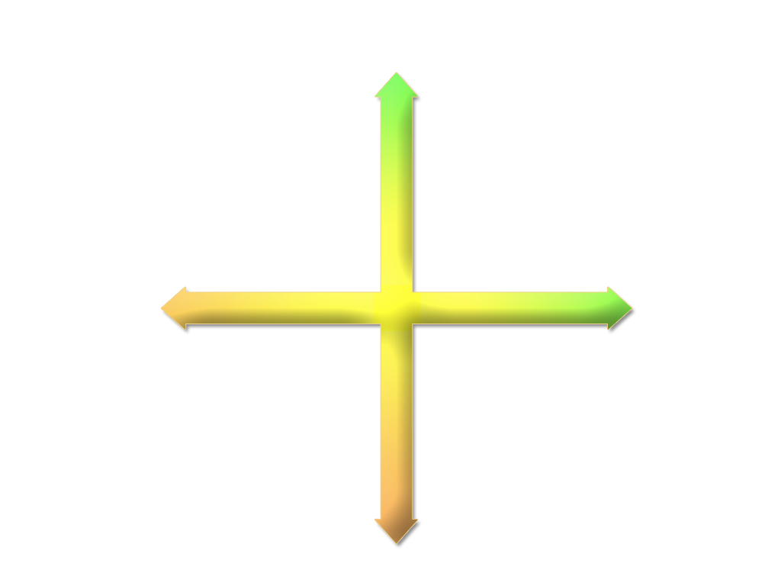
HOW I SHOW UP
CONTROLLED
A
E M
O
T
I
O
N
S
C
E
X
P
E
D
I
E
N
C
E
P
R
O
C
E
S
S
Analyzer
Controller
RESULTS
RESULTS
S
E M
O
T
I
O
N
S
P
Stabilizer
Persuader
RESPONSIVE
24
Notes:
So these two dimensions create four quadrants, looks similar to the “how I use energy” graph, right?
Those that are at the top of the emotions dimension are Analyzers and Controllers, and they tend to focus on the task, and are more emotionally controlled.
Those that are on the bottom of the emotions dimension are Stabilizers and Persuaders, and they tend to focus on relationships, and are more emotionally responsive.
Those that are to the right of the results dimension are Controllers and Persuaders, and they tend to focus on initiating things, and have a more expedience-oriented behavior.
Those that are to the left of the results dimension are Analyzers and Stabilizers, and they tend to focus on implementing htings, and have a more process-oriented behavior.
What’s the difference between the “How I use Energy” graph that we did earlier, and this “How I Show Up” graph?
Energy: how we see ourselves at work, and what’s more natural or challenging for us in terms of rotating our iceberg.
Show up: how we generally behave to get things done. This is what I do.
Rotating boxes:
(click) so we know we have controllers, persuaders, stabilizers and analyzers.
(click) we can rotate between all four at one point or another, depending on the situation and the environment.
(click) Controllers can rotate pretty easily between Persuader and Analyzer, but it is really hard for them to go on this diagonal to Stabilizer
(click) Persuaders can rotate pretty easily between Controller and Stabilizer, but it is really hard for them to go on this diagonal to Analyzer
(click) Stabilizers can rotate pretty easily between Analyzer and Persuader, but it is really hard for them to go on this diagonal to Controller
(click) Analyzers can rotate pretty easily between Stabilizer and Controller, but it is really hard for them to go on this diagonal to Persuader
We’re going to talk about these geometrically diagonal behavior styles, and why it’s hard for them to rotate to each other, and at times, hard for these styles to work together.

Slide 36
“How I Show Up” Profile
Notes:
So this may have shifted from your AISM because you’re either in a new job or your behaving in a way that’s completely different from what you’re comfortable with.
This is a visual picture of the behaviors that you demonstrate based on how answered those dimensions questions.
Which profile do you think people will use to identify your style? (How I Show Up, or AISM?)
So there’s an upside and a downside to how you show up that you need to be aware of.
From this class, you’re going to walk away with:
Awareness
Practical and tactical things that you can do to have a positive influence on others.

Slide 37
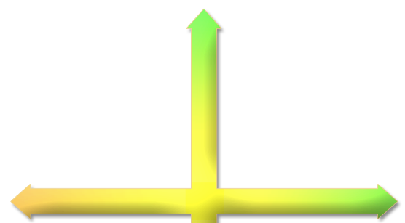
ENERGY AND BEHAVIOR STYLE
When working with…
A
C
Focus on task
Don’t socialize
25
Notes:
Read introductory paragraph at top of 25.
Let’s go through some pointers for how you should work with the styles as they fall in their dimensions.
(Read Above Midline Styles sentences)
When working with Analyzers and Controllers…

Slide 38
ENERGY AND BEHAVIOR STYLE
When working with…
Make a relationship connection
Acknowledge emotions
S
P
25
Notes:
(Read Below Midline Styles sentences)
When working with Stabilizers and Persuaders…

Slide 39
ENERGY AND BEHAVIOR STYLE
When working with…
A
Create a context
Be precise
S
25
Notes:
(Read Left of Midline Styles sentences)
When working with Analyzers and Stabilizers…

Slide 40
ENERGY AND BEHAVIOR STYLE
When working with…
C
Move quickly
Be brief
P
25
Notes:
(Read Right of Midline Styles sentences)
When working with Controllers and Persuaders…

Slide 41
BEHAVIOR TENDENCIES
CONTROLLER
Results
To be in control
Uses conflict
Listening
Their objectives and results
Be efficient
Action
CONTROLLER
Results
To be in control
Uses conflict
Listening
Their objectives and results
Be efficient
Action
E M
O
T
I
O
N
S
A
C
Analyzer
Controller
RESULTS
RESULTS
S
E M
O
T
I
O
N
S
P
Stabilizer
Persuader
26
Notes:
Let’s make this as behaviorally explicit as possible.
Step through each of these points for the behavior styles.
Pick someone to go through the questions with (does this sound right to you?).
Verify these attributes with other styles.

Slide 42
BEHAVIOR TENDENCIES
CONTROLLER
Results
To be in control
Uses conflict
Listening
Their objectives and results
Be efficient
Action
PERSUADER
People
To be liked
Uses verbal skills
Following systems
Their ability to take risks
Get acquainted, have fun
Approval and praise
E M
O
T
I
O
N
S
A
Analyzer
RESULTS
RESULTS
PERSUADER
People
To be liked
Uses verbal skills
Following systems
Their ability to take risks
Get acquainted, have fun
Approval and praise
S
E M
O
T
I
O
N
S
P
Stabilizer
Persuader
26

Slide 43
BEHAVIOR TENDENCIES
CONTROLLER
Results
To be in control
Uses conflict
Listening
Their objectives and results
Be efficient
Action
STABILIZER
Relationships
Security
Maintaining harmony
Initiating quickly
Them as a person
Understand their goals
Appreciation
E M
O
T
I
O
N
S
A
Analyzer
RESULTS
RESULTS
STABILIZER
Relationships
Security
Maintaining harmony
Initiating quickly
Them as a person
Understand their goals
Appreciation
PERSUADER
People
To be liked
Uses verbal skills
Following systems
Their ability to take risks
Get acquainted, have fun
Approval and praise
S
E M
O
T
I
O
N
S
Stabilizer
26

Slide 44
BEHAVIOR TENDENCIES
ANALYZER
Quality, accuracy and perfection
To get it right
Uses facts, data, history
Declaring a position
Their standards and principles
Be accurate
Facts and data
CONTROLLER
Results
To be in control
Uses conflict
Listening
Their objectives and results
Be efficient
Action
ANALYZER
Quality, accuracy and perfection
To get it right
Uses facts, data, history
Declaring a position
Their standards and principles
Be accurate
Facts and data
E M
O
T
I
O
N
S
A
Analyzer
RESULTS
RESULTS
STABILIZER
Relationships
Security
Maintaining harmony
Initiating quickly
Them as a person
Understand their goals
Appreciation
PERSUADER
People
To be liked
Uses verbal skills
Following systems
Their ability to take risks
Get acquainted, have fun
Approval and praise
E M
O
T
I
O
N
S
26
Notes:
These points build the framework for “shortcut clues” that you can use.
I’m going to hand out the Quick Reference Card, which gives you easy access to a summary of style information on the four primary behavior styles.

Slide 45
Break
10 minutes

Slide 46
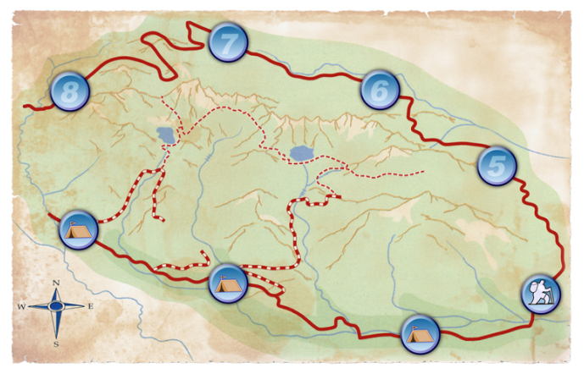
MODULE 4
How You See Me
27
Notes:
So we’ve talked about how you show up. Now let’s go into how others see you.

Slide 47
INTENT AND IMPACT
INTENT
IMPACT
Your behavior makes an IMPACT.
When your IMPACT is positive, credibility increases; over time this builds trust and respect.
When your IMPACT is negative, credibility decreases; over time this breaks down trust and respect.
TOXIC
28
Notes:
Everyone has a certain way that they like to do things.
We do what we do because we think it’s the best way to do things. Let’s step through the bullets on 28.
(step through bullets)
Everything you do every day involves someone, impacts them, and influences them.
Think about the girl in the theater from my believes, perceptions and behavior example: what do you think my impact was on her and her dad? Probably very negative.
How many times have you been at the checkout at the grocery store, and the clerk is not overly friendly? There intent could be to get you through the line as quickly as possible. But the impact could be that they come across as cold, or uncaring since they didn’t try to make small talk or seem friendly at all.
Which do you think is more important, intent or impact?
Answer: Impact. Others don’t know your intent. Any guesses on what percent of the time others are going to guess negatively about your intent?
In the absence of information, others are going to assume negative intent 92% of the time.
In order to be effective, your intent must equal your impact.

Slide 48
TWO KEY POINTS
You need to know your IMPACT.
1
People will guess your INTENT based upon your IMPACT so…
Even if your INTENT is positive your IMPACT could be negative.
You can choose behaviors that create positive IMPACT.
2
29
Notes:
Step through points on slide. Have class fill in blanks on 29.
You’ll know #1 through the “As Others See Me Profile” that we’ll do here in a bit, and you can also learn it through conversations with others.
People will use their beliefs, perceptions and values to asses your impact.
We can assume positive intent. But more often than not, we assume negative intent. Your intent does not always equal your impact.

Slide 49
“As Others See Me” Profile
Notes:
Have you ever wondered what your impact is on other people?
If we’re able to understand and recognize our impact, then we can situationally, intentionallly and temporarily modify our behavior to create positive impact, which increases credibility, which builds trust and respect.
Completing the “As Others See Me” profile will provide you with insight into the impact your behavior has on others.
Ask how everyone did. Was anyone dead on? (do you work closely with this person) Was anyone way off? (do you work with this person?)
So what does this tell us? If we are aware of our impact, we can choose behaviors that build credibility, trust and respect.

Slide 50
IMPACT AND CREDIBILITY ACTIVITY
Notes:
**need to figure out how we want to do this (at tables, or in groups)
Tell participants to go to page 31.
Read what the other three behavior styles have to say about your behavior style. Highlight words that resonate with you, so that you’re more aware of how you’re being perceived by the other styles.

Slide 51
Break
10 minutes

Slide 52
ACTIVITY: HOW WE PERCEIVE
1
Get into table groups by style.
Answer all questions in the assigned box from page 34.
2
Have a scribe write your answers on page 35.
3
Be prepared to share your answers with other groups.
4
34
Notes:
Now we’re going to help each other understand more about our behavior style and how different styles can perceive things differently.
Step through bullets on slide.
*either select one box for everyone to answer, or have them answer two from each box.
Once everyone’s done, go around the room to get answers, and have other groups ask questions.

Slide 53
OBJECTIVES REVIEW
DAY ONE FOCUS
1
Know your behavior style and how you impact others
Understand the differences between behavior and personality, and how/why behavior is situational
2
3
Gain awareness of and identify four behavior patterns
Explore two dimensions of behavior in terms of how you use energy when working with others
4
Discover how others experience you and how intent versus impact could influence perceptions
5
4
Notes:
Page iv in Workbook
So in order to create that trust in respect in your relationships, here’s what we’re going to be doing throughout today.
Day 1 = all about you
* If doing the full course ===> Day 2 = all about others

Slide 54
People Skills
NETC 2017
Bonus material from Day Two content

Slide 55
TEAM DISTRIBUTION PROFILE
T A S K E N E R G Y
A-A
A-C
C-A
C-C
IMPLEMENTING
E NE RGY
I NI TI ATI NG ENERGY
A-S
A-P
C-S
C-P
S-A
S-C
P-A
P-C
S-S
S-P
P-S
P-P
R E L A T I O N A L E N E R G Y
5.11
Notes:
Transition:
We have been exploring ourselves and the ways in which we can quickly perceive the Behavior Style preferences of other people. We’re now going to look at how behavior styles preferences can impact a team.
Do this first, then do one real time with the class.
(click –build 1)
Is this team primarily left or right of the midline? What does that mean in terms of behavior?
Is this team primarily above or below the midline? What does this mean in terms of behavior?
How will this team generally respond to conflict?
What does this team probably do well?
What is the probable quality of work?
What are the team’s likely blindspots or challenges?
(click – build 2)
What could happen when this person joins the team?
How could the rest of the team perceive this new member if trust and respect are not built?
What might happen if trust and respect are built between this person and the other team members?
What potential benefits does the new member bring to the team?
(click – build 3)
What could happen when this person joins the team? How could the rest of the team perceive this new member?
What potential benefits does the new member bring to the team?
Summary
It is advantageous to have all Behavior Styles on a team.
The addition of a person with a Behavior Style new to a team does not mean ineveitable conflict. On the contrary, they could help create an increase in productivity and harmony. However, his/her integration and perceived value by the group hinges on his/her ability, and each team member’s ability, to develop trust and respect with each other. Otherwise, the team may isolate and exclude the newcomer.
Let’s talk about bridge styles:
Bridge styles occupy the four inner squares of the distribution: C-S, P-A, S-C, and A-P.
They are called bridge styles because they are able to bridge communication between styles which would naturally have a more challenging time “speaking others’ language”
These styles have a unique characteristic that allows for bridging: they demonstrate seemingly opposite behaviors.
We say that a bridge style possesses learned behaviors because the person with this style most likely has a dominant (natural) style and has learned to behave consistent with a diagonal style for specific purposes. For example, a financial analyst with an analyzer preference who has had to, throughout his career, make dynamic presentations of his/her work that requires persuader energy and regularly engage with a sales team with mostly persuader preferences.
Those with bridge styles can be excellent communicators within and between teams. For this reason, it’s helpful to identify any teammates who regularly demonstrate bridge style behaviors.
Have each table create a team profile based on their primary and secondary behavior styles. Have tables discuss their strengths/weaknesses/dynamics/etc.

Slide 56
CONSEQUENCES SCHEMA
WIN-WIN
Share talents, skills and expertise
Positive effect on trust and respect
Meet
STYLE NEEDS
CHOICE
Deny
Tension-reaction behavior instinctive and reactive
Spiraling deterioration
of relationship
LOSE-LOSE
6.2
Notes:
Transition:
Yesterday and today we’ve been building our awareness of Behavior Styles. Now we’re going to look at the specific needs of each style and how to meet those needs. This information will help give you options and choices to build trust and respect.
(Build out win-win)
When we choose to apply what we’ve learned and meet the needs of others, we will create a positive effect on trust and respect. This choice will ultimately lead to the sharing of talents, skills and expertise. In this scenario, both parties win.
(Build out lose-lose)
When we don’t apply what we’ve learned and deny the needs of others, we will create tension-reaction behaviors. This choice will eventually lead to a spiraling deterioration of the relationship where both parties lose.
It is important to keep in mind that when one party “wins” and another “loses,” the situation will eventually become “lose/lose” because at some point the “loser” will find a way to “even the score.”
Examples:
Withdraw support
Not share information that would be helpful
Dismiss your ideas
Work “behind the scenes” to undermine your success
Make you or your ideas look bad in front of your boss
“Evening the score” may not mean actively trying to get revenge; it can also be accomplished through passive-aggressive behavior

Slide 57
TWO VARIABLES
There are two important variables that influence what you will do under tension:
CORE
Family of Origin
Cultural Norms
Personal Belief System
World View
SITUATIONAL
What is happening?
Who is the person involved?
Who else is present or involved?
Where is this happening?
What is my current energy level?
1
2
7.3
Notes:
Transition
There are two variables that influence tension.
There are core values:
Family of Origin refers to the norms established in our families as we were growing up. Because these were instilled in us from the beginning of our lives, they sometimes consciously affect our tension responses.
i.e., being raised in a family where conflicts were never discussed may affect someone’s ability to participate in conversations where conflict exists
Cultural Norms refers to how the culture you are in, be it geographic or corporate, can influence how you respond to tension.
i.e., depending on the country or company in which you are working, there may be cultural norms that either support or discourage an open expression of disappointment towards another person.
Personal Belief System refers to how we believe interpersonal tension should be addressed based on the experiential, spiritual and/or religious beliefs we have.
i.e., Someone may believe that is it ungracious and harsh to openly express his/her feelings of frustration toward another person, while someone else may believe such an act is a demonstration of trust and honor.
World view refers to the different ways people may perceive the behavior of others based upon their ethnic and/or racial background.
i.e., a person may have a perception about behavior norms of a specific ethnic group and how they should respond to tension when interacting with a person of that ethnicity.
Note: this list of core values is not intended to be exhaustive, and some of these may overlap. For example, my Family of Origin variables may also show up in any or all of the other three Core Variables. Reinforce that Core Variables will influence our tension behaviors but typically require a deeper level of awareness and more conscious effort before they can be changed. (i.e., they are “below the waterline”).
There are also situational variables:
These five Situational Variables are always present and changing, and they heavily influence our tension-reaction behaviors.
Example 1 – I have hard evidence that a direct report has been making career damaging false accusations about me behind my back. After thinking about it overnight, I have called them into my office for a meeting to discuss what I heard. My HR rep knows about the accusations and is present at the meeting.
Example 2 – I have been accused by a former colleague of inappropriate behavior. I’m standing on the front steps of the company at the end of the day and a reporter is asking me questions about the charges with a microphone and a live camera is being locally broadcast.

Slide 58
Break
10 minutes

Slide 59
VIDEO
7.5
Notes:
This video will help you gain insight into the initial tension-reaction responses of each behavior style. Tension-reaction responses are not the same as a proactive response, which is flexibility.
Take notes on page 7.5 of the workbook, but do not pay attention to the page references mentioned in the video.

Slide 60
INITIAL TENSION-REACTION BEHAVIOR
WITHDRAW
DICTATE
E
M
O
T
I
O
N
S
A
C
R E S U L T S
R E S U L T S
S
P
E
M
O
T
I
O
N
S
ACQUIESCE
VERBAL ATTACK
7.5
Notes:
Build 1 – this is the comfort zone of the Controller without tension-free behavior (the natural “iceberg” behavior)
Build 2 – This illustrates a controller not having their style needs met and getting pushed out of his/her comfort zone. (click) This triggers initial tension-reaction behavior in an effort to get back into their comfort zone.
Build 3 – The controller’s initial tension-reaction response is to overextend their normal behavior and get both overly emotionally controlled and extremely expedient focused. This will give them a perception that they have control over results again, which is their major focus.
Build 4 – This behavior is as taking control or dictating.
Step through other behavior styles in the other builds:
Review the style (focus, results)
Push them out somehow
They will try to get back in
When you’re pushed outside of your comfort zone, you use your strengths to get back in (until they become weaknesses)
Controllers become more assertive and more aggressive; they become more controlled and move even faster
Persuaders become more aggressive and more emotional; they become more emotional and move even faster
Stabilizers put more systems in place and have a greater need for people; they become more emotional and move even slower
Analyzers put more systems in place and become more responsive; they become more controlled and move even slower
When you realize there’s no way out with dignity, you’ll go to the extremes
Will demonstrate (name the behavior)
If you won’t meet my needs, I’ll meet my needs
You don’t see it because you’re not aware of your impact
No access to talents, skills and knowledge
It’s predictable to everyone else, but not ourselves
You don’t realize you’re violating the needs of the other styles
Talk about what they do to themselves afterwards

Slide 61
BEHAVIOR STYLE NEEDS
TASK
ANALYZER
Driving Need: To get it right
Additional needs:
Precision and accuracy
Time for decisions
Detailed explanations
To know the rules
Flag Word: ______________
CONTROLLER
Driving Need: To be in control
Additional needs:
Options
To make decisions
Action and results
To win
Flag Word: ______________
ANALYZER
Driving Need: To get it right
Additional needs:
Precision and accuracy
Time for decisions
Detailed explanations
To know the rules
Flag Word: ______________
ANALYZER
Driving Need: To get it right
Additional needs:
Precision and accuracy
Time for decisions
Detailed explanations
To know the rules
Flag Word: ______________
A
E M
O
T
I
O
N
S
I
M
P
L
E
M
E N T
I
N
I
T
I
A
T E
Analyzer
WHY
WHAT
RESULTS
RESULTS
STABILIZER
Driving Need: Security
Additional needs:
Guarantees
Agreement
Appreciation
To avoid conflict
Flag Words: ______________ ______________ ______________
PERSUADER
Driving Need: To be liked
Additional needs:
Recognition and praise
To work with others
Incentives
To touch
Flag Word: ______________
E M
O
T
I
O
N
S
WHY
WHY
HOW
WHO
WHEN
WHERE
RESPONSIVE
6.3
Notes:
Step through bullets
A analyzer’s flag word is WHY.
If you knock on a analyzer’s office door, you wouldn’t necessarily hear him/her say “why?” However, once you were engaged in conversation with the analyzer, you’d likely hear him/her question the reason behind any action being discussed or suggested. Remember, the analyzer is focused on precision and accuracy. A question starting with the word why would naturally come from that focus.
**see page 6.7 of facilitator’s manual for examples**

Slide 62
TWO VARIABLES
There are two important variables that influence what you will do under tension:
CORE
Family of Origin
Cultural Norms
Personal Belief System
World View
SITUATIONAL
What is happening?
Who is the person involved?
Who else is present or involved?
Where is this happening?
What is my current energy level?
1
2
Notes:
Now we’re going to focus on the situational variables.
Moving to that 4th level of tension-reaction behavior greatly depends upon the situational variables.
Remember:
When I move to #2, it’s easier to change the way I deal with me than how I deal with you, so that’s the emotional dimension.
When I move to #3, I’m saying I’ll change the way I deal with you.
When I move to #4, that means a core value has been violated.
Persuaders give away trust.
Analyzers want to be in integrity
Stabilizers’ greatest core value is loyalty
Controllers’ want respect.
When you get to that 4th level, there is a
Physical breakdown of the human body
Serious illness, accident, injury or deal is imminent.
Again, this course is all about making you aware of these things, and letting you know of some options to keep this from happening.

Slide 63
SITUATIONAL RESPONSES
Withdraw
Take Control
E M
O
T
I
O
N
S
A
C
RESULTS
RESULTS
S
P
E M
O
T
I
O
N
S
Acquiesce
Verbal Attack
Notes:
So here are our four quadrants with their four behavior styles.
(click) Here are their tension-reaction behaviors in the corners.
Let’s say I’m a controller and I’m dependent upon other team members to help me complete a project that’s important to me. My other teammates have been uncooperative, and my boss comes to me and says that this is a high priority and to get it done ASAP.
Normally, the first thing I’m going to do is take control, so I might go over the head of the project manager or team leader and take full control of the project.
If that doesn’t work, I’m going to change the way I deal with me and my emotions, so I might come down here and verbally attack some fellow teammates and tell them what they’ve done wrong.
If that doesn’t work, I’m going to change the way I deal with you and withdraw all together until I know I can stand my ground with facts and data and without emotions.
The last thing I’m going to do is acquiesce… give in and just go along with whatever the group decides because it’s not worth it anymore to try and prove my point.
Now your order may change based on the situational variables. I could just go straight to verbal attack, or I could just withdraw; it all depends.

Slide 64
SITUATIONAL RESPONSES
WITHDRAW
2
Withdraw
Take Control
E M
O
T
I
O
N
S
A
C
TAKE CONTROL
3
RESULTS
RESULTS
S
P
4
VERBAL ATTACK
E M
O
T
I
O
N
S
ACQUIESCE
1
Acquiesce
Verbal Attack
7.8
Notes:
Turn to page 7.8 in your workbook, and fill in the order of the situational responses that you’re most likely to follow. For example, you may acquiesce first, withdraw next, take control, and then verbal attack last.
If you’re not sure, you can always fill in your #1 and #4 first, then decide on #2 and #3.
Allow 2 minutes.

Slide 65
Break
10 minutes

Slide 66
FINAL REFLECTION
Review your answer to the Ice Breaker from earlier this morning. Reflect on what you have learned that will be helpful in managing those frustrations.
Select 2 specific actions you will take and record them on the People Skills Action Plan, page 8.11.
Share one commitment at your table.
Complete course evaluation.
Notes:
Step through bullets. Have class fill out page 8.11.

Slide 67
Questions?
Jonathan B. Hardy – jonathan.hardy@uga.edu
Patrick Wagman – patrick.wagman@ucr.edu

Slide 68
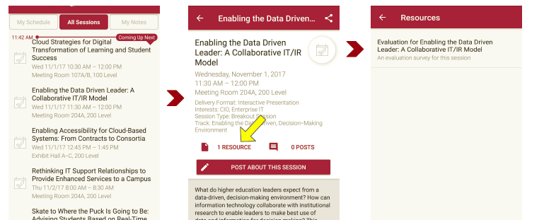
Please take a moment to evaluate this session
There are two ways to access the session and presenter evaluations:
1
2
In the online agenda, click on the “Evaluate Session” link
From the mobile app, click on the session you want from the schedule > then click the associated resources > and the evaluation will pop up in the list

