Slide 1
Why I Need IT to Survive in Higher Ed

Slide 2
How do I see the world around me??
Notes:
In my quest to help everyone appreciate why I need IT, I going to talk a little bit about how we see the world around us, and how that world affects our expectations and worldview.
We begin with the basic question….”How do I see the world around me?”
….

Slide 3
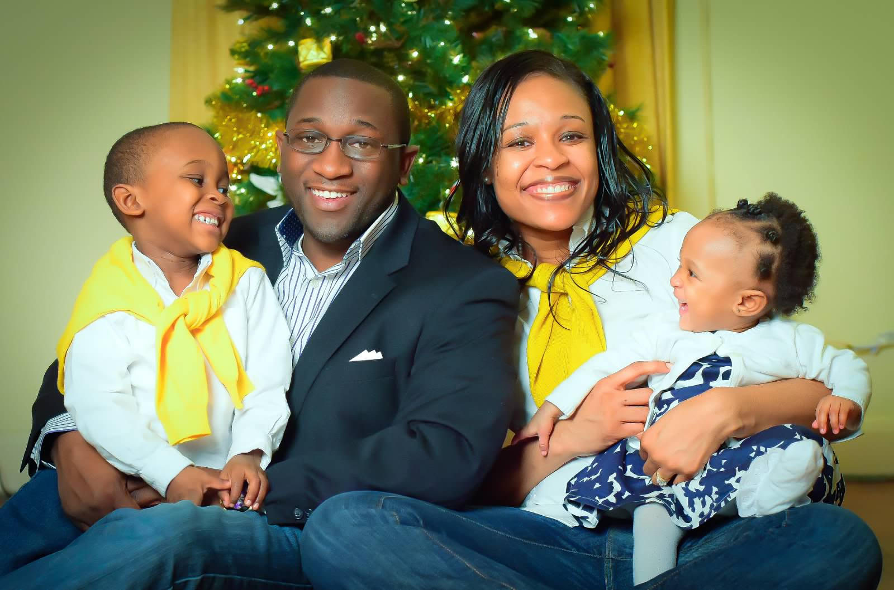
Notes:
I mean think about it....
Take this picture of the my family. This is a picture that we took last christmas, and it's hanging up on my wall in my office.
When people see this picture they automatically think awww what a beautiful family. They also say themselves that there is a wholesome family man - he must love his kids and his wife.
You in turn might expect me to say beautiful things about them when reality is I love those jokers - but I think my kids parasites.
Think about it they are living organisms that attach themselves to other living organisms and suck the life out of them all for the purposes of their own survival.
And my wife is the ringleader of the group because I swear the most popular statement in my house is “go talk to your father”
However, based how you saw me that may not be what you would have expected me to say about them
But when I look in the mirror this is what I see of myself

Slide 4
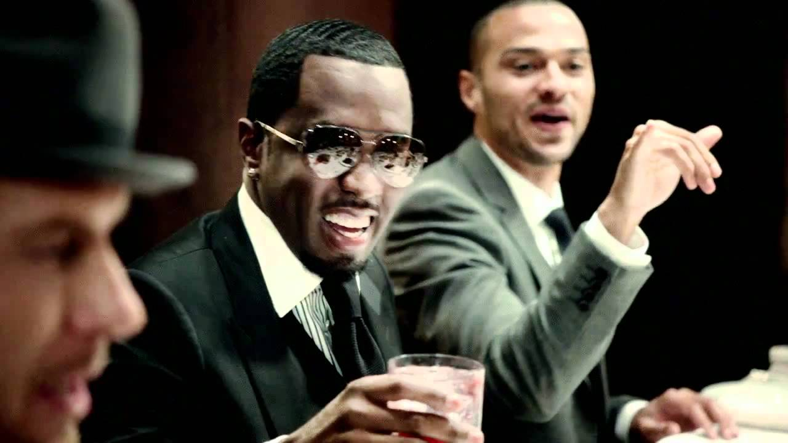
Notes:
Diddy….
Who else but diddy could pull off wearing shades at an indoor party. Like who wouldn’t want to be that guy
But again right this is how I see myself in the world. So as a result now only do I think that I'm cool not only do I think that I'm in touch with what's going on around me and fashionable, I also have a set of expectations for myself right?
I expect myself to be up on the latest trends, I expect myself to always be knowledgeable what was going around in my sphere I expect myself to be able to throw a hell of a party in a moments notice.
The point here being - how you see the world around you and how you see yourself in that world changes what you think about yourself and what expectations you carry.
But again, while this is what I see when I look in the mirror, when my students look at me, here's what they see

Slide 5
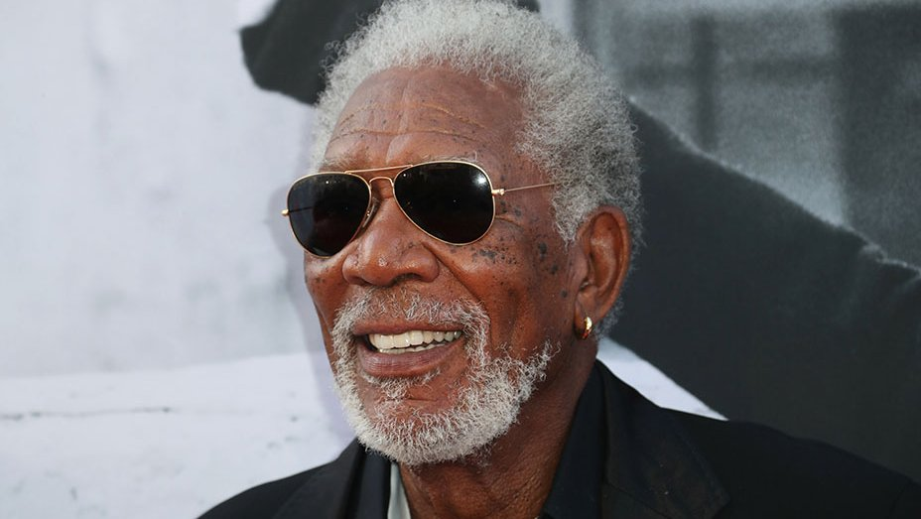
Notes:
Good Ol Mr. Shawshannk Redemption --- Morgan Freeman
I'm in my early 30s yet they think I'm some out of date grandfather who couldn't possibly understand the realities of their world today.
While they have lofty expectations about their higher education experience, because this is how they see me - they don't want to talk to me because they think that I won't be able to connect with them.
They expect that I won't have the answers to meet their technological demands, so instead of trying to talk with me and partner with me they'd rather point and complain.
While I could be upset about this fact I'm not. Why? Because I think we created that environment for them to look at us is outdated to look at us as being out of touch.

Slide 6
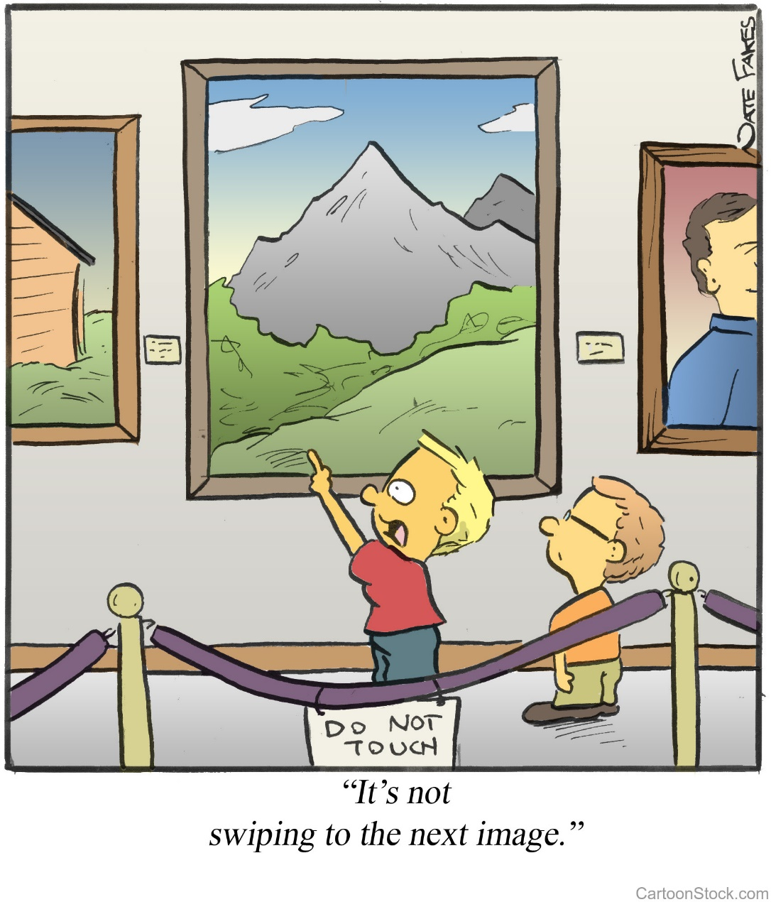
Notes:
STOP ME if you’ve seen this before
While I know all of this, it didn’t truly crystalize for me until about a year ago
You see, I my preparation for Freshmen spring registration, I had the bright idea…”Lets meet them where they are” so I setup satellite registration booths all over campus….the student center, dorms, cafeterias….if it was a place where they hung out, I was there.
And on this particular day I witnessed a student walk up to the kiosk and attempt to register. Having difficulty he came over to the support table that we had setup and said “ excuse…I think something wrong with the computer. I said yeah no problem I can help you…we walk over the computer and I say ok show me what me what going on.
The student proceeds to say, “everytime I touch the Internet Explorer icon” its not working. I looked at him and said “Did ya try the mouse?”
Now to appreciate this moment, you have to understand the type of population I serve. Some of these students are some of the brightest students in the world. We prid eourselves on saying, some of our students have perfect SAT scores. And in that moment, the only thing I could think of was “perfect score huh?
However, I had to catch myself, because in that moment I realized, I judged him for his ignorance, before addressing my own. Its not his fault that most of the PUBLIC kioks hes every worked with touchscreen. It was mine for NOT recognizing that.
And that’s what started me on my path to saying “I need to understand my students and the landscape a little better and that understanding started with technology.

Slide 7
Notes:
You see, Technology has evolved dramatically over the past 185 years from the computer based punch cards of 1832 to the voice-controlled personal assistants of today.
Thanks to people like you, Technology has effectively changed our everyday worlds, learning structures, and expectations
Which lead me to my first true guiding principal of my career understanding Needs vs. Expectations as it relates to the student experience

Slide 8
Need vs. Expectations
Needs
Courses
Advisors
Library
Buildings/Classrooms
Expectations
Register Online and Textbooks
Skype/Chat Sessions
Voice-enabled reservations
Wifi/USB powered enabled seats
Notes:
Any school worth their salt…

Slide 9
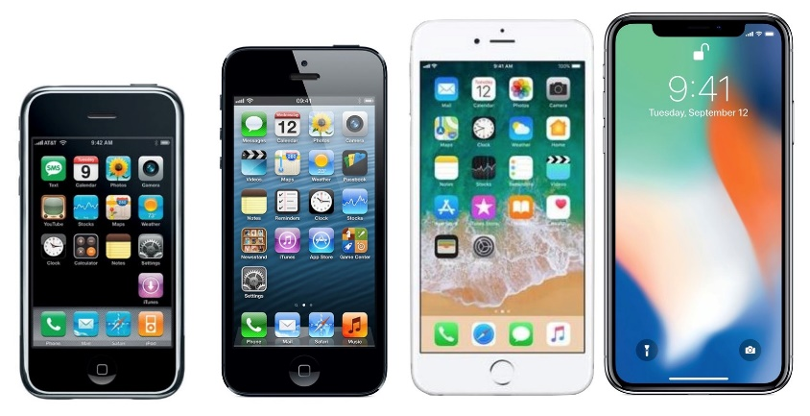
Generation Z/iGen (1995-2012)
Notes:
If you havenet noticed, since 2013, many of us have been dealing with a completely new generation of Student on our campuses…Generation Z or the iGen student
These are students born between 1995 and 2012, and would have hit your campuses right around 2013.
They are very active, optionated, and spends more of their time on mobile devices instead of latops, tablets, and desktops like the previous generations
But ireally what to focus on the kind of world they entered
2006 – Facebook made available to the public to anyone 13 or older
Likely had an account for 5-10 years – THUS social media plays a HUGE role in their lives
2007 – First iPhone was released
Likely in 1st Grade/Kindergarten – theve never known the cell phone s with the neon green screens that you could play snake on or the old flip phones
Netflix, Amazon, and Google are all older than most undergraduates
Internet has always existed
Our students live a Digital Life

Slide 10
Notes:
Walk into a daycare in today and its not far fetched to see an image like this.
My princess Madison can not only order up her favorite activity on my cell phone, she knows how to use the voice remote to order up on-demand episodes of Sofia the Princess on the TV..

Slide 11
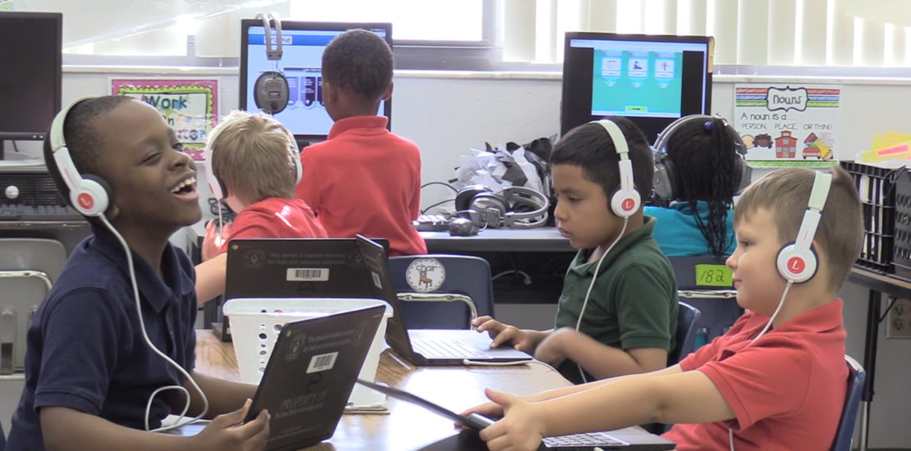
Notes:
This may be a stock photo, but I kid you not, this is what my son’s 2nd grade classroom looks like.
My son is in the 2nd grade and hes already learning how to type in addition to being exposed to coding.
This morgan freeman look a like didn’t have his 1st typing class until my sophomore yr in high school
The GAME HAS CHANGED Ladies and gentlemen, and there are new players coming in
But one of the coaches to me with my strategy since 2013 has been IT.

Slide 12
My IT Guy
Notes:
Before that moment, my IT collegues were valueable, but regulated them to be no better than pizza deliver folks.
I call up, place an order, give minimal instructions, and expect it to be delivered in a reasonable time frame.
Every now and again id call and say…”Where’s my pizza?” But ultimately, they'd deliver and it was see ya until the next time.

Slide 13
The Dawn of Collaboration
Notes:
After this moment everything shifted – I no longer viewed our relationship as transactional; in turn it became truly collaborative and our students were the biggest benefactors.
From an administrative standpoint
Our teams instituted monthly joint team meetings
I became a dedicated tester for new software and SIS upgrades
I started being invited to concept meetings and product demos
As proof, you can see that they even drafted an article about me and our partnerships

Slide 14
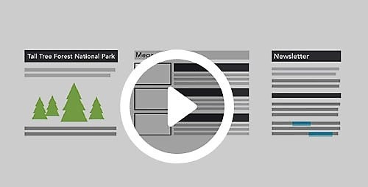
Career of Innovation
Notes:
From a Student standpoint I was finally able to turn that corner and finally begin to not only meet students needs but their expectations
I was able to implement online transcripts
Create a new ticketing system where I reduced time to resolution by 30%
Created virtual classrooms where students could watch videos instead of reading through long instructional
Develop digital degree audit solutions for students
And today, I sponsor Hackathons and partner with graduate students to develop apps and tools to further the student experience
Its safe to say, my relationship with IT transformed not only the student experience at my various institutions, but also my career.
Today, in addition to being a progressive student centered leader I am a strong advocate for the collaborative relationship with between end-users and developers, always ensuring that members of my IT teams are always represented whenever we are discussing new student initiatives and programs.

Slide 15
How do I see the world around me??
Notes:
Today with my IT friends…I think the world around me looks pretty cool.
I cant wait to see what we do next.

