Slide 1
Bill’s Visit
Timothy M. Renick, Ph.D.
Sr. Vice President for Student Success
Georgia State University

Slide 2
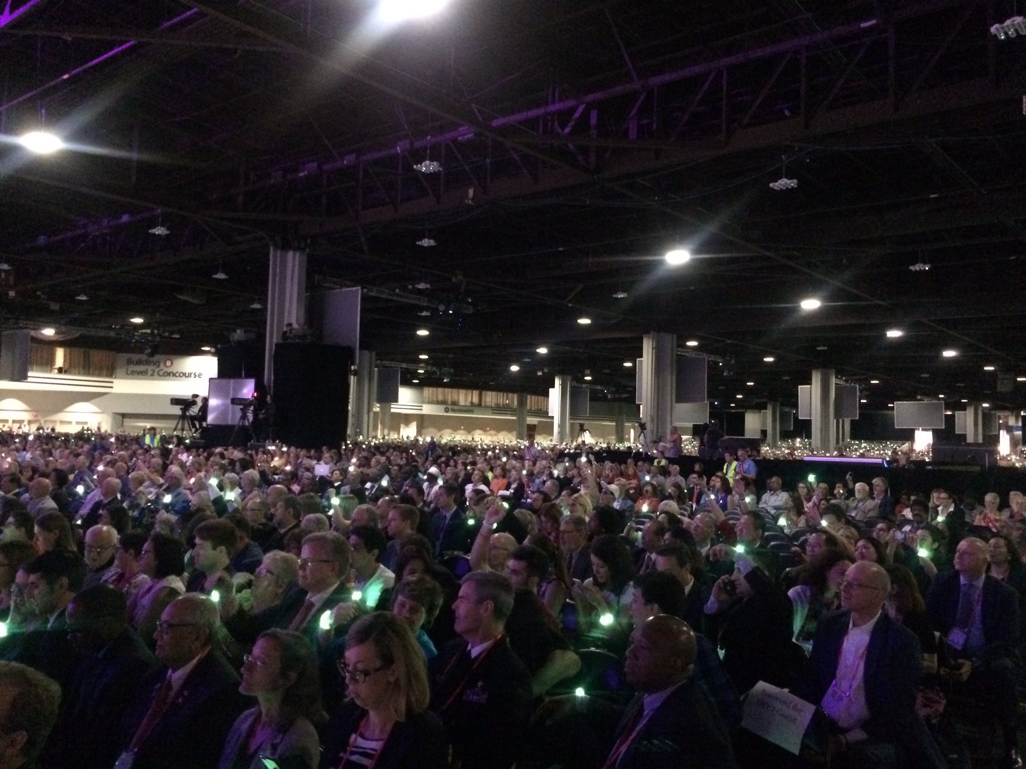
Overwhelming Choices

Slide 3
Overwhelming Choices

Slide 4
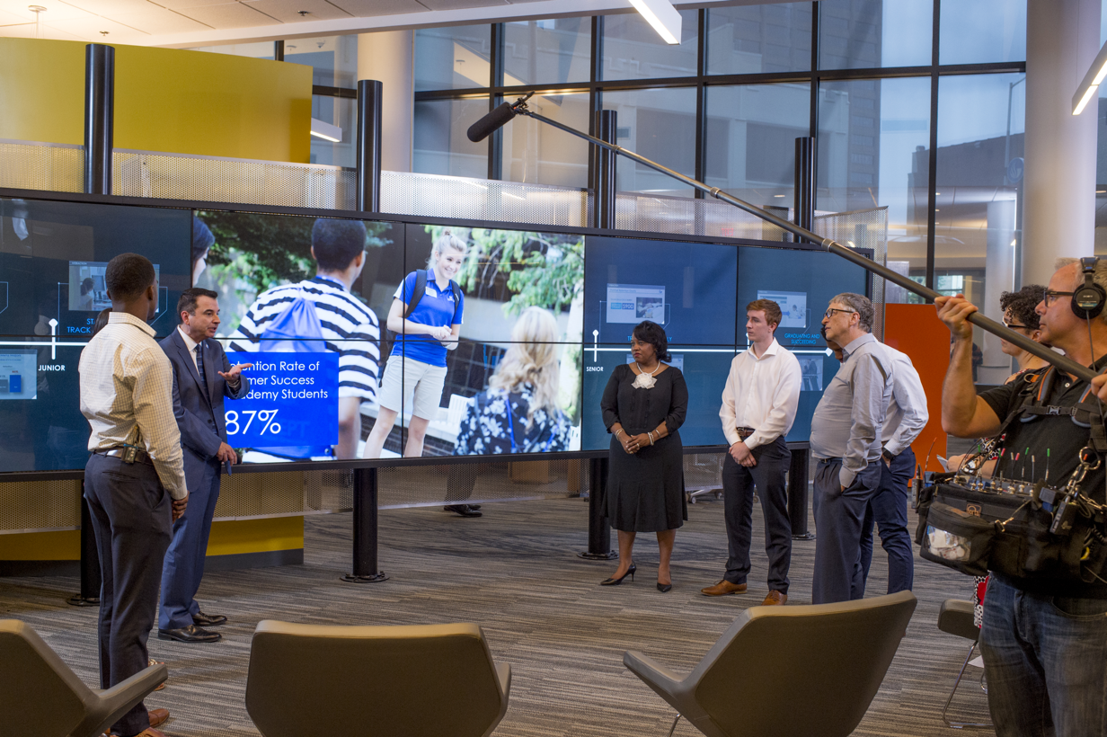
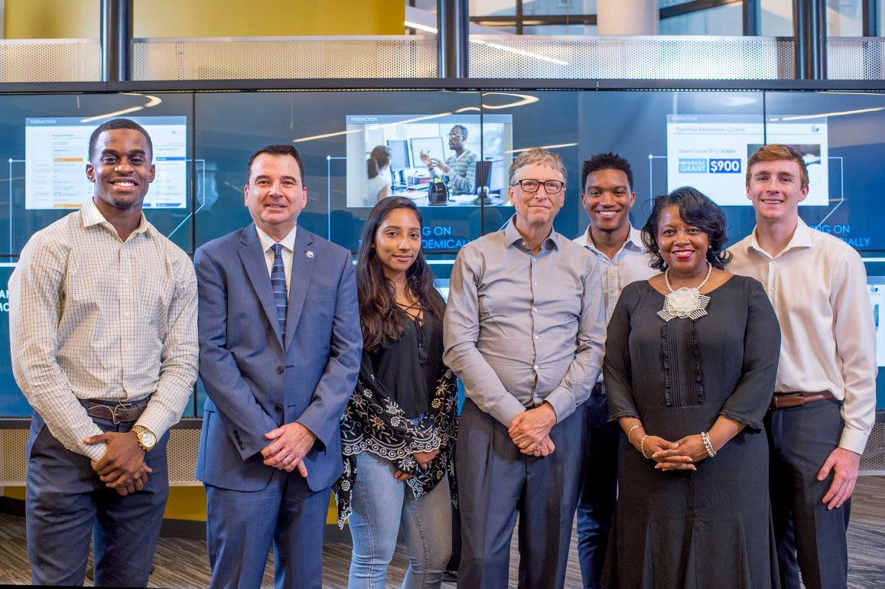
Overwhelming Choices

Slide 5
Overwhelming Choices

Slide 6
19%
Percent of Confirmed Freshmen Who Did Not Enroll Summer 2015

Slide 7
278
Students
78% Non white
71% Low Income
3.34 High School GPA

Slide 8
The Hidden Obstacles to Enrollment

Slide 9
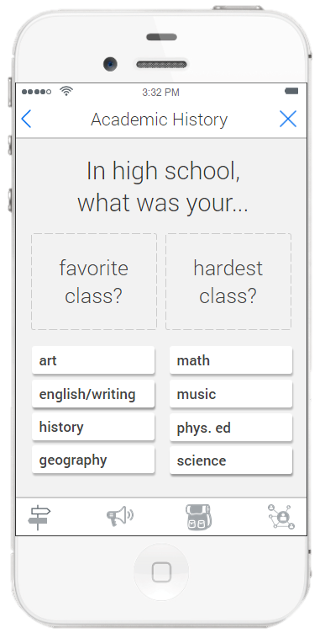
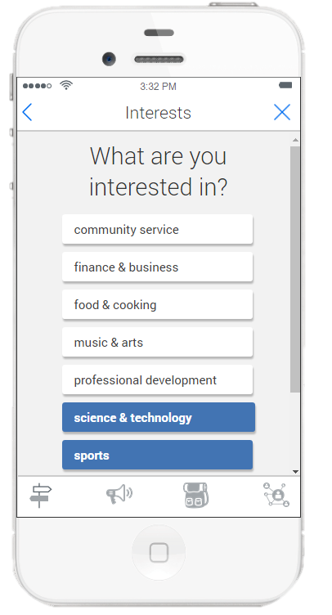

Slide 10
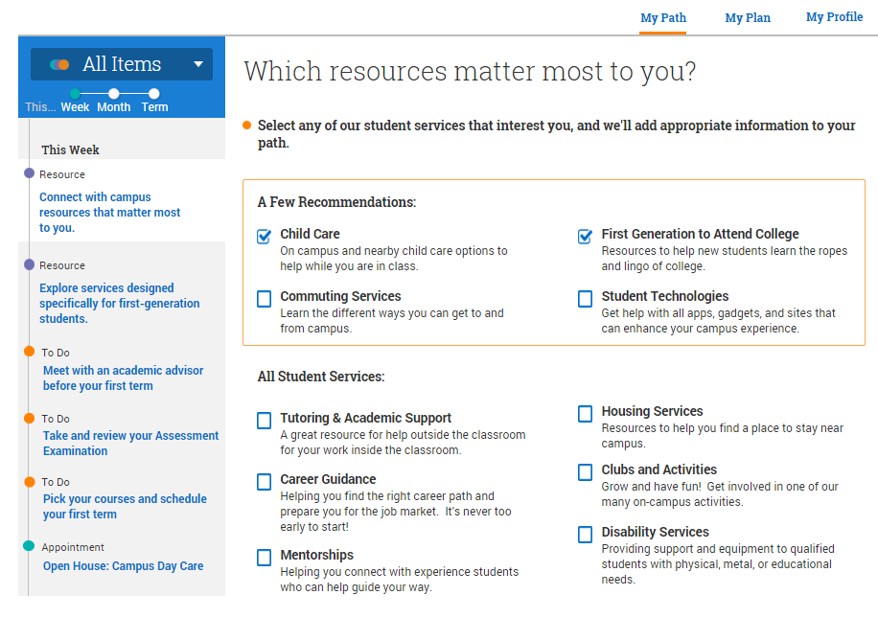
EAB Navigate

Slide 11
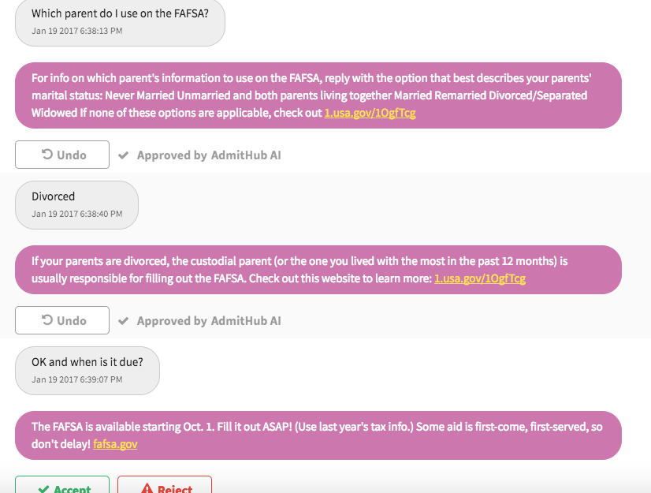

Slide 12
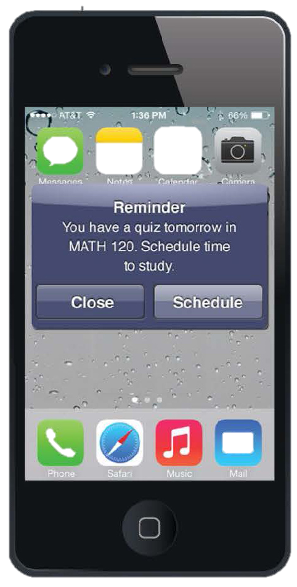
201,000

Slide 13
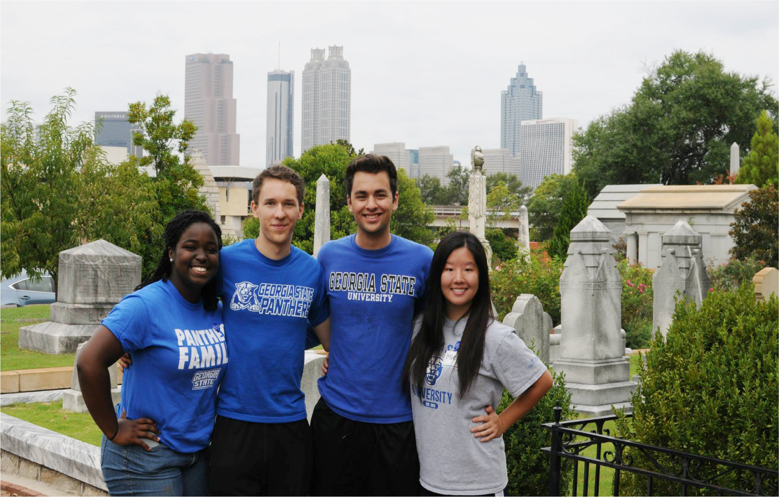
One-Year Drop in Summer Melt: 22%
+324
Students

Slide 14
Overwhelming Choices

Slide 15
Overwhelming Choices

Slide 16
Overwhelming Choices

