Slide 1
Digital Transformation in Higher Education:
What it Means for You
PRESENTED BY:
Brendan Aldrich • Josie DeBaere • Joe Moreau
Betsy Reinitz • Karen Wetzel
Notes:
Betsy starts. 1:30-1:35 to get through slide 6

Slide 2
Our goals for you
Understand what Dx means for higher education
Understand how the role of IT and its workforce is changing in response to an anticipation of Dx
Take specific steps to help your institutions prepare for Dx
Notes:
Betsy

Slide 3
Today’s presenters
Members of the
Digital Transformation Task Force
Brendan Aldrich
Chief Data Officer
California State University
Office of the Chancellor
Josie DeBaere
Director of Technology Architecture
Boston University
Joe Moreau
Vice Chancellor of Technology and CTO
Foothill-DeAnza Community College District
EDUCAUSE Staff
Betsy Reinitz
Director, Enterprise IT Program
EDUCAUSE
Karen Wetzel
Director, Working and Community Groups
EDUCAUSE
Notes:
Betsy will do a very quick intro for each person. Feel free to add more about yourself or your institutions when you’re speaking later.

Slide 4
Dx Task Force Goals
Develop a definition of digital transformation appropriate to higher education that could be used across EDUCAUSE programs and offerings
Issue recommendations for how EDUCAUSE should help its members understand the importance of digital transformation and position their institutions to move forward with it in areas such as IT organization and leadership, workforce and staffing, and analytics
Notes:
Betsy

Slide 5
Dx Definition
Digital transformation is a cultural, workforce, and technological shift.
In its cultural dimension, it requires
A new approach to how campus leaders interact with each other
An emphasis on change management
A movement toward institutional agility and flexibility to meet quickly changing needs
Dx requires dramatic shifts in workplace skills at all levels and professional development that enables the workforce to keep pace with the rapid tempo of change
Dx is being driven by technology trends and changes that enable new approaches that in turn propel new business models, improved student outcomes, different teaching and learning methods, and new research capabilities

Slide 6
From Disruption to Transformation
WE ARE HERE
Refine
Disrupt
Transform
Improving current technologies
Inventing new technologies, initial impact
Broad change and lasting Impact on industries, culture, people
Source: Adapted from Scenarios, Pathways, and the Future-Ready Workforce, Jim Phelps, EDUCAUSE Review, September/October 2018

Slide 7
But what does digital transformation really mean for higher ed?
Opportunities:
Why do you care? Why should our audience care?
Notes:
TIME 1:35-1:43
Brendan to start.
Task force members take turns with each question, riff on each other.

Slide 8
But what does digital transformation really mean for higher ed?
Implications:
What are the implications, both short and long term, for your institution?
Notes:
TIME 1:43-1:51
Joe to start.
Task force members take turns with each question, riff on each other.

Slide 9
But what does digital transformation really mean for higher ed?
Urgency:
What is the urgency for doing this work?
Notes:
TIME 1:51-1:59
Josie to start.
Task force members take turns with each question, riff on each other.

Slide 10
Discussion
First, jot down what Dx means for you, and what you plan to do when you return to your campus.
Then, let’s talk about it.
Notes:
TIME 1:59-2:10 for this whole part
Betsy kicks off with instructions. Have audience jot down what it means for them, and what they plan to do when you return to your campus. Turn to the person next to you and discuss your ideas (2 minutes?)
Then one of the task force member facilitates discussion
Ask for volunteers from 2-3 groups to report out about their conversation. Ask people to keep their comments brief so more people have a chance to participate.

Slide 11
EDUCAUSE Plans
Develop a 2019 Dx strategic goal
Adjust current EDUCAUSE resources to reflect Dx focus
Design and develop a webpage to house Dx resources: www.educause.edu/dx
Design and develop a Dx communication toolkit
Produce a series of products to focus on key areas of impact
Incorporate Dx in professional learning offerings
Address Dx through external relationships and partnerships
Notes:
TIME 2:10-2:15 to get to the end
Karen

Slide 12
Dx Next Steps
What can EDUCAUSE do to help you? We want to hear from you.
From any device, go to sli.do
Enter code U541
Enter your suggestions for what EDUCAUSE should do to help you move forward with Dx
Notes:
Karen

Slide 13
Dx Next Steps
New website, new materials, new toolkits, coming in 2019
Email: dx@educause.edu
Website: www.educause.edu/dx
EDUCAUSE Library Dx Topic Page
7 Things You Should Know about Digital Transformation
Contact us:
Betsy Reinitz breinitz@educause.edu
Karen Wetzel kwetzel@educause.edu
Brendan Aldrich brendan.aldrich@calstate.edu
Josie DeBaere jdebaere@bu.edu
Joe Moreau moreaujoseph@fhda.edu
Notes:
Karen

Slide 14
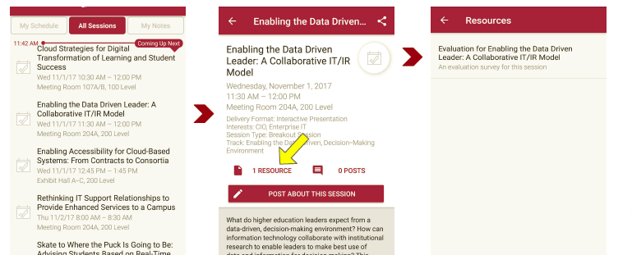
Please take a moment to evaluate this session There are two ways to access the session and presenter evaluations
1
2
In the online agenda, click on the “Evaluate Session” link
From the mobile app, click on the session you want from the schedule > then click the associated resources > and the evaluation will pop up in the list

