Slide 1
Custom Classroom Solutions for Unique Active Learning Challenges Julian Allen, PhD, Senior Director of Learning Innovations, Georgia State University
Lee Webster, Assistant Director, Learning Environments, Georgia State University

Slide 3
6 campuses, 52,000 students,
2016 full time & 1375 part time
instructors

Slide 4
Today’s Goals
Identify techniques for exploring unique teaching and learning challenges across disciplines
Match specific technology and furniture solutions to instructor and student needs
Develop a strategy for creating and evaluating a portfolio of learning spaces across campus
Identify campus partners to optimize learning space design and sustainability

Slide 5
541
instructional spaces
49
19
large lecture rooms
Computer classrooms
Notes:
Instructor reports low student engagement in a large lecture hall: Pedagogy? Technology?

Slide 6
Our Challenges
How to respond to unique teaching and learning needs through active classroom design?
What elements of a classroom are most effective at solving pedagogical challenges?
Lack of comprehensive classroom strategy at a University level.

Slide 7
Analyzing Teaching Requirements:
What questions would you ask?

Slide 8
In small group and one-on-one conversations, we asked:
Describe an activity you want your students to engage in.
How many students will typically work together at a time?
What methods do you use to engage your students?
Will all the students be engaging in the same activities at the same time?
Do students need access to a computer? Can they share?
Name one thing that’s unique in your teaching style.
How will you measure the success of your student engagement?

Slide 9
Unique Spaces for Unique Challenges

Slide 10
#1
Classroom Design Challenge

Slide 11
Pedagogical Program: Multi-Disciplinary Active Learning Room
Requirements
Solutions
Classroom must meet needs of lecturers
Must not lose seat count
Great for teams and individuals
Completed over a holiday break
Flexible for multiple disciplines
Rectangular tables can be aligned in straight rows
Used similarly-sized tables and chairs
Work-group displays attached to walls, but tables movable
Minimized overall room renovations not related to room requirements.
Multiple configurations documented

Slide 12
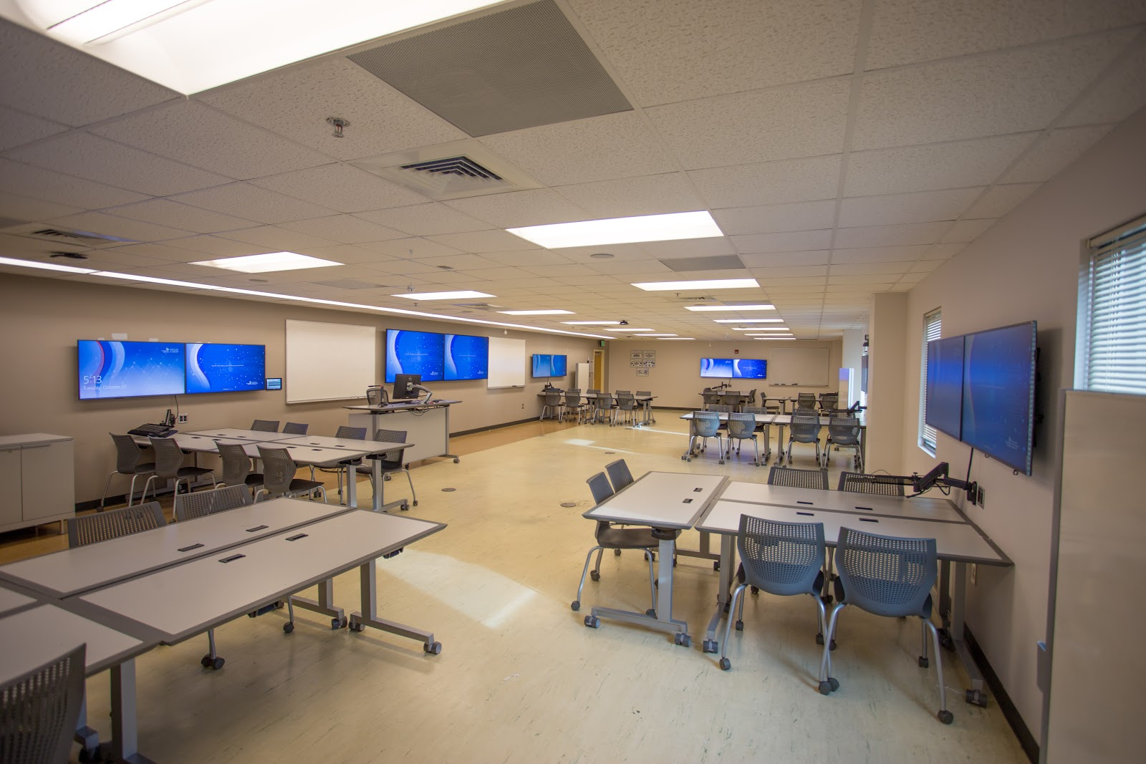
Notes:
An online class delivers lower student performance and lower grades. Technology or Pedagogy?

Slide 13
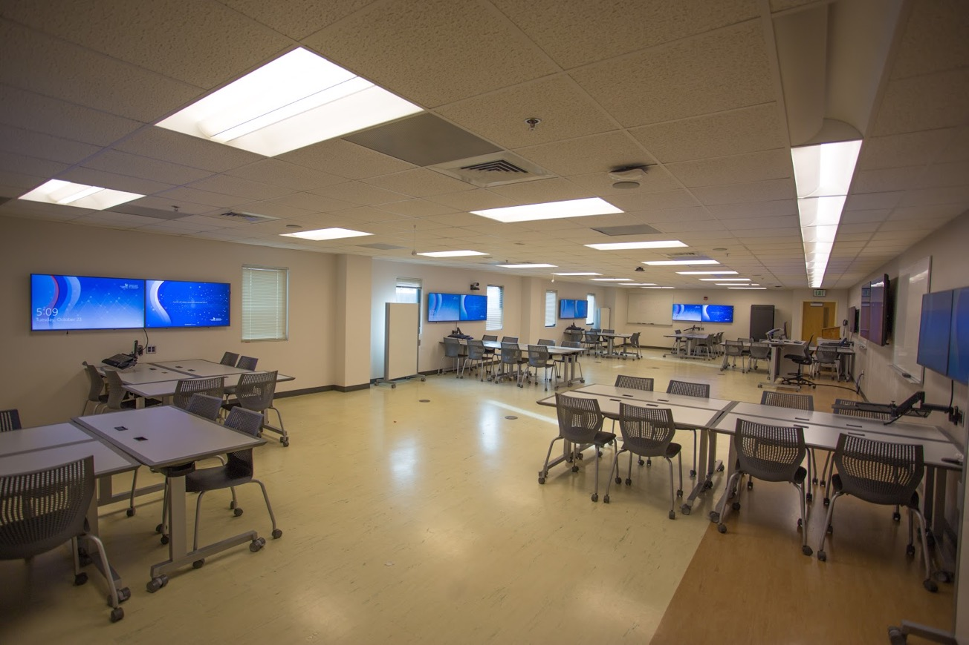
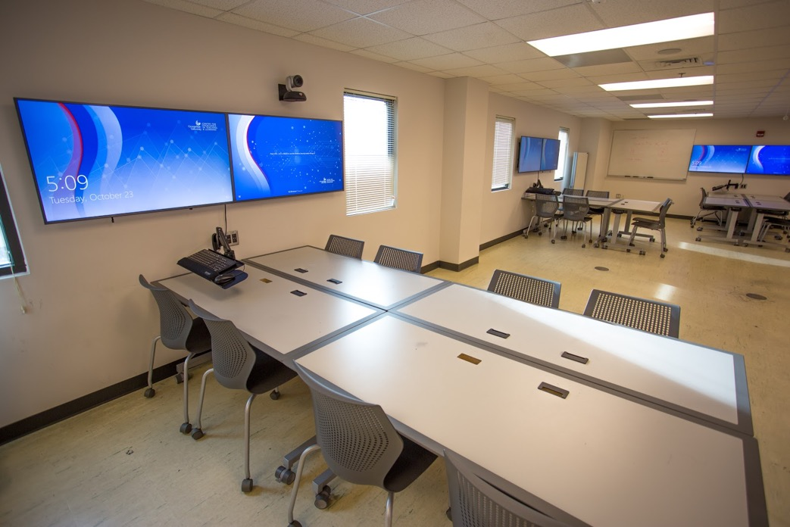
Notes:
An online class delivers lower student performance and lower grades. Technology or Pedagogy?

Slide 14
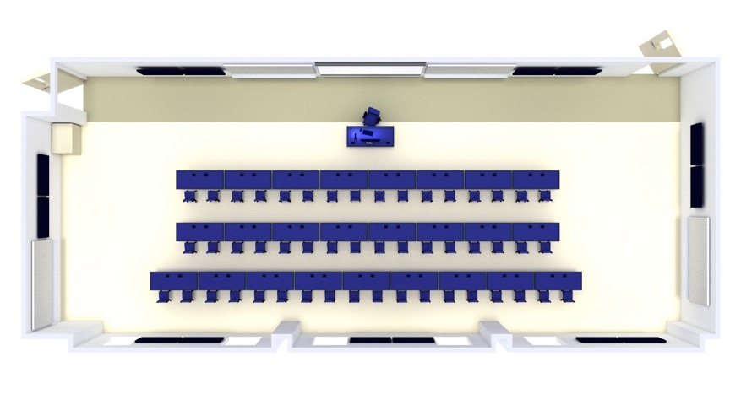
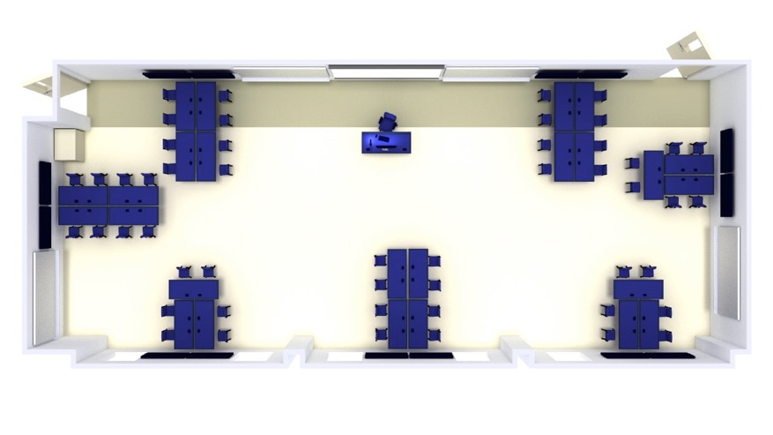
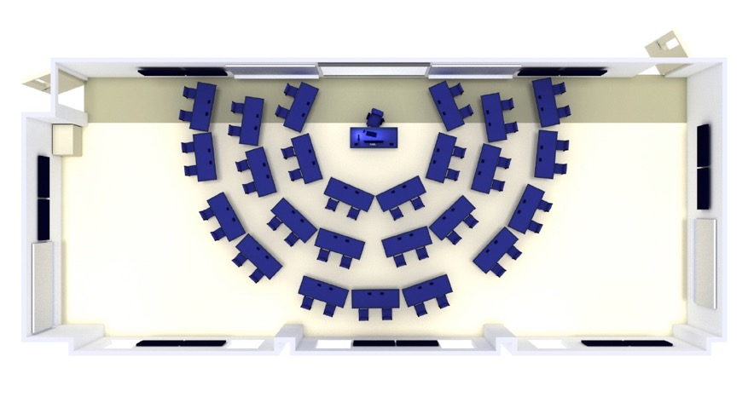
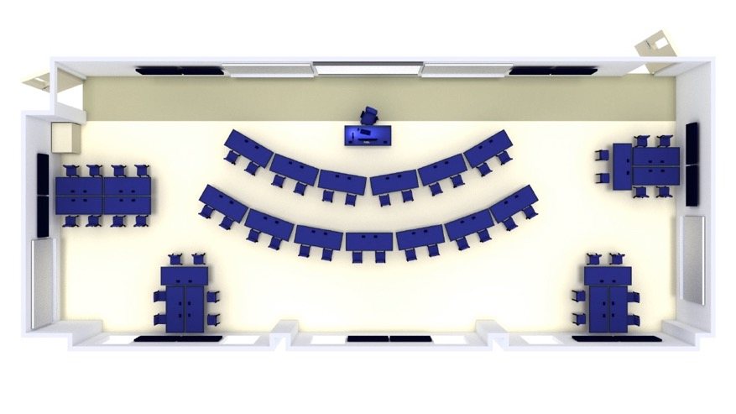
Notes:
An online class delivers lower student performance and lower grades. Technology or Pedagogy?

Slide 15
#2
Classroom Design Challenge

Slide 16
Pedagogical Program: Digital Literacy Classroom
Requirements
Solutions
Two existing classroom spaces; neither adequately meeting needs
25 students need access to computing
Sharing and collaboration spaces
Spaces to support phases of student projects
Removed solid wall, replaced with glass wall and sliding doors
Place computers tightly around room perimeter
Leave space for collaboration, use existing column as whiteboard
Turn smaller space into collaboration and project support room

Slide 17
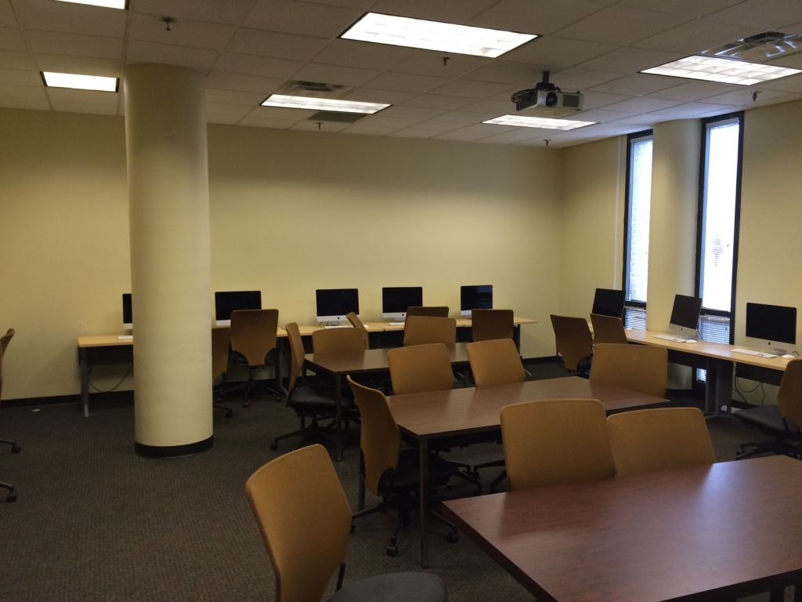
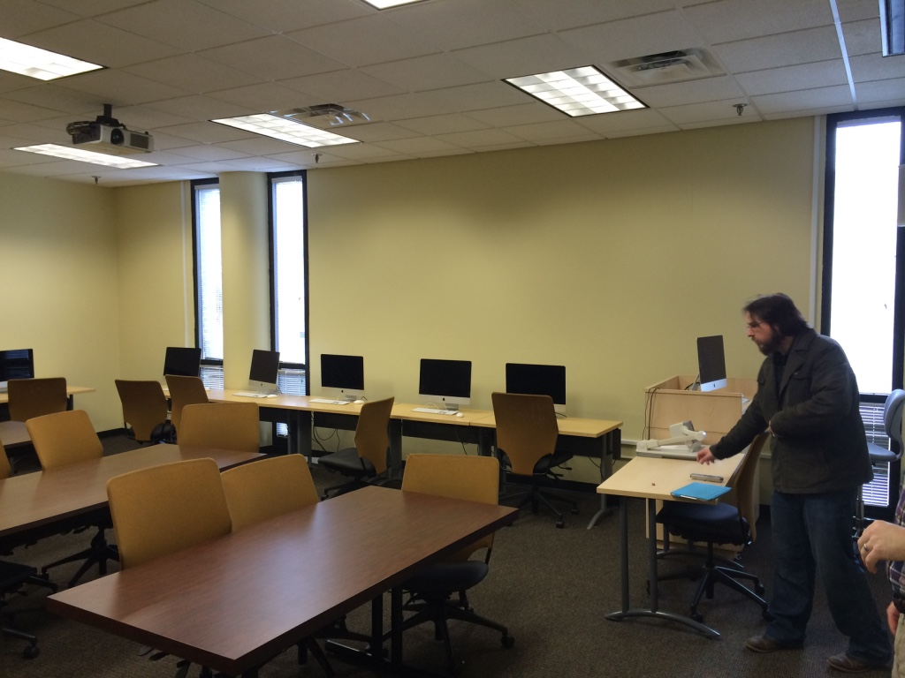

Slide 18
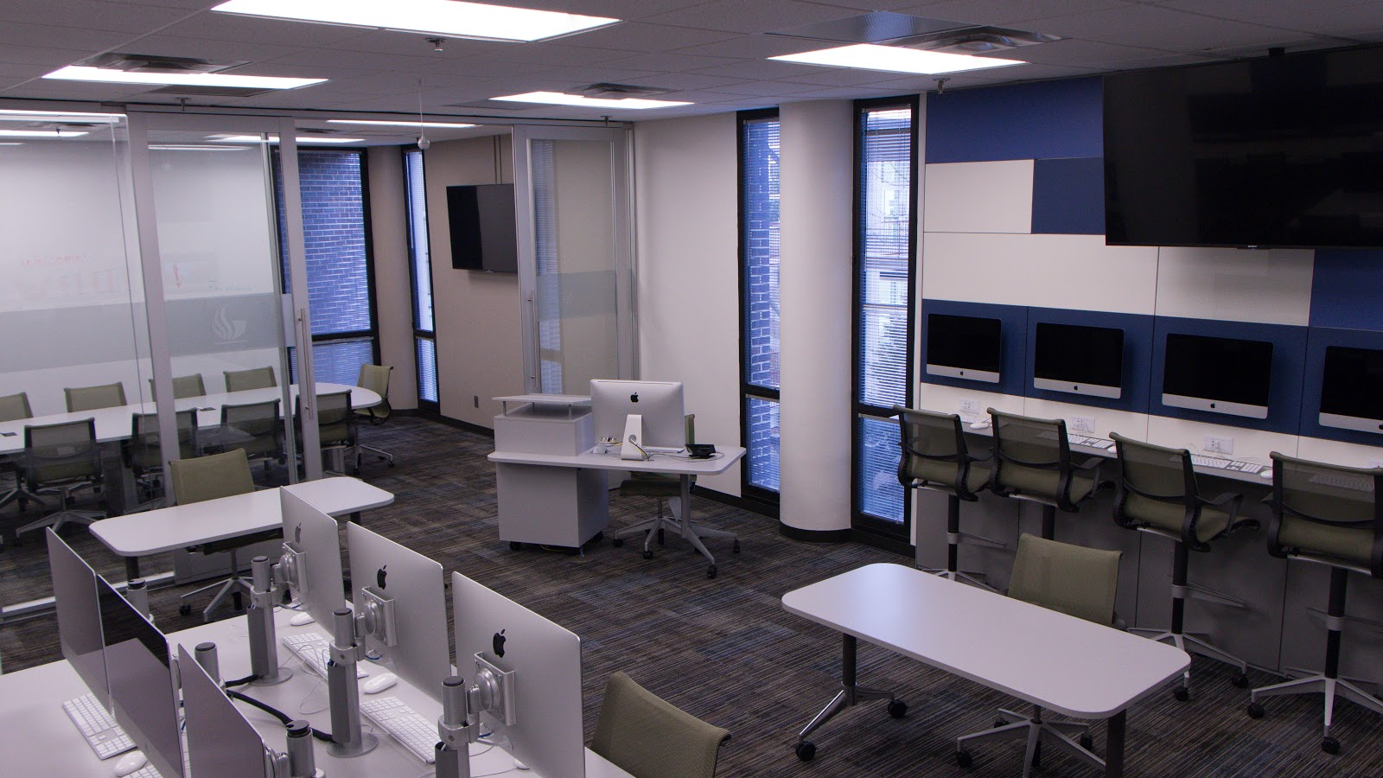

Slide 19
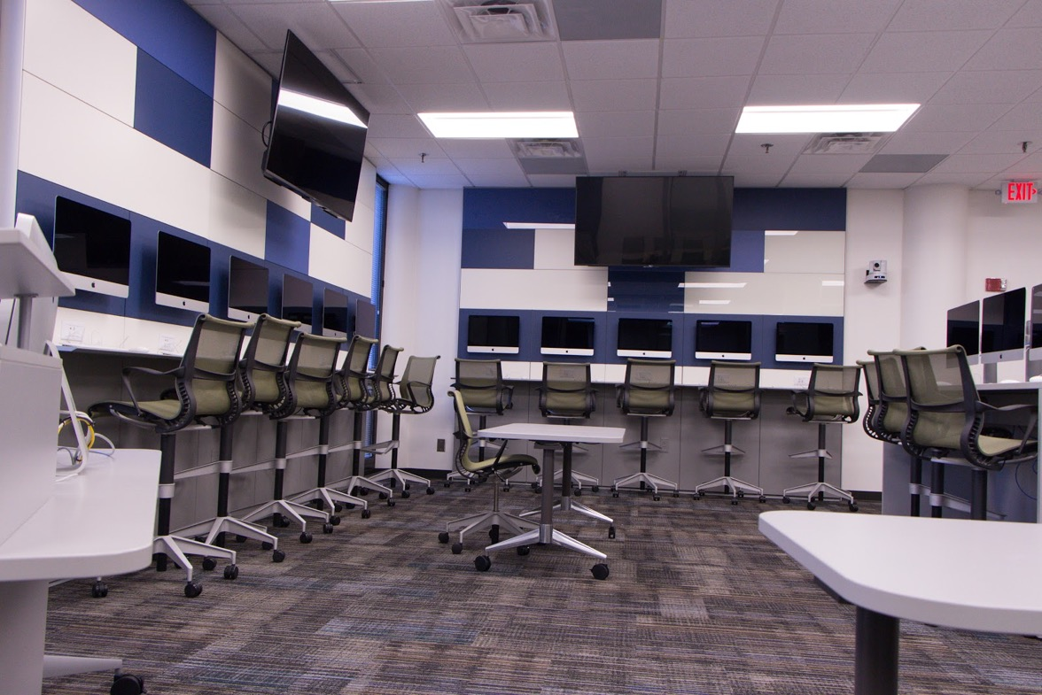
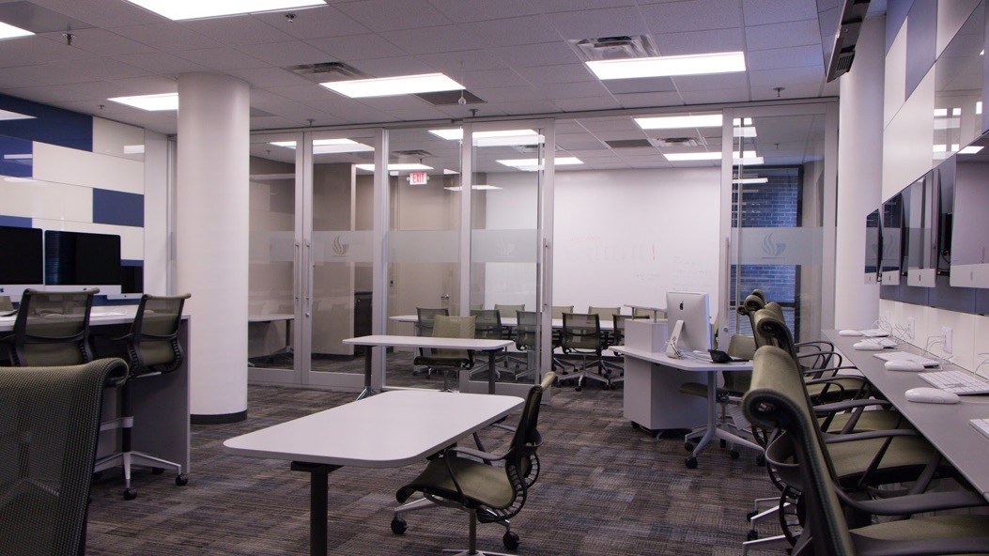

Slide 20
#3
Classroom Design Challenge

Slide 21
Pedagogical Program: Computer Science Active Learning Lab
Requirements
Solutions
Computer science students need to work alone and in small teams
Work group activities including coding charrettes
Maintain seat count, but provide more space for group collaboration
Fix ADA problems with raised floor and multiple entrances
Replace rows of computer desks with grouped work station pods
Place all-in-one computers on rotating arms to allow for multiple screen grouping
Surround room with white boards
Remove raised floor and replace with floor cores

Slide 22
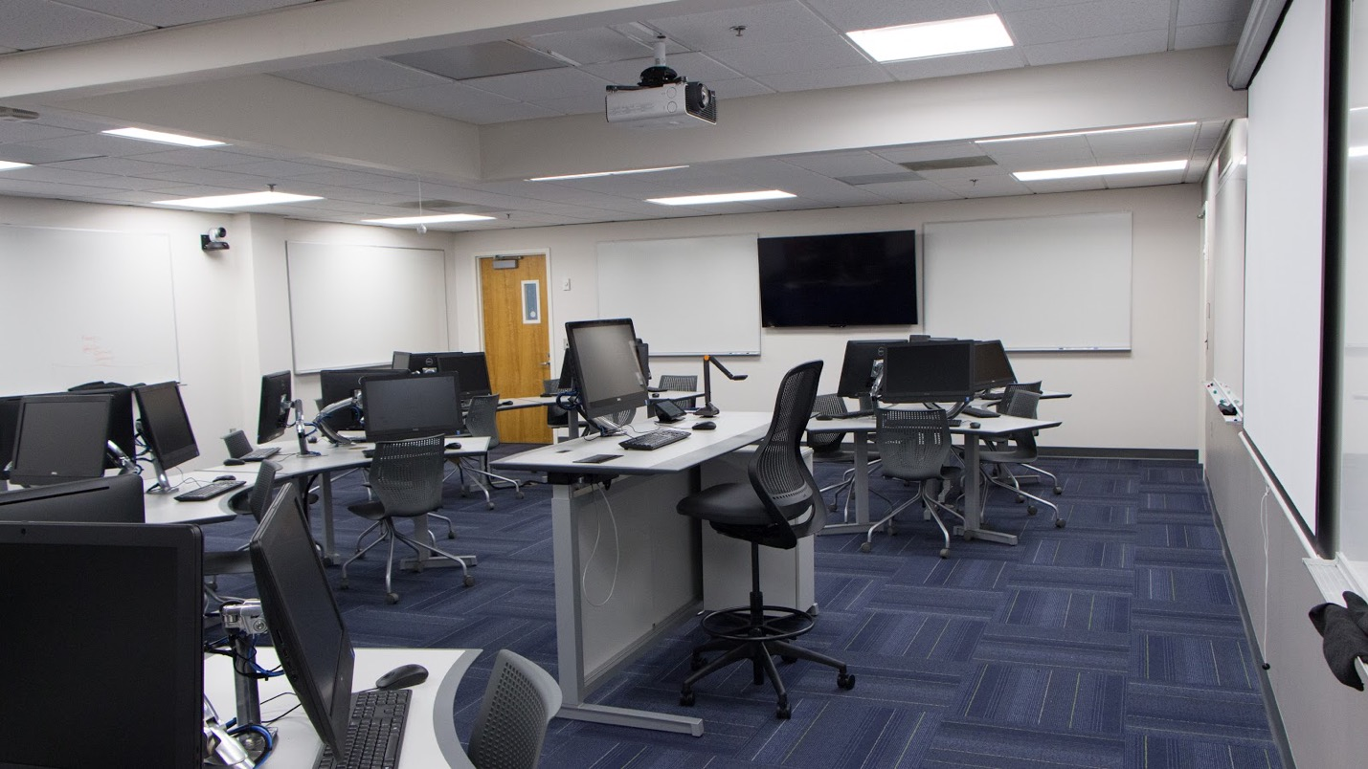
Notes:
An online class delivers lower student performance and lower grades. Technology or Pedagogy?

Slide 23
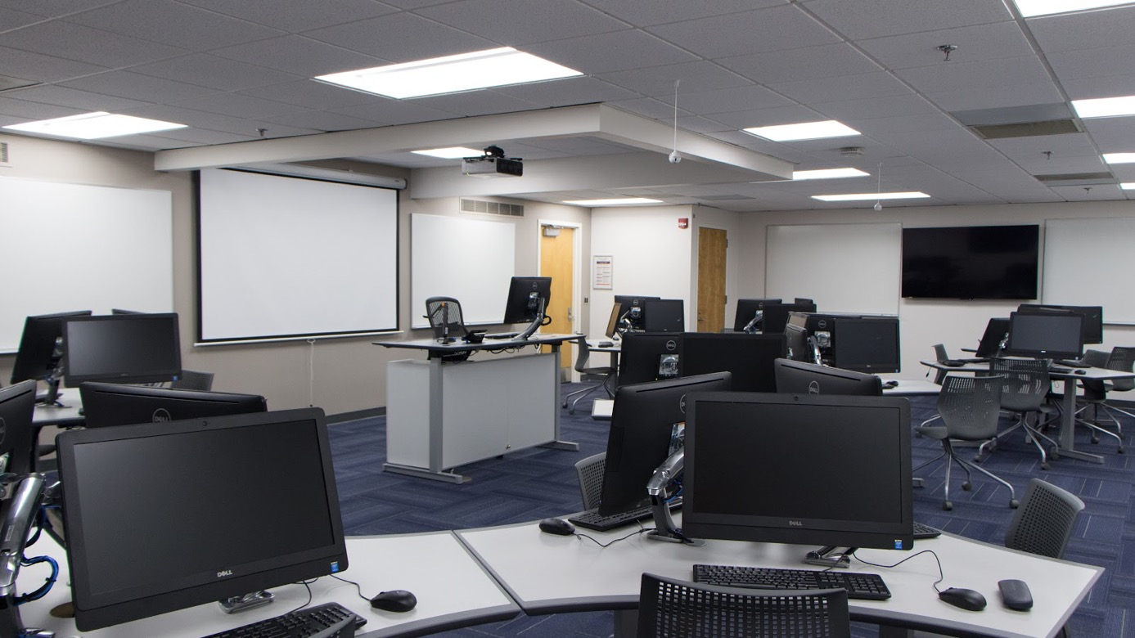
Notes:
An online class delivers lower student performance and lower grades. Technology or Pedagogy?

Slide 24
#4
Classroom Design Challenge

Slide 25
Your Challenge: Design a space that…
Functions as a physics lab
Encourages group work among lab participants (groups of 3 ideal)
Visually shares lab instructions and demonstrations easily throughout the room
Provides excellent space for experiments
24 Students, 1 instructor / GTA,

Slide 26
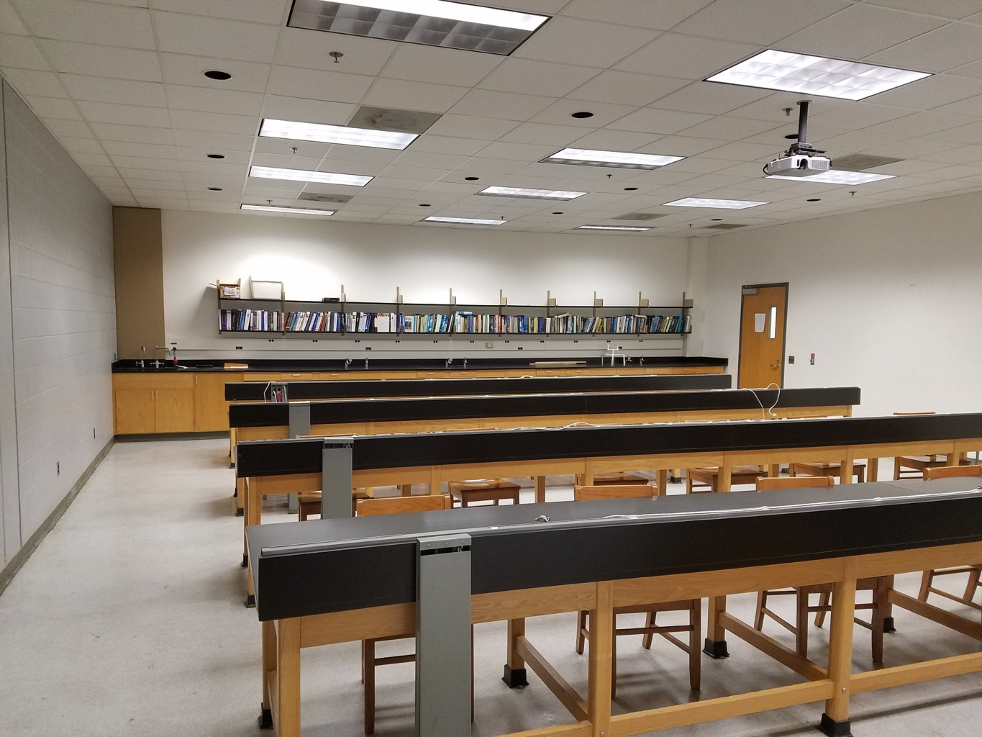
Notes:
An online class delivers lower student performance and lower grades. Technology or Pedagogy?

Slide 27
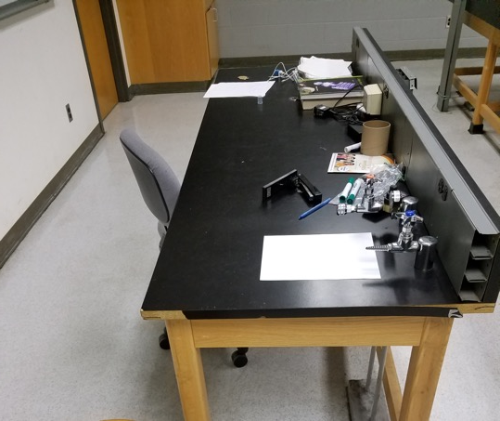
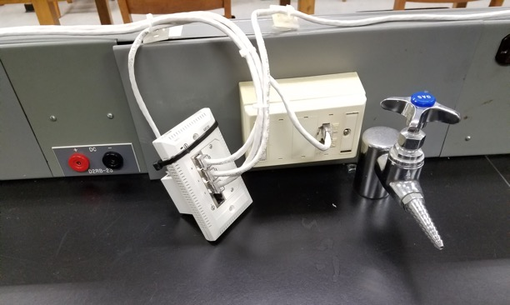
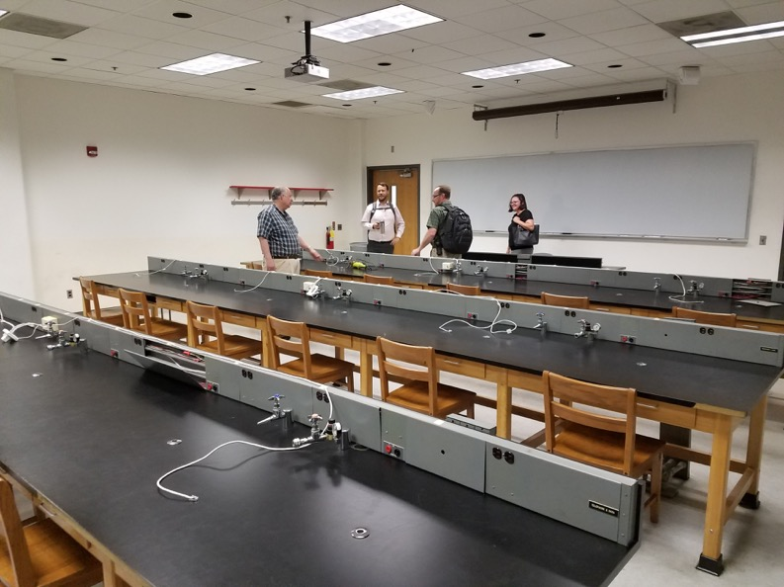
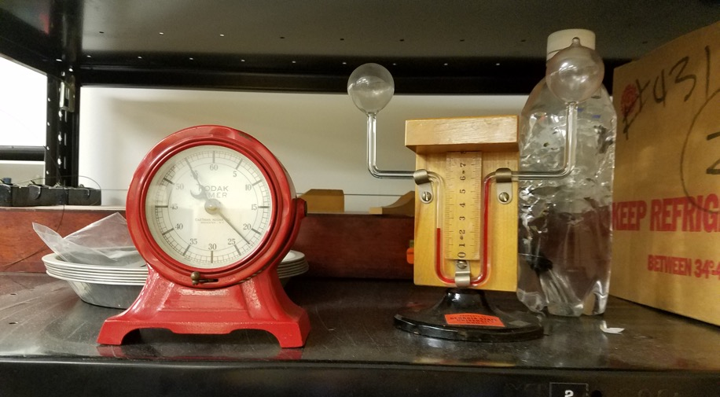
Notes:
An online class delivers lower student performance and lower grades. Technology or Pedagogy?

Slide 28
Your Challenge: Design a space that…
Functions as a physics lab
Encourages group work among lab participants (groups of 3 ideal)
Visually shares lab instructions and demonstrations easily throughout the room
Provides excellent space for experiments
24 Students, 1 instructor / GTA,

Slide 29
Share your work!

Slide 30
Pedagogical Program Active Learning Physics Lab
Requirements
Solutions
Functions as a physics lab
Encourages group work among lab participants (groups of 3 ideal)
Visually shares lab instructions and demonstrations easily throughout the room
Provides excellent space for experiments
24 Students, 1 instructor / GTA,
Eliminate rows and replace with standing-height collaborative workstations
Dual screen installations to display faculty instructions and for shared student work
Include multiple small white boards
Workstations allow 8 groups of 3 students
Specifications of desks were custom matched to each requirement identified by instructors

Slide 31
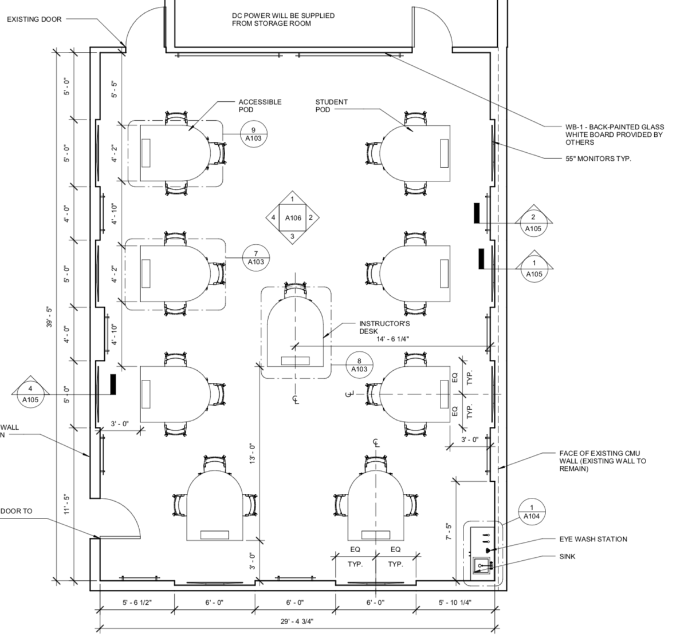
Notes:
An online class delivers lower student performance and lower grades. Technology or Pedagogy?

Slide 32
Notes:
An online class delivers lower student performance and lower grades. Technology or Pedagogy?

Slide 33
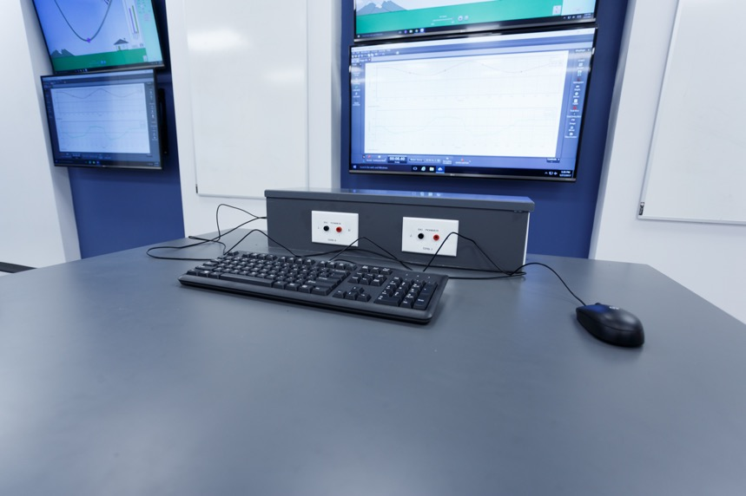
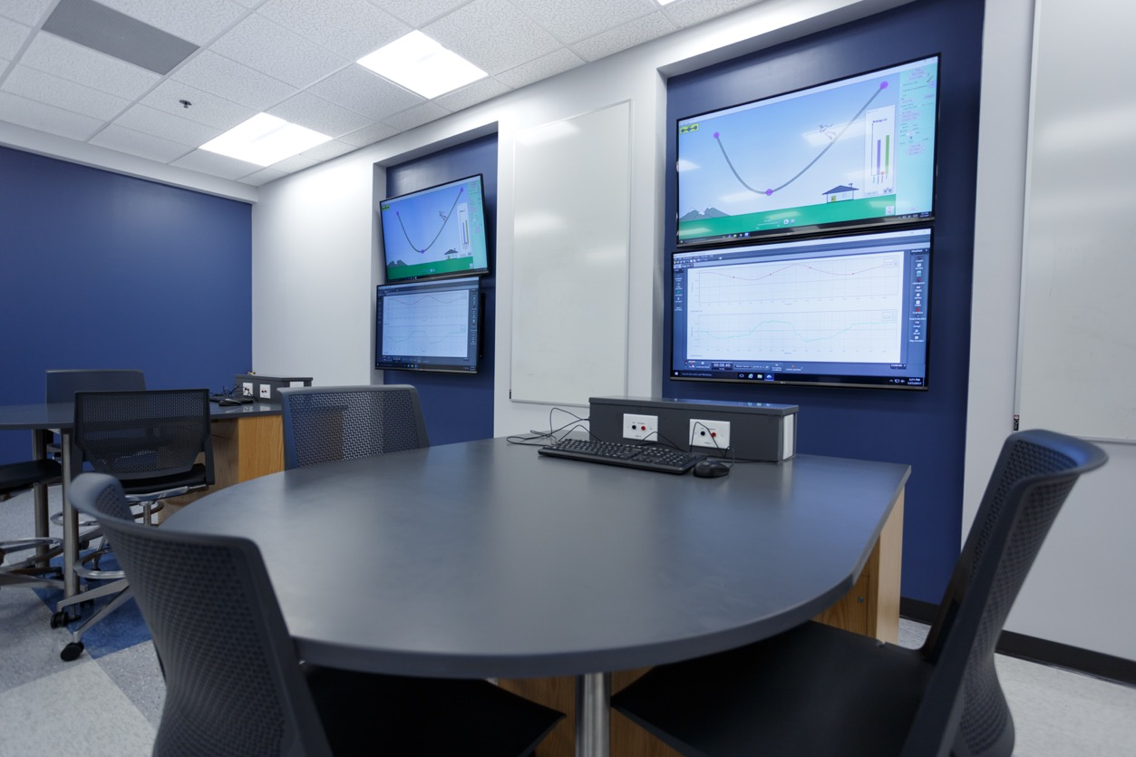
Notes:
An online class delivers lower student performance and lower grades. Technology or Pedagogy?

Slide 34
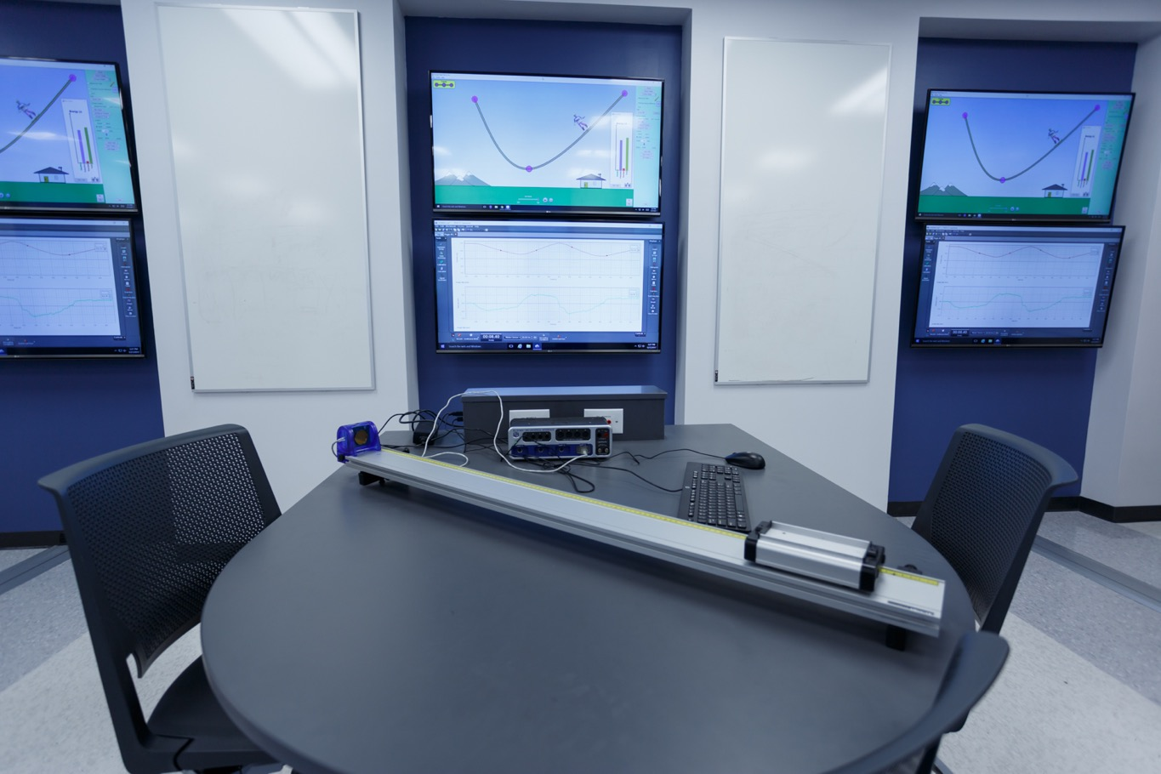
Notes:
An online class delivers lower student performance and lower grades. Technology or Pedagogy?

Slide 35
Strategic
Campus Partnerships

Slide 36
Classroom Council
Technology
Security
Registrar / Scheduling
Facilities
Teaching & Learning
Provost's Office
Notes:
An online class delivers lower student performance and lower grades. Technology or Pedagogy?

Slide 37
Current Initiatives
Create accurate inventory of space based on learning activities.
Develop and share a “State of the Classrooms” report.
Using faculty guidance, determine future state of classrooms
Conduct and share original research on classroom activities (observations, focus groups, etc.)
Create a gap analysis
Present multi-year plan and budget to senior administration

Slide 38
Questions? Comments?
Notes:
Interview process…. What would you do next?

Slide 39
cetl.gsu.edu
Julian Allen, Senior Director of Learning Innovations
Lee Webster, Assistant Director, Learning Environments

