Slide 1
Defining and Dashboarding Student Success: Jumpstarting Data-Driven Decision Making
• Jennifer M. Harrison • Associate Director for Assessment • Faculty Development Center •
• Sherri N. Braxton • Senior Director of Instructional Technology •
• University of Maryland, Baltimore County •
Notes:
Welcome to our session. I’m Jennifer Harrison, Associate Director for Assessment for the Faculty Development Center at the University of Maryland, Baltimore County or UMBC.
And I’m Sherri Braxton, Senior Director of Instructional Technology at UMBC
We’re glad you’ve joined us to learn about assessment technologies, share ideas from your institution to help us improve, and consider ways our collective ideas can support student learning at our institutions.

Slide 2
Defining and Dashboarding Student Success: Jumpstarting Data-Driven Decision Making
How can we help our institutions create a data-enabled culture that improves decision making and student success? What are the key student success indicators? Where is the information stored? How can data be synthesized for more precise analysis? Our session begins to answer these questions by challenging attendees to define student success and delve into the technologies that collect and manage the data. Our session will help attendees to practice bridging direct and indirect evidence through scenarios that model effective practices adaptable to many institutions.
Notes:
We made a few promises in our session description and thank you for joining us to collaborate on dashboarding student learning and success indicators
Institutions struggle to meaningfully use evidence to improve student learning, and assessment experts admit that student learning data is not being used effectively (NILOA, 2018; Eubanks, 2017). In fact, even when academics do implement evidence-based interventions, these interventions may not respond meaningfully to student learning needs if they fail to connect learning data to indirect evidence that contextualizes the results (Eubanks 2017). Conversely, learning analytics experts seek meaning through vast arrays of indirect data, often overlooking the analytical depth of direct evidence. Yet when we triangulate multiple data points, we can begin to answer vital questions about student learning. In related research, we establish a process for synthesizing direct and indirect student success evidence, which requires the aggregation of direct evidence to the institutional level (Harrison & Braxton, 2018). In an era that questions higher education’s contributions to student learning, we need a more holistic view of the data available to the institution to make more informed decisions to improve student outcomes.

Slide 3
Our Learning Outcomes
When we complete this session, we will be able to …
Create a dashboard of indicators to define student success
Reflect on student success indicators your institution might use to build a data-enabled culture and improve decision making
Collaborate to apply key concepts to a scenario that includes multiple direct and indirect data points
Notes:
When institutions bridge student learning outcomes and success data, they gain capacity to aggregate, disaggregate, and reaggregate learning data to answer targeted questions about student learning, achievement gaps, and intervention effectiveness. Integrating direct and indirect evidence yields deeper understanding of student performance, adds depth and nuance to predictive analytics, and offers insights that can foster equity through enhanced capabilities to to pinpoint achievement gaps. Our goal is to help faculty, staff, and other campus leaders create a culture of data-informed decision making, empowering them to synthesize evidence into decisions that foster inclusive excellence.

Slide 4
Key Terms
Outcomes
Direct Learning Data
Indirect Learning Data
Taxonomy
Analytics
Indicators
Intervention
Dashboard
Data-Driven Decision Making
Notes:
Other key words from our proposal: Data-enabled institutional culture
Data-driven decision making
Synthesizing student outcomes and success analytics
Indicators
Dashboard
student learning outcomes and success
JH: Outcomes are central to student learning assessment. The Assessment Cycle has four parts: setting student learning outcomes (measurable goals), offering learning opportunities, measuring (direct and indirect), and closing the loop, applying the results to improve learning. Analytics and other experts also use the term “outcomes” to indicate, for example, employment and graduation rates.
SB: Learning Analytics collects and analyzes data associated with student learning to improve student success through evidence-based interventions. The Student Success movement often relies on analytics like DFW rates (grades), retention, graduation, loan repayment, etc.
Indicators: provide specific information on whether or not students have achieved a benchmark
Direct Measures, like rubrics, tests, and minute papers, look directly at demonstrations of student learning and often rely on subject-matter expertise. They yield direct evidence, which needs to be aligned from the assignment to the course, program, and institutional levels.
Indirect Measures, like student surveys and grades, retention and graduation rates, and usage data look at factors related to learning.
Taxonomy, a way to classify technologies by their assessment functions
Intervention: a revision to a current practice designed to improve student learning outcomes and success
Dashboard: a high-level tool that presents key indicators to enable stakeholders answer key questions at a glance
Data-Driven Decision Making: craft interventions and other student success strategies based on key indicators
Other terms
Narrative Aggregation gathers assessment data into cohesive views of student learning. Until institutions can aggregate learning data to the institutional level, they rely on narrative aggregation to tell their story of student learning
Triangulation integrates multiple measures of student learning, so educators can contextualize learning evidence.

Slide 5
Why should we collect, analyze, and apply assessment data?
Learning Outcomes Data
Learning Analytics Data
Demonstrate Mission
Notes:
Colleges and universities must prove that they are achieving their mission and institutional and program-level learning outcomes to many different audiences. As a result, many institutions juggle technologies to capture and use data to demonstrate success in meeting these goals. These multiple data sources are further complicated by various audiences and users, often siloed, who seek answers to a range of questions—even questions not yet articulated. How can institutions find ways to present assessment data to their various stakeholders in formats that resonate effectively?
These are vital questions. In fact, as David Eubanks suggests in the AAHLE 2017 Fall Intersection that sparked a national conversation about student learning assessment that even appeared on the New York Times op-ed page: “If existing resources were redirected to trying to understand student learning, we could revolutionize education in the next ten years.”
But, even though many schools have adopted Assessment Management Systems, the new NILOA Provosts Survey suggests that “meaningful implementation remains elusive.” While 29% of provosts would like tools that can “aggregate assessment results to represent overall institutional performance,” 51% of provosts do not find their AMS fully supportive of assessment efforts (Jankowski, Timmer, Kinzie, & Kuh, 2018, p. 4, 15, 23).

Slide 6
Direct Evidence
e.g., Rubrics, Portfolios, Exams, Clickers
Indirect Evidence
e.g., Retention, Grades, Clickstream Data
Student Learning & Success
Learning
Management
System
Student
Information
System
Assessment
Management
System
Data Analysis Tools
Data
Warehouse
Notes:
Triangulation of student learning outcomes data and student success data is at the core of this discussion. How do institutions integrate these data systematically, so leaders can more effectively use the results?
We recommend seeking tools that will allow institutions to drill down into DFW, retention, and graduation rates, so student learning outcomes evidence informs and contextualizes learning analytics.
We need tools that integrate multiple measures of student success—especially direct evidence of student learning—to strengthen the institutional analytics movement.
To bridge student success and outcomes data, we need software that enables institutions to aggregate outcomes data by rolling up direct measures to both the program and the institutional levels.
The Council of Regional Accrediting Commissions (C-RAC) shares this concern about the national tendency to narrowly define “student outcomes” in terms of graduation, employment, and student loan repayment rates. The Council has called these “inadequate measures of student achievement,” claiming that “student outcomes must be assessed above and beyond these indirect measures through direct measures of what students learn” (CRAC, 2016, par. 1).
Additionally, in Fall 2016 the Association for the Assessment of Learning in Higher Education (AAHLE) proposed a transformation in assessment data practices intended to “generate better quality assessment data” by linking “learning outcomes to grades and graduation at the campus or institutional level” and creating connections to institutional research data (Wehlburg & Eubanks, 2016, p. 1-2).

Slide 7
Minute Papers
Capstone Data
Direct Evidence
Rubrics Data
Adaptive Learning
Data
Exams
Portfolio Data
Clicker Data
Notes:
What other types of direct evidence..
Employer ratings aligned to outcomes

Slide 8
Student Surveys
Grades
Indirect Evidence
Exit Interview Data
Retention & Persistence Data
Cardswipe Engagement Data
Grad- uation Rates
Click-stream Data
Notes:
What other types of direct evidence..
Employer ratings aligned to outcomes

Slide 9
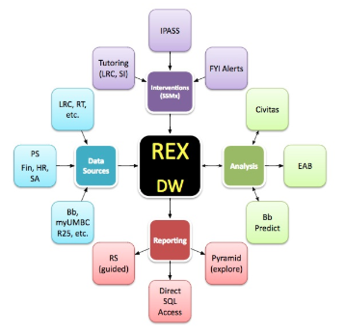
At UMBC …
Notes:
This UMBC ecosystem slide color codes the types of functions

Slide 10
At UMBC …
Data Analysis Tools
Data
Warehouse
Learning
Management
System
Assessment
Management
System
Student
Information
System
Notes:
This is the plan for UMBC technology … we are growing towards it
Levels 1-3 are sound, level 4 is in development, 5 is aspirational

Slide 11
Overview
Technology Solutions for Assessment
Notes:
Assessment technologies continue to emerge, and those already in place often evolve in response to institutional needs. While numerous assessment management software solutions are available (NILOA, Assessment Management Systems, nd), unfortunately, at this point, no single tool meets all the needs of authentic assessment practices.
In fact, some of the tools on the market today do not demonstrate core understanding of how to integrate learning data and why and how people would want to use it. We need a way to sort, clarify, and evaluate what these tools can do to improve assessment practices on campuses—a taxonomy.

Slide 12
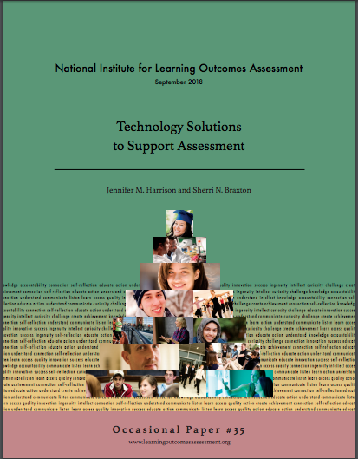
Technology Solutions for Assessment
Taxonomy
Process
Rubric

Slide 13
Assessment Technology Taxonomy
What tools, systems, and/or technologies do you use?
What function(s) do they perform?

Slide 14
What functions do your tools offer?
Collecting
Connecting
Organizing
Archiving
Analyzing
Communicating
Closing the Loop
Notes:
A useful and authentic process likely requires assessment technologies to help with the following:
Collecting: supports creation and delivery of assessments (diagnostic, summative, and formative), building and applying rubrics, tests, course-level grading, student evaluations, and linking standards to outcomes.
Connecting: supports linking/aligning of outcomes both horizontally and vertically, creating and generating curriculum maps, integrating budget and financial information, tracking and managing strategic planning information, and linking data from both student information and learning management systems. Connecting data has become more complex, as institutions diversify their assessment approaches (Jankowski, Timmer, Kinzie, & Kuh, 2018, p. 9).
Organizing; supports data management and collecting/tracking program-, course-, and co-curricular assessment; integrates new and existing evidence/data sources; offers reports and/or customizable dashboards.
Archiving: stores assessment evidence/data; serves as a long-term repository for student submissions/assignments and other artifacts.
Analyzing: supports statistical examination of evidence/data, enables manipulation of data/evidence for detailed investigation.
Communicating: supports assessment report generation and documentation of progress toward institutional level priorities, goals, missions, and outcomes. Additionally, NILOA’s Provost Survey suggests communication about assessment is key to future assessment efforts, since provosts want to be able to communicate a “nuanced, complicated picture of student learning” (Jankowski, Timmer, Kinzie, & Kuh, 2018, p. 23).
Closing the Loop: supports decision making and action-taking, assessment plan development, status reporting, and reporting of assessment evidence/data and results to stakeholders; makes it easier to engage double-loop analysis, or measuring the impact of closing-the-loop interventions.

Slide 15
Taxonomy/Tool | Collecting | Connecting | Organizing | Archiving | Analyzing | Communicating | Closing the Loop
Acrobatiq | * | * | * | * | * | *
AEFIS | * | x | * | * | x | x | x
Blackboard Learn | x |  |  | x | *
Civitas Learning |  | * | * |  | x | * | *
ExamSoft | * |  | * |  | *
Explorance | * | * | * |  | * | * | *
Learning Objects | * | * | x | x | * | * | *
PASS-PORT | * | * | * | * | * | x | x
PeopleSoft Campus |  | * |  |  | * | * | *
Portfolium | x | * | * | x | * | * | *
WaterMark TaskStream Tk20 | x | * | x | x | * | x | x
X = provides all capabilities of category; * = provides at least one of the capabilities of the category
Notes:
A useful and authentic process likely requires assessment technologies to help with the following:
Collecting: supports creation and delivery of assessments (diagnostic, summative, and formative), building and applying rubrics, tests, course-level grading, student evaluations, and linking standards to outcomes.
Connecting: supports linking/aligning of outcomes both horizontally and vertically, creating and generating curriculum maps, integrating budget and financial information, tracking and managing strategic planning information, and linking data from both student information and learning management systems. Connecting data has become more complex, as institutions diversify their assessment approaches (Jankowski, Timmer, Kinzie, & Kuh, 2018, p. 9).
Organizing; supports data management and collecting/tracking program-, course-, and co-curricular assessment; integrates new and existing evidence/data sources; offers reports and/or customizable dashboards.
Archiving: stores assessment evidence/data; serves as a long-term repository for student submissions/assignments and other artifacts.
Analyzing: supports statistical examination of evidence/data, enables manipulation of data/evidence for detailed investigation.
Communicating: supports assessment report generation and documentation of progress toward institutional level priorities, goals, missions, and outcomes. Additionally, NILOA’s Provost Survey suggests communication about assessment is key to future assessment efforts, since provosts want to be able to communicate a “nuanced, complicated picture of student learning” (Jankowski, Timmer, Kinzie, & Kuh, 2018, p. 23).
Closing the Loop: supports decision making and action-taking, assessment plan development, status reporting, and reporting of assessment evidence/data and results to stakeholders; makes it easier to engage double-loop analysis, or measuring the impact of closing-the-loop interventions.

Slide 16
At UMBC …
Taxonomy/Tool | Collecting | Connecting | Organizing | Archiving | Analyzing | Communicating | Closing the Loop
Acrobatiq | * | * | * | * | * | *
Blackboard Learn/EAC | x |  |  | x | *
Civitas Learning |  | * | * |  | x | * | *
EAB | * | * | * |  | * | * | *
Bb Predict |  |  |  |  | * | *
Pyramid |  |  |  |  | * | *
PeopleSoft Campus |  | * |  |  | * | * | *
Portfolium | x | * | * | x | * | * | *
WaterMark TaskStream Tk20 | x | * | x | x | * | x | x
X = provides all capabilities of category; * = provides at least one of the capabilities of the category
Notes:
At UMBC, our indirect measure capacities are highly refined with a sophisticated data analytics suite, including Civitas, Blackboard Analytics, Blackboard Predict, Pyramid, and SSMX.
Our direct measure data is less technologically systematized, though the reporting process is well established. Academic Program Review and program assessment processes are centralized in Blackboard, our LMS; General Education is supported by customized software linked to our portal. Leaders encourage programs to develop authentic assessment for their disciplines, including divisions like Student Affairs and Undergraduate Academic Affairs that connect curricular and co-curricular learning data. Instructional technology and faculty development staff work with departments to implement diverse tools and identify ways to bridge the evidence with our data warehouse. For example, some programs have invested in Tk20 or Acrobatiq; others rely on Excel spreadsheet templates (see Harrison & Williams, 2017, Summer), Scantron, Qualtrics, or tools in our LMS. Since Blackboard Outcomes is designed for a secondary evaluation process, it does not fit our assessment culture. However, EAC Visual Data, a Blackboard Learn integration, allows us limited capacity to align direct evidence to outcomes and extract aggregated data. EAC adapts our LMS, but fails to facilitate the vertical data rollup that we need. Instead leaders integrate data via narrative aggregation, (synthesizing assessment data into cohesive narratives of student learning) at Council of Deans meetings, Data Days, and other collaborations at the college/division and institutional levels.

Slide 17
At UMBC …
Taxonomy/Tool | Collecting | Connecting | Organizing | Archiving | Analyzing | Communicating | Closing the Loop
myUMBC | *
Clickers | *
Card Swipe | *
Qualtrics | * |  |  | * | *
Scantron | * |  |  | * | * | *
Excel | * | * | * | * | * | * | *
PowerPoint |  |  |  |  |  | * | *
Word | * |  |  |  |  | * | *
X = provides all capabilities of category; * = provides at least one of the capabilities of the category
Notes:
At UMBC, our indirect measure capacities are highly refined with a sophisticated data analytics suite, including Civitas, Blackboard Analytics, Blackboard Predict, Pyramid, and SSMX.
Our direct measure data is less technologically systematized, though the reporting process is well established. Academic Program Review and program assessment processes are centralized in Blackboard, our LMS; General Education is supported by customized software linked to our portal. Leaders encourage programs to develop authentic assessment for their disciplines, including divisions like Student Affairs and Undergraduate Academic Affairs that connect curricular and co-curricular learning data. Instructional technology and faculty development staff work with departments to implement diverse tools and identify ways to bridge the evidence with our data warehouse. For example, some programs have invested in Tk20 or Acrobatiq; others rely on Excel spreadsheet templates (see Harrison & Williams, 2017, Summer), Scantron, Qualtrics, or tools in our LMS. Since Blackboard Outcomes is designed for a secondary evaluation process, it does not fit our assessment culture. However, EAC Visual Data, a Blackboard Learn integration, allows us limited capacity to align direct evidence to outcomes and extract aggregated data. EAC adapts our LMS, but fails to facilitate the vertical data rollup that we need. Instead leaders integrate data via narrative aggregation, (synthesizing assessment data into cohesive narratives of student learning) at Council of Deans meetings, Data Days, and other collaborations at the college/division and institutional levels.

Slide 18
Planning for Assessment Technologies
Clarify Common Ground
How do outcomes at each level align to the mission?
Use Backward Design
What direct evidence do you need to demonstrate learning?
Take Inventory
What processes and technologies are already in place?
Clarify Common Ground
How do outcomes at each level align to the mission?
Use Backward Design
What direct evidence do you need to demonstrate learning?
Take Inventory
What processes and technologies are already in place?
Clarify Common Ground
How do outcomes at each level align to the mission?
Use Backward Design
What direct evidence do you need to demonstrate learning?
Take Inventory
What processes and technologies are already in place?
Clarify Common Ground
How do outcomes at each level align to the mission?
Use Backward Design
What direct evidence do you need to demonstrate learning?
Take Inventory
What processes and technologies are already in place?
Notes:
First, we encourage you to clarify your institution’s common ground by defining (or reviewing) how student learning outcomes align from the mission to the students’ demonstration of learning.
Next, we suggest beginning at the end—determine what types of evidence you need, then
inventory technologies already in place
Sherri adds this: Keep in mind that we already began to inventory technologies with our first worksheet …

Slide 19
Planning for Assessment Technologies
Identify Audiences
Seek Expert Advice
Form a Team
Who can evaluate and test potential technology solutions?
Who needs to know about student learning? What are their questions?
Who has expertise in assessment, instructional technology, and analytics?
Clarify Common Ground
How do outcomes at each level align to the mission?
Use Backward Design
What direct evidence do you need to demonstrate learning?
Take Inventory
What processes and technologies are already in place?
Clarify Common Ground
How do outcomes at each level align to the mission?
Use Backward Design
What direct evidence do you need to demonstrate learning?
Take Inventory
What processes and technologies are already in place?
Clarify Common Ground
How do outcomes at each level align to the mission?
Use Backward Design
What direct evidence do you need to demonstrate learning?
Take Inventory
What processes and technologies are already in place?
Notes:
4. Next identify audiences who will use the technology or resulting data.
5. Once you have synthesized these steps, you’ll want to seek expert advice on your campus to identify potential solutions.
6. Finally, you’ll need to form a collaborative team to evaluate and pilot these solutions.

Slide 20
Usability
Criteria | Questions to Consider
Usability | Is the software intuitive and easy to use? (Will users need extensive training?) Does it work well with software we already have (and are using)? Does it require additional steps/staff to enter and extract data? Does it make assessment feel like an add-on? Or does it make assessment work part of the teaching and learning process? Does data export in a useable format? Is it IMS Global Learning Tools Interoperable (LTI)? What about accessibility?

Slide 21
Functionality
Criteria | Questions to Consider
Functionality | Does the software reflect best practices in assessment? Can it manage multiple levels of assessment? Does it help users create and align outcomes? Does it walk users through curriculum mapping and rubric development? Does it offer easy-to-use reports and dashboards customizable to audience needs?

Slide 22
Costs
Criteria | Questions to Consider
Costs | How much is the annual software license? Are updates included? If not, how much will they cost? How much will it cost for support and training? What hardware/cloud costs are needed to support it? What hidden costs might emerge?

Slide 23
Audiences
Criteria | Questions to Consider
Audiences | Who will need to use this software? How will they learn to use it? What questions can they answer with this tool?

Slide 24
Flexibility
Criteria | Questions to Consider
Flexibility | Is the software flexible enough to meet your needs? How will the system grow with your institution? How will the system adapt to anticipated (and unforeseen) changes in assessment demands?

Slide 25
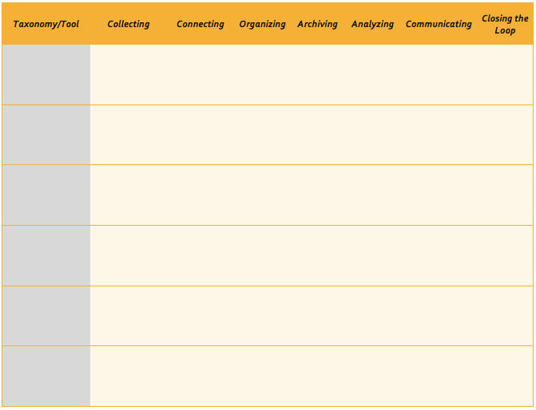
Bridging Education Data
Notes:
Start thinking about your inst. What do you have on your campus? How does it fall in the taxonomy?
We’ll walk you through the exercise using an example from our DOE

Slide 26
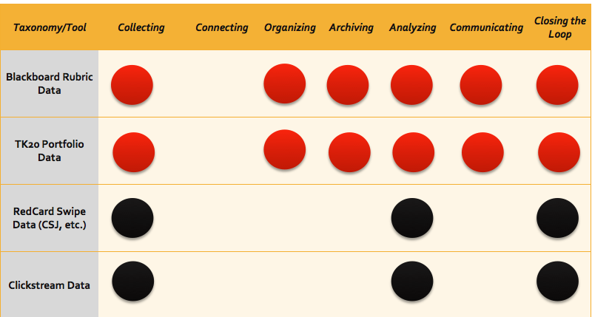
Bridging Education Data
Notes:
Red are direct
Black are indirect

Slide 27
Program Results Show Gap
Notes:
602 has another story beyond multicultural ed. A long time ago, some of the teacher programs did not have students practice teaching in front of actual students before they did their internship. The accreditors said, no this isn’t enough. So we redesigned 602 to include an early field experience, created measures, and now students demonstrate this learning in indicators X, Y, and Z
The accreditors came back again to review our intervention, and they wanted us to help students to build their reflection skills. This led to the adaptation assignment, where students metacognitively review the elements of their course design and identify ways to improve in the next teaching opportunity. Thus, we are teaching and modeling double loop analysis for our students, measuring if they have learned this skill, and building in deliberate practice throughout the program to ensure that when our student become the teachers they can do this too.

Slide 28
Course Results Confirm Gap

Slide 29
Double-Loop Results Measure Improvement

Slide 30
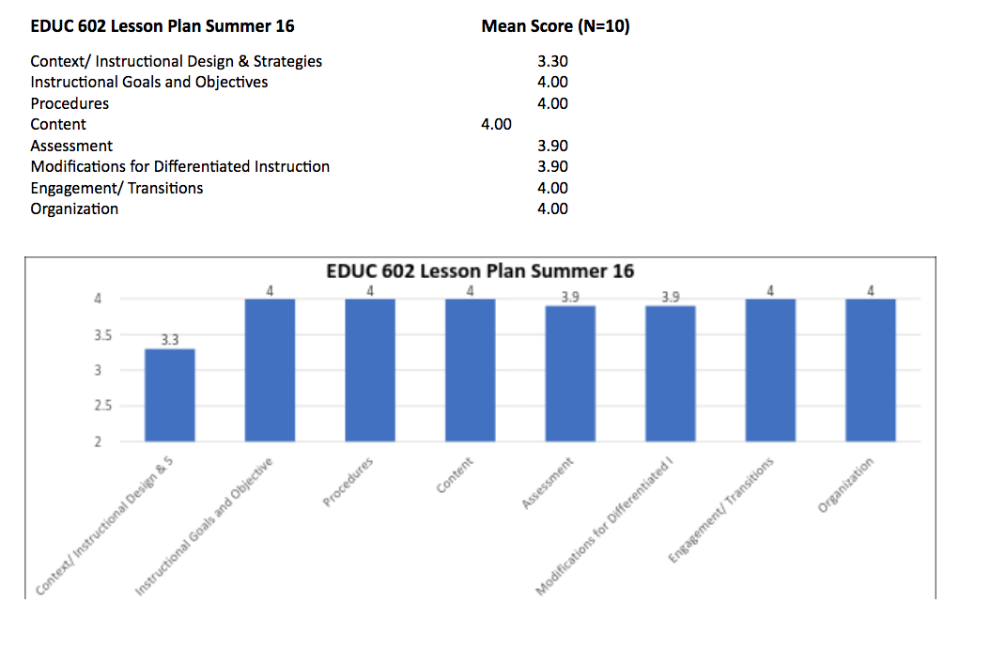
Lesson Plans
Notes:
Focused on Content Instructional Design and Strategies—only average of 3.3

Slide 31
Closing-the-Loop Analysis*
Learning Challenge
3 Interventions
Remeasure
Program Closing-the-Loop Discussion: Internship rubric (TK20) shows problem with multicultural indicators
Remeasured with rubrics**
Students demonstrated improved competency after revision
Created Multicultural Classroom: group assignment (Su2016)
Required revisions
Created Lesson Plan individual assignment
Created Adaptation revision reflection
*Program-Level measurement for student teaching pending
**aka double-loop analysis
Notes:
Now let’s look at the double loop analysis. What impact did the intervention have on student learning? Can we call it an improvement based on these data?

Slide 32
How can you connect the dots?
What are the data systems readily available to you?
What systems are available on campus that you need other experts to help you access?
What kinds of data do they store? (direct, indirect, or both)
What kinds of data do they store? (direct, indirect, or both)
Notes:
Gamified Think Pair Share
Give them about 1-2 min to think … then remind them to pair 1-2 min to pair, then call on volunteers to share
Use dots to indicate the types of data
i.e., Red= direct, Black= indirect

Slide 33
Dashboard Your Indicators

Slide 34
Bridging Education Data

Slide 35
Student Success Infrastructure Think-Pair-Share
Notes:
We showed you this slide earlier. Now we want you to do a think-pair-share to think about the architecture at your institution, so you can identify the gaps. You might not use all the levels, and you can write in systems that we don’t offer for you.

Slide 36
At Your Institution…

Slide 37
Student Success Infrastructure

Slide 38
Scenario 1
Scenario 1: Intervention via Tutoring
Intervention Strategy: Institutional Student Success Course/Tutorial- Academic Success for Lifelong Learning Course
Data Source(s): Direct data from multiple semesters and multiple sections of the intervention
Problem Description: You are a learning resources center leader or teacher who wants to explore student learning in multiple sections of a course where faculty use a common rubric and assignment. You set up your rubric in your LMS; all faculty are using it to give feedback and assess learning and grades, and each teacher can access a report to view the aggregated data from the individual course-level assignment. But you can’t figure out how to aggregate the data across courses. What technology tools would make this possible? How could you compare data across semesters and years? (Harrison & Braxton, 2018).
Student Success Indicators:
Student Learning Outcomes Evidence (direct measure test data)
Student Success data (indirect measures: grade point average, retention, persistence, and academic progression via First Year Intervention alert)
Notes:
Present example of use cases (Vickie’s
We feel like there are common questions across institutions … connecting is key. Gamify via scenarios.
Our game board is the taxonomy sheet

Slide 39
Rubric Data
Notes:
{Click for chart} Here you see a chart presenting the results from data aggregated across upper-level courses. Faculty hypothesized that students struggled to integrate the skills needed for an APA research paper … they used a shared rubric, and we helped them tag outcomes and aggregate data using Blackboard and EAC.
This is a roll-up from the course to the program, and we’ve aligned the program outcomes to the institutional outcomes (the FC notations). We have this programmed and tagged in Blackboard/EAC.(note limitations)
In contrast, faculty may wish to aggregate data in other ways ….

Slide 40
Scenario 2
Scenario 2: Course Sequencing—Progress Across Program
Intervention Strategy: Redesign of gateway course
Data Source(s): Direct and indirect data from multiple semesters and multiple sections of the intervention and the next course in the sequence
Problem Description: You are a program or department leader who wants to explore the impact an intervention has had on student learning in a gateway course across time and in the next course in the sequence. You need data on both direct and indirect measures. How can you extract the relevant rubrics and institutional data and triangulate them? (Harrison & Braxton, 2018).
Student Success Indicators:
Student Learning Outcomes Evidence (direct measure rubric data)
Student Success data (indirect measures: grade point average, retention, persistence, and academic progression in the program)
Student Satisfaction Data: student survey (Likert scale plus qualitative reflection questions)
Notes:
Present example of use cases (Vickie’s
We feel like there are common questions across institutions … connecting is key. Gamify via scenarios.
Our game board is the taxonomy sheet

Slide 41
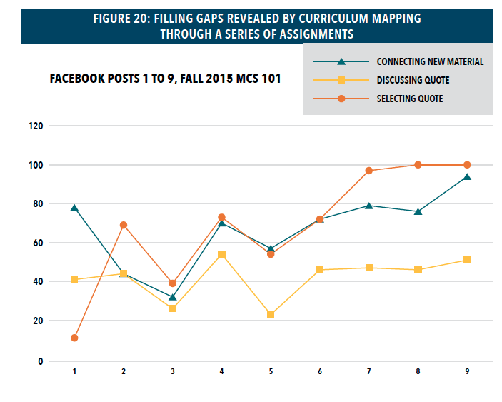
Notes:
Maybe you want to know if an intervention is working. In this example, faculyt measured student learning in a repeated assignment to find out if it was building information literacy skills. The assignment data confirmed that the series of assignments is working. Since the course itself is an intervention designed to improve learning in the program, we can roll up the data to the program level to determine if it worked. Since we’ve aligned the assignment to the institutional-level outcomes, we can also roll up the data for institutional insights.
Once you’ve spent some time thinking about the kinds of data you need to share, consider taking inventory. What processes and technology tools are already in place at your institution?

Slide 42
Scenario 3
Scenario 3: Provost’s Report on Achieving Institutional Learning Outcomes
Intervention Strategy: Institution-wide curriculum mapping and vertical alignment
Data Source(s): Both direct measures of student learning and indirect measures of student success
Problem Description: You are the Provost and you want to know how well students are learning in relation to the institutional learning outcomes across the campus for the current term. For example, how many programs in each college have created direct measures of student learning in your LMS that align to program and institutional outcomes? What data do you need on your Learning Outcomes Dashboard so you can easily determine if students are achieving the institutional-level outcomes? What are the data sources? What tools can help you analyze the data, so you can identify institutional-level learning challenges? (Harrison & Braxton, 2018).
Student Success Indicators:
Student Learning Outcomes Evidence (direct measure data)
Student Success data (indirect measures: grade point average, retention, persistence, and academic progression in the program)
Student Satisfaction Data: NSSE and HERI data
Notes:
Present example of use cases (Vickie’s
We feel like there are common questions across institutions … connecting is key. Gamify via scenarios.
Our game board is the taxonomy sheet

Slide 43
Questions?
Thanks for joining us today!
Please share your scenarios
Contact with questions, ideas, or suggestions
See our NILOA Occasional Paper!

