Slide 1
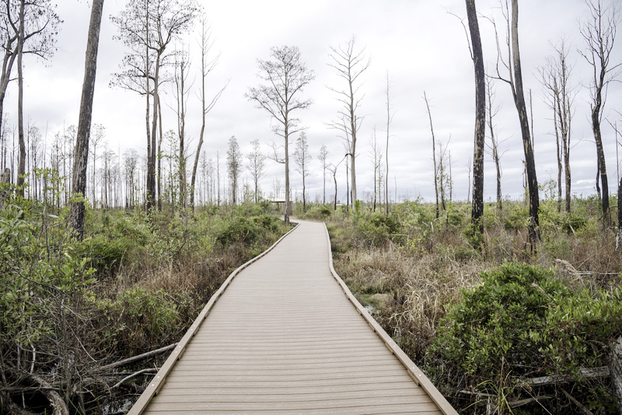
Navigating the data swamp:
Lessons Learned in Data Management
1
Notes:
Jane: thank you and welcome. I am pleased to be here today with Clint Davies and Marty Mosley, of BerryDunn
When you think about data at your institution, what image comes to mind? Is it a tidy closet, with clothes and shoes well organized and easy to find? Or is it dusty boxes in the garage, piled up and unopened for years? Or is it a large patch of murky water, where plants and animals are submerged and you have to search hard to find them?
Whatever the image for YOUR institution, we all know that data can be very challenging to identify, inventory, and catalog; say nothing about manage! Where are the true “systems of record”? How many spreadsheets and databases reside outside of these systems? Who keeps little pockets of data tucked away in their desks or computer folders? Where do you go to find consistently accurate and timely across the enterprise? How do you manage data when you don’t know where it lives?
These were some of the questions that California Western School of Law tackled, in trying to understand its existing data, which we classified as a swamp. There were many dark and murky pools and nobody had explored where all the creatures lived. As the institution started to identify and inventory its data, it also wanted to create some clear channels through its data swamp. It wanted to learn about data management, and how to establish data governance. And most of all, it wanted to navigate its data swamp in preparation for implementing new ERP systems – Student, Finance, Human Resources that provide the promise of new data repositories and data query tools.

Slide 2
SPEAKERS
Jane Courcy
MEd
Executive Director,
Enterprise Systems
Clint Davies
MBA
Principal
Marty Moseley
BA
Data Architect
2
3
Notes:
JANE – INTRODUCE MYSELF AND THEN TO CLINT

Slide 3
AGENDA
Approach to Data Challenges
Navigating the Data Swamp
DMAP Project Phases
Data Governance
Educating the Team
Other Implications
Samples of Deliverables
Outcomes & Next Steps
3
3
Notes:
CLINT

Slide 4
CALIFORNIA WESTERN SCHOOL OF LAW
APPROACH TO DATA CHALLENGES
1
2
3
CWSL poised to implement new ERP systems and unsure of its data sources
No established ways to discuss data collection and use: what, where, who, when, and why
No formal approach to managing data effectively across the enterprise
Create a comprehensive data catalog, data inventory, and data quality analysis
Develop a data governance structure to support short-term and long term data decision-making
Use data management to support a successful ERP implementation; with a goal that enterprise data will be integrated, accurate, and real-time accessible
4
Notes:
JANE – TALK ABOUT CAL WESTERN BRIEFLY

Slide 5
Polling QUESTION #1
5
Notes:
CLINT ASKS THE FIRST POLLING QUESTION
Question: Show of hands, please, if your institution has similar data challenges.
Second show of hands if you are addressing them in a structured manner.

Slide 6
NAVIGATING THE DATA SWAMP
Created the Data Management Assistance Project (DMAP)
Engaged administrative and academic functional areas
Recognized the need to adopt data management practices
Educated and built foundation for data governance
6
Notes:
CLINT

Slide 7
DMAP Project Phases
1
Jan – July 2017
2
Aug – Dec 2017
3
Jan 2018 - Dec 2019
Jan: planned project, reviewed existing materials, created new tools
March: designed and scheduled “Data Discovery” work
April – June: held 25+ departmental visits
July: compiled findings and summary
Aug-Sept: presented summary report to ERP Core Committee
Oct: created draft “Institutional Blueprint for Data Governance”
Nov - Dec: reviewed blueprint and provided data management workshops
Jan – March: used knowledge gained to inform ERP planning
April – Sept: conducted implementation/data work sessions
Oct – Aug: continue to prepare for SIS go-live March & FIS/HRIS August
7
Notes:
JANE

Slide 8
WHAT IS DATA GOVERNANCE?*
Starting point to manage data and mitigate risks
Means to identify current and future data needs
Structuring of data roles across enterprise
Shared responsibility among institutional constituents
APPROACH TAKEN AT CWSL
Established a framework and guiding principles in a blueprint
Focused on how data is used and shared
Defined key roles for data owners, stewards and governing group
Provided education for constituents across campus
*See “The Compelling Case for Data Governance”- ECAR Working Group Paper 3/19/15
8
Notes:
CLINT

Slide 9
EDUCATING THE TEAM*
Data Management workshops addressed:
Building awareness, desire, knowledge
DMAP project findings and work to be done
Small groups/flip chart sessions on:
how data is collected
data problems and gaps
institutional data needs now and in the future
Responsibilities for data owners, data stewards, and ERP Core Committee
*See “Establishing Data Stewardship Models” - ECAR Working Group Paper 12/18/15
9
Notes:
CLINT

Slide 10
Polling QUESTION #2
10
Notes:
CLINT asks the second polling question:
Show of hands; if you institution has data governance in place?
Second show of hands if it is working well.

Slide 11
OTHER IMPLICATIONS &
PERSPECTIVES FROM A DATA ARCHITECT
Key considerations for data architecture
Linkages to data management and governance
11
Notes:
MARTY to JANE/she will tie this back to next slide

Slide 12
Data Catalog
Created to meet needs and existing documentation formats (XLS)
Catalogs systems, data, technical specifications, business process maps and inventory documents
Resides on DMAP SharePoint as “living document"
DELIVERABLES
12
Notes:
JANE

Slide 13
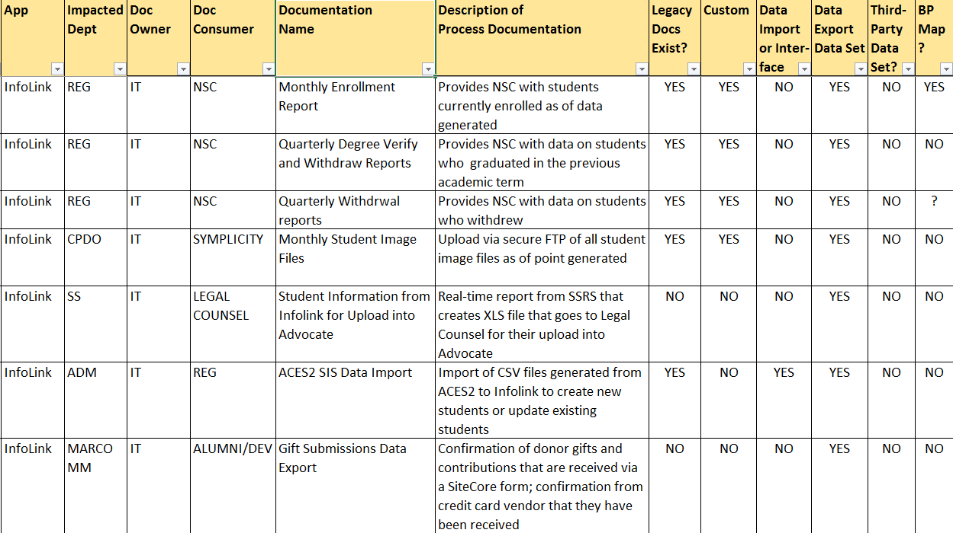
Data Catalog Sample
116
13
Notes:
JANE

Slide 14
Data Inventories
Created for “Data Discovery” visits and updates
Inventories business processes, potential ERP challenges, data definitions and technical information
Resides on DMAP SharePoint site and referenced in ERP work
DELIVERABLES
14
Notes:
JANE

Slide 15
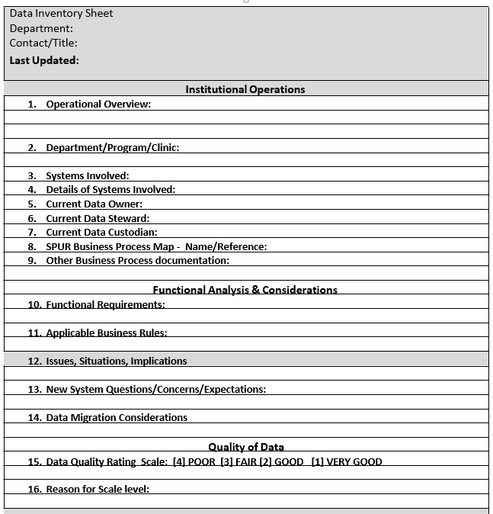
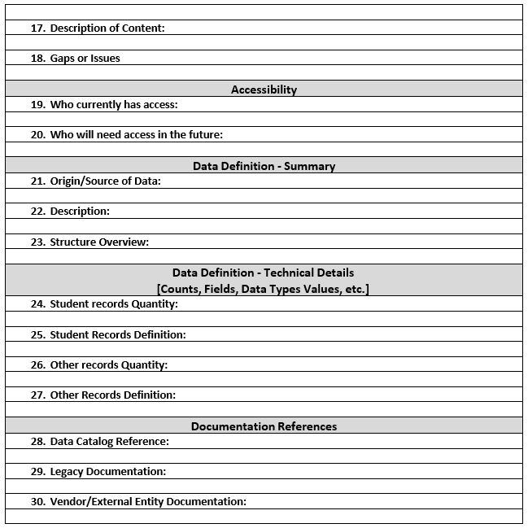
Data Inventory Sample
116
15
Notes:
JANE

Slide 16
Data Diagram
Created to use in presentations
Illustrates high-level future enterprise systems and data
Resides on DMAP SharePoint site and revised often
DELIVERABLES
16
Notes:
JANE

Slide 17
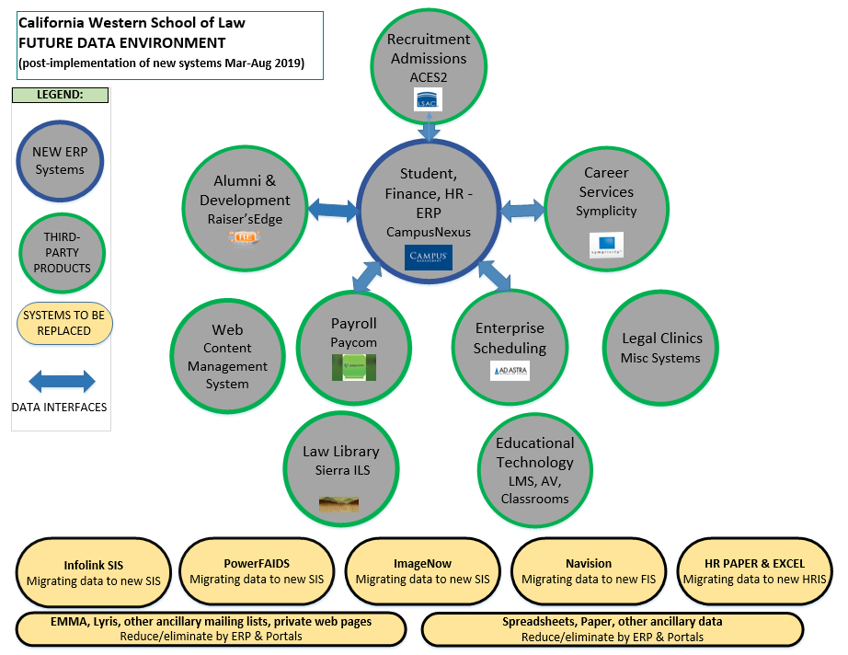
Data Diagram Sample
116
17
Notes:
JANE

Slide 18
Data Quality Report Card
Created to summarize and rate data quality by specific criteria
Evaluates institutional data gaps, concerns and questions
Resides on DMAP SharePoint site and used in ERP planning
DELIVERABLES
18
Notes:
JANE

Slide 19
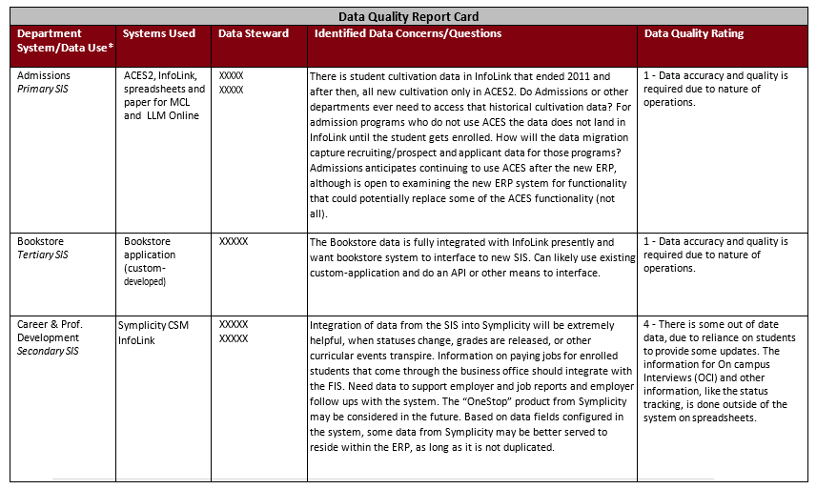
Data Quality Report Card Sample
116
19
Notes:
JANE

Slide 20
PROJECT OUTCOMES
Increased understanding of data assets and constituent roles
Road map for data issues to address in ERP implementation
Blue print and guiding principles for data governance
First steps toward effective data management
NEXT STEPS
Collaborate to navigate the data swamp
Focus on data issues in ERP implementation
Continue data governance foundations and practice
Strengthen the roles of data owners and stewards
20
Notes:
CLINT

Slide 21
Discussion & Questions
This presentation leaves copyright of the content to the presenter. Unless otherwise noted in the materials, uploaded content carries the Creative Commons Attribution 4.0 International (CC BY 4.0), which grants usage to the general public, with appropriate credit to the author.
21
Notes:
ALL THREE

Slide 22
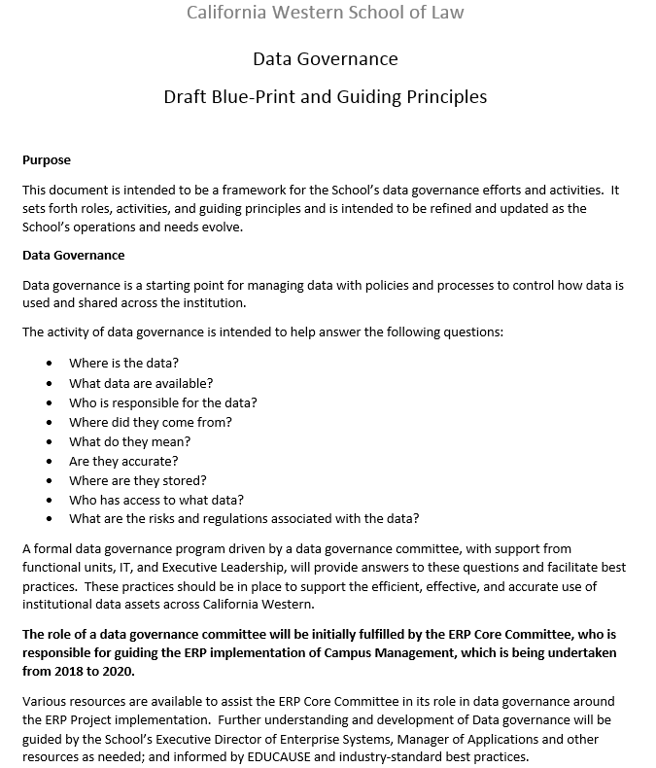
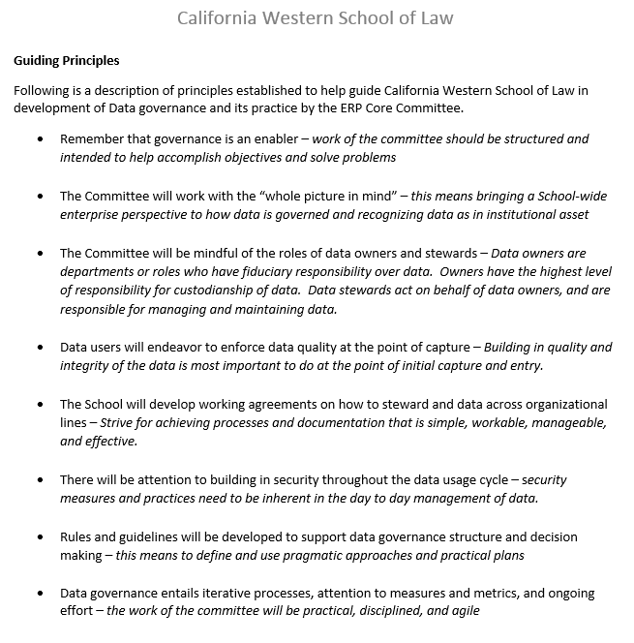
ADDENDUM: SAMPLE OF BLUE PRINT
22
Notes:
JANE – if needed

