Slide 1
The (Free) IT Accessibility Coordinator’s Tool Belt
PRESENTED BY:
Eric Nambo • Jerrod Thomas

Slide 2
Overview
Introductions
Background
Challenge
The Tools
Examples
Closing

Slide 4
Introductions

Slide 5
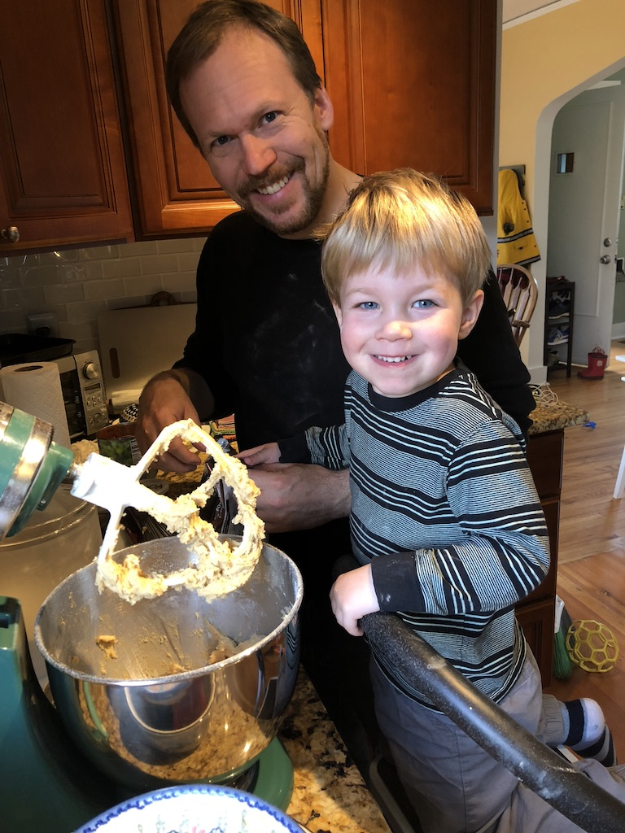
Jerrod Thomas
Ran a BBS in middle school
~10 years of ‘odd nerd jobs’
14 years in HiEd IT
M.Sc. Engineering & Tech Mgmt
Academic & Tech Services:
Service Desk, Academic & Business Apps, Technology Labs & Classrooms, Lecture Capture, Event AV, IT Accessibility

Slide 6
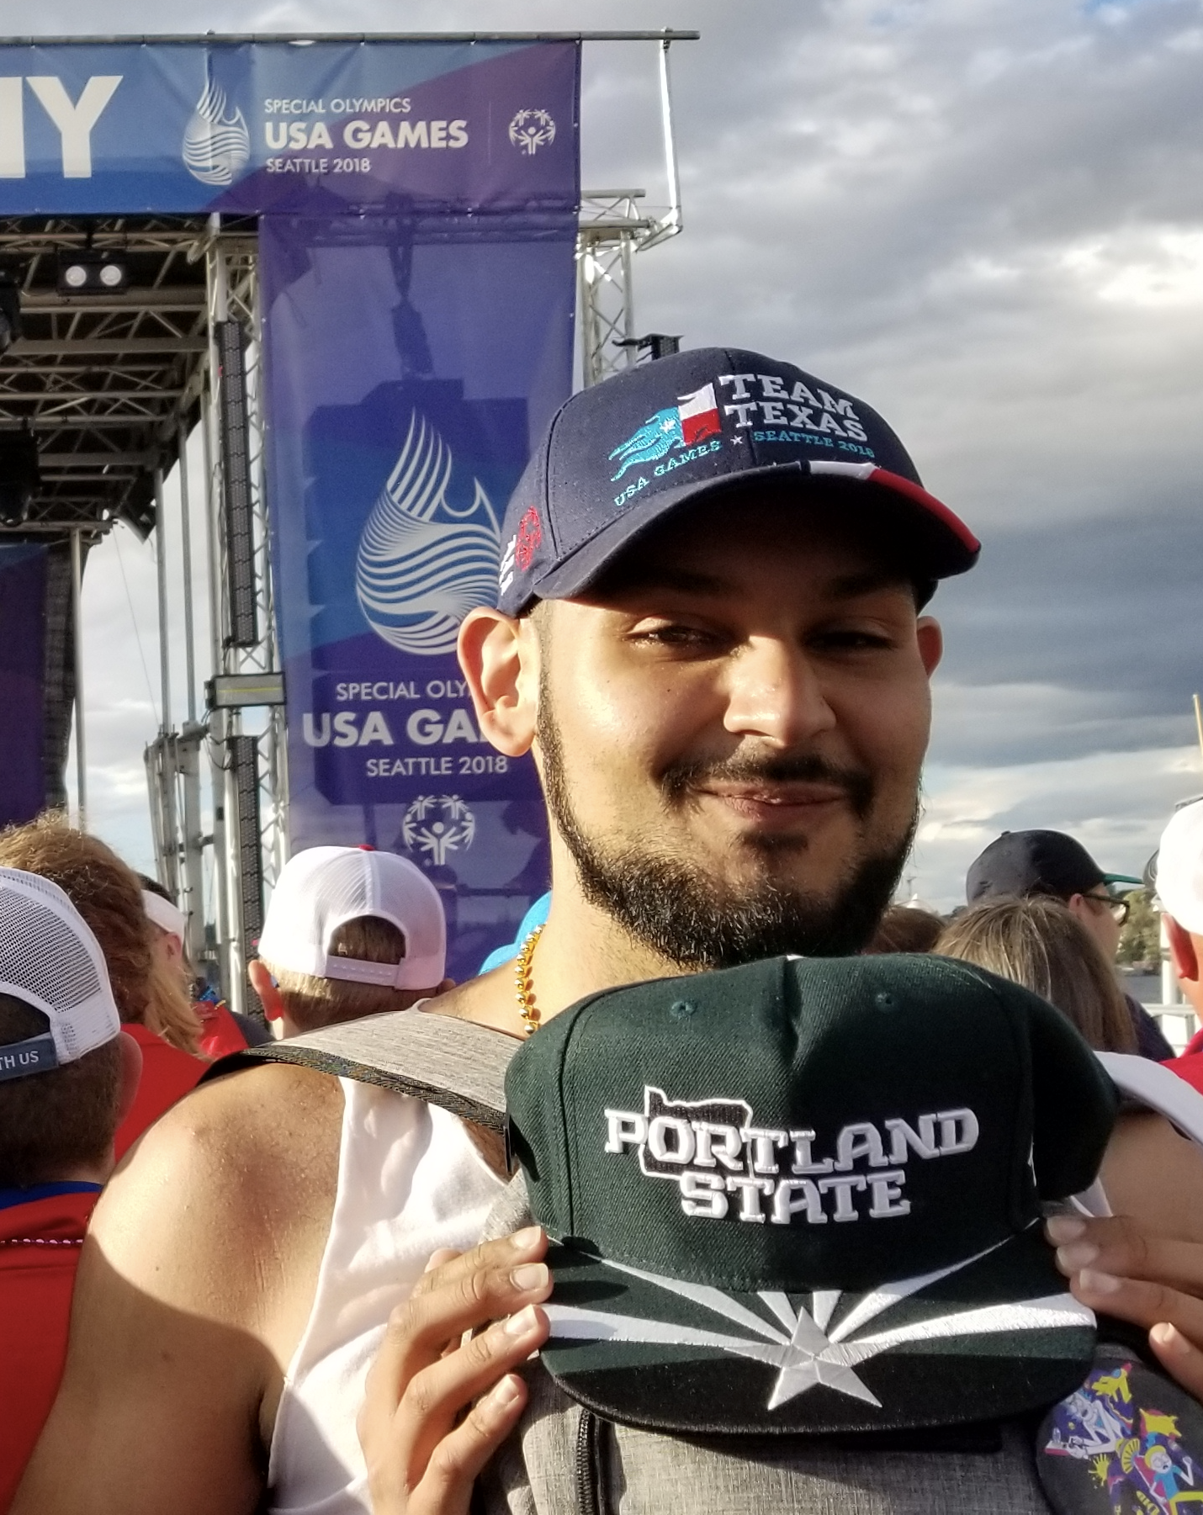
Eric Nambo, CPACC
Certified Professional in Accessibility Core Competencies
Tejano “millennial”
Cognitive Challenges
6 year career; from student, to intern, to faculty instructional designer, to statewide leader & grant writer, to IT, and beyond!
… I used to draw on the walls as a kid =]

Slide 7
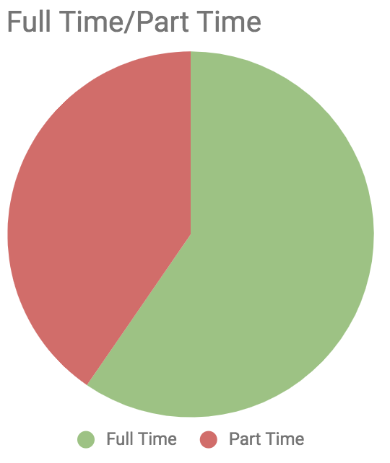
Portland State University
Beautiful Portland, Oregon
~27,000 students, ~19k FTE
Urban commuter campus; non-traditional
“... access, inclusion and equity as pillars of excellence”
Office of Information Technology
Highly centralized (~85% IT spend)
Computer World Top 100 IT Companies to work for 2017, 2018
First person in your immediate family to attend college?
ETRAC Student Survey (2017)

Slide 8
Background

Slide 9
Office of Civil Rights
Deliverables:
Disability notice/statement
Training - Leadership and IT
Plan for new content
Resourcing
Policy
Audit
Corrective Action Plan (CAP)
Fulfill CAP
Complaints against three sites
Voluntary Resolution Agreement
Required some changes
Prior to the resolution agreement, the Accessibility Committee at Portland State was well into drafting an EIT Policy.

Slide 10
Institution’s Initial Response
EIT policy moved forward
Funding secured
Agreed IT was appropriate area
Started hiring process
Provided senior academic leadership training
Terrill Thompson from UW Accessible Tech Services
Formed RFP committee for audit vendor

Slide 11
OCR Timelines
RFP
AUDIT
FIX
D8
Vendor Selection
Corrective Action Plan
Distribute CAP to Content MGRs
Migrate with accessible content
Many steps in the Resolution Agreement require Office of Civil Rights approval before proceeding.

Slide 12
Challenge: Build while flying

Slide 13
Eric Arrives
In process:
Policy
done-ish
Training
done
UW Speaker
Auditors
In progress
Interviews
Pressing deliverables:
Select Auditor
Assist in major CMS design/migration
Communicate & build trust with OCR complaint targets

Slide 14
Things slow down
While we waited for the office of civil rights:
Support requests steady
Service design
Develop documentation
Goals:
Clarify what we do
Create repeatable processes
Track requests and demand
Recommend the best-fit solutions

Slide 15
Ad hoc to repeatable
What do I do for people?
Need to turn into services offerings
What do I use when I do it?
Resources
Need to make checklists
Collect reference material
What do I give them?
Outputs
Need to turn into templates

Slide 17
The Tools

Slide 18
Service Offerings
Service | Description | Outputs
Testing* | Discover actionable accessibility issues | Express Report
Design | Create and/or redesign content w/ focus on universal design | Design System-ish
Development | Code compliantly, fix bugs, recommendations | Code Snippets, references
Contracts | Incorporate accessibility into technology procurement cycle | Boilerplate Language
*Not an audit!

Slide 20
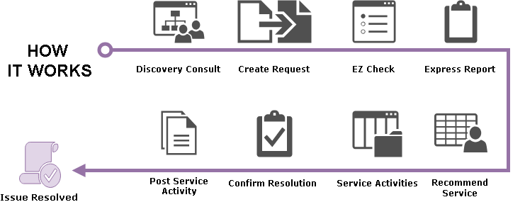
Service Delivery Model

Slide 21
Discovery Consultations
“Diversity”
Technologies
Roles
Timing
Consults became key: “Is this accessible?”
Ask customer WHY!!
Express Report kept appearing around first consult...
“Because I don’t know what might be wrong” Testing “Because we are currently building it” Design “Because this component isn’t accessible” Developer “Because we’re about to buy this new student-facing tool” Contracts

Slide 22
EZ Checks
Page title
Image text alternatives ("alt text")
Text:
Headings
Contrast ratio
Resize Text
Interaction:
Keyboard access and visual focus
Forms, labels, and errors
General:
Moving, Flashing, or Blinking Content
Multimedia (video, audio) alternatives
Basic Structure Check
Adapted from W3C-WAI Easy Checks: A First Review
No Screen Reader Required
Not

Slide 23
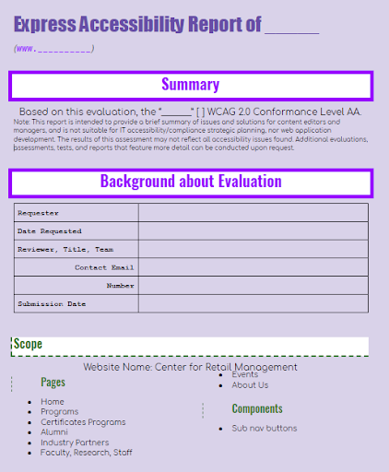
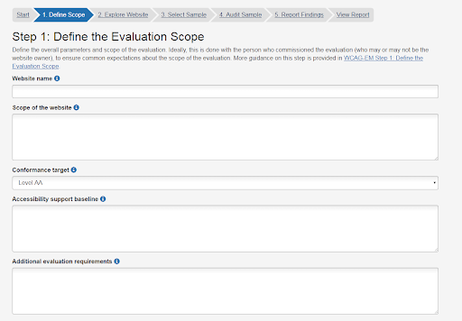
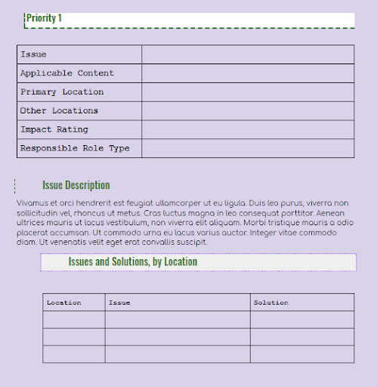
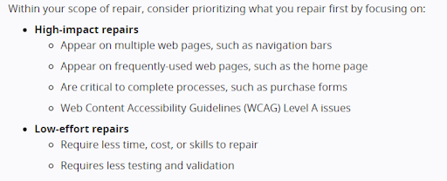
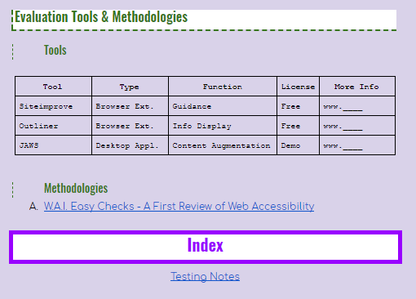
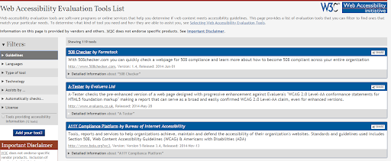
Express Reports
Cover Page: Summary, Background, Scope
Adapted from WCAG-EM Report Tool
Role, Scope, and other Ticketing info
Page: Failed Check
Reports remediation Priorities by Issue
Found via EZ Check
Details about the issue
Where/what about content issue
Impact Rating on Users
Roles that can fix it
Last Page: Tools, Methodologies, & Index
Testing notes (screenshots, audit sheets, etc)

Slide 24
Examples

Slide 25
#1 Issue Resolution at Express Report (EXPrpt -> REZ)
DISCOVERY CONSULT:
Designed a new home page + sub pages
Want to ensure these meet the accessibility standards held by PSU
EZ CHECK:
Headings
Img Text Alternatives
Structure
EXPRESS REPORT:
Priority 1: Make sure headings are used appropriately
Priority 2: Place Headings adjacent to image links
Priority 3: Add alt text to images
ISSUE RESOLUTION:
Be mindful of using image link blocks, especially when content visually provides structure.
Fixed by content editor

Slide 26
#2 Express Report to Design Service (EXPrpt -> DZN)
DISCOVERY CONSULT:
Old google sites
Need a way to show users all programs within department
Want to make custom nav widget accessible
EZ CHECK:
Page Title
Resize Text
KBD & Visual Focus
EXPRESS REPORT:
Priority 1: Consider migration to New Google Sites...
RECOMMEND SERVICE:
DZN: “Pattern Library”
Design Thinking exercise to understand desired UX result, then use better technology (new gSite) to recreate
DZN: “Accessible Media Copy”

Slide 27
#3 Design Service (DZN)
DISCOVERY CONSULT:
Student assistant
Quarterly report infographic (PDF) needs to be accessible
Authored in Canva
EZ CHECK:
Img Text Alt’s
Resizable Text
Structure
EXPRESS REPORT:
Priority 1: Tag PDF
Priority 2: Include Real Text
Priority 3: Use headings for structure
RECOMMEND SERVICE:
DZN: “Accessible Media Copy”
Open PDF in Word
Grab Assets
Create in Powerpoint
Save as PDF
natively axy doc > PDF remediation

Slide 28
#4 Developer Service (DEV + DEV)
DISCOVERY CONSULT:
Old Google search functionality depreciating
New Google Search Engine is being integrated
Is it accessible?
SERVICE ACTIVITY:
DEV: “Targeted Usability Review”
UX Testing
SCENARIO: Search Form Functionality
RESULT: fail
RECOMMEND SERVICE:
Inform developer of issue
DEV: “Component Development & Support”
Send code snippet:
aria-live="polite"
MDN
CONFIRM RESOLUTION:
Retest under identical conditions

Slide 29
#5 Contracts Service (EZ -> CNT)
DISCOVERY CONSULT:
Assess technology of student portfolio software. User should be able to:
Create content
Share content
EZ CHECK:
Page Title
KBD Access & Visual Focus
Forms, Labels, & Errors
EXPRESS REPORT:
Does not meet ATAG 2.0
A.2.2: “editing-view presentation can be programmatically determined”
Priorities 1-3: Issues with WYSIWYG (A.3)
RECOMMEND SERVICE:
CNT: “Equally Effective Alternate Access Plan (EEAAP)”
“4. How will EEAA be provided?”
New Google Sites
Thanks CSU! <3

Slide 31
Closing

Slide 32
Tools & Resources
Service | Tools | Resources
Testing | Siteimprove Free JAWS 40min Trial | WAI Easy Checks
Design | Draw.io | Material.io Designkit.org UXpin.com
Development | ChromeDev Tools | WAI Authoring Practices 1.1
Contracts | Section 508.gov: Define Accessibility Criteria in Contracts | EU Mandate 376: Axy ICT Procurement Toolkit
Link to Tools:
https://goo.gl/y7nVYe
Slide deck
IT Accessibility Workbook
EZ Check
Express Report templates
Jerrod Thomas Eric Nambo
jerrodt@pdx.edu nambo@pdx.edu

Slide 33
Questions?

Slide 34
Poll Time - Why Accessibility
Why Are You Pursuing Accessibility?
What level best describes how you present your accessibility support offerings?
Where is your campus on the Accessibility Maturity Model?
If you could only focus on one service offering, which one would you focus on for your campus?

Slide 35
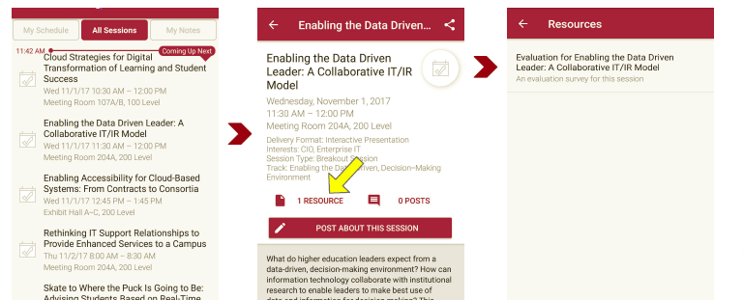
Please take a moment to evaluate this session There are two ways to access the session and presenter evaluations
1
2
In the online agenda, click on the “Evaluate Session” link
From the mobile app, click on the session you want from the schedule > then click the associated resources > and the evaluation will pop up in the list

