Slide 1
IPv6 at the University of Colorado Denver
Mattias Lindgren
Senior Network Engineer

Slide 2
University of Colorado Denver
Anschutz Medical Campus in Aurora and Auraria Campus in downtown Denver.
Approximately 40,000 wired ports and peaks of approximately 18,000 wireless clients.
Running MPLS on both campuses.
Working on more closely integrating connectivity with other CU institutions in Colorado Springs and Boulder – IPv6 will be an important piece.

Slide 3
Address Plans: There are many like it, but this one is mine.
Assigned a /40 from ARIN, advertised by our two internet connections.
Assigned a /42 to each campus, reserving two /42s for future use.
Assigning a /52 to each building on campus. With IPv6 on 95% of wired networks, IPv6 routing table is less than 100 routes.
Clients get addresses from two DHCPv6 servers.
Clients use IGP metric to select “closest” egress to internet.

Slide 4
Future growth and challenges
Deploy IPv6 to wireless. Working with vendor to resolve RA bugs.
Deploy IPv6 to datacenter and server infrastructure.

Slide 5
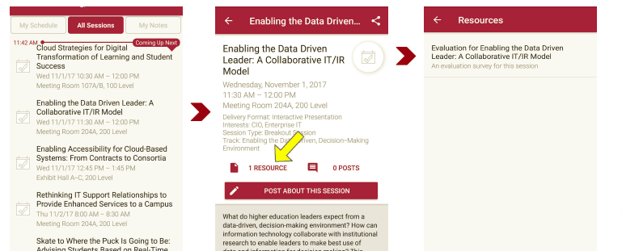
Please take a moment to evaluate this session There are two ways to access the session and presenter evaluations
1
2
In the online agenda, click on the “Evaluate Session” link
From the mobile app, click on the session you want from the schedule > then click the associated resources > and the evaluation will pop up in the list

