Slide 1

IPv6 at Virginia Tech
Brian E Jones
bjones@vt.edu
October 31, 2018

Slide 2

What is IPv6?
From wikipedia:
Internet Protocol version 6 (IPv6) is the most recent version of the Internet Protocol (IP), the communications protocol that provides an identification and location system for computers on networks and routes traffic across the Internet. IPv6 was developed by the Internet Engineering Task Force (IETF) to deal with the long-anticipated problem of IPv4 address exhaustion. IPv6 is intended to replace IPv4.^{[1]} IPv6 became a Draft Standard in December 1998, and became an Internet Standard on 14 July 2017.^{[2]}

Slide 3

Notes:
Everyone has more than one device, not including house hold items such as smart homes, cars, etc…

Slide 4
DIVIDER SLIDE #1

Slide 7
DIVIDER SLIDE #1

Slide 8
DIVIDER SLIDE #2

Slide 10
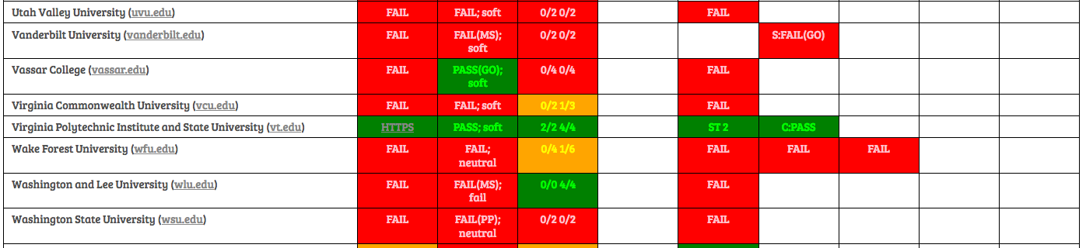
DIVIDER SLIDE #1

Slide 13
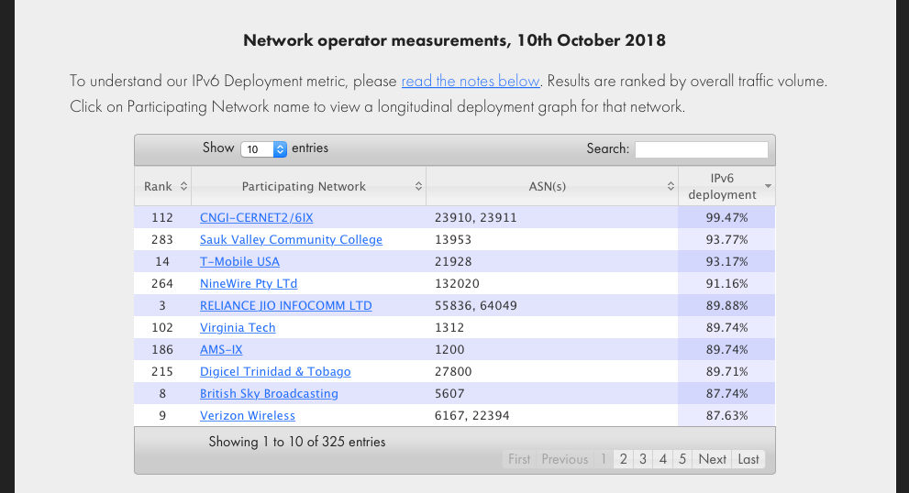
http://www.worldipv6launch.org/measurements/
http://www.worldipv6launch.org/measurements/

Slide 14
https://ahecta.org

Slide 15

The End
Questions?
Brian Jones
email: bjones@vt.edu
LinkedIn:https://www.linkedin.com/in/brianjusa/

Slide 16
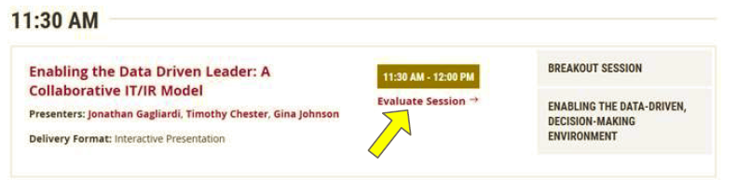
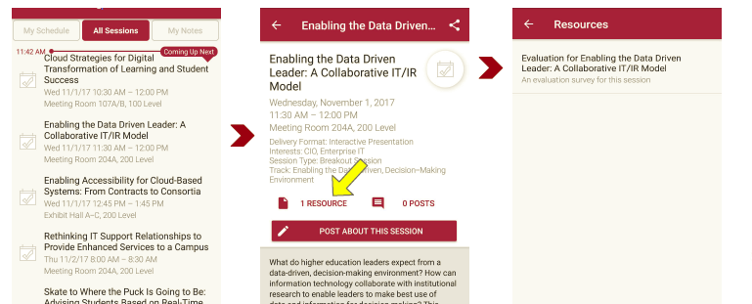
Please take a moment to evaluate this session
There are two ways to access the session and presenter evaluations
1
2
In the online agenda, click on the “Evaluate Session” link
From the mobile app, click on the session you want from the schedule > then click the associated resources > and the evaluation will pop up in the list

