Slide 1
Lead the Charge:
CSU’s Transformational Data Program
PRESENTED BY:
Brendan Aldrich
Chief Data Officer
California State University, Office of the Chancellor

Slide 2
This presentation leaves copyright of the content to the presenter. Unless otherwise noted in the materials, uploaded content carries the Creative Commons Attribution 4.0 International (CC BY 4.0), which grants usage to the general public, with appropriate credit to the author.

Slide 3
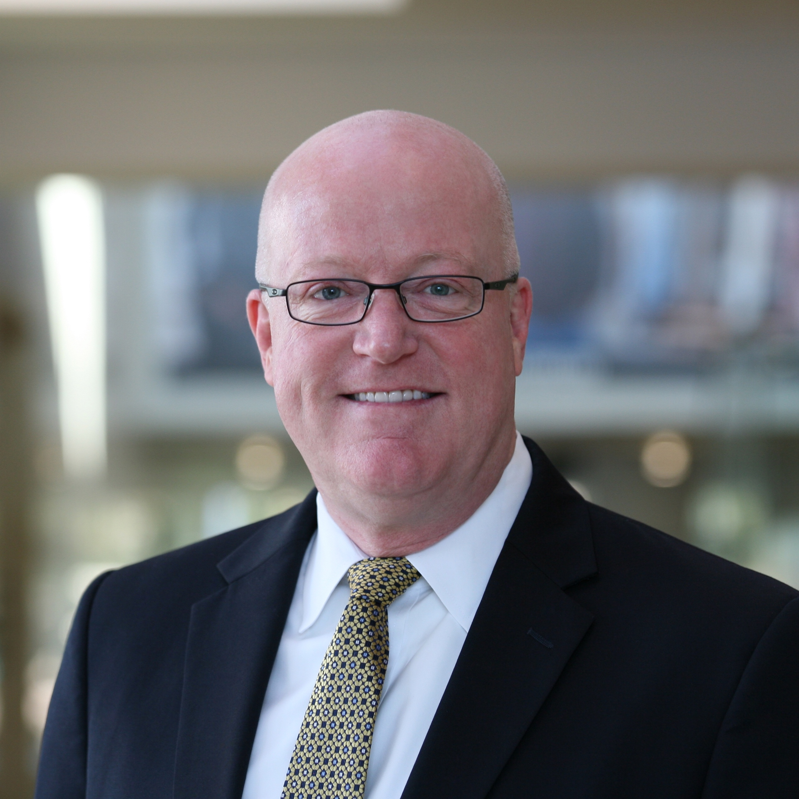
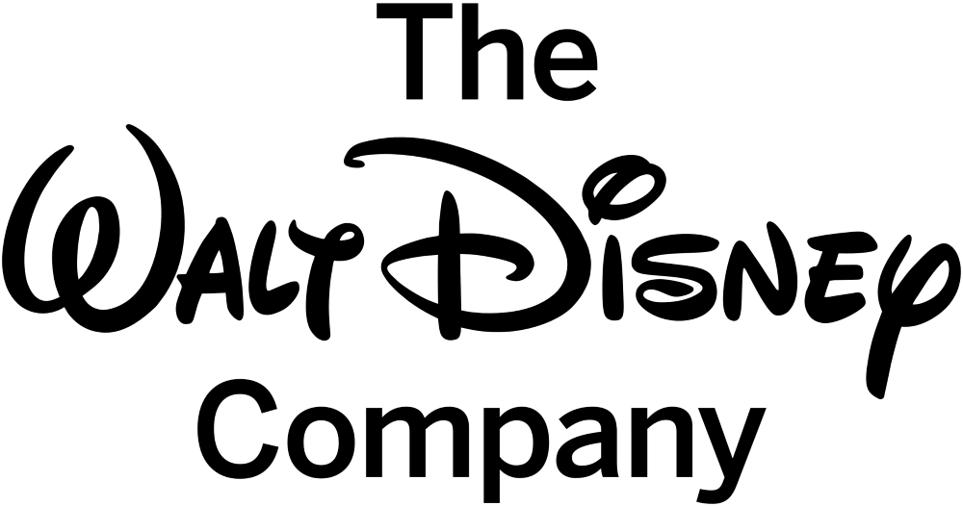
R. Brendan Aldrich
Chief Data Officer
California State University, Chancellor’s Office
18+ years focused on the fields of data warehousing, business intelligence, analytics & research
Have led data transformation and modernization initiatives for private and public organizations:
Co-chair of the EDUCAUSE Higher Education Chief Data Officers Working Group

Slide 4
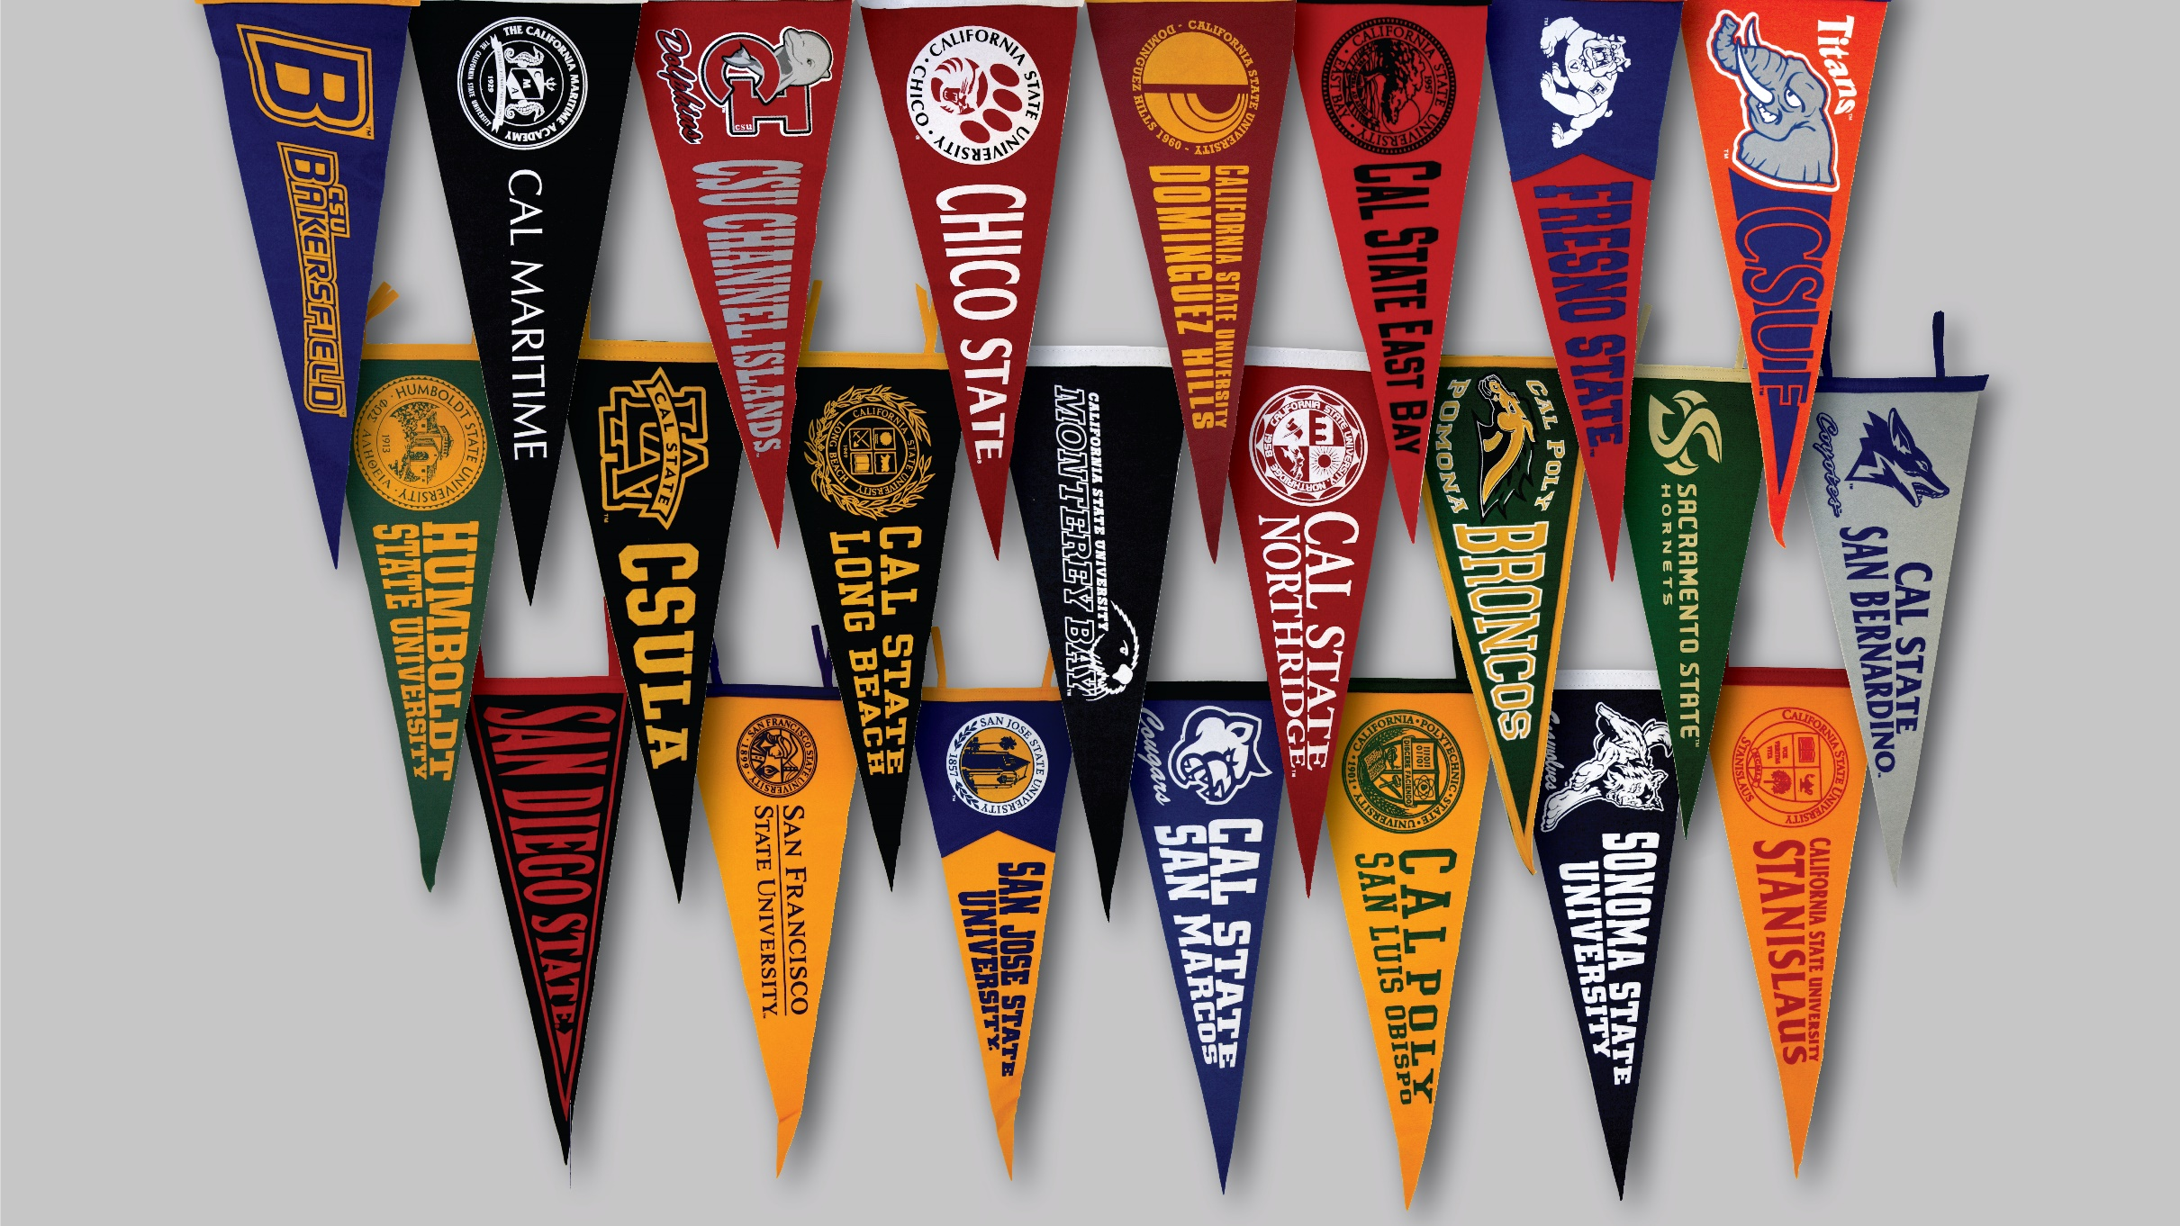
The Largest and most diverse system of 4-year higher education in the Nation
23 Campuses
~50K Employees
Nearly 500k enrolled students this year
Notes:
The CSU awards nearly half of the state’s baccalaureate degrees.
1 in 10 employed graduates came from CSU… representing 1 in 20 college degree holders nationwide!
We produce in the neighborhood of 120,000 graduates per year and our more than 3.4 MILLION living alumni are employed in every field across the world

Slide 5
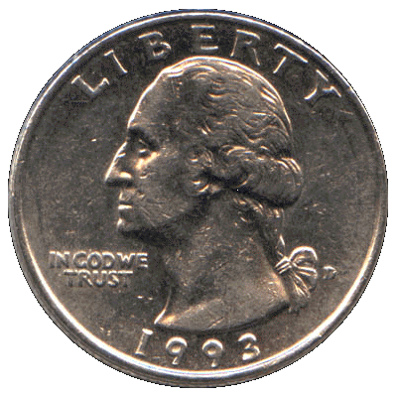
Improving the Odds

Slide 6
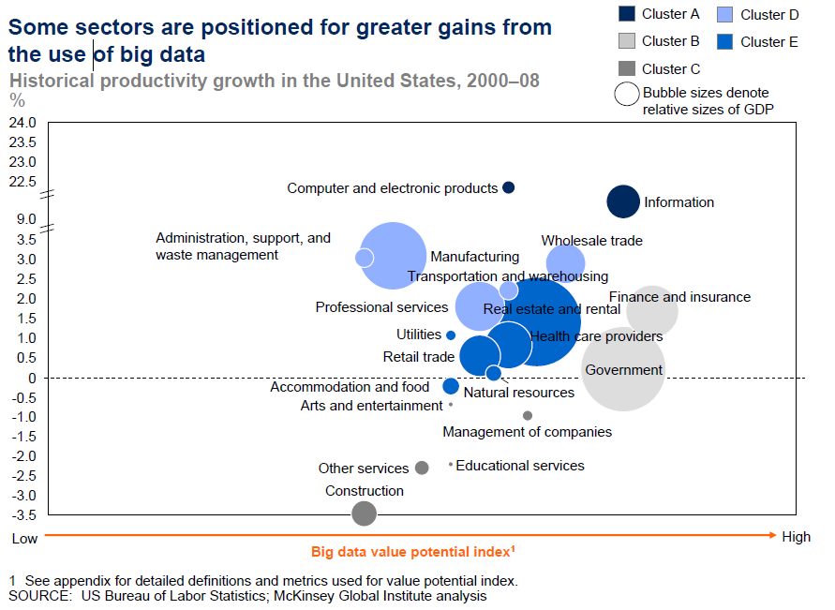
Big Data: Systemic Barriers for Education
James Manyika, Michael Chui, Brad Brown, Jacques Bughin, Richard Dobbs, Charles Roxburgh and Angela Hung Byers, McKinsey Global Institute, “Big data: The next frontier for innovation, competition and productivity”, 5/11, http://www.mckinsey.com/insights/business_technology/big_data_the_next_frontier_for_innovation
Notes:
Education NEEDED to think differently about data because it was positioned so poorly!
McKinsey revisited this report in December 2016 and found that most companies are capturing AT MOST… 30% of the value they could
They mention how Education can leverage Radical Personalization as one disruptive model
Work that we had already started at Ivy Tech
Project Early Success
Comprehensive Degree Audit

Slide 7
The More Things Change…
1960’s: General Mills/Dartmouth College, “Facts” & “Dimensions”
1970’s: Technology Growth and Advancement
1980’s: Barry Devlin & Paul Murphy, “The Business Data Warehouse”
1990’s: Ralph Kimball and Bill Inmon
1996 – 2010’s: The Golden Age of Data Warehousing

Slide 8
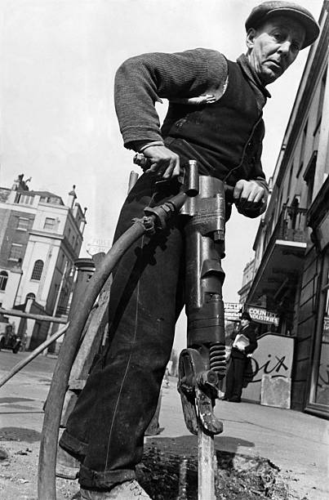
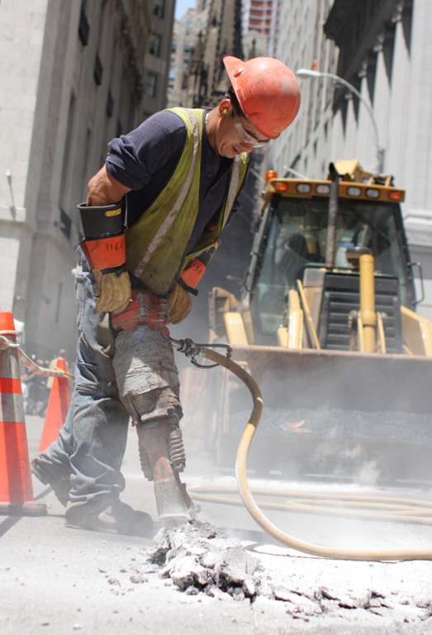
…The More They Stay The Same.
By and large, the vast majority of organizations are still managing their data assets using the same techniques they have for over 30 years.

Slide 9
Uncommon Sense…
The traditional enterprise data warehouse copies the data it needs into a central location, transforms it into a common format, removes the noise, reconciles the inconsistencies, and creates a pristine, holistic, enterprise view that seamlessly combines information from disparate business units and third-party data brokers.
Then, just as it reached maturity, the enterprise data warehouse died, laid low by a combination of big data and the cloud.
Ian Dudley, Enterprise Architect
¹ - Dudley, Ian; “Uncommon Sense: The Big Data Warehouse”, 6/23/2016, http://www.nielsen.com/us/en/insights/news/2016/uncommon-sense-the-big-data-warehouse.html

Slide 10
Traditional Data Warehouse Problems
FIN
Data Marts
PS
HR
Data Sources
Data Warehouse
Cubes
Reports / Dashboards

Slide 11
Traditional Data Warehouse Problems
FIN
Data Marts
PS
HR
Data Sources
Data Warehouse
Cubes
Reports / Dashboards
Transactional Source(s) = No stable data history
Like trying to dip your toe in the same place of the river twice… it doesn’t work
Notes:
Getting the same data out of these systems repeatedly is like trying to dip your toe in the same part of a river twice. It just doesn’t happen.
This means that when we add new data to a traditional data warehouse we have to wait... months... a year... to build up enough data for trending and multi-year analytics.
What are the chances that your hot button issue right now will wait a year for good depth of data to develop before you need to take action?

Slide 12
Traditional Data Warehouse Problems
A + B = No
A + C = No
FIN
Data Marts
PS
HR
Data Sources
Data Warehouse
Cubes
Reports / Dashboards
Schema-first means we only focus on the questions we know
No guarantee we can answer questions we haven’t yet been asked
Notes:
The data included only represents (best case) the questions we’re asking today - meaning that the data you need to answer business questions you haven’t thought of yet isn’t there.

Slide 13
Traditional Data Warehouse Problems
Student Data Warehouse
Fewer than 100 tables
Dozens student tables
100’s of attributes
FIN
PeopleSoft Student
23,000 tables
400 student tables
1,000’s of attributes
Data Marts
PS
HR
Data Sources
Data Warehouse
Cubes
Reports / Dashboards
Entire DW is just a limited set of ALL the available information
Even from just a single system… much less LMS, card swipe, housing, etc.
Notes:
Housing, parking, advancement, card swipe, network logins, e-mail activity, LMS data, advising data, marketing data...
Seriously, the list just goes on and on.

Slide 14
Traditional Data Warehouse Problems
FIN
Data Marts
PS
HR
Data Sources
Data Warehouse
Cubes
Reports / Dashboards
It’s SLOW to add new data to a traditional data warehouse
We have to build structure before we can add the data to START using it!
Notes:
It’s slow to add new data since we have to take the time to build structures for that data before we can even load it and START to think about how we’ll use it.

Slide 15
Traditional Data Warehouse Problems
FIN
Data Marts
PS
HR
Data Sources
Data Warehouse
Cubes
Reports / Dashboards
Cleansing instead of Validating
Creates a warehouse that is increasingly disconnected from source systems
Notes:
Trying to “cleanse” data in the warehouse as opposed to the source system(s) from where the data was obtained. This creates a warehouse that is increasingly disconnected from what we see in our front-of-house systems and does nothing to improve the data we use every day to operate our institutions and support our students.

Slide 16
Traditional Data Warehouse Problems
FIN
Interesting!
Useful
Interesting!
Data Marts
PS
Interesting!
Useful
HR
Data Sources
Data Warehouse
Cubes
Reports / Dashboards
Can’t tell the difference between Interesting and Useful
Enormous efforts spent integrating data that will never be used again

Slide 17
Traditional Data Warehouse Problems
FIN
Data Marts
PS
HR
Data Sources
Data Warehouse
Cubes
Reports / Dashboards
Bottlenecking the enterprise through a single team
You can only move as fast as the assigned resources… and no faster
Notes:
Bottlenecking: we think of an “enterprise” data warehouse as a single thing for the organization. If it’s a single thing, we should have one group of people who build, support, analyze, and produce reports from it, right? How many people do you need in that group to effectively address the needs of 5k employees? How about 43k employees? And in a timely manner? How many people do you have?

Slide 18
So What Do We Do?

Slide 19
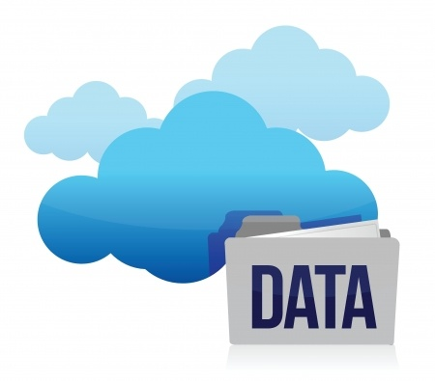
Data Lakes and the Cloud

Slide 20
Getting More from the Data Lake…
FIN
PeopleSoft Student
23,000 tables
400 student tables
1,000’s of attributes
PS
HR
Data Sources
Delphix
(Rolling 365 Days)
Cloud-based Copy
Data Lake
(No historical limit)
The CSU Data Lake creates a historically stable daily copy of all tables utilized for analytics with the ability to add 365-days worth of history for any tables not already included.

Slide 21
Getting More from the Data Lake…
FIN
PeopleSoft Student
23,000 tables
400 student tables
1,000’s of attributes
Expected Completion: Oct/Nov 2018
PS
HR
Data Sources
Delphix
(Rolling 365 Days)
Cloud-based Copy
Data Lake
(No historical limit)
Better than a Traditional Data Warehouse:
We now create historical stability in systems that don’t natively do this.
Collecting all data means we can now answer questions that haven’t yet been asked
Data is quickly added to Data Lake and adding a year’s worth of tables is done in hours

Slide 22
Extending the Data Lake…
We will coordinate with campus teams starting around Feb 2019 for training on how to build a campus data lake using this process.
FIN
CO
PS
HR
LMS
Campus
ADV
Swipe
Data Sources
Delphix
(Rolling 365 Days)
Cloud-based Copy
Data Lake
(No historical limit)

Slide 23
Extending the Data Lake…
We will coordinate with campus teams starting around Feb 2019 for training on how to build a campus data lake using this process.
FIN
CO
PS
HR
LMS
Better than a Traditional Data Warehouse:
ALL historically stable data from all systems is available for use
Campus
ADV
Swipe
Data Sources
Delphix
(Rolling 365 Days)
Cloud-based Copy
Data Lake
(No historical limit)

Slide 24
Extending the Data Lake…
Better than a Traditional Data Warehouse:
Using the data lake as a source, campus data warehouses will be able to bring in years of historically stable data.
FIN
CO
PS
HR
LMS
Campus
ADV
Swipe
Data Sources
Delphix
(Rolling 365 Days)
Cloud-based Copy
Data Lake
(No historical limit)
Transformations
Campus
DW

Slide 25
Capitalizing on the Data Lake…
S
S x T
FIN
S x C
CO
PS
S x D
HR
…
CO DW
LMS
Better than a Traditional Data Warehouse:
Data will be validated (not cleansed) and we will help teams build exception reports for data entry teams.
Campus
ADV
Swipe
Data Sources
Delphix
(Rolling 365 Days)
Cloud-based Copy
Data Lake
(No historical limit)

Slide 26
Better than a Traditional Data Warehouse:
Ability for local teams to support their constituents while maintaining statewide integrity
Capitalizing on the Data Lake…
S
S x T
FIN
S x C
CO
PS
S x D
HR
…
CO DW
S_cmp
LMS
S x T_cmp
Campus
ADV
S x C_cmp
Swipe
S x D_cmp
Data Sources
Delphix
(Rolling 365 Days)
Cloud-based Copy
Data Lake
(No historical limit)
Transformations
Campus
DW
S x ?_cmp
…

Slide 27
Athena
Better than a Traditional Data Warehouse:
Ability to query the entire data lake to prototype “interesting” questions before curating data into your “useful” data collections!
Capitalizing on the Data Lake…
S
S x T
FIN
S x C
CO
PS
S x D
HR
…
CO DW
S_cmp
LMS
S x T_cmp
Campus
ADV
S x C_cmp
Swipe
S x D_cmp
Data Sources
Delphix
(Rolling 365 Days)
Cloud-based Copy
Data Lake
(No historical limit)
Transformations
Campus
DW
S x ?_cmp
…

Slide 28
Athena
Capitalizing on the Data Lake…
S
S x T
FIN
S x C
CO
PS
S x D
HR
…
CO DW
BI App
S_cmp
LMS
S x T_cmp
Campus
ADV
S x C_cmp
Swipe
S x D_cmp
Data Sources
Delphix
(Rolling 365 Days)
Cloud-based Copy
Data Lake
(No historical limit)
Transformations
Campus
DW
S x ?_cmp
BI App
…

Slide 29
End of Phase 1
What’s Next?
Data Governance
Beyond Platforms and Governance

Slide 30
A Note About Data Governance:
Data Governance is often best engaged once we have data to govern
Data governance is a living, breathing, ongoing effort… just like everything else we do
We must correctly identify, engage, and mobilize the correct “Data Stewards”
A lack of engagement has multiplying negative effects down the road
When creating data governance, don’t let “perfect” become the enemy of “good”
Plan for an inclusive vocabulary that represents all needs distinctly

Slide 31
Beyond Platforms and Governance:
Data Realization:
Improving access to data will improve operational and student success
Creating “Knowledge Partners”:
Concierge-type data interpretation services instead of data provisioning
Focus on promoting the “Insight -> Action -> Result” Cycle
Often we gain insights without taking action, or we do take action without measuring the results. Only through all three steps to we gain effective transformation

Slide 32
Improving the Odds

Slide 33
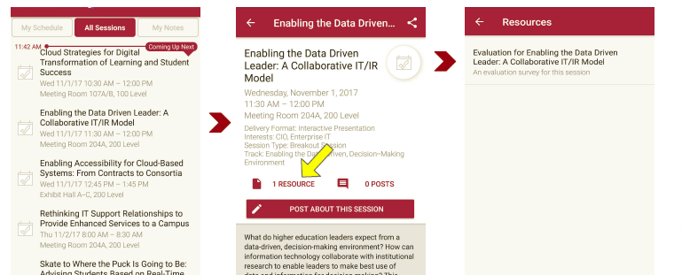
Please take a moment to evaluate this session There are two ways to access the session and presenter evaluations
1
2
In the online agenda, click on the “Evaluate Session” link
From the mobile app, click on the session you want from the schedule > then click the associated resources > and the evaluation will pop up in the list

Slide 34
Let’s Connect!
R. Brendan Aldrich
Chief Data Officer
California State University, Chancellor’s Office
LinkedIn:
www.linkedin.com/in/brendanaldrich/
Twitter:
@CalStateCDO

Slide 35
Appendix

