Slide 1
Leveraging Technology for Holistic Advising: Lessons from the Field
Brian Hinote, Middle Tennessee State University Christopher Roth, Guttman Community College
Associate Vice Provost Academic Technology Coordinator
Lauren Pellegrino, CCRC Serena Klempin, CCRC
Senior Research Associate Senior Research Associate
Notes:
Welcome
Thank you

Slide 2
Objectives/Agenda
Introduce iPASS
The Middle Tennessee State University Story
The Guttman Community College Story
Questions

Slide 4
iPASS/Technology-Mediated Advising

Slide 5
Definition of Technology-Mediated Advising and Student Support
Use of technology to promote, support, and sustain long-term, holistic advising relationships. Technology enables personnel throughout the college to engage in advising and student support relationships that:
approach student support as a teaching function,
touch students on a regular basis, and
connect them to the information and services they need when they need them, in order to keep students on track to graduation.
(Karp, Kalamkarian, Klempin, & Fletcher, 2016)

Slide 6
…So Why iPASS?
Exponential expansion of investment in technology for student support
Bill & Melinda Gates Foundation launched second round of funding for iPASS in 2015
Over 40 institutions represented in iPASS grantee cohort
Over 120 planning and advising technology vendors (Tyton, 2014)
Despite extensive investment in iPASS, we need to know…
if and how students who experience iPASS make greater academic progress
Notes:
Why study IPASS?

Slide 7
…So Why iPASS?
Developmental advising contributes to student persistence.
Developmental advising helps students define, clarify, and achieve their personal, academic, and career goals
(Donaldson, McKinney, Lee, & Pino, 2016; Hatch & Garcia, 2017; Mier, 2018; Tinto, 1993; Varney, 2007, 2012).
Yet…little is known about developmental advising in a technology-mediated environment.

Slide 8
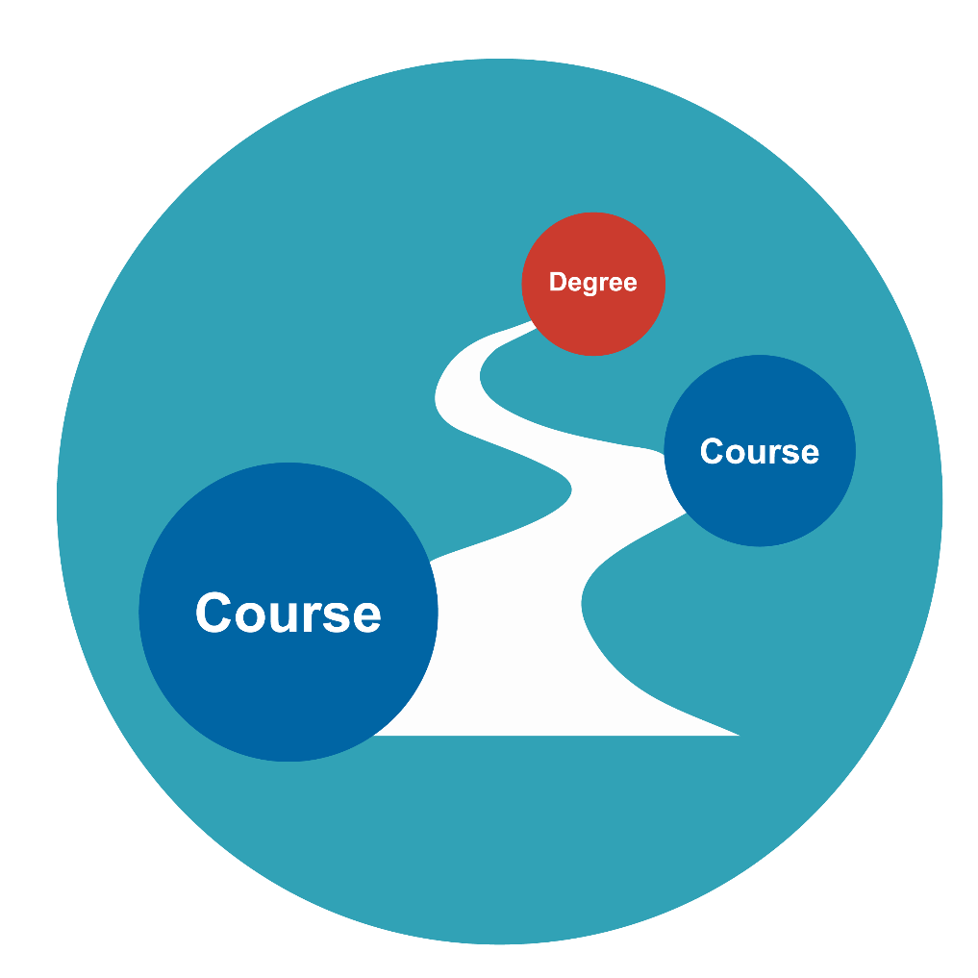
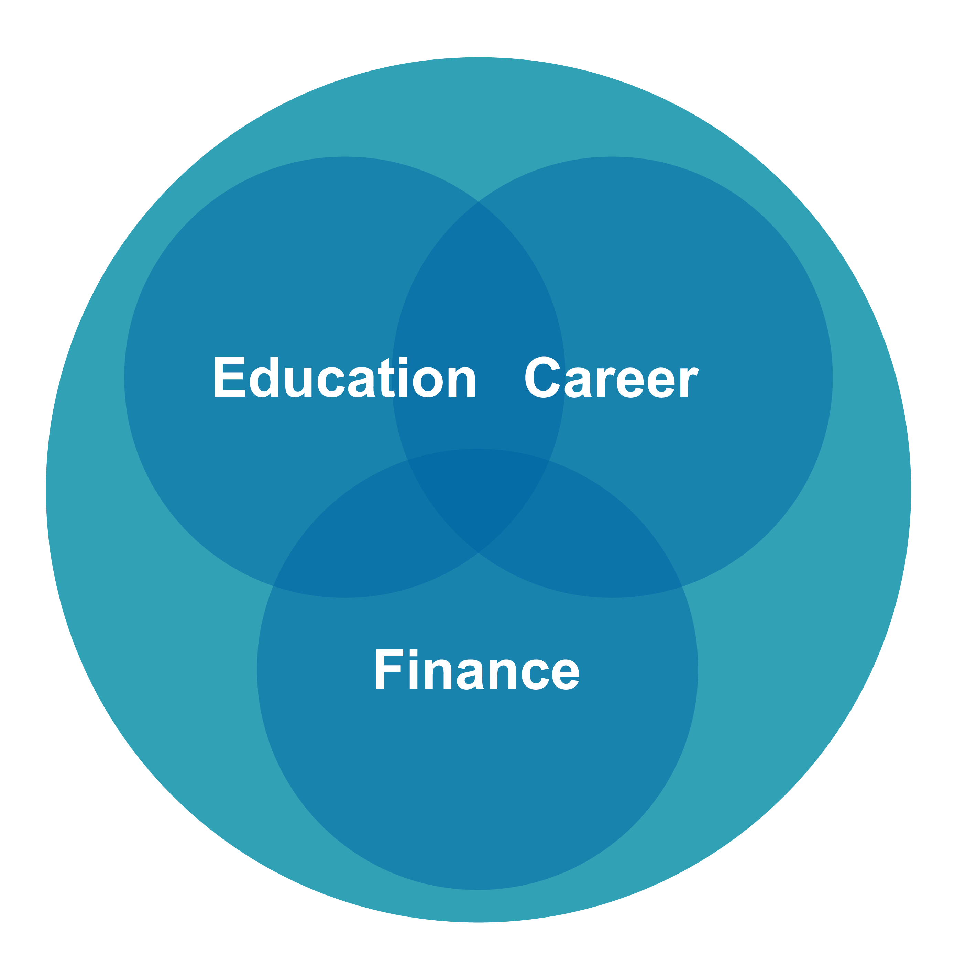
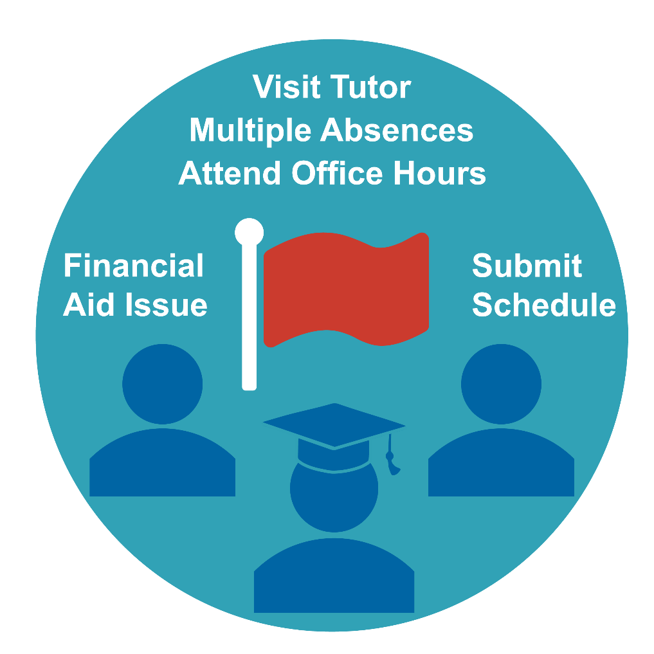
What are iPASS Technologies?
+
+
Degree Planning
Coaching & Advising
Early Alerts & Risk Targeting
Notes:
WHAT DO I MEAN WHEN I SAY TECHNOLOGY-MEDIATED ADVISING OR IPASS? THESE TERMS REFER TO STUDENT RETENTION SYSTEMS THAT ARE DESIGNED TO LEVERAGE TECHNOLOGY TO ENHANCE DEGREE PLANNING, COACHING AND ADVISING, AND RISK TARGETING. FOR EXAMPLE, IPASS INCLUDES TOOLS THAT STUDENTS AND ADVISORS CAN USE TO MAP OUT COURSES STUDENTS HAVE TO TAKE FOR A PARTICULAR MAJOR OR EARLY ALERT SYSTEMS THAT ASK FACULTY TO RAISE FLAGS IDENTIFYING ACADEMICALLY AT RISK STUDENTS.
-------------------------------------------
THESE ARE STUDENT RETENTION SYSTEMS THAT ARE DESIGNED TO LEVERAGE TECHNOLOGY TO ENHANCE AND STREAMLINE COURSE ADVISING, SELECTION, REGISTRATION, TRACKING OF STUDENT PROGRESS AND TARGETING OF SUPPORT SERVICES. TO GIVE YOU AN EXAMPLE, EARLY ALERTS SYSTEMS THAT
THAT ARE SOMETIMES REFERED TO AS A INTEGRATED PLANNING AND ADVISING SERVICES
Student retention systems designed to leverage technology to enhance and streamline course advising, course selection, and course registration, tracking of student progress, and targeting of support services in order to improve academic decision-making as well as institutional strategies to help students stay on track to degree attainment.
HIGHER EDUCATION INSTITUTIONS ARE INCREASINGLY INTERESTED IN USING TECHNOLOGY TO DELIVERY SUPPORT SERVICES. THESE TECHNOLOGY-MEDIATED SYSTEMS ARE SOMETIMES CALLED INTEGRATED PLANNING AND ADVISING SERVICES OR IPAS. IPAS PRODUCTS INCLUDE EARLY ALERT SYSTEMS AND EDUCATION PLANNING MODULES, OR TOOLS THAT STUDENTS AND ADVISORS CAN USE TO MAP OUT COURSES STUDENT HAVE TO TAKE FOR A PARTICULAR MAJOR.

Slide 9
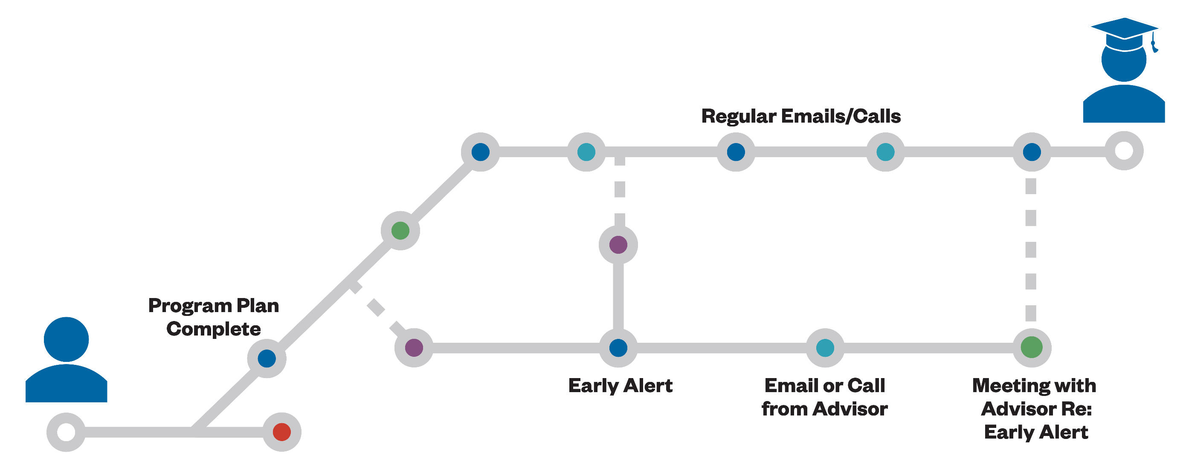
iPASS Can Enable Holistic Student Support
Notes:
Technologies may be leveraged to move advising closer to a SSIPP model. Ideally, these tools offer efficient delivery of information, freeing up advisor time to provide more holistic support.
Can help resolve the capacity and other structurally issues that make SSIPP difficult to implement. Allow for TRIAGE of students.
For example, some advising technologies allow:
advisors to quickly send messages to students with links for setting up an advising appointment, making it easier to check-in with students over the course of the semester
Advisors can review early alert and predictive analytic data and REFER students exhibiting academically risky behavior to services such as tutoring; or submit the referral electronically and notify both the student and the service provider.
This is the broader theory. In a bit will hear from colleges about implementation in practice.

Slide 10
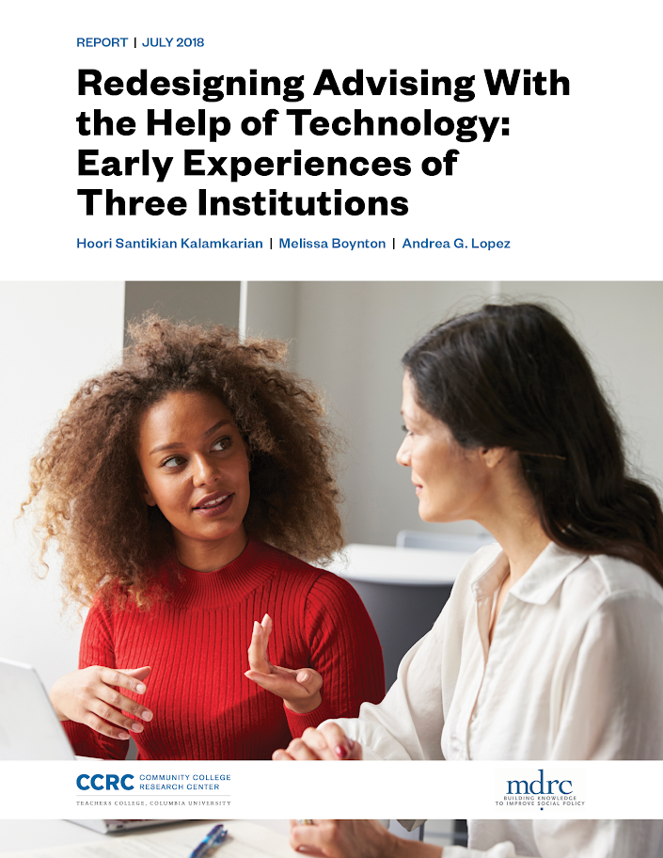
Check out our latest brief and stay tuned for upcoming publications! ccrc.tc.columbia.edu

Slide 11
Middle Tennessee State University
Brian Hinote

Slide 12
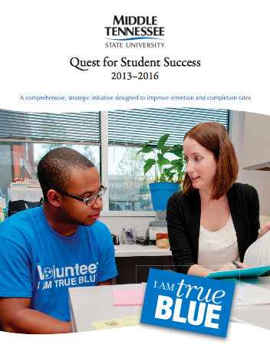
Background
Quest for Student Success
Advising Enhancements
Setting the stage for tech
SSC Campus, DegreeWorks
Holistic advising
Primary element of record persistence, retention, completion

Slide 13
iPASS Implementation
SSC-C, March 2016
Phased adoption, university wide advisor utilization
Note-taking, documentation first
Online scheduling, population analytics
Early alerts, progress reports student support offices
Learner Support, Athletics, Housing, CSCS, CDC, etc.
DegreeWorks, May 2018
Intermediate advisor application/utilization
Veterans Center, CPoS
Student utilization sporadic

Slide 14
iPASS Today
Technology as catalyst for culture change
Striving to enhance holistic advising
College-level
Faculty
Scholars Academy, Vets, CSCS, etc.
No going back!

Slide 15
Challenges
A decentralized advising model
Working through the university structure
Maintaining momentum
Resistance to change

Slide 16
Opportunities
Unequivocal leadership
Empowering advisors’ work
Focus – strategic, tactical, technical
Process over product
Multi-/Cross-functional teamwork

Slide 17
Looking Forward
Pushing the limits of these technologies
Leveraging analytics, early identification
“Leading” indicators
Catching risk factors/behaviors early
Increasing utilization
Opening up new user bases

Slide 18
Lessons: Implementation
Cast your narrative – start with the “why”
Then the “what” and the “how”
Run toward criticism
Communicate vision, but also progress
Customize your messaging
Build momentum, keep pressing
Include, engage front-line users

Slide 19
Lessons: Post-Implementation
Maintain momentum, customize training models
Seek out new applications/enhancements
But don’t chase all the new features
Work from vision, and serving students
Communicate progress
Narrow range of metrics aligned with vision
Follow closely, report regularly
Add value, paint a clear picture, advance change.

Slide 20
Guttman Community College
Chris Roth

Slide 27
Thank you!
Questions?

