Slide 1
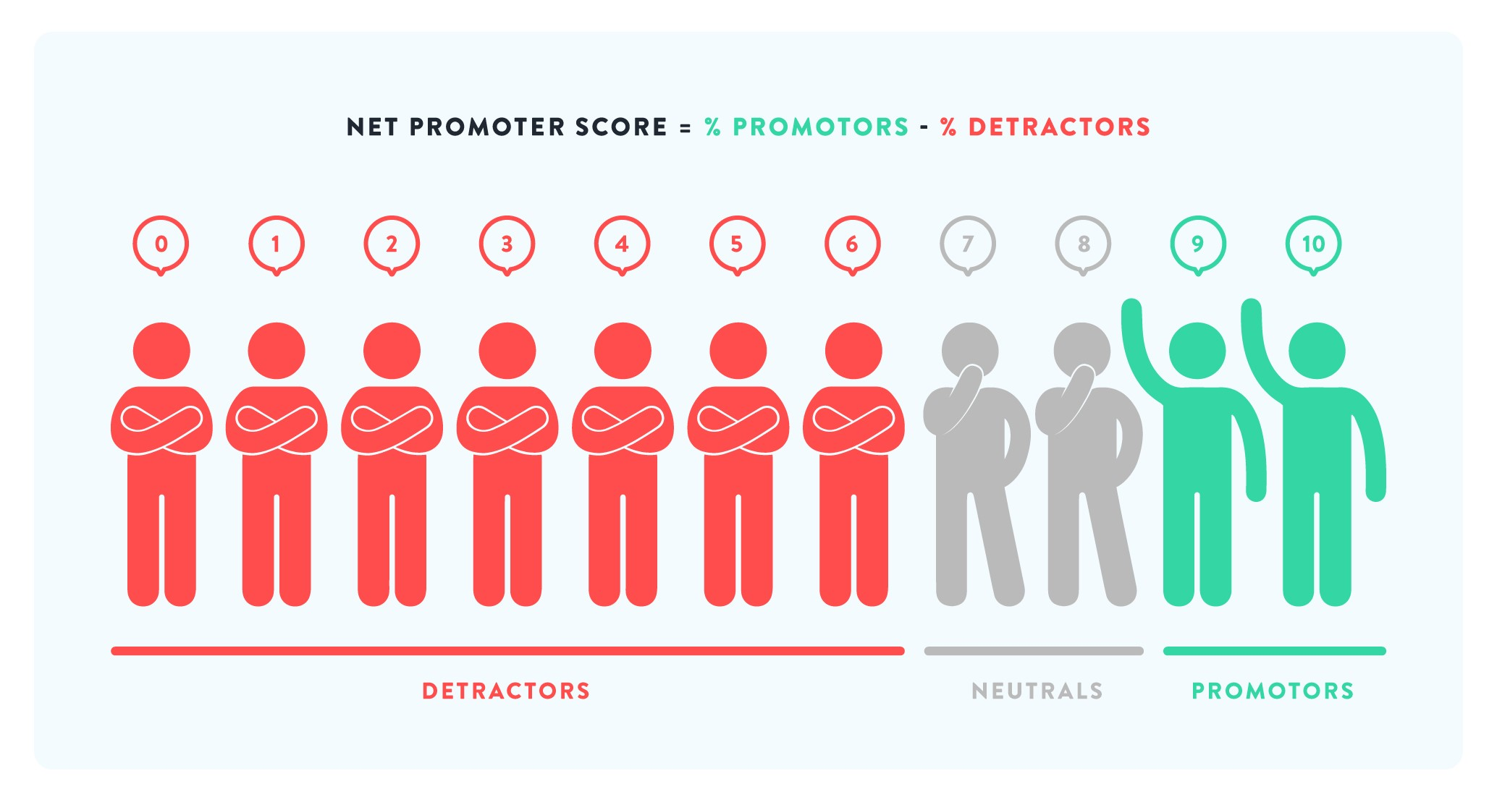
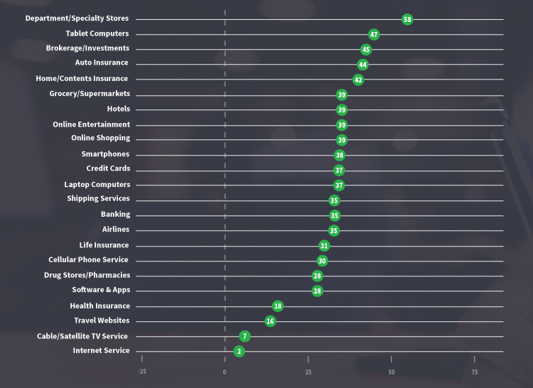
Customer Relationship Improvement Planning
Define the problem(s)
Based on what you know through conversations, service metrics, observations, etc., what issues with customer satisfaction are you facing in your current IT environment? _______________________
_____________________________________________________
Measure!
What tools can you use to measure customer attitudes toward your IT services? _____________________________________________
______________________________________________________
On a Net Promoter Score scale (0-10), how might your customers rate your IT services? ___
Analyze
How can you collect, review, and interpret qualitative data to enrich your quantitative feedback? ______________________________________
___________________________________________________________________________________________
Improve..
What projects can you undertake for improvement? ____________
__________________________________________________________
Who can lead these projects? ______________________________
__________________________________________________________
Control and Continuously Improve
How can you measure the customer experience in an ongoing way? _______________________________________________________
What approach can be used to continuously improve? ___________
______________________________________________________

