Slide 1
Lindsay MacDonald
Sessions
BRM presentation: Slot 2, Wed October 31 1.30 – 2.15pm Value Leakage presentation: Slot 9, Friday Nov 2 8.00 – 8.45am

Slide 2
STOP LEAKING VALUE Deliver more value with no extra effort
Lindsay MacDonald
Monash University - Australia

Slide 3
Lindsay MacDonald
PollEverywhere Quiz
Please go to;
pollev.com/lindsaymacdo908
(Or download the PollEverywhere App)

Slide 4
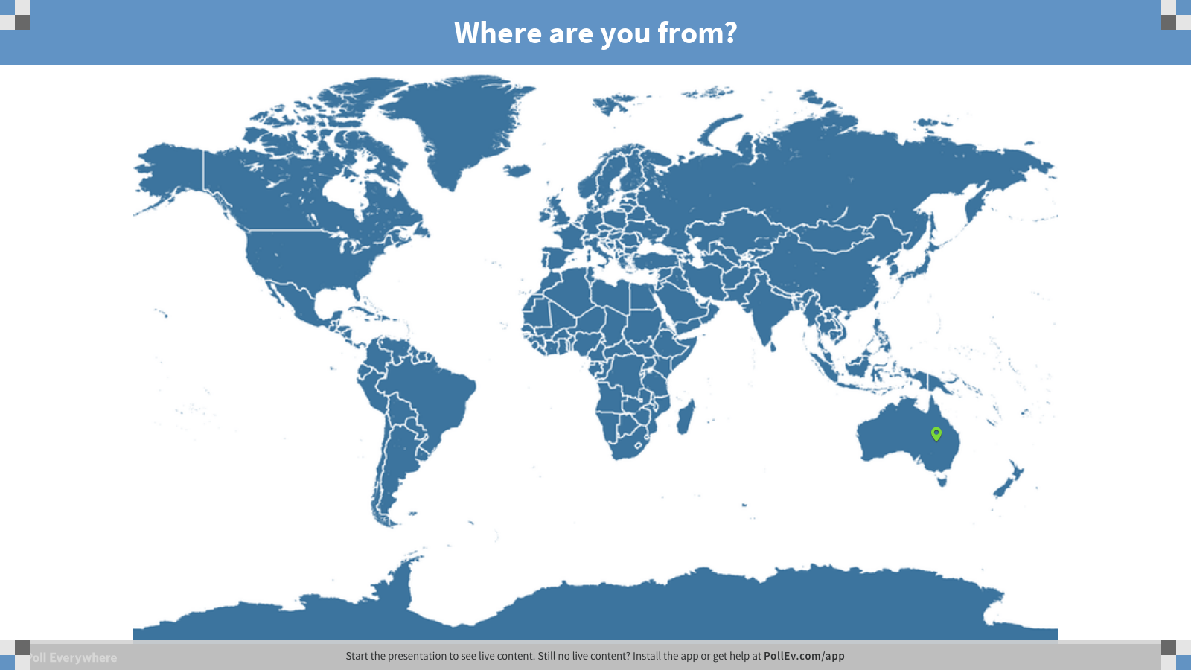
Notes:
Poll Title: Where are you from?
https://www.polleverywhere.com/clickable_images/xJQax03ujEOsBRH
https://www.polleverywhere.com/my/polls
https://pollev.com/lindsaymacdo908

Slide 5
Notes:
Poll Title: How are you feeling today?
https://www.polleverywhere.com/clickable_images/2uNBfP2SL0QFYG5
https://www.polleverywhere.com/my/polls
https://pollev.com/lindsaymacdo908

Slide 6
VALUE LEAKAGE
Notes:
Expectations v reality = value leakage

Slide 7
Cho La Pass
NEPAL

Slide 8
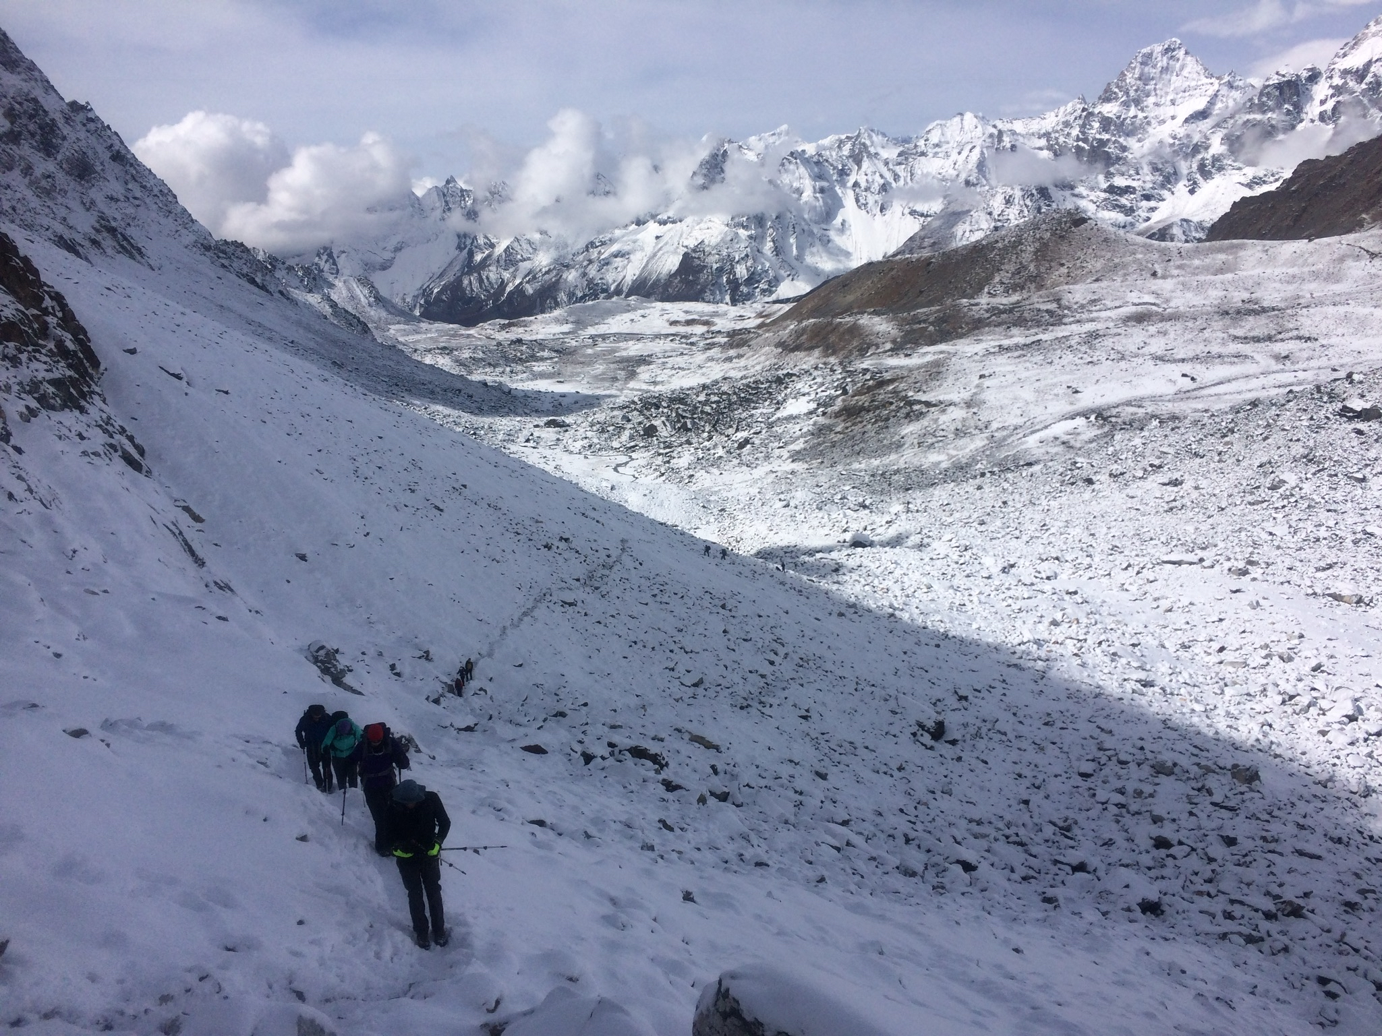

Slide 9
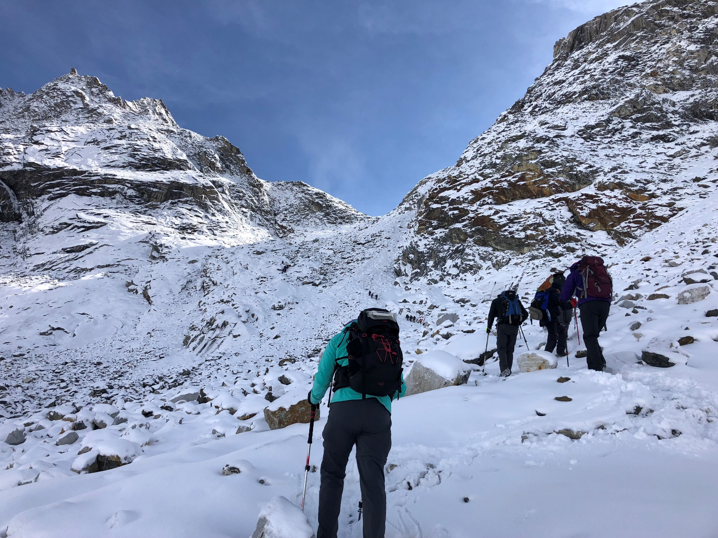

Slide 10
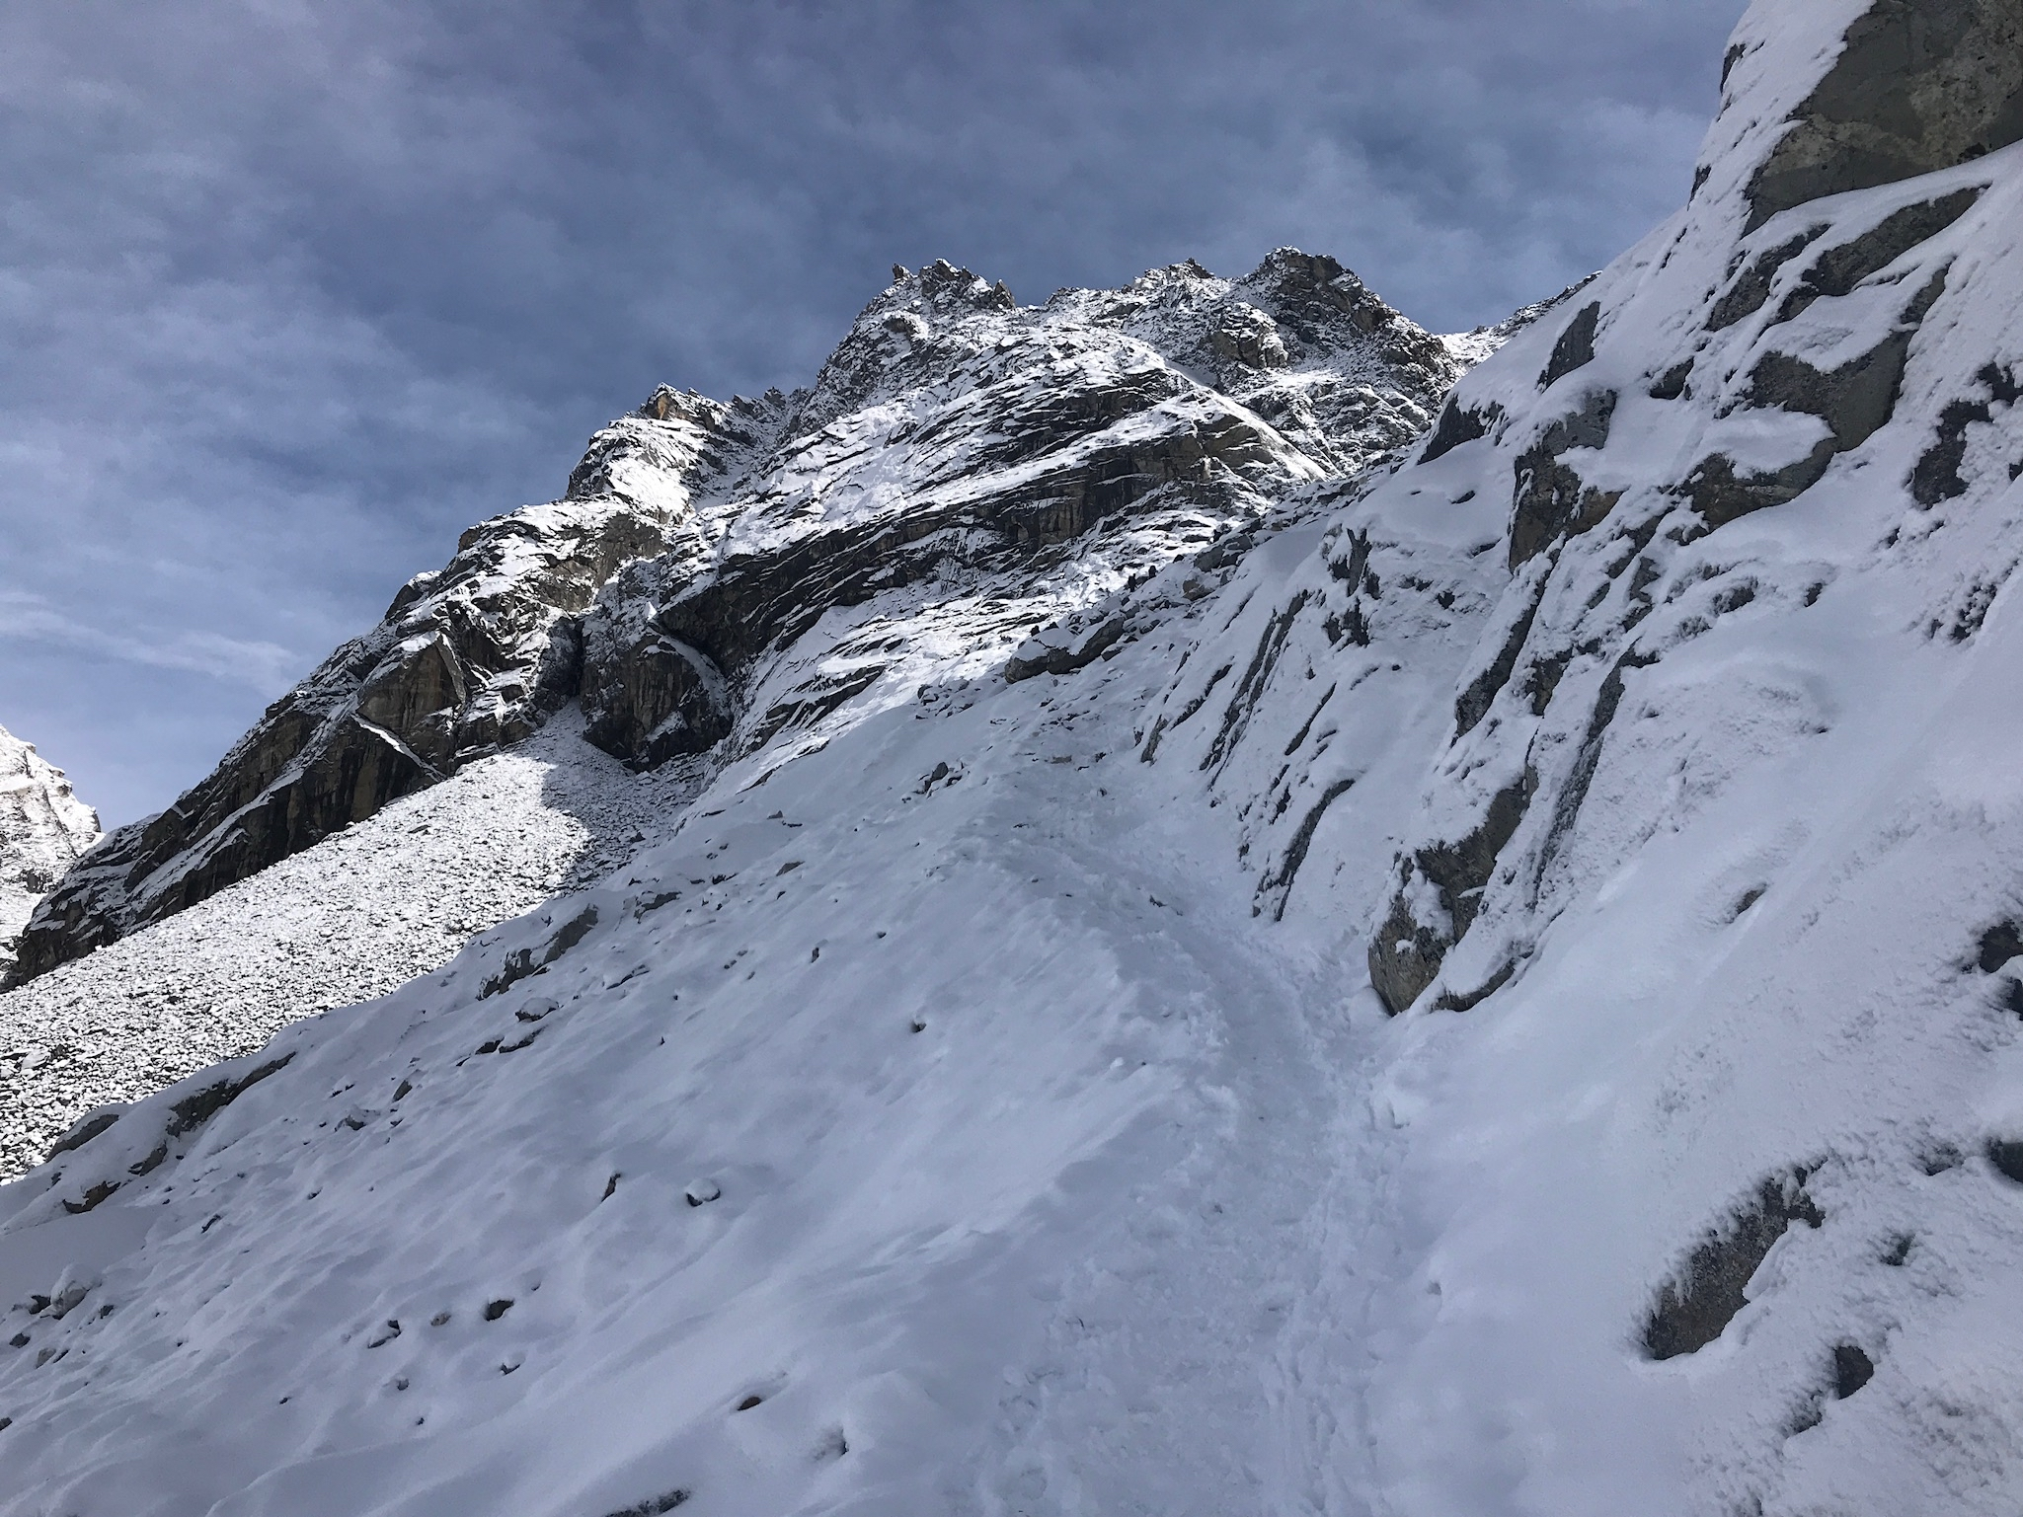

Slide 11
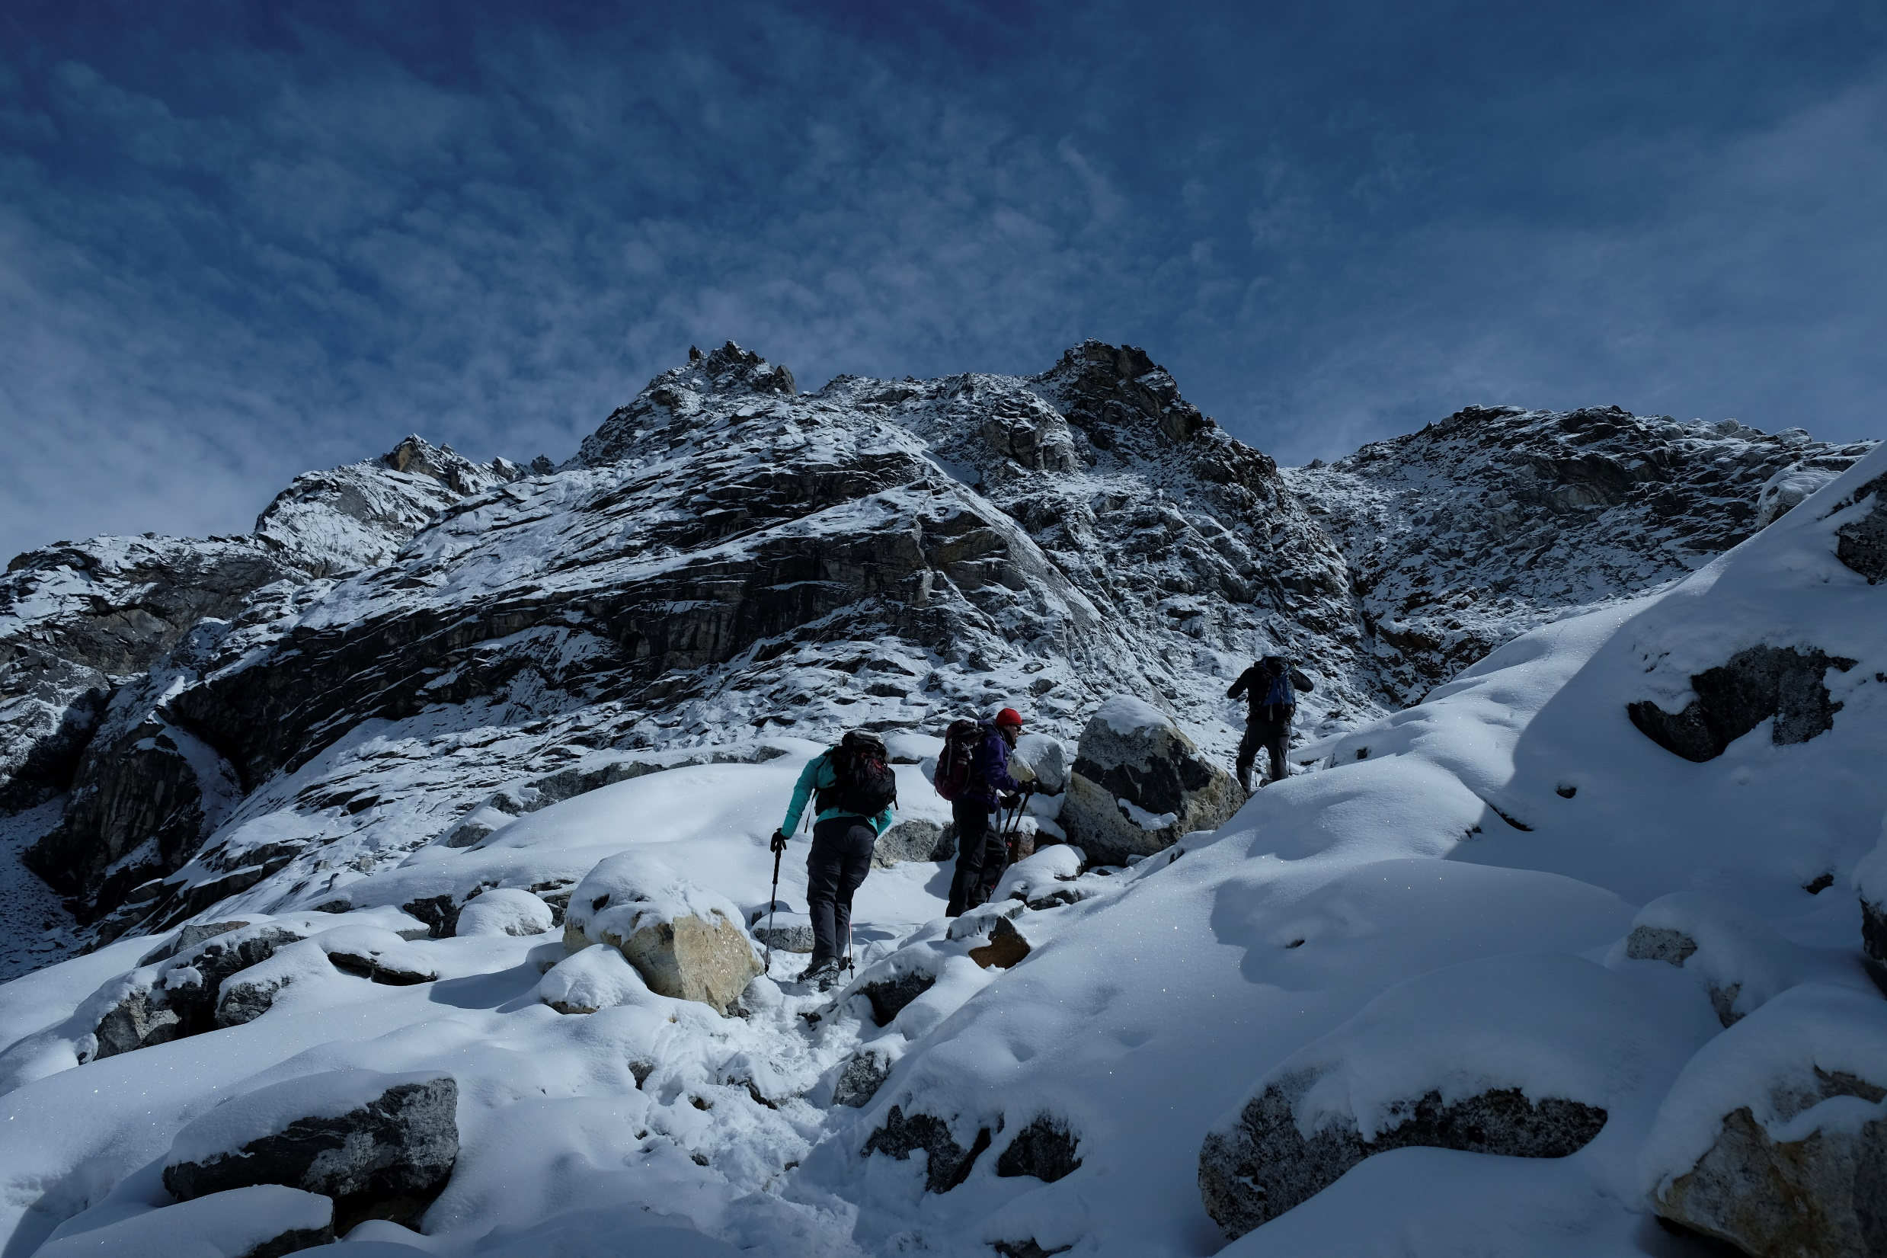

Slide 12
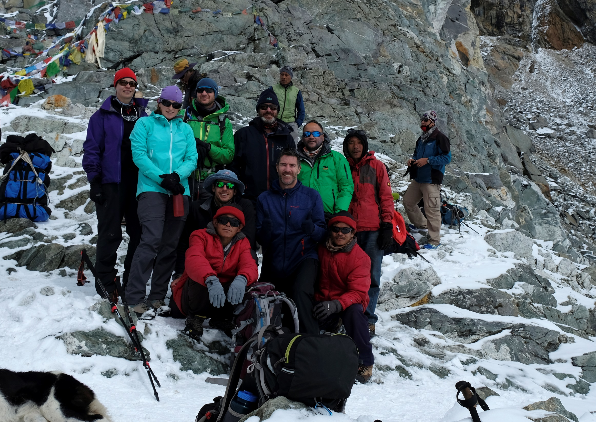

Slide 13
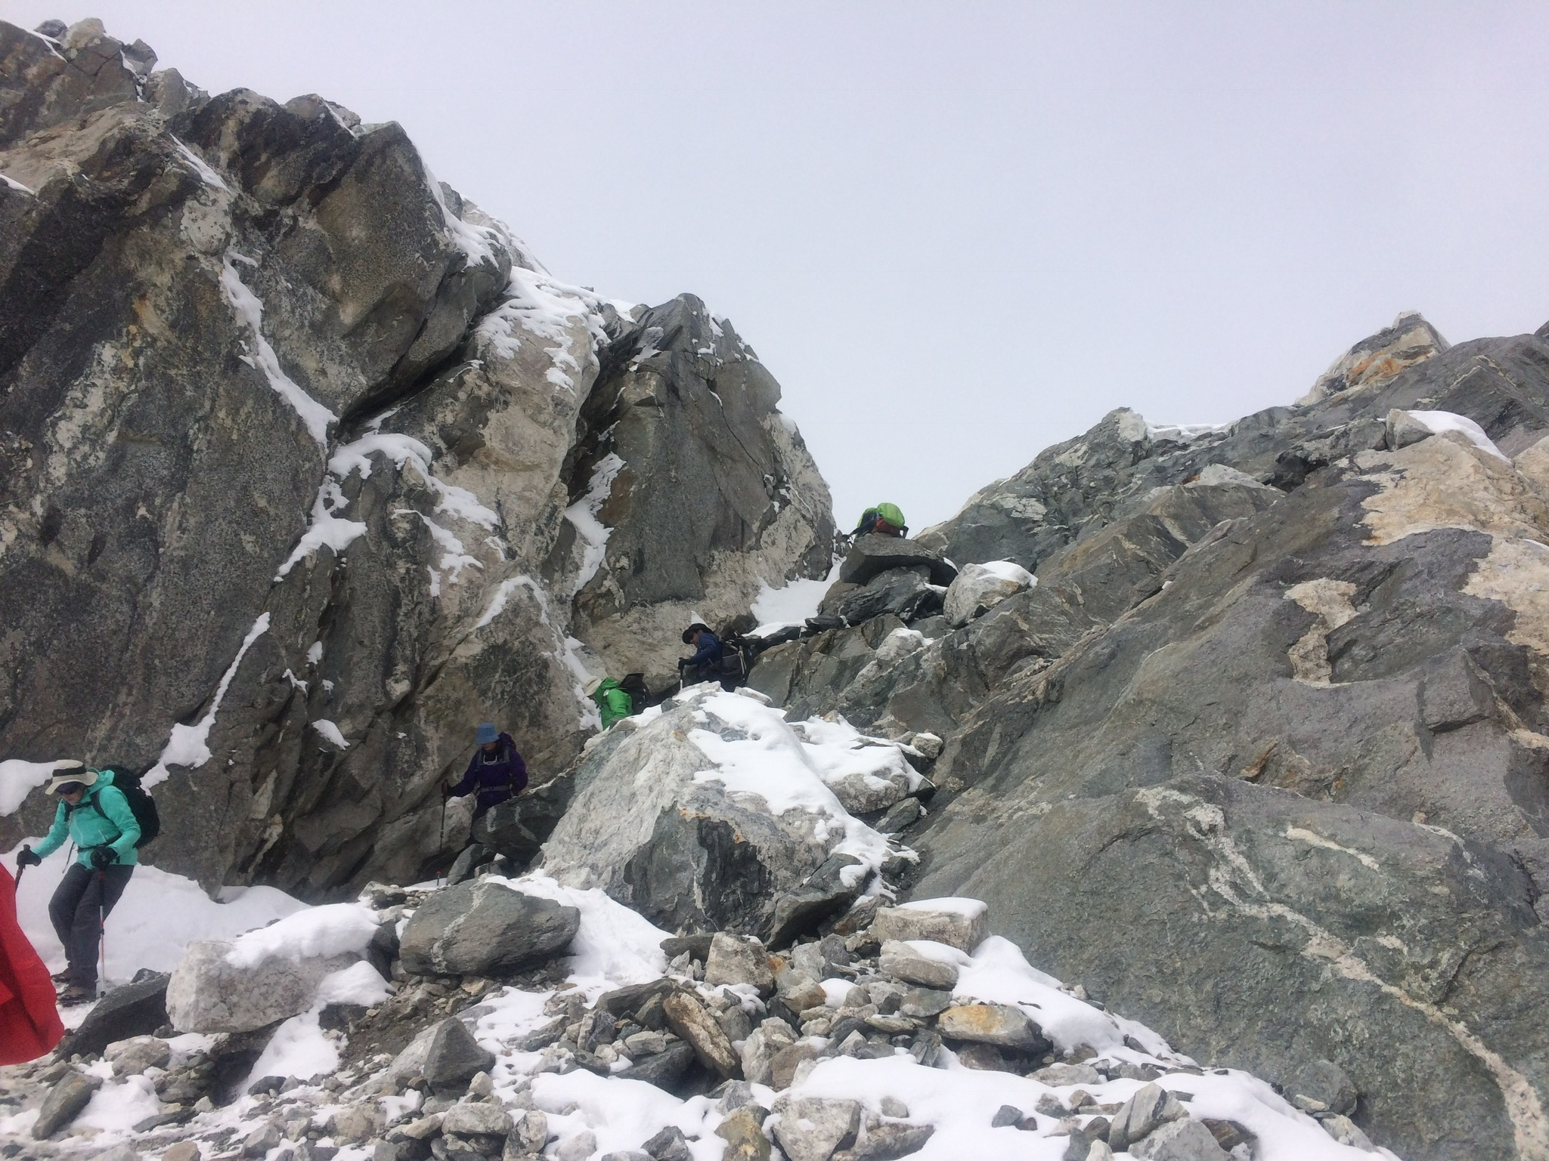

Slide 14
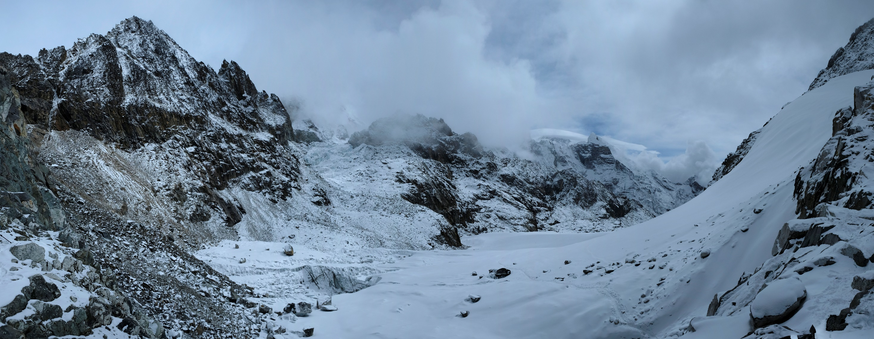

Slide 15
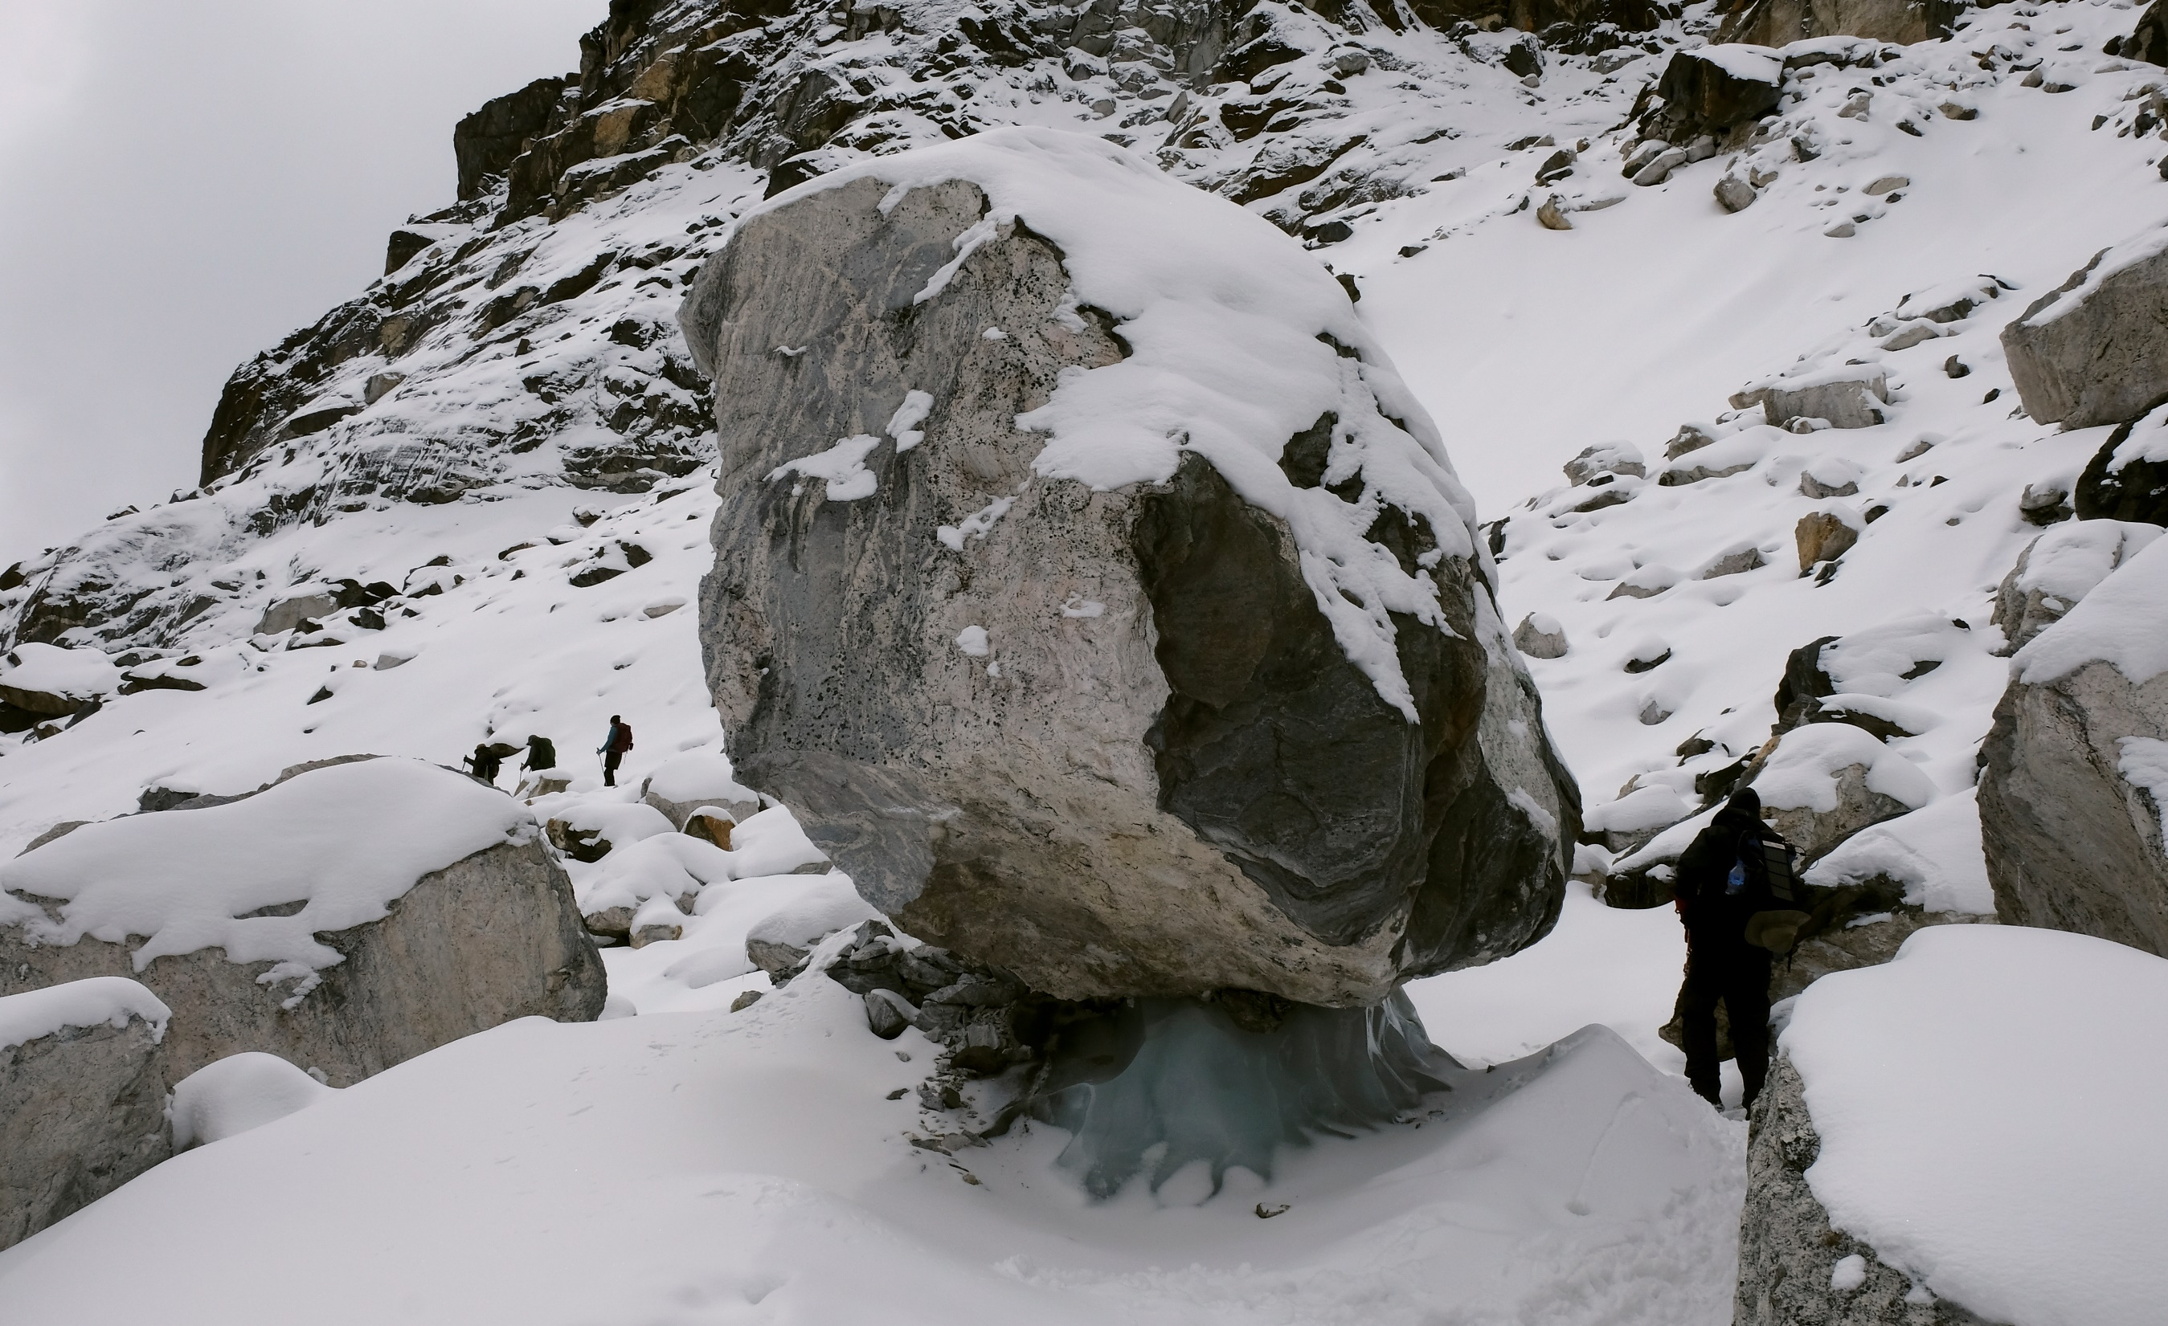

Slide 16
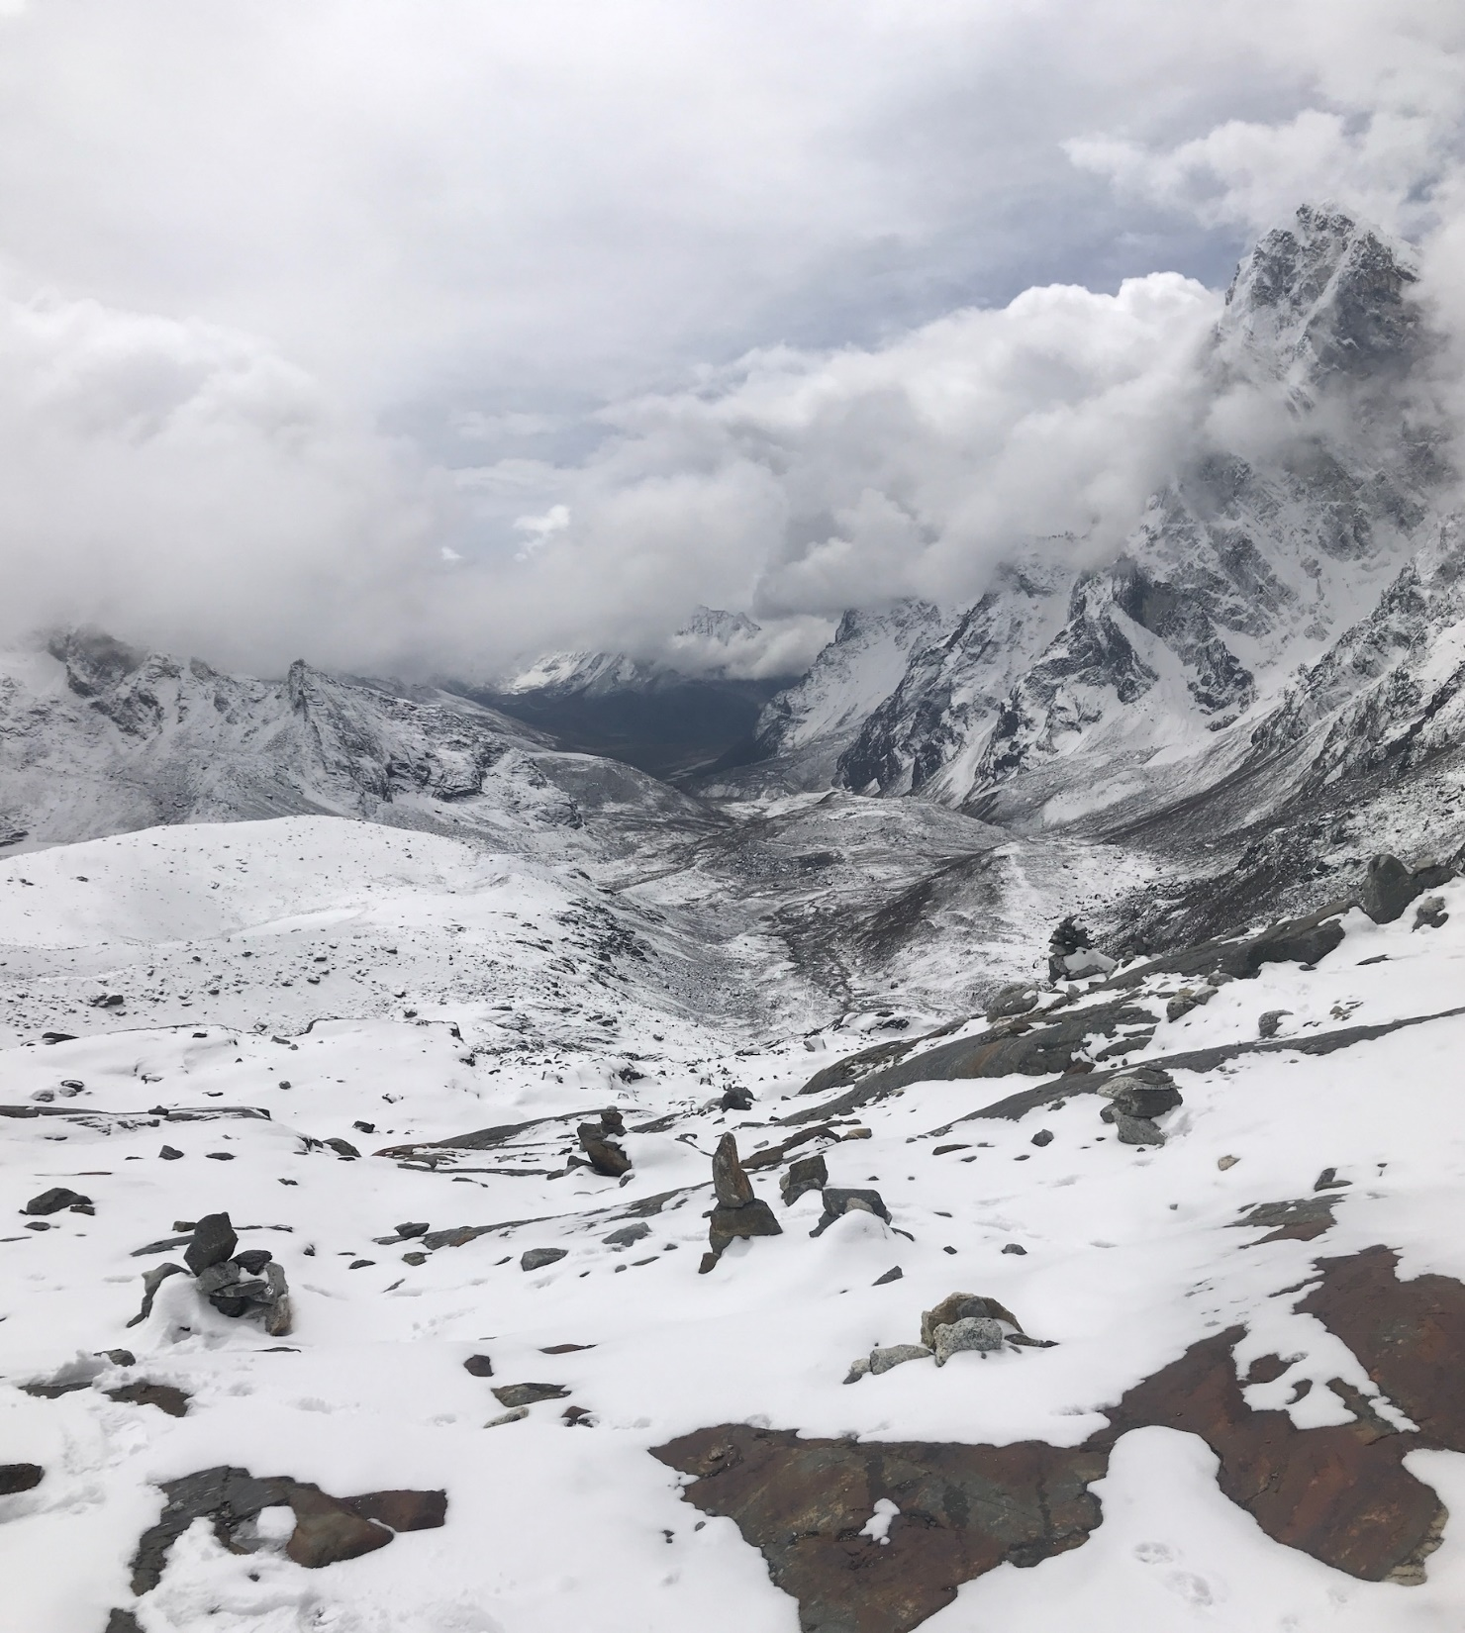

Slide 17
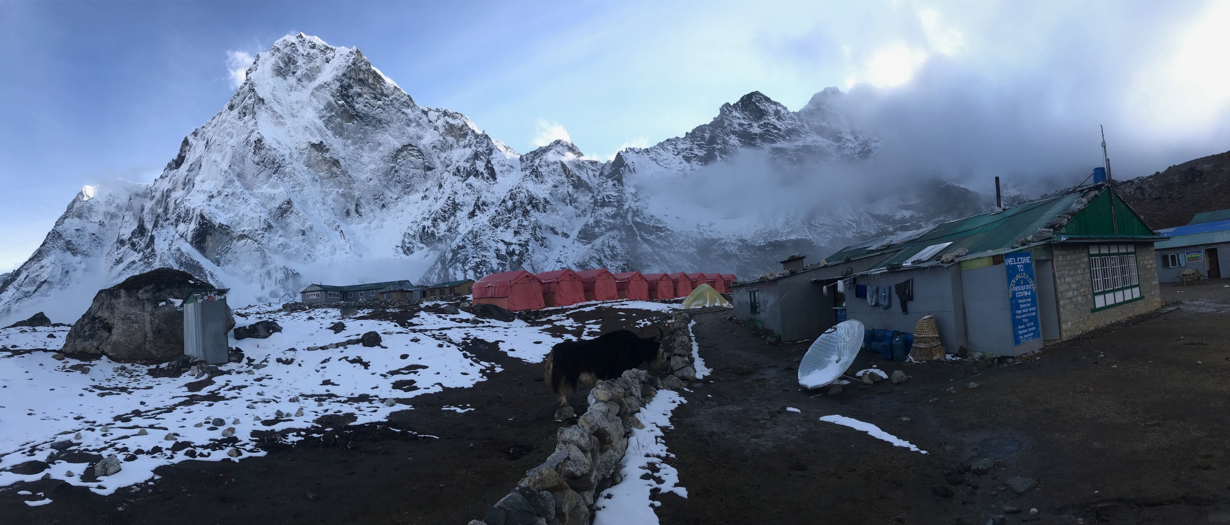

Slide 18
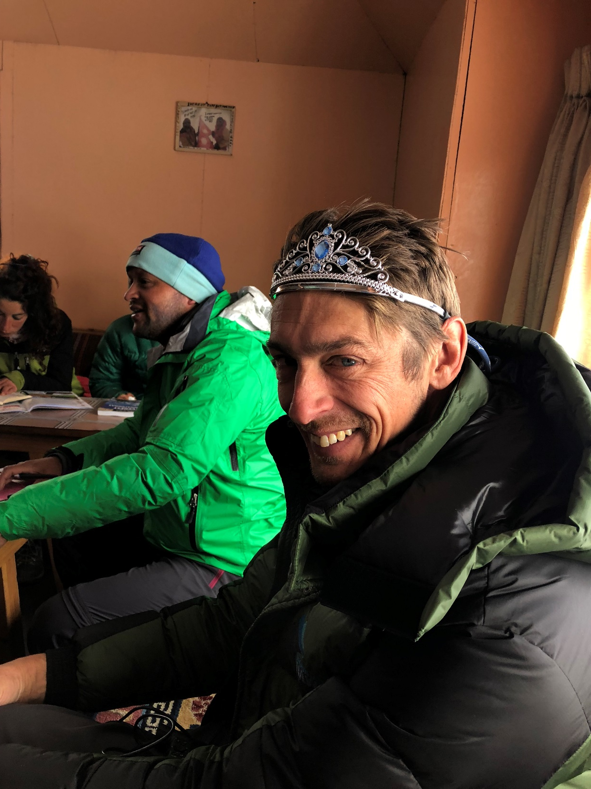

Slide 19
THINGS
NEVER GO TO PLAN YOU ALWAYS
LEAK VALUE

Slide 20
PARTICIPANTS WILL BE ABLE TO …
REDUCE
VALUE
LEAKAGE
Strengthen relationships by understanding business value
Understand the Value Delivery Cycle
Identify and reduce value leakage
Ignite a ‘virtuous
value cycle’
Notes:
"There is nothing quite so useless as doing with great efficiency something that should not be done at all.“ – Peter Drucker
Value is what the customer wants (not you)
Subjective
Expectations vs Reality
MUST understand customer
Make them want what you have to give (marketing)

Slide 21
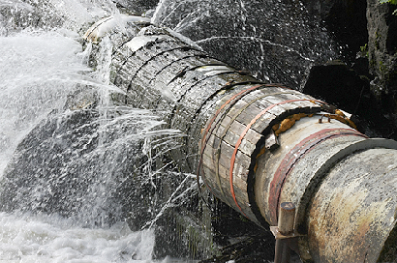
WHICH IS IMPORTANT TO …
REDUCE
VALUE
LEAKAGE
Deliver more value

Slide 22
MONASH UNIVERSITY
Notes:
Monash commenced in 1961 with 347 students
Now Australia's largest university
Young & ambitious
Research Intensive
Monash = Highest International Competitive Research Income of any Australian Uni = $79m 2017
“If you don’t like it, change it”
Excellent Research & Education to solve the great challenges of our age
Question the status quo and #CHANGEIT Our work is making an impact all over the world, from bringing clean water to villages in Africa to creating new life-saving medicines.
With four Australian campuses, one in Malaysia, and over 100 international partners, we’re making a difference on a global scale.
At Monash we challenge ourselves and the world, “If you don’t like it, change it!” (https://www.monash.edu/news/internal/newsletter/the-insider/2018/26-mar-2018/articles/if-you-dont-like-it-change-it?utm_medium=email&utm_content=button1&utm_source=the-insider-26-mar&utm_campaign=Staff%20newsletter%20-%20Introducing%20%22If%20you%20don%27t%20like%20it%2C%20change%20it%22).
We have the people, the platforms, the intellect, the passion, the scale, the diversity of expertise and the appetite to make a difference.
To free up Monash’s capacity to leave our dent in the world, eSolutions is reducing Monash’s administrative burden, processes and costs.
We are transforming Monash into a agile, innovative and digital business, liberating its capacity to compete in an increasingly commoditised and globalised educational market while also achieving world leading research to solve the great challenges of our age (https://www.monash.edu/about/who/strategic-plan ).

Slide 23
Notes:
Times Higher Ed = #80
US News World Rankings = #68
QS World Uni Rankings = #59
#28 – Asia’s most Innovative Ini
#21 – World’s most International Uni
#57 – Global Uni Employability ranking
Monash = Highest International Competitive Research Income of any Australian Uni = $79m 2017

Slide 24
Notes:
CIO Portfolio
800+ staff
Infrastructure
Applications
Service desk
Cybersecurity
Monash Connect
Adoption over Delivery
Lean (reduce waste)
Agile (continual delivery of value)
Relationships
Bus value
Iterative delivery

Slide 25
Notes:
Monash commenced in 1961 with 347 students (57 years old)
Now Australia's largest university
Young & ambitious
Research Intensive
Marketing Campaign = “If you don’t like it, change it”
challenging the way people think, challenging them to take action and make change
https://change-it.monash.edu/
We have people, the platforms, the intellect, the passion, the scale, the diversity of expertise and the appetite to make a difference.
To free up Monash’s capacity to leave our dent in the world, eSolutions is reducing Monash’s administrative burden, processes and costs.
We are transforming Monash into a agile, innovative and digital business, liberating its capacity to compete in an increasingly commoditised and globalised educational market while also achieving world leading research to solve the great challenges of our age (https://www.monash.edu/about/who/strategic-plan ).
#CHANGEIT Our work is making an impact all over the world, from bringing clean water to villages in Africa to creating new life-saving medicines.
With four Australian campuses, one in Malaysia, and over 100 international partners, we’re making a difference on a global scale.
At Monash we challenge ourselves and the world, “If you don’t like it, change it!”
(https://www.monash.edu/news/internal/newsletter/the-insider/2018/26-mar-2018/articles/if-you-dont-like-it-change-it?utm_medium=email&utm_content=button1&utm_source=the-insider-26-mar&utm_campaign=Staff%20newsletter%20-%20Introducing%20%22If%20you%20don%27t%20like%20it%2C%20change%20it%22).
We have the people, the platforms, the intellect, the passion, the scale, the diversity of expertise and the appetite to make a difference.
To free up Monash’s capacity to leave our dent in the world, eSolutions is reducing Monash’s administrative burden, processes and costs.
We are transforming Monash into a agile, innovative and digital business, liberating its capacity to compete in an increasingly commoditised and globalised educational market while also achieving world leading research to solve the great challenges of our age (https://www.monash.edu/about/who/strategic-plan ).

Slide 26
VALUE
LEAKAGE

Slide 27
IDENTIFY
VALUE LEAKAGE
Context, Culture, Values, Environment
Vision, Strategy, Objectives
Expectations, Processes
Change readiness, Accountabilities
Identify Opportunity
Create Solution
Implement Change
Potential Value
Achieved Value
Missed Opportunities
Poor
Design
Poor
Development
Poor
Adoption
Notes:
Understand – Deliver – Value
value leakage
Misaligned expectations
Missed opportunities
Poor design
Poor development
Poor adoption
Adoption + change = value

Slide 28
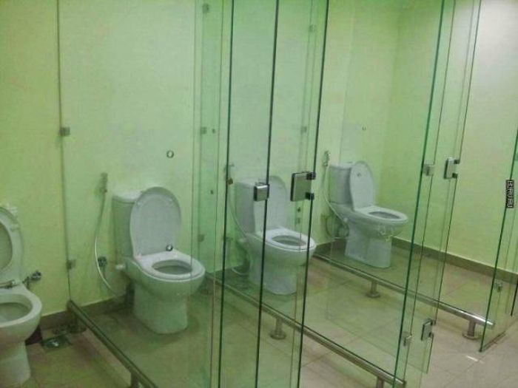
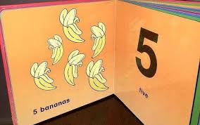
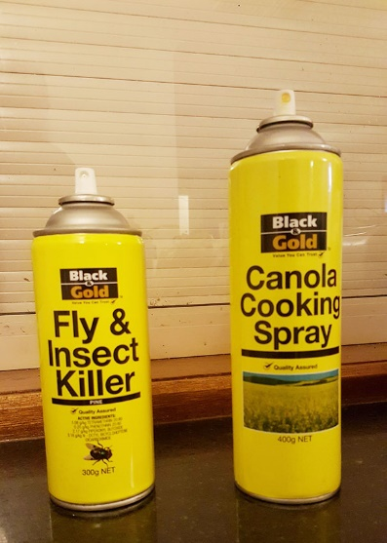
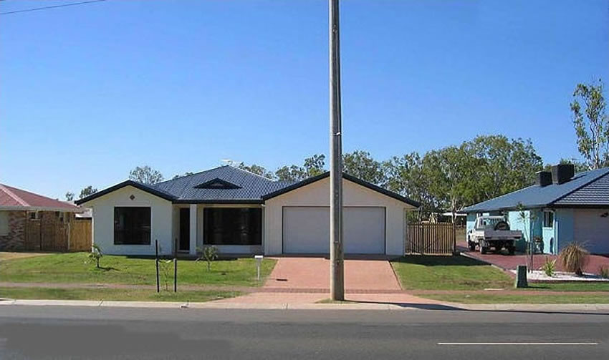
IDENTIFY
VALUE
LEAKAGE
VALUE LEAKAGE
Notes:
Understand – Deliver – Value
"Organisations, full of smart people, do stupid things" - Steven Little (The Milkshake Moment)

Slide 29
WHAT
REPRESENTS VALUE?
Notes:
Value is what the customer wants (not you)
Subjective
Expectations vs Reality
MUST understand customer
Make them want what you have to give (marketing)
Adoption over Delivery
Else shelf ware

Slide 30
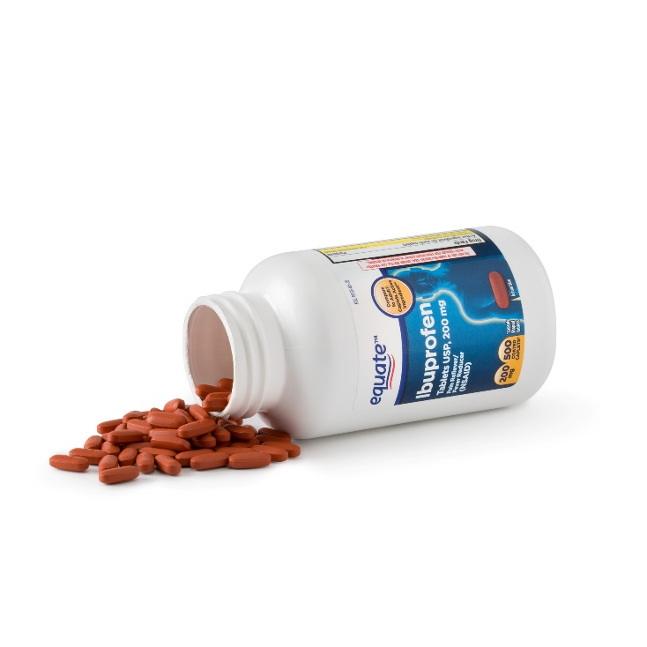
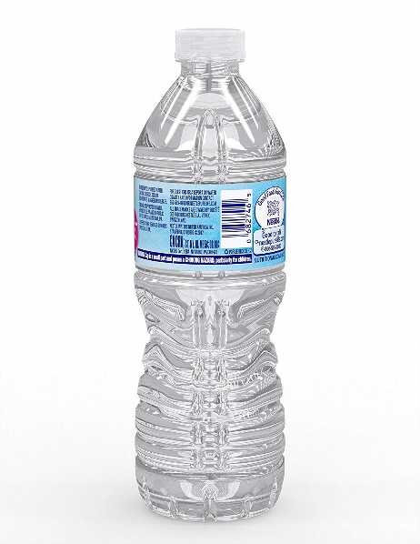
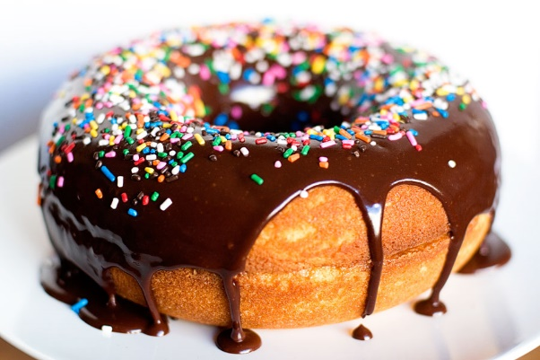
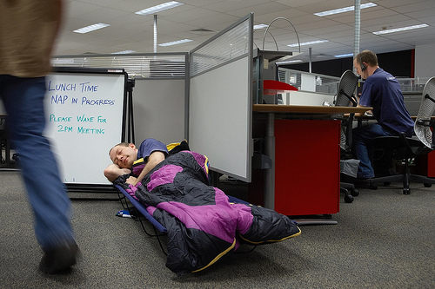
WHAT DO YOU VALUE?
A B C D E
pollev.com/lindsaymacdo908

Slide 31
Notes:
Poll Title: Which do you value most?
https://pollev.com/lindsaymacdo908
https://www.polleverywhere.com/multiple_choice_polls/VjGlZvBfP6YQOBg

Slide 32
VALUE
DELIVERY
CYCLE

Slide 33
UNDERSTAND
VALUE
DELIVERY
VALUE DELIVERY CYCLE
How do you deliver value?
Think of a recent customer initiative
How many steps to deliver value?
Notes:
Retro
Recent business initiative?
Steps = hand overs, touch points, potential break points, delays, misunderstandings
Things that add delay and risk
Waste

Slide 34
VALUE DELIVERY CYCLE
How many steps to deliver value?
A) 1-5
B) 5-10
C) 10-15
D) 15-20
E) 20+
pollev.com/lindsaymacdo908
Notes:
Value is what the customer wants (not you)
Subjective
Expectations vs Reality
MUST understand customer
Make them want what you have to give (marketing)
Adoption over Delivery
Else shelf ware

Slide 35
Notes:
Poll Title: How many steps to deliver value? https://www.polleverywhere.com/multiple_choice_polls/BPL4A6qQrzFYGyL

Slide 36
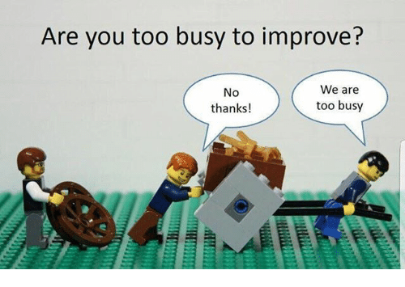
UNDERSTAND
VALUE
DELIVERY
VALUE DELIVERY CYCLE
Notes:
Retro
Recent business initiative?
Steps = hand overs, touch points, potential break points, delays, misunderstandings
Things that add delay and risk
Waste

Slide 37
UNDERSTAND
VALUE
DELIVERY
VALUE DELIVERY CYCLE
Discover
Define
Connect
Design
Develop
Deliver
Harvest
Demand Management
Delivery Management
Relationship Management

Slide 38
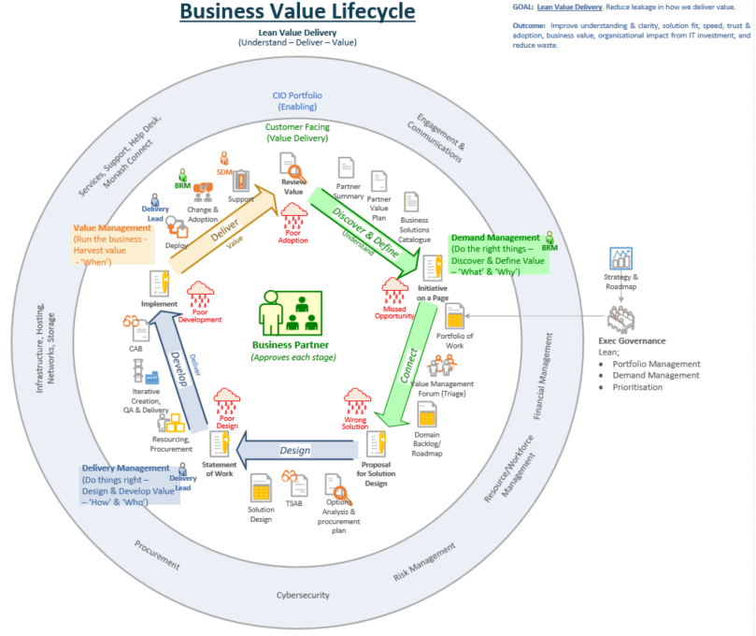
VALUE DELIVERY CYCLE
Discover
Define
Connect
Design
Develop
Deliver
Harvest
Demand Management
Delivery Management
Relationship Management
Notes:
Understand – Deliver – Value
Define value opportunity
Connect to capability
Design solution
Develop
Deliver & Harvest Value

Slide 39
IDENTIFY
IDENTIFY
VALUE
LEAKAGE
VALUE LEAKAGE
Deliver salient value
At Monash;
Earlier engagement, understanding
Capture opportunities at inception
Agile/shared delivery, collaboration
Expectation Management
Notes:
Understand – Deliver – Value
Relationships – Consistency
Our critical change was to
extend IT engagement earlier and later, = BRM
identifying ideas at inception and
focussing on business adoption. We also took time to
identify key documents, decision points, and handovers, which define the stages of our value cycle.
Role clarity – BRM, Service Delivery Mgr, Service Centre Mgr, Delivery Lead
Consistency = Trust
Value Delivery Forum
Agile Delivery
Opportunity Summaries

Slide 40
IDENTIFY
VALUE LEAKAGE
Earlier engagement, understanding
Expectation Management
Capture opportunities at inception
Agile/shared delivery, collaboration
Notes:
Established BRM
Consistent Opportunity template
Agile delivery
Relationships

Slide 41
IDENTIFY
IDENTIFY
VALUE
LEAKAGE
VALUE LEAKAGE
Deliver salient value
Next;
Demand Management
Consistent Proposal & SoW
Notes:
Understand – Deliver – Value

Slide 42
IDENTIFY
VALUE LEAKAGE
Demand Management
Consistent Proposal/SoW
Notes:
Understand – Deliver – Value

Slide 43
VIRTUOUS
VALUE
CYCLE

Slide 44
VIRTUOUS
REDUCE
VALUE
LEAKAGE
VALUE CYCLE
↑ Trust
↑ Relationship
↑ Understanding
↑ Value
↓ Leakage
Notes:
Understand – Deliver – Value
"There is nothing quite so useless as doing with great efficiency something that should not be done at all.“ – Peter Drucker
Understanding = EASIER to reduce leakage = deliver more value

Slide 45
VIRTUOUS
REDUCE
VALUE
LEAKAGE
VALUE CYCLE

Slide 46
TIPS FOR SUCCESS
Show Value
Partners, Peers, Exec
Iterative (agile) Delivery
Collaboration
Business value
focus
MANAGE EXPECTATIONS
BUILD TRUST

Slide 47
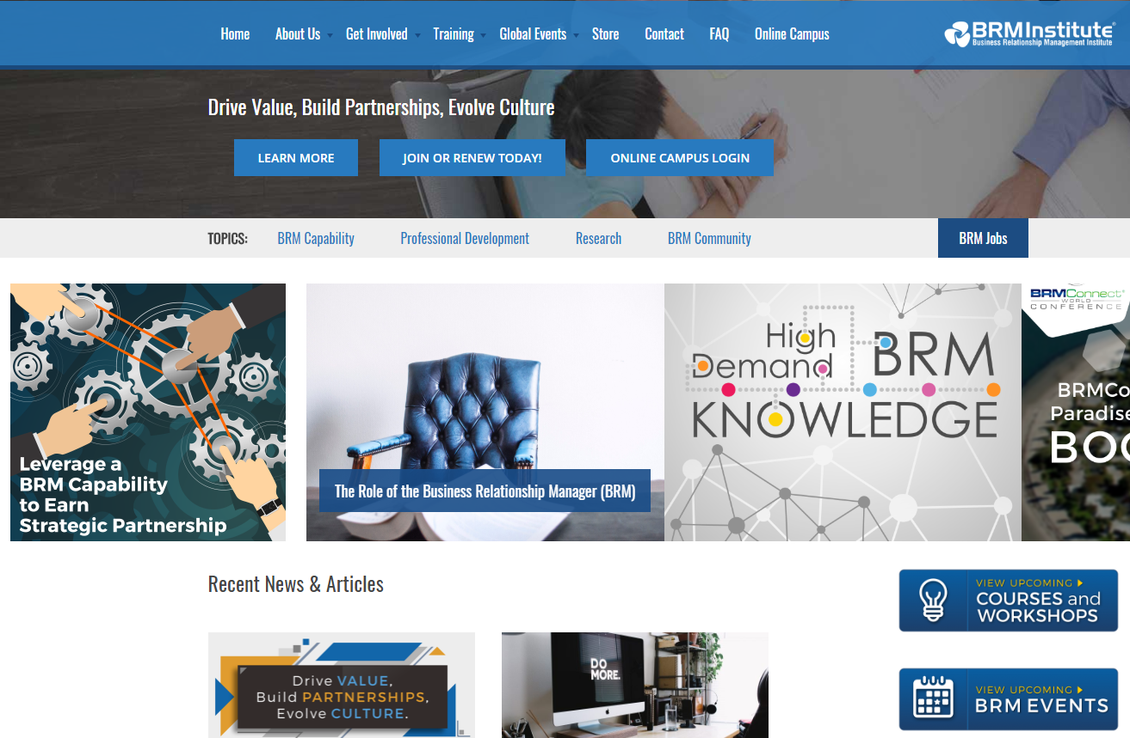
BUSINESS RELATIONSHIP MANAGEMENT INSTITUTE
COMMUNITY OF PRACTICE
ADVICE & TRAINING
TOOLS
https://brm.institute/

Slide 48
IN
SUMMARY
What did you learn?
pollev.com/lindsaymacdo908
Notes:
Do Poll Everywhere quiz
WHAT DID YOU LEARN?
- use Vendor giveaways for prizes?
Business Value Focus
Understand business value (Relationships)
Value Delivery Cycle
Value Leakage
Mitigations
Relationships, Understanding
Iterative/Agile delivery
Consistency (documents, behaviours)
‘Virtuous value cycle' by improving business relationships to shape IT delivery for greater business value

Slide 50
IN
SUMMARY
Understand
Business Value
Value Delivery Cycle
Value Leakage

Slide 51
IN
SUMMARY
↑ Trust
↑ Relationship
↑ Understanding
↑ Value
↓ Leakage

Slide 52
IF YOU DON’T LIKE IT
CHANGE IT
Do …
Identify an area of value leakage
How will you reduce leakage?
Who will help you?
When will you do it?
How will you show improvement?
(… Repeat …)
Notes:
Get started
As business matures, you need to grow ahead of them – to keep offering value

Slide 53
IF YOU DON’T LIKE IT
CHANGE IT
So that …
DELIVER
MORE
VALUE
Notes:
Achieve success, deliver value, small steps
Learn your organisational maturity, readiness and scope for change
Show your partner you genuinely want to provide value

Slide 54
Notes:
Poll Title: How are you feeling today? https://www.polleverywhere.com/clickable_images/Rn7TRfqmV7f17Yz

Slide 55
THANK YOU
Notes:
If you don’t like it, change it!

Slide 56
QUESTIONS?
LINDSAY MACDONALD
LINDSAY.J.MACDONALD@MONASH.EDU
FOLLOW @LINDSAYMAC6
FIND OUT MORE AT MONASH.EDU
LIKE @MONASH.UNIVERSITY ON FACEBOOK
FOLLOW @MONASHUNI ON TWITTER
Notes:
https://docs.google.com/document/d/19HYBE2mV5ostUKhDDAaQxcZxr5vFKjb6rY8OaEqcoEI/edit?ts=5bc67cc0

Slide 57
Questions?
“If you want to build a ship,
Don’t drum up the men to gather wood, divide the work and give the orders.
Instead, teach them to yearn for the
vast and endless sea”
Antione de Saint Exupery

Slide 58
Notes:
If you don’t like it, change it!
https://change-it.monash.edu/
https://www.youtube.com/watch?v=5v3DvG-HvjU
Marketing Campaign = “If you don’t like it, change it”
challenging the way people think, challenging them to take action and make change
https://change-it.monash.edu/
We have people, the platforms, the intellect, the passion, the scale, the diversity of expertise and the appetite to make a difference.
To free up Monash’s capacity to leave our dent in the world, eSolutions is reducing Monash’s administrative burden, processes and costs.
We are transforming Monash into a agile, innovative and digital business, liberating its capacity to compete in an increasingly commoditised and globalised educational market while also achieving world leading research to solve the great challenges of our age (https://www.monash.edu/about/who/strategic-plan ).

