Slide 1
The Essentials of Esports in Higher Education
Jeanne Weber, Sr Higher Education Strategist
@JeanneW85965858

Slide 2
Presentation Agenda
Introduction and Overview of esports for Higher Education
Panel Discussion
Closing
Follow-up / Questions

Slide 3
Overview

Slide 4
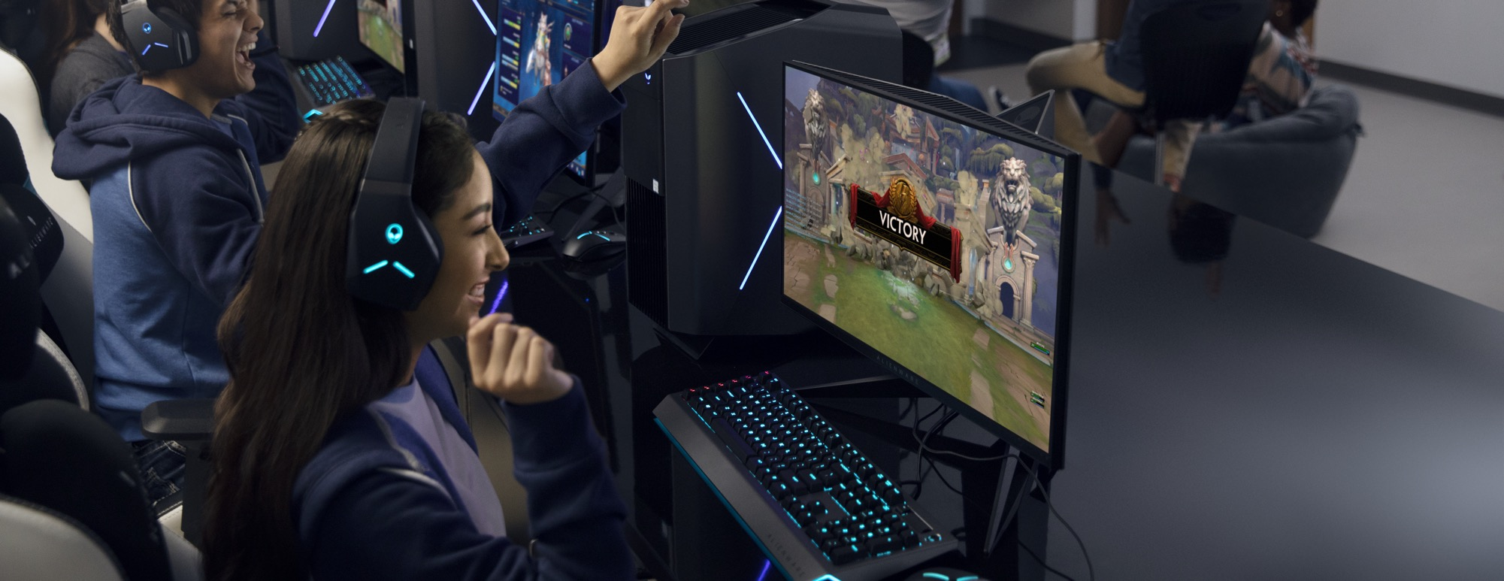
What is Esports?
Multiplayer video games played competitively for spectators

Slide 5
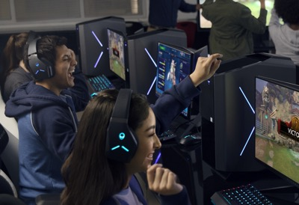
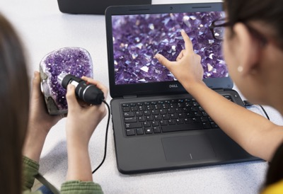
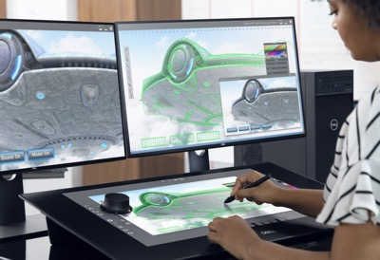
Global Competencies
Critical Thinking and Problem Solving
Innovation and Creativity
Entrepreneurship
Collaboration
Communication
Learning to Learn and Self Directed Learning
Global Citizenship
Notes:
Esports promotes all the global competencies – the skills and dispositions we want for all of our students.
Players demonstrate all the team work skills that make a traditional sports team successful.

Slide 6
Our Panelists

Slide 7
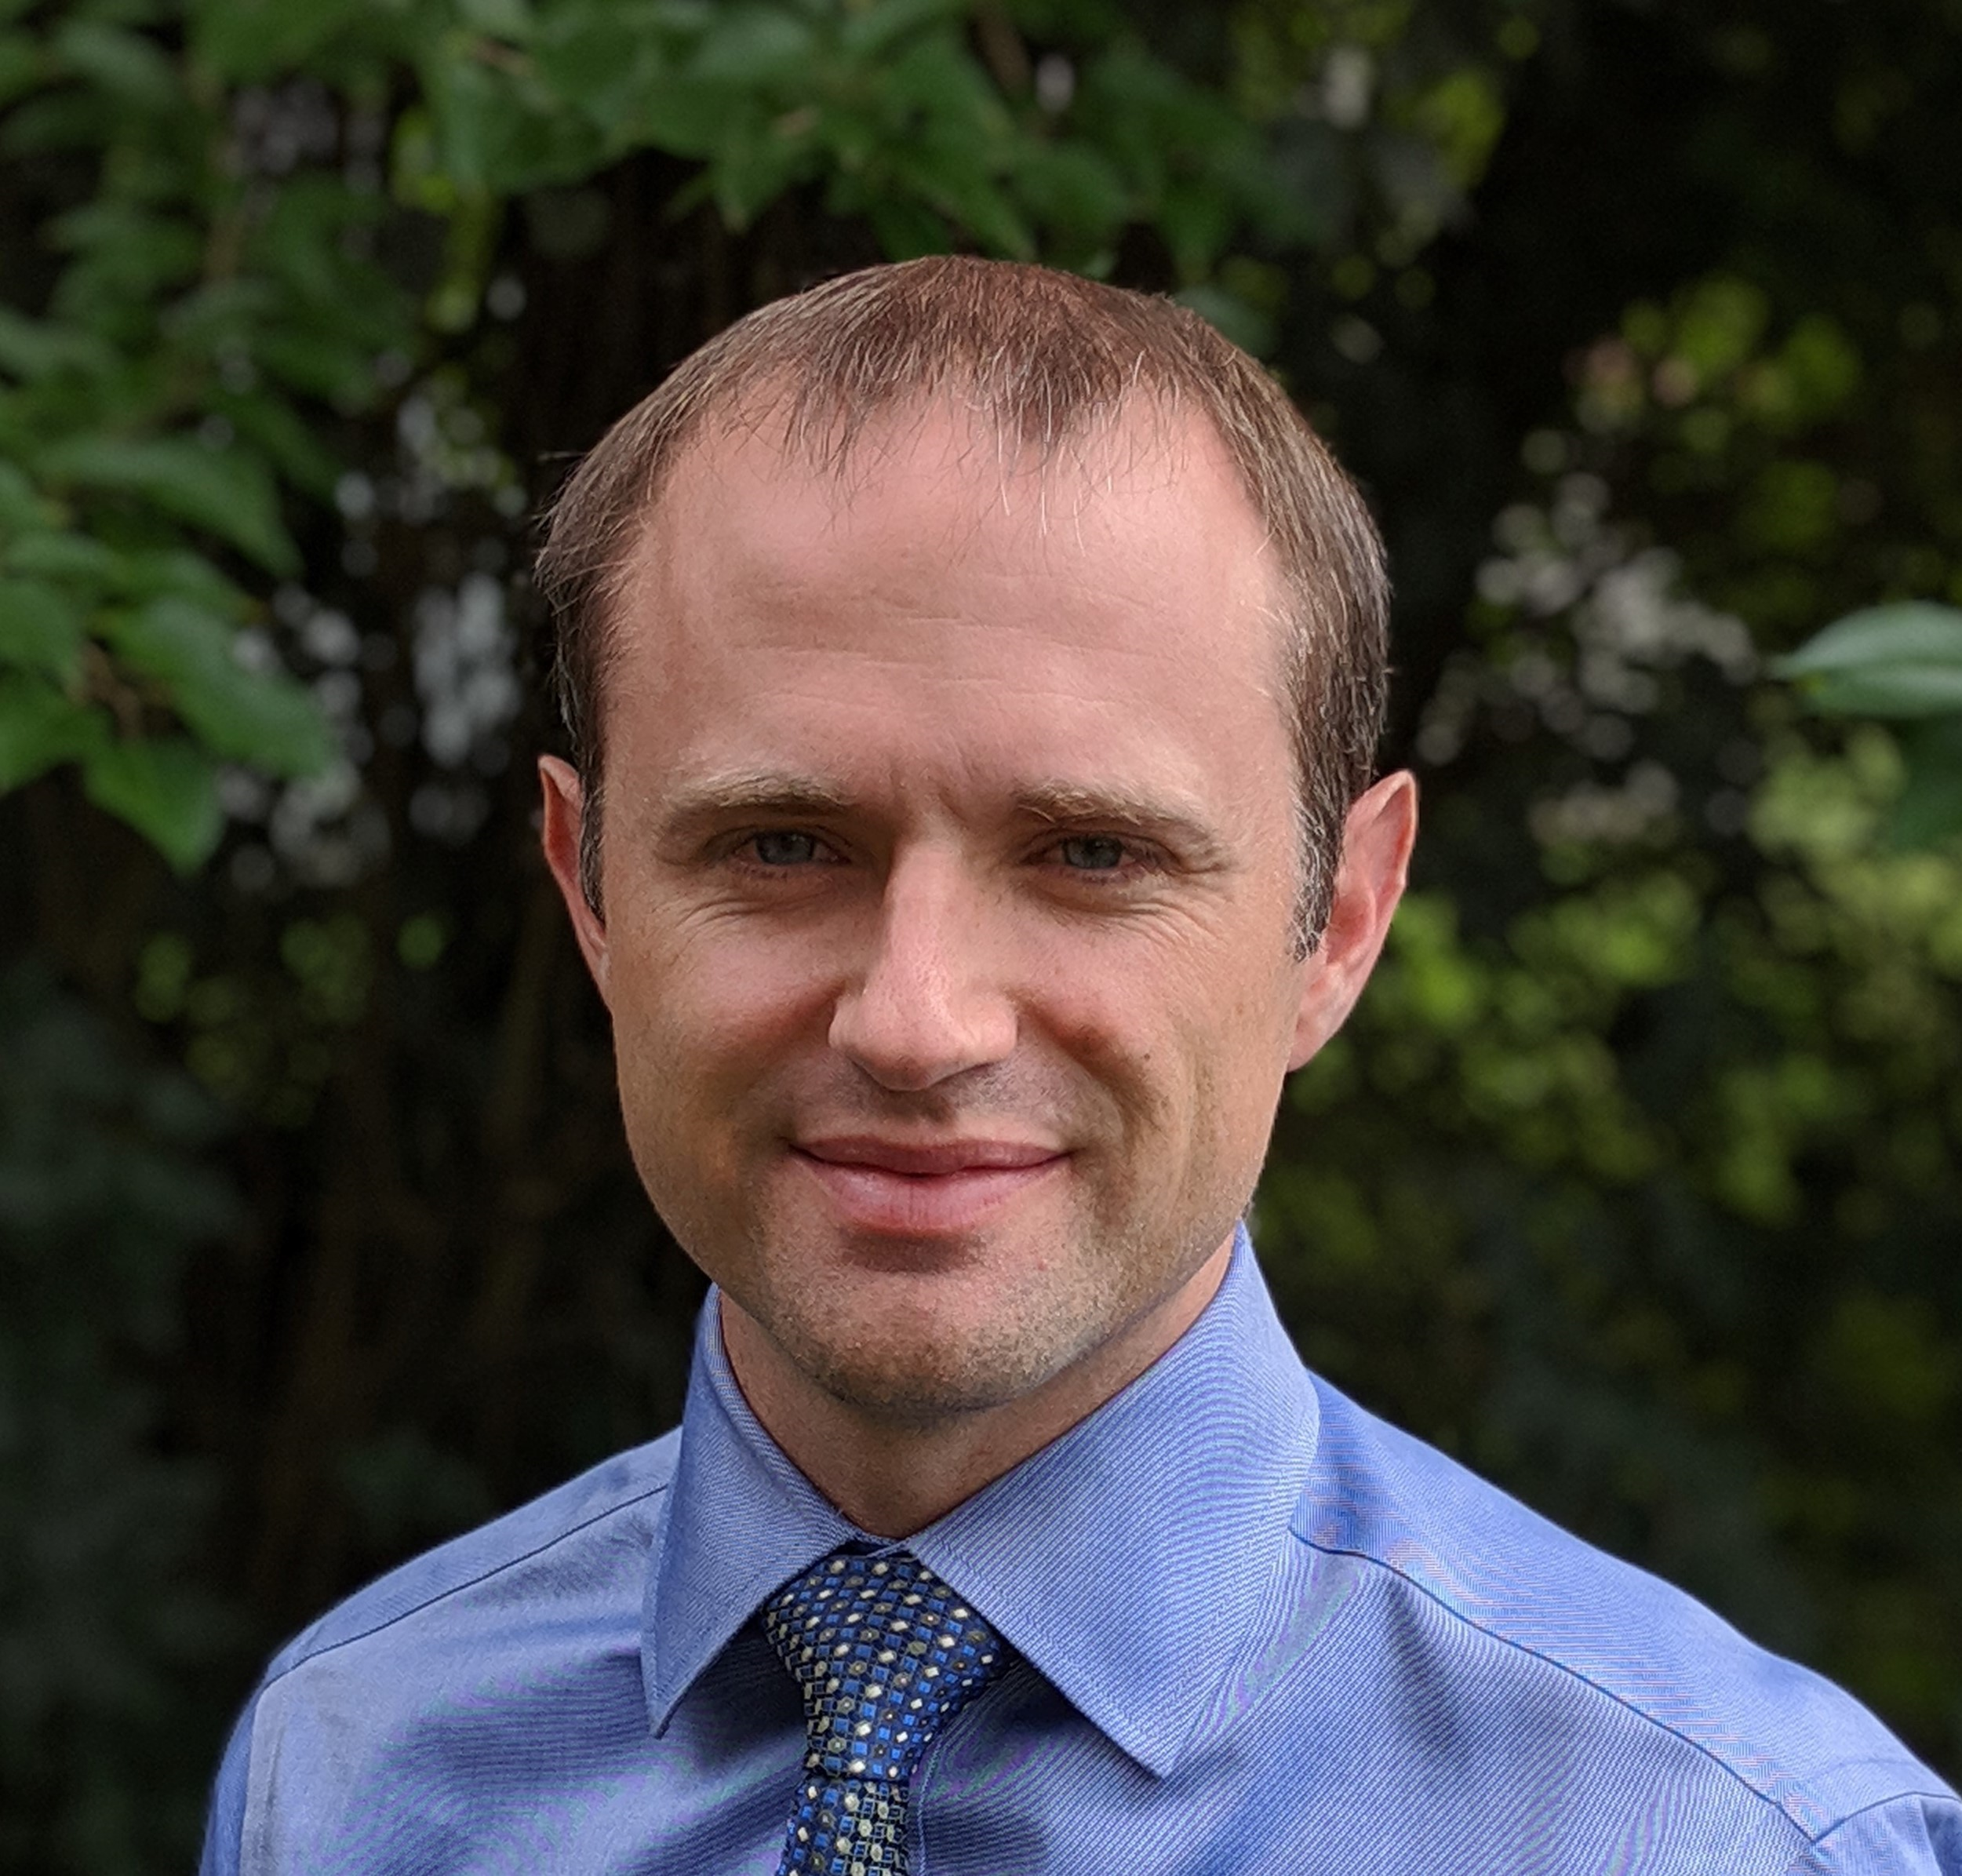
Our Panelists
Rob Bailey Director, Student Affairs Information Technology, Illinois State University
Jackie Stampalia Director, Client Information Services, Rensselaer Polytechnic Institute
Todd Harris COO of Hi-Rez Studios and President of Skillshot Media

Slide 9
Rensselaer Polytechnic Institute
Jackie Stampalia
Director, Client Information Services
15 October 2019

Slide 10
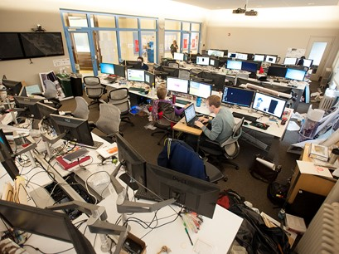
Rensselaer By the Numbers
Five Schools
Engineering
Science
Humanities, Arts and Social Sciences
Management
Architecture
Statistics
Undergraduates = 6,628
UG Degrees = 1,425
Graduate Students = 1,262
Ph.D. Degrees = 164
Faculty = 534
Women = 32%
Underrepresented Minorities = 15%

Slide 11
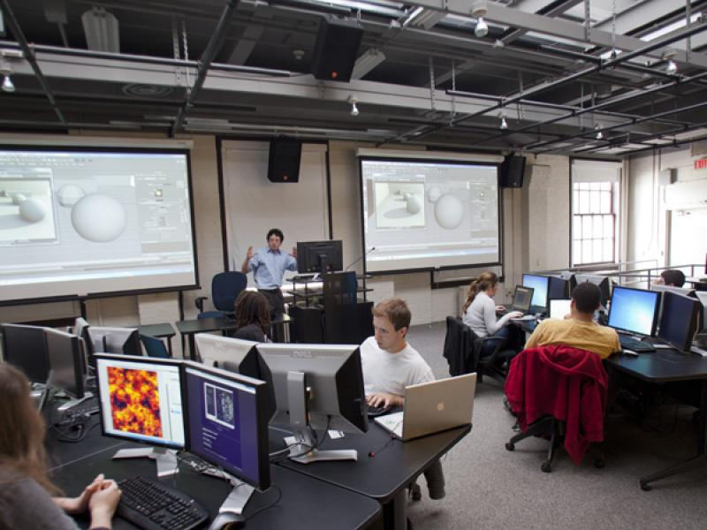
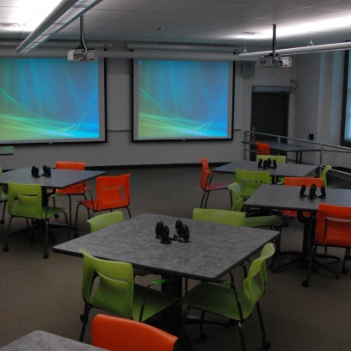
Gaming at Rensselaer
Game Development and Design
NYS Center of Excellence in Digital Game Development
Tech Valley Digital Gaming Hub
Degrees
Games and Simulation Arts and Sciences, B.S.
Critical Game Design, M.S., Ph.D.
Student Clubs
Next Steps

Slide 12
Todd Harris

Slide 13
Discussion

Slide 14
Question 1:
How did you start your esports program?
What sparked your interest in pursuing esports?
Why are esports important to students today?

Slide 15
Question 2:
How are you helping students to integrate game design into their career / degree pathways?

Slide 16
Question 3:
What are some career paths that you envision students today will pursue/explore as a result of their interests in esports from all perspectives?
Shoutcasting/Broadcasting
Game design
Graphics design
Infrastructure engineering
Finance/Sports Management
Health and physical therapy
Research
etc …

Slide 17
Question 4:
What are the most important things you have learned/need to know when designing your gaming spaces?

Slide 18
Question 5:
Which league/s have/are you considering/ recommending colleague institutions consider joining and why?

Slide 19
Question 6:
What do you envision the future will be for esports in the collegiate landscape and beyond?

Slide 20
Questions??

Slide 21
Thank you

Slide 22
Follow us on Twitter @DellEMCedu #TransformEDU
Explore Higher Education solutions, visit
https://www.DellTechnologies.com/highereducation

Slide 23
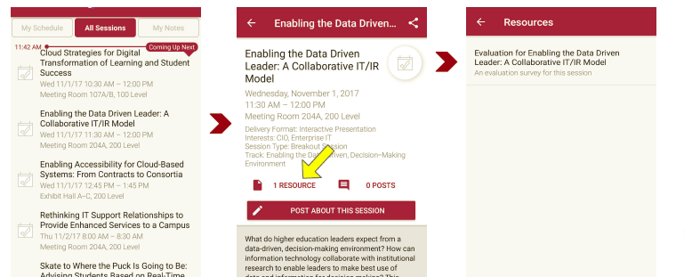
Session Evaluations There are two ways to access the session and presenter evaluations:
1
2
In the online agenda, click on the “Evaluate Session” link
From the mobile app, click on the session you want from the schedule > then scroll down or click on the associated resources > and the evaluation will pop up in the list

Slide 24
Contact Information
Jeanne Weber, Sr Higher Education Strategist
@JeanneW85965858
@DellEMCedu
NOTE: This presentation leaves copyright of the content to the presenter. Unless otherwise noted in the materials, uploaded content carries the Creative Commons Attribution 4.0 International (CC BY 4.0), which grants usage to the general public, with appropriate credit to the author.

