Slide 1
Speak Their Minds: Using Student Mindsets to Drive Personalized Engagement

Slide 2

Panelists:
Elizabeth Stovall (Moderator)
Higher Education Strategy Leader
Microsoft Education
Kurt Ewen
Vice Chancellor Strategy, Planning & Institutional Effectiveness
Houston Community College
Tracy Woods
President, AccelerEd
CTO, University of Maryland Global Campus
Sidney Fernandes
Vice President IT/CIO
University of South Florida System

Slide 3

The world is
rapidly changing
Advances in technology are creating new knowledge, new experiences, and new opportunities.
We must move forward, without leaving people behind.
Notes:
The world is changing, but this has always been true. What is different now is the pace and the nature of the change.

Slide 4


·
Empowered Students:
In the drive to improve student outcomes, institutional leaders are increasingly focused on individual students: their life circumstances and their entire academic journey. Leaders are relying on analytics and technology to make progress in retention, persistence, and other student outcomes.
https://er.educause.edu/articles/2019/1/top-10-it-issues-2019-the-student-genome-project#students

Slide 5

Houston Community College
Leveraging the Student Voice to Accelerate Institutional Change
Kurt Ewen, Ph.D.
Vice Chancellor, Strategy, Planning & Institutional Effectiveness

Slide 6
HCC OVERVIEW

Slide 7
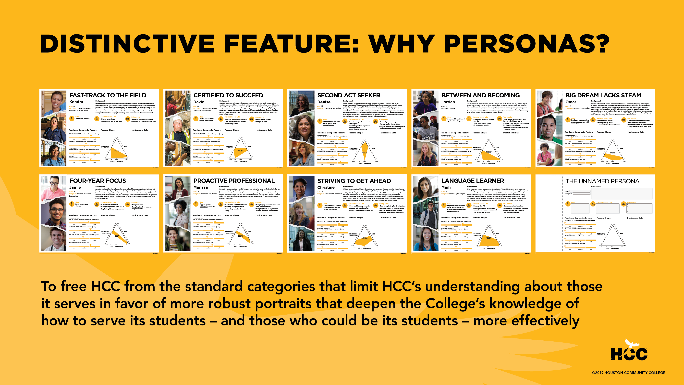

Slide 8
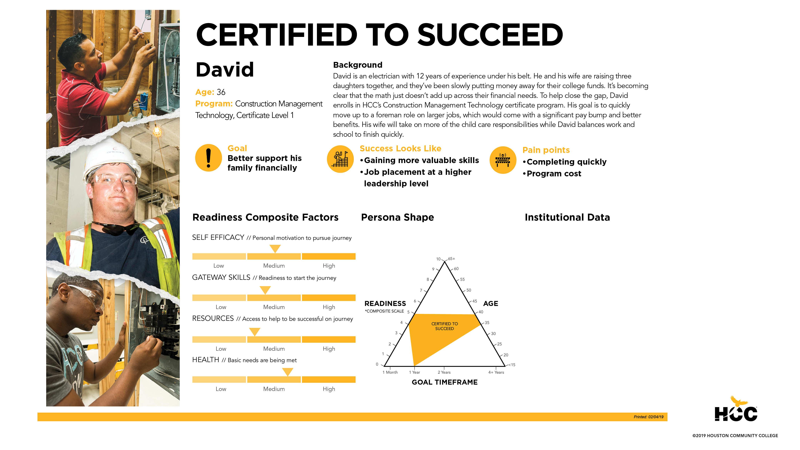

Slide 9
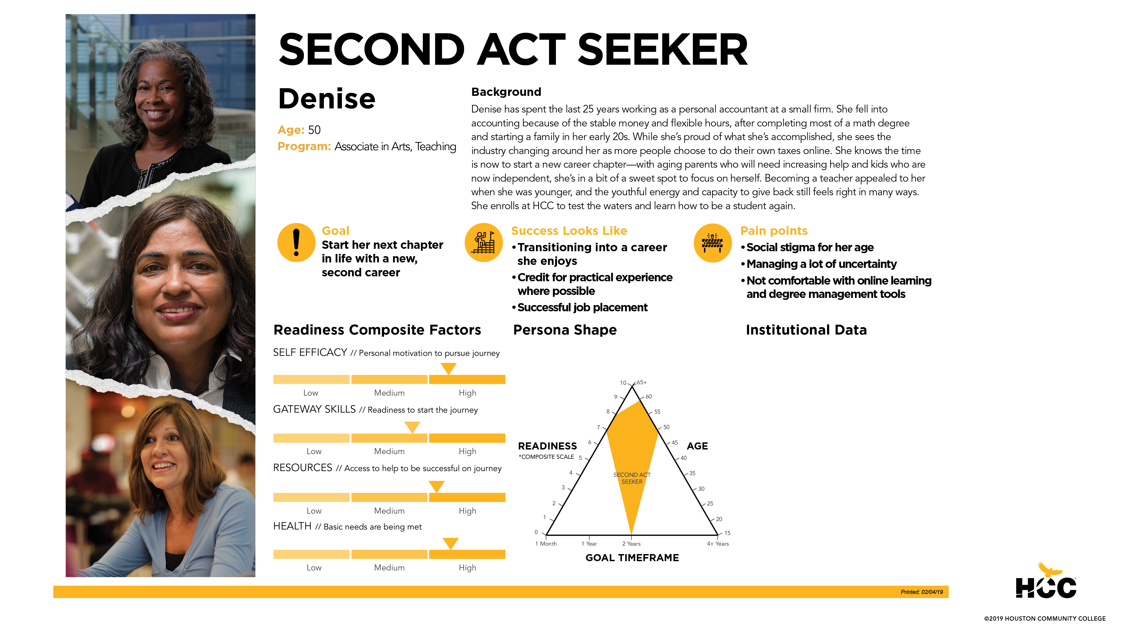

Slide 10
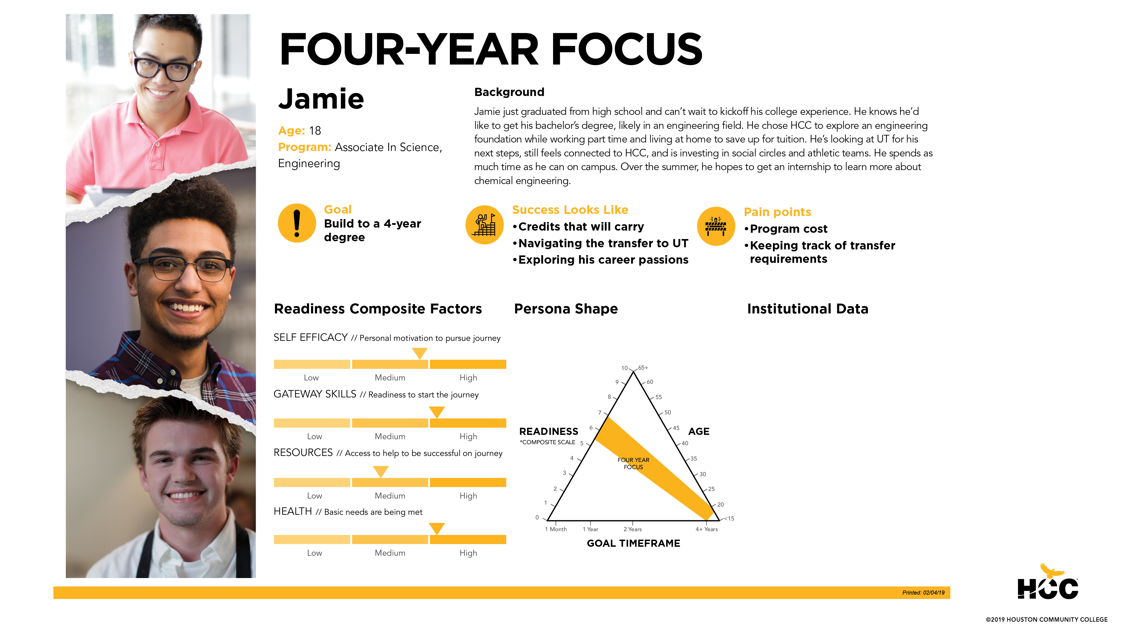

Slide 11
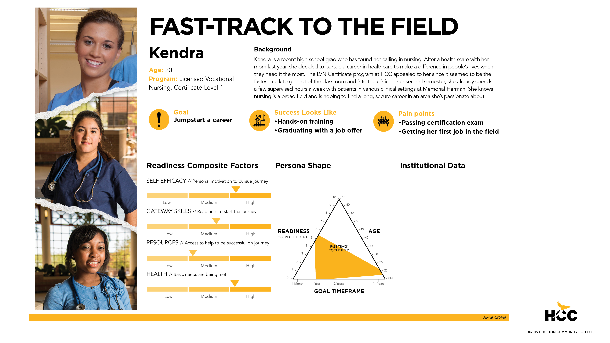

Slide 12
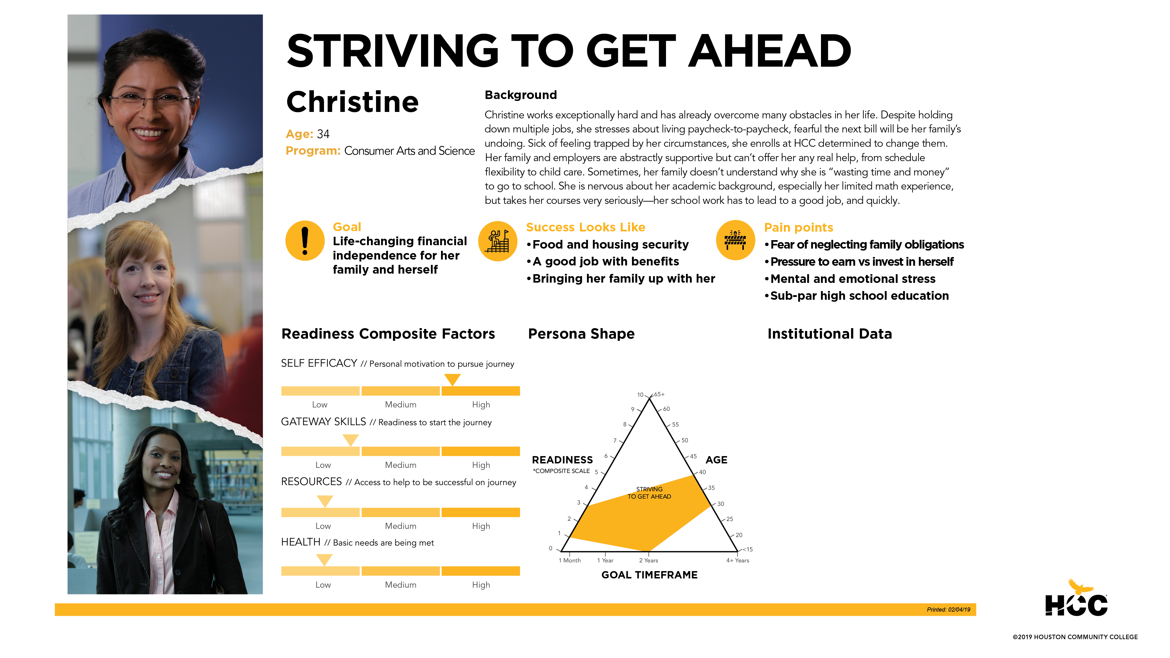

Slide 13
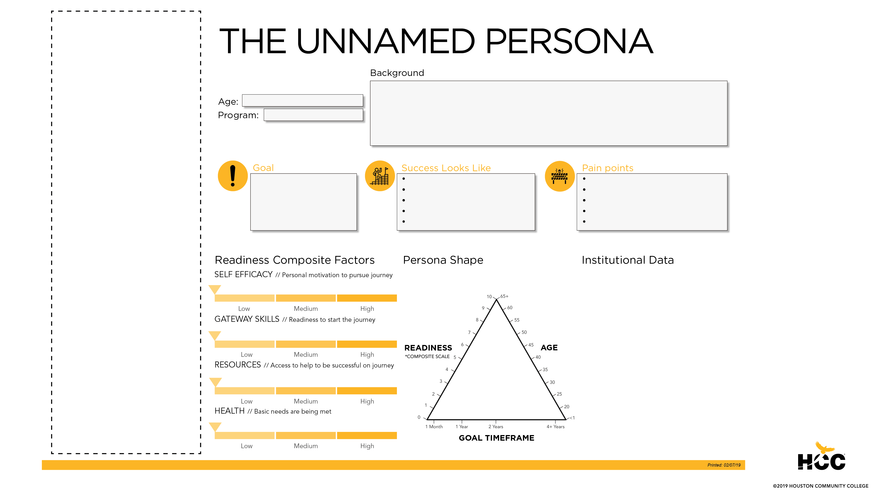

Slide 14
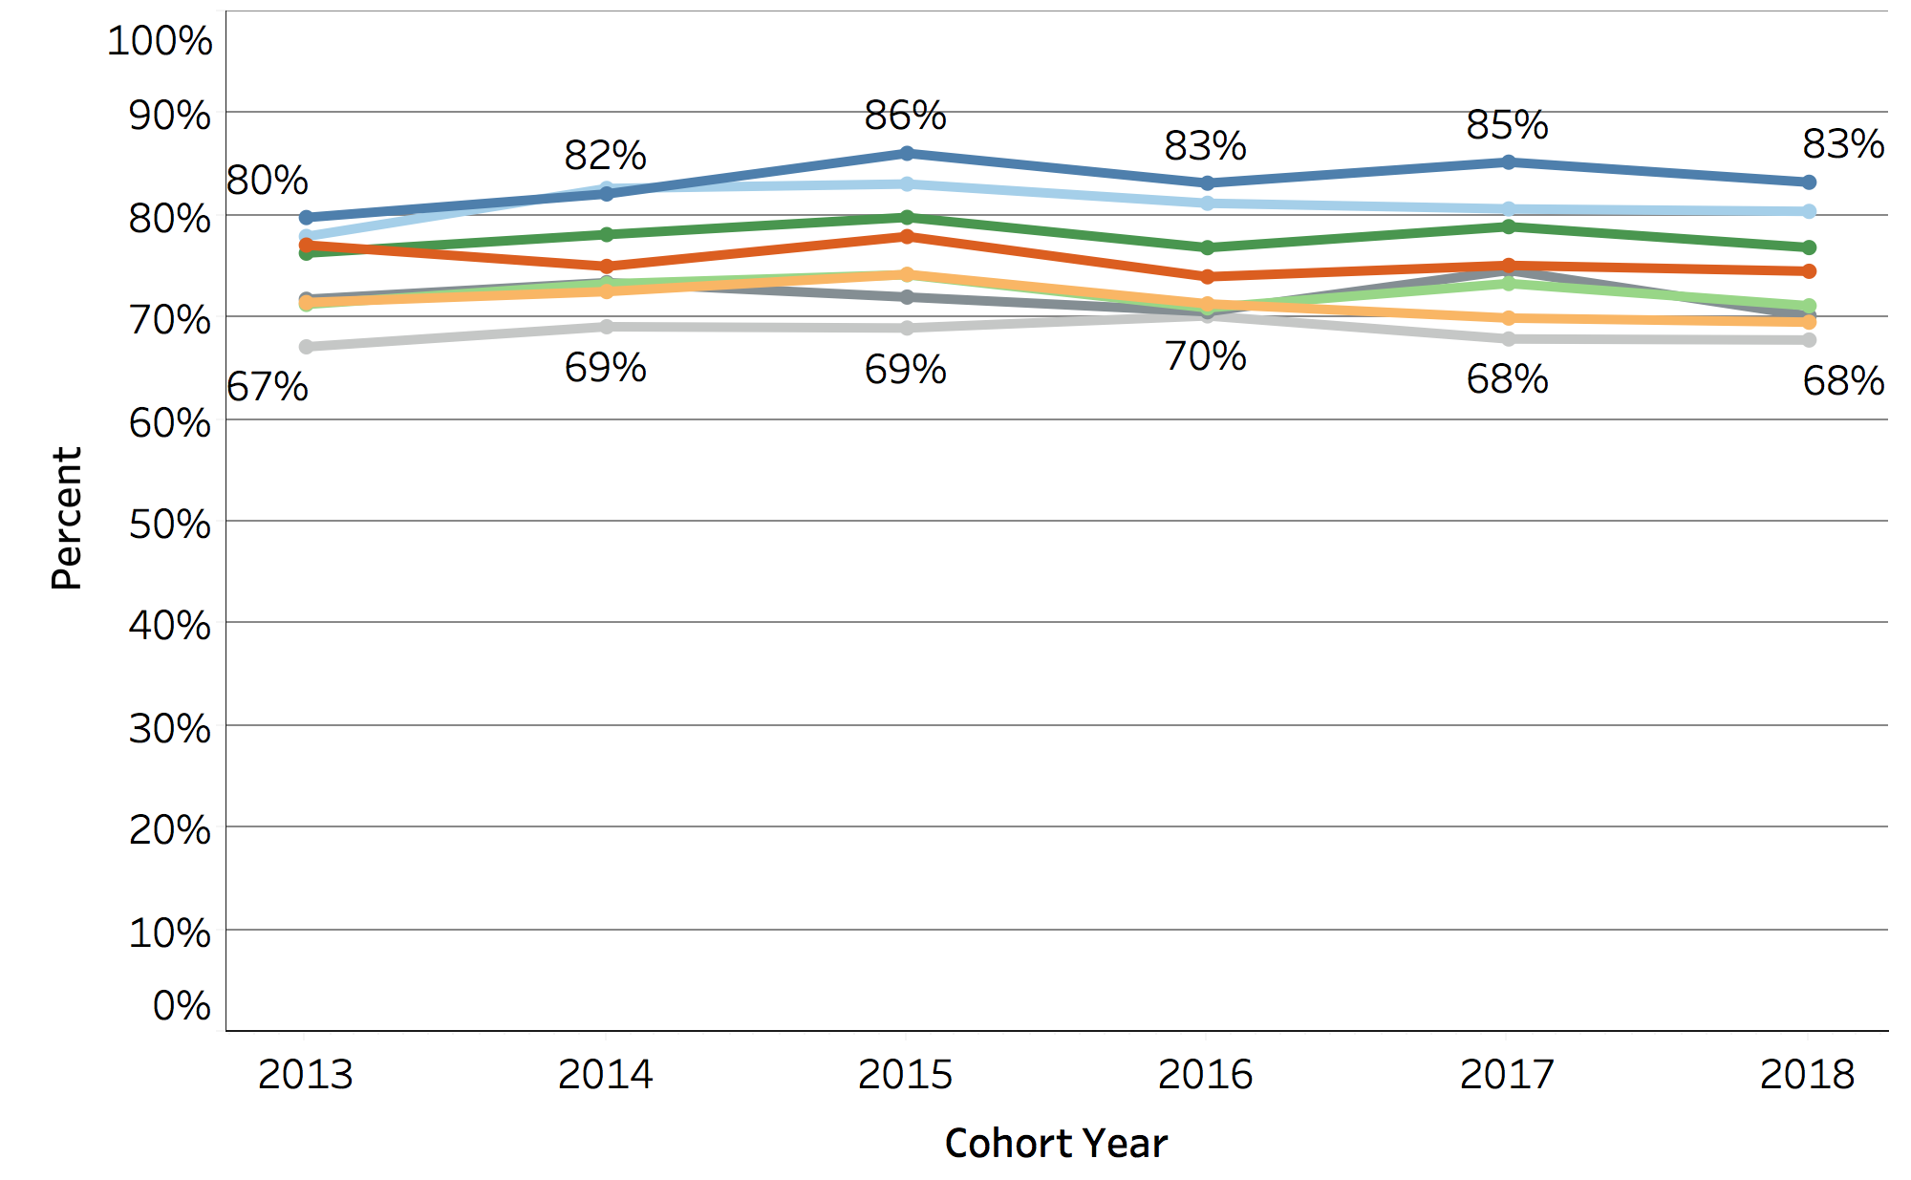
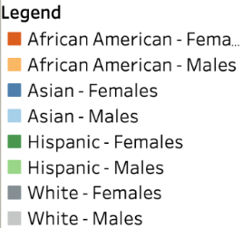
Fall to Spring Persistence
les
Source: OIR AtD Report, 04/20/2019.
Enrollment ongoing for Spring 2019.

Slide 15
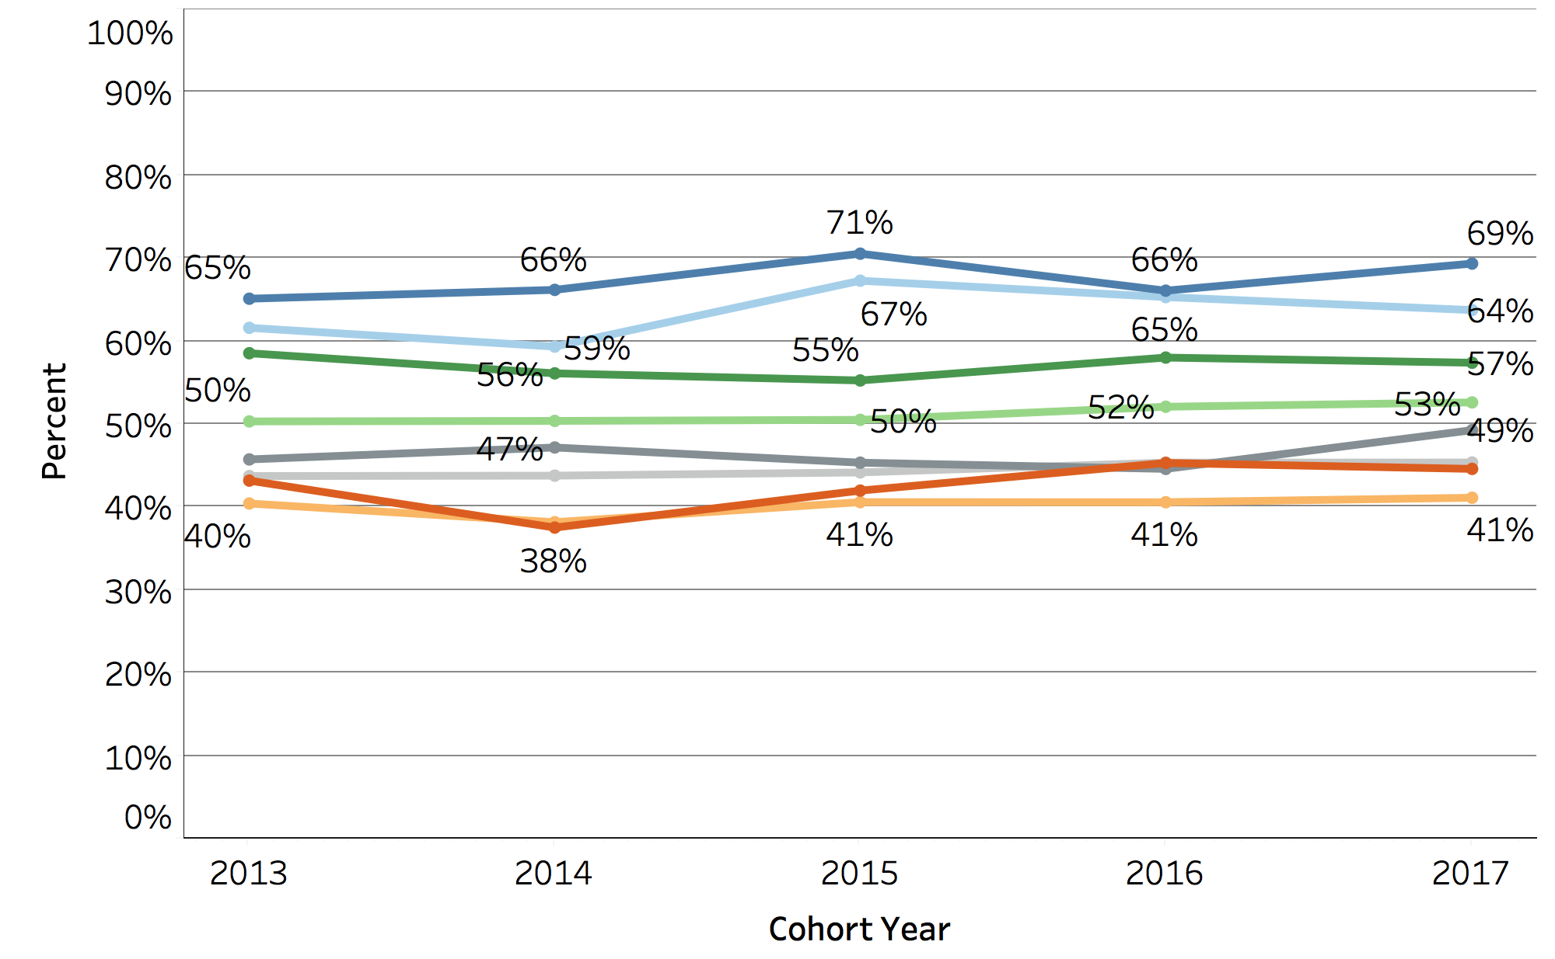
Fall to Fall Persistence
les
Source: OIR AtD Report, 04/20/2019.
Enrollment ongoing for Spring 2019.

Slide 16
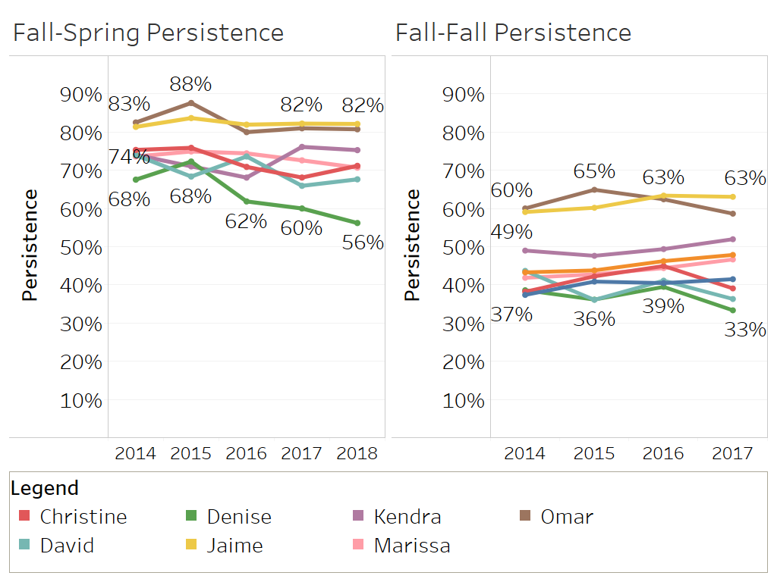
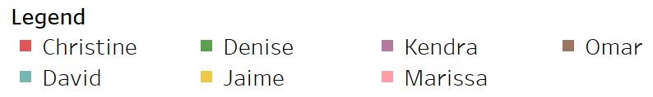
Persistence by Persona

Slide 17


Using Student Mindsets to Drive Personalized Engagement
Tracy Woods
President, AccelerEd
CTO, University of Maryland Global Campus

Slide 18
From Higher Ed, For Higher Ed
AccelerEd was founded in 2017 as an LLC of UMUC Ventures, which is a 501(c)(3) nonprofit supporting organization of the University of Maryland Global Campus (UMGC).
AccelerEd was chartered to develop, deliver, and manage technology services for UMUC and other higher education institutions.
Born from the UMUC Office of Technology, AccelerEd is uniquely positioned to provide services to higher education.
AccelerEd has a deep understanding of the higher ed market: its opportunities, challenges, change lifecycle, and budget sensitivity. We both support and enable transformation.
Our Mission:
“To enable higher education institutions to adapt and transform their operations in a continuously evolving market environment.”

Slide 19
Student-Centric Transformation
In order to really achieve student-centric transformation, you must understand and align the student perspective to the strategic goals of the university.
Possible outcomes include:
Improving outcomes for all stakeholders
(students, faculty, and staff)
Streamlining processes for efficiency
Improving visibility and delivery
Enabling scalability and growth
Identifying, improving, and allowing for key measures
Reducing operational costs and creating value

Slide 20
Journey Mapping Workshops
We facilitate cross functional workshops during which we:
Develop personas – humanizing the student ID
Walk the journey from the student’s perspective, keeping in mind that the student has expectations and choices.
  See the experience from the student’s viewpoint: view the institution from the outside in.
  Identify areas of friction that stop or slow the student from achieving goals.
Make recommendations on what to tackle first to improve the experience.
  In many cases, the changes are related to processes and policies.
  Create a plan to quickly deliver incremental value.

Slide 21
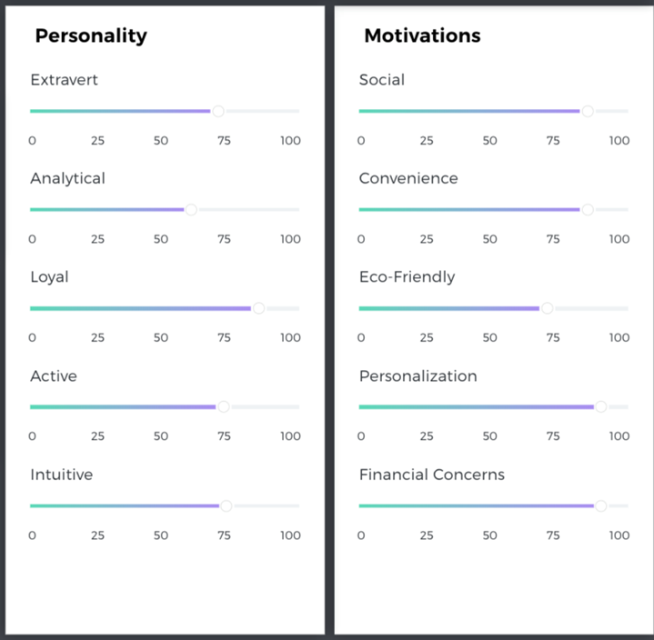
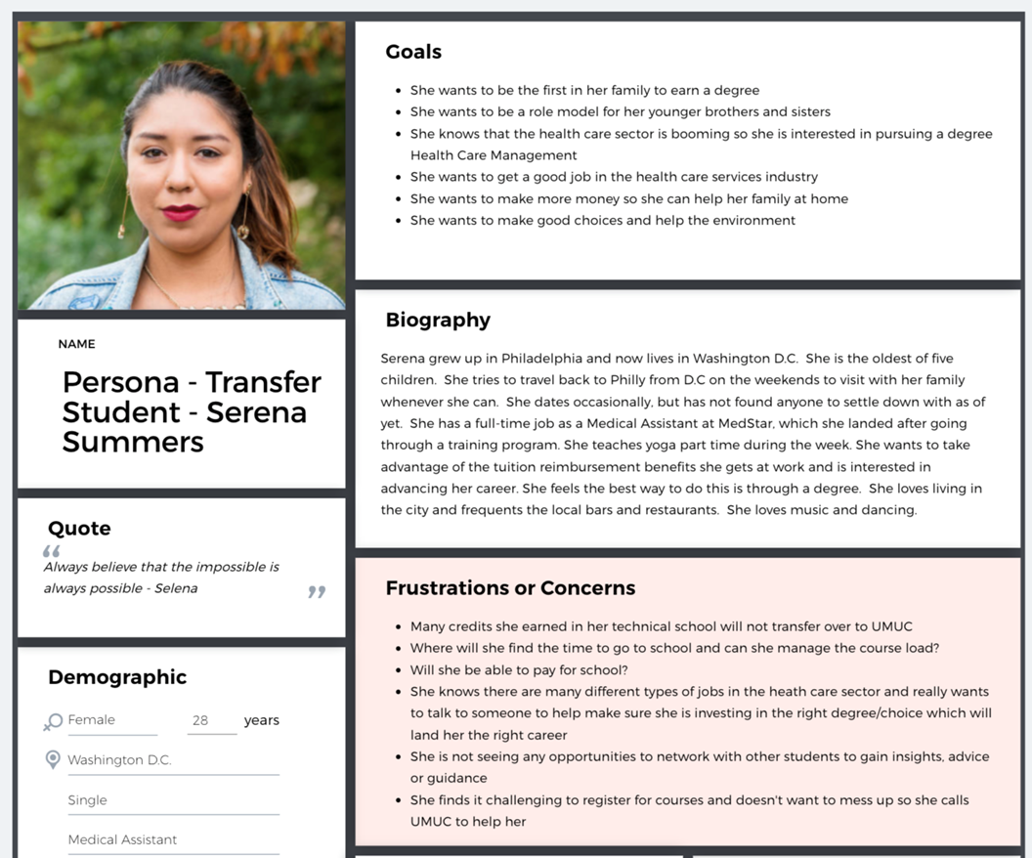
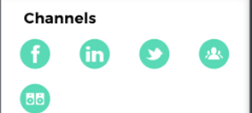
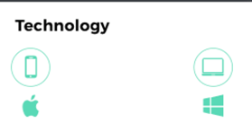
Sample Persona

Slide 22
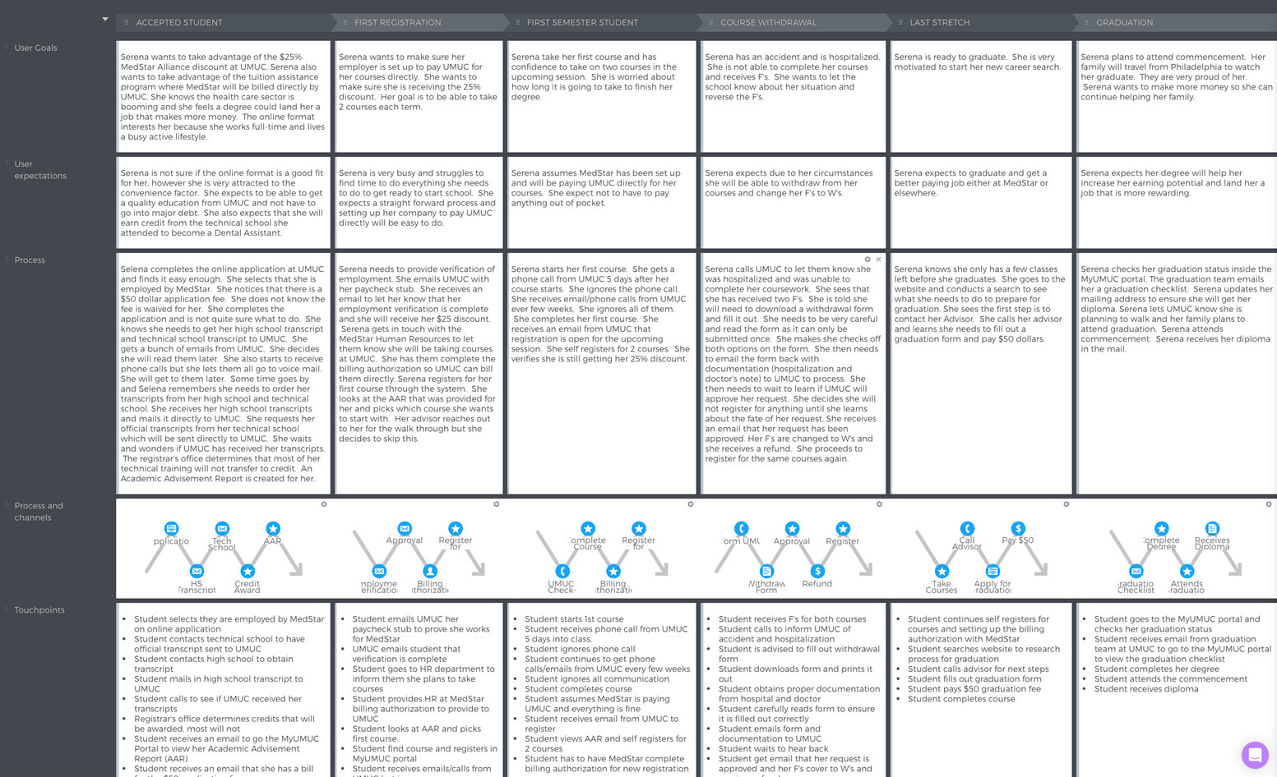
Sample User Journey

Slide 23
Meet Students Where They Are
Create a plan to improve the experience.
Commit to business process re-engineering, if needed.
Examine policies and procedures for potential changes.
Identify and implement technology to support new operational models.

Slide 24

University of South Florida System
Scaling Innovation
Sidney Fernandes
Vice President IT/CIO

Slide 25

Scaling Innovation = A New IT mindset
  Lazer focus on client outcome
  Pivot with empathy to client realities
  Scale and sustain innovative practices
  Break down IT silos
  Create platforms for transformation
  Rapidly deliver value-producing products NOT individual projects
  Hire and reward a growth mindset

Slide 26




Agile = Eternal Learning:
Do you remember?...

Slide 27
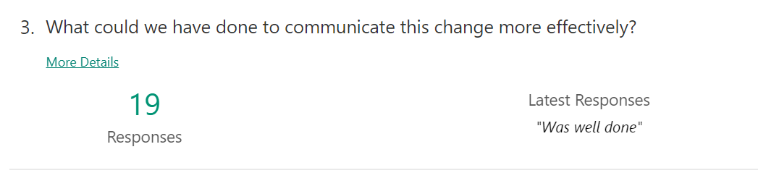
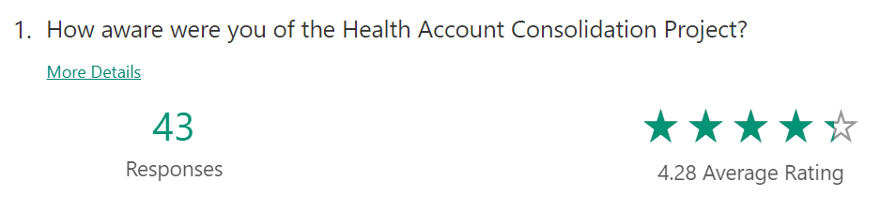
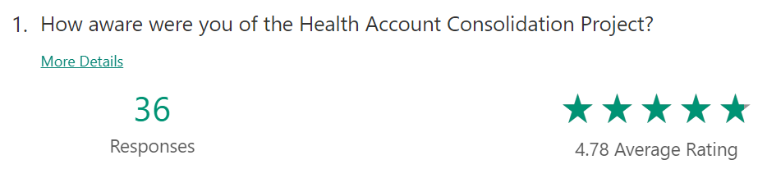
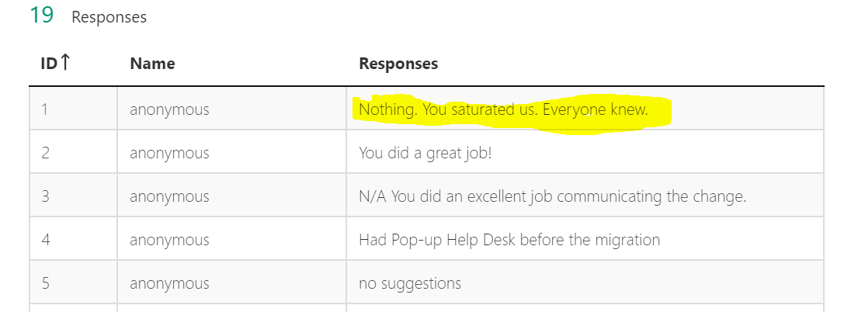
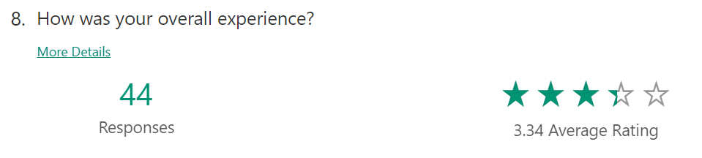
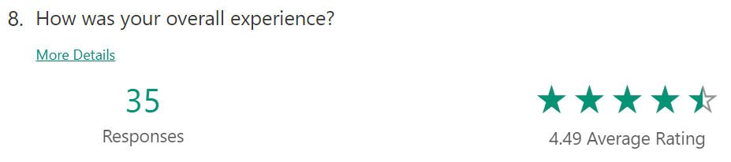
Change management = Tight feed back loops
1st client wave
2nd client wave

Slide 28
Questions?
Thank you!
https://www.linkedin.com/in/kurt-ewen-ph-d-a2a64672/
https://www.linkedin.com/in/tracy-woods-85732a1/
https://www.linkedin.com/in/sidney-fernandes-6305b71/
https://www.linkedin.com/in/estovall/
NOTE: This presentation leaves copyright of the content to the presenter. Unless otherwise noted in the materials, uploaded content carries the Creative Commons Attribution 4.0 International (CC BY 4.0), which grants usage to the general public, with appropriate credit to the author.

Slide 29

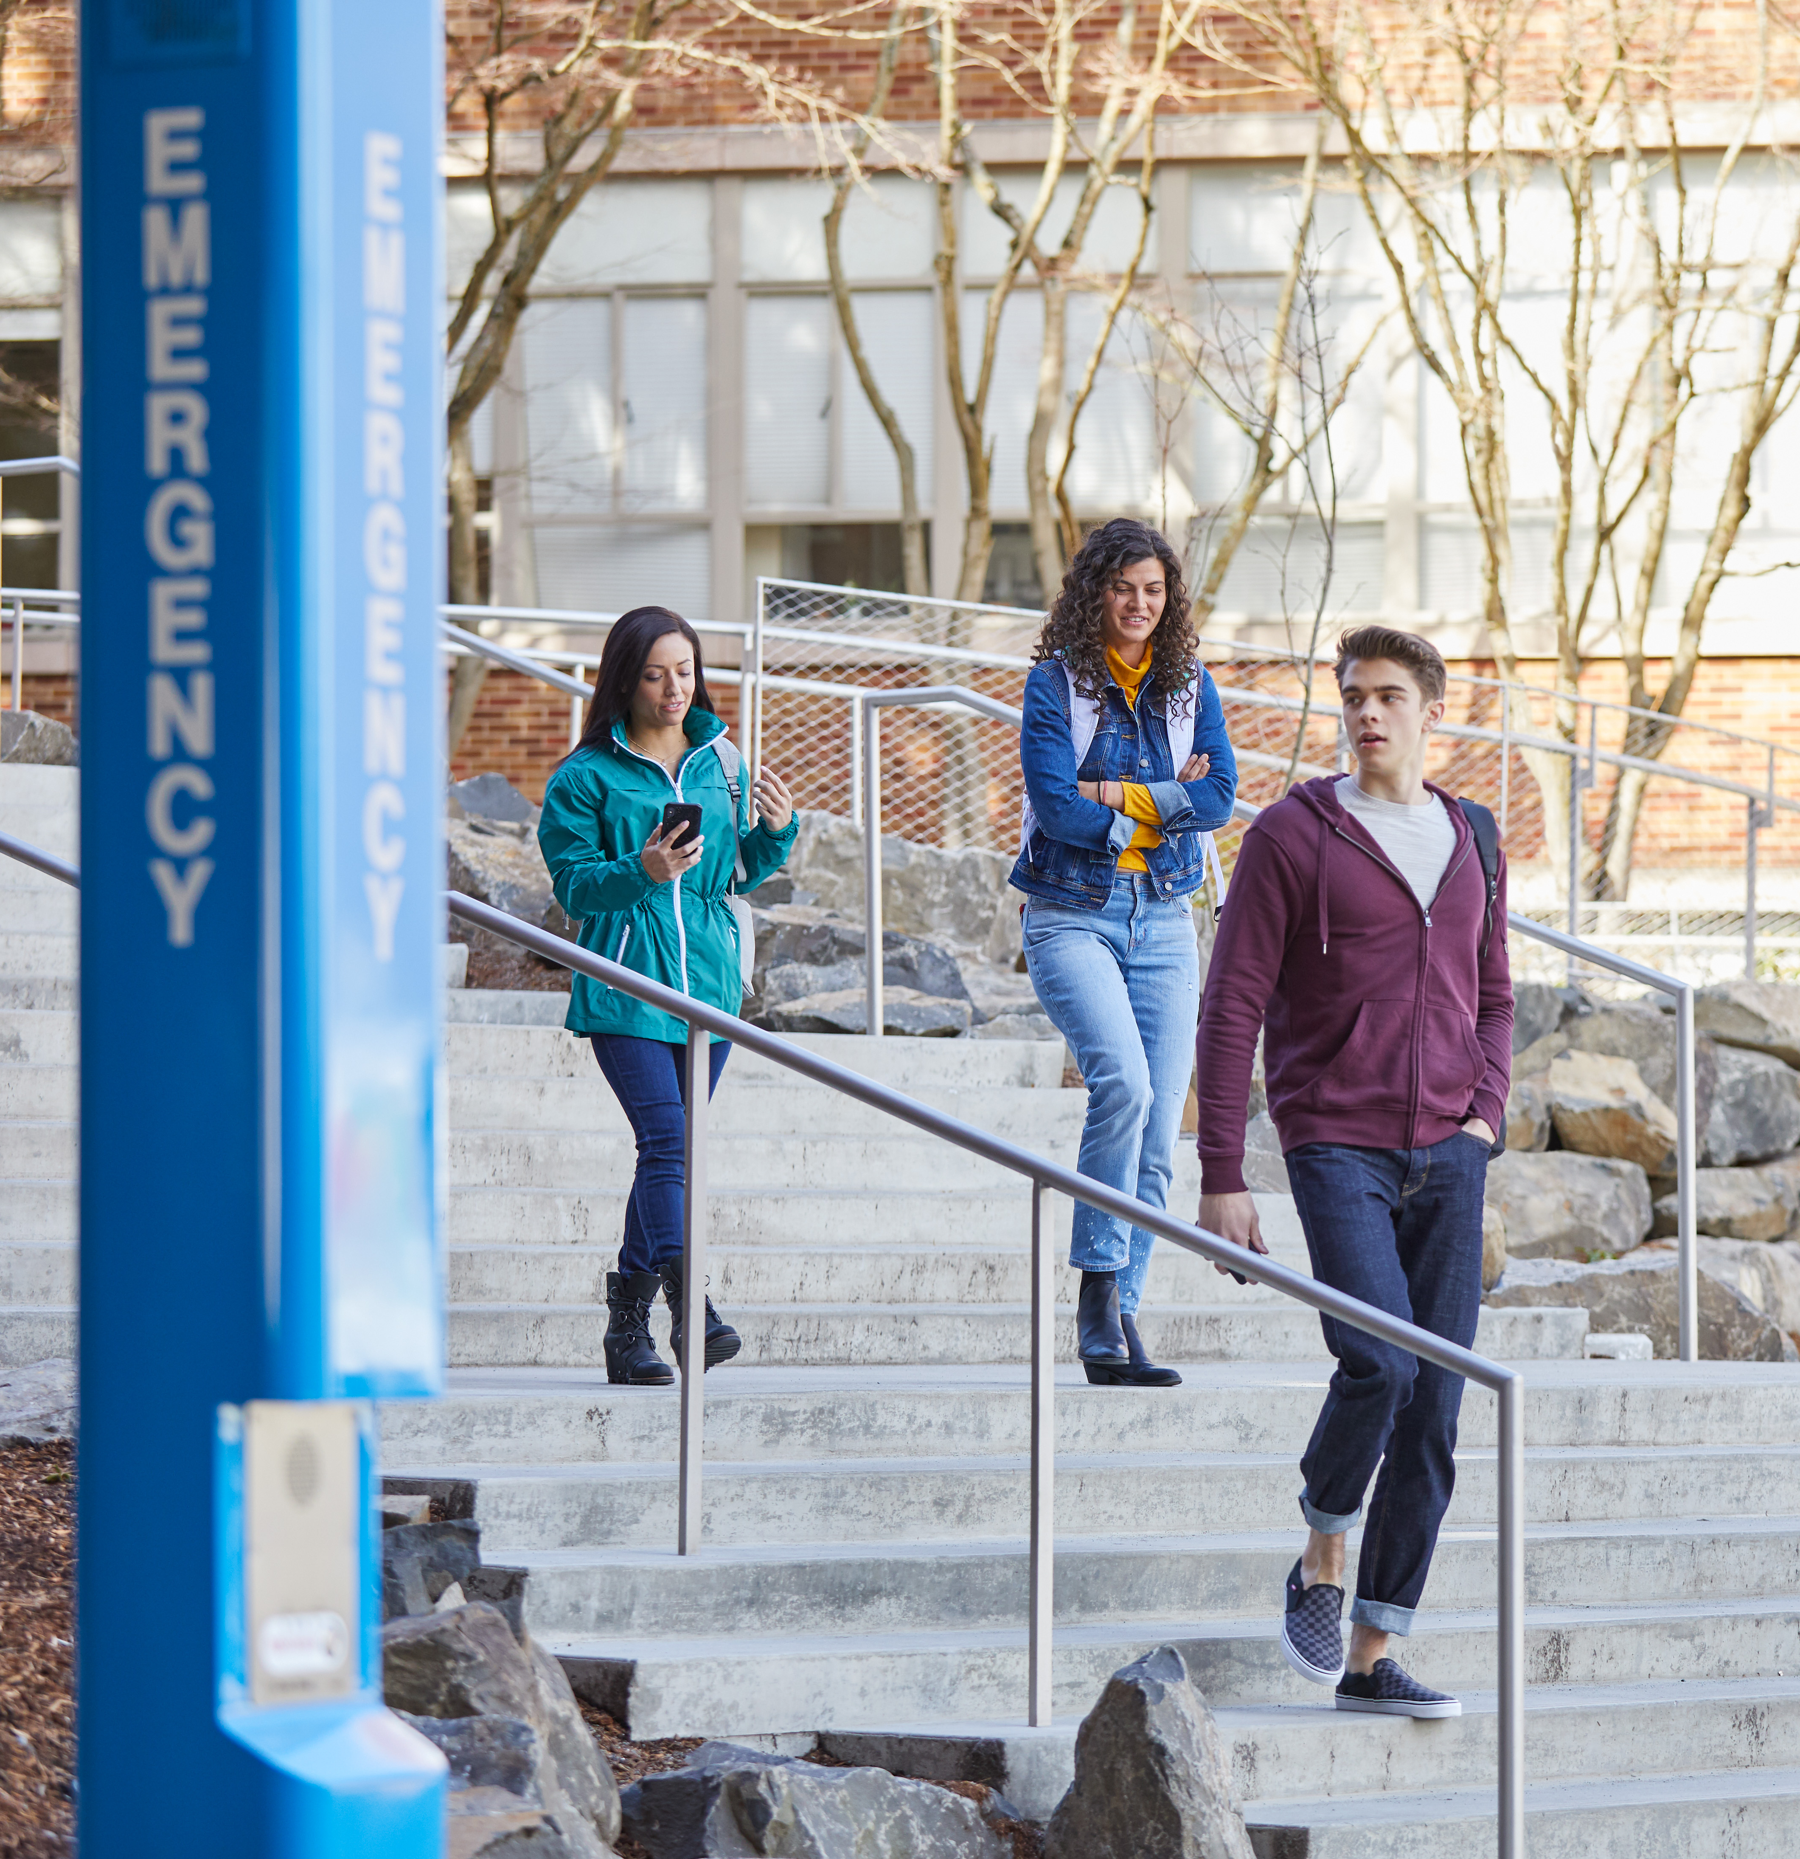
Next steps…
Visit us in booth #1431
Come experience our solutions, insight and conversations about a reimagined campus.
Attend sessions
Oct. 16, 3:15PM – 4:00PM
Campus Reimagined for Humans: propelling students to self-actualization
Continue the learning at aka.ms/HED
To stay up to date with digital transformation in Higher Education.

Slide 30
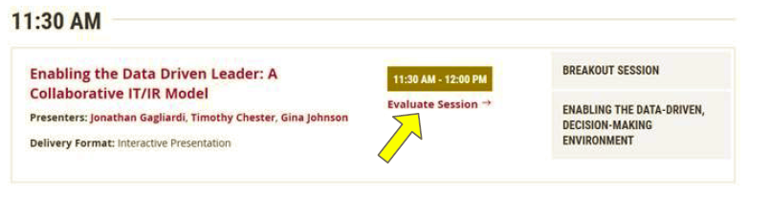
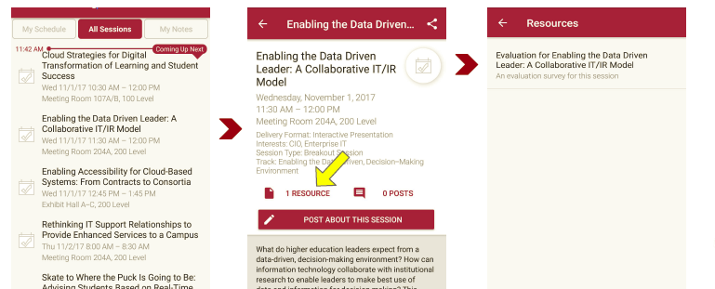
Session Evaluations
There are two ways to access the session and presenter evaluations:
1
2
In the online agenda, click on the “Evaluate Session” link
From the mobile app, click on the session you want from the schedule > then scroll down or click on the associated resources > and the evaluation will pop up in the list

