Slide 1
Navigating the Changing Landscape of Student Support in the Age of Amazon

Slide 2
Goals for Today
Understand the service expectations of students based on data
Learn how Miami University has evolved their service strategy
Gather ideas of how to move forward on your service strategy

Slide 3
Customer Service in Higher Education
STUDENTS FEEL CONSTANT FRUSTRATION
ADMISSIONS
REGISTRAR
FINANCIAL AID
BURSAR
ADVISING
“When is the deadline for my application?”
“I need to order
my transcript!”
“How do I apply
for FAFSA?”
“When is my tuition due?”
“How many more credits
do I need?”
TRANSFER CENTER
ADVANCEMENT
CAREER CENTER
HELP DESK
“What classes do
I need to take?”
“How do I make
a donation?”
“When is GE
coming to campus?”
“I can’t login
to Blackboard.”
Notes:
The customer service model in Higher Ed traditionally has been broken. There are many questions a student has over the course of the lifecycle as a student. Often times it is frustrating for them to know who is the right person to speak to, what can the person actually do, in the scope of knowledge, and

Slide 4
A Widening Service Gap
INCREASED EXPECTATIONS
AND DEMAND doesn’t always mean increased resources, so the institutional workload pays the price
DEMANDS FOR STUDENT SERVICES
WIDENING
SERVICE GAP
Needs & Expectations
RESOURCES
Time
Notes:
This has created a widening service gap where the needs and expectations of students are growing and the time and resources continue to shrink.

Slide 5
Customer Service is Key
NEARLY
67%
1 in 3
76%
CUSTOMERS
SAID THEY PREFERRED SELF-SERVICE OVER SPEAKING TO A COMPANY REPRESENTATIVE
OF PEOPLE ACROSS GENERATIONS VIEW CUSTOMER SERVICES AS A “TRUE TEST” OF VALUE
WOULD RATHER CLEAN A TOILET THAN TALK TO SOMEONE IN CUSTOMER SERVICE
3/4
CONSUMERS PREFER A SELF-SERVICE OPTION
SOURCES: Aspect.com, Zendesk.com
Notes:
The good news is that users want self-service, in fact many prefer it to interacting with a human. As you might expect, that preference increases the with youth and most of the research available is focused on millennials and generation Z. However, Millennials and GENZ are your students today and they are your faculty and staff of tomorrow. A couple points to call out here. Millennials expect that you will use their personal information to their benefit…benefit being personalized service. They are significantly less concerned with privacy. They assume that if they are sharing information it will be used to positively impact their experience. But, millennials are extremely fickle when it comes to technology…they expect it to just work. If they attempt to use a tool (a self-service portal) and they don’t easily find what they need. Its likely they’ll never come back.
Why do you think this is the case? I think it comes down to control. Younger consumers are used to having access to information. For instance…I don’t want to be on the phone with an airline and be told what flights are available. I want to tell them which flight I want and how many seats are available and even what seats are available and which one I want. I don’t want someone from the cable company trying to sell me a package that will cost more, I can take my time to analyze which package works for me. Of course if I’m GenZ, I’m probably never going to have cable to being with.
I want to stress that this is not about being impersonal and cold, we can be there with a personal touch when a user wants it, and many of them do…this is about provide support in a way that users expect…in the channels they are used to with multiple options available based on their preference

Slide 6
User Preferences Shifting Towards Self-Service
GENZ
MILLENNIALS
GENX
BABY BOOMERS
Self-service
Human Interaction
Millennials and Gen Z prefer using self-service FAQ pages over speaking with an agent on the phone. (Forrester Research’s Customer Life Cycle Survey)
Millennials have the lowest tolerance for errors and delays of any other generation studied—they simply expect things to work. . (JD Power)
Millennials prefer to solve their customer service issues on their own (Aspect.com)
Millennials are less concerned than other generations about privacy. They accept the erosion of privacy as inevitable and are generally willing to have their information collected if it comes with benefits in the form of personalized services. (JD Power)
Notes:
Millennials and GENZ are your students today and they are your faculty and staff of tomorrow.
Millennials expect that you will use their personal information to their benefit…benefit being personalized service.
Millennials are extremely fickle when it comes to technology…they expect it to just work. If they attempt to use a tool (a self-service portal) and they don’t easily find what they need. Its likely they’ll never come back.
40% of students that post something on your Facebook page expect and answer in under an hour.
4 Cs of Technology Lifecycle: 1. Cute 2. Convenient 3. Compelling 4. Compulsory

Slide 7




The Rise of the Machines (Chatbots)
67%
of users worldwide used a chatbot for customer support in the past year
40%
of consumers do not care whether a chatbot or a real human helps them, as long as they are getting the help they need
85%
Of all customer interactions will be handled without a human agent by the end of 2020
80%
Chatbots are helping businesses and companies on support costs by speeding up response time and answering up to 80% of routine questions
SOURCES: https://www.invespcro.com/blog/chatbots-customer-service/
Notes:
https://www.insidehighered.com/news/2019/09/06/expansion-chatbots-higher-ed

Slide 8





Benefits of Chatbots According to Users
24 hour service
Getting instant response
Answers to simple questions
24h
64%
55%
55%
Easy communication
Friendliness
51%
32%
SOURCES: https://www.invespcro.com/blog/chatbots-customer-service/

Slide 9
Miami University’s Service Strategy
Bob Black, Assistant Director of IT Process and Planning

Slide 10
Mature IT Service Management
IT Services
Feb15
Jun14
May19
Feb15
Nov14
Nov14
July 15
Jun14
Jun14
eLearning
Jun15
Jun15
ComDoc
Jul 16
Jul 16
Legend
Student Success
Jul 16
Jul 16
Jan19
Jan19
2014
Arts and Sciences
Apr17
Nov16
Nov16
2015
Libraries
Service Catalog Management
Apr17
Mar17
Mar17
ProjectManagement
Service Level Management
Portfolio Management
Change Management
Configuration Management
Knowledge Management
Incident Management
Request Fulfillment
2016
Engineering
Apr17
Mar17
Mar17
2017
Education & Health
Apr17
Oct17
Oc17
2018
Finance
Mar19
Apr19
Nov17
Nov17
2019
Regional
Mar19
Sep18
Sep18
Myaamia Center
Jun19
Jun19
Student Success
Jun19
Jun19

Slide 11
Extending ITSM to Enterprise Service Management
Facilities
Feb18
HR
Dec18
Feb19
Campus Services
Jul19
Jul19
Legend
Global Initiatives
?
Jun19
Libraries
Aug19
2018
Service Catalog Management
ProjectManagement
Service Level Management
Portfolio Management
Change Management
Configuration Management
Knowledge Management
Incident Management
Request Fulfillment
2019

Slide 12
Investment in Knowledge Management
Milestone | Published Articles | Page Views | Ticket Link Rate | Cost per Interaction
August 2015 (KB Launch) | 100 | 48k/mo | 0% | $22
Oct-Dec 2016 Wave 1) | 500 | 44k/mo | 25% | $22
Jan-Mar 2017 (Wave 2) | 1500 | 66k/mo | 90% | $14
Oct 2017 – Oct 2018 (Outsource) | 1620 | 83k/mo | 80% | $10
Nov 2017 – Oct 2019 (Stabilize) | 2169 | 95k/mo | 75% | $9

Slide 13
The Rise and Fall – Channel Distribution
100%
90%
80%
70%
60%
50%
40%
30%
20%
10%
0%
Phone
Chat
Email
Web
Other
Nov 26, 17
Feb 18, 18
May 13, 18
Aug 5, 18
Oct 28, 18
Jan 20, 19
Apr 14, 19
Jul 7, 19
Sep 29, 19

Slide 14
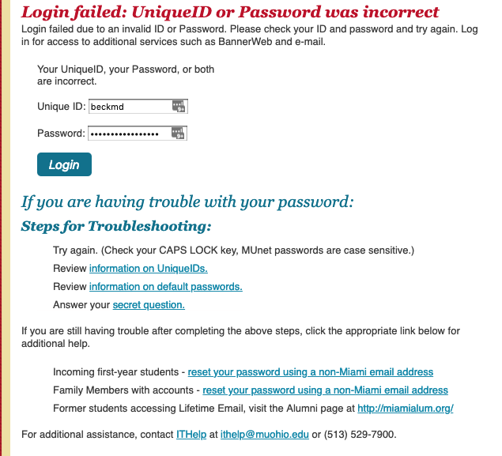
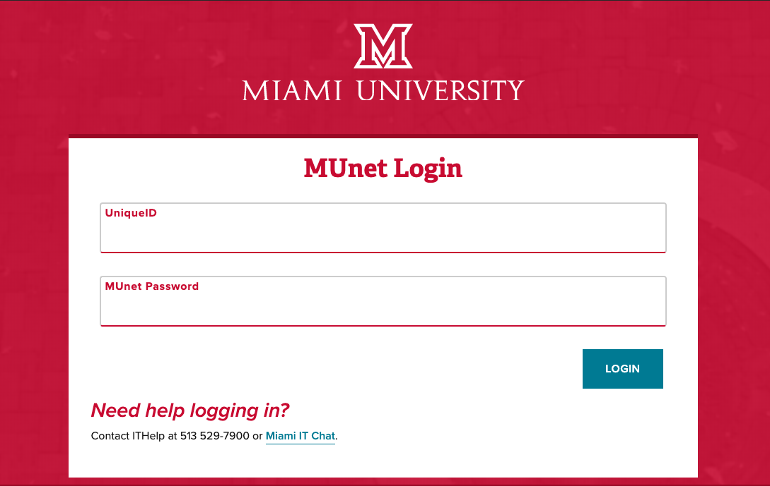

Slide 15


Human Difficulties
Documenting Complex Problems
Fluidity of Knowledge
Acceleration and Agility
Consistency
Chatbot
Findability of Knowledge Content
Natural Language Processing

Slide 16
A Path Forward

Slide 17







Reducing support costs
Enterprise Wide Knowledge
Insights from interactions
Miami Service Desk 2020
Consistent Experiences
Efficiency Gains
Convenience of Chat
Continuous Learning
Instant Responses
Multi-modalities automation
Elimination of Email channel

Slide 18
Finding the Balance
OLD SCHOOL
NEW SCHOOL
Phone
Portal
Self-service
reset
Live Chat
Automated Workflows
Artificial Intelligence
KCS
Agent
Assisted Bots
Knowledge Management
Notes:
As you think about shifting left and thinking about the tools and processes that can support that strategy let’s shift the conversation to talk about the traditional service delivery and why we consider them to be old school. You’ve got live support technicians or advisors. We’ve covered how costly it is to delivery live support the same goes for live chat. It is a nice mode to have (many users prefer chat), but it doesn’t drive down volume and frankly it usually increases volume. Requests don’t typically just shift directly from one channel to another. Phone calls may be reduced, but overall volume increases. Both require expensive labor and overhead to deliver. You’ve got self-service password resets (always the highest driver of volume), but many still users call. Their somewhat effective, but they solve a only a portion of the problem. Then you’ve got the self-service portal. Is it a necessity? I would argue that it is. But portals are frequently underutilized by users. Why is that? It could be that it is too hard to find. How many clicks does it take to get to the portal? Is the information up to date? Is it comprehensive?
So let’s look about some “new school” tools. Think about these as layering and enhancing our old school technology. Keep in mind, the engine that powers all of these tools are only as strong as your foundation of knowledge.

Slide 19






Student Services by Blackboard
STRATEGY
MARKETING
ENROLLMENT
RETENTION
ONE STOP
HELP DESK
Market Research
Performance
marketing
Enrollment
coaching
1:1 Retention Coaching
24-7-365
Technology agnostic
Business Modeling
Positive ROI
Optimized experience
One-on-one
1-1 customized support
ITSM methodology
Enrollment Growth
Student Success

Slide 20








Student Services by Blackboard Capabilities
End User Support
Integrations into SmartView
Scalable and flexible U.S. based staffing solutions to provide 24x7 support for end users
Integration capabilities supporting APIs that could provide key insights and detail to support agents
A.I. Powered Chatbots
Reporting & Insight
Supplemental to the live agent experience, chatbots provide enhanced self-service for end users
An enhanced level of insight into end user problems, service levels and customer satisfaction
Multichannel Support
Continuous Improvement
Chat, Web, Email, Facebook Messenger, Text, and Phone modalities are all available to use
Account Management to analyze and report on the user experience to improve and develop training resources
Proactive Solutions
Customized Knowledge Management
Reach end users through campaigns and nudging to prevent support requests and improve experience
Our consultants will work with our content management team to build your external and internal knowledge base

Slide 21
Contact Information
Miami University of Ohio
Bob Black, Assistant Director, IT Process and Planning, bob.black@miamioh.edu
Blackboard
Daniel Woodcock, Director of Help Desk Services, Daniel.Woodcock@blackboard.com
NOTE: This presentation leaves copyright of the content to the presenter. Unless otherwise noted in the materials, uploaded content carries the Creative Commons Attribution 4.0 International (CC BY 4.0), which grants usage to the general public, with appropriate credit to the author.

Slide 22
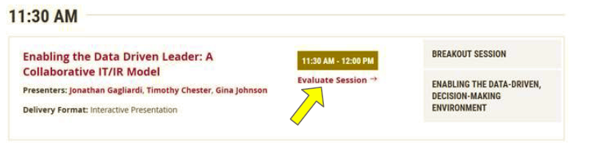
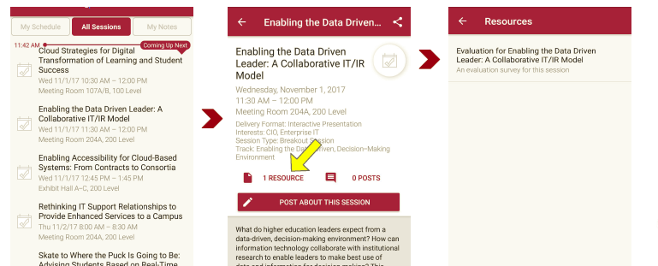
Session Evaluations
There are two ways to access the session and presenter evaluations:
1
2
In the online agenda, click on the “Evaluate Session” link
From the mobile app, click on the session you want from the schedule > then scroll down or click on the associated resources > and the evaluation will pop up in the list

