Slide 1



Expanding Reach, Engagement and Impact with Enterprise Event Management
October 16, 2019
Kyle Flinn, University of Missouri
Mary Seaton, Penn State
Nick Bonora, Purdue University
Notes:
Presenter: MIKE
https://www.cvent.com/en/meet-cvent-educause-2019

Slide 2
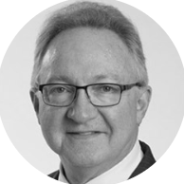
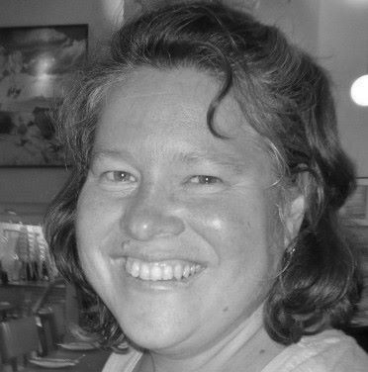
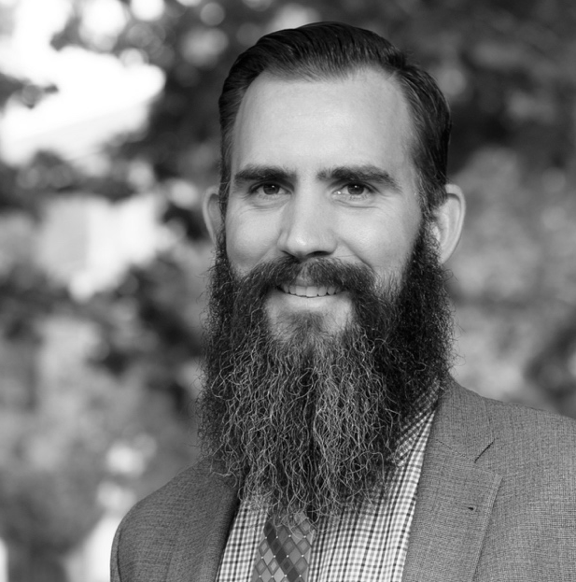


Our Panelists
Kyle Flinn
Director
Enterprise Program Management
Mary Seaton
Assistant Director
College Relations &
Manager, Office of Conferences and Short Courses
Nick Bonora
Director
Purdue Conferences
Notes:
Presenter: MIKE
Kyle Flinn, Director of Enterprise Program Management for Extension (University of Missouri)
Mary Seaton, Assistant Director of College Relations, Manager, Office of Conferences and Short Courses (Penn State)
Nick Bonora, Director, Purdue Conferences (Purdue University)
Call out that some are system-wide, large university wide or focused solely on Extension and Continuing Ed
Kyle Flinn is the Director of Enterprise Program Management for Extension at the University of Missouri. He joined Extension in April 2016 to lead a comprehensive technology program which integrated best-in-class e-commerce, e-marketing, e-learning and event management platforms. Previously, Kyle worked for Sprint Corporation for 20 years where he led highly complex technology upgrade programs. He finished his Sprint career as a technologist and staff manager in the Office of the CEO. He holds a Bachelor of Arts degree from the University of Kansas and an MBA from Baker University.
Mary Seaton is the Assistant Director of College Relations at Penn State University. In addition to external relations, one of her many responsibilities includes leading the Office of Conferences and Short Courses, which she has helped transformed to a highly productive central service unit for the entire university. She has spent 18 years developing, implementing, and managing programs and events. During this time, she identified opportunities to increase efficiency through technology investments and integrations, streamline operations and deliver greater value to stakeholders across the university. They have been using Cvent for 16 years.
Nick Bonora is Director of Purdue Conferences. A natural storyteller who studied theater in college, Nick arrived at Purdue Conferences in 2012 after stints with the Los Angeles Opera, the Autry Museum of the American West and the UCLA Conferences Services department. He considers hospitality to be a way of life, rather than just an industry. Nick enjoys his job because he sees his work as the convergence of service, hospitality and storytelling. He loves being a part of making connections, bringing people together, learning new things and watching the team succeed.

Slide 3
Agenda
Introductions
Events Program Overview
Event Management Strategies & Technology Infrastructure
Implementation, Measuring Success & Vision for Future
Q&A
Notes:
Presenter: MIKE
Panel Outline
1. Introductions
Institution
Role and how long in role
Cvent experience and usage
Event management strategy and technologies used
2. Event Management Strategy
Initial drivers
Evolution over time
Key stakeholders across the institution – how their usage evolved over time
People, processes and technologies that support this strategy
3. Implementation, Measuring Success & Vision for Future
Implementation Best Practices – what you’d repeat, revise or not recommend as it relates to implementation
Measuring Success – best practices as it relates to measuring success
Vision for the Future – how tracking success, ROI and vision for the future
EXTRA
4. Measurement and ROI
Data and Analytics - What kind of data and analytics do you have access to in your role? How do you leverage this information? What data do you wish you had that you don’t today?
ROI – How are you able to measure the reach and impact of your event strategy and tactics? What have you learned as it relates to the ROI of your events?
Anecdotes – Can you share a before and after anecdote with the audience that helps paint the picture of the role Cvent has played in helping you achieve your objectives?
6. Q&A

Slide 4
Introductions
&
Events Program Overview
Notes:
Presenter: MIKE
Let’s start with having each of you introduce yourself, your role, your core objectives and internal stakeholders, and your meetings, events and continuing education program.
Focus on primary use cases for event technology
Highlight what makes your implementation unique
Starting with Kyle, the “newest” member of the Cvent higher ed family…please introduce yourself and provide an overview of:
Your institution, your department, your role and how long you’ve been there
Core stakeholders
Your events program overview - the initial drivers for Cvent and how usage of Cvent across your institution has evolved over time

Slide 5
QUICK FACTS
Location: Columbia, MO
Type: Public, 4-year, land-grant institution
Enrollments: 34,000+ students
Employees: 2,150 faculty and instructors
Events Program:
  200+ programs and events per year
  20,000+ registrations per year
#EDU19
Notes:
Presenter: KYLE
Let’s start with Kyle Flinn from MU Extension. Kyle, please provide an overview of your role, how they’re different so audience members can identify. Who owns it, how implemented, etc.

Slide 6


MU Conference Office Client Base
Notes:
Presenter: KYLE
Scope beyond Ag school, much broader in scope and unique

Slide 7
Event Technology Evolution
Pre-2016
2016 - 2017
2018
September 2019 - 2020
Disparate Systems
Internal ”home grown”
“Freeware”
Ad hoc licenses across the state for paid events
RFP Process
Standardized on Cvent
Transitioned events that MU Conference Office historically supported into Cvent
Centralized Event Management & Scale
All “free” and ”for fee” events statewide will be managed in Cvent
Scale to 250,000 registrations per year
Notes:
Presenter: KYLE
From Kyle
· Pre-2018 – some units used an internally developed IT tool. Others used freeware like Event Brite or ad hoc licensed various tools across the state for paid events. Free events were coordinated in offline tools like email, Microsoft Excel/Access or other home grown tools.
· 2018 – standardized on Cvent, transitioned events that MU Conference Office historically has supported into Cvent.
· September 2019/2020 – all free and for fee events statewide will be managed in Cvent. Scale to 250K registrations per year.
Here’s a high-level timeline of how the use of event technology has evolved at MU Extension over the past few years, from disparate, decentralized usage to a centralized approach enabling broad and deep usage across a number of strategic initiatives.
As you see from this timeline, we went through a fairly lengthy RFP process in 2016 and in early 2017, Cvent was selected.
“After more than a year of hard work, the Nexus@Mizzou platform has successfully launched. In approximately two years, a nascent idea to enable e-commerce has turned into a showcase platform in higher education to better engage Missourians and those beyond.”
Kyle Flinn, Nexus Enterprise Project Director, MU Extension, 12/12/2017
The Alumni Association’s interest was a catalyst for our central IT organization to establish a master services agreement with Cvent. This approach increased access to the broad and deep event management capabilities through a centralized initiative, which also made it easier for University Development to begin using Cvent for our events.
eCommerce was a bit part of that centralized approach. Cvent’s compliance with Duke’s eCommerce standards allowed for this expanded approach.
As a result, we have been able to introduce greater efficiency across our organizations, scale our operations, and increase the reach and our alumni engagement and fundraising initiatives. we are now much more data-centric in our approach to events for engagement and development. This also paved the way for the creation of the Duke Alumni Network that Mark will speak to a bit later in the presentation.
With this groundwork laid, we are well-prepared for a more data-centric approach to events for engagement and development.

Slide 8
QUICK FACTS
Location: West Lafayette, IN
Type: Public, 4-year, land-grant institution
Enrollments: 41,000+ students
Faculty: 3,000+ faculty and instructors
Events Program:
  600-700 programs and events per year
  35,000 registrations per year
#EDU19
Notes:
SOURCE: https://giving.purdue.edu/s/1461/campaign/start.aspx?sid=1461&gid=1010&pgid=4977
Land-grant institution founded in 1869.
West Lafayette campus (2000+ acres) enrolls over 41,000 students.
Ranked the 2nd largest international student population of any U.S. public university by Open Doors.
3,000 tenured/tenure-track and non-tenure faculty.
https://www.purdue.edu/hr/General_Information/audience/currentfacultystaff.html

Slide 9
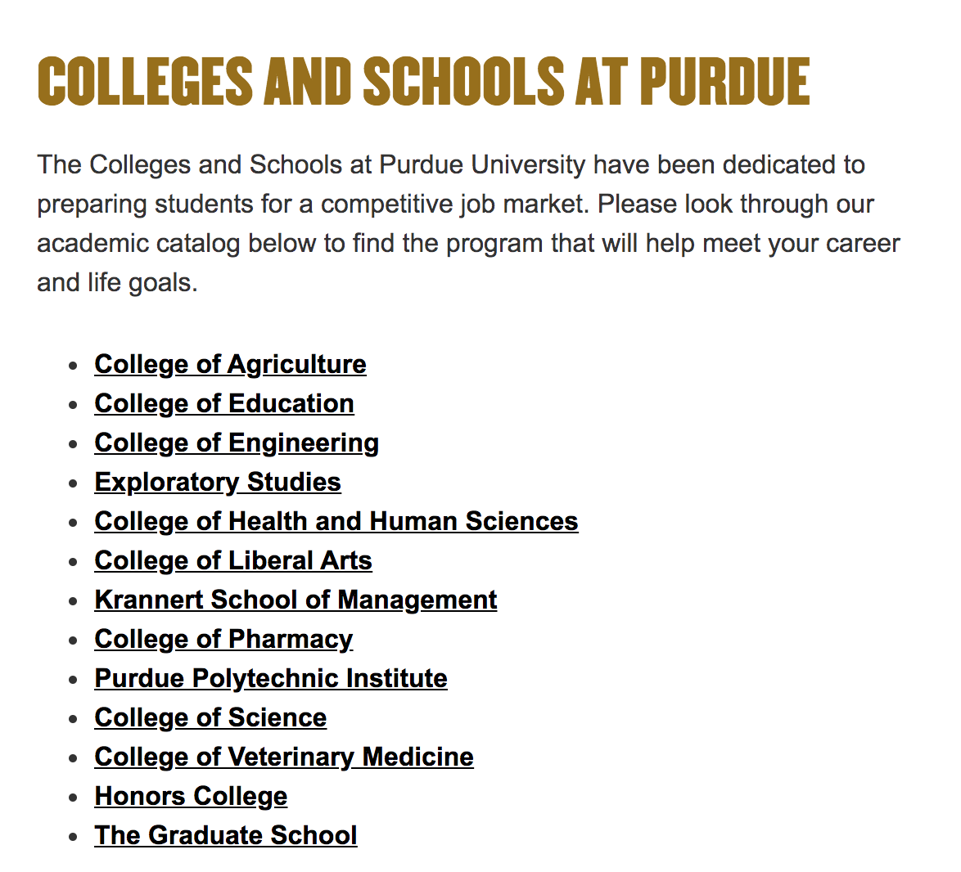









Purdue Conference Office Client Base
CORPORATE CLIENT BASE
ACADEMIC DEPARTMENTS
20 Colleges and Schools
Notes:
Presenter: NICK
98% of our business is internal to Purdue covering every college, school, and department therein. A sampling of our corporate client base consists of Eli Lilly, CAT, SAAB, GE, SIA, John Deere, Fiat/Chrysler, Ford, GM, INDOT

Slide 10
Event Technology Evolution
Pre-2012
2012
2013 - Present
Unreliable System
RFP Process
Implementation
Organic Growth (word of mouth)
Multiple Use Cases & Licenses
Conferences and Events
Alumni Association
County Extension
Notes:
Presenter: NICK
Pre-2012 – Challenge. didn’t have a reliable online registration system. Uphill battle. Hiring manager explained that they needed more people who understood how important this was. Nick was experienced with online registration because they had a homegrown system at UCLA. He had been in an environment that used it and knew how successful it was and how successful it could be.
2012
September 2012, Purdue was in the RFP process and Cvent was a finalist (top 3) and Cvent was doing demos with IT and other departments.
Fall 2012 – Nick and the Director made decision together. Clearly the right solution or Purdue because “Cvent is an event registration tool.” This was one of the things that stood out because this was THE RIGHT tool to do the job. The department was limping along with a system that was not designed for people who run events. Event registration is the core competency of Cvent.
Had been working with another company to do abstract submissions and collections and they also had registration to sell them.
2013 - January 2013 - implementation

Slide 11
QUICK FACTS
Location: State College, PA
Type: Public, 4-year, land-grant institution
Enrollments: 97,100+ students
Employees: 31,000+ faculty and staff
4000 programs and events per year
100,000 registrations per year
#EDU19
Notes:
One of these is Penn State, Cvent client since 2003
~4000 Programs & 100,000 a Year Registrations for the University

Slide 12

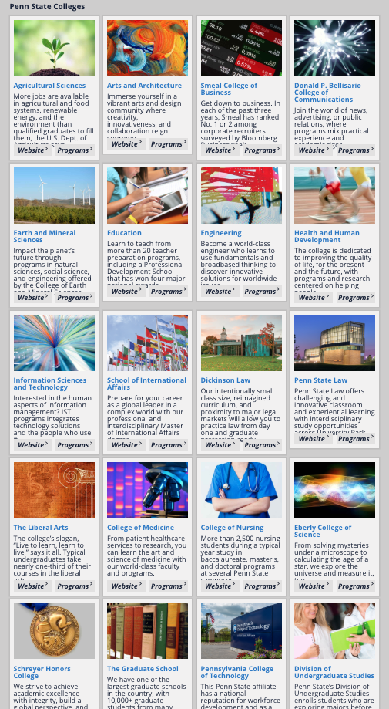
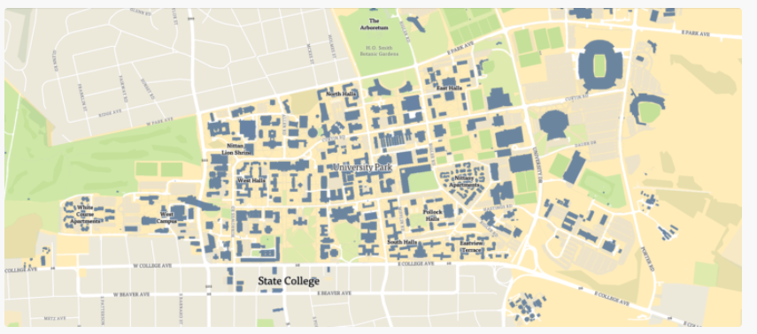
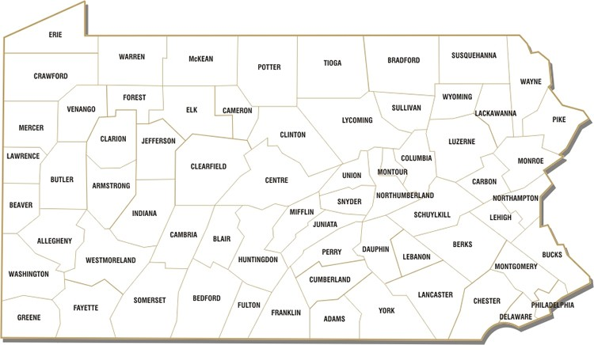
OCSC Client Base
UNIVERSITY PARK CAMPUS
ACADEMIC DEPARTMENTS
20 Colleges and Schools
67 COUNTIES
ACROSS THE STATE
Notes:
Presenter: MARY
https://www.psu.edu/academics/colleges

Slide 13
Event Technology Evolution
BEFORE CVENT
AFTER DEPLOYMENT
Multiple databases
Manual registration process
No standardized brand/ market research
No product consistency
Decentralized, no accountability
Highly Resistant to change
Standardized process and products
Automated marketing platform
Decision making based on data
and expertise
Customer centric
Organizational Structure supports strategic goals
Notes:
Presenter: MARY
Drivers for Cvent – 2003:
Demand for event services exceeding supply - Addressing the increasing demand for programmatic events support from OCSC became unsustainable.
Growth to support demand hindered by inefficiencies
time-consuming registration process
outdated infrastructure dependent upon multiple databases
overreliance on manual processes from marketing, to registration to onsite event management
absence of standardized services and programs
The College of Agricultural Sciences was in the midst of a transformational process, and success ultimately depended on fundamentally changing the way we do business.
Change needed to be quickly implemented and integrated into a new business model
Cvent as a tool was used to create change and efficiency across the College
Evolution – Before and After
Before:
Multiple databases
Manual registration process
No standardized brand/ market research
No product consistency
Decentralized, no accountability
Highly Resistant to change
After:
Standardized process and products
Automated marketing platform
Decision making based on data and expertise
Customer centric
Organizational Structure supports strategic goals
Penn State’s Using Cvent Strategically
Without systematic, strategic integration of a system or tool, progress towards organizational goals will be limited
Continuous improvement is necessary
Document your success and build on it

Slide 14
Event Management Strategies
&
Technology Infrastructure
Notes:
Presenter: MIKE
Please tell us about your event management strategy, the initial drivers for Cvent and how usage of Cvent across your institution has evolved over time.
Please also provide an overview of your technology infrastructure to support your programs.
Also, I noticed that each of you use the eCommerce gateway. It would be helpful to learn a little more about that in this next section.
Let’s start with Kyle and MU’s story
Penn State next (growth and expansion from within a department across institution)
Purdue next

Slide 15
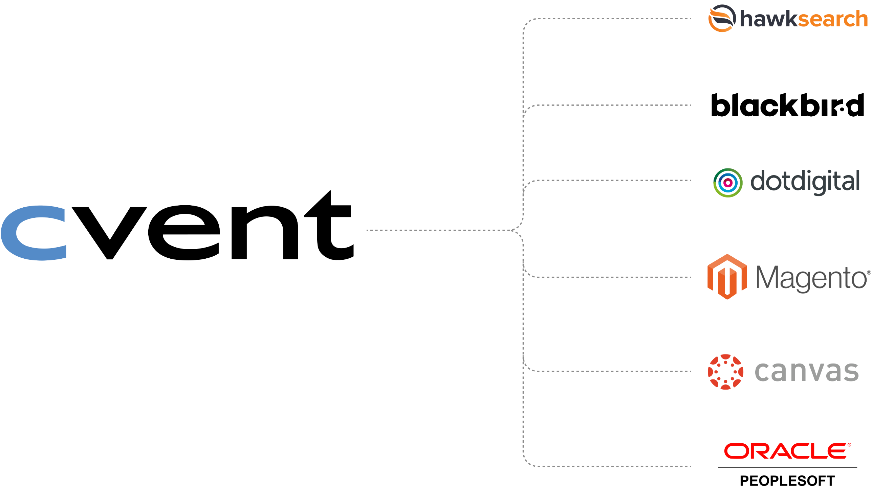
Technology Infrastructure: MU Extension
Integrated Enterprise Platform
• Search – Hawksearch
• CMS – Blackbird ACM
• Email marketing – dotdigital
• e-Commerce web tool – Magento
• LMS – Canvas
• ERP – PeopleSoft
Standardized – and Flexible
Notes:
Presenter: KYLE
Cvent is the center of all events (whether for free or for fee)
Where we do charge for a fee, we need to enough cost recovery in higher ed so that we can subsidize those events that they can offer for free (new paradigm for higher ed because we’re in a world where state and federal funds are declining.
80% of revenue generated by Extension is through events – if we do not price well where we can’t charge, then we aren’t able to provide the same level of service to audiences that aren’t able to pay
and integrates

Slide 16
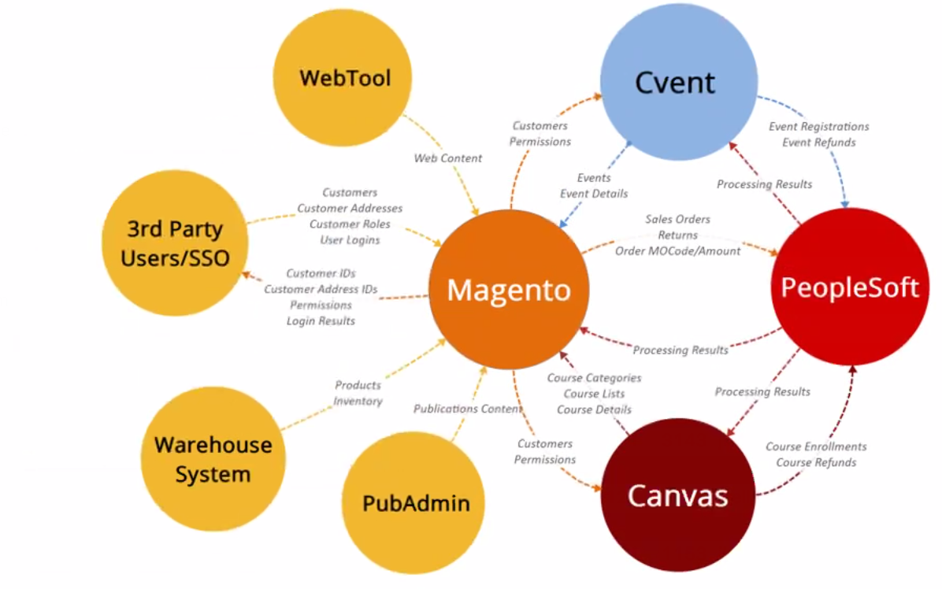
Technology Infrastructure: MU Extension
INTEGRATIONS DIAGRAM
Notes:
Presenter: KYLE
Cvent is the system to help pass through the information to make the accounting and financial side work
Being able to manage the monies and also show the ROI of the
Everything is feeding into Magento and then Magento permissions need to flow through Cvent and then Cvent integrates with all the financial side.
If Cvent weren’t there, they wouldn’t be able to track or streamline their approach.
Cvent’s role
Accounting railroad – university funding and grants and tracking the spend of grants on specific initiatives and it’s an accounting railroad that Cvent allows to happen
Why is Cvent even more important – they need to track where the monies go and what’s the return on their investment
What if we didn’t do this? What are we trying to solve for? What are we looking for?
We could have replaced their registration platform that they previously had. We would not be able to market it the way they want to (250K – Cvent’s central database will have contact information on anybody the programs have touched). They wouldn’t be able to feed into Magento. Wouldn’t have ease of use for shopping cart. They’d have to re-route funds which is manual and tons of room for human error and wouldn’t be able to scale the way they have and want to.
A university is like a conglomerate of 15 different businesses that have to play nice in the sandbox together.
Scalable and

Slide 17


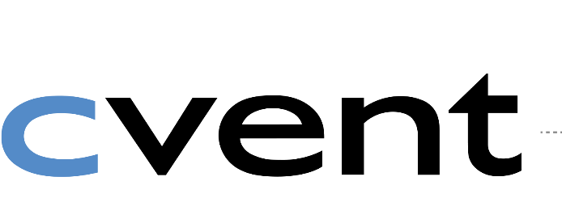
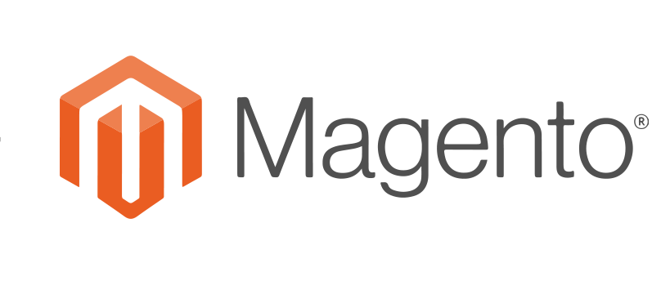


Technology Infrastructure: Penn State
INSTRUCTORS & STAFF
Marketing
Customer Service
Team Communication
Analysis & Reporting
Event Management
WAREHOUSE & POD
Notes:
Presenter: MARY

Slide 18








Technology Infrastructure: Purdue
Notes:
Presenter: NICK
Integrated Enterprise Platform

Slide 19
Implementation, Measuring Success & Vision for Future
Notes:
Presenter: MIKE
In my discussions with each of you leading up to this session, I heard some great examples of best practices as it relates to implementation and measuring your success.
While we could easily have separate sessions dedicated to each of your experiences, lessons learned and best practices, let’s try and give this audience the cliff’s notes version.
Mary: You’ve mentioned that the most common question you receive is around implementation. Could you tell us your best practices as it relates to IMPLEMENTATION?
Nick: could you tell us your best practices as it relates to MEASURING SUCCESS?
Kyle: Could you share how you’ve been tracking your success, ROI & VISION FOR THE FUTURE for MU Extension?

Slide 20
Best Practices: Implementation
Tools are only part of the solution
Continuous improvement is necessary
Document your success and build on it
STRUCTURE
Create an Operational Framework
1
PROCESS
Set Standards and Protocols
2
AGREE TO AGREE
Set Common Goals
3
ACCOUNTABILITY
Hold People Accountable
4
Notes:
Presenter: MARY
Mary shared the most common question she receives is around implementation.
Tools are only part of the solution: Without systematic, strategic integration of a system or tool, progress towards organizational goals will be limited
STRUCTURE
Implementation of centralized systems demands standardized processes
Documented implementation plan
System must be used as an integrated part of business operations
Define clear job functions and responsibilities
Drive staff to use their time for the highest and best use (not everything, everywhere)
AGREE TO AGREE
Reach clear agreement on common goals with leadership in your organization
Understand vision versus reality – a clear baseline of where you are and how to accomplish organizational goals
Identify real obstacles and constraints and differentiate from perceived obstacles or personal preferences
Use common goals to hold the line on how the system is used and for what purposes.
Consistency is the enemy of choice
ACCOUNTABILITY
Defined decision making process based on expertise
Leadership buy in and support
Develop clear lines of communication
Clearly define performance expectations around execution
Define hierarchy of accountability throughout organization

Slide 21
Why Implementation Matters
Year | 2004 | 2006 | 2009 | 2011 | 2012 | 2013 | 2014 | 2015 | 2016 | 2017 | 2018
Alumni Association | 10,000 | 12,000 | 15,000 | 17,000 | 20,000 | 20,000 | 15,000 | 15,000 | 15,000 | 15,000 | 15,000
College of Ag Sciences |  | 7,000 | 13,000 | 14,500 | 16,500 | 20,000 | 24,000 | 25,000 | 25,000 | 25,000 | 25,000
Abbington |  |  | 1,500 | 1,500 | 1,500 | 2,000 | 2,000 | 2,000 | 2,000 | 2,000 | 2,000
Penn State Extension |  |  |  | 5,000 | 10,000 | 15,000 | 20,000 | 30,000 | 35,000 | 35,000 | 40,000
Donor Relations |  |  |  |  |  |  |  | 10,000 | 10,000 | 10,000 | 10,000
College of IST |  |  |  |  |  |  |  | 1,200 | 1,200 | 1,200 | 1,200
Eberly |  |  |  |  |  |  |  |  | 1,500 | 1,500 | transferred
Smeal |  |  |  |  |  |  |  |  | 600 | 600 | 600
Nursing |  |  |  |  |  |  |  |  |  | 1,000 | 1,000
IT |  |  |  |  |  |  |  |  |  | 2,500 | 2,500
TOTAL REGISTRATION |  |  |  |  |  |  |  |  |  |  | 97,300
Adoption and growth varies
across units and departments,
regardless of start date.
Notes:
Presenter: MARY
You can see here why implementation matters –
When a school or college or department starts doesn’t correlate with their growth.
Some plateau because they have no ability to ramp up or scale up within same unit – Abbington – no leadership support and no plan
Some don’t have leadership support and act on changes desired – Alumni Association
Some previous Cvent accounts were decommissioned (Eberly College of Science) and turned into something else – Nursing, IT,

Slide 22
Importance of a Needs Assessment
MESSAGING
OUR PURPOSE
What do you want to say?
What do you want to come across?
Design and engineer an event that conveys these inputs.
BEHAVIOR
What’s the behavior of the audience and stakeholders when they get there?
What’s the behavior you want out of them when they leave?
Notes:
Presenter: NICK
Lessons Learned – Implementation Lifecycle
Implementation lifecycle
Implementation took a while
Some instances of us getting in our own way – took us a while to get it off the ground and up and running. Took us a while to get customers used to this tool. Pricing model was something we struggled with our customers to overcome. They needed to educate stakeholders on budgeting.
Shut down the old system – it exists on campus and is now only a student academic registration system
“We can’t imagine a life without Cvent because we use it all the time”
Importance of a Needs Assessment
Exposure and experience to all aspects of the hospitality lifecycle. Back of the house, front of the house.
Look at it as a play. The event is the play. But there are other motifs that are happening simultaneously and altogether they are telling the complete overarching narrative. Music, lights, etc. One character’s piece of the story may be smaller but what we’re all doing collectively is what we need to see. We’re all doing this together. It’s not about “it’s their event and we put it on for them”. In a collegiate environment, it’s very diverse in worldviews, life stories, etc. all of that is different and it colors their perspective when telling their story. When you have all this diversity, we as collegiate hospitality professionals, need to realize it’s our responsibility to be a part of this. A needs assessment is most important
What do you want to say
What do you want to come across
What’s the behavior of the audience and stakeholders when they get there
What’s the behavior you want out of them when they leave
We need to design and engineer an event that conveys that level of thinking

Slide 23
Vision for the Future: Growth & Scale
BEFORE
NOW
FUTURE
Face-to-face
Face-to-face
High Tech
+
High Touch
Online
Blended
Notes:
Presenter: KYLE
Scale to 250,000 registrations per year
This is table stakes to remain relevant today and the only way to scale in a way to meet the demands.
All under the mission of high tech, high touch.
Critical reach to Missourians enabling high tech, high touch.

Slide 24
Q&A

Slide 25
Contact Information
Kyle Flinn: flinnk@missouri.edu
Mary Seaton: mbs13@psu.edu
Nick Bonora: nbonora@purdue.edu
Mike Dietrich: mdietrich@cvent.com
VISIT US AT
BOOTH # 512
Slides available at: cvent.com/en/meet-cvent-educause-2019
NOTE: This presentation leaves copyright of the content to the presenter. Unless otherwise noted in the materials, uploaded content carries the Creative Commons Attribution 4.0 International (CC BY 4.0), which grants usage to the general public, with appropriate credit to the author.

Slide 26
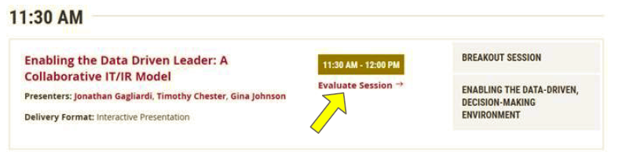
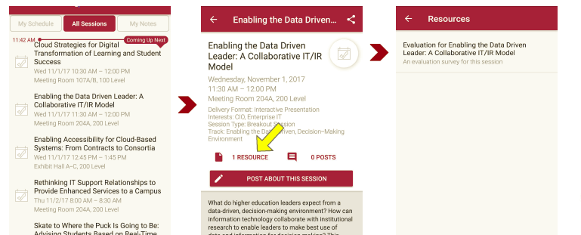
Session Evaluations
There are two ways to access the session and presenter evaluations:
1
2
In the online agenda, click on the “Evaluate Session” link
From the mobile app, click on the session you want from the schedule > then scroll down or click on the associated resources > and the evaluation will pop up in the list

