Slide 1
Unlearning Decision-Making
Christy Clark
Manager, Institutional Analytics Services
The University of Sydney
Shekaran Sury
Global Head, Analytics & AI Consulting
Wipro

Slide 3

Values we live by
Be passionate about clients’ success
Treat each person with respect
Be global and responsible
Unyielding integrity in everything we do
Endowment value of 15 bn USD for philanthropy
Included in the Dow Jones Sustainability Index (DJSI)
40% of Wipro profits go towards philanthropy through the Chairman’s foundation
World and Emerging Markets for the 9th time in succession
World’s Most
Ethical Companies
2% of Wipro’s net profits go directly towards CSR
By Ethisphere Institute for the 7th successive year, 2018
Wipro’s Community Initiatives
Science Education Fellowship program
Science Education Fellowship program
Spirit of Wipro fundraising
First Book Partnership
Million women mentors initiative

Slide 4
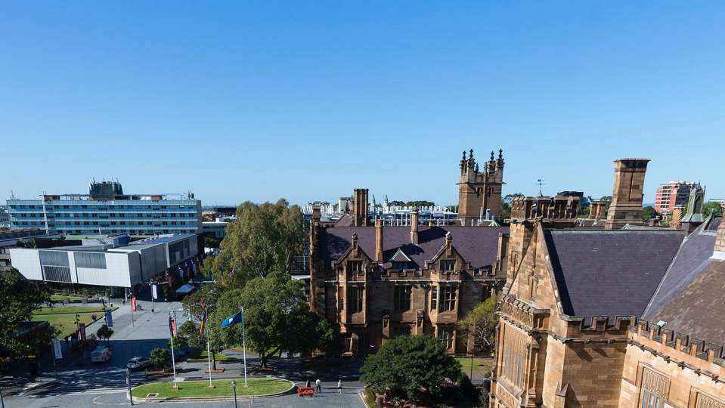
The transformation to an Intelligent Enterprise

Slide 5
Transforming to an Intelligent Enterprise
Fit for purpose
Data and Insights platforms enabled for varying needs
Modernize the core
Enable the future
01

Slide 6
Transforming to an Intelligent Enterprise
AI Infusion
Innovate with AI by infusing into processes
Applied Intelligence
Automation
02

Slide 7
Transforming to an Intelligent Enterprise
Digital & Cloud
Accelerate transformation by leveraging microservices
Platform Services
DevOps
03

Slide 8
Transforming to an Intelligent Enterprise
Service Transformation
Adopt next gen delivery to render superior value to customers
Talent Re-skilling
Crowd-Sourcing
04

Slide 9
Transforming to an Intelligent Enterprise
Tap into Partnerships
Gain leverage through internal and external networks of innovation
Startups
Consulting Organizations
05

Slide 10

Unlearn: to make an effort to forget your usual way of doing something so that you can learn a new and sometimes better way
Cambridge Dictionary

Slide 11
What do we need to unlearn to change the decision-making culture?
Decisions based on gut feeling and estimates
Not insisting on verified source of truth
Statements made before checking the facts
Relying solely on history to decide the future

Slide 12

Working collaboratively to liberate data utilising cloud-based technologies

Slide 13
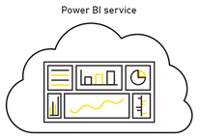

Target Conceptual Architecture
Azure USYD Cloud
USYD
On-Premise
PRD Environment
Data warehouse
Snowflake
On Azure (DWaaS)
EDW | TDA
Azure On Prem Data Gateway (VM)
Semantic
Layer
Azure Analysis Services (PaaS)
Source Systems / Oracle Data Warehouse
DEV Environment
Data warehouse
Snowflake
On Azure (DWaaS)
EDW | TDA
Semantic
Layer
Access Governed Data
Azure On Prem Data Gateway (VM)
Access Governed Models
Azure Analysis Services (PaaS)
Access Ungoverned Data
Publish Reports

Slide 14
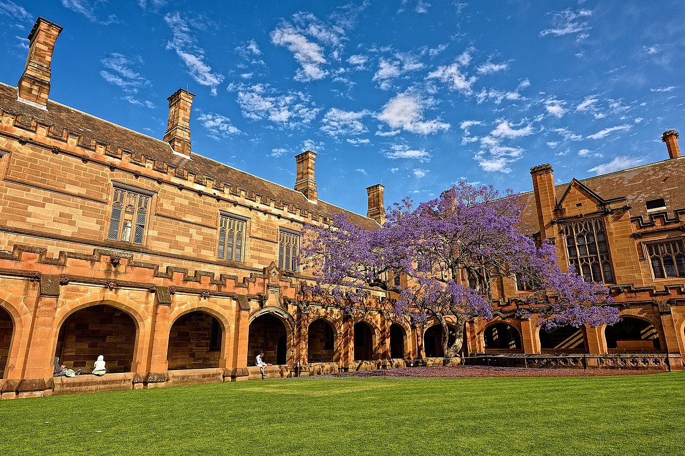
Making crucial information more accessible via persona-based and self-serve analytics

Slide 15



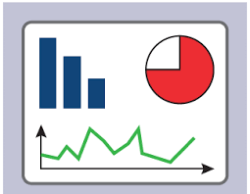

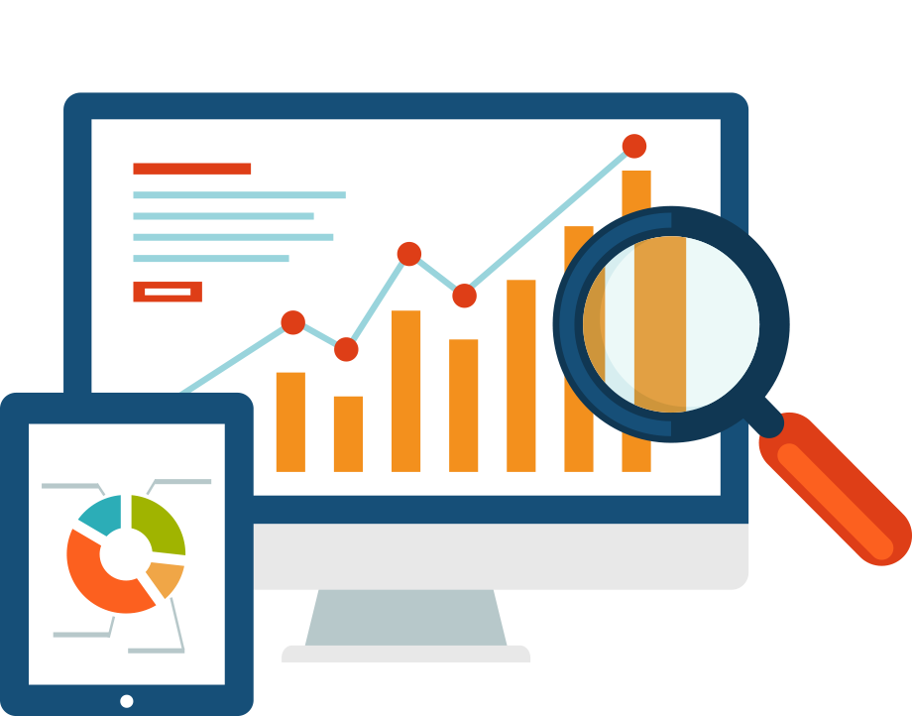
Creating a federated approach to share and connect people and data
To be process
Power User
Power User
Request for report
Request for report
IAP
IAP
Share with other users
Dig deeper into data
Self serve new report
Provide dashboard/report
Provide dashboard/report
Valuable new reports identified and offered based on new insights

Slide 16
Implementing data governance to ensure accurate, consistent data is available

Slide 17
Data Governance
Data Governance Principles
Liberated
Valued
Reused
Managed
Governed

Slide 18

So… Where do we start?

Slide 19
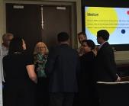
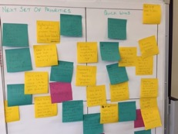
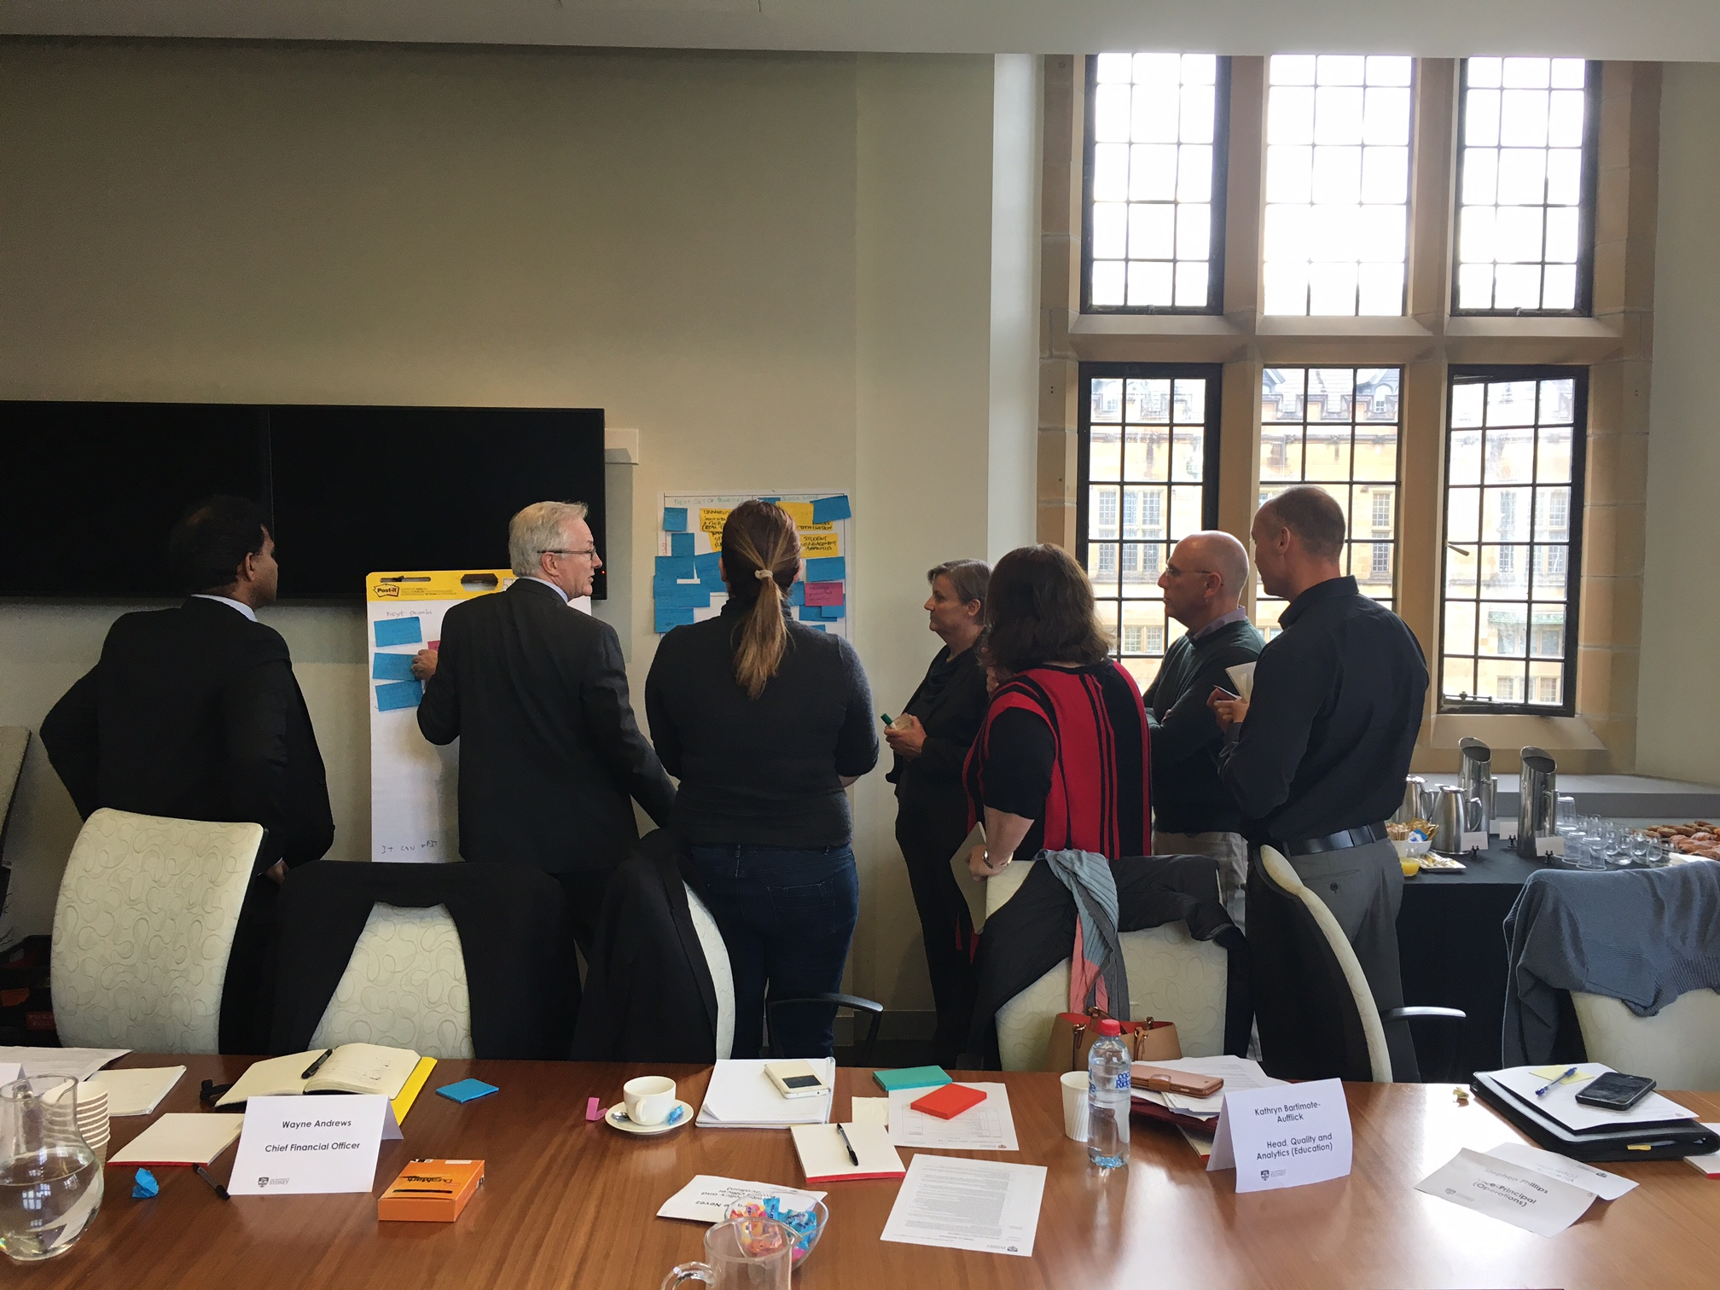
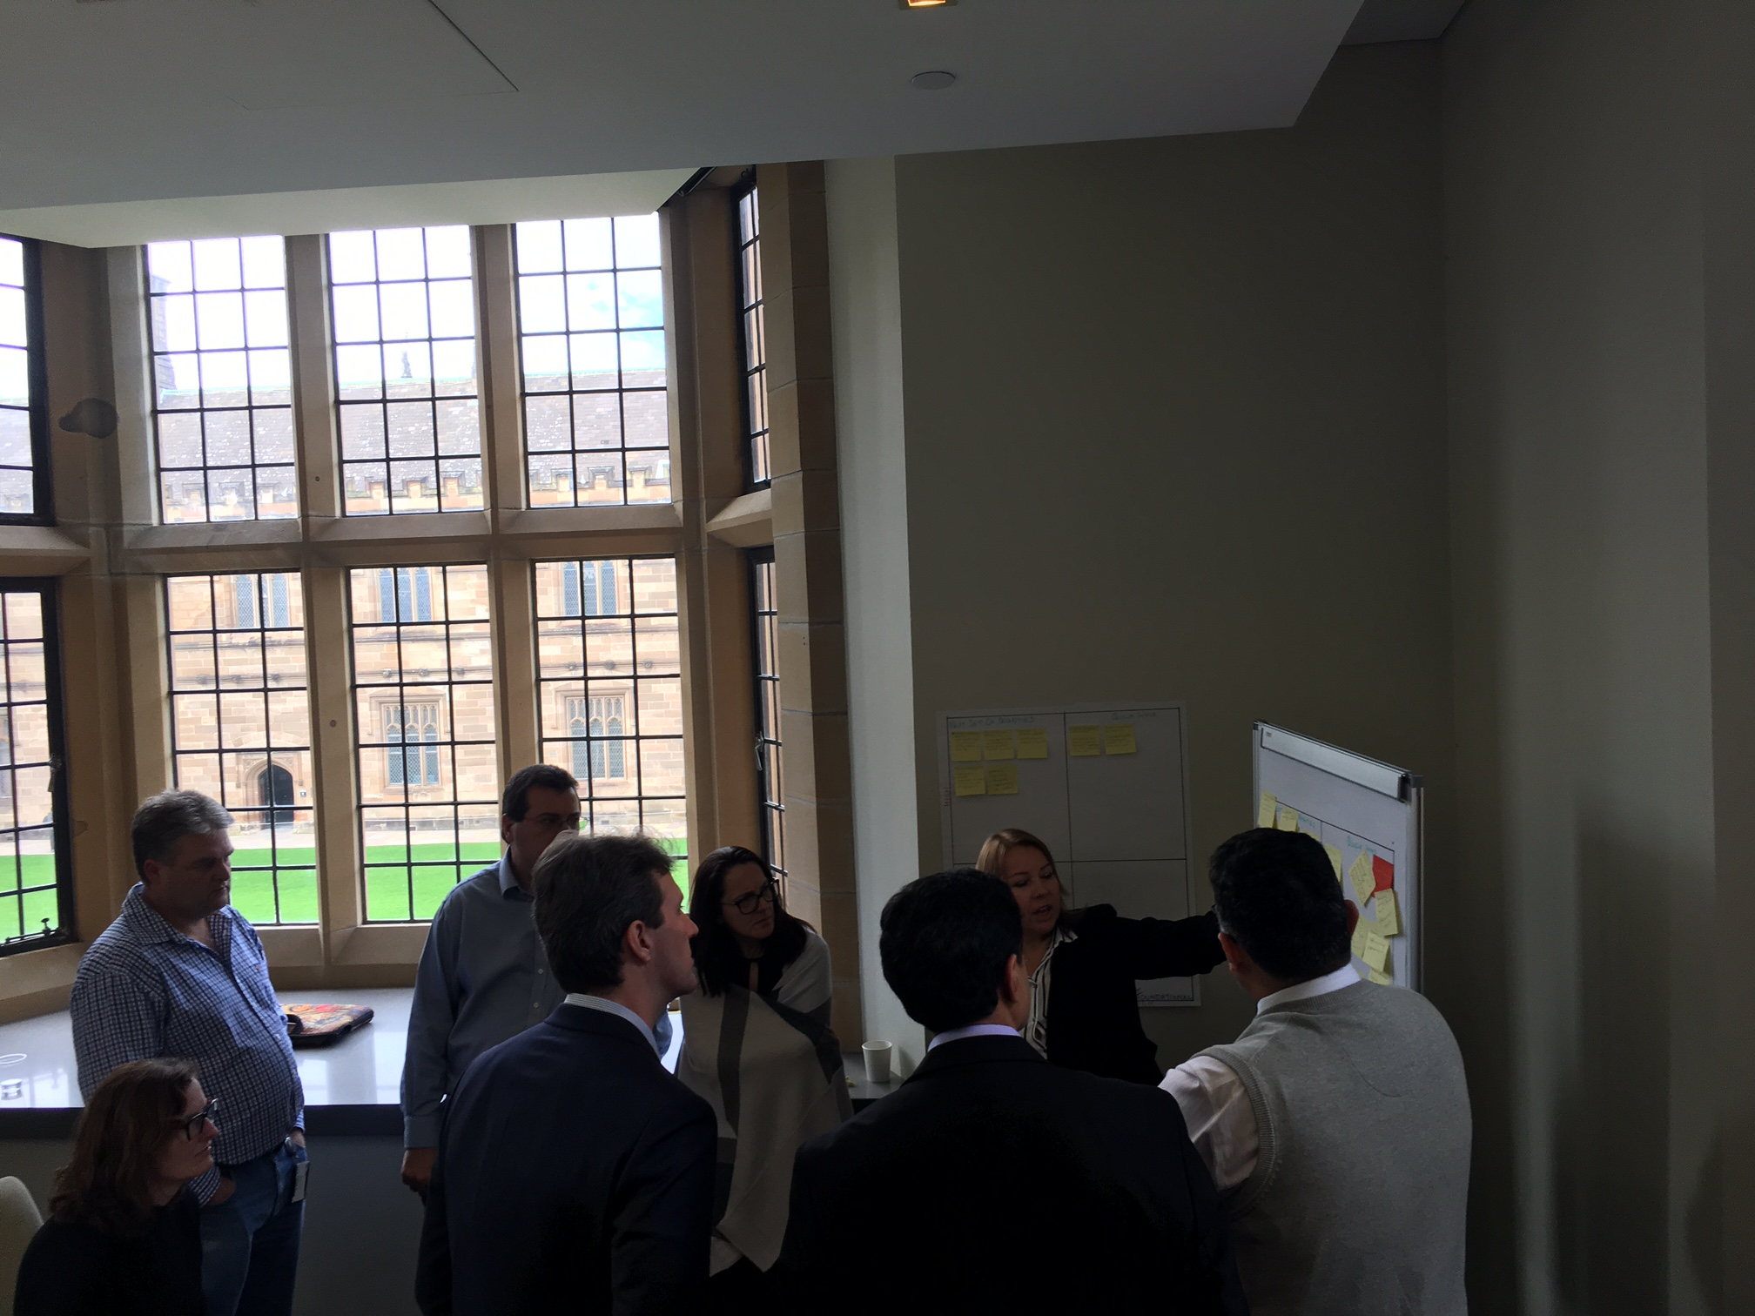
An advisory & design led approach…
Define - 1
Analyze - 2
Envision - 3
Target state requirements are prioritized based on specific business needs and intelligent enterprise strategy
AI & Analytics Workshops to explore business challenges and identify the scope
Identified use cases mapping on a matrix to determine the perceived business value and complexity
Operationalize - 4
The use case matrix is used to define the transformation roadmap to operationalize
Use cases are operationalized through Hypothesis, Build and DevOps
Metro Map – Data Strategy
KPI Libraries
Data Science Accelerator
Reference Architectures
Change Management
Bot libraries
Pre-curated solutions

Slide 20
Imagine what could be possible if we all learn to unlearn.

Slide 21
Questions?

Slide 22
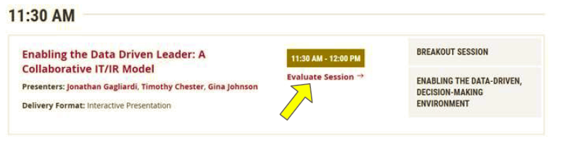
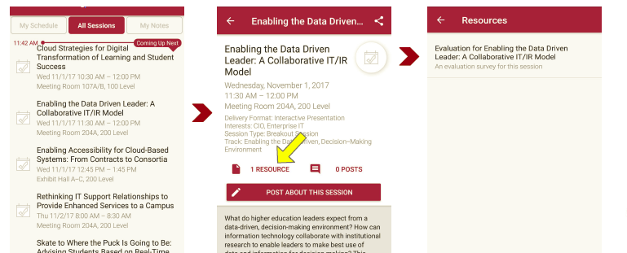
Session Evaluations There are two ways to access the session and presenter evaluations:
1
2
In the online agenda, click on the “Evaluate Session” link
From the mobile app, click on the session you want from the schedule > then scroll down or click on the associated resources > and the evaluation will pop up in the list

Slide 23
Contact Information
Christy Clark | Manager, Institutional Analytics Services
Institutional Analytics and Planning (IAP)
Office of the Vice-Principal (Strategy)
THE UNIVERSITY OF SYDNEY
T +61 2 9114 1313
E christina.clark@sydney.edu.au | W sydney.edu.au/staff-iap
Shekaran Sury| Global Head
Analytics & AI Consulting
Wipro
L https://www.linkedin.com/in/shekaransury/
E Chandrashekaran.sury@Wipro.com
NOTE: This presentation leaves copyright of the content to the presenter. Unless otherwise noted in the materials, uploaded content carries the Creative Commons Attribution 4.0 International (CC BY 4.0), which grants usage to the general public, with appropriate credit to the author.

